Slide 1
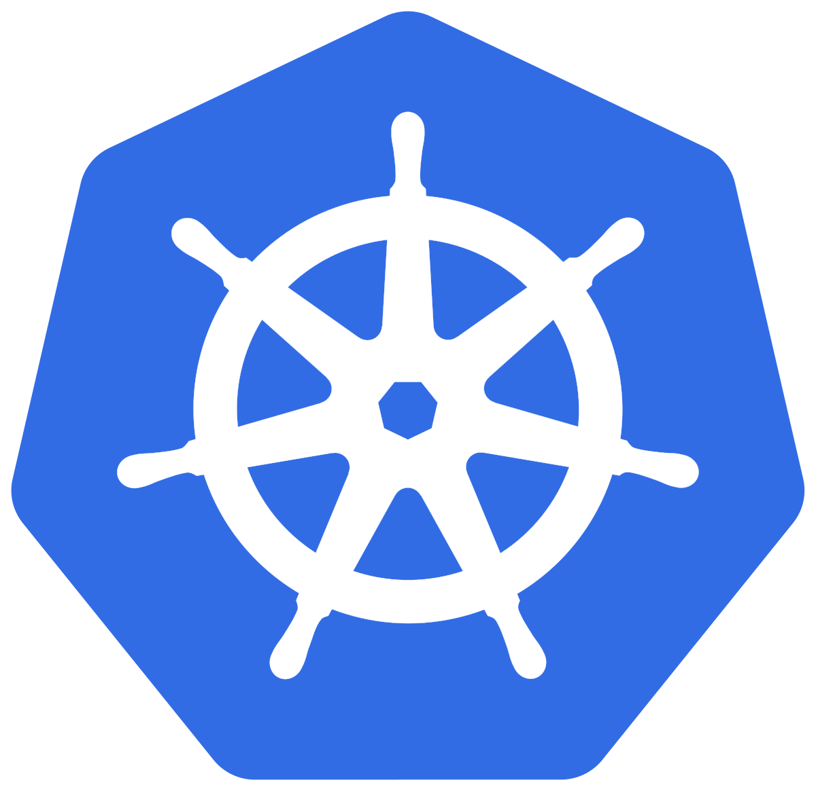
Hands-on : A Beginner-Friendly Crashcourse to Kubernetes
ML Ops World,
2022/06/09
Rocket Science Development Inc.

Slide 2
Today’s plan
10:45 am to 12:15pm :
  1 hour presentation on concepts and basics
  30 minutes setup :
    Kubectl installation
    Cluster creation
    GCP CLI installation
    Connection to cluster
1 pm to 2:30
  Actual hands-on

Slide 3
Intro
  What is container orchestration?
  What is Kubernetes?
Kubernetes Architecture
  Architecture description
  How does K8S solves the challenges of container orchestration
  K8S components
How do you deploy your app on k8s ?
  Kubectl : the CLI to interact with your cluster
  Imperative
  Declarative
Set-up docker desktop
Rocket Science Development : who are we?
MLOps Institute & MLOps Engineering Certification
Ressources

Slide 4
Introduction

Slide 5
What is container orchestration?
Increasing number of containers to manage
Need Automation of much of the operational effort required to run containerized workloads and services.

Slide 6
What is container orchestration?
Container orchestration tools help manage containers and micro-services at scale.
Many C.O. tools exist such : kubernetes, Hashicorp Nomad, Docker Swarm, Apache Mesos

Slide 7
Why k8s and not other solutions ?
Multi-cloud support : Main Cloud providers have a managed service offer
Extensive community support, e.g, many ML Ops tools have a helm chart allowing production grade deployment
Enhanced portability and flexibility
Open Source, and supported by the CNCF

Slide 8
What is kubernetes?
We already know : Kubernetes (or k8s pour les intimes) is container orchestration platform for linux-based containers
Want to have an in-depth about k8s history check this 2 parts series by Honeypot on YT : https://www.youtube.com/watch?v=BE77h7dmoQU&t=18s

Slide 9
Kubernetes Architecture

Slide 10
Definition time
Control plane : The collection of processes/services that control workers. This is where all task assignments/orchestration/scheduling originate.
Worker Node : A virtual or physical machine where is container application (or pod) will run
Cluster : the collection of both Control Plane and worker nodes

Slide 11
  How does K8S solves the challenges of container orchestration?

Slide 12
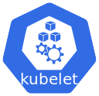
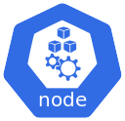
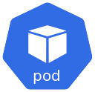
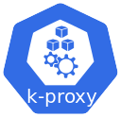
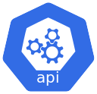

  Architecture description
Cluster
Node 1
Control Plane
Resource creation command
Node 2

Slide 13
  K8S resources you will use on a regular basis
K8S resources
  namespace
  Pods
  Deployment & replicaSet
  Services & ingress
  ConfigMap & Secrets
  Volumes, claims, storage class,statefulSet
  Other objects will be addressed in later section (declarative approach)

Slide 14
  K8S component : namespace
Mechanism for isolating groups of resources within a cluster
Assign quotas to avoid namespaces taking too many resources

Slide 15
  K8S component : namespace
K8S Cluster
Node 1
Node 2
Node 3
Namespace 1
Namespace 2
Namespace 3

Slide 16
  K8S component : Pods
Smallest deployable unit
Pod => group one or more tighly-coupled containers
Non permanent => ephemeral resource
  When deleted pod doesn’t restart, other abstractions allow setting restarting behaviour
Schedule with affininity/anti-affinity rules
Scheduled with resources limits/quotas specific to individual pods

Slide 17
  K8S component : Deployment & replicaSet
Extend pod properties
Deployment object configure a ReplicaSet which contains the parameter for a fixed number pod replicas to keep up all the time

Slide 18
  K8S component : Deployment & replicaSet
Deployment
ReplicatSet
Pod
Pod
Pod
Pod

Slide 19
  K8S component : Deployment & replicaSet
DaemonSet is specific type of deployment which run every individual pod replica on the different cluster nodes

Slide 20
  K8S component : Service & ingress
Component abstraction that exposes a pod (or set of pods) as a network service
Service mainly used to expose pods internally, i.e. communication between pods in the same namespace
Ingress used to expose specific pods (e.g. frontend) to users/consumers/clients outside of the cluster

Slide 21
  K8S component : Service
Several service types depending on type of exposure
  ClusterIP : Exposes the Service on a cluster-internal IP.
  NodePort : Exposes the Service on each Node's IP at a static port (the NodePort).
  LoadBalancer : Exposes the Service externally using a cloud provider's load balancer.

Slide 22
  K8S component : Ingress
Ingress exposes HTTP and HTTPS routes from outside the cluster to services within the cluster. Traffic routing is controlled by rules defined on the Ingress resource.
In order for the Ingress resource to work, the cluster must have an ingress controller running.
  Many ingress controller exist in the eco-system, e.g, Ingress Nginx Controller

Slide 23
  K8S component : ConfigMap & Secrets
Injecting configuration into pods
ConfigMaps : non-confidential config files
Secrets : confidential config files

Slide 24
  K8S component : Volumes, claims, storage class,statefulSet
Components helping with handling data/states, i.e., read/write operations to a bucket or Database

Slide 25
How do you deploy your app on k8s ?

Slide 26
  Kubectl : the CLI to interact with your cluster
Command Line tool, main way to interact with a cluster/namespace

Slide 27
  Imperative
Kubectl CLI helps to create or delete resources using one command
All parameters are passed through CLI, result in long commands
  Less readable
  More prone to error or typo
  Always to retype it, if not in a script (usually bash)
  Less easy to keep track of change in resource parameter (e.g. more replicas, port change, name change, label change etc.)

Slide 28
  Declarative
yaml is your friend

Slide 29
  Declarative : yaml is your friend
yaml is your friend
Kustomize : a k8s native config management solution

Slide 30


Slide 31


Slide 32
About me
https://github.com/Blizter
https://www.linkedin.com/in/eric-hammel/

Slide 33
Resources
https://www.youtube.com/watch?v=kBF6Bvth0zw
https://www.youtube.com/watch?v=2vMEQ5zs1ko
https://www.redhat.com/en/topics/containers/what-is-container-orchestration
https://www.redhat.com/en/topics/containers/what-is-kubernetes-deployment
https://www.youtube.com/watch?v=s_o8dwzRlu4
https://www.henrydu.com/2020/09/13/k8s-creates-pods/
https://thechief.io/c/cloudplex/what-mlops-and-how-kubernetes-can-help/
https://medium.com/analytics-vidhya/mlops-dockers-and-kubernetes-essentials-for-a-data-scientist-8bc7b5866957
https://www.youtube.com/watch?v=90kZRyPcRZw
https://www.youtube.com/watch?v=BE77h7dmoQU
https://www.youtube.com/watch?v=318elIq37PE

Slide 34
Hands-on workshop : set up
Install Docker desktop

Slide 35
Hands-on workshop
Inspired by this tutorial : https://www.magalix.com/blog/deploying-an-application-on-kubernetes-from-a-to-z
Step to follow : https://github.com/Blizter/hands-on-sample-api

