Slide 1
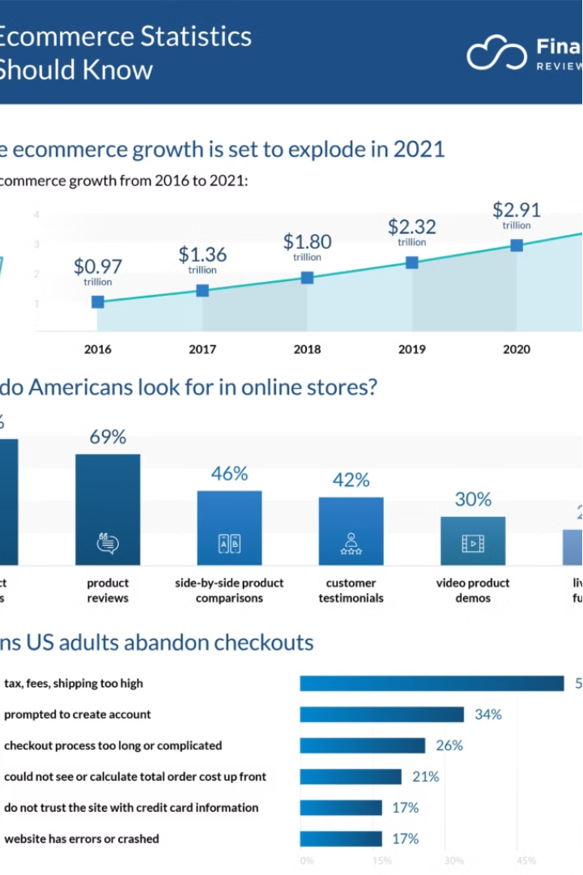
E-Commerce Data Analysis and Insights.
This presentation explores key findings and trends from an
e-commerce data analysis. The analysis covers various aspects of customer behavior, order patterns, and revenue generation.

Slide 2
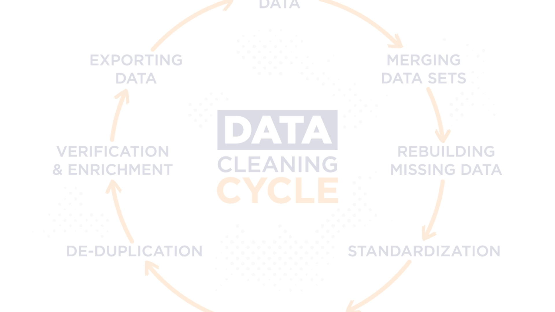
Data Cleaning and Preparation
The data cleaning process involved identifying and correcting inconsistencies, missing values, and data type errors. This ensured data accuracy and reliability for further analysis.

Slide 3
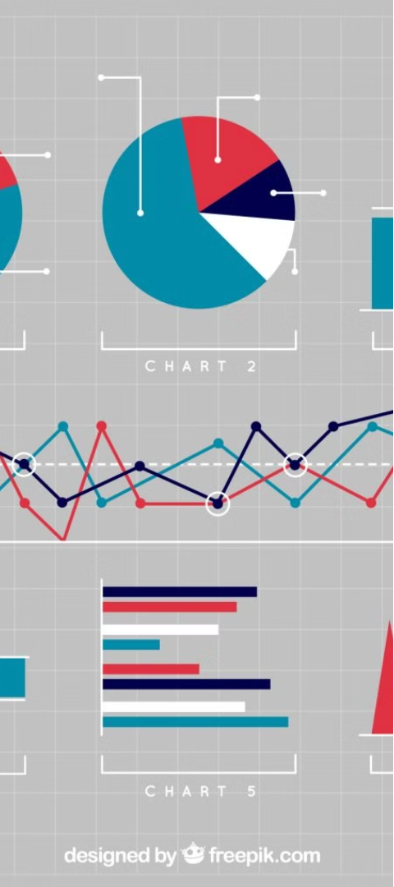
Customer Spending Analysis
1
High Spenders
2
Segmentation
Customers with total spending greater than 350,000 are identified.
This analysis helps segment customers based on their spending habits.
3
Targeted Marketing
Insights can be used for targeted marketing campaigns to retain high-value customers.

Slide 4

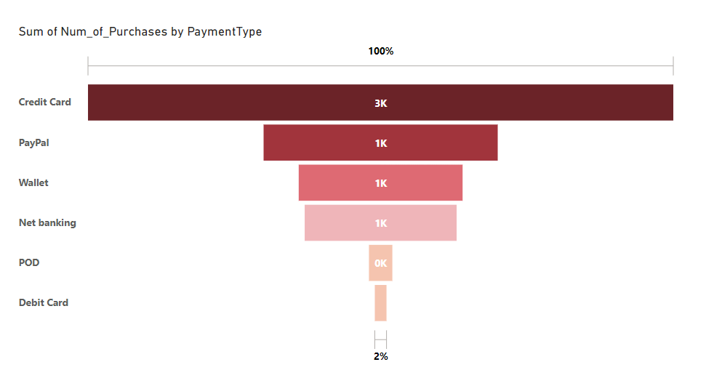


Payment Methods Analysis
Credit Card
The most popular payment method, accounting for a significant portion of transactions.
PayPal
A widely used payment method, offering convenience and security.
Wallet
A popular online payment platform, providing a secure and convenient way to make payments.

Slide 5
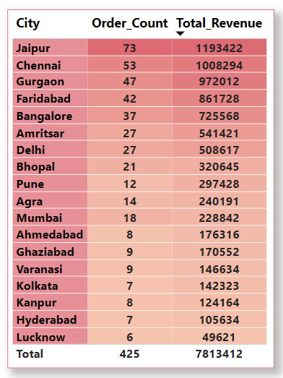
Revenue by City (India)

Slide 6
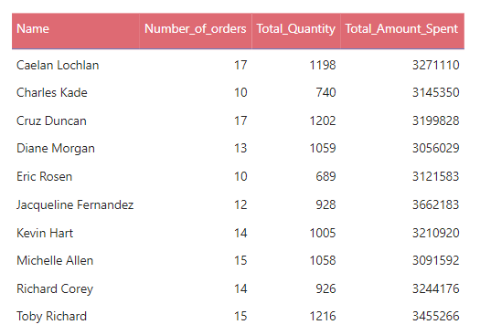
Top Customers by Spending

Slide 7
City Revenue Buckets
High Revenue
Medium Revenue
Cities (San Francisco, Brandenburg, New York, Johannesburg) with revenue exceeding a certain threshold, indicating strong market potential.
Cities (Bhopal, Berlin, Lisbon, Jacksonville) with moderate revenue levels, representing a stable market presence.
Low Revenue
Cities (Belfast, Amsterdam, San Francisco) with lower revenue, suggesting
potential for growth and expansion.

Slide 8
Monthly Revenue Analysis for 2020
January
February
March
205323
310858
105104
Revenue for the month of January.
Revenue for the month of February.
Revenue for the month of March.

Slide 9
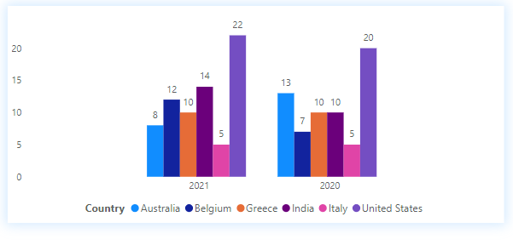
Total orders placed from India, Italy, Australia, United States, Belgium and Greece for the Years 2020 and 2021.

Slide 10
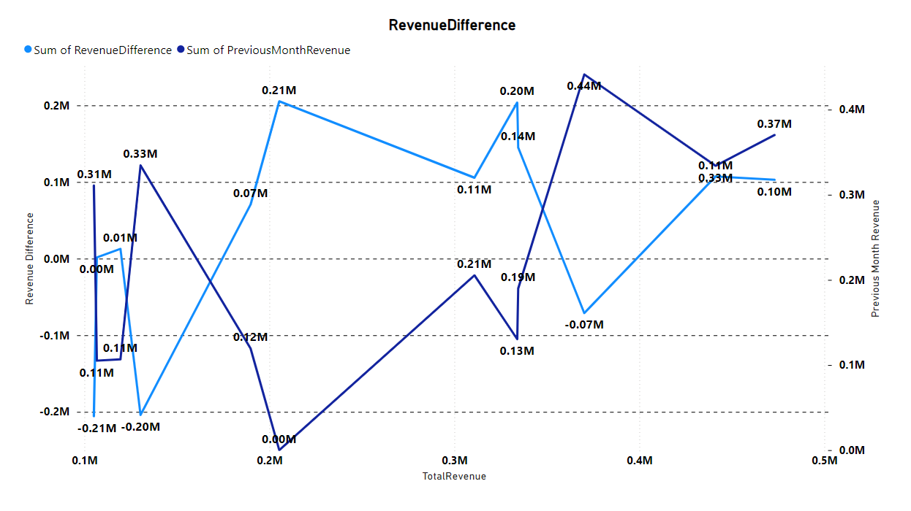

Slide 11

Thank You
We appreciate your time and attention. Your feedback and support are invaluable to us.

