Slide 1
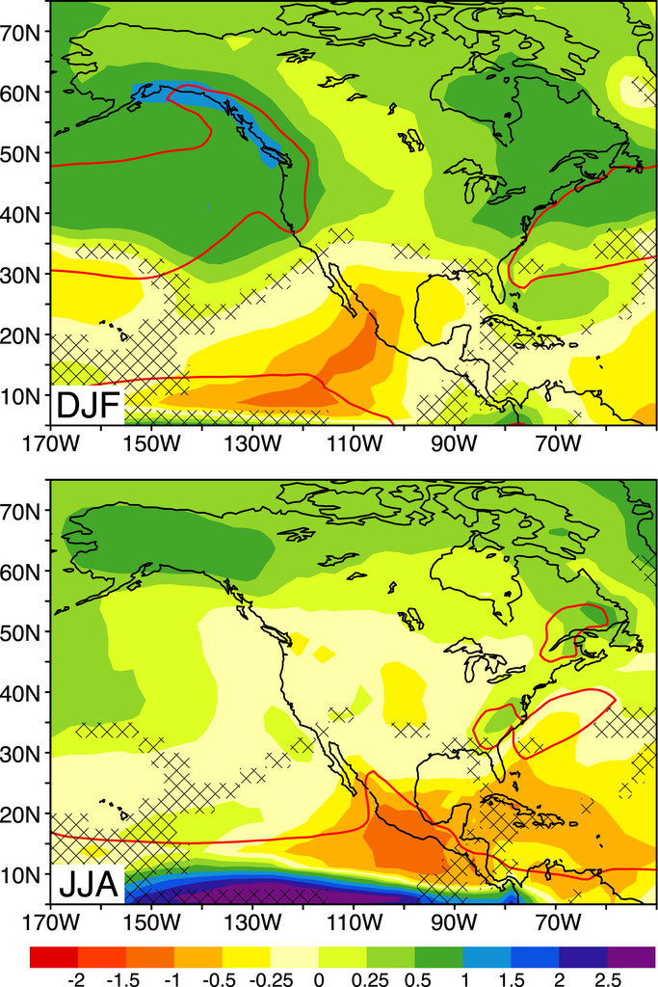
Fig. 1.
CMIP5 17-member multimodel, multirun ensemble-mean precipitation change (mm day−1) for RCP8.5 for 2070–99 relative to 1961–90 base period for (top) DJF and (bottom) JJA. Models used: BCC_CSM1.1, CanESM2, CCSM4, CNRM-CM5.1, CSIRO Mk3.6.0, FGOALS-s2, GFDL CM3, GFDL-ESM2M, GISS-E2-R, HadGEM2-CC, INM-CM4.0, IPSL-CM5A, MIROC5, MIROC-ESM, MPI-ESM-LR, MRI-CGCM3, and NorESM1-M (see Table 1). The red line is the 4 mm day−1 contour of the 1961–90 climatology. Grid points are cross hatched where the MEM does not pass a two-sided t test for differences of the mean with respect to interannual variability at the 95% level (see text). All models are interpolated to a common 2.5° by 2.5° latitude–longitude grid as in the corresponding climatology figure in Part I (Fig. 1).

