Slide 1
Cooperative UAV Trajectory Planning for Plume Wrapping of a Spherical Dome
Baisakhi Chatterjee & Rudra Dutta

Slide 2







INTRODUCTION
Autonomous Multi-UAV Groups have a variety of applications
Network Coverage
Search and Rescue
Traffic Surveillance
Thus, communication in autonomous UAVs for dynamic path planning is an area of considerable research interest
Notes:
Network coverage is the problem of optimizing the placement of mobile stations to increase connectivity between groups of users. UAVs are uniquely suited for this task. Another activity where UAVs thrive is that of Search and Rescue. UAVs can locate groups of survivors in potentially dangerous conditions and alert rescue organizations. Traffic surveillance, too benefits from the UAVs usage. These devices can monitor traffic patterns and detect anomalous behaviours.

Slide 3
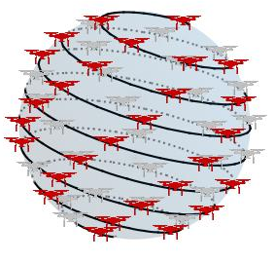
MOTIVATION - PLUME WRAPPING
In our previous work, we focused on studying the dependence of communication on mission correctness
Exemplar of Plume Wrapping
Problem of finding the boundary of a gaseous, possibly toxic, plume
Practical problem in real world scenario
Multi-UAV communication & adaptive trajectory planning based on dynamic data
We made the simplifying assumption of a perfectly spherical plume
In this research, we focus on dome shaped plumes
Notes:
While it is reasonable to assume that the starting phase of a plume with pollutants lighter than air will assume a roughly spherical shape [11], this technique poses a challenge when the contaminants are heavier than air and drop to the ground.

Slide 4
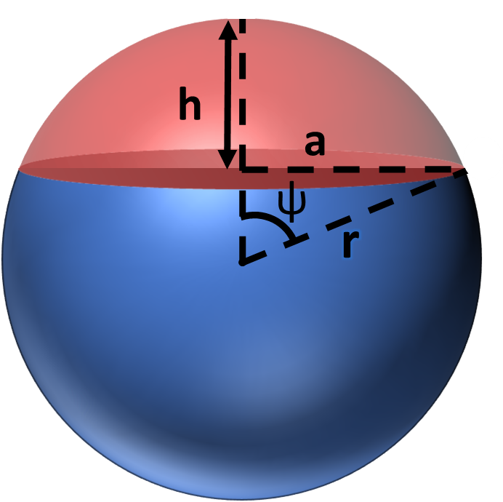
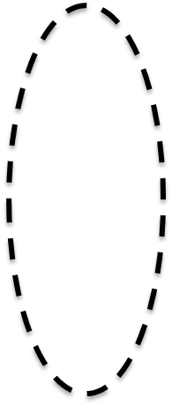
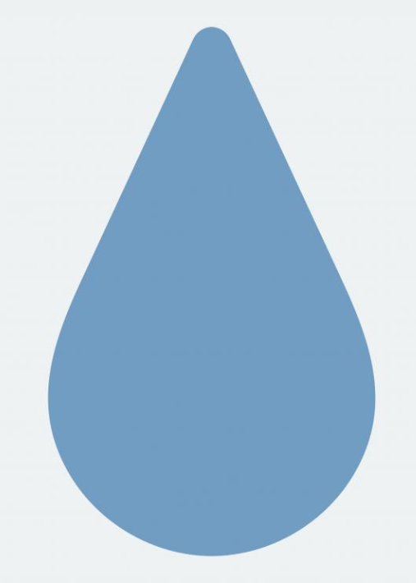
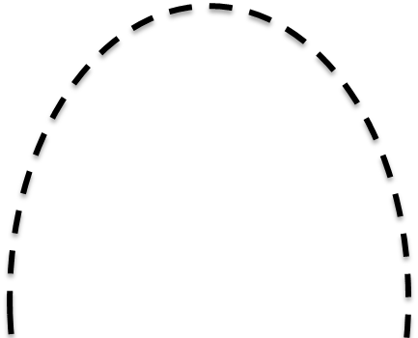


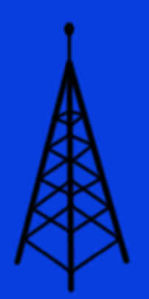

MOTIVATION – DOME SHAPED PLUMES
When the pollutants are heavier than air, they fall to the ground
This creates a dome-like plume
This can also work for cell towers by sensing radiation
Shape of Dome – Spherical Cap
Chemical Fire
Bubble Plume
Base Station

Slide 5
ALGORITHM

Slide 6
DESIGN
Initialization
Initial Sphere Formation
Stop-Click Phase
Termination

Slide 7
DESIGN
Initialization
Initial Sphere Formation
Stop-Click Phase
Termination

Slide 8
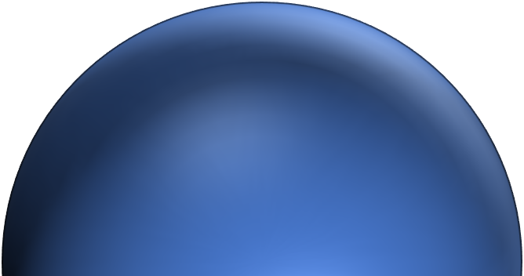
BOUNDARY SEARCH
For boundary search we adopted a hill climbing approach
Initially, a single UAV flies vertically upward and samples the plume density periodically
Once it detects a boundary region, it moves in four directions to check if higher concentration is detected
If yes, it keeps moving upward
Else, stop at boundary

Slide 9
DESIGN
Initialization
Initial Sphere Formation
Stop-Click Phase
Termination

Slide 10
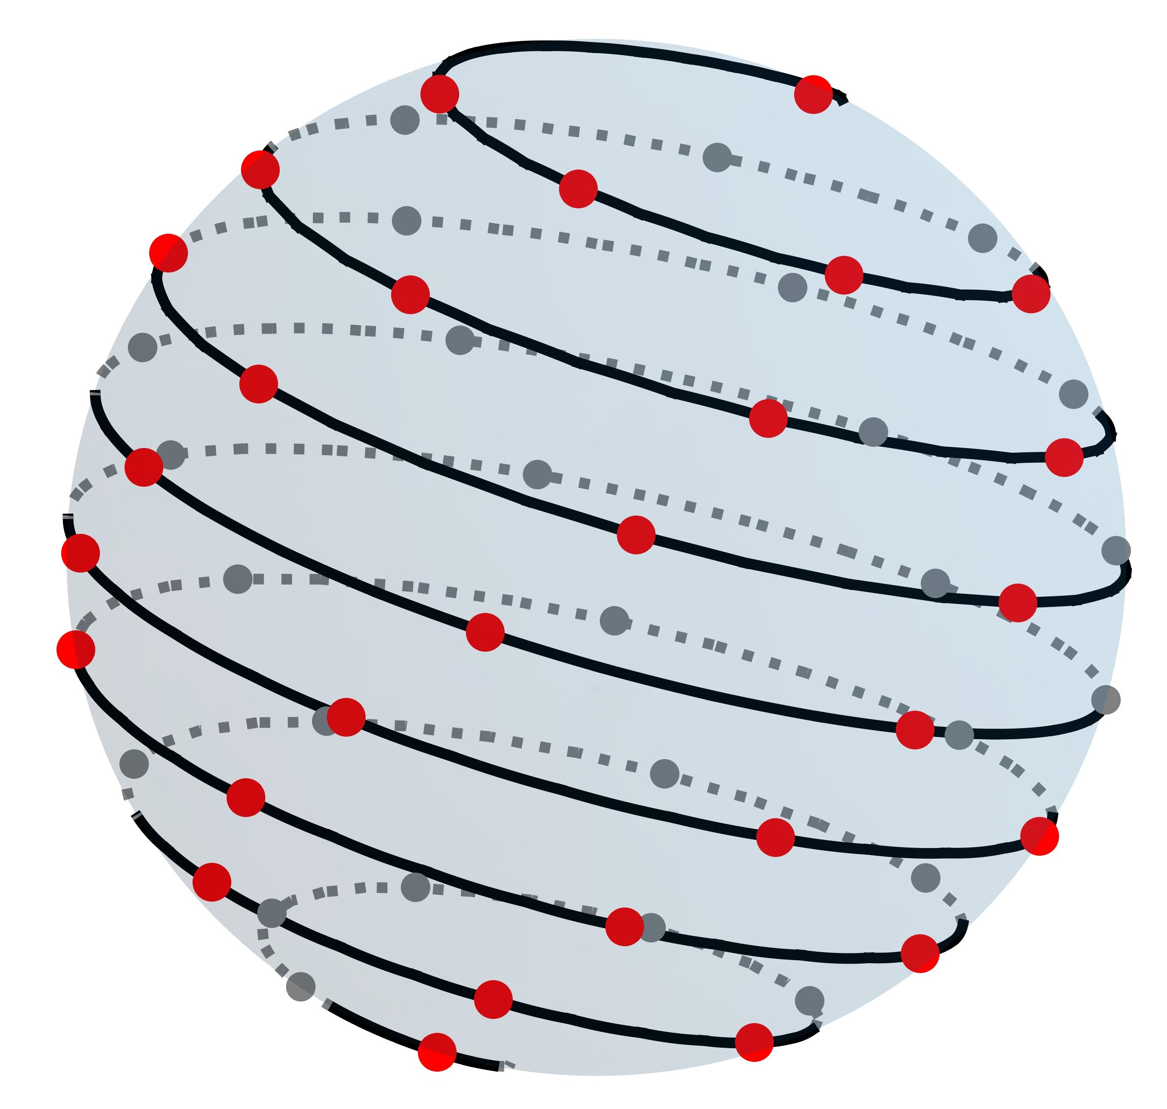
SPHERE FORMATION
Boundary UAV broadcasts message
Other UAVs calculate target position on a sphere at origin using Fibonacci Sphere Formula
The spiral is oriented such that it moves down from the top
UAVs translate sphere to the boundary
UAVs move to the target position
Z
Y
X

Slide 11
DESIGN
Initialization
Initial Sphere Formation
Stop-Click Phase
Termination

Slide 12
STOP-CLICK PHASE
Each round has 2 turns – Stop and Click
STOP
This phase is triggered when the UAV has received updates from all group members
Once all updates are received, UAV calculates next target position
The UAV then broadcasts its current position and density
CLICK
During this phase, the UAV again waits to receive updates from group members
Each UAV begins moving to their target destination
Once the UAV has reached the position it stops moving
The UAV then broadcasts its current position and density

Slide 13
EXPANSION & ROTATION
Expansion
Movement of every UAV such that radius of the Fibonacci Sphere is increased
Occurs when every point is INSIDE the plume boundary
Rotation
Movement of every UAV such that Fibonacci Sphere moves towards the plume
Occurs when at least one point is OUTSIDE the plume boundary

Slide 14
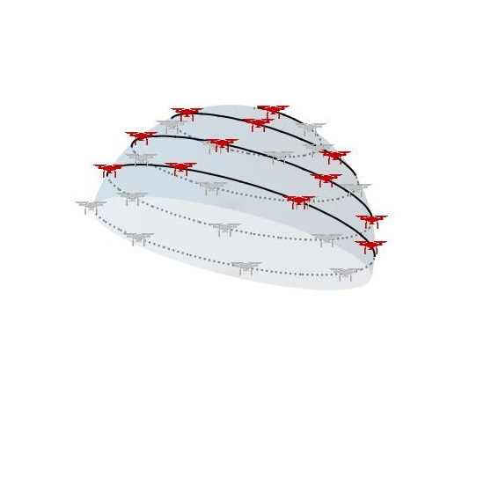
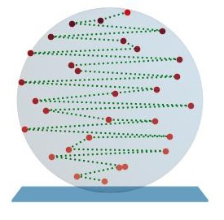
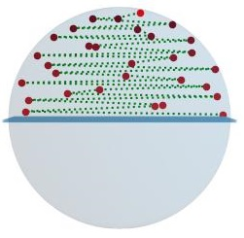
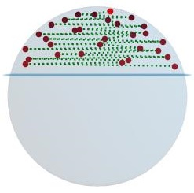
SPIRAL TIGHTENING
Tightening refers to the movement of UAVs such that the spiral becomes a dome of reducing height
We plot q*n Fibonacci points.
UAVs occupy first n points
q = number of times the spiral was tightened minus 1
Tightening occurs when any UAV goes below the safety threshold, i.e., too close to the ground
q = 1
q = 2
q = 3
Desired Mapping

Slide 15
DESIGN
Initialization
Initial Sphere Formation
Stop-Click Phase
Termination

Slide 16
TERMINATION
Every UAV is INSIDE the plume → Expansion
At least one UAV is OUTSIDE the plume → Rotation
Any UAV hits the ground level → Tightening
Every UAV is at the Boundary Region → No Movement
No change in two successive Stop-Click rounds → Algorithm Terminates

Slide 17
RESULTS

Slide 18
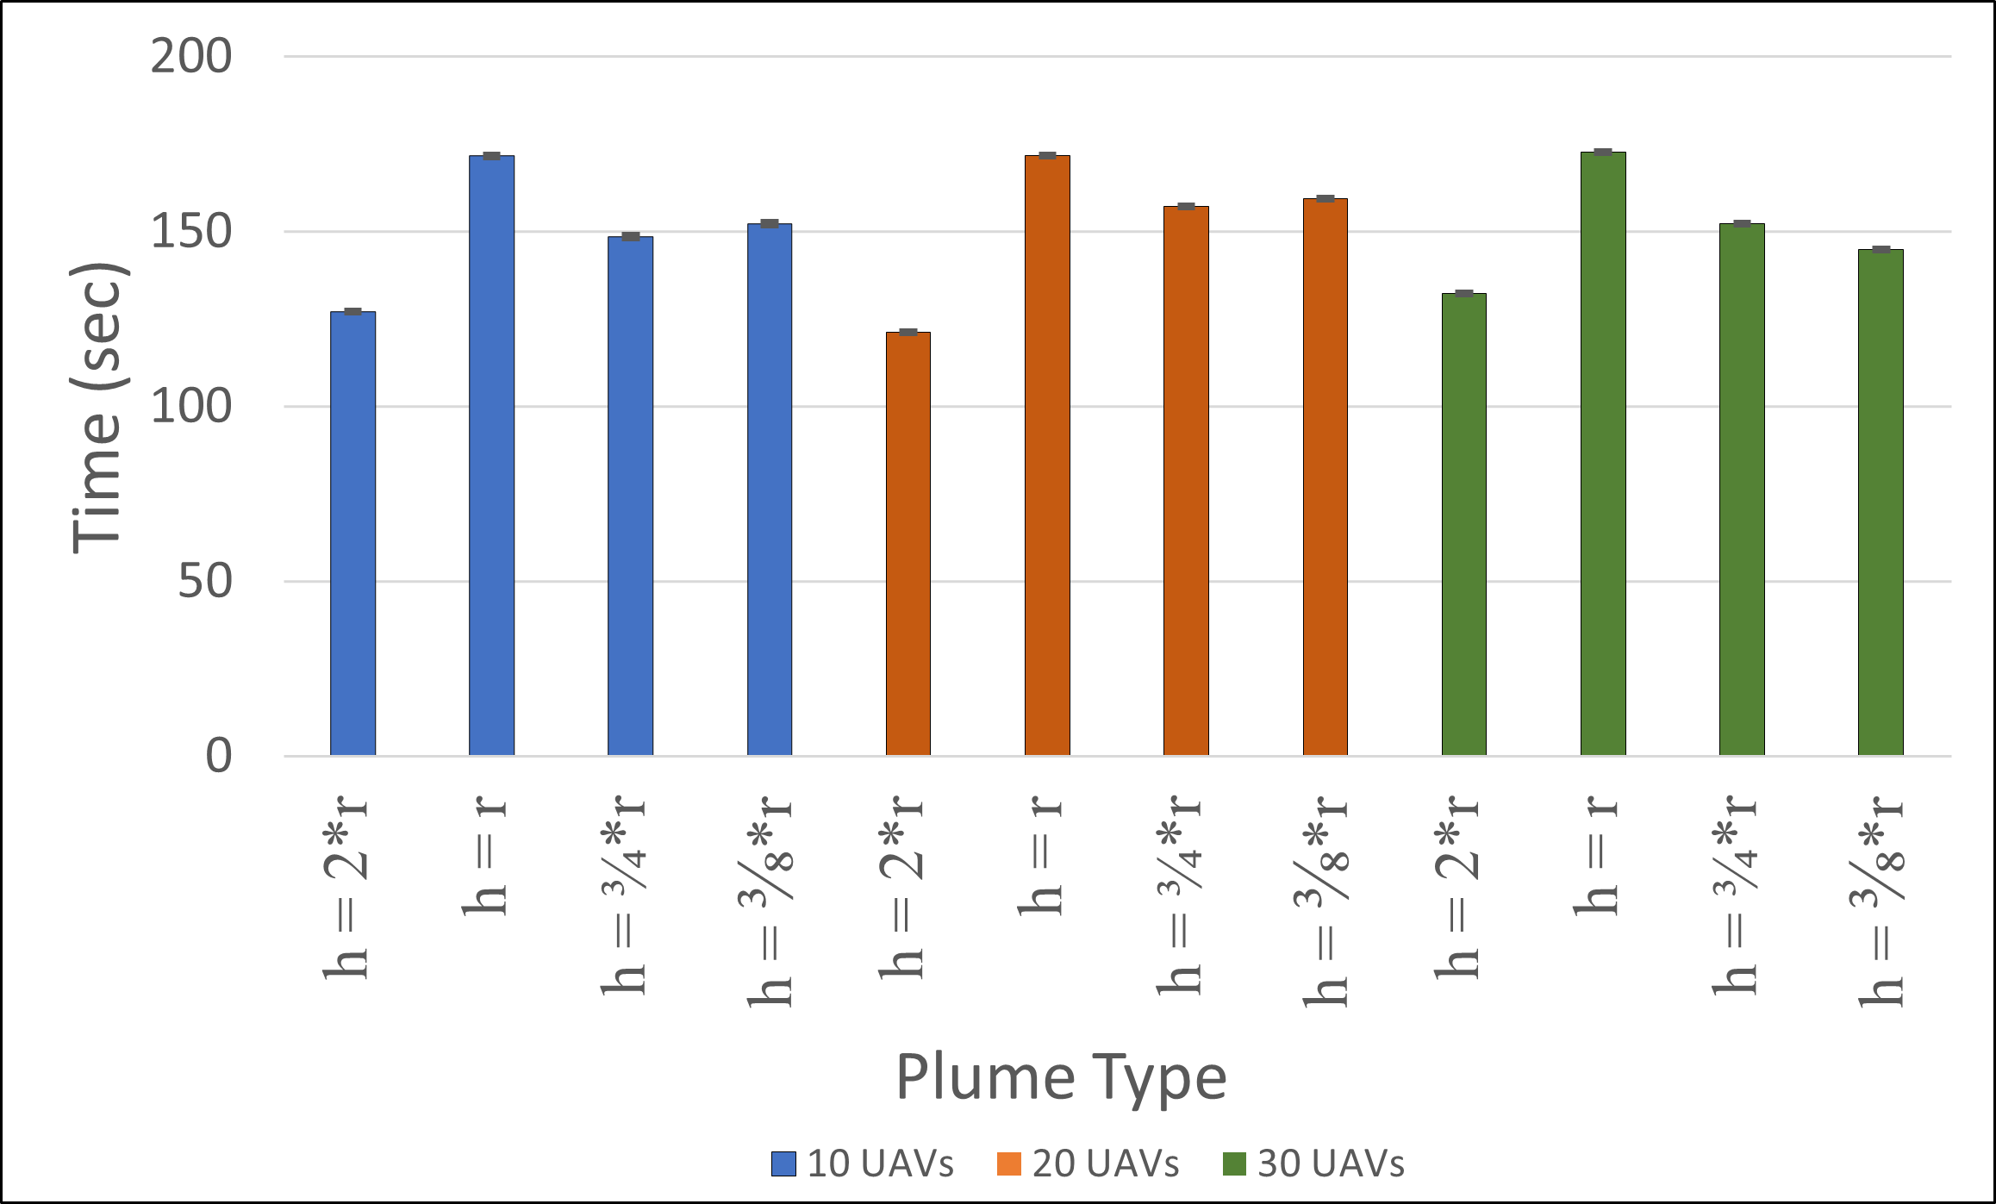
Time per Dome Height
h = height of plume dome which needs to be wrapped
Time taken by UAVs during Stop-Click
Phase for different heights

Slide 19
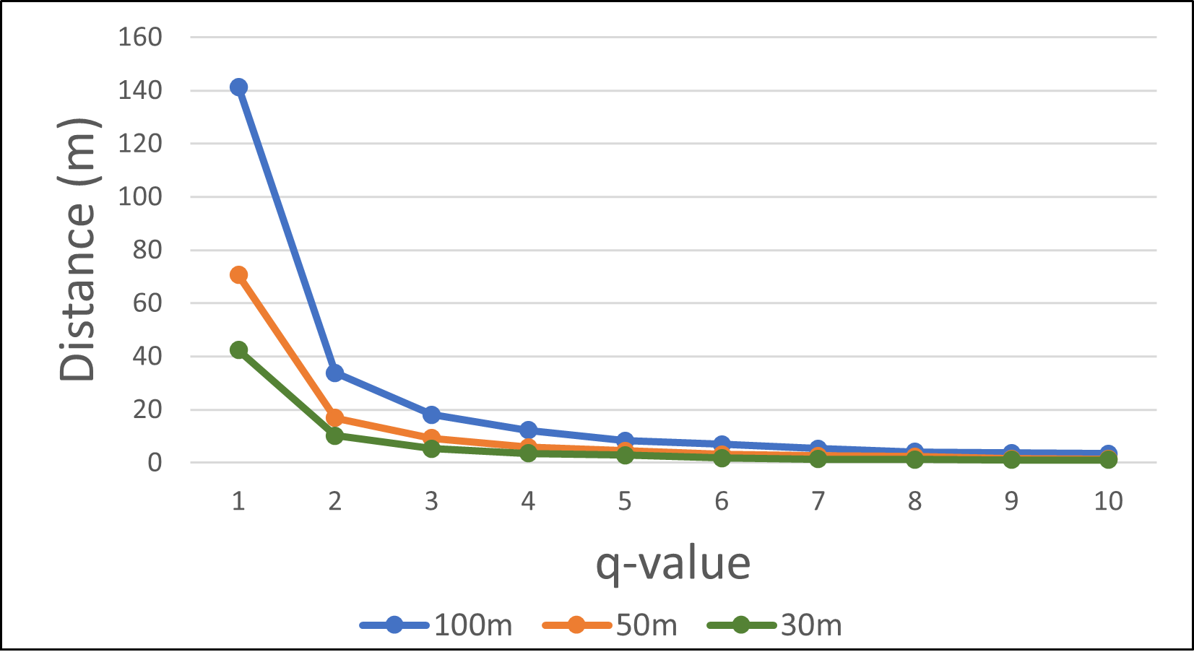
Distance Moved per Tightening Operation
Maximum distance moved as q-value increases. Blue, Orange and Green lines indicate radius of 100m, 50m and 30m, respectively.

Slide 20
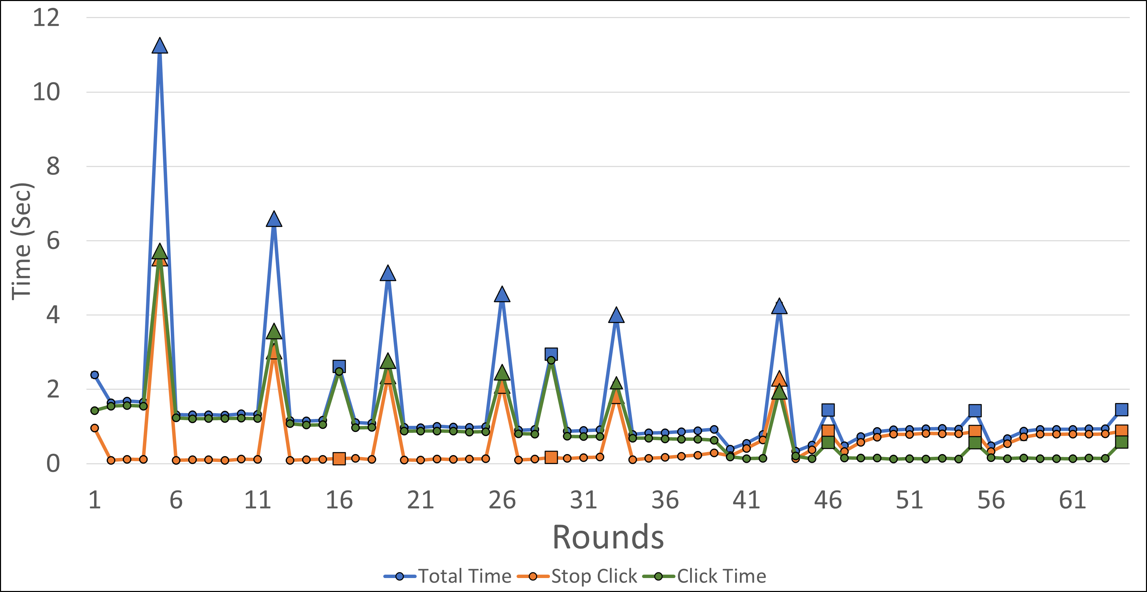
Time Per Round
Time taken by 30 UAVs per round during Stop-Click Phase.

Slide 21
CLOSING REMARKS

Slide 22
SUMMARY & FUTURE WORK
We have presented an algorithm for mapping a dome shaped plume by a fully autonomous UAV group.
Our algorithm is robust, efficient and able to correctly map a dome of any height.
In the future, we would like to take a look at other Plume Types, which may be less regular or dynamic in nature.
We would also like to delve into a more realistic communication model which would include message loss and multi-hop communication.

Slide 23
Thank you

