Slide 1




On the “Naturalness” of Buggy Code
Baishakhi Ray, Vincent Hellendoorn, Saheel Godhane,
Zhaopeng Tu, Alberto Bacchelli, Prem Devanbu
^{NSF Grant No. 1414172}
Notes:
Good morning every one. I am Baishakhi Ray from University of Virginia. Today I will talk about “On the “Naturalness” of Buggy Code”.
This is a joint work from UC Davis, TU Delft, and Huawei
NSF grant No

Slide 2
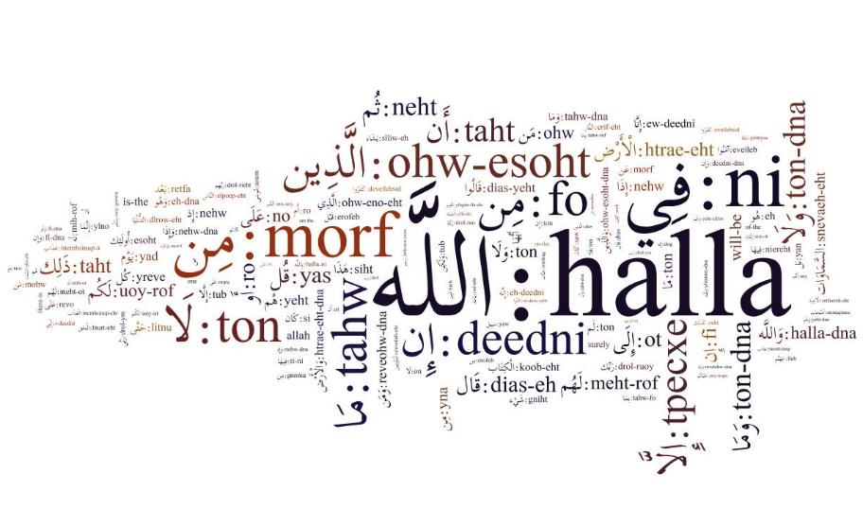
Notes:
When we speak in natural language like English, it is usually very repetitive and has regularities that allow us to communicate naturally.

Slide 3

Coffee or …?
for ( …?
Notes:
It turns out, Real software, that developers produce everyday to solve real-world problems, tend to be natural like speech.

Slide 4
Real Programs are Natural!!
Highly repetitive, predictable,
amenable to large-sample statistical methods
[Hindle Et al., Allamanis et al., Nguyen et al.]
Notes:
They are highly repetitive, predictable, and amenable to large-sample statistical methods.
This Naturalness was exploited to build different software engineering applications
like code suggestion engines, porting tools, coding standards checkers, and idiom miners

Slide 5

What does it mean when code is “unnatural” ?
Is “unnatural” code more defect-prone?
What is unnatural
code?
How are they related to bugs?
Notes:
So, what does it mean about unnatural code?
In particular, today we will discuss: is “unnatural” code more defect-prone?
In the first part of my talk, I will explain what do we mean by un-naturaless?
And then we will see how such unnatural code is related to bug?

Slide 6
Naturalness of Code : N-Gram Language Model
Given the previous words, learn the conditional distribution of the next word.
n-grams
frequencies
probabilities
for ( int i = 0 … 14 0.70
for ( int i = start … 5 0.25
for ( int i = end … 1 0.05
Notes:
Previously, naturalness of code was successfully captured by n-gram language model,
which learns conditional distribution of a word given its previous words.
For example, in a code corpus, if tokens “for int i equals“ are followed by three distinct tokens:
“0” , “start”, and “end” with frequencies 14, 5, and 1 respectively,
n-gram will assign higher probability to token “start” since it is most likely to occur.

Slide 7
Naturalness of Code : N-Gram Language Model
Given the previous words, learn the conditional distribution of the next word.
n-grams
frequencies
probabilities
for ( int i = 0 … 14 0.70
for ( int i = start … 5 0.25
for ( int i = end … 1 0.05
Less seen token
Un-natural Code
Notes:
In contrast, less seen token ‘end’ will have least probability.
We call such improbable program element as “unnatural” code.

Slide 8
Naturalness of Code : N-Gram Language Model
n-grams
frequencies
probabilities
for ( int i = end … 1 0.05
Unnaturalness is measured by entropy (“improbability”)
Higher entropy value = lower probability
= less naturalness
Notes:
We measure the unnaturalness by cross-entropy, a widely used metric from information theory.
Entropy measures the improbability of seeing a tokens in a given corpus.
Higher the entropy value, the token is more likely to be unnatural.

Slide 9
How does “unnatural” code relate to bugs?
=> Buggy lines of code
for Defect prediction
vs. Static analysis tools
in defect prediction
Unnatural code
Notes:
RQ1. Are buggy lines more unnatural than non-buggy lines? What happens when the bugs are fixed?
RQ2. Is unnaturalness useful for defect prediction?
RQ3. How does Unnaturalness vs. Static analysis preform for defect prediction?

Slide 10
Methodology
Step 1: Identify buggy lines in each version
Step 2: Measure entropy of each program line

Slide 11

Methodology: Identify Buggy Lines
Post Release Bugs
Issue DB
Pre Release Bugs
Commit Message
Fixed minor
batch request
bugs. This solves
issue #XXX
Project
Time Line
c0
c1
c2
c3
Notes:
To identify the buggy lines in a given corpus.
First, in a project evolutionary history, we retrieved all the commits.
Out of them, we tried to locate the bug-fix commits.
We consider both the pre-release and post-release bugs.
For post-release bugs, we retrieved such information from issue data base.
For pre-release bugs we looked at the commit messages for bug-fix specific words (like fix, error, correction, etc.) to identify bug-fix commits.

Slide 12

Methodology: Identify Buggy Lines
Post Release Bugs
Issue DB
Pre Release Bugs
Commit Message
Fixed minor
batch request
bugs. This solves
issue #XXX
Project
Time Line
c0
c1
c2
c3
Bug-fix
Notes:
If a commit messages include such key words, we mark them as a bug-fix patch.

Slide 13
Methodology: Identify Buggy Lines
Bugs
Fixes
Project
Time Line
c0
c1
c2
c3
Bug-fix
Notes:
1. The lines deleted in the patch are considered as buggy lines, while the lines added are marked as their fixes.

Slide 14
Methodology: Identify Buggy Lines
Bugs
Fixes
git blame
Project
Time Line
Project
Time Line
c0
c1
c2
c3
Bug
Bug-fix
Notes:
Next, we used git-blame to locate the original bug introducing commits.
These steps are analogous to the SZZ algorithm [50].

Slide 15
Methodology: Identify Buggy Lines
Buggy lines
Bugs
Fixes
Buggy lines
c0
c1
c2
c3
Snapshot 1
Snapshot 2
Snapshot 3
Notes:
1. Finally, we take snapshots of the project at different time interval
2. We then map those bugs to these snapshots
3. Thus, for each snapshot, we have annotated buggy and fixed lines.

Slide 16
Methodology: Measure Entropy
Training:
Other files in the snapshot
Cache-based n-gram
language model ($gram) [Tu et al., FSE 2014]
Output:
Entropy per
program line
Test:
Single file in a snapshot
Notes:
Next we use a cached based language model to generate entropy of each program line.
By using cache based model, we give priority to the n-grams that appear more in the local context.
For a file under test, we train the model with other files from the same snapshot.

Slide 17

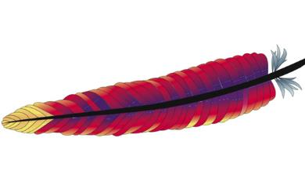
Study Subjects
Apache
Derby, Lucene, OpenJPA, Qpid, Wicket
GitHub
Atmosphere, Presto, Elasticsearch, Netty,
Facebook-android-sdk
10 projects, 120 versions, 113K Files, 35M Lines, 7K bugs
Notes:
Using this method, we studied 10 Open Source Java projects: five are taken from Github, while the others are from the Apache Software Foundation.
We studied 1 year of their evolutionary history, by taking snapshots at every month interval.
In total, we studied 10 projects, 113 thousands files, 35 Million Lines, and 7thousands bugs.

Slide 18


Slide 19
RQ1. Are buggy lines more “unnatural" than non-buggy lines?
The difference is more for low latency & less scattered bugs
Notes:
We begin with the question 1. Are buggy lines more “unnatural" than non-buggy lines?
2. To evaluate this question, we compare entropies of buggy and non-buggy lines for all the studied snapshots.
3. As you can see from the box plot, buggy lines indeed have more entropy than the non-buggy lines with statistical significance.

Slide 20
RQ2: Do buggy lines become more “natural" after bug-fixes?
Notes:
4. A natural question follows: whether the entropies of these buggy lines drop once the bugs are fixed.
5. As the box plot suggests, this is also true. Buggy lines indeed become more natural after repair.

Slide 21
RQ2. Do buggy lines become more “natural" after bug-fixes?
Netty: incorrect method call
if (isTerminated()) { - terminationFuture.setSuccess(null); // entropy = 5.96 + terminationFuture.trySuccess(null); // entropy = 1.34 }
Entropy dropped after bugfix : 4.63
Lucene: missing conditional check
if (!directory.exists()) - directory.mkdir(); // entropy = 9.21 + if (!directory.mkdir()) // entropy = 5.34 + throw new IOException (…)
Entropy dropped after bugfix : 3.87
Buggy lines have higher entropies than non-buggy lines; entropy drops after bug-fixes.
Notes:
Let’s see couple of examples.
This is an instance of incorrect method call in project Netty.
Instead of calling the method trySuccess, which were used many times in the same file,
the developer incorrectly called the method setSuccess.
Once developer fixed it, the entropy drops by more than 4 bit.
Here is another example of missing conditional check in Project Lucene.
The developer should check whether directory creation is successful by checking return value of mkdir() call.
Once it was fixed, the entropy again drops by around 4 bits.
So in conclusion, we can say that buggy lines in general has higher entropies than non-buggy lines; entropy drops after bug-fixes.

Slide 22
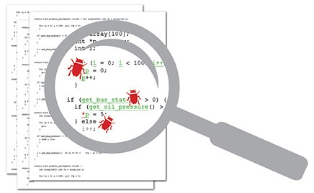
RQ3. Is unnaturalness useful for defect prediction?
Baseline:
Order lines
randomly
Order lines
by decreasing entropy
Notes:
- Next, we check whether unnaturalness can be used for defect prediction?
- Specifically, if we order the lines by decreasing entropy score, and inspect only top 5% lines, whether we can find more bugs than just ordering the lines at random.

Slide 23
RQ3. Is unnaturalness useful for defect prediction?
AUCEC = Area under the cost-effectiveness curve.
Cost is inspection effort and payoff is number of bugs found
Notes:
To evaluate the defect prediction performance, we adopt AUCEC , Area Under the Cost-Effectiveness Curve.
Here, cost is inspection effort and payoff is the number of bugs found.
Like ROC, AUCEC is a non-parametric measure that does not depend on the defects’ distribution

Slide 24

RQ3. Is unnaturalness useful for defect prediction?
Order lines
by decreasing entropy
Problem: some line types are more entropic than others (eg., import statement vs. for loop)
Notes:
Such inter-type entropy differences do not necessarily reflect their true bug-proneness.
In fact, for-statements, though less entropic, are often more bug-prone than the more entropic import-declarations.

Slide 25

RQ3. Is unnaturalness useful for defect prediction?
Problem: some line types are more entropic than others (eg., import statement vs. for loop)
Solution: can we leverage the line types?
$gram+Type: how much a line’s entropy
deviates from the mean entropy of its own
line-type (normalized Z-score)
$gram+Type+History: how much a line-type
was buggy in the past.
Notes:
We extend our model by checking how much a line’s entropy deviates from the mean entropy of its own line-type.
We further enhance the model by considering bug proneness of individual type, i.e., how much a line-type
was buggy in the past.

Slide 26
RQ3. Is unnaturalness useful for defect prediction?
$gram
$gram+Type
$gram+Type+History
random
Entropy can be used to guide bug-finding efforts
at line level
Notes:
With Type information, unnaturalness based defect prediction is
performing more than two times better than random, while inspecting top 5% of the ordered source code lines.
The performance is further improved while considering the bug-prone history.
So, we can say that entropy can be used for bug finding effort.

Slide 27
RQ4. How does unnaturalness perform against static bug finding technique?
decreasing warning
level of Static Bug Finder
decreasing entropy
Compared against two popular static bug finding tools:
FindBugs and PMD
Notes:
Next we check, how does “unnaturalness” perform against static bug finding technique?
And here in one setting, we order the line with decreasing entropy score.
In another setting, we order the line with warning level of static bug finder.
We compared with two popular tools: PMD and FindBugs.

Slide 28
RQ4. How does unnaturalness perform against static bug finding technique?
$gram+Type+History
PMD
random
Entropy achieves comparable performance to commonly used Static Bug Finders in defect prediction.
Notes:
Performance varied substantially between projects and between releases of the same project.
Across all releases both the models performed significantly better than random.
However, Static and Naturalness based bug finders perform comparably;

Slide 29
RQ5. Does unnaturalness boost inspection effort on Static Bug Finder’s warnings?
Ordering Static Bug Finder’s warnings by priority and entropy significantly improves SBF performance.
Notes:
However, if we order the Static Bug Finder’s warnings by both priority and entropy, we see the maximum
Boost in defect prediction performance.

Slide 30

Summary
=> Buggy lines of code
for Defect prediction
vs. Static analysis tools
Unnatural code
Implications: Search-based bug repair may benefit for both fault-localization and searching for fixes
Notes:
RQ1. Are buggy lines more unnatural than non-buggy lines? What happens when the bugs are fixed?
RQ2. Is unnaturalness useful for defect prediction?
RQ3. How does Unnaturalness vs. Static analysis preform for defect prediction?

Slide 31





Acknowledgement
National Science Foundation
(Grant 1414172)

Slide 32
Questions?
=> Buggy lines of code
for Defect prediction
vs. Static analysis tools
Unnatural code
Implications: Search-based bug repair may benefit for both fault-localization and searching for fixes
Notes:
RQ1. Are buggy lines more unnatural than non-buggy lines? What happens when the bugs are fixed?
RQ2. Is unnaturalness useful for defect prediction?
RQ3. How does Unnaturalness vs. Static analysis preform for defect prediction?

Slide 33
Naturalness of Code: Cache Language Model
Global Context
Local Context
for ( int i = 0; i < 10; ++ i )
…
for ( int i = 0; i < 10; ++ i )
…
for ( int i = 0; i < 10; ++ i )
…
for ( int i = start; i < end; ++ i )
…
for ( int i = start; i < end; ++ i )
…
An additional cache component that memorizes the n-grams in the locality to capture [Tu et al. FSE.14]
0: n-gram model
for (int i = ?
start: cache model ($gram)
^{$gram is used} measure entropy of each program statement
Notes:
We measured entropy using a cache-based language model
Consider, in most of the files in a project we have a loop variable i, initialized with 0
However, in a particular file, the loop variable is initialized with start
Tu et al. proposed an a new model based on additional cache component that memorizes the n-grams in the locality to capture.
Thus, for the given prefix, regular n-gram model would find 0 more natural, while cache gram model will find “start” to be more natural in the given local context
We use such cache based model to measure entropy of each lines of code.

Slide 34
RQ4. How does “unnaturalness” perform against static bug finding technique?
There might be unwarned lines!!
decreasing warning
level of SBF
decreasing entropy
Assign 0 value to unwarned lines
Some lines will have same warning level!!
Add a random tie-breaker!!
Notes:
Next we check, how does “unnaturalness” perform against static bug finding technique?
And here in one setting, we order the line with decreasing warning level of static bug finder
First assign each line the value zero if it was not marked by the SBF and the value of the SBF priority otherwise.
Then, we add a random tie-breaker from to all line-values and order the lines by descending value.
This last step simulates the developer randomly choosing to investigate the lines returned by SBF: first from those marked by the SBF in descending (native, SBF tool- based) priority, and within each priority level at random. We repeat the simulation multiple times and average the performance.
Performance varied substantially between projects and between releases of the same project. Across all releases all models performed significantly better than random. However, Static and Naturalness based bug finders perform comparably;

Slide 35
Summary
Unnatural code is more likely to be buggy.
Can be effective for defect prediction, even at line granularity.
A simple way to complement static bug finding techniques.
Search-based bug-fixing methods may benefit from using entropy both for fault-localization and searching for fixes.
Check it out @ http://odd-code.github.io

