Slide 1
APEx: Automated Inference of Error Specifications for C APIs
Yuan Kang¹, Suman Jana¹, Baishakhi Ray²
¹Columbia University
²University of Virginia
ASE 2016, September 6, 2016

Slide 2

Incorrect error handling: a serious source of bugs
One of OWASP’s top 10 sources of security vulnerabilities
CVE-2015-0208
CVE-2015-8617
CVE-2015-0288
CVE-2015-7941
CVE-2014-9826
CVE-2015-8340
CVE-2015-0285
CVE-2014-0092
CVE-2015-0292
...

Slide 3
Error handling is especially problematic in C
int ret = func1(...);
if (ret == 0) {
/* pass the error upstream or exit */
}
char *ptr = func2(...);
if (!ptr) {
/* pass the error upstream or exit */
}
No built-in exception reporting mechanism
Developers design custom error protocols (e.g., 0 means error)

Slide 4

We need error specs
What are the errors?
Where are the errors?
Dynamic analysis: Fault injection [Marinescu et al.]
Static analysis: EPEx [Jana et al.]

Slide 5
Automated, accurate & relevant
Manually from documentation and code
Apply general intuition
Not Automated
Not Accurate
Is the error critical?

Slide 6
APEx: automated error path exploration

Slide 7

Non-error paths
if (inflateInit2(...) != 0)
return;
buf = malloc(...);
if (buf != NULL) {
while(1) {
status = inflate(...);
if (status == 0) {...}
else break;
}
}
inflateEnd(...);

Slide 8

Error paths
if (inflateInit2(...) != 0)
return;
buf = malloc(...);
if (buf != NULL) {
while(1) {
status = inflate(...);
if (status == 0) {...}
else break;
}
}
inflateEnd(...);

Slide 9
Error vs. non-error paths
Error paths are less complex
Less statements
Less function calls
Less branches
Error constraints:
Less paths
if (inflateInit2(...)
!= 0)
return;
buf = malloc(...);
if (buf != NULL) {
while(1) {
...
}
}
inflateEnd(...);

Slide 10
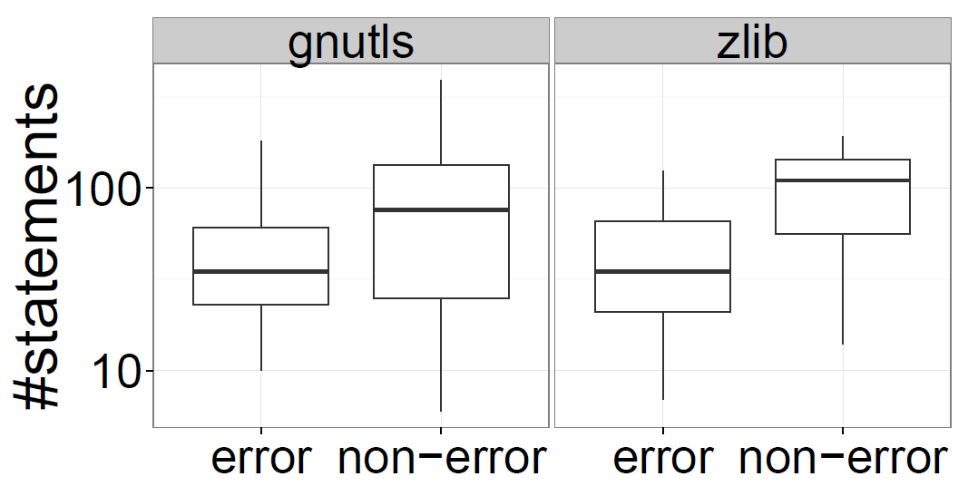
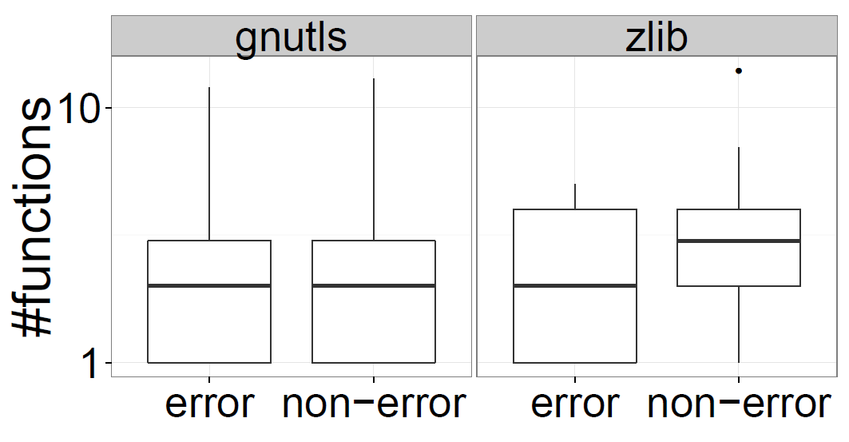

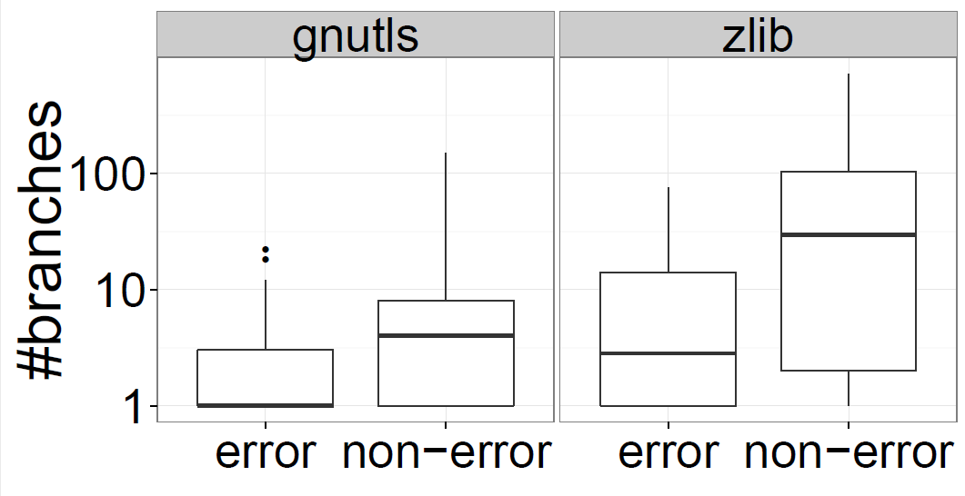
What matters?

Slide 11
Identifying error constraints
Gather path features
Statement count
Combine path features of constraints
Path count
Median statement count
if (inflateInit2(...)
!= 0)
return;
buf = malloc(...);
if (buf != NULL) {
while(1) {
...
}
}
inflateEnd(...);
!= 0 is the inferred error constraint

Slide 12



What about mistakes?
No error spec

Slide 13
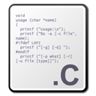


APEx architecture
Error spec
Application source codes
Gathering path features
Voting
APEx

Slide 14
Implementing APEx in Clang
Used Clang static analyzer for under-constrained symbolic execution
Implemented as a custom checker
1180 lines of C++ code and 7063 lines of Python code

Slide 15






Evaluation subjects
GnuTLS
GTK
libc
libgcrypt
6 libraries
28 applications
67 combinations

Slide 16
Precision
APEx | Baseline
77% | 64%

Slide 17
Running time
Application | LOC | Time
ClamAV | 575104 | 1h 3m 39s
Pidgin | 343416 | 1h 37m 50s
Grep | 285705 | 6m 59s
GnuTLS | 179322 | 59m 18s

Slide 18
A simple application
Is fallible function checked?
If not, it’s a bug
Ignore if majority does not check
Probably not a critical error

Slide 19
Bug finding accuracy
Unfiltered bugs | Filtered bugs | Real bugs | Precision
3256 | 175 | 118 | 67%

Slide 20
Exhibit 1: OpenSSL & Mutt
static int ssl_socket_open (CONNECTION *conn)
{
...
data->ctx = SSL_CTX_new (SSLv23_client_method ());
if (!option(OPTTLSV1)) {
SSL_CTX_set_options(data->ctx, SSL_OP_NO_TLSv1);
}
...
}
Crash

Slide 21
Exhibit 2: GnuTLS & Pidgin
static PurpleCertificate *
x509_import_from_datum(const gnutls_datum_t dt,
gnutls_x509_crt_fmt_tmode)
{
...
gnutls_x509_crt_init(&(certdat->crt));
...
}
Invalid certificate

Slide 22
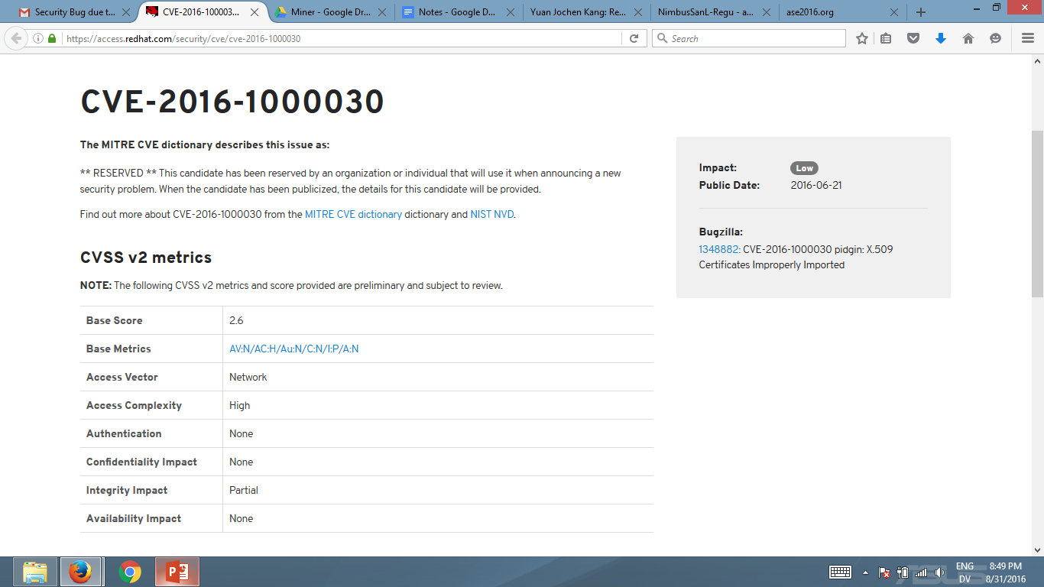
Exhibit 2: GnuTLS & Pidgin

Slide 23
Exhibit 3: libgcrypt & misc
Missing thread safety
gcry_control (GCRYCTL_SET_THREAD_CBS, ...);
gcry_control (GCRYCTL_INIT_SECMEM, ..., ...);
Insecure memory and user privileges

Slide 24
Limitations
Cleanup functions are always followed by simple code
Can the caller safely avoid an error in some cases?
Cleanup function
{
...
inflateEnd(...);
}

Slide 25
Conclusions
Error specs are needed for correct error handling and finding bugs
APEx can automatically identify error paths and error specs
Error paths have less statements
Error return values lead to less paths
APEx can successfully find error handling bugs
Check us out on: https://github.com/yujokang/APEx

