Slide 1
Basic Program Analysis: AST
CS 4501
Baishakhi Ray

Slide 2
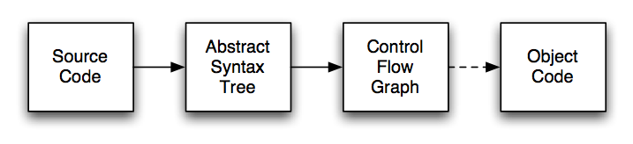
Compiler Overview
Abstract Syntax Tree : Source code parsed to produce AST
Control Flow Graph: AST is transformed to CFG
Data Flow Analysis: operates on CFG

Slide 3
The Structure of a Compiler
Source code (stream of characters)
scanner
stream of tokens
parser
Abstract Syntax Tree (AST)
checker
AST with annotations (types, declarations)
code gen
Machine/byte code

Slide 4
Syntactic Analysis
Input: sequence of tokens from scanner
Output: abstract syntax tree
Actually,
parser first builds a parse tree
AST is then built by translating the parse tree
parse tree rarely built explicitly; only determined by, say, how parser pushes stuff to stack

Slide 5
Example
Source Code
4*(2+3)
Parser input
NUM(4) TIMES LPAR NUM(2) PLUS NUM(3) RPAR
Parser output (AST):
*
+
NUM(4)
NUM(2)
NUM(3)

Slide 6
Parse tree for the example: 4*(2+3)
EXPR
EXPR
EXPR
NUM(4) TIMES LPAR NUM(2) PLUS NUM(3) RPAR
leaves are tokens

Slide 7
Another example
Source Code
if (x == y) { a=1; }
Parser input
IF LPAR ID EQ ID RPAR LBR ID AS INT SEMI RBR
Parser output (AST):
IF-THEN
==
=
ID
ID
ID
INT

Slide 8
Parse tree for example: if (x==y) {a=1;}
STMT
BLOCK
STMT
EXPR EXPR
IF LPAR ID == ID RPAR LBR ID = INT SEMI RBR
leaves are tokens

Slide 9
Parse Tree
Representation of grammars in a tree-like form.
Is a one-to-one mapping from the grammar to a tree-form.
A parse tree pictorially shows how the start symbol of a grammar derives a string in the language. … Dragon Book

Slide 10
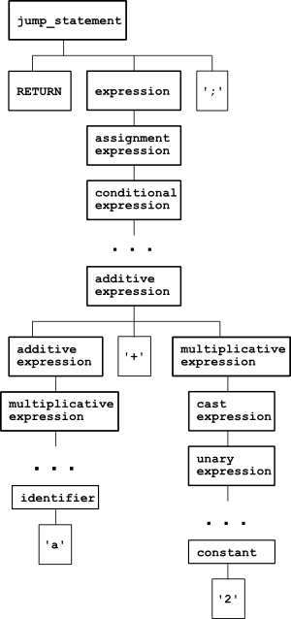
C Statement: return a + 2
a very formal representation that strictly shows how the parser understands the statement return a + 2;

Slide 11
Abstract Syntax Tree (AST)
Simplified syntactic representations of the source code, and they're most often expressed by the data structures of the language used for implementation
Without showing the whole syntactic clutter, represents the parsed string in a structured way, discarding all information that may be important for parsing the string, but isn't needed for analyzing it.
ASTs differ from parse trees because superficial distinctions of form, unimportant for translation, do not appear in syntax trees.. … Dragon Book

Slide 12
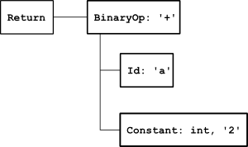
AST
C Statement: return a + 2

Slide 13
The Structure of a Compiler
Source code (stream of characters)
scanner
stream of tokens
parser
Abstract Syntax Tree (AST)
checker
AST with annotations (types, declarations)
code gen
Machine/byte code

Slide 14
Checker (Semantic Analysis)
Determine whether source is meaningful
Check for semantic errors
Check for type errors
Gather type information for subsequent stages
– Relate variable uses to their declarations
Some semantic analysis takes place during parsing
Example errors (from C)
function1 = 3.14159;
x = 570 + “hello, world!” scalar[i];

Slide 15
Syntactic & Semantic Analysis
Symbol Tables
Compile-time data structures
Hold names, type information, and scope information for
variables
Scopes
A name space
e.g., In C, each set of curly braces defines a new scope
– Can create a separate symbol table for each scope

Slide 16
Syntactic & Semantic Analysis
Using Symbol Tables
For each variable declaration:
Check for symbol table entry
Add new entry (parsing); add type info (semantic analysis)
For each variable use:
Check symbol table entry (semantic analysis)

Slide 17
Disadvantages of ASTs
AST has many similar forms
E.g., for, while, repeat...until
E.g., if, ?:, switch
Expressions in AST may be complex, nested
(x * y) + (z > 5 ? 12 * z : z + 20)
Want simpler representation for analysis
...at least, for dataflow analysis
int x = 1 // what’s the value of x ?
// AST traversal can give the answer, right?
What about int x; x = 1; or int x= 0; x += 1; ?

