Slide 1
Program Slicing
Baishakhi Ray
University of Virginia
Adopted From U Penn CIS 570: Modern Programming Language Implementation (Autumn 2006)

Slide 2
Program Slicing
In computer programming, program slicing is the computation of the set of programs statements, the program slice, that may affect the values at some point of interest, referred to as a slicing criterion. ---- Wikipredia
int i;
int sum = 0;
int product = 1;
for(i = 1; i < N; ++i) {
sum = sum + i;
product = product * i;
}
write(sum);
write(product);
int i;
int sum = 0;
for(i = 1; i < N; ++i) {
sum = sum + i;
}
write(sum);

Slide 3
Program Slicing
Backward slice
The backward slice at program point p is the program subset that may affect p
Executable
A slice is executable if the statements in the slice form a syntactically correct program that can be executed.
Forward slice
The forward slice at program point p is the program subset that may be affected by p
Dynamic Slice
A dynamic slice of a program with respect to an input value of a variable v at a program point p for a particular execution e of the program is the set of all statements in the program that affect the value of v at p during execution e.
Chop
The chop between program points p and q is the program subset that may be affected by p and that may affect q

Slide 4
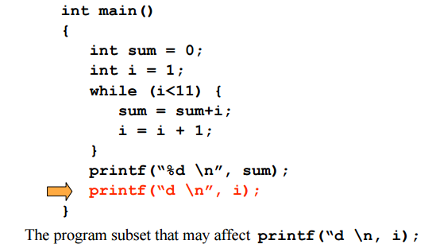
Backward Slice

Slide 5
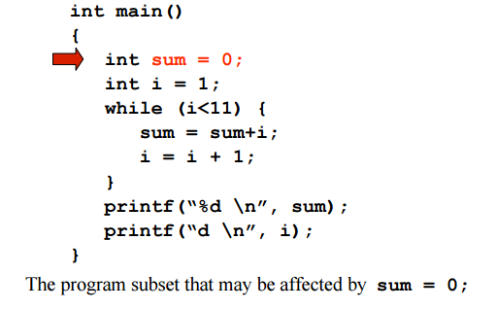
Forward Slice

Slide 6
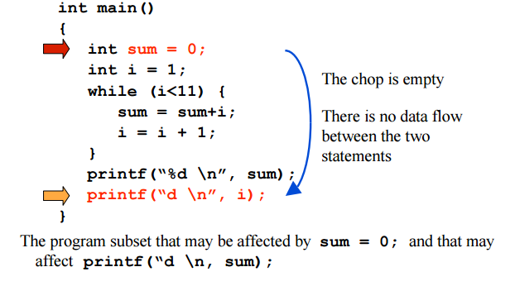
Chop

Slide 7
Dynamic Slice
read (n)
for I := 1 to n do 3. a := 2
if c1 then
if c2 then
6. a := 4
7. else
8. a := 6
z := a
write (z)
Input n is 1; c1, c2 both true Execution history is
1¹, 2¹, 3¹, 4¹, 5¹, 6¹, 9¹,
2², 10¹
Criterion<1, 10¹, z>

Slide 8
Static vs. Dynamic
read (n)
for I := 1 to n do 3. a := 2
if c1 then
if c2 then
6. a := 4
7. else
8. a := 6
z := a
write (z)
read (n)
for I := 1 to n do 3. a := 2
if c1 then
if c2 then
6. a := 4
7. else
8. a := 6
z := a
write (z)
Static slice
<10, z>

Slide 9
Uses of Program Slicing
Program understanding & debugging
What is affected by what?
Program restructuring
Isolate functionally distinct pieces of code
Program specialization and reuse
Use slices to represent specialized pieces of code
Only reuse relevant slices
Program differencing
Compare slices to identify program changes

Slide 10
Uses of Program Slicing
Test coverage
What new test cases would improve code coverage?
What regression tests should be run after a change?
Model checking
Reduce state space by removing irrelevant parts of the program
Automatic differentiation
Activity analysis– what variables contribute to the derivative of a function?

Slide 11
How Do We Compute Slices?
Reachability in a dependence graph
Program Dependence Graph (PDG)
Represents dependences within one procedure
Intra-procedural slicing is reachability in one PDG
System Dependence Graph (SDG)
Represents dependences within entire system
Inter-procedural slicing is reachability in the SDG

Slide 12
Intra-procedural Slicing
Program Dependence Graph (PDG)
Nodes are statements
Edges represent either:
Control dependence
Data dependence
Backward slice at point p:
compute backward reachability in the PDG from node p
Forward slice at point p:
compute forward reachability in the PDG from node p
Chop between points p and q:
identify all paths between p and q

Slide 13
Control Dependence Graph
A node Y is control-dependent on another node X iff X determines whether Y executes
there exists a path from X to Y such that every node in the path other than X and Y is post-dominated by Y
X is not post-dominated by Y

Slide 14
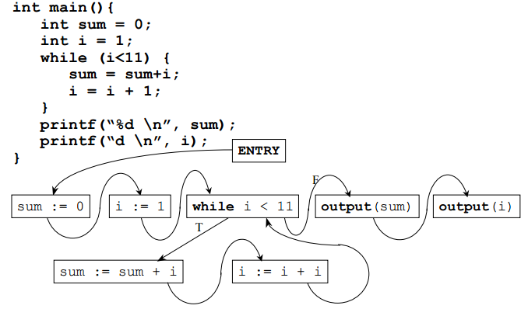
Control Flow Graph (CFG)

Slide 15
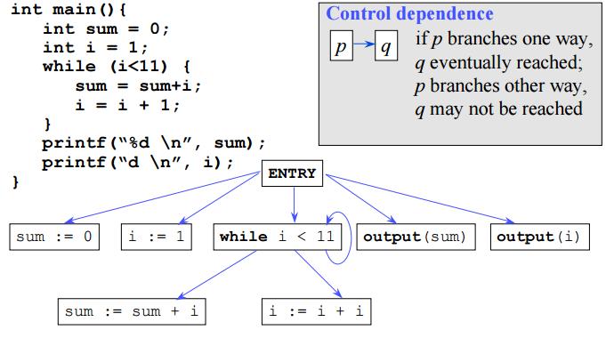
Control Dependence Graph

Slide 16
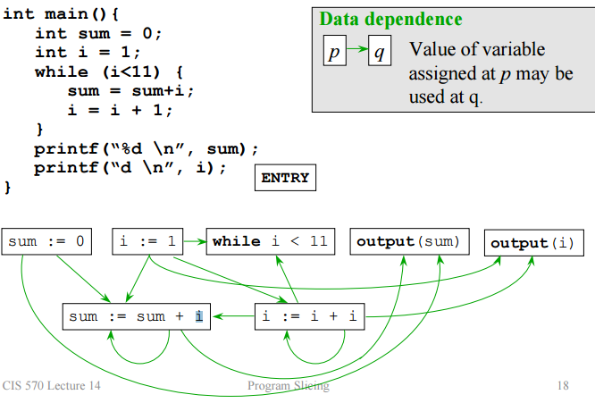
Data Dependence Graph

Slide 17
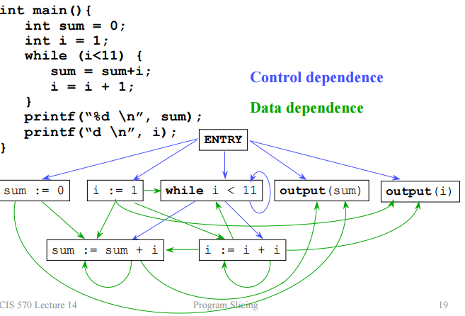
Program Dependence Graph (PDG)

Slide 18
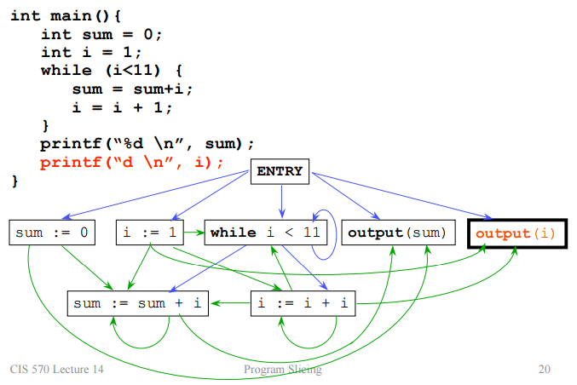
Backward Slice

Slide 19
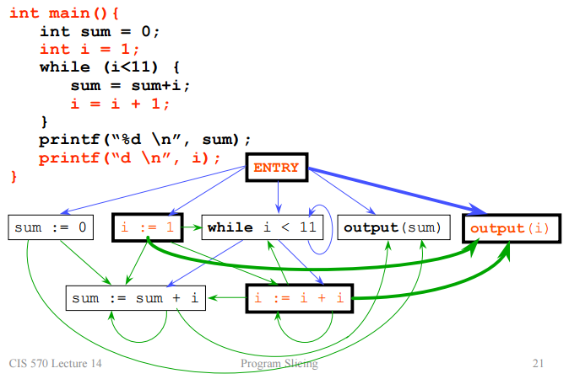
Backward Slice

Slide 20
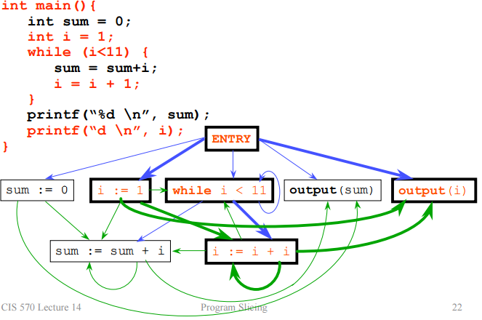
Backward Slice

Slide 21
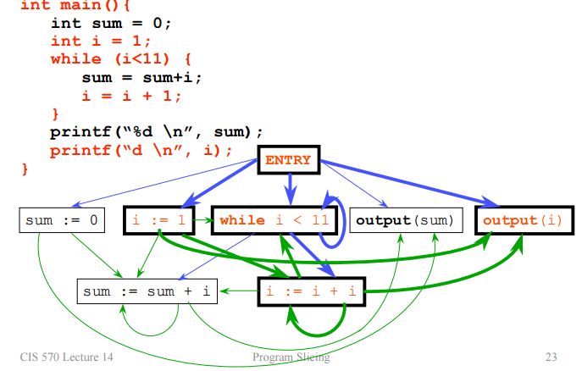
Backward Slice

Slide 22
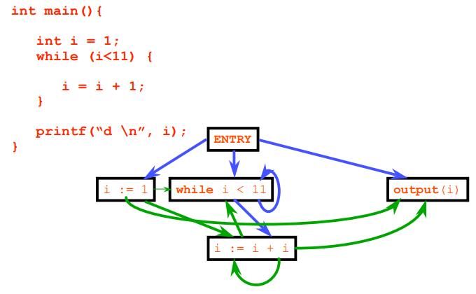
Slice Extraction

Slide 23
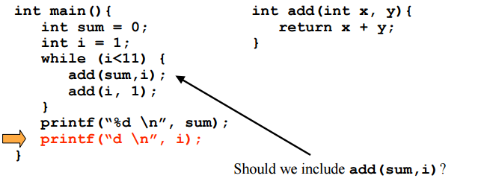
Interprocedural Analysis

Slide 24
Interprocedural Slicing
System Dependence Graph (SDG)
One PDG for each procedure
Additional edges
Connect calls to entries
Connect actual parameters to formal parameters
Connect procedure results to call-site return values

Slide 25
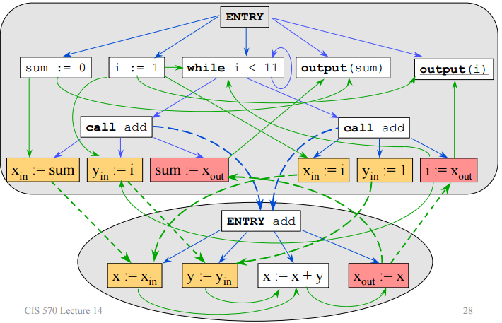
Example SDG

Slide 26
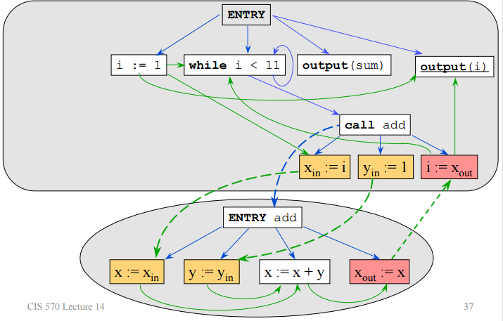
Example SDG

Slide 27
Recap
Parsing: Parse Tree & Abstract Syntax Tree
Control Flow Analysis: Basic Block, Dominant Analysis, natural Loop
Data Flow Analysis: Liveness analysis, Def-Use Chain, Reachability Analysis
Program Slicing

