Slide 1




The Uniqueness of Changes:
Characteristics and Applications
Baishakhi Ray, Meiyappan Nagappan,
Christian Bird, Nachi Nagappan, Thomas Zimmermann

Slide 2

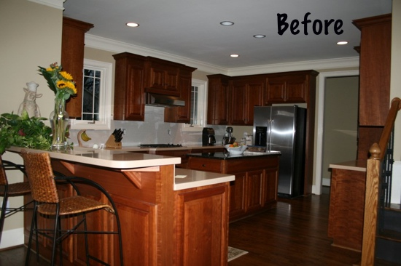
Renovating kitchen?
MOTIVATION | METHODOLOGY | CHARACTERISTICS | APPLICATION | Conclusion
Notes:
Most engineering work goes through several remodeling phases to cater evolving requirements.
Here we see pictures of a kitchen before and after its renovation.
Most of the changes are very common, you would probably expect in a typical kitchen renovation.
For example, they introduce marble top, changed colors.
However, the tables lamps and chairs gave a special look to the kitchen.

Slide 3

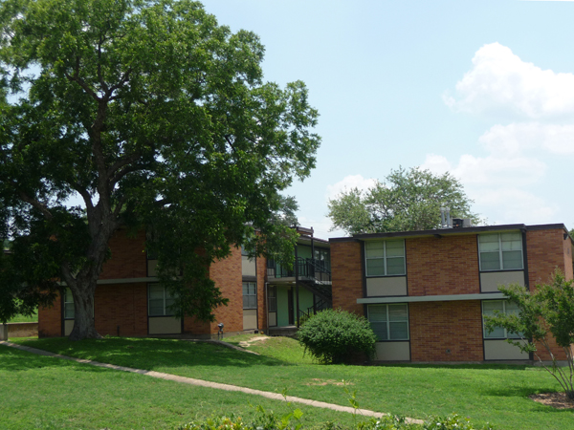
Unique vs. Non-Unique changes
MOTIVATION | METHODOLOGY | CHARACTERISTICS | APPLICATION | Conclusion
Notes:
If you want to create a major change, say building a tower……..that often becomes landmark.
It requires huge cost, planning etc.
Even changing this unique pattern also are non-trivial.
On the contrary, this is university housing, where we live.
It follows a very well-defined repetitive pattern.
So if you want to introduce something new in one apartment, you can easily follow the same for the rest of the apartment.

Slide 4

What about Software?
MOTIVATION | METHODOLOGY | CHARACTERISTICS | APPLICATION | Conclusion
Notes:
We argue that software also follows the same renovation model.

Slide 5
Unique vs. Non-Unique changes
src file: rtl8192ce/hw.c developer: Johannes Berg commit date: 2013-02-07 | src file: rtl8192cu/hw.c developer: Larry Finger commit date: 2013-05-30
void rtl92ce_update_hal_rate_mask(...) { ... u8 ratr_index; u8 ci_40mhz = (cap & 80211) ? 1 : 0; - u8 ci_20mhz = (cap & 80211) ? 1 : 0; + u8 cbw_40mhz = (sbandwidth >= 80211) ? 1 : 0; + u8 cgi_40mhz = cbw_40mhz ? 1 : 0; + u8 cgi_20mhz = cap & 80211 ? 1 : 0; … bool shortgi = false; ... } | void rtl92cu_update_hal_rate_mask(...) { ... - u8 ci_40mhz = mac->sgi_40; - u8 ci_20mhz = mac->sgi_20; - enum wireless_mode wirelessmode = mac->mode; + u8 cbw_40mhz = (bandwidth >= 80211) ? 1 : 0; + u8 cgi_40mhz = curtxbw_40mhz ? 1 : 0; + u8 cgi_20mhz = cap & 80211 ? 1 : 0; ... bool shortgi = false; ... }
Unique Changes
Non-unique Changes
MOTIVATION | METHODOLOGY | CHARACTERISTICS | APPLICATION | Conclusion
Notes:
Some changes are unique……it does not occur anywhere in the codebase.
Note that we are talking about unique and non-unique changes and not just the source code itself.
PatchID1 startLine1 endLine1 time1 u1 PatchID2 startLine2 endLine2 time2 u2 add delete
6151 214 269 2011-06-15 03:22:07.0000000 REDMOND\DEF 4839 942 945 2011-10-24 23:43:47.0000000 REDMOND\ABC 1 1

Slide 6
RQ: Are there Non unique changes?
MOTIVATION | METHODOLOGY | CHARACTERISTICS | APPLICATION | Conclusion

Slide 7
detecting Non-UNIQUE changes
Input: Set of program differences
- Program differences are generated by comparing different versions of a file.
Output: Lines that are changed similarly
- Similarly added lines
- Similarly deleted lines
Methodology
- Adopt Repertoire [Ray et al.]
MOTIVATION | METHODOLOGY | CHARACTERISTICS | APPLICATION | Conclusion

Slide 8
Study subject
 | Two Microsoft Projects | Linux
#Changed Files | 58k | 17k
Development Period | 2010 to 2013 | 2011 to 2013
#Developers | 1,627 | 4,216
#Changed LOC | 13M | 4M
MOTIVATION | METHODOLOGY | CHARACTERISTICS | APPLICATION | Conclusion
Notes:
We studied windows phone for this study
Altogether we studied around 59,000 file changes
Spanning over more than 2 years
It involves around 300 and 1300 developers respectively

Slide 9
Extent of Unique CHANGEs
Unique changes are more common than non-unique changes.
Non-unique changes form distinct patterns that often repeat multiple times in the code base within a short span of time.
MOTIVATION | METHODOLOGY | CHARACTERISTICS | APPLICATION | Conclusion

Slide 10
CHARACTERISTICS OF CHANGES
Developers have their own set of change non-unique patterns
that they use repeatedly.
Unique & non-unique changes are localized in certain modules.
MOTIVATION | METHODOLOGY | CHARACTERISTICS | APPLICATION | Conclusion

Slide 11
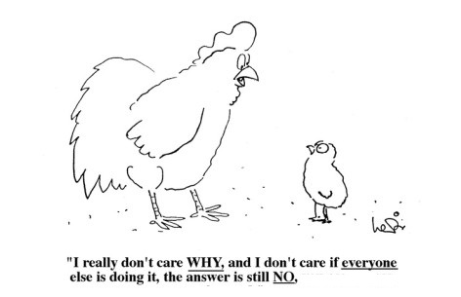
Why Should WE CARE?
MOTIVATION | METHODOLOGY | CHARACTERISTICS | APPLICATION | Conclusion

Slide 12
RISK ANALYSIS
non-uniqueness threshold | Lookup Period (month) | Linux | Microsoft (proj A + B)
 |  | Risk (significant p-values)
0.6 | 1 | 0.93 | 0.46
 | 2 | 0.88 | 0.46
 | 3 | 0.88 | 0.46
 | 4 | 0.87 | 0.46
 | 5 | 0.86 | 0.46
 | 6 | 0.85 | 0.45
Unique changes are more error-prone than non-unique changes.

Slide 13
RECOMMENDATION SYSTEM-I
When developers select a code fragment to modify, it recommends possible changes that similar code has experienced previously.
Avg. recall = 65.44%
Avg. Precision = 57.41%
MOTIVATION | METHODOLOGY | CHARACTERISTICS | APPLICATION | Conclusion

Slide 14
RECOMMENDATION SYSTEM-II
When developers commit a non-unique change, it recommends other change patterns that co-occurred with that committed change in the past.
Avg. recall = 0.47
Avg. precision = 0.41
MOTIVATION | METHODOLOGY | CHARACTERISTICS | APPLICATION | Conclusion

Slide 15
conclusion
Software evolution introduces both unique and non-unique patterns in the codebase.
Source code have different characteristics based on change uniqueness.
Knowledge of uniqueness of change help to build different applications.
MOTIVATION | METHODOLOGY | CHARACTERISTICS | APPLICATION | Conclusion

Slide 16

Questions!!
MOTIVATION | METHODOLOGY | CHARACTERISTICS | APPLICATION | Conclusion

Slide 17
Outline
Methodology
Characteristics
Applications
Conclusion

Slide 18
STEP1: Divide diffs into hunks
hunk1
File diff
(diff between two file versions)
hunk2
MOTIVATION | METHODOLOGY | CHARACTERISTICS | APPLICATION | Conclusion

Slide 19
Step 2: Identify Non-Unique code between HUNKS
Hunk1 | Hunk2
**** Old **** X1 for(i=0;i<MAX;i++){ X2 - x = array[i]+x; X3 - y = foo(x); X4 - x = x-y; X5 } **** New **** X6 for(i=0;i<MAX;i++) { X7 + y = x+y; X8 + x = array[i]+x; X9 + y = foo(x,y); X10 } | **** Old **** Y1 for(j=0;j<MAX;j++) { Y2 q = p + q; Y3 - q = array[j]+p; Y4 - p = foo1(q); Y5 } **** New **** Y6 for(j=0;j<MAX;j++) { Y7 q = p + q; Y8 + q = array[j] + q; Y9 + p = bar(p,q); Y10 }
Use CCFinderX, a token based clone detector to detect similar content [Kamiya et al.]
50 tokens of continuous changes
MOTIVATION | METHODOLOGY | CHARACTERISTICS | APPLICATION | Conclusion
Notes:
It first detects similar edit content between two hunks using a widely known clone detection tool CCFinderX.
CCFinderX identify cloned code among a fairly large set of programming language including C, C++, Java, Cobol etc.
In the figure, colored lines show the similar edit contents between patch1 and patch2.

Slide 20
Step 3: Identify NON-UNIQUE CHANGE between HUNKS
Hunk1 | Hunk2
**** Old **** X1 for(i=0;i<MAX;i++){ X2 - x = array[i]+x; X3 - y = foo(x); X4 - x = x-y; X5 } **** New **** X6 for(i=0;i<MAX;i++) { X7 + y = x+y; X8 + x = array[i]+x; X9 + y = foo(x,y); X10 } | **** Old **** Y1 for(j=0;j<MAX;j++) { Y2 q = p + q; Y3 - q = array[j]+p; Y4 - p = foo1(q); Y5 } **** New **** Y6 for(j=0;j<MAX;j++) { Y7 q = p + q; Y8 + q = array[j] + q; Y9 + p = bar(p,q); Y10 }
Discard unchanged lines from previously identified cloned region.
MOTIVATION | METHODOLOGY | CHARACTERISTICS | APPLICATION | Conclusion

Slide 21
NON-UNIQUE pattern
- H1.L1
- H2:L11
H1
(-L1, -L2, +L3)
H2
(-L11, -L12, +L13)
- H1.L2
- H2:L12
Non-Unique Group - A
+ H1.L3
+ H2:L13
MOTIVATION | METHODOLOGY | CHARACTERISTICS | APPLICATION | Conclusion
Notes:
First, we group the similar lines of a hunk pairs.
The hunk pair then form a similarity group.
The lines form signature of the similarity pattern

Slide 22
Non-unique pattern
H1
(-L1, -L2, +L3)
H2
(-L11, -L12, +L13)
H1
(-L1, -L2, +L3)
H2
(-L11, -L12, +L13)
H1
(-L1, -L2, +L3)
H3
(-L5, -L6, +L8)
H3
(-L5, -L6, +L8)
Non-Unique Group - A
MOTIVATION | METHODOLOGY | CHARACTERISTICS | APPLICATION | Conclusion
Notes:
Merge the group with similar signature.

Slide 23
Extent of Unique CHANGEs
 | Total Changed Lines | Unique (loc) | Non-Unique (loc)
MS Project A | 364,737 | 82.77% | 17.44%
MS Project B | 12,864,319 | 74.82% | 25.18%
Linux | 4,623,333 | 87.41% | 12.59%
MOTIVATION | METHODOLOGY | CHARACTERISTICS | APPLICATION | Conclusion

Slide 24
Extent of Unique CHANGEs
 | Non-Unique Change (KLOC) | Non-Unique Patterns | Avg. Occurrence | Avg. Lifetime
MS Project A + B | 3,278 | 324,285 | 3.4 | 63.04
Linux | 582 | 142,633 | 3.3 | 67.79
MOTIVATION | METHODOLOGY | CHARACTERISTICS | APPLICATION | Conclusion

Slide 25
Outline
Methodology
Characteristics
Applications
Conclusion

Slide 26
Risk analysis
pre-release period
post-release period
c1
c2
c3
c4
c5
c6
File f
★
★
★
bug1
bug2
bug3
T₁
T₁
lookup time
Release
Avg. bug potential of a non-unique commit
Risk of non-unique commits =
Avg. bug potential of an unique commit
MOTIVATION | METHODOLOGY | CHARACTERISTICS | APPLICATION | Conclusion

Slide 27
applications
Risk Analysis
Facilitating code review process
Recommendation System
Automated program repair
MOTIVATION | METHODOLOGY | CHARACTERISTICS | APPLICATION | Conclusion
Notes:
Risk Analysis : are some changes more error-prone than others?
Facilitating code review process
Change summarization
Choosing the right reviewer
Put more attention to error-prone changes
Recommendation System:
Is this code changed similarly in past?
What else has changed together with this change?
Where can I apply these changes?
Automated program repair : Exploiting the suggestion of the recommendation system, generate automatic program repair

