Slide 1
Control Flow Analysis
CS 4501
Baishakhi Ray

Slide 2
Representing Control Flow
High-level representation
Control flow is implicit in an AST
Low-level representation:
Use a Control-flow graph (CFG)
Nodes represent statements (low-level linear IR)
Edges represent explicit flow of control

Slide 3
What Is Control-Flow Analysis?
1
a := 0
b := a * b
1
2
a := 0
b := a * b
3
c := b / d
c < x?
3 L1: c := b/d
4
5
6
if c < x goto L2 e := b / c
f := e + 1
5
e := b / c f : e + 1
7 L2: g := f
8
9
h := t - g
if e > 0 goto L3
7
g := f
h := t – g
If e > 0 ?
10 goto L1
11 L3: return
Yes
No
10
goto
11
return

Slide 4

Basic Blocks
A basic block is a sequence of straight line code that can be entered only at the beginning and exited only at the end
Building basic blocks
– Identify leaders
g := f
h := t – g
If e > 0 ?
The first instruction in a procedure, or
The target of any branch, or
An instruction immediately following a branch (implicit target)
– Gobble all subsequent instructions until the next leader

Slide 5
Basic Block Example
1
2
a := 0
b := a * b
Leaders?
– {1, 3, 5, 7, 10, 11}
3 L1: c := b/d
4
5
6
if c < x goto L2 e := b / c
f := e + 1
Blocks?
– {1, 2}
– {3, 4}
– {5, 6}
– {7, 8, 9}
– {10}
– {11}
7 L2: g := f
8
9
h := t - g
if e > 0 goto L3
10 goto L1
11 L3: return

Slide 6
Building a CFG From Basic Block
Construction
Each CFG node represents a basic block
There is an edge from node i to j if
Last statement of block i branches to the first statement of j, or
Block i does not end with an unconditional branch and is immediately followed in program order by block j (fall through)
goto L1:
goto L1:
i
i
j
L1
L1
j

Slide 7
Building a CFG From Basic Block
Construction
Each CFG node represents a basic block
There is an edge from node i to j if
Last statement of block i branches to the first statement of j, or
Block i does not end with an unconditional branch and is immediately followed in program order by block j (fall through)
1
a := 0
b := a * b
3
c := b / d
c < x?
No
5
e := b / c
f : e + 1
Yes
7
g := f
h := t – g
If e > 0 ?
Yes
No
10
goto
11
return

Slide 8
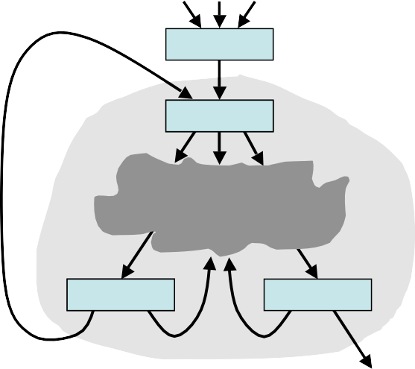
Looping
backedge
Why?
backedges indicate that we might need to traverse the CFG more than once for data flow analysis
preheader
entry edge
head
Loop
tail
exit edge
Exit edge

Slide 9
Looping
Not all loops have preheaders
– Sometimes it is useful to create them
backedge
preheader
Without preheader node
– There can be multiple entry edges
entry edge
head
Loop
With single preheader node
– There is only one entry edge
tail
exit edge
Exit edge

Slide 10
Looping Terminology
Loop:
Loop entry edge: Loop exit edge:
Loop header node:
Strongly connected component of CFG
Source not in loop & target in loop Source in loop & target not in loop
Target of loop entry edge
Natural loop: Loop with only a single loop header
Back edge:
Loop tail node:
Target is loop header & source is in the loop
Source of back edge

Slide 11
Looping Terminology
Loop preheader node: Single node that’s source of the loop entry edge
Nested loop: Loop whose header is inside another loop
Reducible flow graph: CFG whose loops are all natural loops

Slide 12
Identifying Loops
Why is it important?
Most execution time spent in loops, so optimizing loops will often give most benefit
Many approaches
Interval analysis
Exploit the natural hierarchical structure of programs
Decompose the program into nested regions called intervals
Structural analysis: a generalization of interval analysis
Identify dominators to discover loops

Slide 13

Dominators
entry
d dom i if all paths from entry to node i include d
Strict Dominator (d sdom i)
If d dom i, but d != i
Immediate dominator (a idom b)
a sdom b and there does not exist any node c such that a != c, c != b, a dom c, c dom b
Post dominator (p pdom i)
If every possible path from i to exit includes p
d dom i
entry
a idom b
a
not  c, a sdom c and c sdom b
b

Slide 14
Dominators
Post dominators (p pdom i)
if every possible path from i to exit includes p
(p dom i in the flow graph whose arcs are
reversed and entry and exit are interchanged)
i
p
p pdom i
exit

Slide 15
Identifying Natural Loops and Dominators
Back Edge
A back edge of a natural loop is one whose target of the back edge dominates its source
Natural Loop
The natural loop of a back edge (m→n), where n dominates m, is the set of nodes x such that n dominates x and there is a path from x to m not containing n
t
back edge
s

Slide 16
Reducibility
A CFG is reducible (well-structured) if we can partition its edges into two
disjoint sets, the forward edges and the back edges, such that
The forward edges form an acyclic graph in which every node can be reached from the entry node
The back edges consist only of edges whose targets dominate their sources
Non-natural loops ⬄ irreducibility

Slide 17
Reducibility
Structured control-flow constructs give rise to reducible CFGs
Value of reducibility:
Dominance useful in identifying loops
Simplifies code transformations (every loop has a single header)
Permits interval analysis

Slide 18
Handling Irreducible CFG’s
Node splitting
Can turn irreducible CFGs into reducible CFGs
a
a
b
b
c
d
c
d
e
d1
e
General idea
Reduce graph (iteratively remove self edges, merge nodes with single pred)
More than one node => irreducible
– Split any multi-parent node and start over

Slide 19
Why go through all this trouble?
We can work on the binary code
Most modern languages still provide a goto statement
Languages typically provide multiple types of loops. This analysis lets us treat them all uniformly
We may want a compiler with multiple front ends for multiple languages; rather than translating each language to a CFG, translate each language to a canonical IR and then to a CFG

