Slide 1
Data Flow Analysis
Baishakhi Ray
University Of Virginia
Adopted From U Penn CIS 570: Modern Programming Language Implementation (Autumn 2006)

Slide 2
Data flow analysis
Derives information about the dynamic behavior of a program by only examining the static code
Intraprocedural analysis
Flow-sensitive: sensitive to the control flow in a function
Examples
Live variable analysis
Constant propagation
Common subexpression elimination
Dead code detection
1 a := 0
2 L1: b := a + 1
3 c := c + b
4 a := b * 2
5 if a < 9 goto L1
6 return c
How many registers do we need?
Easy bound: # of used variables (3)
Need better answer

Slide 3
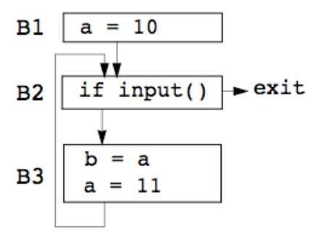
Data flow analysis
Statically: finite program
Dynamically: can have infinitely many paths
Data flow analysis abstraction
For each point in the program, combines information of all instances of the same program point

Slide 4
Example 1: Liveness Analysis

Slide 5
Liveness Analysis
Definition
A variable is live at a particular point in the program if its value at that point will be used in the future (dead, otherwise).
To compute liveness at a given point, we need to look into the future
Motivation: Register Allocation
A program contains an unbounded number of variables
Must execute on a machine with a bounded number of registers
Two variables can use the same register if they are never in use at the same time (i.e, never simultaneously live).
Register allocation uses liveness information

Slide 6
Control Flow Graph
Let’s consider CFG where nodes contain program statement instead of basic block.
Example
1. a = 0
2. b = a + 1
a := 0
L1: b := a + 1
c:= c + b
a := b * 2
if a < 9 goto L1
return c
3. c = c + b
4. a = b * 2
5. a < 9
No
Yes
6. return c

Slide 7
Liveness by Example
Live range of b
Variable b is read in line 4, so b is live on 3->4 edge
b is also read in line 3, so b is live on (2->3) edge
Line 2 assigns b, so value of b on edges (1->2) and (5->2) are not needed. So b is dead along those edges.
b’s live range is (2->3->4)
1. a = 0
2. b = a + 1
3. c = c + b
4. a = b * 2
5. a < 9
No
Yes
6. return c

Slide 8
Liveness by Example
Live range of a
(1->2) and (4->5->2)
a is dead on (2->3->4)
1. a = 0
2. b = a + 1
3. c = c + b
4. a = b * 2
5. a < 9
No
Yes
6. return c

Slide 9
Terminology
Flow graph terms
A CFG node has out-edges that lead to successor nodes and in-edges that come from predecessor nodes
pred[n] is the set of all predecessors of node n
succ[n] is the set of all successors of node n
1. a = 0
2. b = a + 1
3. c = c + b
4. a = b * 2
Examples
– Out-edges of node 5: (5→6) and (5→2)
– succ[5] = {2,6}
– pred[5] = {4}
– pred[2] = {1,5}
5. a < 9
No
Yes
6. return c

Slide 10
Uses and Defs
Def (or definition)
An assignment of a value to a variable
def[v] = set of CFG nodes that define variable v
def[n] = set of variables that are defined at node n
a = 0
Use
A read of a variable’s value
use[v] = set of CFG nodes that use variable v
use[n] = set of variables that are used at node n
a < 9
More precise definition of liveness
– A variable v is live on a CFG edge if
v live
∃ a directed path from that edge to a use of v (node in use[v]), and
that path does not go through any def of v (no nodes in def[v])
∉ def[v]
∈ use[v]

Slide 11
The Flow of Liveness
Data-flow
Liveness of variables is a property that flows through the edges of the CFG
Direction of Flow
Liveness flows backwards through the CFG, because the behavior at future nodes determines liveness at a given node
1. a = 0
2. b = a + 1
3. c = c + b
4. a = b * 2
5. a < 9
No
Yes
6. return c

Slide 12
Liveness at Nodes
Just before computation
1. a = 0
a = 0
Just after computation
2. b = a + 1
3. c = c + b
Two More Definitions
– A variable is live-out at a node if it is live on any out edges
4. a = b * 2
– A variable is live-in at a node if it is live on any in edges
5. a < 9
No
Yes
6. return c

Slide 13
Computing Liveness
Generate liveness: If a variable is in use[n], it is live-in at node n
Push liveness across edges:
If a variable is live-in at a node n
then it is live-out at all nodes in pred[n]
Push liveness across nodes:
If a variable is live-out at node n and not in def[n]
then the variable is also live-in at n
Data flow Equation:
in[n] = use[n] ∪ (out[n] – def[n])
out[n] =
∪ in[s]
s ∈ succ[n]

Slide 14
Solving Dataflow Equation
for each node n in CFG
in[n] = ∅; out[n] = ∅
repeat
for each node n in CFG
in’[n] = in[n]
out’[n] = out[n]
in[n] = use[n] ∪ (out[n] – def[n])
out[n] = ∪ in[s]
s ∈ succ[n]
until in’[n]=in[n] and out’[n]=out[n] for all n
Initialize solutions
Save current results
Solve data-flow equation
Test for convergence

Slide 15
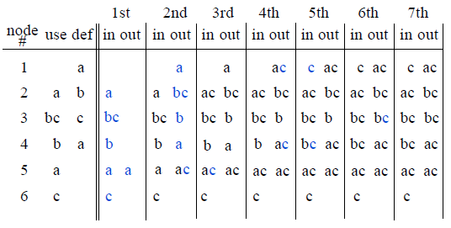
Computing Liveness Example
1. a = 0
2. b = a + 1
3. c = c + b
4. a = b * 2
5. a < 9
No
Yes
6. return c

Slide 16
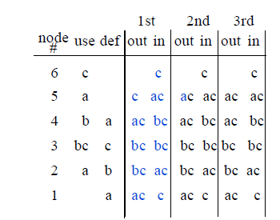
Iterating Backwards: Converges Faster
1. a = 0
2. b = a + 1
3. c = c + b
4. a = b * 2
5. a < 9
No
Yes
6. return c

Slide 17
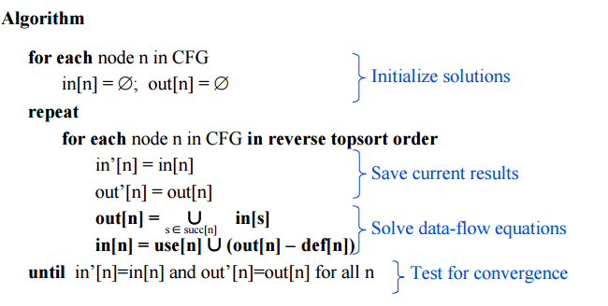
Liveness Example: Round1
Node | use | def
6 | c
5 | a
4 | b | a
3 | bc | c
2 | a | b
1 |  | a
A variable is live at a particular point in the program if its value at that point will be used in the future (dead, otherwise).
1. a = 0
2. b = a + 1
3. c = c + b
4. a = b * 2
5. a < 9
No
Yes
6. return c

Slide 18
Liveness Example: Round1
Node | use | def
6 | c
5 | a
4 | b | a
3 | bc | c
2 | a | b
1 |  | a
in: c
1. a = 0
out: ac
in: ac
2. b = a + 1
out: bc
in: bc
3. c = c + b
out: bc
in: bc
Yes
4. a = b * 2
out: ac
in: ac
5. a < 9
out: c
No
in: c
6. return c

Slide 19
Liveness Example: Round1
Node | use | def
6 | c
5 | a
4 | b | a
3 | bc | c
2 | a | b
1 |  | a
in: c
1. a = 0
out: ac
in: ac
2. b = a + 1
out: bc
in: bc
3. c = c + b
out: bc
in: bc
Yes
4. a = b * 2
out: ac
in: ac
5. a < 9
out: ac
No
in: c
6. return c

Slide 20
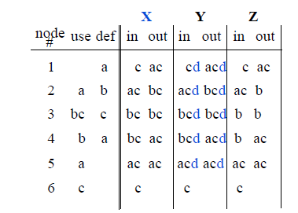
Conservative Approximation
1. a = 0
2. b = a + 1
3. c = c + b
4. a = b * 2
Solution X:
- From the previous slide
5. a < 9
No
Yes
6. return c

Slide 21
Conservative Approximation
1. a = 0
2. b = a + 1
3. c = c + b
4. a = b * 2
Solution Y:
Carries variable d uselessly
– Does Y lead to a correct program?
5. a < 9
No
Yes
6. return c
Imprecise conservative solutions ⇒ sub-optimal but correct programs

Slide 22
Conservative Approximation
1. a = 0
2. b = a + 1
3. c = c + b
4. a = b * 2
Solution Z:
Does not identify c as live in all cases
– Does Z lead to a correct program?
5. a < 9
No
Yes
6. return c
Non-conservative solutions ⇒ incorrect programs

Slide 23
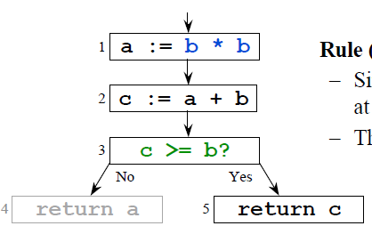
Need for approximation
Static vs. Dynamic Liveness: b*b is always non-negative, so c >= b is always true and a’s value will never be used after node
No compiler can statically identify all infeasible paths

Slide 24
Liveness Analysis Example Summary
Live range of a
(1->2) and (4->5->2)
Live range of b
(2->3->4)
Live range of c
Entry->1->2->3->4->5->2, 5->6
You need 2 registers Why?
1. a = 0
2. b = a + 1
3. c = c + b
4. a = b * 2
5. a < 9
No
Yes
6. return c

Slide 25
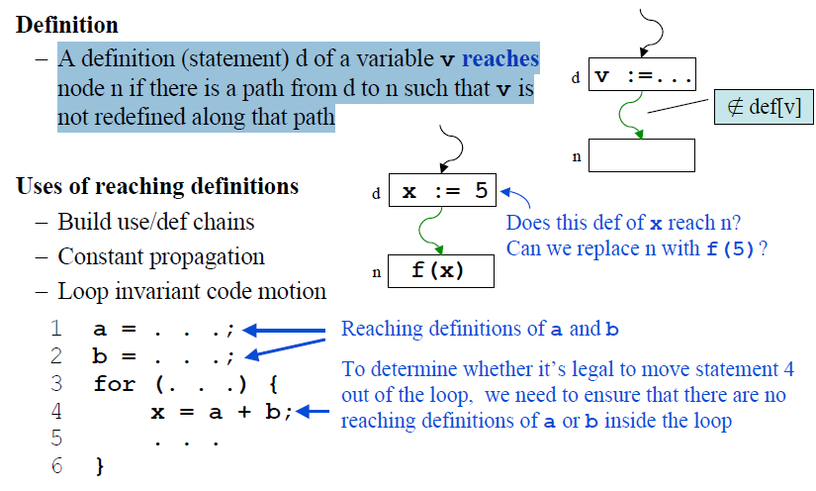
Example 2: Reaching Definition

Slide 26
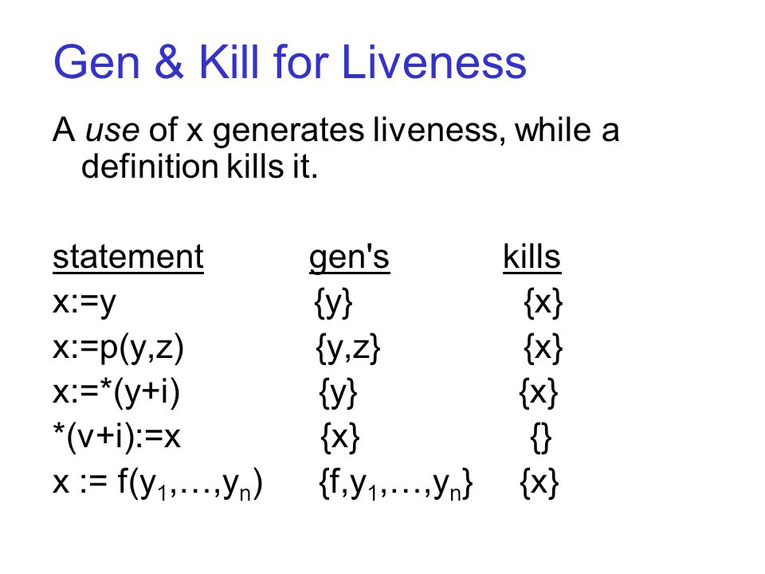
Computing Reaching Definition
Assumption: At most one definition per node
Gen[n]: Definitions that are generated by node n (at most one)
Kill[n]: Definitions that are killed by node n
{y,i}

Slide 27
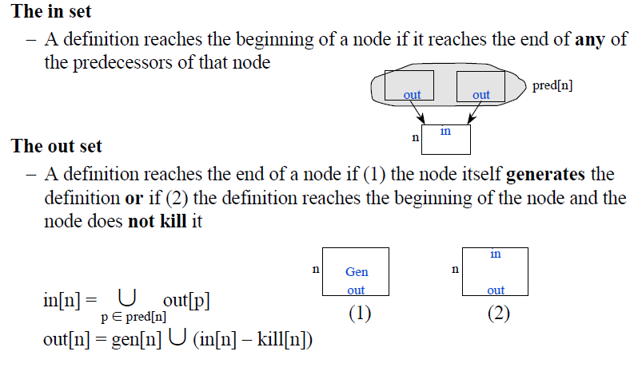
Data-flow equations for Reaching Definition

Slide 28

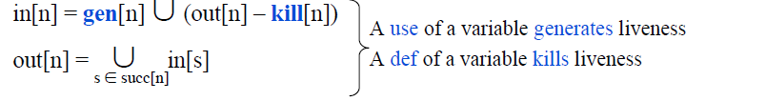
Recall Liveness Analysis
Data-flow Equation for liveness
Liveness equations in terms of Gen and Kill
Gen: New information that’s added at a node
Kill: Old information that’s removed at a node
Can define almost any data-flow analysis in terms of Gen and Kill

Slide 29
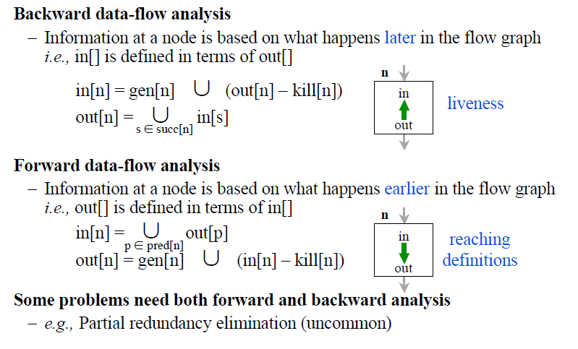
Direction of Flow

Slide 30
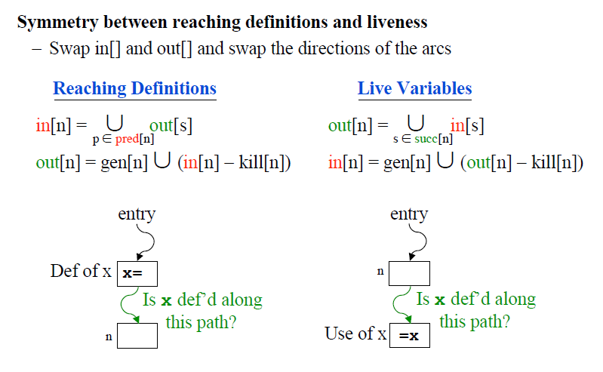
Data-Flow Equation for reaching definition

Slide 31
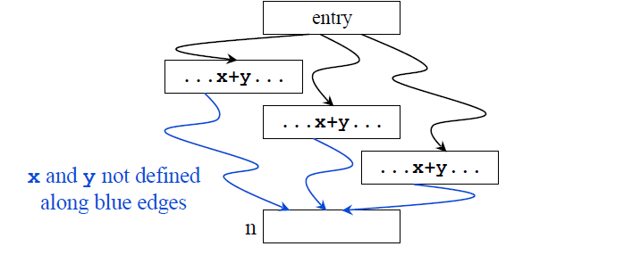
Available Expression
An expression, x+y, is available at node n if every path from the entry node to n evaluates x+y, and there are no definitions of x or y after the last evaluation.

Slide 32
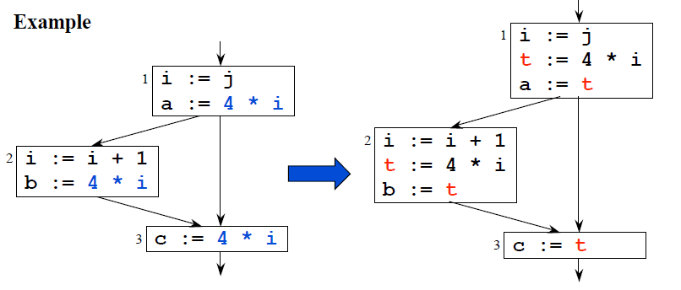
Available Expression for CSE
Common Subexpression eliminated
If an expression is available at a point where it is evaluated, it need not be recomputed

Slide 33
Must vs. May analysis
May information: Identifies possibilities
Must information: Implies a guarantee
 | May | Must
Forward | Reaching Definition | Available Expression
Backward | Live Variables | Very Busy Expression

