Slide 1

Enhancing Business Efficiency and Reducing Operational Costs of Visista Fashions
Business Data Management Capstone Project
Presented By
Baishali Das
22F1000998

Slide 2
OUTLINE
1.
About Visista Fashions
2.
Identified Challenges
3.
Data collection & Cleaning
4.
Data Analysis
5.
Findings
6.
Recommendations

Slide 3

VISISTA FASHIONS
“Visista Fashions” is a B2C online business based in Kolkata. The company offers a variety of women’s clothing, men’s clothing, and home products.
Mr. Shuvendu Kundu and his brother, Mr. Prosenjit Roy, started this business on December 1, 2021.
They use WhatsApp and Facebook for marketing and sales and are gradually expanding their business to offline channels.

Slide 4



IDENTIFIED CHALLENGES
The business faces three key challenges:
Procurement issues with disputed products from suppliers
2. Inventory overload due to bulk ordering and slow-moving items
3. Inefficiency in managing returns
5.

Slide 5
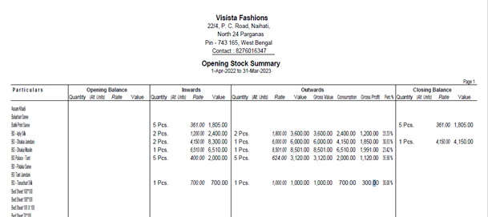
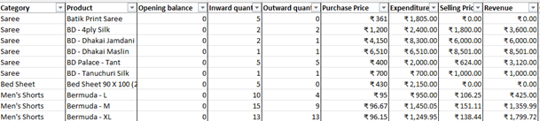

Data collection and cleaning
Received one years of business data (1st April 2022 to 31st March 2023) for “Visista Fashions” in a PDF file.
This file includes sales, purchases and closing balances all in one sheet.
Hence, the data was converted to Excel format for cleaning and analysis.
.

Slide 6

Data analysis
Sarees and bed sheets contribute the highest revenue and expenditure, indicating strong sales but also high costs.
Some categories, like men's t-shirts and shrugs, show low revenue and expenditure, hinting at limited market demand.
.
Men's shorts and kurti pants lead in profit margins, achieving 35-36% profitability.
Items like shrugs and costwool show the lowest profit margin

Slide 7
High Inventory Activity: Sarees, bed sheets, and ankle-length leggings exhibit the highest inward and outward quantities, indicating strong demand and turnover.
Turnover Insights: Categories like cotswool and dohar have the highest turnover rates, suggesting efficient inventory movement despite relatively lower quantities.
Low Activity Categories: Items such as shrugs and petticoats have minimal inventory movement, pointing to a need for stock optimization or demand generation.

Slide 8
This chart shows each category’s cumulative contribution to total sales volume
Sarees and Bed sheets are the top selling categories.
Categories like Women night dress, Men’s Short and Ankle Length Leggings also have significant sales.
The profit chart reveals which categories generate the most gross profit.
Sarees, Bed Sheets, and Kurtis are again leading contributors, showing that these items not only sell well and also profitable.
Lower-sales items with decent profit margins, such as Dohar, could benefit from targeted marketing.

Slide 9

Findings
Products like Sarees and Bed Sheets generate significant revenue but have lower profit margins, indicating the need for cost optimization in sourcing.
Items like Women's Night Dresses and Men's Shorts show the highest profit margins, suggesting an opportunity to expand these categories to maximize overall profitability.
Products with low sales, like Shrugs and Cotswool, take up storage space and lock in capital, making it important to find ways to sell off old stock.
High-demand items like Sarees and Bed Sheets risk running out of stock, making it essential to keep sufficient inventory levels.

Slide 10

Recommendations
Optimize costs for high revenue but low-margin items like sarees and Bed sheets by negotiating supplier prices or improving operation efficiency.
Expand high-profit categories (Women’s night dress, Men’s shorts)
Apply targeted marketing to boost slow-moving high-margin products(e.g.,Dohar)
Offer discounts or special deals on long-standing stock to create space for new products.
Regularly check fast-moving items to keep them well-stocked and avoid stock out.
Develop a structured returns and dispute management process to improve operational efficiency.

