Slide 1
Elastic Sketch: Adaptive and Fast Network-wide Measurements
Tong Yang, Jie Jiang, Peng Liu Peking University, China
Qun Huang, ICT, CAS, China
Junzhi Gong, Yang Zhou, Peking University, China
Rui Miao, Alibaba Group, China
Xiaoming Li, Peking University, China
Steve Uhlig. Queen Mary University of London, UK
Tong Yang, Peking University
yangtongemail@gmail.com
http://net.pku.edu.cn/~yangtong
Notes:
Good afternoon, everyone. My name is Tong Yang. I am from Peking University.
Today my topic is ``Elastic Sketch: Adaptive and Fast Network-wide Measurements’’.

Slide 2
Outline
PART 01
Background
PART 02
Elastic Sketch
PART 03
Optimizations
PART 04
Applications
PART 05
Implementations
PART 06
Experimental results
PART 07
Conclusion
Notes:
Here is the outline, and we first introduce the background.

Slide 3
01
PART ONE
Background
Notes:
First, we introduce the background.

Slide 4
01
Background
Measurements are important
Network measurements provides indispensable
information for network applications.
Best solution: Sketches
1) Memory efficient 2) Constant and Fast speed
3) High accuracy
Notes:
Network measurements provide indispensable information for network operations, such as quality of service, capacity planning, network accounting and billing, congestion control, anomaly detection in data centers and backbone networks.

Slide 5
01
Background
Most of existing solutions focus on:
A good trade-off among
1) memory usage
2) speed
3) accuracy
Recent work: UnivMon [SIGCOMM 16]
the above 3 dimensions plus 4) generality
Notes:
Existing measurement solutions mainly focus on a good trade-off among accuracy, speed and memory usage. The state-of-the-art UnivMon [2] pays attention to
an additional aspect, generality, namely using one sketch to process many tasks, and makes a good trade-off among these
four dimensions.

Slide 6
01
Background
Our paper :
the above 4 dimensions plus
5) adaptive to traffic characteristics
6) cross platform
Measurements are especially important when network is undergoing problems, such as
1) network congestion
2) scans
3) DDoS attack
In these cases, traffic characteristics vary a lot
Notes:
In additional to the above four dimensions, we pay attention to another two aspects:

Slide 7
01
Background
traffic characteristics:
1) the available Bandwidth
2) flow size distribution
3) packet arrival rate
Notes:
traffic characteristics vary drastically, significantly degrading the measurement performance. Therefore, it is desirable to achieve accurate network measurements when
traffic characteristics vary a lot.

Slide 8
01
Background---Bandwidth
Naïve Solutions：
Sketch
Merging
Measurement node
Server
Merging
Measurement node
Collector
Server
Measurement node
Our Solutions：
Measurement node
Compress
Notes:
The first traffic characteristic is the available bandwidth. In data centers, administrators care more about the state of the whole network than a single link or node, known as network-wide measurements.
In data centers, administrators often deploy many measurement nodes, which periodically report sketches to a collector.
However, in data centers, network congestion is common. It can happen frequently within a single second.
Our solution is to actively compress the sketch with little accuracy loss, thereby reducing bandwidth usage.
This is the first work to compress sketches.

Slide 9
01
Background---packet rate
The packet rate is
1) naturally variable
2) could vary drastically.
Existing sketches
1) fixed speed
2) drop packets
when packet rate becomes much higher
Our goal:
1) minimize #memory accesses → 1
2) minimize #hash computations → 1
Notes:
The packet rate is naturally variable and could vary drastically.
The processing speed of existing sketches on software platforms is fixed in terms of packet rate.

Slide 10
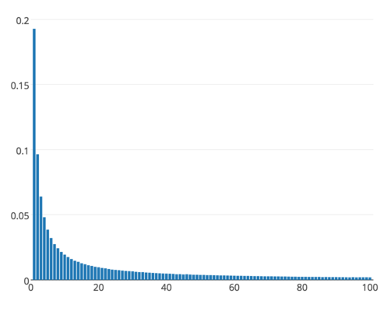
01
Background---flow size distribution
Network traffic is skewed
1) Majority: mouse flows
2) Minority: elephant flows
Separation is effective
1) use large and small counters
2) use different data structures
Our goal:
1) accurate separation
2) dynamically allocate memory

Slide 11
01
Background---Cross platform
Existing solutions:
1) for CPU platforms
2) for netFPGA (OpenSketch)
3) for P4Switch (UnivMon)
Our goal:
1) P4Switch
2) FPGA
3) GPU
4) OVS
5) CPU
6) multi-core
Notes:
Existing solutions are designed for a specific platforms.
Our goal is to achieve that the designed sketches can be implemented on six platforms.
Including …

Slide 12
01
Background- Tasks and sketches
Tasks | Sketch Algorithms
Frequency estimation | Count-Min, CM-CU, Count, ASketch
Top-k Hot items | Count-Min, CM-CU, Space-Saving ASketch, FlowRadar, UnivMon
Heavy changes | RevSketch, FlowRadar, UnivMon
Superspreader /DDoS detection | TwoLevel
Frequency distribution | MRAC, FlowRadar
Cardinality | FM, LC, UnivMon
Entropy | FlowRadar, UnivMon
Notes:
There are many stream processing tasks. Typical ones include: frequency estimation …

Slide 13
01
Background- CM sketches
Insertion
+1
+1
+1
+1
Query
19
24
’frequency: 18
= Min{19, 24, 26, 18}
26
18
Notes:
Here we show the most classic sketch: Count-min sketch, CM sketch for short.

Slide 14
02
PART TWO
Elastic Sketches
Notes:
Next, we present out solution – Cold filter

Slide 15
Elastic Sketch
01
Rationale
02
Basic Version
03
Adaptivity
04
Software version
05
Hardware version
06
P4 version
Notes:
We explain our Elastic sketch in terms of the following six aspects.

Slide 16
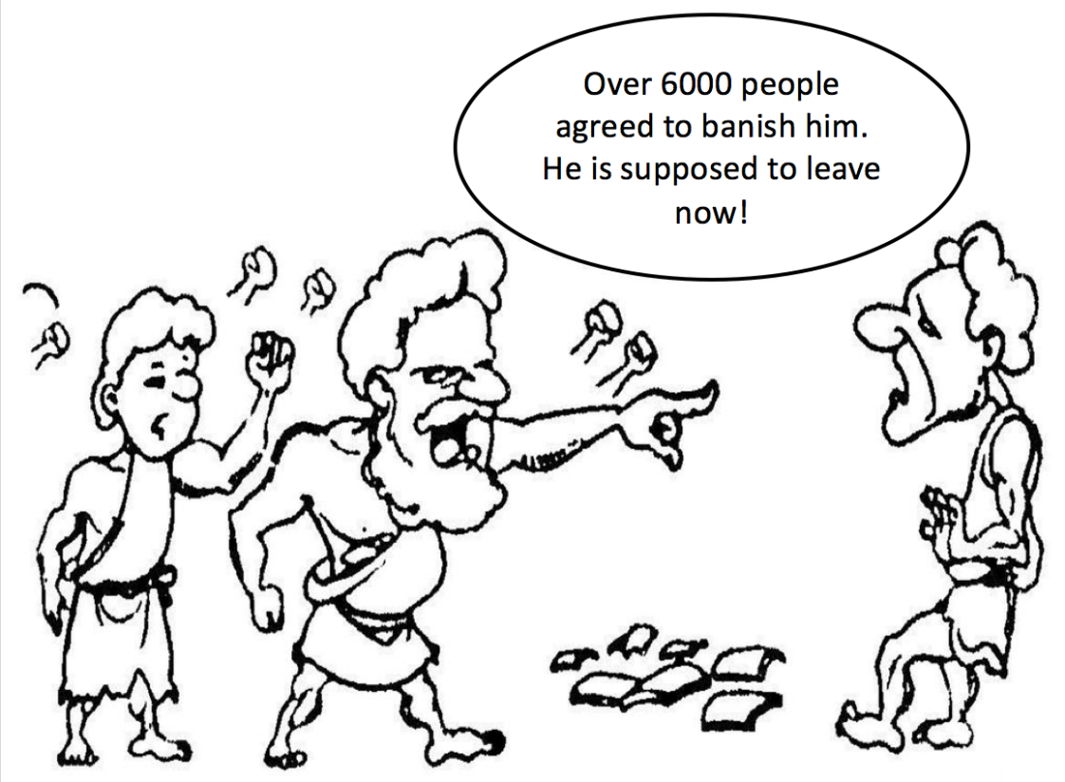
02
Elastic (Rationale)
Goal: separate elephant flows from mouse flows
Ostracism: vote for elephant flows
ostracism was a procedure in ancient Athens, any citizen could be voted to be evicted/expelled.
Problem: use one bucket
to elect the largest flow
One bucket
Notes:
The packet rate is naturally variable and could vary drastically.
The processing speed of existing sketches on software platforms is fixed in terms of packet rate.

Slide 17

02
Elastic (Basic version)
Heavy part
Light part
v: positive votes
n-votes: negative votes
<key, v, flag, n-votes>
freq
freq
h(.)
92
+1
1
f1
<f1,5,T,15>
f1,6,T,15
. . .
g1(.)
4
0
h(.)
0
6
+1
f5
f5,1,F,0
g2(.)
h(.)
11++
f8
7
+7
87
f8
<f3,10,F,11>
. . .
g1(.)
1
3
h(.)
g2(.)
f9,1,T,0
f4
2
10
+7
f9
<f4,7,F,55>
$λ$=8, 55+1$≥7∗λ$
A CM sketch

Slide 18
02
Elastic (Basic version)
To query a flow, heavy part → light part
1. To query it in the heavy part
check the flag of the mapped bucket
1) flag = false: report the vote⁺ with no error
2) flag = true: vote⁺ + f_light
2. To query it in the light part
report its frequency f_light as how CM sketch does
Notes:
The packet rate is naturally variable and could vary drastically.
The processing speed of existing sketches on software platforms is fixed in terms of packet rate.

Slide 19
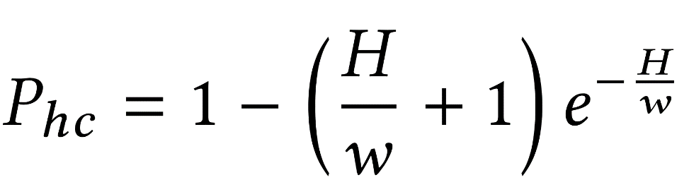
02
Elastic (Basic version)
Elephant collision
1+ elephant flows are mapped to the same bucket
Elephant collision rate
H: the number of elephant flows
w: the number of buckets
f_{A}
f_{B}
f_{C}
Notes:
The packet rate is naturally variable and could vary drastically.
The processing speed of existing sketches on software platforms is fixed in terms of packet rate.

Slide 20
02
Elastic (Adpativity)
1) Adaptive to Available Bandwidth
2) Adaptive to Packet Rate
3) Adaptive to Flow Size Distribution
Notes:
The packet rate is naturally variable and could vary drastically.
The processing speed of existing sketches on software platforms is fixed in terms of packet rate.

Slide 21
02
Elastic (Adaptive to Bandwidth)
To adapt to available bandwidth
1) the light part is large
2) compress the light part before sending
key steps to compress the sketch
1) how to group counters?
2) how to merge counters in a group?
3) how to change hash functions?
Notes:
The packet rate is naturally variable and could vary drastically.
The processing speed of existing sketches on software platforms is fixed in terms of packet rate.

Slide 22
02
Elastic (Adaptive to Bandwidth)
To group counters
1) spilt the sketch A into z divisions
2) build a sketch B
3) counters with the same index as one group
10%6%3=10%3
10%8%4=10%4
A₁¹[1]
A₁²[1]
A₁²[3]
A₁^{Z}[1]
A₁^{Z}[3]
B₁[1]
B₁[2]
B₁[3]
A1
9
8
87
3
4
88
12
2
9
12
8
88
h(.)%9 → h(.)%3
A2
31
12
3
77
0
6
5
10
0
77
12
6
…
…
…
A_{d}¹[1]
A_{d}²[1]
A_{d}^{Z}[1]
B_{d}[1]
Ad
51
14
11
9
10
0
99
1
15
99
14
15
max

Slide 23
02
Elastic (Adaptive to Bandwidth)
Merging sketches
1) sum merging
2) max merging

Slide 24
02
Elastic (Adaptive to packet rate)
How to adapt to high packet rate?
1) buffer the incoming packets in an input queue
2) when # packets in the input queue > Threshold
(1) access only the heavy part
(2) the insertion operation is modified:
if f1 is replaced by f2, then sizeof(f2)= sizeof(f1).

Slide 25
02
Elastic (Adaptive to flow size distribution)
#elephant flows is unknown and can vary a lot
1) # elephant flows in the heavy part is increasing
2) heavy part should be adaptive to changes in
traffic distribution
Solution: double the heavy part when #elephant flows in it is over a threshold

Slide 26
02
Elastic (Adaptive to flow size distribution)
h(.)%4 → h(.)%8

Slide 27
03
PART THREE
Optimizations
Notes:
Next, we present the third part -- Optimizations

Slide 28
03
Optimizations
1) Software Version
2) Hardware Version
3) P4Switch Version
4) Multi-Core Version
Notes:
There are four optimized version:

Slide 29
03
Optimizations (Software Version)
storing several flows in each bucket
1) bottleneck: accessing the heavy part
2) method: using SIMD
3) all the flows in each bucket share one vote⁻ field
4) try to evict the smallest flow in the mapped bucket
n-votes
40
<f11,5,T>
<f51,5,T>
0
. . .
. . .
. . .
. . .
4
0
+1
Light part
Heavy part
f8
<f3,72,F>
<f6,11,F>
<f5,55,F>
10+1
f8
7
. . .
. . .
. . .
. . .
1
+7
f9
<f2,16,F>
<f1,74,F>
<f4,7,F>
55+1
f4
2
<f9,1,T>
0
12
Notes:
First, we introduce the software version.

Slide 30
03
Optimizations (Hardware Version)
using several sub-tables in the heavy part
1) elephant collision rate decreases exponentially
as the number of sub-tables increases linearly
2) the sub-tables have the same operation but different
hash functions, thus fit into hardware.
Notes:
The packet rate is naturally variable and could vary drastically.
The processing speed of existing sketches on software platforms is fixed in terms of packet rate.

Slide 31
03
Optimizations (P4Switch Version)
1) each stage in two physical stages: vote^{all} , and (key, vote+)
2) When vote^{all} /vote+⩾ λ′, we perform an eviction operation. We recommend λ′ = 32.
3) When an item in a bucket is evicted to the next stage, we consider its frequency as 1.
4) When ( f , vote+) is evicted by ( f1, 1 ), we set the bucket to ( f1, vote+ + 1 ).
vote^{all}
f
vote+
Notes:
The packet rate is naturally variable and could vary drastically.
The processing speed of existing sketches on software platforms is fixed in terms of packet rate.

Slide 32
03
Optimizations (Multi-Core Version)
10
2
15
thread 1
92
max
4
10
h(.)%2
f4
h(.)%2*3 +h(.)%3
7
15
thread 2
1
92
7
6
4
0
6
Notes:
The packet rate is naturally variable and could vary drastically.
The processing speed of existing sketches on software platforms is fixed in terms of packet rate.

Slide 33
04
PART FOUR
Applications
Notes:
Next, we present out solution – Cold filter

Slide 34
04
Applications
1) Flow size
2) Heavy Hitter
3) Heavy Change
4) Flow Size Distribution
5) Entropy
6) Cardinality

Slide 35
05
PART Five
Implementations
Notes:
Next, we present the implementations

Slide 36
05
Applications
1) P4Switch
2) FPGA
3) GPU
4) CPU
5) multi-core
6) OVS

Slide 37
06
PART SIX
Experimental results
Notes:
Next, we present experimental results

Slide 38
06
Experiments (Setup)
Traces: CAIDA
Metrics:
ARE, AAE, WMRE, RE, F1Score, Throughput
Trace Date #packets #flows (SrcIP)
CAIDA1 2015/02/19 1164.9M 2.6M
CAIDA2 2015/05/21 1081.0M 3.9M
CAIDA3 2016/01/21 1835.1M 8.9M
CAIDA4 2016/02/18 1799.7M 8.4M
Notes:
This is the experimental setup.
We use four one-hour public traffic traces collected in Equinix-Chicago monitor from CAIDA.

Slide 39
06
Experiments (Setup)
Comparisons:
1) Flow size: CM, CU, Count
2) Heavy Hitter: SS, CM/C+heap, UnivMon, Hash pipe
3) Heavy Change: Reversible sketch, FlowRadar, UnivMon
4) Distribution: MRAC
5) Entropy: UnivMon, Sieving
6) Cardinality: UnivMon, linear counting (LC)
Notes:
This is the algorithms compared in our experiments.

Slide 40
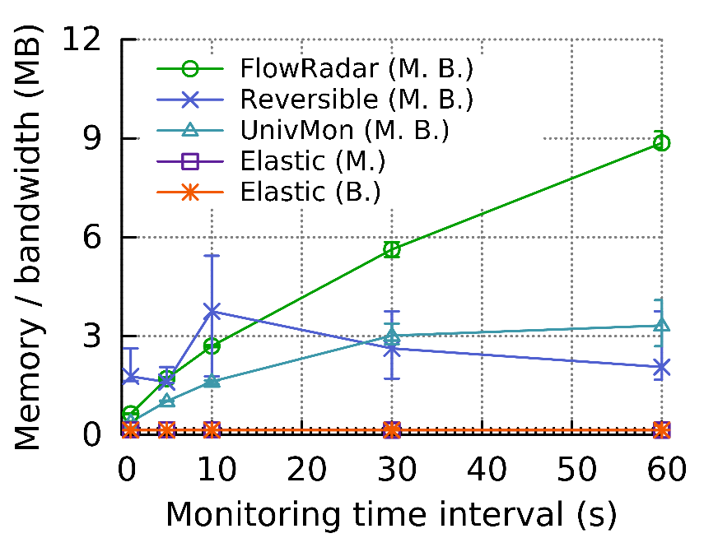
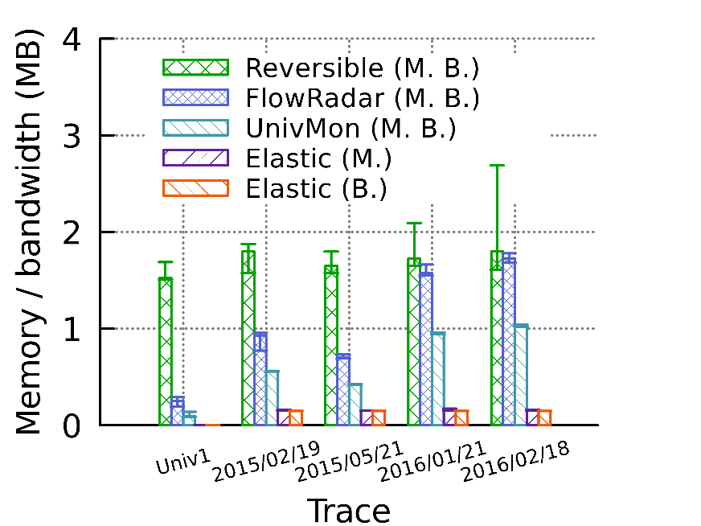
06
Experiments (Memory/Bandwidth)
Memory or bandwidth needed to achieve 99%
precision and recall in heavy change detection
Notes:
This is the experimental results for accuracy

Slide 41
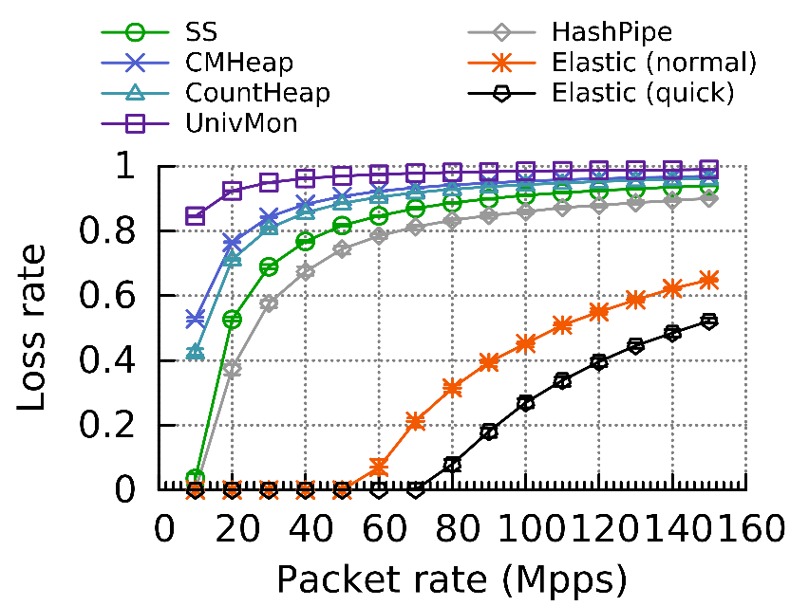
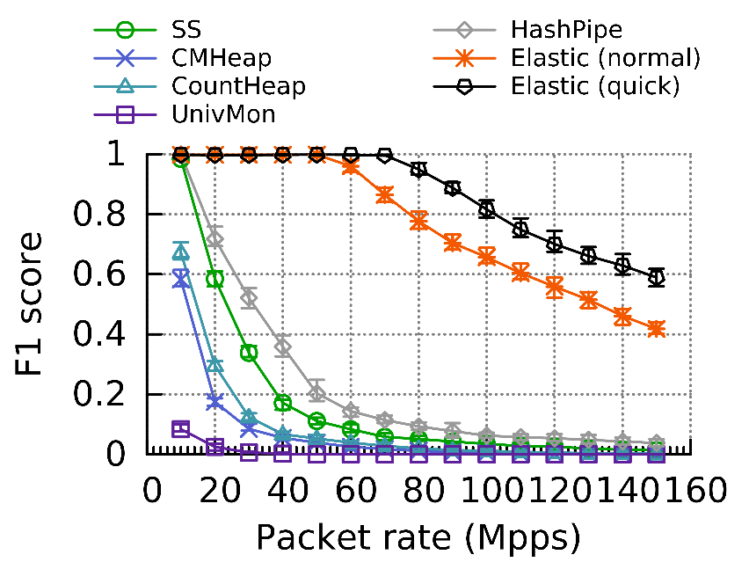
06
Experiments (Adaptivity)
Adaptivity to packet rate
Notes:
We use four one-hour public traffic traces collected in Equinix-Chicago monitor from CAIDA.

Slide 42
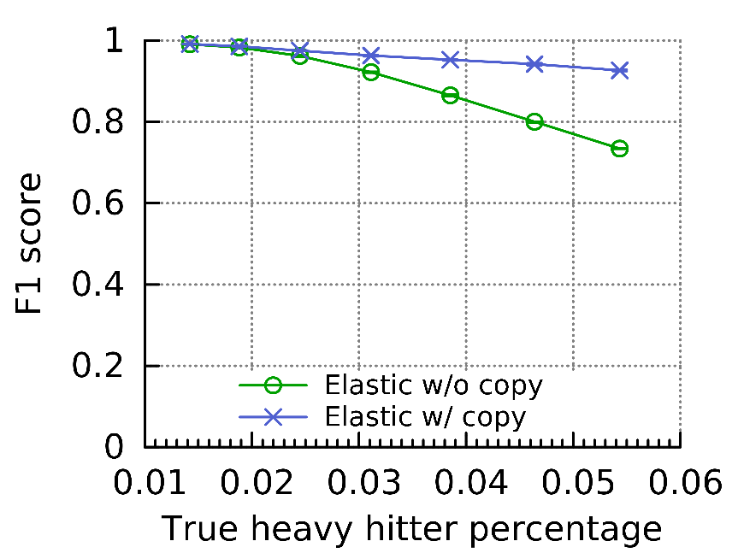
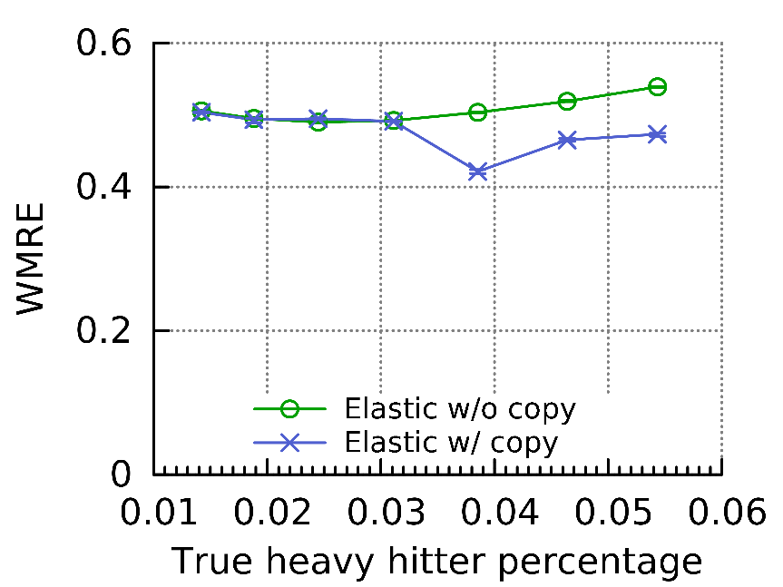
06
Experiments (Setup)
Adaptivity to flow size distribution
Notes:
We use four one-hour public traffic traces collected in Equinix-Chicago monitor from CAIDA.

Slide 43
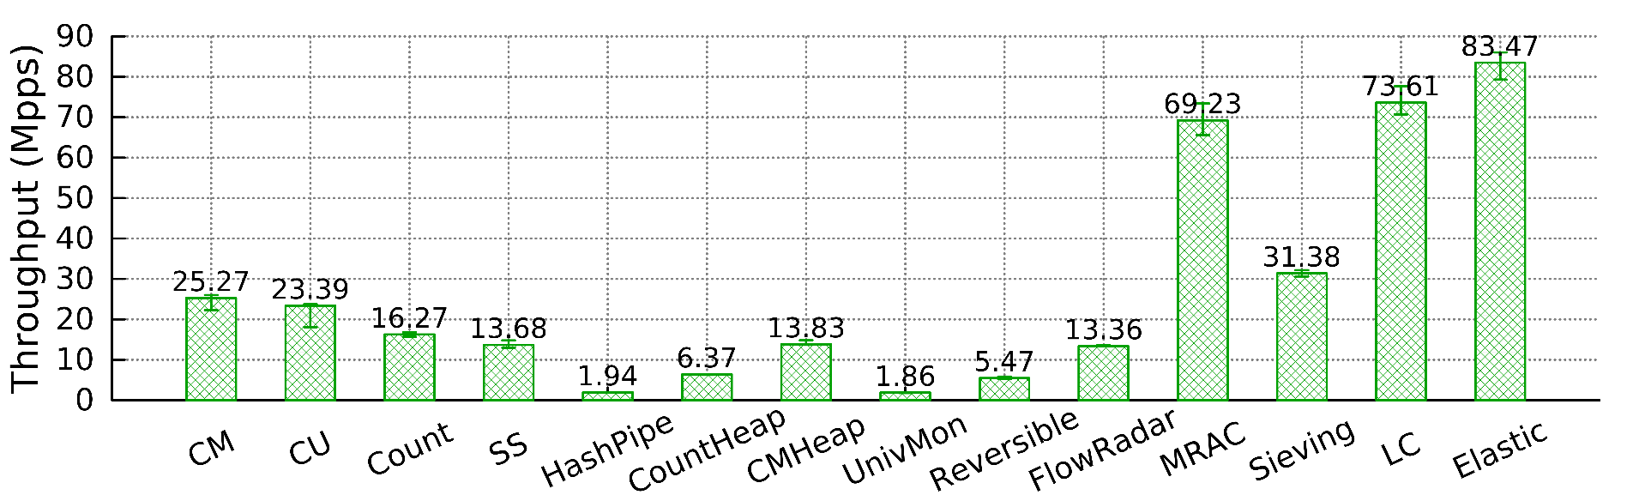
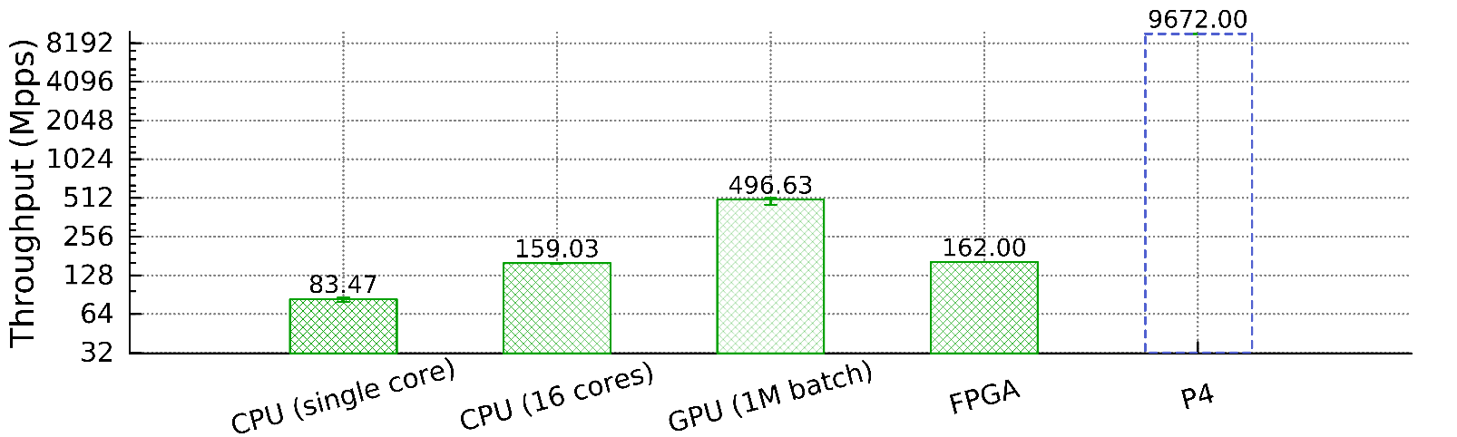
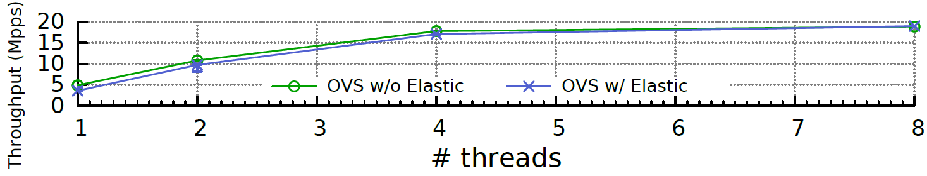
06
Experiments (Processing Speed)
Notes:
We use four one-hour public traffic traces collected in Equinix-Chicago monitor from CAIDA.

Slide 44
06
Experimental Results Summary
Experiments on three typical stream processing tasks
speed improvements: 44.6 ∼ 45.2 times
accuracy improvements: 2.0 ∼ 273.7 times
Applications for more tasks in the future work.

Slide 45
07
PART SEVEN
Conclusion
Notes:
Next, we present out solution – Cold filter

Slide 46
07
Conclusion
Elastic sketch:
1) elastic, generic, fast, and accurate
2) adaptive to traffic characteristics
3) one sketch for 6 tasks
Key techniques: ostracism and compression
implemented on 6 platforms
P4Switch, FPGA, GPU, CPU, multi-core CPU and OVS
Notes:
We use four one-hour public traffic traces collected in Equinix-Chicago monitor from CAIDA.

Slide 47
THANKS
Source code: https://github.com/ElasticSketch/ElasticSketch
Tong Yang
Peking University, China
Email: yangtongemail@gmail.com
Homepage: http://net.pku.edu.cn/~yangtong/
Notes:
Thanks.

