Slide 1
Toward Highly Available Cloud Systems
Chuanxiong Guo
Bytedance
APNET 2018
Notes:
Title: Toward Highly-Available Cloud Systems
Abstract: IT companies around the globe are building large-scale cloud systems to meet the demands of an increasing number of cloud computing services. These cloud systems, however, can be brought down to their knees, by a large number, sometimes high profile, incidents. These incidents reduce cloud system availability and cost companies’ money, brand reputation, and team moral.
In this talk, I will present my on-going journey of building highly-available cloud systems, from measurement and monitoring, to failure localization and understanding, and to automatic mitigation and intervene. The goal of this journey is to build highly-available systems that recover from failures when they happen, and that avoid avoidable failures by learning from the past.
Brief bio:
Chuanxiong Guo is a director of the AI Lab of Bytedance Inc. He is currently working on data center networking and machine learning systems.

Slide 2
Outline
Background
Gray failure understanding
Panorama: Capturing in-situ observability for gray failure detection
ByteBrain: Real-time WAN Traffic Burstiness Detection and Scheduling
Summary

Slide 3


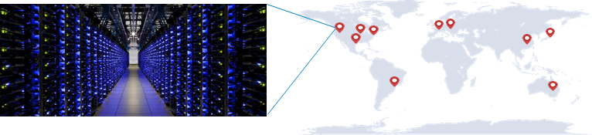
Software rules the clouds
Code Repo
Data Repo
Software systems
Deployment/provisioning
Config/ Management
Monitoring
Resource mgmt

Slide 4
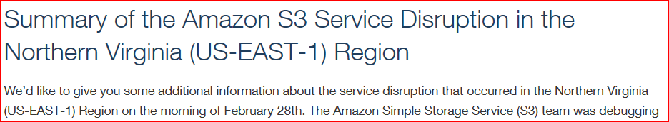


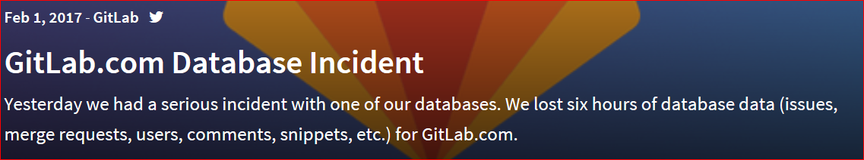
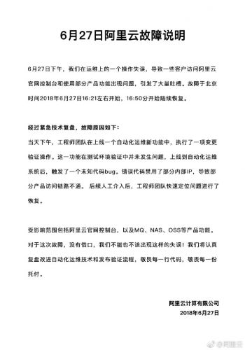
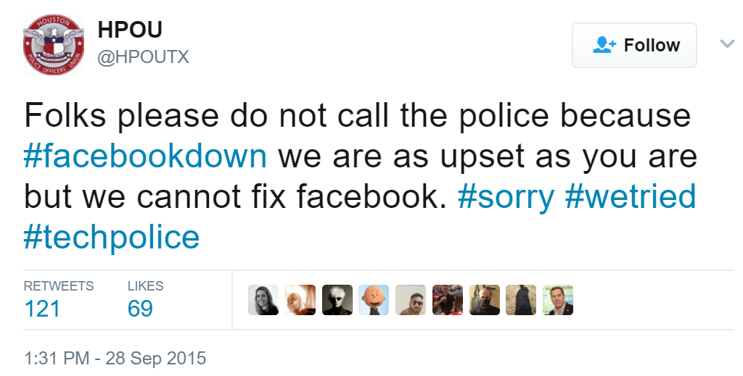
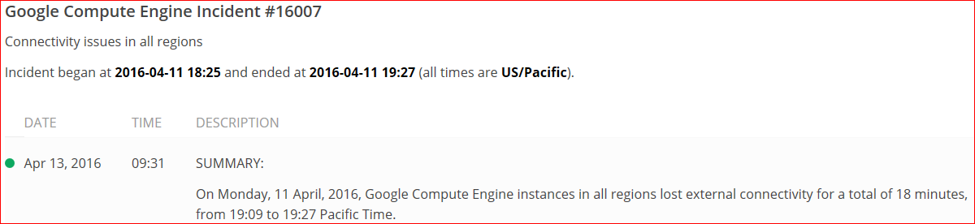
Incidents, incidents, incidents
Notes:
All looks great, but there is one big problem.

Slide 5

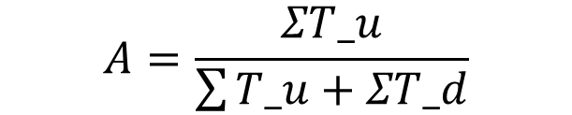
System availability is plagued by incidents
$$A=\frac{ΣT_u}{\sum{T_u}+ΣT_d}$$
5 min downtime per year
99.999%
99.99%
53 min downtime per year
Notes:
As a result, five nines availability is still a challenge

Slide 6

Incident handling practice
Lessons learned
Code Repo
Data Repo
Software systems
Deployment/ provisioning
Config/ Management
Monitoring
Resource mgmt
Notes:
The current incident handling is mainly a manual process.
We typically have dev, and ops.

Slide 7
Design
implement
Dev
Incident resolution, mitigation, localization,
detection
Ops
Deployment
Provisioning
Monitoring
Resource mgmt
Automation
Notes:
This figure shows my understanding of the journey of software automation.

Slide 8
Design
implement
Dev
Software takeover:
Future to go
Software takeover:
we are here
Incident resolution, mitigation, localization,
detection
Ops
Software takeover:
Done
Deployment
Provisioning
Monitoring
Resource mgmt
Automation

Slide 9
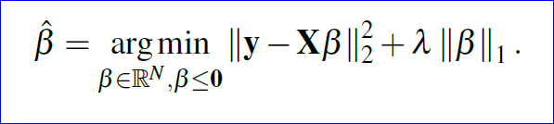
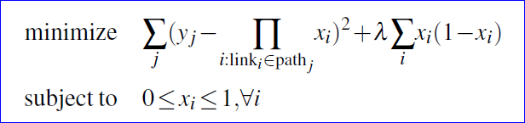
Design
implement
Dev
Gray failure
ByteBrain
Panorama
Incident resolution, mitigation
Availability fundamentals
Incident localization
detection
Deepview
Netbouncer
Pingmesh
Automation
Deployment
Provisioning
Monitoring
Resource mgmt
Automation
Notes:
I am taking a bottom up approach.
Started from incident detection and localization, and then took a detour, to understand the availability fundamentals, and now is working on automatic incident mitigation and resolution.

Slide 10
Understanding Gray Failure
Notes:
Start from gray failure

Slide 11



Case study: redundancy in datacenter network (1)
increasing # of core switches helps with availability
crash
Core
r₁
r₂
Aggregation
ToR
A
B

Slide 12
Case study: redundancy in datacenter network (2)
p
packets will not be re-routed application glitches or increased latency
increasing # of core switches may not affect chance of being affected
random packet drop
Core
r₁
r₂
Aggregation
ToR
A
B
Workload: single round trip

Slide 13

Case study: redundancy in datacenter network (3)
high chance to involve every core switches for each front-end request
gray failure at any core switch will cause delay
more core switches worse tail latencies
$$1−{(1−p)}^{n}$$
random packet drop
Core
r₁
r₂
r₃
r₄
Aggregation
ToR
A
B
C
D
E
Workload: send multiple requests
wait for all to finish (e.g., search)

Slide 14


The many faces of gray failure
So, what is a gray failure?
A performance issue.
A problem that some thinks is a failure but some thinks is not, e.g., a 2% packet loss. The ambiguity itself defines gray failure. If everyone agrees it is a problem, it is not a gray failure.
What is a formal way to define and study gray failure, one that potentially sheds light on how to address it?
A Heisenbug, sometimes it occurs and sometimes it does not.
The system is failing slowly, e.g., memory leak.
There is an increasing number of transient errors in the system, which results in reduced system capacity even if the system still manages to continue working.
Notes:
We typically call the above failure a gray failure. But what is a gray failure?
Then different people may have very different views.

Slide 15
An abstract model
web app
analytics
system2
user/operator
App₁
App₂
App₃
App_{n}
…
probe
System Core
Observer
distributed storage system
IaaS platform
data center network
search engine
…
report
Reactor
System
Note: these are logical entities

Slide 16

Gray failure trait: differential observability
Healthy or w/ minor latent fault
 | All apps deem system good | App_{i} deems system bad
observer deems system good
observer deems system bad
different entities come into different conclusions about whether a system is working or not
Gray Failure!
❶
❷
❸
❹
Crash, fail-stop
Fault tolerance at play, or a false positive
observation
App₁
App₂
App₃
App_{n}
difference
probe
System Core
observation
Observer
report
Reactor
System

Slide 17

Recap from gray failure viewpoint
$$1−{(1−p)}^{n}$$
random packet drop
Core
r₁
r₂
r₃
r₄
_{a1}
Aggregation
ToR
A
B
C
D
E

Slide 18
Panorama: Capturing In-Situ Observability for Gray Failure Detection
Notes:
Based on above observation, we further carried out a project called panorama for gray failure detection and localization.

Slide 19
How failures were detected
Req
Are u ok?
Try:
….
Catch exception:
log_error(“oops”)
Watchdog
Workers
Failure detector
Yes

Slide 20
How Panorama detects failure
Verdict service
Observation exchange
Observation exchange
Local Observability Store
A
Req
Try:
….
Catch exception:
report_error(“oops”)
Try:
….
Catch exception:
report_error(“timeout!”)
Req
C
B
Workers

Slide 21
ByteBrain: Real-time WAN Traffic Burstiness Detection and Scheduling
Notes:
Now I have touched gray failure, and how to take the understanding to do better detection.
Next, I will introduce a project that we currently are doing for automatic incident mitigation.

Slide 22
ByteBrain motivation
A
B
WAN
C

Slide 23
ByteBrain software stack
ByteBrain Controller
Burstiness Detection
Network Context
Switches
Servers
Real-time
Streaming
NetStore
Agents

Slide 24
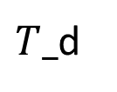

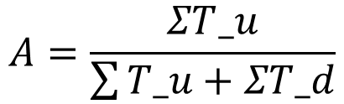
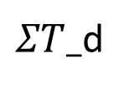
Toward highly available cloud systems
Gray failure
Understanding Insight
Engineering
ByteBrain
Design Implementation
Incident mitigation, detection
Panorama
$$Σ$$
$T_$d
$ΣT_$d
$$A=\frac{ΣT_u}{\sum{T_u}+ΣT_d}$$

Slide 25

Toward highly available cloud systems
Come and join us!
Networking plus systems
Many networking systems (e.g., switch software) need systems thinking
Networking plus machine learning
A field that becomes a melting pot of two (very different) ways of thinking

Slide 26
Acknowledgement
Pingmesh (sigcomm15): Lihua Yuan, Dong Xiang, Yingnong Dang, Ray Huang, Dave Maltz, Zhaoyi Liu, Vin Wang, Bin Pang, Hua Chen, Zhi-Wei Lin, Varugis Kurien
Gray failure (hotos17): Peng Huang, Lidong Zhou, Jacob Lorch, Yingnogn Dang, Murali Chintalapati, Randolph Yao
Panorama (osdi18): Peng Huang, Lidong Zhou, Jacob Lorch
Deepview (nsdi18): Qiao Zhang, Guo Yu, Yingnong Dang, Nick Swanson, Xinsheng Yang, Randolph Yao, Murali Chintalapati, Arvind Krishnamurthy, and Thomas Anderson
NetBouncer (nsdi19): Cheng Tan, Ze Jin, Tianrong Zhang, Haitao Wu, Karl Deng, Dongming Bi, Dong Xiang
ByteBrain: Bytedance Networking Team

Slide 27
Q&A

