Slide 1



Augmenting Proactive Congestion Control with Aeolus
Shuihai Hu, Wei Bai, Baochen Qiao, Kai Chen, Kun Tan
APNet 2018, Beijing
Notes:
Hello everyone, I am Wei Bai from Microsoft Research Asia. Today, I am going to talk about our work: augmenting proactive congestion control with Aeolus
. This is a joint work with Shuihai Hu, Baochen Qiao, Prof. Kai Chen from HKUST, and Dr. Kun Tan from Huawei. [click]

Slide 2



Recent Trends in DCNs
The link speed scales up fast
Applications demand ultra-low latency (<100us)
1Gbps
10Gbps
40Gbps
100Gbps
200Gbps
…
2007
2010
2013
2016
2018
Notes:
Data center networks have been evolving fast in recent years. First, the link speed of DCNs significantly increases, from 1Gbps to 10Gbps, to 100Gbps with 200Gbps on the horizons. Second, modern cloud applications, such as web search and retailing, impose ultra-low latency from the underlying network.

Slide 3


DCNs Become More Challenging
10-100x higher BDP
More bustiness
Flows finish in much fewer RTTs
10-100X link speed
$$⟹$$
Stricter latency demand
$$⟹$$
More sensitive to
queueing delay & packet loss
Notes:
Given recent trends, congestion control in DCNs have become more challenging. [click] On the one hand, with link speed increased by 10-100 times, today’s DCNs have much higher bandwidth-delay product and more bustiness. As a result, flows now finish in much fewer RTT, leaving the transport very little time to react to congestion. [click] on the other hand, stricter latency demand means applications are more sensitive to queueing delay and packet loss.

Slide 4
Congestion Control Today
Mainly achieved using reactive protocols
End-hosts react to signals after congestion occurs
TCP, DCTCP, DCQCN, TIMELY, …
Switch queue build-ups
Severe loss under incast
Slow convergence speed
Worsens with higher link speed
Notes:
Today’s congestion control are mainly achieved using reactive protocols. [click] Reactive congestion control algorithms, such as TCP and DCTCP, react only after congestion already happens. [click] Reactive solutions have long-standing problems including switch queue build-ups, severe loss under incast and very slow convergence speed. With higher link speed, all these problems now become worse.

Slide 5
Proactive Congestion Control (PCC)
Key idea: explicitly schedule packet transmission based on the availability of network bandwidth
Fastpass[sigcomm14]: centralized schedule
Notes:
Recently, proactive congestion control have drawn great attention in the community. The key idea of proactive solutions, unlike reactive ones, is to explicitly schedule packet transmission based on the availability of network bandwidth. There are several ways to realize this idea. [click] For example, Fastpass uses a centralized arbiter to control all network transfers, including when senders can send packets and what paths packets should take.

Slide 6

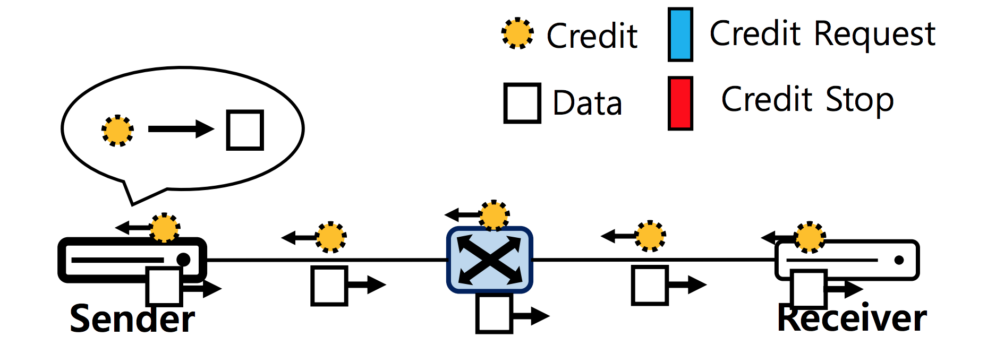
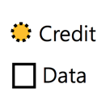
Proactive Congestion Control (PCC)
Key idea: explicitly schedule packet transmission based on the availability of network bandwidth
ExpressPass[sigcomm17]: receiver-driven credit-based approach
Notes:
proactive congestion control can also be decentralized. For example, a more recent work ExpressPass takes a receiver-driven credit-based approach. This approach let receivers proactively schedule packet transmission by distributing credits to senders.

Slide 7
Proactive Congestion Control (PCC)
Key idea: explicitly schedule packet transmission based on the availability of network bandwidth
Near-zero queueing
Zero packet loss
Fast convergence
Support multiple user objectives
Notes:
Compared with reactive solutions, proactive solutions have several advantages, including [click] near-zero queueing, [click] zero packet loss, [click] and fast convergence. [click] As network bandwidth is allocated before packet transmissions, proactive solutions can also support multiple user objectives such as shortest remaining time first, weighted fair sharing, and so on.

Slide 8
the Problem of PCC
Problem: 1 RTT extra latency for scheduling
1 RTT is significant at high link speed
 | Cache Follower | Web Server | Data Mining
1Gbps | 8.0 RTT | 11.1 RTT | 18.9 RTT
100Gbps | 2.1 RTT | 2.1 RTT | 2.1 RTT
Average FCTs of 0-100KB flows under ExpressPass
At high speed, 1 RTT contributes to nearly 50% of FCT!
Notes:
While being promising, a major drawback of proactive solutions is that new arrival flows need one RTT extra latency to get allocated bandwidth. As a result, all flows are delayed by one RTT, even when the network is very idle. [click] Note that 1 RTT is actually significant when at high link speed. [click] In the Table, we measured the average FCTs of 0-100KB small flows using both 1G and 100G link speed. Flows are generated according to three realistic workloads including Cache Follower, Web Server and Data Mining. We choose ExpressPass as the congestion control algorithm. As we can see from the table, , under 1Gbps networks, on average it takes around 8-19 RTTs for small flows to finish, hence it may not be a big concern to introduce 1 RTT extra delay. However, under 100Gbps networks, on average only 2 RTTs are needed for small flows to complete. [click] 1RTT extra latency is significant, as it contributes to nearly 50% of FCT!

Slide 9
Existing Solutions
Pay the cost of 1 RTT extra latency
Fastpass[sigcomm’14], ExpressPass[sigcomm’17]
All flows unnecessarily delayed by 1 RTT
Bandwidth waste
New flows blindly send unscheduled traffic in the 1st RTT
NDP[sigcomm’17], Homa[sigcomm’18]
Severe queue buildup & packet loss
Violation of policy goals
Notes:
Regarding this problem, existing solutions fall in two lines. [click] One line of works, such as Fastpass and ExpressPass, pay the cost of 1 RTT extra delay to preserve all the benefits of proactive congestion control. As a result, all flows are unnecessarily delayed by 1 RTT. [click] The second line of works, such as NDP and Homa, let new flows blindly send unscheduled traffic in the first RTT. While this approach removes the 1 RTT extra latency, it will unavoidably cause severe queue buildup and packet loss. Furthermore, the policy goals will also be violated as the bandwidth is no longer shared as the proactive solution indicates.

Slide 10
Can we eliminate 1 RTT extra latency while preserving all the benefits of PCC?
Our answer: Aeolus
Notes:
To this end, it is natural to ask such a question: can we eliminate 1 RTT extra latency while preserving all the benefits of PCC? [pause] [click] our answer to this question is Aeolus.

Slide 11
Aeolus’S DESIGN
Notes:
Now, we talk about the design of Aeolus.

Slide 12

Design
Key Idea: let new flows only utilize the spare bandwidth for the first RTT transfers
Solution: selective dropping mechanism
dropping threshold
Switch queue
Notes:
The key idea of Aeolus is to let new flows only utilize the spare bandwidth for the first RTT transfers. [click] To realize this idea, we developed a selective dropping mechanism. So, what is selective dropping mechanism? [pause]. I use this figure to show it. [click] As we can see, selective dropping is a switch buffer management scheme. It configures a dropping threshold at switch queues.

Slide 13
Design
Key Idea: let new flows only utilize the spare bandwidth for the first RTT transfers
Solution: selective dropping mechanism
Unscheduled traffic as low priority
Scheduled traffic as high priority
dropping threshold
High priority
Low priority
Switch queue
Notes:
When queue occupancy reaches the preset dropping threshold, [click] the incoming packets carrying low priority tag will get dropped. [click] In contrast, packets carrying high priority tag will be accepted. [click] By assigning unscheduled packets with low priority and scheduled packets with high priority, we can ensure that unscheduled packets sent by new flows only utilize the spare bandwidth for the first RTT transfers.

Slide 14
Why Selective Dropping Works?
Case-1: network under-utilized
Unscheduled packets fully utilize spare bandwidth
No 1 RTT extra latency
scheduled pkt
unscheduled pkt
Notes:
Now, let’s see why selective dropping works. [click] When network is under-utilized, [click] unscheduled packets can fully utilize the spare bandwidth left by scheduled packets. As a result, [click], there is no 1 RTT extra latency. [click]

Slide 15
Why Selective Dropping Works?
Case-2: network fully-utilized
Unscheduled packets are selectively dropped
All the benefits of PCC are preserved
scheduled pkt
unscheduled pkt
Notes:
When network is fully-utilized, [click] unscheduled packets are selectively dropped. As a result, [click], scheduled packets are not affected, [click] and all the benefits of proactive congestion control are preserved. [click]

Slide 16
How to Implement?
An interesting observation about ECN:
ECN-capable packets are marked
ECN marked
ECN-capable
01
11
ECN marking threshold
Notes:
While the selective dropping mechanism is appealing, the key question is how to implement it at commodity switches. [click] In our past testbed experiments with ECN, We made an interesting observation. [click] Let’s assume the queue occupancy reaches the ECN marking threshold. Our finding is that, [click] if a packet is ECN capable, [click] it will enter the queue and get ECN marked.

Slide 17
How to Implement?
An interesting observation about ECN:
ECN-capable packets are marked
ECN-incapable packets are dropped
ECN-incapable
00
dropped
ECN marking threshold
Notes:
But if a packet is not ECN capable, [click] it will be dropped by the switch. [click]

Slide 18
ECN-based Implementation
End-host tagging:
Scheduled packets tagged as ECN-capable
Unscheduled packets tagged as ECN-incapable
Switch configuration:
ECN marking threshold = selective dropping threshold
Notes:
Based on this observation, we can implement the selective dropping mechanism by reinterpreting the ECN marking function. [click] At the endhost, we tag scheduled packets as ECN-capable, and unscheduled packets as ECN-incapable. [click] At the switch, we set the ECN marking threshold to the selective dropping threshold we want to configure. [click]

Slide 19
Why not Priority Queueing?
Priority queueing is an alternative solution
Scheduled packet → high priority queue
Unscheduled packet → low priority queue
Scheduled packet
high priority
Unscheduled packet
low priority
Notes:
[click] Priority queueing is an alternative solution to selective dropping mechanism. [click] As shown in the figure, by having scheduled packet enter high priority queue, and unscheduled packets enter low priority, we can also ensure unscheduled packets only utilize the spare bandwidth for the first RTT transfers. [click]

Slide 20
Why not Priority Queueing?
Drawback #1: 1 additional queue per service class
# of supported service classes reduced by half
Notes:
However, priority queueing have two drawbacks. [click] First, it will require one additional queue for each service class, such that the number of supported service classes will be reduced by half. [click]

Slide 21
Why not Priority Queueing?
Drawback #1: 1 additional queue per service class
# of supported service classes reduced by half
Drawback #2: packet reordering problem
Notes:
Second, due to the queueing delay in the low-priority queue, there can be packet reordering problem.

Slide 22
More Details in the Paper
Loss recovery scheme for unscheduled packets
Fast Loss detection
Reliable loss retransmission
Parameter selection for Aeolus
Discussion of Future Works
Notes:
In the paper, we also deigned a loss recovery scheme for unscheduled packets. We also discussed parameter selection of Aeolus. For these details, please refer to our paper.

Slide 23
Simulations Setup
Topology:
192-host 100Gbps 3-level fat-tree fabric
Workloads:
Web Server, Cache Follower, Web Search
Compared schemes:
ExpressPass
ExpressPass + Aeolus
Metrics:
Flow completion time (FCT)
Queue length
Notes:
This is the simulation setup. We use a 100Gbps 3-level fat-tree consisting of 192 hosts. The traffic is generated using realistic workloads including web server, cache follower and web search. We compare the FCT and queue length under two schemes: ExpressPass with or without Aeolus. [click]

Slide 24
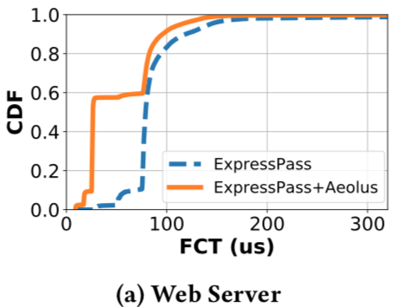
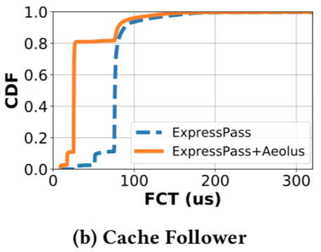
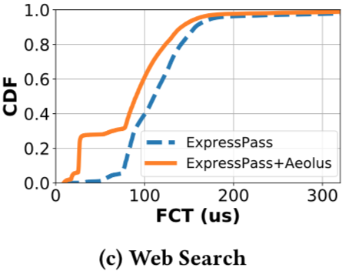
Average FCT (<100KB) at 40% Load
80%
60%
30%
Aeolus significantly speeds up small flows by removing 1RTT extra delay
Notes:
These three figures show the average completion times of small flows. [click] As we can see, with Aeolus, a large portion of small flows complete within the first RTT. [click] This indicates that Aeolus can significantly speeds up small flows by removing 1RTT extra delay. [click]

Slide 25
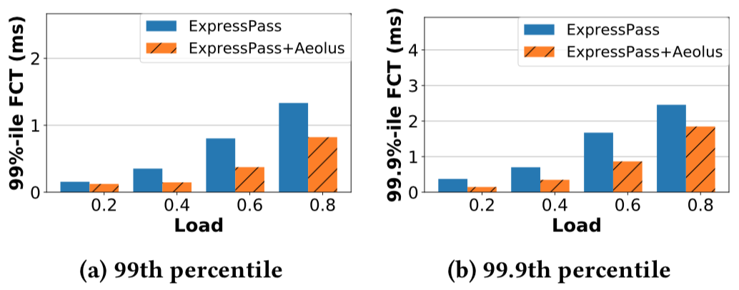
Tail FCT (<100KB)
First RTT burst will not hurt tail FCT
Notes:
These two figures show the 99%-ile FCT and 99.9%-ile FCT of 0-100KB flows with the varying load for the web server workload. [click] The results indicate that, first RTT burst will not hurt tail FCT of small flows. Instead, better tail FCT can be achieved due to the remove of one RTT extra delay. [click]

Slide 26
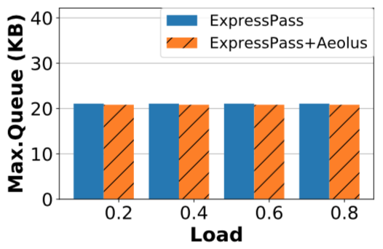
Maximum Queue Length
Aeolus preserves PCC’s zero loss & small queue
Notes:
This figure shows the maximum queue length. As we can see, both schemes’ maximum queues are small and stable with increasing load. [click] The results indicate that Aeolus can well preserve PCC’s benefits including zero loss & small queue.

Slide 27
Conclusion
Problem: PCC requires 1 RTT extra latency
Solution: Selective Dropping Mechanism
Differentiating traffic at the end
Enforcing selective dropping in the network
No 1 RTT extra latency & preserving PCC’s benefits
ECN-based implementation (readily-deployable)
Notes:
At last, let me do a brief conclusion. Aeolus is motivated by the problem that proactive congestion control requires 1 RTT extra latency for scheduling. To solve this problem, we designed a selective dropping mechanism. By differentiating traffic at the end and enforcing selective dropping in the network, Aeolus removes the 1 RTT extra latency while preserving all the benefits of PCC. Our solution is also readily-deployable, as it can be implemented with ECN function supported by most commodity switches.[click]

Slide 28
We are Hiring
Networking Research Group (NRG) at MSRA is looking for both FTE and interns
FPGA networking
Network function virtualization
Contact my manger Yongqiang Xiong (yqx@microsoft.com)

Slide 29
Thanks!
Notes:
Thanks! I am pleased to take question.

Slide 30
Notes:
Thanks! I am pleased to take question.

Slide 31
Backup slides
Notes:
Thanks! I am pleased to take question.

Slide 32

Fast Recovery of Unscheduled Packets
Fast loss detection
Per packet ACK for unscheduled packets
Network
3
2
1
3
2
1
3
1
Sender
Receiver
Unscheduled pkt
ACK
Notes:
While the selective dropping mechanism protects scheduled packets, unscheduled packets could suffer from excessive packet loss under heavy load. To handle this, we designed a fast recovery scheme for unscheduled packets. [click] The first step is to detect loss quickly. [click] To do that, we enable per packet ACK for unscheduled packets. In the next, we use a simple example to illustrate how it works. [click] As shown in the figure, the sender sends 3 unscheduled packets, [click] but packet #2 get dropped in the network. [click] So only packet #1 and packet #3 arrived at the receiver. [click]

Slide 33
Fast Recovery of Unscheduled Packets
Fast loss detection
Per packet ACK for unscheduled packets
Network
1
3
Sender
Receiver
Unscheduled pkt
ACK
Notes:
The receiver generates two ACKs corresponding to these two packets. Based on the ACKs, the sender can figure out packet #2 was lost. Note that all ACK packets are tagged as high priority, so it is rare for ACKs to get lost in the network. [click]

Slide 34
Recovery of Unscheduled Packets
Fast loss detection
Per packet ACK for unscheduled packets
Network
3
2
1
Sender
Receiver
Sender cannot know whether packet #3 is lost based on ACKs
Notes:
However, if the last packet get dropped, [click] Sender cannot know packet #3 was lost based on the received ACKs. [click]

Slide 35
Recovery of Unscheduled Packets
Fast loss detection
Per packet ACK for unscheduled packets
Tail loss probing
Network
3
3
2
1
3
3
2
1
3
2
1
Sender
Receiver
Unscheduled pkt
ACK
Probe
Notes:
To handle this, we designed a tail loss probing mechanism. [click] The idea is to send a probe packet right after the transmission of last unscheduled packet. This probe packet carries the sequence number of last sent packet, and is of minimum Ethernet size. [click] The probe packet is tagged with high priority, [click] such that it can be received by the receiver even if the network is congestion. [click]

Slide 36
Recovery of Unscheduled Packets
Fast loss detection
Per packet ACK for unscheduled packets
Tail loss probing
Network
1
2
3
Sender
Receiver
Unscheduled pkt
ACK
Probe
Notes:
At the receiver side, the probe packet will be bounced back to the sender. [click] Then based on the received ACKs and probe, the sender can figure out packet #3 was lost. [click]

Slide 37
Recovery of Unscheduled Packets
Retransmission only with scheduled packet
Network
3
1
2
3
Sender
Receiver
Scheduled pkt
ACK
Probe
Notes:
To ensure reliable retransmission, [click] lost unscheduled packets are retransmitted only with scheduled packet. This ensures that no lost packet needs to be retransmitted more than once. [click]

