Slide 1


Toward Effective and Fair RDMA Resource Sharing
Haonan Qiu, Xiaoliang Wang, Tiancheng Jin, Zhuzhong Qian, Baoliu Ye, Bin Tang, Wenzhong Li, Sanglu Lu
National Key Laboratory for Novel Software Technology, Nanjing University
APNet 2018, August 2

Slide 2
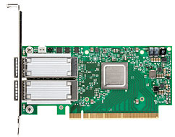






RDMA in Datacenter
RDMA NIC(RNIC)
Datacenter
Cheaper price
Low latency(~ 1us)
High throughput(100GbE)
Large scale
7 x 24h online real time service
High volume traffic (TB level)

Slide 3




RDMA-Based Datacenter Applications
KVStore
Pilaf
[ATC’ 13]
HERD
[SIGCOMM’14]
RPC
FaSST
[OSDI’ 16]
RFP
[EuroSys’ 17]
DSM
FaRM
[NSDI’ 14]
INFINISWAP
[NSDI’ 17]

Slide 4
RDMA Communication and Resources
Application
Application
Buf
Buf
Kernel
⑤
②
①
④
Kernel
Poll CQE
Post Send WQE
Post Recv WQE
Poll CQE
RNIC
RNIC
CQ
QP
QP
CQ
③ Transmission
WQE: Work Queue Element
QP: Queue Pair
CQ: Completion Queue
CQE: Completion Queue Element

Slide 5
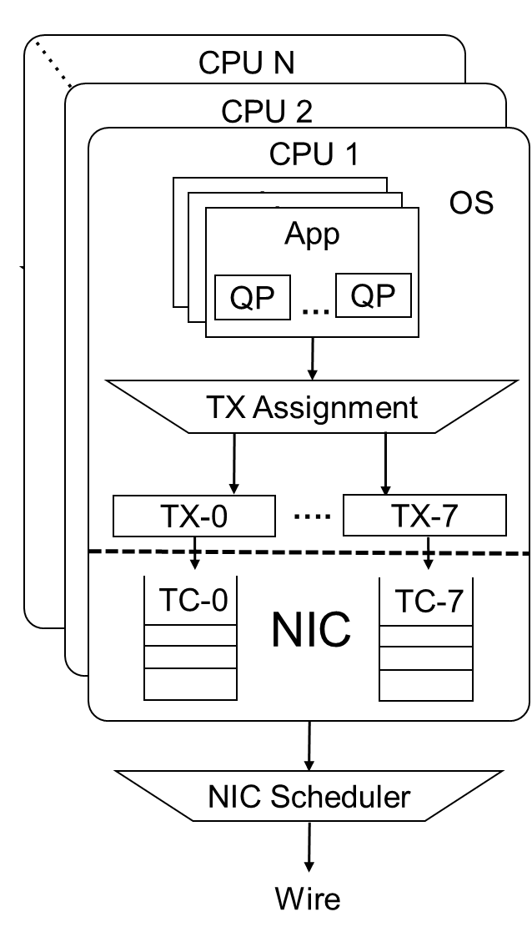
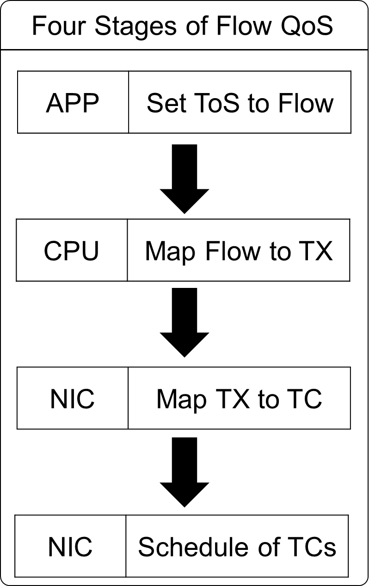
QoS of RDMA NIC
Application-level Strategy
QPs can be mapped to different Traffic Class (TCs).
Available Mechanism for TCs
Strict Priority (Strict)
Prior over non strict priority TCs (ETS).
Enhanced Transmission Selection (ETS)
Share the left bandwidth according to a minimal guarantee policy.

Slide 6
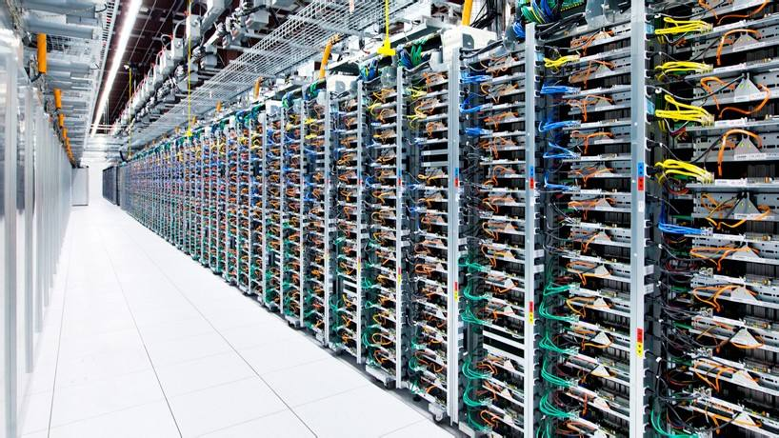
Explosive Volume of Resources
Cache miss will frequently happen in large-scale data center network.
Memory
WQE
qp_context
Virt-to-phy addr
Swapping
RNIC
WQE
qp_context
Virt-to-phy addr
(1) Large-scale Datacenter with large number of connections
(2) Cache miss caused by overfull meta data

Slide 7
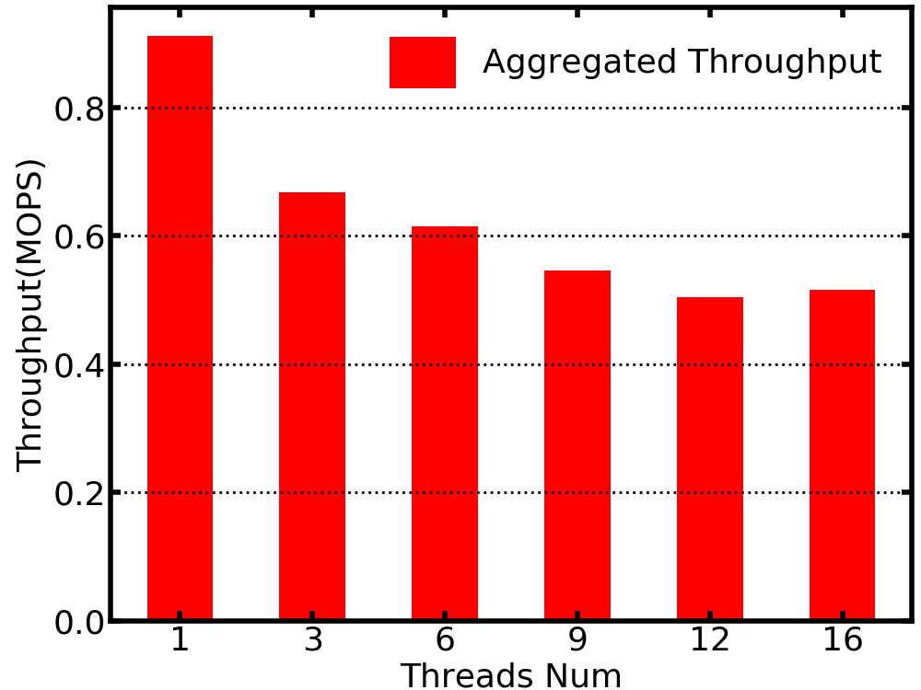
Resource Sharing Problem
Thread 1
Thread 2
Thread 3
Lock
CQ
QP
SRQ
(1) Synchronous Resource Sharing Model
(2) Throughput on the Shared QP with Varied number of Threads
Lock mechanism must be applied in synchronous sharing.
The SRQs provided by verbs are application isolated and not effectively shared.
Serious performance loss when applying lock mechanism.
34% performance loss for 6 threads
44% performance loss for 9 threads.
Resources should be effectively shared among applications

Slide 8

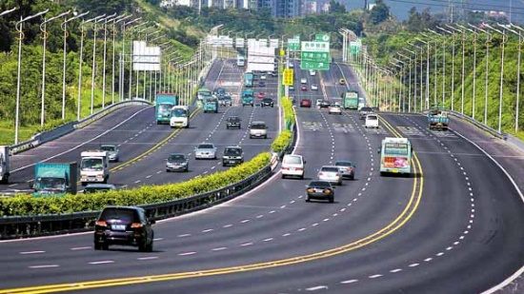


QoS Demand
Occasion
Flows in datacenter with deadlines should be served as high priority.
Most flows in datacenter are short flows(<50KB) and should be served quickly.
Demand
Short flows should not be blocked by long flows.
The high priority flows should not be blocked by low priority flows.

Slide 9
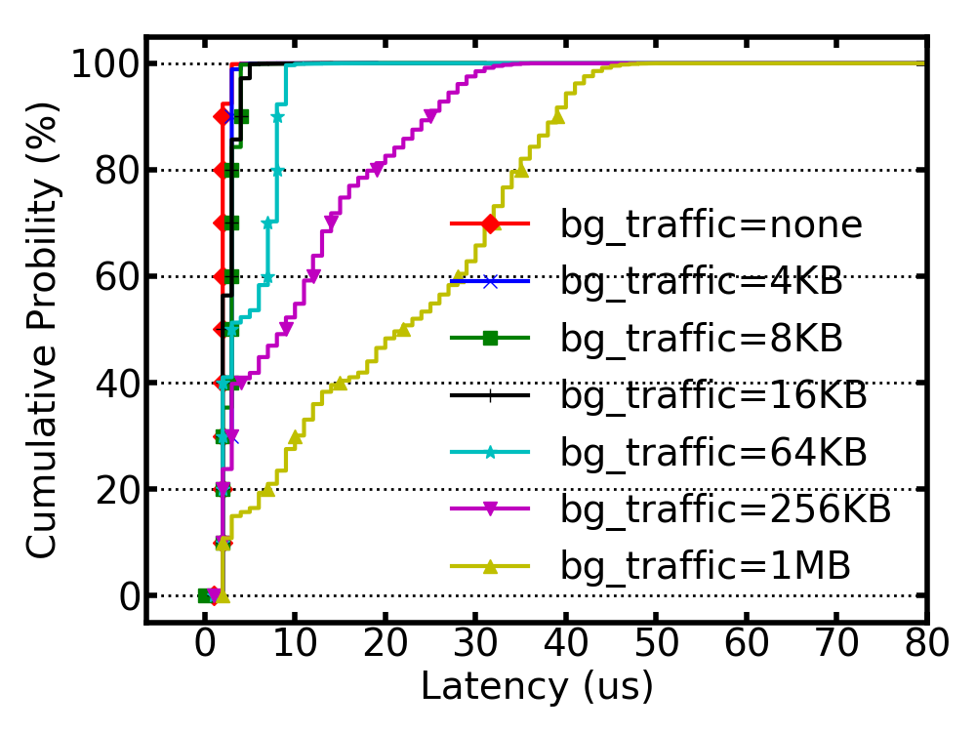
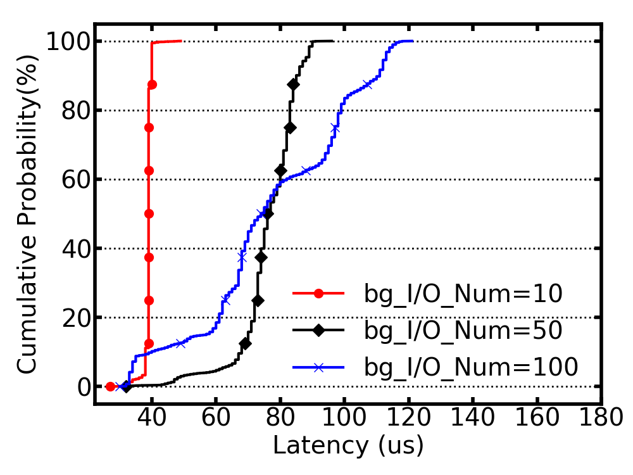
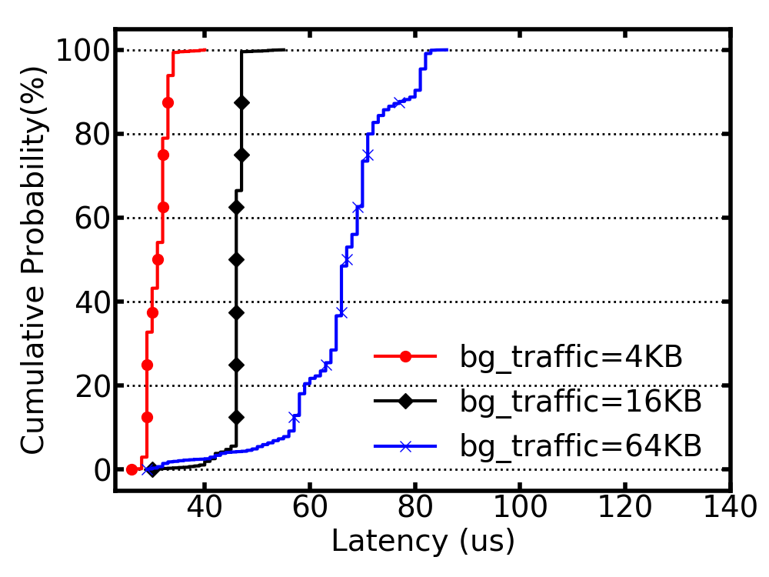
HoL Blocking and Corase-grained Scheduling
TC
TC
TC0(ETS)
TC1(Strict)
Flow A
Flow B
HoL Blocking
Corase-grained
Scheduling
Processing
Processing
Processing
(1) Small Flow Completion Time
(2) Small Flow Completion Time
(3) High Priority Flow Completion Time

Slide 10




When Resource Sharing Meets QoS Demand
Low-level engineers must guarantee effective QoS for our applications.
Help!
We focus on the design of base function and hardware performance of RNIC now.
Application Engineers
Applications
RNIC Driver Engineers
All problems in computer science can be solved by another level of indirection.
Preserve the performance while adding an extra layer

Slide 11
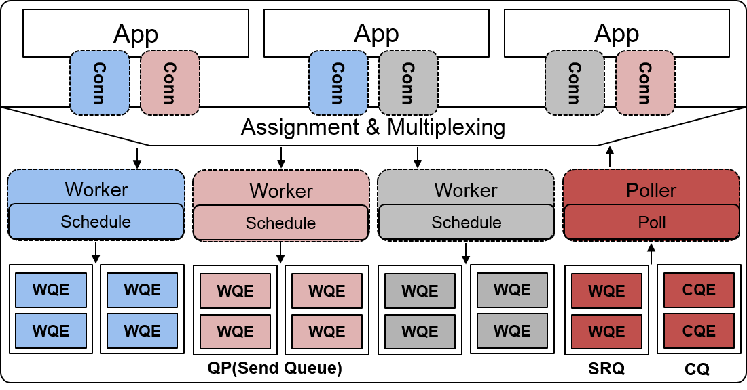
Goals and Model
Design Goals
Effective resource sharing
Fair fine-grained scheduling
Model (Avatar)
Connection establishment
Connections to the same remote node share the same resources (QP and Worker)
Traffic scheduling
Workers process WQEs from connections
Traffic receiving
One SRQ handels all remote QPs.
Poller polls the CQ to distribute the traffic.
System Model

Slide 12
Asynchronous Resource Sharing
Data structure in each connection for asynchronous resource sharing
An unique identifier to differentiate traffic sharing the same QP.
An egress queue to cache WQEs of each applications.
An event file descriptor to request Avatar for service.
Application
Application
①
①
Connection
Connection
S
S
ID:1
ID:2
②
②
fd
fd
③
③
Worker
Fd Vector
④
④
QP

Slide 13
Fair Traffic Scheduling
Fairness in the same priority
Split traffic into same small size.
En-queue the traffic in Round-Robin.
Fairness between High Priority and Low priority
Split traffic into same small size.
Traffic with low priority will not block traffic with high priority.
Connections
Low Priority
High Priority
TC(ETS)
TC(Strict)

Slide 14
Traffic Receiving and Thread Working Mode
Traffic Receiving
Poller polls CQ and pushes CQEs to the ingress queue of the connection according to the ID in CQEs.
Thread Working Mode
Blocked, Interrupted, Running
Save CPU resources in light load.
Keep running in heavy load environment for avoiding extra latency.
Application
Application
⑥
③
Connection
Connection
R
R
ID:1
ID:2
fd
fd
⑤
②
Poller
ID Vector
④
①
SRQ
CQ

Slide 15
Testbed Setting
Four Nodes
CPU
Xeon E5-2650v2(24 cores, 2.1Ghz)
DRAM
4 * 16GB DDR3 DIMMs, 1.6Ghz
RNIC:
Mellanox EDR ConnectX5 100GbE
Mellanox QDR ConnectX3 40GbE.
Switch
Mellanox MSN 2100 100GbE
Switch
NIC
NIC
NIC
NIC
Dell R720
Dell R720
Dell R720
Dell R720
RoCE Node
RoCE Node
RoCE Node
RoCE Node

Slide 16
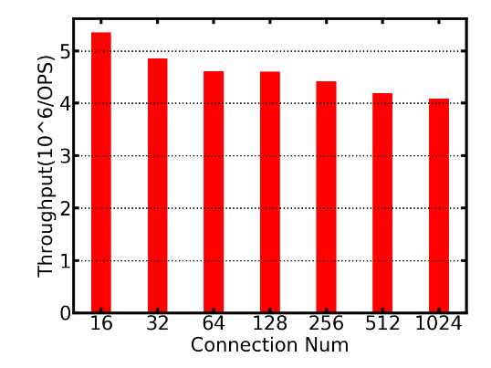
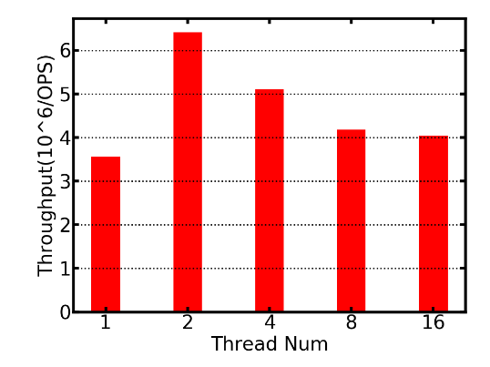
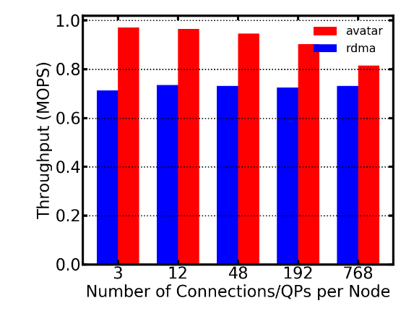
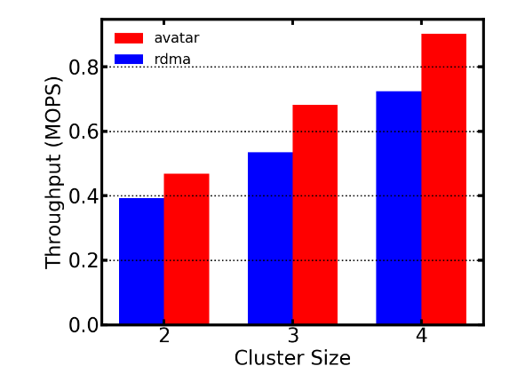
Scalability
Scalability
Support 1024 connections with below 20% performance loss between two nodes.
No loss caused by mutex-lock contention among applications.
10% - 20% higher throughput than native RDMA when connection size varies in four nodes.
8% - 25% higher throughput than native RDMA when cluster size varies.
Connection Scalability
between 2 nodes
(2) Application Scalability
(emulated by thread) on 1 QP
(3) Connection Scalability
between 4 nodes
(4) Cluster Scalability

Slide 17
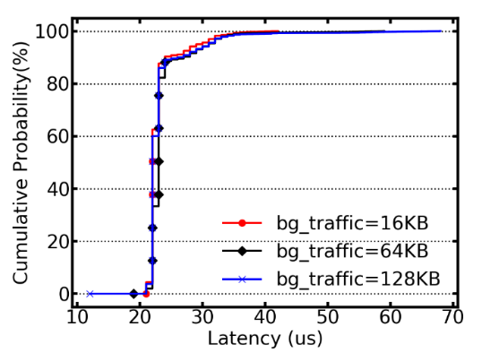
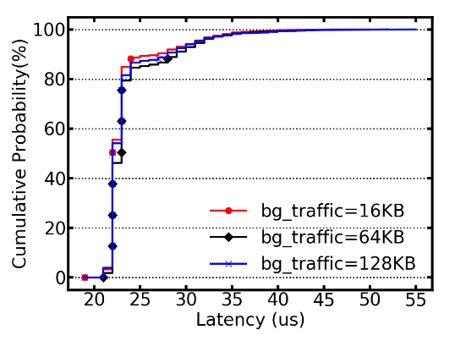
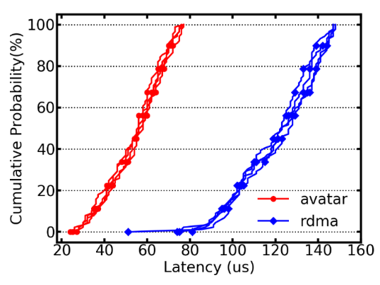
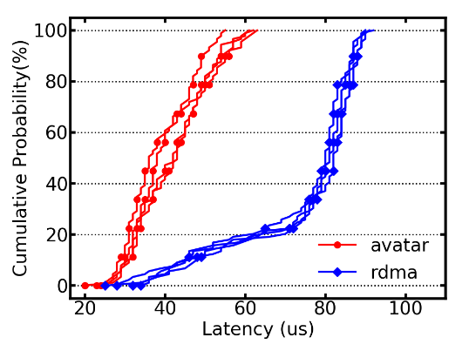
Fairness
Fairness
Mitigate the HoL blocking when both large flows and small flows with same priority (w/o PRI) exist.
Achieve fine-grained preemptive scheduling when large flows and small flows with different priorities (w/ PRI) exist.
Reducing FCT of mice flows and flows with high priority up to 50% when multiple flows exist.
(1) Round-Robin w/o PRI
(2) Round-Robin w/ PRI
(3) 8 Traffics w/o PRI
(4) 8 Traffics w/ PRI

Slide 18
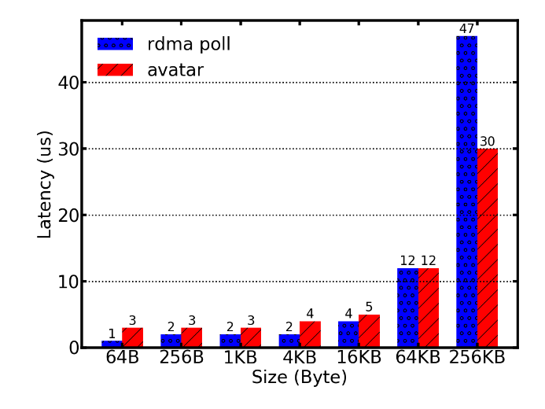
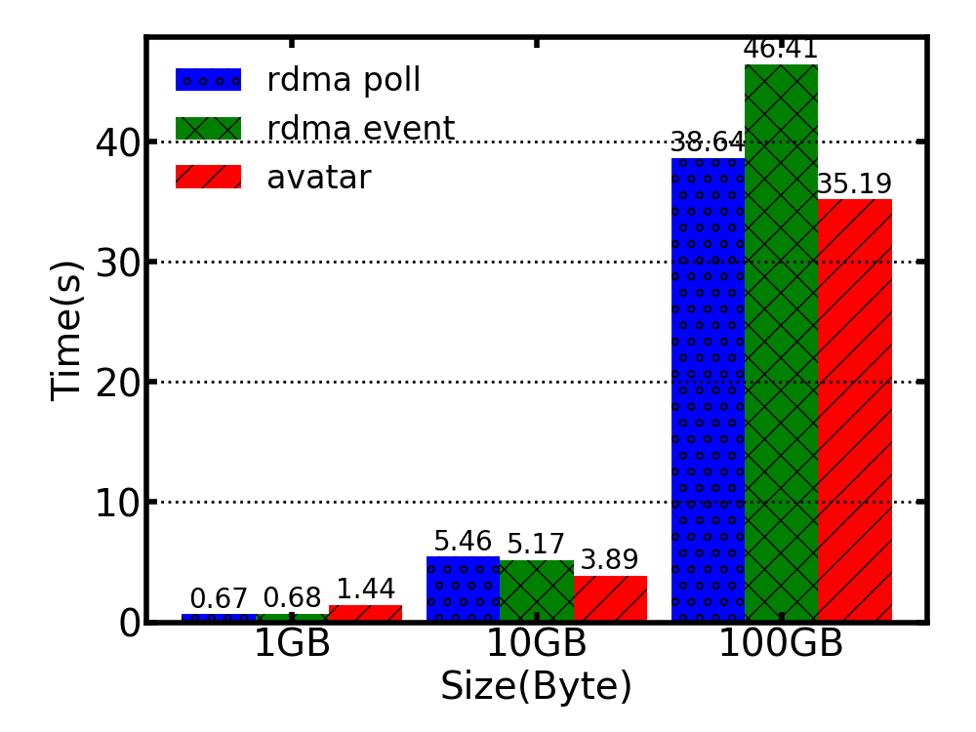
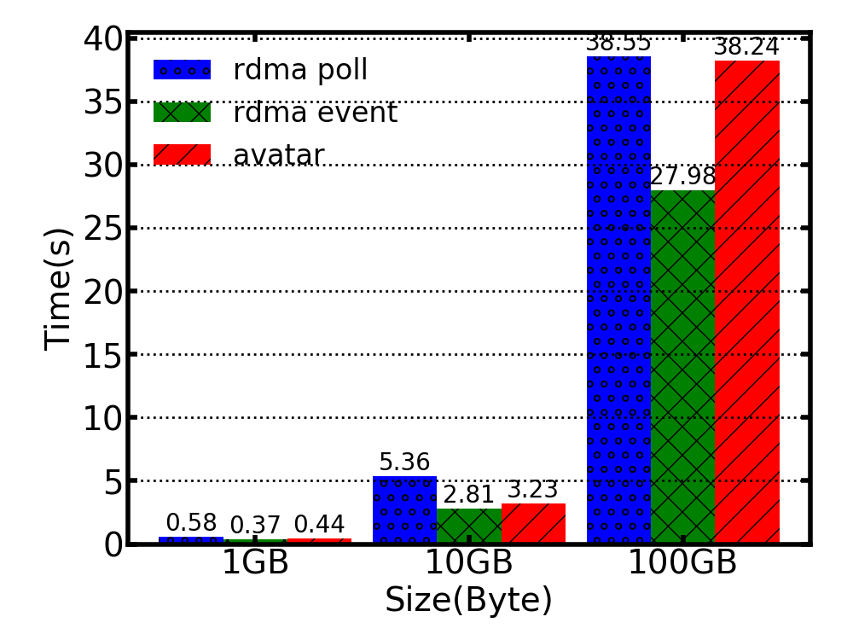
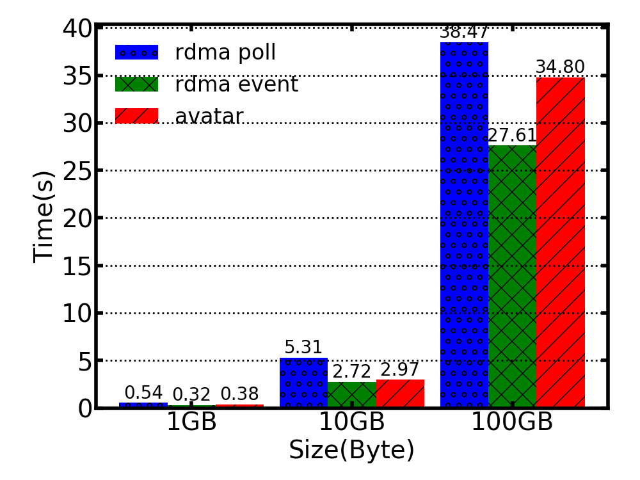
Latency and CPU Cost
Latency
Transfer M KB data
Extra 1~2us when M < 16 KB.
37% less latency when M = 256KB.
CPU Cost
Transfer 1GB, 10GB and 100GB data.
Less time than busy-polling RDMA.
Less Real time but more User space time than event-triggered RDMA .
(1) Latency Comparison
(2) Real Time
(3) User space Time
(4) User space + Kernel space Time

Slide 19
Summary
Avatar
A new model to better take advantage of RDMA
Effective resource sharing
Fair traffic scheduling on RNICs
Low latency and low CPU cost

Slide 20
Thank you!
Q&A

