Slide 1


Dante: Enabling FOV-Aware Adaptive FEC Coding for 360-Degree Video Streaming
Zhetao Li Fei Gui Xiangtan University
Jinkun Geng Dan Li Tsinghua University
Zhibo Wang Wuhan University
Junfeng Li
Yang Cheng Tsinghua University
Usama Zafar
Notes:
Hello, I am Fei Gui from Xiangtan University. The topic I would like to share with you is Dante: Enabling FOV-Aware Adaptive FEC Coding for 360-Degree Video Streaming. This work is supervised by Prof. Dan Li and Prof. Zhetao Li and it is cooperated with Jinkun Geng, Junfeng Li, Yang Cheng, Usama Zafar,

Slide 2





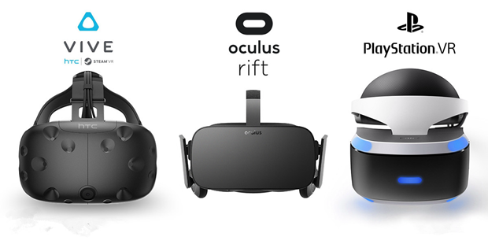
Background
360-degree videos are coming to age largely driven by content providers and HMD(Head-mounted display) device vendors
Notes:
360-degree video is currently served by more and more major platforms, like Facebook, Youtube, NBC.
360-degree video is coming to age, largely driven by these content providers and Head-mounted display (HMD) device vendors

Slide 3

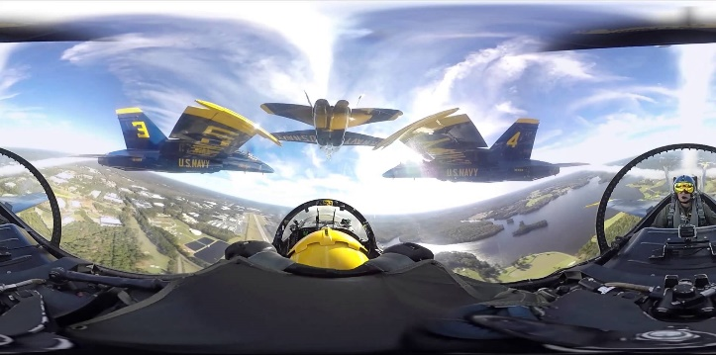


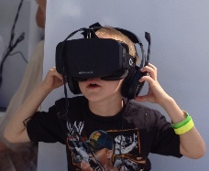
Background
Notes:
Watching 360-degree videos wearing wirelessly connected devices provides users with unprecedented immersive experience.

Slide 4
Background
The demanding requirements of low latency and high bandwidth of 360°videos pose a challenge to current network architecture
Notes:
However, to oﬀer true immersive experience, 360-degree videos must be streamed in high resolution and within a small, bounded delay. That render current network architecture insufficient.

Slide 5
Background
360-degree videos
Stringent low delay
High bandwidth
Wireless networks
Limited bandwidth
Prone to packet loss (high packet loss rate)
How to achieve good video quality ? !
Notes:
* 360-degree videos is featured by Stringent low delay and High bandwidth requirement
* But wireless networks are characterized as limited bandwidth and high packet loss rate
* So, How to achieve good video quality in wireless networks is a challenging problem

Slide 6
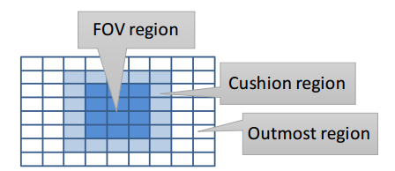
Current solutions
Key observation
User only watch a small portion of the frame in the direction of user’s view anytime.
FOV-aware tile-based streaming
Mainly adapt the video bitrate to optimize the quality of time-varying FOV
The bitrate of the region in and around FOV prioritized over non-FOV region
Notes:
Let’s first have a glance at the current solutions. Generally, current schemes are based on the key observation that users only watch a small portion of the frame in the direction of user’s view anytime. The small portion of video is usually in the FOV region.
That means that the small portion of video should be underscored and prioritized.
So, many of efforts have been devoted to FOV-aware tile-based streaming. They try to prioritize the video bitrate of FOV region over non-FOV region to optimize the video quality of FOV region thus boosting whole video quality.

Slide 7
Current solutions
FOV-aware tile-based streaming
Split into multiple files
+
+
Highest video bitrate
Medium video bitrate
Lowest video bitrate
Notes:
In these schemes, * spherical videos are split into multiple regions, for example, FOV region and non-FOV regions.
When choosing video bitrate, * highest video bitrate is preferentially chosen for FOV, * medium video bitrate for cushion region and * lowest video bitrate for outmost region.

Slide 8
Current solutions
FOV-aware tile-based streaming
Application
control
FOV-aware bitrate adaptation
Application level strategy !
Application protocol
DASH(HTTP)
Transport layer
TCP
IP layer
IP
Notes:
* Essentially, these schemes are application level solution

Slide 9
Current solutions
FOV-aware tile-based streaming
To some extent, the scheme mitigate the requirement of high bandwidth
However, these schemes fail to directly optimize the streaming delay.
Notes:
To some extent, these schemes mitigate the requirement of high bandwidth
However, these schemes fail to directly optimize the streaming delay.

Slide 10
Deficiencies of FOV-aware tile-based streaming
Run on top of retransmission-based transport mechanisms (like TCP)
Absolute reliability usually means bad performance for real time video application
playback interruptions frequently
Worse performance in lossy wireless networks
Application
control
FOV-aware bitrate adaptation
Application protocol
DASH(HTTP)
Transport layer
TCP
IP layer
IP
Notes:
* Because they run top of retransmission-based transport mechanisms;
As we know, TCP is a reliable protocol, absolute reliability usually means bad performance, especially for real time video applications;
So, playback interruptions may happen frequently;
Furthermore, worse performance will be achieved in lossy wireless network.

Slide 11
Latency problem
Low delay requirement of 360 videos
User’s FOV is time-varying and predictable in short term
To guarantee quality of user’s FOV, FOV of downloaded video segment should be consistent with the FOV of video users actually watch
Therefore, buffer level should be always so shallow, for example 1s, 2s.
How to optimize the latency of 360-degree videos
Notes:
The 360 video latency problem is unsolved;
Because User’s FOV is time-varying and predictable in short term;
To guarantee quality of user’s FOV, FOV of downloaded video should be consistent with the FOV of video users actually watch.
Therefore, buffer level should be shallow, for example 1s, 2s.

Slide 12


Alternative solution
Transport level solution to reduce latency
If no retransmission ?
Notes:
* If can we remove the retransmission?

Slide 13


Alternative solution
Transport level solution to reduce latency
UDP + FEC
Sounds great!
Application
control
FOV-aware bitrate adaptation
FOV-aware bitrate adaptation
Application protocol
DASH(HTTP)
FEC + real-time streaming
Transport layer
TCP
UDP
IP layer
IP
IP
Notes:
FEC (Forward Error Correction) can be used to recover data losses within transmission to mitigate the re-transmission and has potential to meet the delay requirement of 360 videos.
To replace retransmission-based TCP, **a alternative scheme is to use FEC coding over UDP to reduce video streaming delay

Slide 14
Deficiencies of current transport level solution
There exists some state-of-the-art custom transport protocols for streaming delay-sensitive videos
Only focus on traditional video content, as opposed to 360-degree videos.
Non-FOV-aware
Can’t achieve good performance in lossy and limited-bandwidth wireless networks!
Notes:
There exists some state-of-the-art custom transport protocols for streaming delay-sensitive videos. But they Only focus on traditional video content, as opposed to 360-degree videos and can’t achieve good performance in lossy and limited-bandwidth wireless networks!

Slide 15
Our Solution
Rather than application-level adapting bitrate
we proposed an FOV-aware FEC coding scheme, Dante:
A custom underlying transport solution for 360-degree videos
FOV-aware FEC adaptation
Dynamically choosing FEC redundancy level based on how close the video content is to the FOV region
Application
control
FOV-aware bitrate adaptation
FOV-aware bitrate adaptation
Application protocol
FEC + real-time streaming
FOV-aware FEC + real-time streaming
Transport layer
UDP
UDP
IP layer
IP
IP
Notes:
And next I will introduce our solution.
Rather than application-level adapting bitrate, * we explore the opportunities of a custom underlying transport solution for 360-degree videos
and use FEC coding over UDP to reduce video streaming delay.
We present Dante, an FOV-aware FEC adaptation that adapts to changing network conditions by dynamically choosing FEC redundancy level based on how close the video content is to the FOV region.

Slide 16
Our Solution
Quick primer on FEC
Why FOV-aware FEC
How to adjust FEC redundancy rate
Notes:
The remaining presentation falls into three main aspects:
we first have a quick primer on FEC;
Then I will give an example explaining why FOV-aware FEC;
Lastly, I will present how to adjust FEC redundancy rate .

Slide 17
Quick primer on FEC
Take in k data packets (symbols) and creates r repair packets (symbols), According to specified redundancy rate,
Any k of the (k+r) packets received are sufficient to completely decode the original k data packets
Data packets
Repair packets
P1
P2
P3
P4
P5
R1
R1
packet loss
k = 5
r = 2
Transmission
Redundancy = r/(k+r) = 2/7,
More redundancy can counter more packet loss
P1
P2
P3
P4
R1
R1
decode
P1
P2
P3
P4
P5
Notes:
let’s firstly take a quick primer on FEC scheme:
At the first step, according to a determined redundancy rate, codec encodes to get a certain number of repair packets * , forming a coded block and send the whole block **.
At the second step, the original data would be completely recovered if enough number of packets are received.
As seen in this slide, Any k of the (k+r) packets received are sufficient to completely decode the original k data packets ***
Redundancy is equal to r divided by r plus k;
Obviously, more redundancy can counter more packet loss

Slide 18
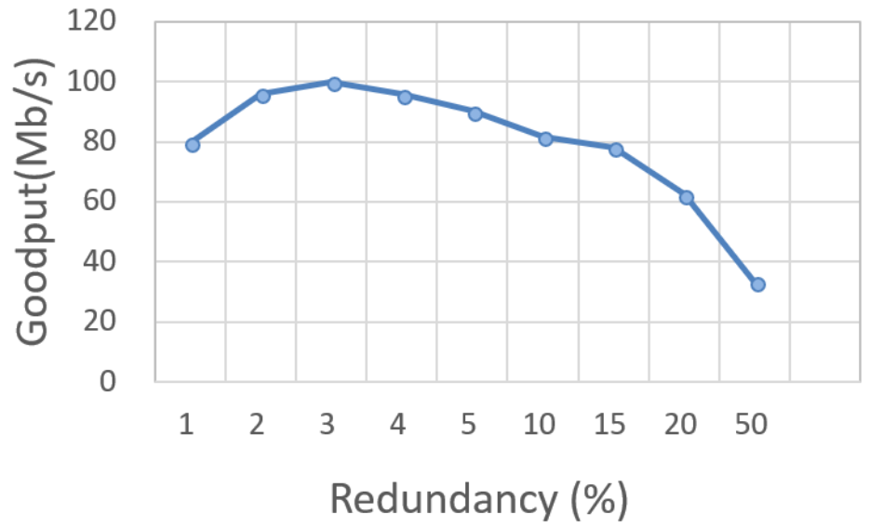
Quick primer on FEC
The FEC-enabled scheme achieves better delay and throughput performance by mitigating retransmission
FEC redundancy should be carefully allocated
Notes:
But, redundancy level can’t be set too high
The figure gives an example and shows the impact of the FEC redundancy on the video streaming goodput. *
Suitable FEC redundancy can mitigate the retransmission to improve goodput, but, * overprovisioning of redundancy will cause the self-conflicted congestion, exacerbating the goodput performance. *
So, we should carefully adjust the value of FEC redundancy.*

Slide 19
Why FOV-aware FEC
FOV region is given more FEC redundancy than non-FOV region
That is, packets in FOV regions is given more bandwidth, higher reliability, and more chance to meet the streaming delay constraint.
Given more bandwidth, higher reliability, and more chance to be received completely with delay constraint
Notes:
The next issue is why FOV-aware FEC;
* It’s our expected thing that the FOV region is given more FEC redundancy than non-FOV region;*
That is to say, data in FOV region is given more bandwidth, higher reliability, and more chance to meet the streaming delay constraint.

Slide 20
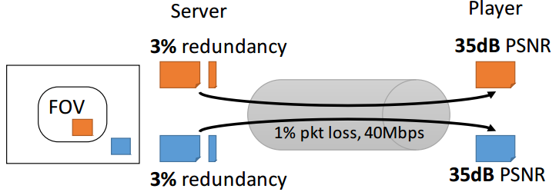
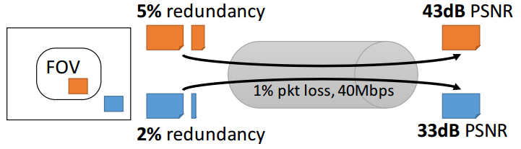
Why FOV-aware FEC
FOV-aware FEC VS Non-FOV-aware FEC
Notes:
As the example in this slide shown, * * * * the case where the FOV region is given more redundancy than non-FOV region can result in better video quality than another case where equal redundancy is allocated for both FOV and non-FOV regions.

Slide 21
Why FOV-aware FEC
FOV-aware FEC VS Non-FOV-aware FEC
FOV-aware FEC achieves significant performance gain!
Notes:
** FOV-aware FEC achieves significant performance gain!

Slide 22

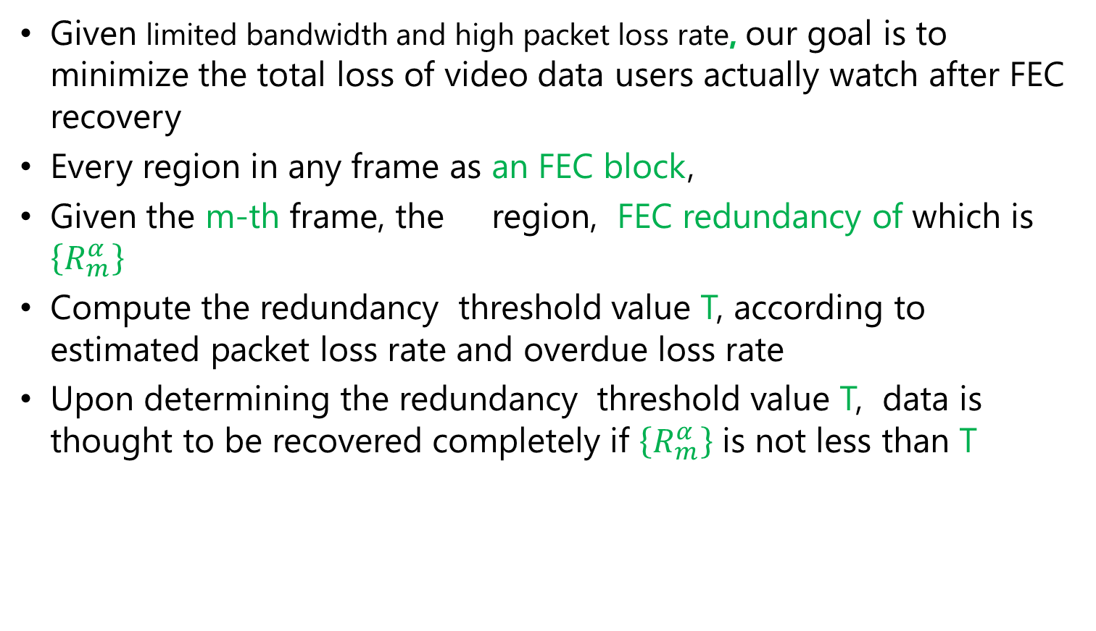
How to Adjust FEC redundancy
Given limited bandwidth and high packet loss rate, our goal is to minimize the total loss of video data users actually watch after FEC recovery
Every region in any frame as an FEC block,
Given the m-th frame, the region, FEC redundancy of which is $\left\{R_{m}^{α}\right\}$
Compute the redundancy threshold value T, according to estimated packet loss rate and overdue loss rate
Upon determining the redundancy threshold value T, data is thought to be recovered completely if $\left\{R_{m}^{α}\right\}$ is not less than T
$$α$$
Notes:
The last issue is how to adjust FEC redundancy:
Firstly, Given limited bandwidth and high packet loss rate, our goal is to minimize the total loss of video data users actually watch.
Every region in any frame is considered as an FEC block,
Given the m-th frame, the alpha region, FEC redundancy of which is $\left\{R_{m}^{α}\right\}$
Compute the redundancy threshold value T, according to estimated packet loss rate and overdue loss rate
Upon determining the redundancy threshold value T, data is thought to be Recovered completely if $\left\{R_{m}^{α}\right\}$ is not less than T

Slide 23
How to Adjust FEC redundancy
360°video is spatially split into 3 regions, FOV region, cushion region and outmost region
Firstly, removing original data size from the available sending rate, the remaining bandwidth is budget of redundancy packet for a GOP
Then, allocate them into every region, from FOV, through cushion, to outmost region, in order.
T
Original data
FOV region
Cushion region
Outmost region
Notes:
In this slide, I will briefly describe the procedure of redundancy adaptation.
360°video is spatially split into 3 regions, FOV region, cushion region and outmost region.
Firstly, removing original data size from the available sending rate, the remaining bandwidth is budget of redundancy packet for a GOP
Then, allocate them into every region, from FOV, through cushion, to outmost region, in order.

Slide 24
How to Adjust FEC redundancy
Total redundancy packets
T
Original data
FOV region
Cushion region
Outmost region
Notes:
* First preferentially allocate for FOV region

Slide 25
How to Adjust FEC redundancy
Total redundancy packets
T
Original data
FOV region
Cushion region
Outmost region
Notes:
**

Slide 26
How to Adjust FEC redundancy
Total redundancy packets
T
Original data
FOV region
Cushion region
Outmost region
Notes:
* Then allocate for cushion region

Slide 27
How to Adjust FEC redundancy
Total redundancy packets
T
Original data
FOV region
Cushion region
Outmost region
Notes:
*lastly, the remain redundancy packets are allocated into outmost region

Slide 28
How to Adjust FEC redundancy
Total redundancy packets
T
Original data
FOV region
Cushion region
Outmost region

Slide 29
How to Adjust FEC redundancy
More bandwidth and reliability is given more important data
T
Original data
FOV region
Cushion region
Outmost region
Notes:
* In this way, when bandwidth is not sufficient, although non-FOV regions can not be allocated enough redundancy, FOV region still can be allocated sufficient redundancy to likely be recovered completely.
The quality of video which is watched by users can be guaranteed.

Slide 30
Performance evaluation
Metric of Video quality
PSNR（ Peak Signal to Noise Ratio ）
Baseline
DASH (TCP-based streaming protocol).
two state-of-the-art FEC-enabled streaming protocols
Main takeaways are two-fold
FEC enabled streaming protocols in general lead to higher PSNR than the TCP-based solution.
By making FEC coding FOV-aware, one can further improve PSNR by giving FOV regions more redundancy
Notes:
Next, we present the performance evaluation.
We take PSNR, a kind of standard metric of video quality, to evaluate the performance of Dante.
And the greater PSNR means better video quality.
The baseline we choose are DASH (TCP-based streaming protocol) and two state-of-art FEC-enabled streaming protocols
Main takeaway are two-fold: 见PPT

Slide 31
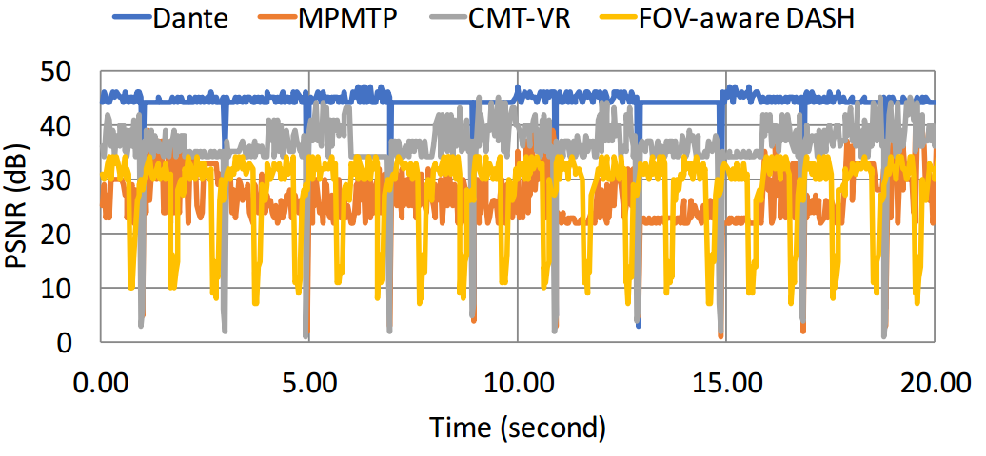
Performance evaluation
Instantaneous PSNR in relatively good network condition
Dante
Notes:
This figure present the Instantaneous PSNR which Dane achieved in relatively good network condition

Slide 32
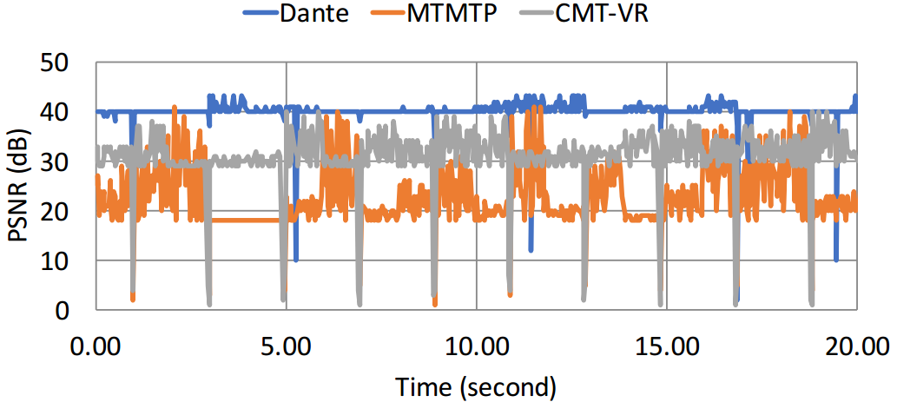
Performance evaluation
Instantaneous PSNR in relatively bad network condition
Dante
Notes:
This figure presents the Instantaneous PSNR which Dane achieved in relatively bad network condition

Slide 33
Conclusion
Performance gain
Dante improves 360-degree video quality over non FOV-aware UDP-based schemes and TCP-based scheme by 20% to 40%;
Relationship to Relationship to bitrate adaptation
Dante and bitrate adaptation are functionally complementary, Dante is a transport-level scheme while bitrate adaptation is an application-level scheme;
Compatibility
Dante is compatible with classic streaming stacks like RTP, which supports FEC and have been deployed in many legacy services.
Notes:
Lastly, let’s get down to the conclusion:
(1) Performance gain
(2) Dante’s relationship to bitrate adaptation:
(3) compatibility

Slide 34
Thanks!
Question?
NASP Research Group
https://nasp.cs.tsinghua.edu.cn/

