Slide 1

Pas de deux: Shape the Circuits, and Shape the Apps too!
--- Application-aware network scheduling over optical datacenter networks
Hong Zhang Kai Chen, Mosharaf Chowdhury

Slide 2
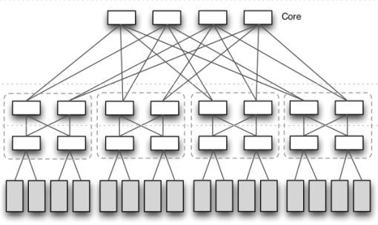
Optical Networking in Data Centers
Optical Fabrics
Advantages of optical networking
High one-to-one bandwidth
Low power consumption
Low wiring complexity
…
Extra constraints for scheduling network traffic
Limited number of concurrent connections for each src/dst rack
Switching/reconfiguration delay (up to 10s of ms)

Slide 3
What is this paper about?
Optical architecture design
A continuing research effort towards novel reconfigurable optical datacenter designs with lower cost, better scalability, …
How to perform network scheduling for these data-parallel applications over the state-of-the-art optical architectures?
---- Three New Challenges
Helios
C-Through
OSA
Mordia
ReacToR
ProjecToR
MegaSwitch
2010
2012
2013
2016
2017
Network scheduling over the optical architecture
How will the extra constraints of the optical fabric affect the end-to-end application performance (e.g., Spark, Hadoop applications)?
Will the evolving optical architecture make a difference?

Slide 4

Challenge 1: Application Semantics
Dst
Existing performance goal:
Maximizing the throughput or minimizing the makespan of a given traffic demand matrix
 | 1 | … | n
1 | - | … | *
… | … | - | …
n | * | … | -
Src
Do not directly benefit any application-level communication performance
The traffic demand matrix
Coflow:
A collection of parallel flows sharing a common application-level goal
Completion time of a coflow depends on the last flow to complete
Minimizing coflow completion time effectively minimizes job completion time
Reduce Stage
Shuffle
Map Stage

Slide 5
Challenge 1: Application Semantics
Dst
App 1
App 2
App 3
 | 1 | … | n
1 | - | … | *
… | … | - | …
n | * | … | -
Src
Coflow 1
Coflow 2
Coflow 3
The traffic demand matrix
 | 1 | … | n
1 | - | … | *
… | … | - | …
n | * | … | -
 | 1 | … | n
1 | - | … | *
… | … | - | …
n | * | … | -
 | 1 | … | n
1 | - | … | *
… | … | - | …
n | * | … | -
Challenge 1: How to minimize the average completion time of all the coflows?

Slide 6
Challenge 2: Traffic Pattern
Dst
 | 1 | 2 | 3
1 | - | … | *
2 | … | - | …
3 | * | … | -
 | 1 | 2 | 3
1 | - | … | *
2 | … | - | …
3 | * | … | -
 | 1 | 2 | 3
1 | - | … | *
2 | … | - | …
3 | * | … | -
 | 1 | 2 | 3
1 | - | … | *
2 | … | - | …
3 | * | … | -
BvN decomp.
Src
The sparse traffic demand matrix
1
1
1
1
1
1
Wavelength/Circuit
assignments
2
2
2
2
2
2
3
3
3
3
3
3
Schedule 1
Schedule 2
Schedule 3
Switching latency
time

Slide 7
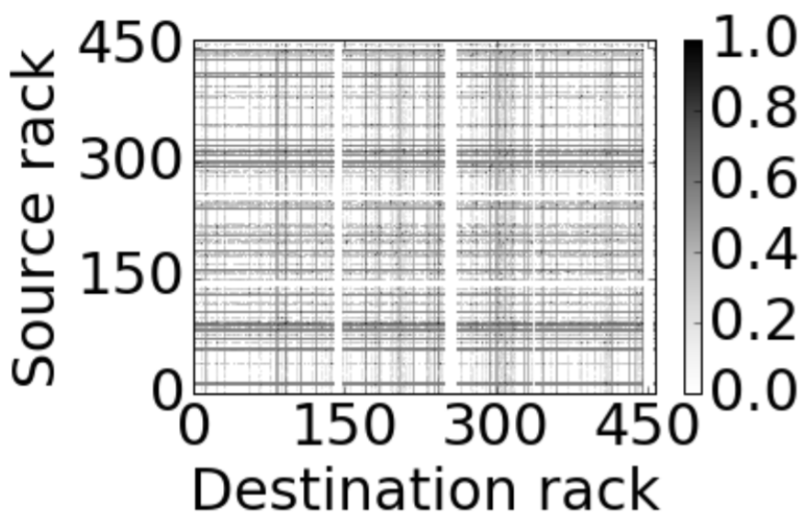
Challenge 2: Traffic Pattern
Wide-spread demand matrix
(ProjecToR, SIGCOMM’16)
Coflow i
All-to-all communication pattern
 | 1 | … | n
1 | - | … | *
… | … | - | …
n | * | … | -
time
Frequent reconfiguration
Longer coflow completion time
Challenge 2: How to efficiently deal with the wide-spread communication pattern?

Slide 8

Challenge 3: Connectivity
Circuit configuration
1
1
Circuit Switching
$\left[\begin{matrix}0 & 1 & 0 \\ 0 & 0 & 1 \\ 1 & 0 & 0\end{matrix}\right]$
2
2
3
3
Constraint:
Each src/dst rack(node) can only establish one circuit concurrently.
Each connection carries a fixed capacity.

Slide 9
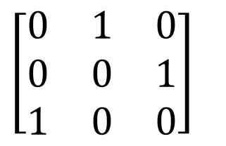
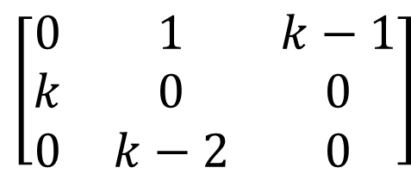
Challenge 3: Connectivity
Helios
C-Through
OSA
Mordia
ReacToR
ProjecToR
MegaSwitch
2010
2012
2013
2016
2017
Circuit configuration
Circuit configuration
Richer Connectivity
1
1
$\left[\begin{matrix}0 & 1 & 0 \\ 0 & 0 & 1 \\ 1 & 0 & 0\end{matrix}\right]$
$\left[\begin{matrix}0 & 1 & k−1 \\ k & 0 & 0 \\ 0 & k−2 & 0\end{matrix}\right]$
Packet Switching
2
2
3
3
Model/Constraint:
Each src/dst rack can establish one k circuit connection concurrently.
Each connection carries a fixed capacity.
Challenge 3: How to effectively leverage such rich connectivity of the latest optical architectures?

Slide 10
The Single Coflow Case
How to effectively leverage the rich connectivity of the latest optical architectures, so that we can schedule a coflow with wide-spread communication pattern in an efficiently way?
With such rich connectivity, can we achieve optimal coflow completion time (CCT) without reconfiguring the circuit for multiple times?
Assumption: one coflow only stick to one circuit configuration, no reconfiguration during scheduling.

Slide 11
What can be achieved via packet switching?
A
A
 | A-D | E
A | 0 | 0.2
B | 0 | 0.4
C | 0 | 0.4
D | 0 | 3
E | 0 | 0
10MB
 | A-D | E
A | 0 | 10
B | 0 | 20
C | 0 | 20
D | 0 | 150
E | 0 | 0
0.2GBps
Good Match
B
B
0.4GBps
20MB
E
E
C
C
0.4GBps
20MB
Coflow completion time: 50ms
3GBps
D
D
150MB
The rate allocation with packet switching
The Coflow demand matrix C
Can we achieve similar coflow completion time via circuit switching?

Slide 12
Solution 1- Circuit Shaping
Given a coflow demand matrix C, find a circuit configuration M* that minimizes the coflow completion time (CCT).
Circuit Shaping
A
 | A-D | E
A | 0 | 10
B | 0 | 20
C | 0 | 20
D | 0 | 150
E | 0 | 0
 | A | B | C | D | E
A | 0 | 1 | 1 | 1 | 1
B | 1 | 0 | 1 | 1 | 1
C | 1 | 1 | 0 | 1 | 1
D | 1 | 1 | 1 | 0 | 1
E | 1 | 1 | 1 | 1 | 0
A
10MB
1 (circuit connection)
{M}
B
B
1
20MB
E
E
C
1
Circuit configurations
(k = 4)
20MB
C
1
D
150MB
D
Mismatch
The Coflow demand matrix C
The circuit configuration M* calculated for C

Slide 13
Solution 1- Circuit Shaping
Under provisioning
Under provisioning
Given a coflow demand matrix C, find a circuit configuration M* that minimizes the coflow completion time (CCT).
Circuit Shaping
A
Integrality gap
A
10MB
 | A-D | E
A | 0 | 10
B | 0 | 20
C | 0 | 20
D | 0 | 150
E | 0 | 0
 | A | B | C | D | E
A | 0 | 1 | 1 | 1 | 1
B | 1 | 0 | 1 | 1 | 1
C | 1 | 1 | 0 | 1 | 1
D | 1 | 1 | 1 | 0 | 1
E | 1 | 1 | 1 | 1 | 0
1 (circuit connection)
{M}
B
B
1
20MB
E
E
C
1
Circuit configurations
(k = 4)
20MB
C
1
D
150MB
D
Mismatch
The Coflow demand matrix C
The circuit configuration M* calculated for C
Coflow completion time: 150ms
App-Topo Structure Mismatch:
The 0-1 constraint of wavelength assignment causes the integrality gap

Slide 14
To Bridge the App-Topo Structure Mismatch
Circuit Shaping
 | A | B | C | D | E
A | 0 | * | * | * | *
B | * | 0 | * | * | *
C | * | * | 0 | * | *
D | * | * | * | 0 | *
E | * | * | * | * | 0
 | A | B | C | D | E
A | 0 | * | * | * | *
B | * | 0 | * | * | *
C | * | * | 0 | * | *
D | * | * | * | 0 | *
E | * | * | * | * | 0
Cannot always find a good match
How about the reverse direction?
The Coflow demand matrix C
Circuit configurations {M}
Intuition
Instead of shaping the circuit to match the coflow, can we find a way to shape the coflow demand to match the circuit configuration?

Slide 15
Solution II - Coflow Shaping
Given a coflow demand matrix C and a circuit configuration M, determine a new coflow demand matrix C* which can be reshaped from the original matrix C by multihop routing, so that the coflow completion time is minimized.
A
10MB
A
 | A-D | E
A | 0 | 10
B | 0 | 20
C | 0 | 20
D | 0 | 150
E | 0 | 0
+ 40MB
 | A | B | C | D | E
A | 0 | 1 | 1 | 1 | 1
B | 1 | 0 | 1 | 1 | 1
C | 1 | 1 | 0 | 1 | 1
D | 1 | 1 | 1 | 0 | 1
E | 1 | 1 | 1 | 1 | 0
10MB
B
20MB
Good
Reshape
40MB
+30MB
B
E
Match
20MB
C
+30MB
E
30MB
20MB
C
30MB
20MB
150MB
D
-100MB
D
150MB
 | A | B | C | D | E
A | 0 | 0 | 0 | 0 | 10 + 40
B | 0 | 0 | 0 | 0 | 20 + 30
C | 0 | 0 | 0 | 0 | 20 + 30
D | 40 | 30 | 30 | 0 | 50
E | 0 | 0 | 0 | 0 | 0
The Coflow demand matrix C
A given circuit configuration M
Coflow completion time: 50ms
The reshaped demand matrix C*

Slide 16
Problem with Coflow Shaping
Does coflow shaping totally solve the App-Topo structure mismatch problem?
Given an arbitrary configuration, it is not always possible to approach the optimal CCT via coflow reshaping.
Multi-hop routing may also result in an inefficient use of the circuit.
A
 | A | B | C | D | E
A | 0 | 0 | 0 | 0 | 10 + 40
B | 0 | 0 | 0 | 0 | 20 + 30
C | 0 | 0 | 0 | 0 | 20 + 30
D | 40 | 30 | 30 | 0 | 50
E | 0 | 0 | 0 | 0 | 0
Total Coflow demand:
200MB
20 + 30MB
20 + 30MB
B
30MB
30MB
10 + 40 MB
10 + 40 MB
Low “bandwidth efficiency”
C
E
20 + 30MB
40MB
20 + 30MB
40MB
30MB
30MB
50MB
Traffic introduced:
100MB + 100MB*2 =300MB
D
The reshaped demand matrix C*

Slide 17
To Bridge the App-Topo Structure Mismatch
Circuit Shaping
 | A | B | C | D | E
A | 0 | * | * | * | *
B | * | 0 | * | * | *
C | * | * | 0 | * | *
D | * | * | * | 0 | *
E | * | * | * | * | 0
 | A | B | C | D | E
A | 0 | * | * | * | *
B | * | 0 | * | * | *
C | * | * | 0 | * | *
D | * | * | * | 0 | *
E | * | * | * | * | 0
Cannot always find a good match
Coflow Shaping
The Coflow demand matrix C
Not efficient enough as well
Circuit configurations {M}
Intuition
How about we jointly shaping both circuit configuration and coflow traffic demand?

Slide 18
Solution III - Joint Shaping
Given a coflow demand C, determine the reshaped coflow demand C* and the circuit configuration M*, so that the CCT is minimized with minimal bandwidth usage.
A
Optimal Coflow completion time
10MB
A
1(circuit connection)
20MB
B
Coflow completion time: 50ms
B
 | A-D | E
A | 0 | 10
B | 0 | 20
C | 0 | 20
D | 0 | 150
E | 0 | 0
Coflow
shaping
E
1
E
Circuit Shaping
C
20MB
C
{M}
Good match!
D
3
150MB
D
 | A | B | C-D | D
A | 0 | 10 | 0 | 0
B | 0 | 0 | 0 | 20+10+20
C | 0 | 20 | 0 | 0
D | 0 | 0 | 0 | 150
E | 0 | 0 | 0 | 0
Minimal Bandwidth Usage
 | A | B | C-D | E
A | 0 | 1 | 0 | 0
B | 0 | 0 | 0 | 1
C | 0 | 1 | 0 | 0
D | 0 | 0 | 0 | 3
E | 0 | 0 | 0 | 0
Circuit configurations
The Coflow demand matrix C
Extra traffic introduced:30MB
The reshaped demand matrix C*
The circuit configuration M* for C*

Slide 19
Preliminary Evaluation
Settings
k (available ports per ToR)= 192
1Gbps per circuit
Evaluate each coflow separately
Workload
1-hour Mapreduce trace
3000-node, 150-ToR Facebook cluster
500 coflows (7x10⁵ flows)
Joint shaping is within 1.18× to optimal;
Joint shaping outperforms circuit shaping by 30%.

Slide 20
The General Case with Multiple Coflows
Problem Definition
 | 1 | … | n
1 | - | 1 | …
… | … | - | 1
n | 2 | 1 | -
 | 1 | … | n
1 | - | 1 | …
… | … | - | 1
n | 2 | 1 | -
 | 1 | … | n
1 | - | 1 | …
… | … | - | 1
n | 2 | 1 | -
Hardness of the problem
A joint Optimization problem with:
Coflow prioritization rate allocation (Strongly NP-hard)
Circuit configuration
Routing (Coflow Shaping)
Goal: minimizing average CCT
Coflow 1
Coflow 2
Coflow 3
An efficient scheduling decision
…
Circuit configuration 1
Circuit configuration 2
Coflow Shape 1
Shape 2
Shape 3
Shape 4
Shape 5
time

Slide 21
The General Case with Multiple Coflows
How to perform efficient scheduling with reasonable complexity?
------ Key: find a good way to decouple the problem.
The Inter-Coflow Scheduling Framework
High-level idea: break the problem into three steps, and each can be transformed to the single coflow problems above.

Slide 22
The General Case with Multiple Coflows
How to perform efficient scheduling with reasonable complexity?
------ Key: find a good way to decouple the problem.
The Inter-Coflow Scheduling Framework
Step 1: Circuit Configuration
Step 2: Coflow Prioritization
Step 3: Rate/routing allocation
Find a good circuit configuration for the current time slot
Determine the prioritization among coflows
Determine the rate
and routing schedule
for each coflow
Joint Shaping
Coflow Shaping
Coflow Shaping

Slide 23
Takeaways
Application-aware network scheduling over the latest optical DC architecture is an important and challenging problem which has previously received little attention.
Unveil the power of joint shaping: efficient scheduling should be a “Pas de deux” – a joint shaping of not only the underlying circuit, but also the application’s traffic demand.
A scheduling framework: an efficient decoupling of circuit configuration, coflow prioritization, and routing/rate allocation.

Slide 24
Thank You!

