Slide 1
Using the Macroflow Abstraction to Minimize Machine Slot-time Spent on Networking in Hadoop
APNet 2018
Bingchuan Tian, Chen Tian, Jiajun Sun, Junhua Yan, Yizhou Tang,
Wei Wang, Haipeng Dai, Nai Xia, Guihai Chen, and Wanchun Dou
Nanjing University, China

Slide 2
Outline
Motivation
Solution
Evaluation

Slide 3
Motivation

Slide 4


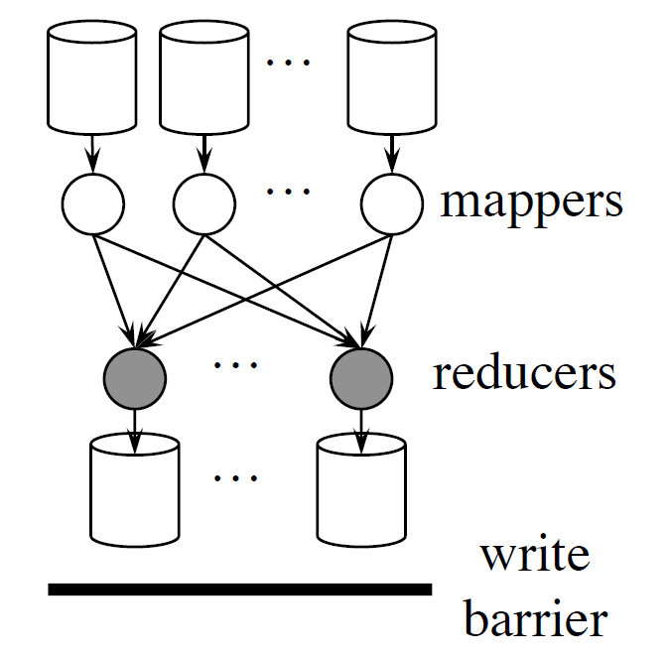
Data-parallel Frameworks
shuffle phase
Goal: to make jobs finish faster
Reference: Coflow: A Networking Abstraction for Cluster Applications

Slide 5
Coflow Abstraction
FCT: Flow Completion Time
CCT: Coflow Completion Time
f
=
1
I
1
1
E
Traditional network metrics ignore application semantics
e.g., the average FCT
Minimizing the average FCT
scheduling 4 flows in the order of (f₁, f₄, f₂, f₃)
the average FCT is (1+2+4+7)/4=3.5
the average CCT is (4+7)/2=5.5
Prioritizing Job A’s shuffle phase
scheduling 4 flows in the order of (f₁, f₂, f₄, f₃)
the average FCT is (1+3+4+7)/4=3.75
the average CCT is (3+7)/2=5
1
I
2
E
2
Coflow A
f
=
3
I
3
1
E
1
I
2
E
2
Coflow B

Slide 6
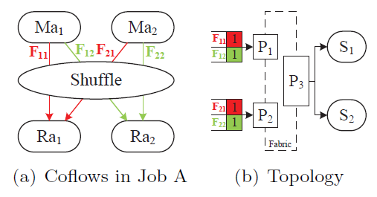
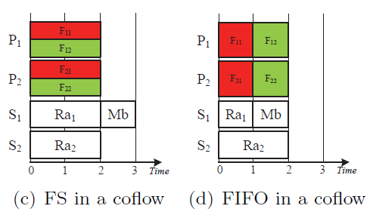
Is Coflow Enough?
JCT: Job Completion Time
Consider 2 jobs
Job A (2 unfinished tasks): M_{a1}, M_{a2}, R_{a1}, R_{a2} ; 4 flows in shuffle phase
Job B (1 waiting task): M_{b}
A host with 2 slot S₁ and S₂
Average JCT
Fair sharing in a coflow: (2+3)/2=2.5
FIFO in a coflow: (2+2)/2 =2

Slide 7
What's wrong?
network scheduling may lead to a waste of slot resource
when slot is not sufficient, JCT can be harmed

Slide 8
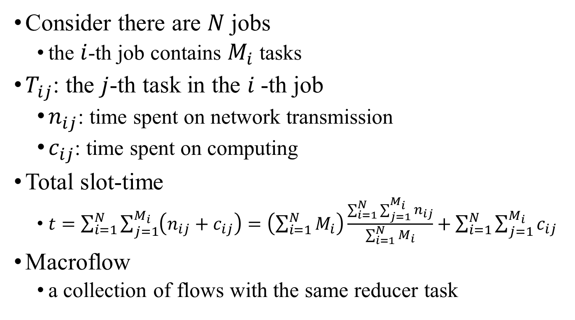
How to save slot?
Consider there are $N$ jobs
the $i$-th job contains $M_{i}$ tasks
$T_{ij}$: the $j$-th task in the $i$-th job
$n_{ij}$: time spent on network transmission
$c_{ij}$: time spent on computing
Total slot-time
$t=\sum_{i=1}^{N}{\sum_{j=1}^{M_{i}}{\left(n_{ij}+c_{ij}\right)}}=\left(\sum_{i=1}^{N}{M_{i}}\right)\frac{\sum_{i=1}^{N}{\sum_{j=1}^{M_{i}}{n_{ij}}}}{\sum_{i=1}^{N}{M_{i}}}+\sum_{i=1}^{N}{\sum_{j=1}^{M_{i}}{c_{ij}}}$
Macroflow
a collection of flows with the same reducer task
average macroflow completion time (MCT)

Slide 9
Coflow v.s. Macroflow
Difference
coflow is designed for minimizing the transmission time cost on network, while macroflow is designed for minimizing the total slot-time cost on network
coflow is a collection of flows in the same shuffle phase of a job, macroflow is a collection of flows with the same destination (reducer)
Similarity
coflow is a union set of all macroflows in a shuffle phase, macroflow is a subset of a coflow

Slide 10
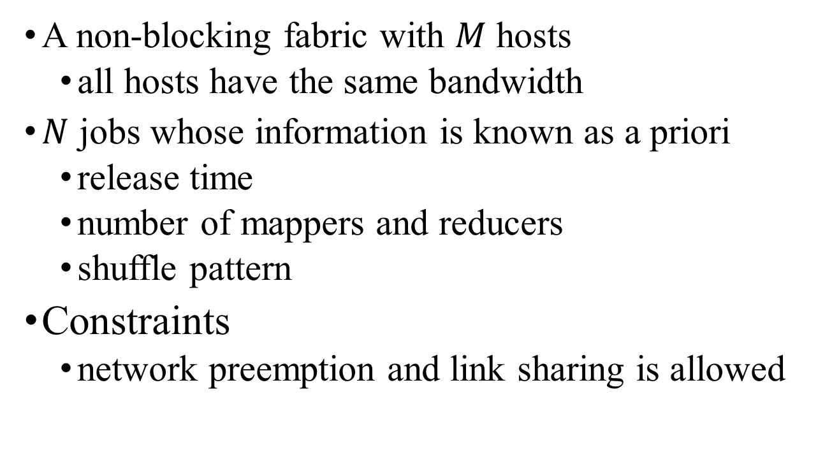
Macroflow Scheduling Problem (MSP)
A non-blocking fabric with $M$ hosts
all hosts have the same bandwidth
$N$ jobs whose information is known as a priori
release time
number of mappers and reducers
shuffle pattern
Constraints
network preemption and link sharing is allowed

Slide 11
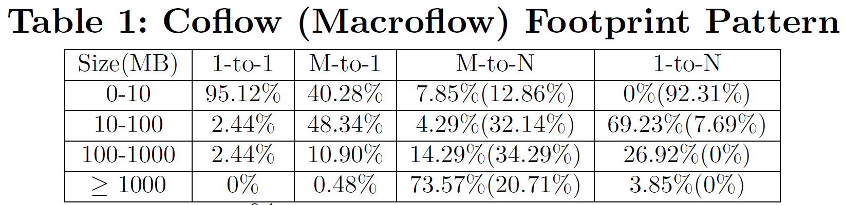
Production Traffic
Compared with coflow scheduling, when scheduling macroflows, most of flows in red box fall into green box
Such priority inversion indicates coflow scheduling and macroflow scheduling have quite different effects on this traffic

Slide 12
Solution

Slide 13
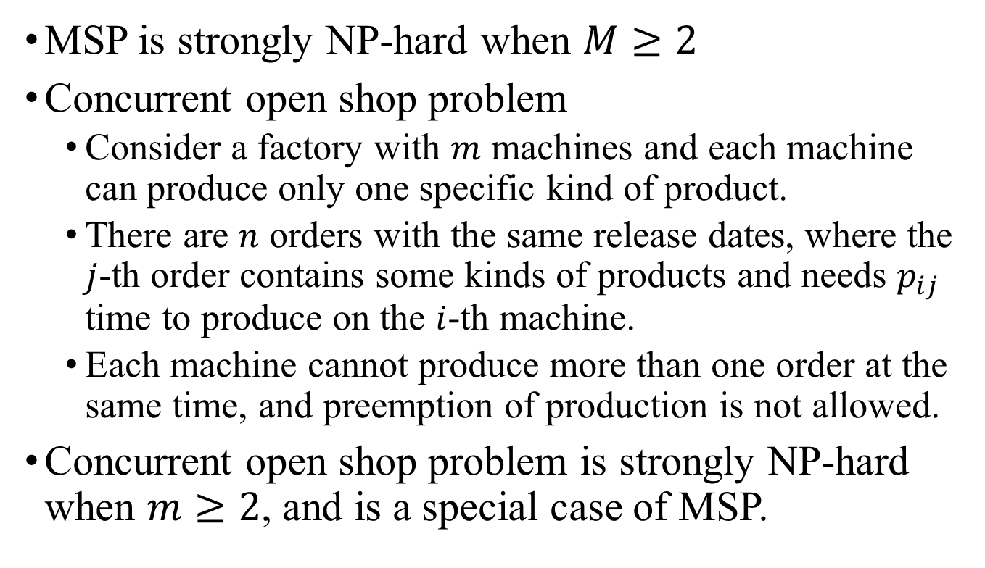
NP-hardness
MSP is strongly NP-hard when $M≥2$
Concurrent open shop problem
Consider a factory with $m$ machines and each machine can produce only one specific kind of product.
There are $n$ orders with the same release dates, where the $j$-th order contains some kinds of products and needs $p_{ij}$ time to produce on the $i$-th machine.
Each machine cannot produce more than one order at the same time, and preemption of production is not allowed.
Concurrent open shop problem is strongly NP-hard when $m≥2$, and is a special case of MSP.

Slide 14
How to schedule macroflow?
Simple heuristics
Smallest-Macroflow-First (SMF)
Assumption: a network device always forwards the packet whose macoflow size is the smallest
Improvement
Switches ususlly support only 8 traffic classes, thus we use DSCP field to mark each packet with a priority

Slide 15
Another Choice
Drawback of SMF
Interleave macroflows within a coflow, due to imbalanced macroflow size
Another heuristics
Smallest-Average-Macroflow-First
Use average macroflow size as a priority

Slide 16
Example of SMF and SAMF
Consider 2 coflows
Coflow A: 3 reducers, size: A₁(1) A₂(1) A₃(3)
Coflow B: 3 reducers, size: B₁(2) B₂(2) B₃(2)
SMF
A₁(1) A₂(1) B₁(2) B₂(2) B₃(2) A₃(3)
SAMF
A₁(1) A₂(1) A₃(3) B₁(2) B₂(2) B₃(2)
A: (1+1+3)/3=1.7 B:(2+2+2)/3=2

Slide 17
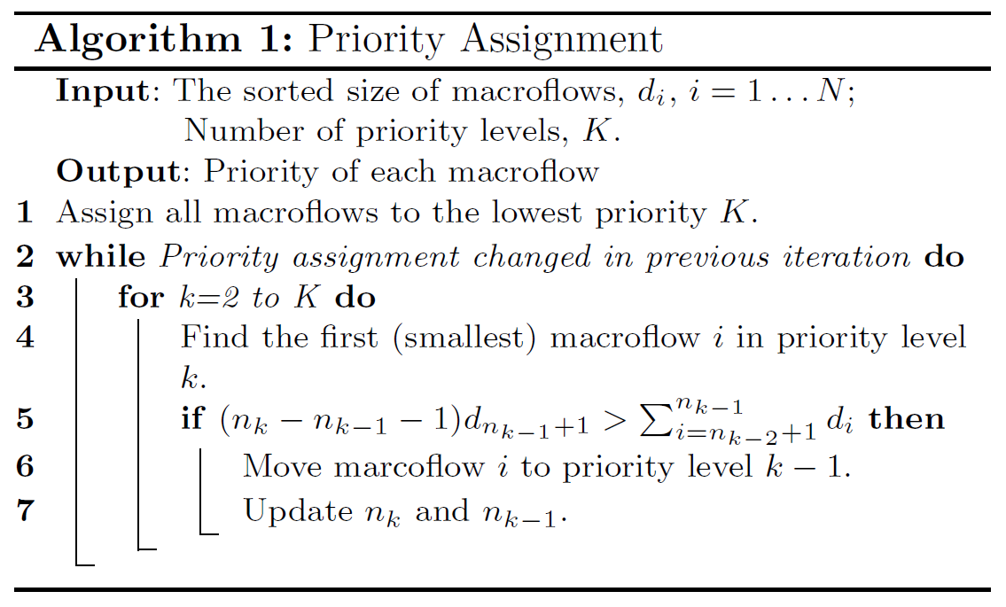
Priority Assignment
How to divide macroflows into 8 priority levels?
A local search algorithm is proposed
not optimal, static

Slide 18
Evaluation

Slide 19
Methodology
We evaluate our algorithms by performing a replay of the collected Facebook log with a flow-level simulator.
We assume there are 30 hosts connected to a switch via a 1Gbps link, while the computation resource in each host is limited.
The Facebook log contains only the shuffle information of a job, thus we generate mappers according to shuffle size to guarantee that the time spent on map-phase and reduce-phase is comparable.
We compare algorithm with coflow based algorithm: shortest-coflow-first

Slide 20
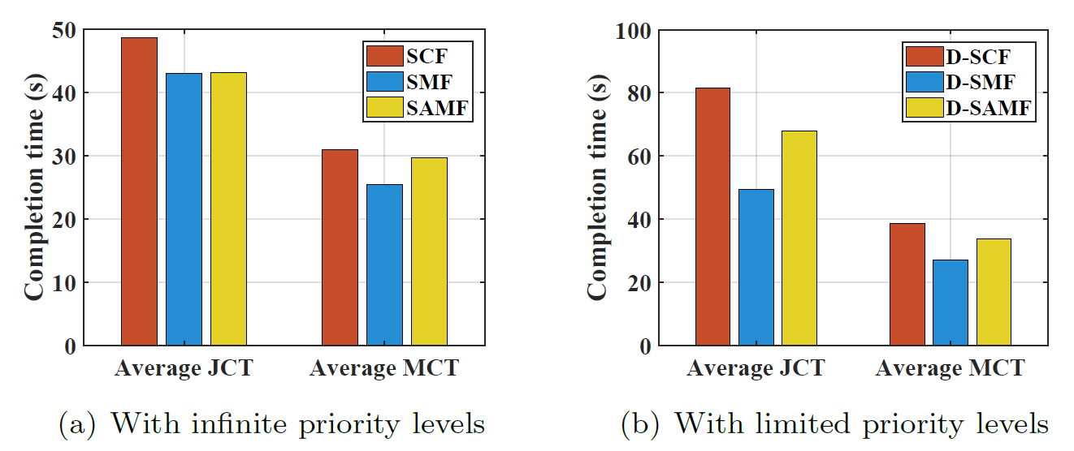
Results
When system load is heavy, macroflow based algorithm performs better than coflow based algorithm

Slide 21
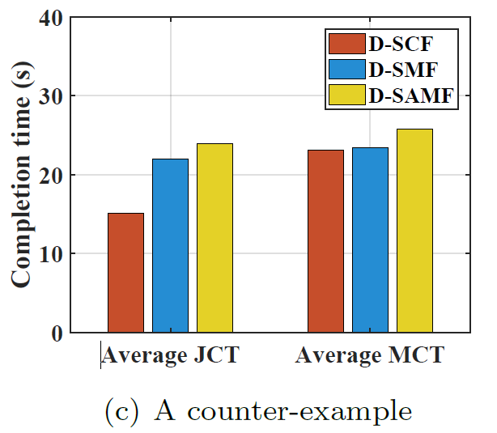
Other scenarios
When system load is not so heavy, coflow based algorithm performs better

Slide 22
Next Step
Combining coflow with macroflow
adapt to system load automatically
Combining task placement with network scheduling
provide a larger decision space
Waiting for our new paper!

Slide 23
Thanks & Questions?

