Slide 1


SketchLearn: Relieving User Burdens in Approximate Measurement with Automated Statistical Inference
Qun Huang, Patrick P. C. Lee, Yungang Bao

Slide 2
Requirements for Measurement
R1: Small memory usage
Hardware switch: at most 50-100 MB
R2: Fast packet processing
10 Gbps link -> 14.88Mpps (64-byte packet) -> 200 CPU cycles (3 GHz)
R3: Fast response
R4: Generality
One architecture for multiple tasks
One architecture for software and hardware

Slide 3
Approximate Measurement
Underlying techniques
Sampling
Top-k counting
Sketch
Trade-offs: accuracy VS computation/storage/communication
No one considers user burdens

Slide 4



User Burden 1: Errors as User Input
Administrator
Sketch developer
Can I use sketch to monitor frequent items?
Of course!
Give me your expected bias $ε$ and failure probability $δ$

Slide 5


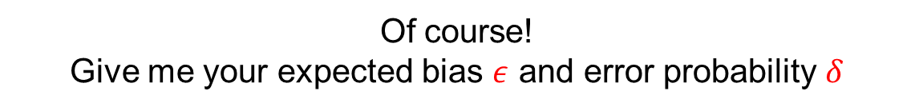
User Burden 1: Errors as User Input
Administrator
Sketch developer
Can I use sketch to monitor frequent items?
Of course!
Give me your expected bias $ε$ and error probability $δ$
User burden: hard to parameterize “best” errors

Slide 6
User Burden 2: Prior Knowledge of Query
Administrator
Sketch developer
I want all frequent items larger than 1% of total
Here you are!
Hmm … 1% is too large, how about 0.1%
Sorry, current configuration is for threshold 1% or larger.
Errors for 0.1% may be very large!

Slide 7
User Burden 2: Prior Knowledge of Query
Administrator
Sketch developer
I want all frequent items larger than 1% of total
Here you are!
Hmm … 1% is too large, how about 0.1%
Sorry, current configuration is for threshold 1% or larger.
Errors for 0.1% may be unbounded!
User burden: one configuration binds to query parameters
Absolute threshold: 10^6, 10^7…
Relative threshold: 1%, 5%, 10% …
Top-k: top 50, top 100, top 200 …

Slide 8
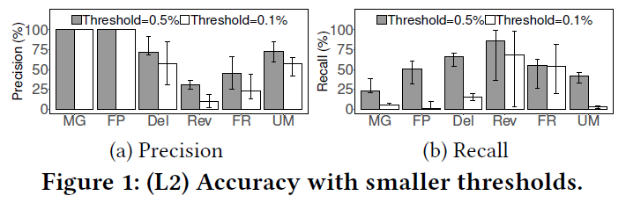
Benchmark Results
In heavy hitter detection, accuracy drops for smaller thresholds

Slide 9
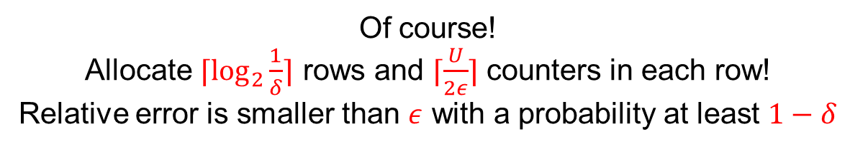
User Burden 3: Complicated Formulas
Administrator
Sketch developer
Can I use sketch to monitor frequent items?
Of course!
Allocate $⌈\log_{2}{\frac{1}{δ}}⌉$ rows and $⌈\frac{U}{2ε}⌉$ counters in each row!
Relative error is smaller than $ε$ with a probability at least $1−δ$

Slide 10
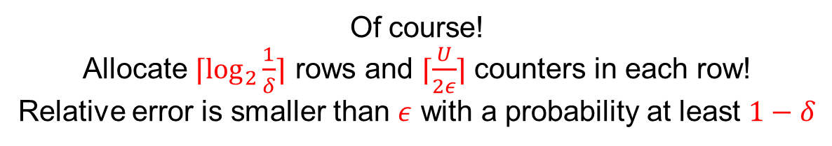
User Burden 3: Complicated Formulas
Administrator
Sketch developer
Can I use sketch to monitor frequent items?
Of course!
Allocate $⌈\log_{2}{\frac{1}{δ}}⌉$ rows and $⌈\frac{U}{2ε}⌉$ counters in each row!
Relative error is smaller than $ε$ with a probability at least $1−δ$
User burden: parameter is complicated

Slide 11
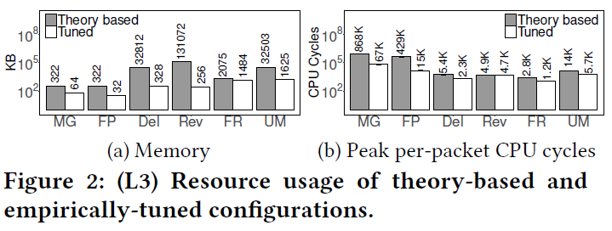
Benchmark Results
Significant differences between theoretical and empirical results

Slide 12
User Burden 4: Fixed Flowkey Definition
Administrator
Sketch developer
I want top-100 (src IP, dst IP) pairs
Here you are!
Hmm … How about top-100 (src IP, src port) pairs
Sorry, current configuration is for (src IP, dst IP) pairs only!

Slide 13
User Burden 4: Fixed Flowkey Definition
Administrator
Sketch developer
I want top-100 (src IP, dst IP) pairs
Here you are!
Hmm … How about top-100 (src IP, src port) pairs
Sorry, current configuration is for (src IP, dst IP) pairs only!
User burden: one configuration binds to one flow definition

Slide 14
User Burden 5: No Error Measures
Administrator
Sketch developer
What’s the error of 192.168.4.12 ?
Hmm … <5% with prob >99%, you specified it…
How about 192.168.4.13 ? It seems to have smaller error …
Sorry, the error estimate is specified by you!
I cannot estimate for a particular run!

Slide 15
User Burden 5: No Error Measures
Administrator
Sketch developer
What’s the error of 192.168.4.12 ?
Hmm … <5% with prob >99%, you specified it…
How about 192.168.4.13 ? It seems to have smaller error …
Sorry, the error estimate is specified by you!
I cannot estimate for a particular run!
User burden: cannot measure the actual extent of errors

Slide 16
Root Cause Analysis
Errors are caused by resource conflicts
Need to careful configuration to mitigate resource conflicts
Less hash collisions
More collisions
The more buckets, the less conflicts (errors) in each bucket

Slide 17
Root Cause Analysis
Resource conflicts depend on many issues
A good configuration should take all of them into account
Binds to many issues
Complicated
Calculations
Flow definitions
Query parameters
Prior errors
Configured
Algorithm
Query parameters
Good Configuration
Resource conflicts (Errors)
Flow definitions

Slide 18
Naive Approach
Automatically adjust configuration
Hardness
Predict prior errors/query parameters/flow definition is hard
History cannot reflect future
Adjusting configuration introduces latency

Slide 19
Our Work
SketchLearn: Sketch-based Measurement System that Mitigates User Burdens
Performance
Catch up with underlying packet forwarding speed
Resource efficiency
Consume only limited resources
Accuracy
Preserve high accuracy of sketches
Generality
Support multiple measurement tasks
Simplicity
Address all user burdens

Slide 20
High-Level Idea
Allow “imperfect” configuration
Not pursue a perfect configuration to mitigate resource conflicts
Characterize inherent statistical properties of resource conflicts
Sketch
Statistical
Modeling
Resource Conflict
Model
Network Queries

Slide 21
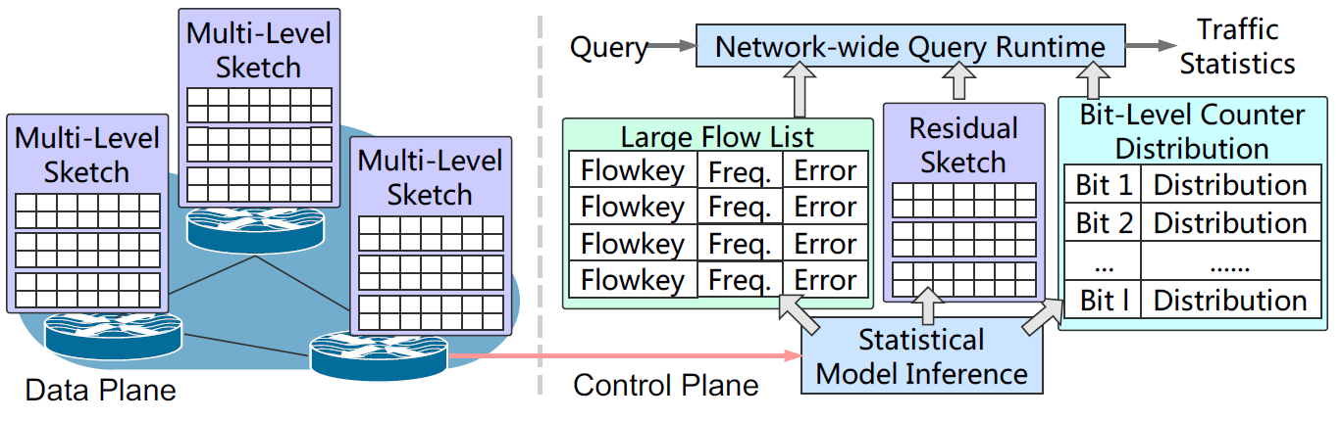
Design Features
Feature 1: Multi-level sketch for per-bit tracking

Slide 22
Design Features
Feature 2: Parameter-free model inference

Slide 23
Design Features
Feature 3: Separation of large and small flows

Slide 24
Design Features
Feature 4: Attachment of error measures with individual flows

Slide 25
Design Features
Feature 5: Network-wide query

Slide 26
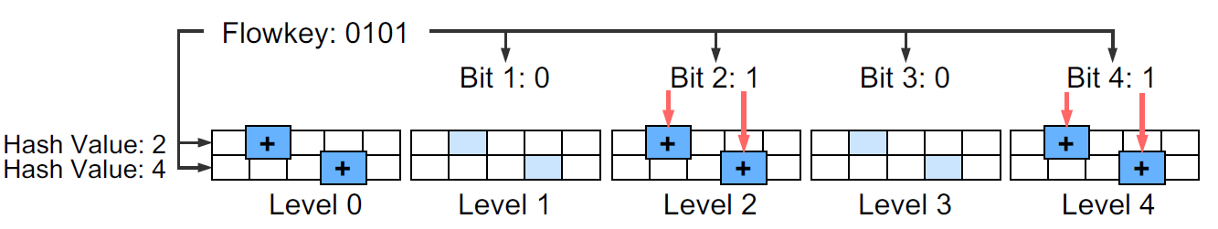
Multi-level Sketch
L: # of bits considered
Data structure: L+1 levels (from 0 to L), each is a counter matrix
Level 0 is always updated
Level k is updated iff k-th bit in a flowkey is 1
All levels share the same hash functions

Slide 27
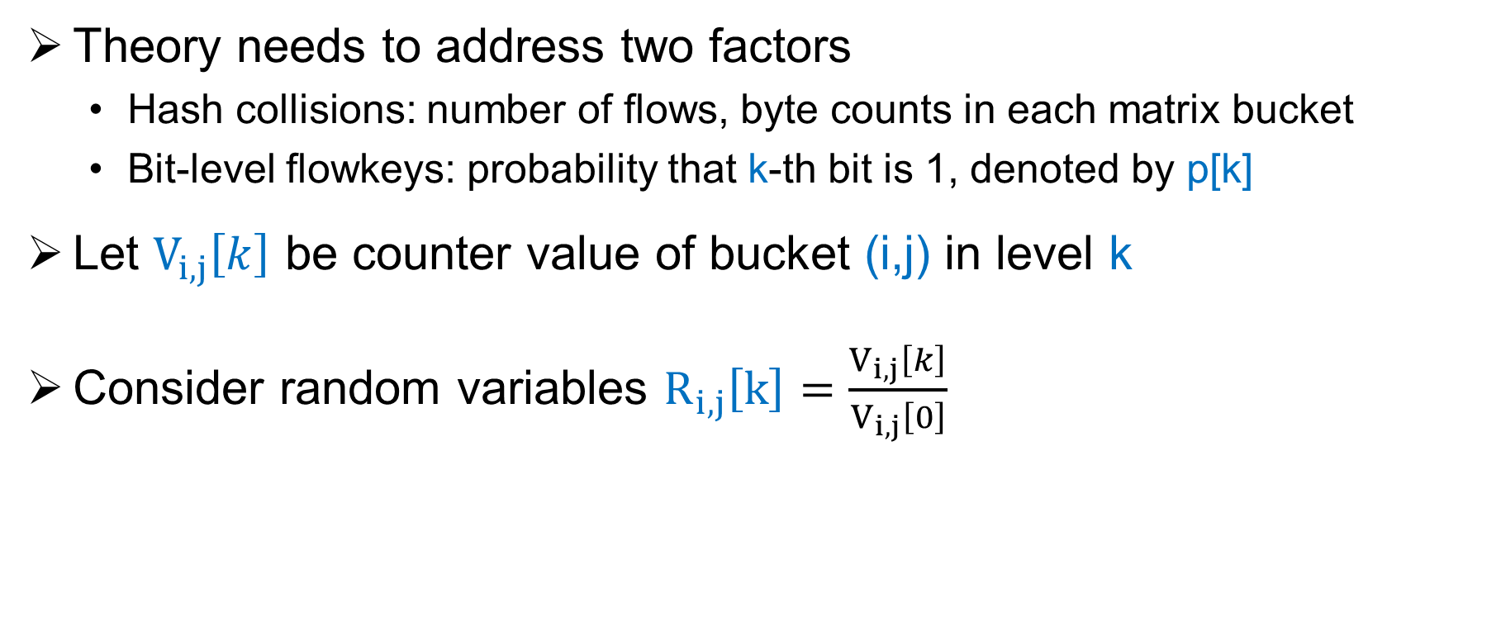
Model Theory
Theory needs to address two factors
Hash collisions: number of flows, byte counts in each matrix bucket
Bit-level flowkeys: probability that k-th bit is 1, denoted by p[k]
Let $V_{i,j}\left[k\right]$ be counter value of bucket (i,j) in level k
Consider random variables $R_{i,j}\left[k\right]=\frac{V_{i,j}\left[k\right]}{V_{i,j}\left[0\right]}$
Theorem: if no large flows in bucket, $R_{i,j}\left[k\right]$ follows Gaussian distribution with mean p[k]

Slide 28
Statistical Model Inference
Goal
Extract all large flows
Guarantee remaining flows in sketches are small
Estimate Gaussian distributions for each level
Challenge
No guidelines to distinguish large and small flows
Hard to directly decompose
Solution: self-adaptive algorithm

Slide 29
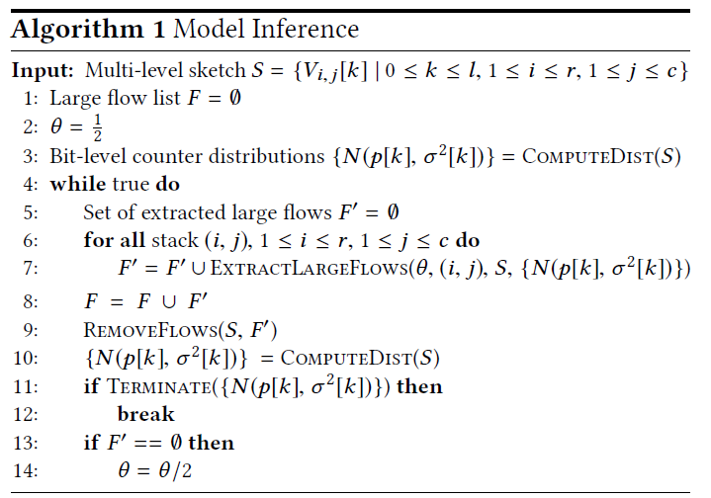
Algorithm
Start with imperfect input distributions
Start with an initial threshold that distinguishes large and small flows
Threshold!
Try to extract some large flows based on current imperfect distributions
Remove large flows and refine distributions
Adjust threshold

Slide 30

Large Flow Extraction
Intuition: a large flow
(i) results in extreme (large or small) $R_{i,j}\left[k\right]$ , or
(ii) at least deviates $R_{i,j}\left[k\right]$ from its expectation p[k] significantly
Update
Counter (i,j) at all levels
Recovery Keys larger than 15
30
Level 0: total counts
Key 0101: size 20
0
Level 1
Counter<15 && Total-counter>=15
0
20
Level 2
Counter>=15 && Total-counter<15
1
Key 0001: size 10
0
Level 3
Counter<15 && Total-counter>=15
0
30
Level 4
Counter>=15 && Total-counter<15
1

Slide 31
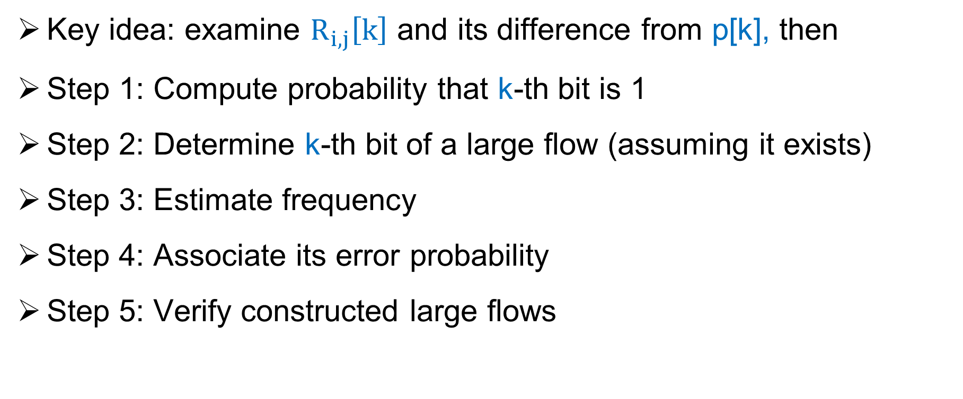
Large Flow Extraction
Key idea: examine $R_{i,j}\left[k\right]$ and its difference from p[k], then
Step 1: Compute probability that k-th bit is 1
Step 2: Determine k-th bit of a large flow (assuming it exists)
Step 3: Estimate frequency
Step 4: Associate its error probability
Step 5: Verify constructed large flows

Slide 32
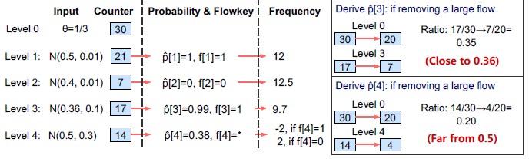
Large Flow Extraction
Example

Slide 33
Guarantee Correctness
Lemma: For each bucket, flows exceeding half of total must be extracted
Update
Counter (i,j) at all levels
Recovery Keys larger than 15
30
Level 0: total counts
Key 0101: size 20
0
Level 1
Counter<15 && Total-counter>=15
0
20
Level 2
Counter>=15 && Total-counter<15
1
Key 0001: size 10
0
Level 3
Counter<15 && Total-counter>=15
0
30
Level 4
Counter>=15 && Total-counter<15
1
Theorem: w is sketch width, flows exceeding 1/w of total must be extracted
Empirical results: flows smaller than 1/w are also extracted with high probability
E.g., >99% flows exceeding 1/2w are extracted

Slide 34
Supported Network Queries
Per-flow byte count
Heavy hitter detection
Heavy changer detection
Cardinality estimation
Flow size distribution estimation
Entropy estimation

Slide 35
Extended Query Model
Allow query for arbitrary flowkeys
Only use corresponding levels
Estimate actual query errors
Use attached errors for each large flow
Use Gaussian distributions

Slide 36
How to Address User Burdens
Need user-specified errors
Guarantee the correctness of model inference
Need query parameters
Robust to very small flows, no thresholds needed
Hard to compute configurations
Simple parameters computed based on memory budget or minimum requirement
Self-adaptive algorithm, no further configurations
One configuration for one flowkey definition
Extended query model supports arbitrafy flowkeys
Fail to estimate actual errors
Extended query model attaches errors to query results

Slide 37
Implementation
Challenge: updating L levels is time consuming
Solution: parallel updating
L levels are independent
Software
Based on OpenVSwitch + DPDK
Parallelism with SIMD
Hardware
Based on P4 programmable switches
Parallelism with P4 pipeline stages

Slide 38
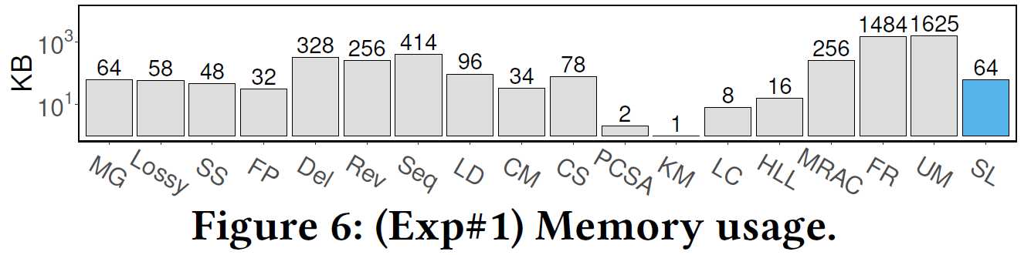
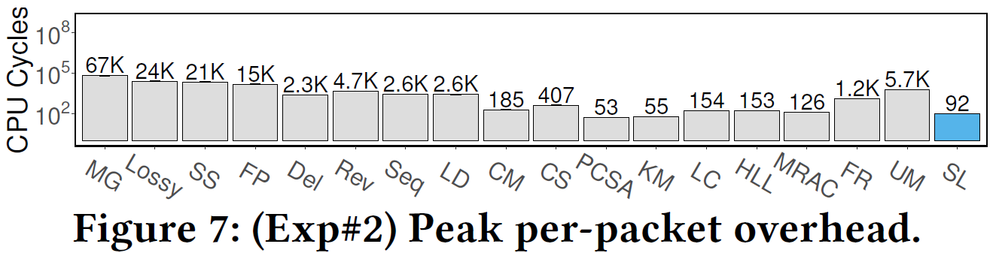
Resource Usage
Memory
CPU cycles

Slide 39
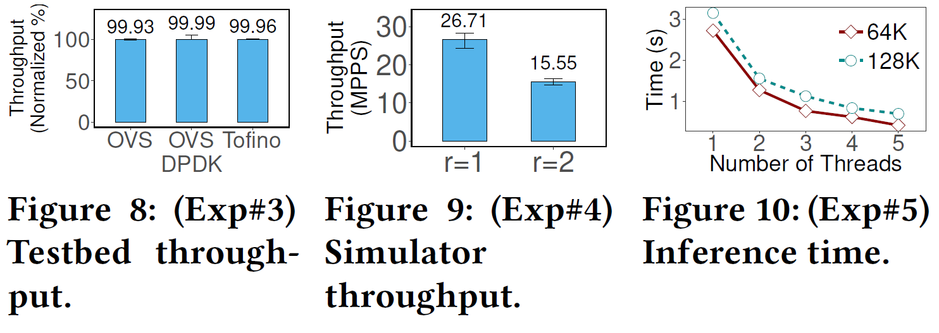
Performance

Slide 40
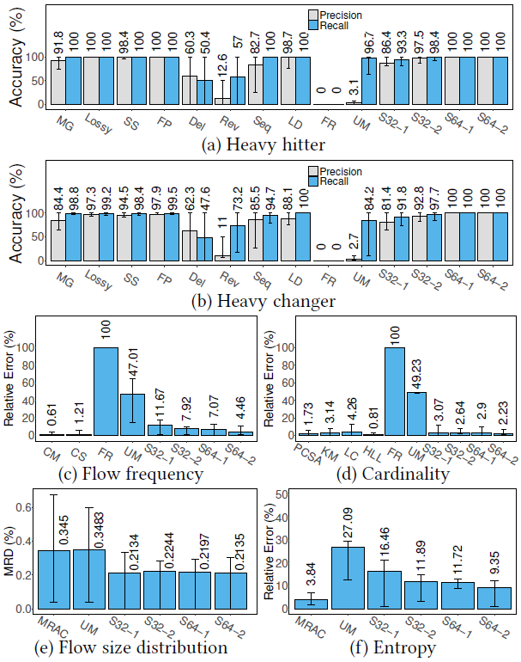
Generality
6 measurement tasks
In each task, compare with state-of-the-arts

Slide 41
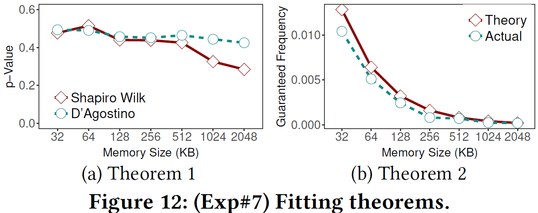
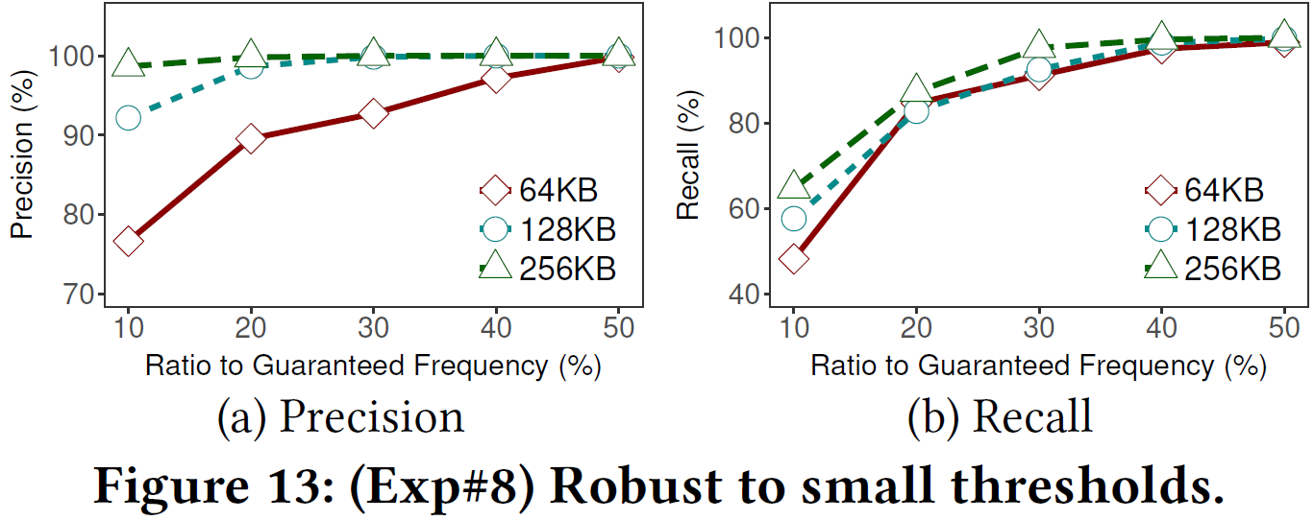
Fitting Theorem and Robustness

Slide 42
Other Experiments
Support multiple flowkey definitions
Attach effective error measures
Support network-wide measurement tasks

Slide 43
Conclusion
Analyze 5 user burdens in existing approximate measurement
SketchLearn architecture
Multi-level data structure design
Theory: counters follow Gaussian distributions when no large flows
Self-adaptive model inference algorithm
Proof of convergence and accuracy
Extended query models
OVS-DPDK and P4 implementation
Evaluations

Slide 44
Future
Consumptions for implicit resources
SIMD registers
P4 pipelines
Sketch + True network controls

