Slide 1


On the Impact of Cluster Configuration on RoCE Application Design
Yanfang Le
Mojtaba Malekpourshahraki
Brent Stephens
Aditya Akella
Michael M. Swift
mmalek3@uic.edu

Slide 2
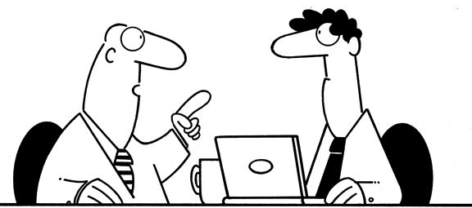
Designing and deploying high performance applications
How to design and deploy applications to have
Low tail latency
High throughput
Low CPU load
Ok I found it!
RDMA ☺
low latency
high throughput and under bursty CPU load
Remote Direct Memory Access (RDMA)

Slide 3
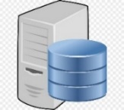
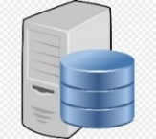
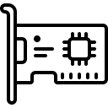
RDMA overview
Zero copy
Kernel Bypass
Protocol Offload
TCP/IP Stack
RDMA Stack
Application
Application
Application
Application
Application
Application
User
Presentation
Presentation
Congestion Control
Congestion Control
Buffer
Buffer
Session
Session
Kernel
Transport
Transport
Driver
Driver
HW
Physical NIC
Physical NIC
Copy operations
TCP/IP procedures
Offload congestion control
RDMA cluster an applications need to be configured

Slide 4


Key question
How should I configure my RDMA cluster and application to achieve best performance?

Slide 5
Configurations
Decisions
How to transmit data?
Design
Configurations
How to handle incoming events?
Should applications be co-located?
Deployment
Configurations
Are NICs fair among all applications?
Can I use jumbo frames?

Slide 6
Design configurations – sending data options
Design configurations
How to transmit data?
How to handle incoming events?
PCIe PIO operations
DMA operations
RDMA data packets
ACKs of data packets
READ
CPU
Mem
RNIC
RNIC
Mem
CPU
Pros
One network round trip regardless to the structure
Cons
Transfer just a single memory value
Data transfer that needs two memory access (e.g., hash table)
Notes:
Applications interface with the network using verbs

Slide 7
Design configurations – sending data options
Design configurations
How to transmit data?
How to handle incoming events?
PCIe PIO operations
DMA operations
RDMA data packets
ACKs of data packets
READ-2
CPU
Mem
RNIC
RNIC
Mem
CPU
8 B address
Pros
Only local CPU is involved
data
Cons
Needs multiple round trip
What if network is congested?

Slide 8
Design configurations – sending data options
Design configurations
How to transmit data?
How to handle incoming events?
PCIe PIO operations
DMA operations
RDMA data packets
ACKs of data packets
WRITE
Send /Receive
CPU
RNIC
RNIC
CPU
CPU
RNIC
RNIC
CPU
Combine WRITE/SEND or SEND/SEND

Slide 9
Design configurations – sending data options
Design configurations
How to transmit data?
How to handle incoming events?
PCIe PIO operations
DMA operations
RDMA data packets
ACKs of data packets
Compound READ
[Kalia, SIGCOMM 14']
CPU
RNIC
RNIC
CPU
Pros
Only one network transfer is required
UC/WRITE
Cons
Both local and remote CPU are involved
UD/SEND
What if remote CPU is busy?

Slide 10
Design configurations – Interrupt vs polling
Design configurations
How to transmit data?
How to handle incoming events?
CPU
Completion Queue
Pros
No CPU overhead for detecting arrivals
Cons
Slower reaction to the arrival events

Slide 11
Design configurations – Interrupt vs polling
Design configurations
How to transmit data?
How to handle incoming events?
Completion Queue
CPU
CPU
Memory
Pros
Fast in reacting to a received data
Cons
CPU is busy for polling memory or CQ

Slide 12
Configurations
Decisions
How to transmit data?
Design
Configurations
How to handle incoming events?
Should applications be co-located?
Deployment
Configurations
Are NICs fair among all applications?
Can I use jumbo frames?

Slide 13



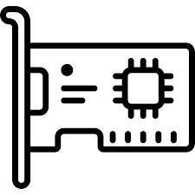



Deployment configurations
Deployment configurations
Should applications be co-located?
Applications competing on CPU
RDMA applications competing on RNIC
Can I use jumbo frames?
Co-located applications
$$
Separated applications
$$$$

Slide 14

Choosing the best configuration
Each configure option has its pros and cons
There are a lot of options to configure a cluster
It is difficult to choose the best configure
We need an experiment to compare all different possible configurations

Slide 15
Measurement goals
Decisions
Measurements
How to transmit data?
What is the best RDMA verbs?
Design
Configurations
How to handle incoming events?
Should we use polling or interrupts?
Should applications be co-located?
What is the effect of applications competing for CPU on RDMA?
Deployment
Configurations
Are NICs fair among all applications?
What is the effect of applications competing for RNIC on RDMA?
Can I use jumbo frames?
What is the effect of frame size on performance?
We evaluate RDMA performance to answer to these questions

Slide 16
Methodology
Cloud Lab Topology
A cluster of 17 servers
8-core ARM Cortex-A57 processor
64 GB of memory
10 GbE Mellanox ConnectX-3 NIC
Ethernet switch
HP 45XGc
Traffic patters
16 connections for each server
No congestion in the switch
Inlined message size | 256 B
Largest RDMA packet | 4 KB
Transport (WRITEs, SENDs) | Unconnected
Total experiment time | 10 seconds
Ethernet switch
16 servers

Slide 17

Methodology
Test cases
READ-Intr
READ-Poll
WRITE/SEND-Poll
SEND/SEND-Intr
READ-Intr-$n$
WRITE/SEND-Poll
SEND/SEND-Intr
CPU
RNIC
RNIC
CPU
CPU
RNIC
RNIC
CPU
UC/WRITE
SEND
UD/SEND
SEND
Read-Intr 2
Read-Poll
Read-Intr
CPU
Mem
RNIC
RNIC
Mem
CPU
CPU
Mem
RNIC
RNIC
Mem
CPU
CPU
Mem
RNIC
RNIC
Mem
CPU
8 B address
data

Slide 18
What to measure?
Three scenarios
Dedicated server for applications
Co-located applications competing on CPU
Co-located applications competing on RNIC
RDMA performance in the terms of
Latency
Throughput
What is the effect of cluster configuration on RDMA performance

Slide 19
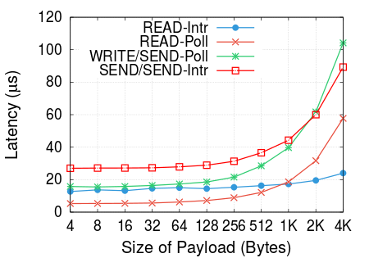
Which is the best verb?
Scenario I: No contention
READ-Intr
Best to fetch large values
READ-Poll
Best to fetch small values
The best verb changes when the payload size changes

Slide 20
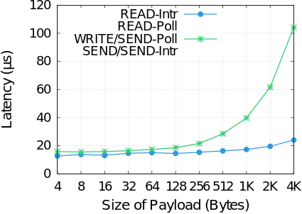

One side vs two side
Scenario I: No contention
WRITE/SEND-poll > READ-Intr
WRITE/SEND-poll $≅$ READ-Intr
One side verbs are better

Slide 21
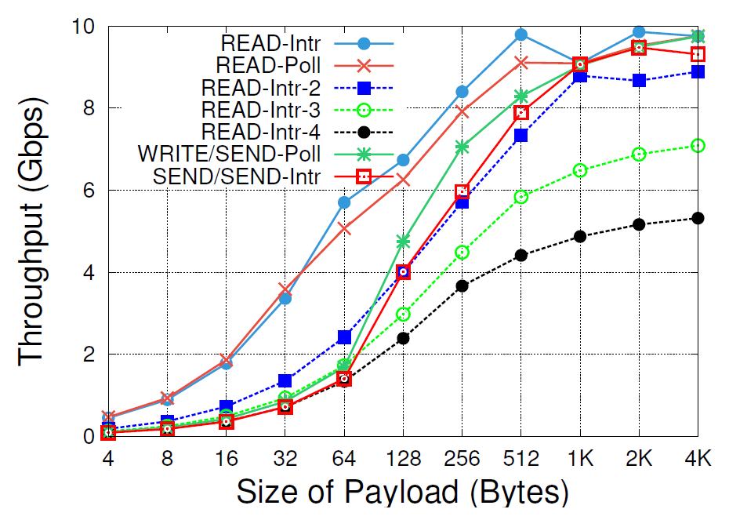
Effect of RDMA verbs on throughput
Scenario I: No contention
Similar performance
READs slower
READs faster
Correct verb size depends on the size of the payload

Slide 22
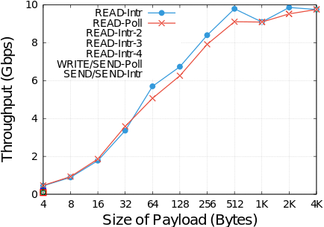
Effect of RDMA READs on throughput
Scenario I: No contention
Interrupts or polling has little impact on throughput (No CPU contention)

Slide 23
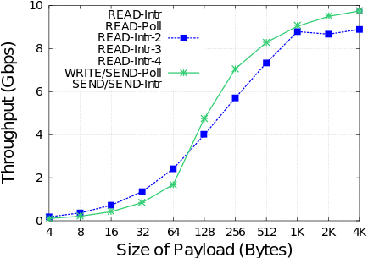
Application needs two memory access
Scenario I: No contention
WRITE/SEND-poll > READ-Intr-2
WRITE/SEND-poll < READ-Intr-2
Best verb changes when the payload size changes

Slide 24
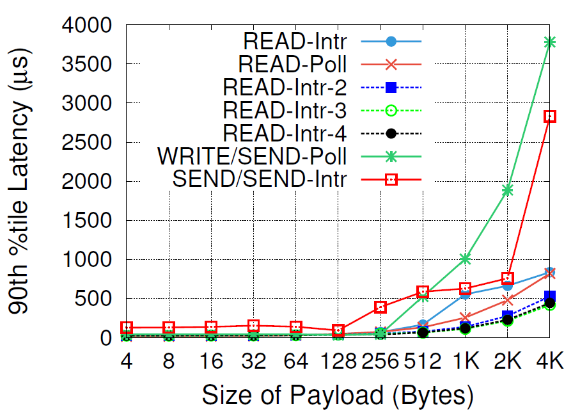
Should I use jumbo frames?
Scenario I: No contention
READs are always better
Stable latency for small messages
Jumbo frames should not be used because they Increase the latency
Notes:
Ways an RNIC may be loaded
Application limited by the number of operations per second
RNIC line-rate

Slide 25
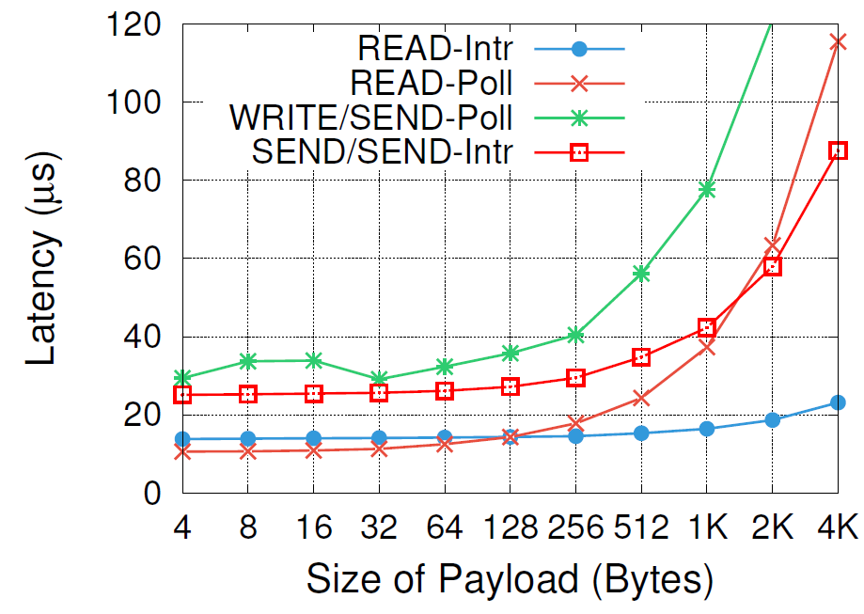

Effect of CPU contention on performance
Scenario II: CPU contention
READ-poll > READ-intr
READ-poll $≅$ READ-intr
CPU contention changes the best verb choice

Slide 26
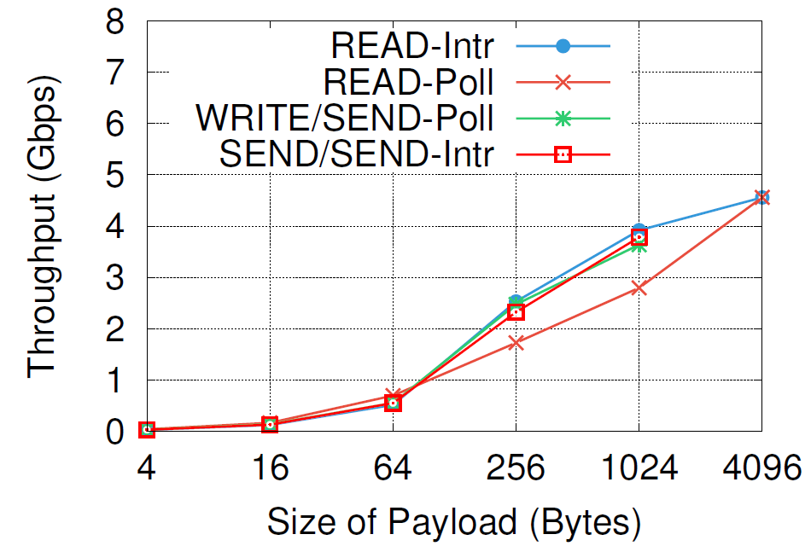
RNIC fairness among short and long messages
Scenario III: RNIC contention
Two traffic patterns (Facebook):
Storage (4 MB)
memcached
Starve massages with small payload
RNIC contention hurts the throughput of small messages for all verbs
Notes:
While Microsoft has said that message transfers
in their RDMA deployment are often less than 4 MB
in size [26], most key-value store accesses are much smaller.
Over 90% of all values in a Facebook memcached cluster
were under 256 B

Slide 27
Observations
Decisions
Measurements
Results
How to transmit data?
What is the best RDMA verbs?
Choosing the best performing verb is difficult
Design
Configurations
How to handle incoming events?
Should we use polling or interrupts?
Correct choice depends on the CPU load
Should applications be co-located?
What is the effect of applications competing for CPU on RDMA?
CPU contention changes the best verbs
Deployment
Configurations
Are NICs fair among all applications?
What is the effect of applications competing for RNIC on RDMA?
RDMA applications do not fairly share the RNIC
Can I use jumbo frames?
What is the effects of frame size on performance?
Never use Jumbo frames because it increases latency
Difficult to decide what is best configuration

Slide 28
Observations
Correct verb choice depends on:
Object size
CPU utilization
RNIC utilization
The number of dependent memory accesses
Monitor
Measure
Configure
Impossible for application to monitor and measure and adjust verbs

Slide 29
high-level library
Needs of a higher-level library
Hide complexities from applications
Monitor important system parameters
Configure the verbs automatically
Monitoring
Application
Application
Application
Adaptive Performance Library
CPU
RDMA Verbs Library
Overlay Router
Optional
Building blocks of the library
RNIC
Existing framework
Host Network

Slide 30
Conclusion
We studied
The impact of co-located applications contending for RNIC and CPU
The impact of large frame sizes hurt tail latency
We observed
Correct verb choice is dependent on many variables
It is impossible for application to monitor and measure all variables
Future work
Implement the library
A higher-level library that hides complexities from applications is needed

Slide 31
Thanks for the attention
Mojtaba Malekpourshahraki
Email: mmalek3@uic.edu
Website: cs.uic.edu/~mmalekpo

