Slide 1

ARGUS : Toward Scalable Replication Systems with Predictable Tails using Programmable Data Planes
Sean Choi, Seo Jin Park, Muhammad Shahbaz,
Balaji Prabhakar and Mendel Rosenblum
Notes:
Hello, my name is Sean and today I will be talking about system we built called ARGUS, a replication system assisted by SmartNIC, which shows higher throughput, lower and predictable tails latencies with no host resource usage.
This work is a joint work with my colleagues at Stanford, Seojin, Shahbaz, professor Prabhakar and my advisor Mendel Rosenblum.

Slide 2
Replication is Crucial
Increases Availability and Fault Tolerance
Localized Data Access
Distributed Databases, Consensus Systems, …
Master
Client
Write
Client
Replicate
Replicate
Replicate
Backup
Backup
Backup
Notes:
First of all, let me briefly define what a replication system in this context is. In this work, replication refers to replicating data across multiple machines.
For example, an example is a simple master to slave replication where write goes to the master and the copies of the data are stored in multiple backups.
Replication increases availability and fault tolerance of the entire system by providing more copies of the data
And allows localized data access for the case for geo-distributed databases. Therefore, it’s widely used for distributed databases and consensus system where these properties are necessary.

Slide 3
Replication Adds Overheads
Increases CPU / Memory / Disk Usage
Requires 2 Round-Trips per update (Higher Latency)
Master
Client
Write X←2
Client
X: 1
Y: 5
X: 2
Y: 5
…
Y 5
X 2
Ok
…
X 1
X 2
Current State
Committed
Uncommitted
Ok
Ok
Ok
Backup
Backup
Backup
…
Y 5
X 2
…
Y 5
X 2
…
Y 5
X 2
Notes:
However replication adds various kinds of overheads and let me show that by a simple example. In the figure, let’s assume that we are writing a new value 2 to x.
Once receiving the values, the master replicates the new value across the backups.
The backups then stores the new value and returns an ack.
The value is then committed in the master
And the ack is returned to the host.
In this process, we can see that this process increases CPU, Memory and Disk usage, because there are more storage and processing involved.
And more importantly, the client must wait until replication completes, resulting in at least 2 RTTs of wait time.

Slide 4
Reasons for 2 RTTs
Client
X ← 1
X ← 3 | X ← 1 | X ← 2
Client
X ← 2
X ← 3 | X ← 1 | X ← 2
X ← 3 | X ← 1 | X ← 2
X ← 3
Client
Master
X ← 3 | X ← 1 | X ← 2
Time to complete an operation
Backups
1 RTT for serialization
1 RTT for replication
Notes:
So what is the main reason for having 2 RTTs.
When the clients send multiple data.
The master must receive the data and serialize them in some fashion.
Then there is an additional RTT spent for sending the data to the backups.
So we can see that there are 2 RTTs in total to complete the process.
So how can we avoid this?

Slide 5
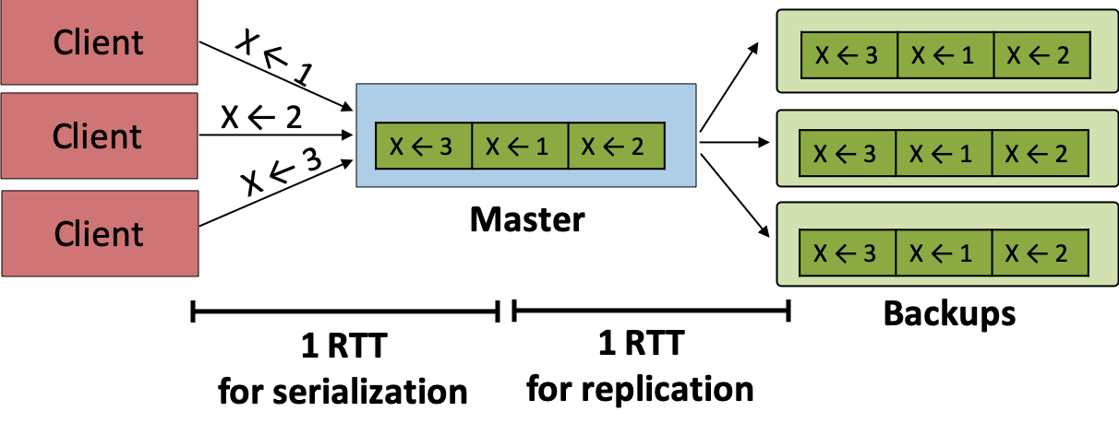
CURP Enables 1 RTT Replication
Totally ordered replication needs 2 RTTs
Idea: Replicate for durability & Exploit commutativity to defer ordering
Consistent Unordered Replication Protocol (NSDI 2019)
Replicate commutative operations without ordering
Fall back to 2 RTT replication otherwise
Notes:
A new replicsation protocol CURP is designed exactly to avoid this. First, having totally ordered replication must need 2 RTT. However, the main idea is that we can avoid ordering for some subset of the writes that are commutative, such as writes to different keys, we can guarantee higher performance.
So, the CURP's main difference is to replicate commutative operations to backups without ordering and fall back to 2 RTT replication in case the operations are not commutative.

Slide 6
CURP Enables 1 RTT Replication
Client
y←5
async
… | x←1 | x←2
… | x←1 | x←2 | y←5 | z←7
z←7
Master
garbage
collection
Backups
Client
z←7
y←5
No ordering info
Temporary until async
Witness data used for recovery
Witnesses
Time to complete an operation
1 RTT
Notes:
Let me try to explain what that looks like.
Let’s assume that there are two clients writing two values, 5 to 7 and 7 to z, which are commutative operations.
The values are written to both the master and a set of other entity called witnesses that store the values temporarily and ack is returned immediately once the values are written in 1 RTT.
Then, the master asynchronously syncs the new values to the back up and
garbage collects old values in the witnesses.
The properties of the witnesses is that there is no ordering info, the values are temporary and the values in the witnesses can be used in case of failures.
You can read more about CURP in the NSDI 2019 paper if interested.

Slide 7
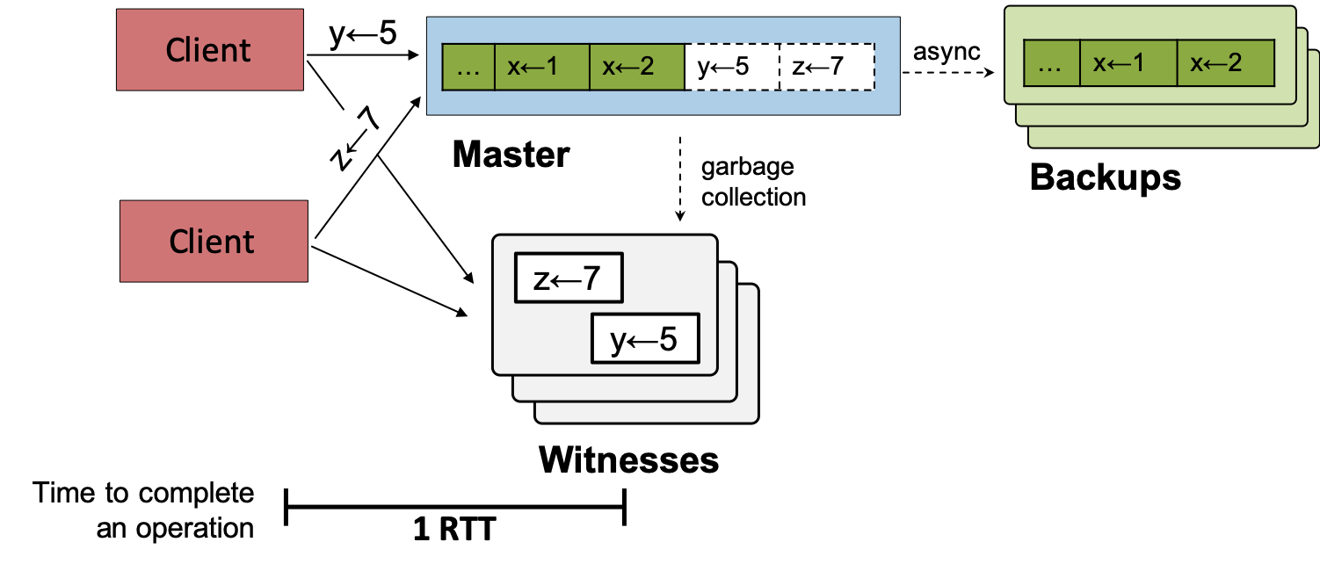
Shortcomings of CURP in User Space
CURP witness is implemented in user space
High latency due to network/OS layers
Tail-at-Scale (More witness -> Worse tail latency)
Added host resource usage
Notes:
However, the main shortcomings of CURP is that it uses a set of servers to implement witnesses, which perform relatively simple operations.
This results in multiple issues, such as high latency due to network/OS layer. This is unavoidable even if we are using DPDK or any other kernel bypass solutions as we are using a CPU.
Tail-at-scale effect, since the witness process must fight for host resources with other various process. This effect is even more prominent in cloud environments where there are multiple tasks running in a server.
Finally, witness use additional valuable host resources. For example, a witness is shown to use around 7% of host CPU usage.

Slide 8
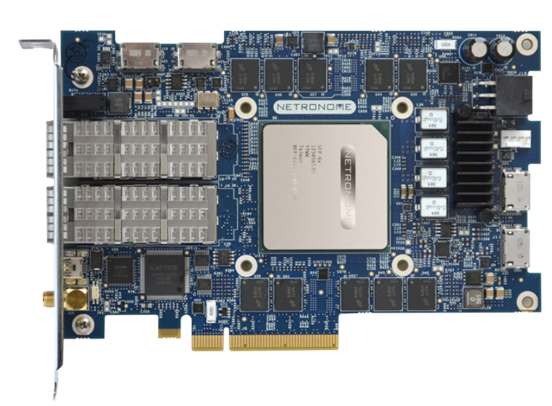
Motivations for ARGUS
ARGUS implements CURP Witnesses in SmartNICS to…
Reduce latency by removing the network/OS layers
Avoid Tail-at-Scale (No resource contention, RTC)
Eliminate host resource usage
z←7
y←5
Witnesses
SmartNIC
Notes:
So, knowing such shortcomings, here comes the motivation for our work ARGUS and the idea is relatively simple and straightforward.
We decided to implement the witness portion of CURP on SmartNICs to reduce latency by removing the network OS/ layer
Avoid tail-at-scale, since NICs do not have a notion of context switching and are run to completion.
And finally to eliminate using any resource on the host.

Slide 9
What are SmartNICs?
Network Interface Cards (NIC) can run user defined tasks that is originally run by a CPU
Categorized based on the type of processor
 | ASIC | FPGA | SoC
Packet Processor | NPU | FGPA | CPU
Programmability | Moderate | Moderate (Hard) | High
Processing Latency | Low | Moderate | High
Notes:
Let me give a brief overview of what SmartNICs are, as they are widely used across multiple work in the field.
We define SmartNICS as Network interface cards that run user defined tasks that is originally run by a CPU. SmartNICs are categorized by the type of processor it contains, ASIC, FPGA and SoC.
We are particularly interested in the ASIC based SmartNICs, because of its low processing latency as the processing happens in the data plane.

Slide 10
Netronome SmartNICs (ASIC-based)
Programmable NPUs capable up to 100G
Runs programs directly in the data plane
Contains up to 120 Cores @ 1.2Ghz and 8GB RAM
Programmable via P4 and Micro-C
Notes:
To give a bit more detail of the card that we are using, we have used a Netronome SmartNIC that contains Programmable NPUs capable of running at 100g.
It can run programs directly in the data plane for low latency.
Contains 120 Cores @ 1.2Ghz and 8GB of RAM
Finally, you can run custom programs defined in P4 or a language called Micro-C. For the details regarding Micro-C, we can talk offline and I can refer you to some publications.

Slide 11
Overview of ARGUS
Notes:
We now give a brief overview of how ARGUS is implemented. To clarify this is the request sent to the witness and the requests to the master stays the same as existing system.
ARGUS starts off with a custom packet header, which contains the protocol of the operation that we want to run and the set of fields to denote the packet data and how they should be hashed to check for commutativity.
Given the protocol definition, we now go over how the packet passes through the system.
First, the client sends a packet with a ARGUS protocol header that reaches the NIC. Then, the P4 portion of the ARGUS program parses the headers and checks if the packet is for the witness. If yes, it performs the operations as noted in the protocol field by running the Micro-C witness program and returns the result. For all other packets, it is sent to the host as if nothing exists in the data plane.

Slide 12
Experiment Testbed Setup
5x Dell R640 1U Server (1 Client, 1 Master, 3 Witnesses)
Intel Xeon 5117 14 Cores @ 2Ghz 32GB DDR4 RAM
Netronome CX 10Gb SmartNIC 56 Cores @ 633MHz 2GB RAM
10Gb Arista Switch
Durable Redis writes to master and witnesses
Notes:
Before giving some detail of our preliminary evaluations, we discuss the details of the testbed and the workload.
…
For the workload, we are running durable Redis writes to both the master and the witnesses
Please refer to the paper for the details of the workload.

Slide 13
Evaluation: Higher Throughput, Lower Latency
Throughput (Kops/s)
 | ARGUS | CURP
Single Witness | 757.66 (+6.70x) | 113
Latencies (μs)
 |  | ARGUS | CURP
Single Witness | Average 99.9th | 30.91 36.72 | 61.28 (+1.98x) 80.63
End-to-End | Average 99.9th | 57.86 59.97 | 80.42 (+1.39x) 108.05

Slide 14
Evaluation: Shorter Tails

Slide 15
Evaluation: Lower Tail-at-Scale Effect

Slide 16
Future Work
Client-side replication on SmartNICs
Test lightweight reliable data-transfer protocols
Try other domain-specific hardware accelerators

Slide 17
Conclusion
ARGUS shows significant improvements in replication throughput, latency and tail latency
All the while saving host CPU & Memory usage!

