Slide 1
Self Introduction
Education:
2013-2017: PhD in Hong Kong University of Science and Technology
2009-2013: BE in Shanghai Jiao Tong University
Work experience:
2019-Present: Microsoft Research Redmond
2017-2019: Microsoft Research Asia
Current focus: RDMA network infrastructure in the cloud
More information: http://baiwei0427.github.io/
Notes:
Thanks Danyang for the introduction, Hello everyone, I am Wei Bai from Microsoft Research. Before I introduce the research work, I would like to briefly introduce myself.

Slide 2




Aeolus: A Building Block for
Proactive Transport in Datacenters
Shuihai Hu, Wei Bai, Gaoxiong Zeng, Zilong Wang,
Baochen Qiao, Kai Chen, Kun Tan, Yi Wang
Notes:
Today, I would like to talk about our work Aeolus, which proposes a new building block to augment proactive transports. This is a joint work with my lab colleagues at HKUST, Shuihai, Gaoxiong, Zilong and Baochen, my advisor Kai Chen, and Kun Tan from Huawei, and Yi Wang from Peng Cheng lab. Note that most of the work was done when I was a PhD student at HKUST.

Slide 3
Era of High-speed DCNs
The link speed of production DCNs grows fast:
1Gbps
10Gbps
40Gbps
100Gbps
200Gbps
…
2007
2010
2013
2016
2020
Notes:
In recent years, as shown in the figure, the link speed of production DCNs grow very fast, from 1Gbps to 10Gbps, to 100Gbps with 200Gbps on the horizons.[click]

Slide 4

Congestion Control Becomes More Challenging
10-100x higher BDP (bandwidth-delay product)
More bustiness
Flows finish in much fewer RTTs
10-100X link speed
$$⟹$$
Notes:
Given this trend, congestion control in DCNs have become more challenging. [c] With link speed increased by 10-100 times, [c] today’s DCNs have much higher bandwidth-delay product and more bustiness. [c] and flows now finish in much fewer RTT, leaving the transport very little time to react to congestion. [c]

Slide 5
Congestion Control Today
Current solution: mainly using reactive protocols
TCP, DCTCP, TIMELY, …
react to signals after congestion occurs
Large switch queues
Severe loss under incast
Very slow convergence
Worse with higher link speed
Notes:
Today’s congestion control are mainly achieved using reactive protocols. [click] Reactive congestion control algorithms, such as TCP and DCTCP, react only after congestion already happens. [click] Reactive solutions have long-standing problems including switch queue build-ups, severe loss under incast and very slow convergence speed. [click] With higher link speed, all these problems now become worse. [click]

Slide 6
Proactive Congestion Control (PCC)
Proactive Solutions
Reactive Solutions
Near-zero queueing
Zero packet loss
Fast convergence
Large switch queues
Severe packet loss
Very slow convergence
VS
Notes:
proactive congestion control solutions, or PCC, have drawn great attention in recent years. [c] Compared with reactive solutions, proactive solutions have several advantages, including [click] near-zero queueing, [click] zero packet loss, [click] and fast convergence. [click]

Slide 7
Existing PCC Solutions
Key idea: proactively schedule network transfer using credit
Centralized
Switch Based
Receiver Based
FastPass (Sigcomm’14)
A central arbiter to globally schedule network transfer.
PDQ (Sigcomm’12)
TFC (Eurosys’16)
Switches explicitly allocate link bandwidth to flows.
ExpressPass (Sigcomm’17)
NDP (Sigcomm’17)
Homa (Sigcomm’18)
Receivers explicitly schedule the transfer of packets for different receivers.
Notes:
Unlike reactive solutions, the key idea of PCC is to proactively schedule network transfer based on the availability of network resources using credit. The idea of PCC can be realized in several ways. [click] For example, Fastpass employs a centralized arbiter to enforce a tight control over network transfer. [click] PDQ and TFC leverage switches to explicitly allocate link bandwidth among the passing flows. [click] ExpressPass, NDP and Homa use receiver-driven credit-based approaches to explicitly schedule the arrival of data packets destined for different receivers. [c]

Slide 8
Existing PCC Solutions
Key idea: proactively schedule network transfer using credit
Centralized
Switch Based
Receiver Based
One extra RTT is required to prepare the schedule!
FastPass (Sigcomm’14)
A central arbiter to globally schedule network transfer.
PDQ (Sigcomm’12)
TFC (Eurosys’16)
Switches explicitly allocate link bandwidth to flows.
ExpressPass (Sigcomm’17)
NDP (Sigcomm’17)
Homa (Sigcomm’18)
Receivers explicitly schedule the transfer of packets for different receivers.
Notes:
While being promising, all existing PCC solutions require one extra RTT to prepare the schedule. When a new message arrives, it cannot start transmission immediately as it has no idea of the ideal sending rate. Instead, it should first ask the centralized arbitrator, the receiver or the per-hop switch how fast it should send. This process will take one RTT. In high speed networks, we find that, the cost of delaying all flows by one extra RTT can be very expensive.[c]

Slide 9
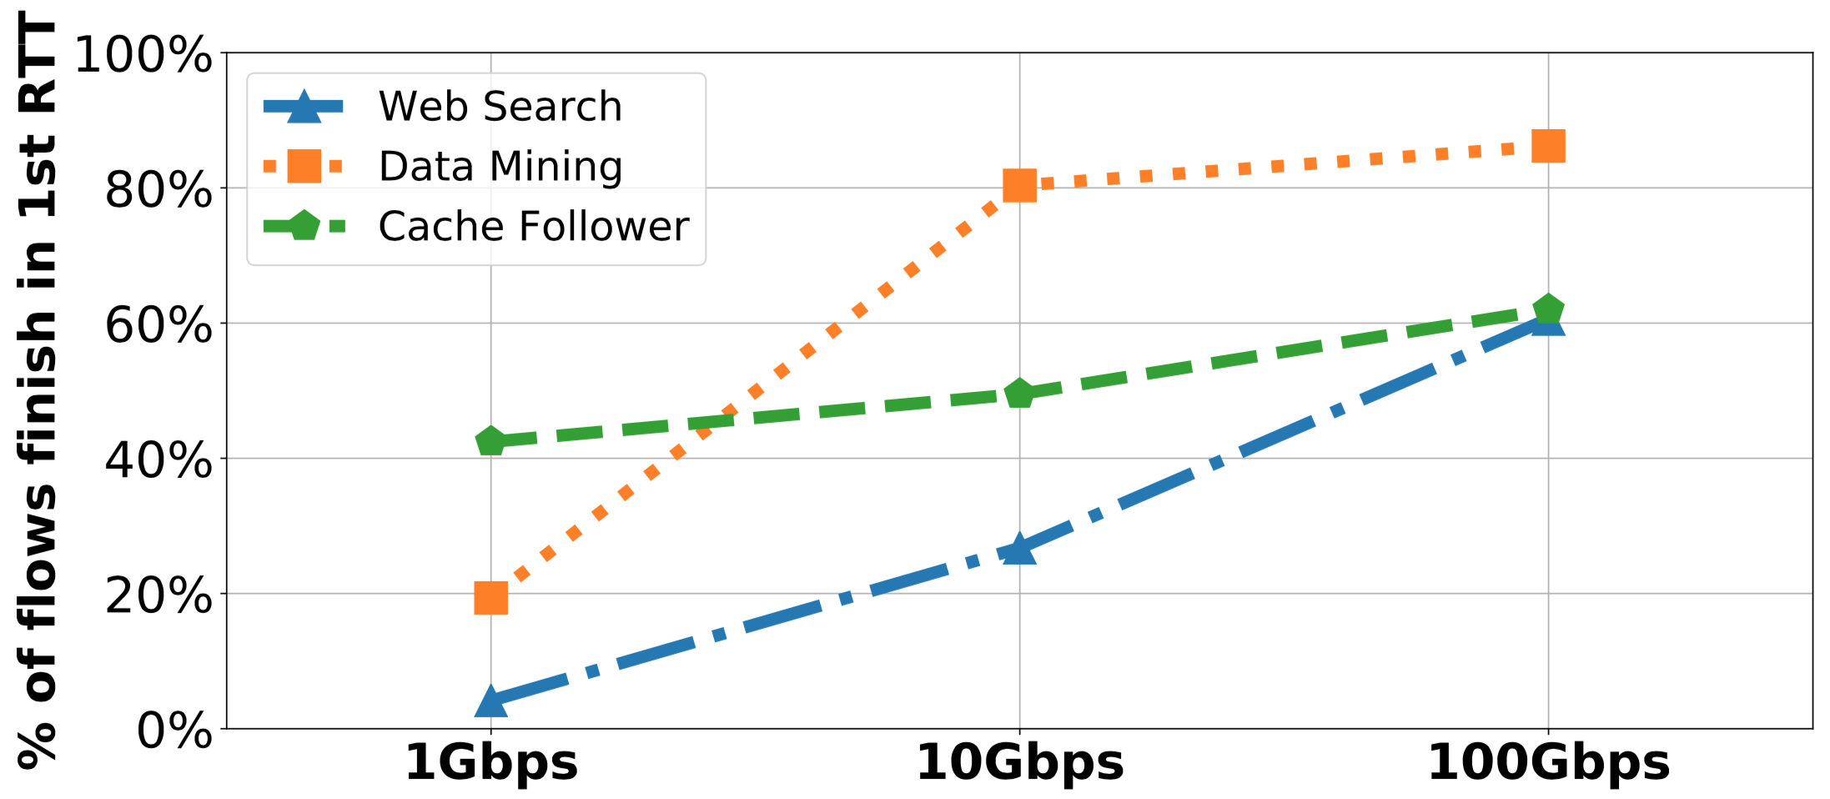
The first RTT Matters!
Observation: At high link speed, a large portion of flows could finish in the 1st RTT
At 100Gbps, 60%-80% of flows could have been finished within the first RTT!
Notes:
[c] Our observation is that, at high link speed, a large portion of flows could complete in the first RTT. [c] In this figure, we show the fraction of flows could have been finished within the first RTT under different link speeds. Although our measurement methodology is idealized, the results suggest a clear trend that, the rise of high-speed DCNs makes the first RTT much more important. [c] As we can see, At 100Gbps, 60-80% of flows could have been finished within the first RTT! [c]

Slide 10

Current Practice for Handling the One Extra RTT
#1: Pay the cost of one extra RTT
Sender
Receiver
Credit Request
ExpressPass needs one RTT to prepare data transmission
Notes:
However, existing solutions cannot well handle the one-extra-RTT problem. They mainly fall in two categories. [click] One line of work choose to pay the cost of one extra RTT. [c] For example, in ExpressPass, [c] the sender will send a credit request to the receiver on the arrival of a new flow. [c]

Slide 11
Current Practice for Handling the One Extra RTT
#1: Pay the cost of one extra RTT
data
2nd rtt:
Credit
Sender
Receiver
ExpressPass needs one RTT to prepare data transmission
Notes:
[c] On receiving credit request, the receiver will send credits to the sender. [c] The sender will send data packets after it receives credit. So all flows are delayed by at least one RTT. [c]

Slide 12
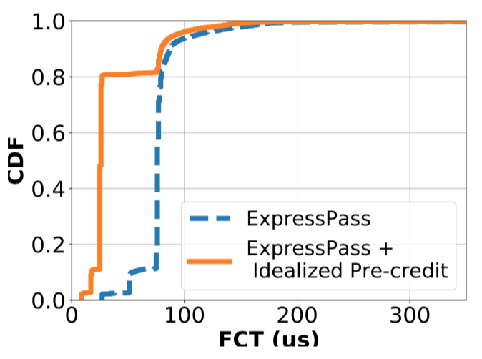
Current Practice for Handling the One Extra RTT
#1: Pay the cost of one extra RTT
one extra RTT
FCTs of 0-100KB flows with 100Gbps link speed
80% of Small flows take one extra RTT to complete
Notes:
At high speed, the cost of wasting 1st RTT can be very expensive! [c] To demonstrate this, we measure the FCT of 0-100KB small flows with 100Gbps link speed. Flows are generated according to Cache Follower workload. [c] As we can see, compare with idealized solution, 80% of Small flows take one extra RTT to complete when under ExpressPass. [c]

Slide 13
Current Practice for Handling the One Extra RTT
#1: Pay the cost of one extra RTT
#2: Blindly burst traffic in the 1st RTT
unscheduled
scheduled
existing flow
new flow
Homa directly sends one BDP of data in 1st RTT
Notes:
[c] A second line of work let new flows blindly send traffic in the 1st RTT, such that the one extra RTT can be removed. [c] For example, in Homa, [c] on the arrival of new flows, [c] the sender will send a BDP of unscheduled data packets. [c]

Slide 14
Current Practice for Handling the One Extra RTT
#1: Pay the cost of one extra RTT
#2: Blindly burst traffic in the 1st RTT
unscheduled
scheduled
existing flow
buffer overflow
new flow
Homa directly sends one BDP of data in 1st RTT
Notes:
These unscheduled traffic, however, [c] may cause Large queue build-ups and severe packet loss. As a result, good properties of PCC are violated. [c]

Slide 15
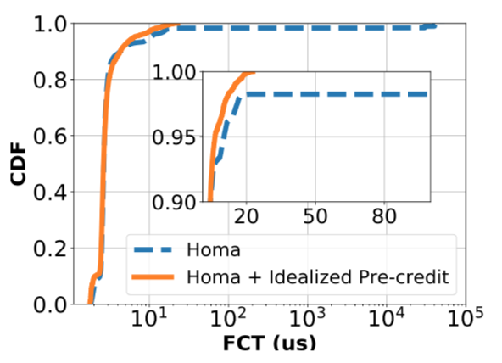
Current Practice for Handling the One Extra RTT
#1: Pay the cost of one extra RTT
#2: Blindly burst traffic in the 1st RTT
tail>25ms
tail<25us
FCTs of 0-100KB flows with 100Gbps link speed
1000x increase on the tail FCT due to violation of PCC’s properties
Notes:
To demonstrate this, [c] we study the flow performance of 0-100 KB small flows under Homa and idealized solution. Flows are also generated according to Cache Follower workload. [c] As we can see, compared with idealized solution, the tail FCT under Homa is extremely long. This is because some scheduled packets get lost due to buffer overflows, and trigger flow timeouts. The results indicate that, blind burst can cause serious performance downgrade! [c]

Slide 16
Can we eliminate 1 RTT extra delay while preserving all the good properties of PCC?
Our answer: Aeolus
Notes:
To this end, it is natural to ask such a question: can we eliminate 1 RTT extra delay while preserving all the good properties of PCC? [pause] [click] our answer to this question is Aeolus. [click]

Slide 17
AEOLUS DESIGN
Notes:
Now, we talk about the design of Aeolus. [click]

Slide 18
Aeolus Overview
Aeolus Control Logic
Rate Control
Selective Dropping
Loss Recovery
unscheduled packet
bandwidth
used up
packet
dropped
scheduled packet
line-rate start
in the 1st RTT
protect packets
scheduled by PCC
preserved PCC
for loss recovery
Notes:
This is a design overview. As we can see, Aeolus mainly contains 3 components: rate control, selective dropping and loss recovery.

Slide 19
Aeolus Overview
Aeolus Control Logic
Rate Control
Selective Dropping
Loss Recovery
unscheduled packet
bandwidth
used up
packet
dropped
scheduled packet
line-rate start
in the 1st RTT
protect packets
scheduled by PCC
preserved PCC
for loss recovery
maximize the chance to utilize spare bandwidth
Notes:
Aeolus adopts a minimal rate control at the end hosts: all flows start at line-rate in the first RTT. This can maximize the chance for new flows to utilize spare bandwidth. [c]

Slide 20
Aeolus Overview
Aeolus Control Logic
Rate Control
Selective Dropping
Loss Recovery
unscheduled packet
bandwidth
used up
packet
dropped
scheduled packet
line-rate start
in the 1st RTT
protect packets
scheduled by PCC
preserved PCC
for loss recovery
preserve all the good properties of PCC
Notes:
In the network, to safeguard scheduled packets and preserve all the good properties of PCC, Aeolus introduces a novel selective dropping mechanism at the switch. More details will be introduced later. [c]

Slide 21
Aeolus Overview
Aeolus Control Logic
Rate Control
Selective Dropping
Loss Recovery
unscheduled packet
bandwidth
used up
packet
dropped
scheduled packet
line-rate start
in the 1st RTT
protect packets
scheduled by PCC
preserved PCC
for loss recovery
fast recovery for dropped unscheduled packets
Notes:
Given Aeolus has safeguarded the scheduled packets, loss recovery is needed only for unscheduled packets. In our design, we leverage the well-protected PCC as a safe and efficient means for recovering lost unscheduled packets. [c]

Slide 22

Selective Dropping Mechanism
2
2
Dropping Threshold
1
2
2
1
2
Egress Queue
1
1
Datacenter Fabric
Packet tagging at end-host
Selective dropping in the network
unscheduled packet (burst in the 1st RTT)
scheduled packet (transmitted by PCC)
Notes:
In the next, I will introduce the selective dropping mechanism in details. [c] At the endhost, this mechanism performs packet tagging. [c] Unscheduled and scheduled packets will be tagged with different tags. [c] In the network, switches perform selective dropping to protect Scheduled packets over unscheduled packets. So, what is selective dropping? [c] As we can see, selective dropping is a switch buffer management scheme. [c] It configures a dropping threshold at switch queues. [c] When queue occupancy reaches the preset dropping threshold, [click] the incoming packets carrying low priority tag will get dropped. [click] In contrast, packets carrying high priority tag can still enter the queue. [click]

Slide 23
Why Selective Dropping Works?
Case-1: network is under-utilized
Dropping Threshold
2
2
2
2
Egress Queue
Datacenter Fabric
spare bandwidth is utilized & no one extra RTT delay
Notes:
Now, let’s see why selective dropping works. [click] When network is under-utilized, [click] unscheduled packets will enter switch queues. As a result, [click], spare bandwidth is utilized and there is no 1 RTT extra delay. [click]

Slide 24
Why Selective Dropping Works?
Case-2: network fully-utilized
1
1
Dropping Threshold
1
2
2
1
2
Egress Queue
2
2
Datacenter Fabric
Low latency & zero loss & fast convergence are preserved for PCC
Notes:
When network is fully-utilized, [click] unscheduled packets are selectively dropped. As a result, [click] scheduled packets are not affected, and [c] all the good properties of PCC are well preserved. [click]

Slide 25
How to Implement?
We leverage ECN (Explicit Congestion Notification), a built-in function of commodity switches, for implementation
What is ECN?
a switch mechanism which performs congestion notification via marking ECT and CE field in the IP header
ECT | CE | Names for the ECN bits
0 | 0 | Not-ECT (Not ECN Capable Transport)
0 | 1 | ECT(1) (ECN Capable Transport (1))
1 | 0 | ECT(0) (ECN Capable Transport(0))
1 | 1 | CE (Congestion Experienced)
Notes:
While the selective dropping mechanism is appealing, the key question is how to implement it with existing commodity switches. [click] We leverage ECN (Explicit Congestion Notification), a built-in function of commodity switches, for the implementation. [c] So What is ECN? [c] ECN is a switch mechanism which allows switch to perform congestion notification via marking a specific field in the IP header.[c] In the IP header, there is a 2-bit field called ECN field. ECN field has 4 codepoints in total. 00 means a flow is not ECN Capable. 01 or 10 means a flow is ECN capable. 11 indicates a flow has encountered congestion in the network. [c]

Slide 26
ECN-based Implementation
An interesting observation about ECN:
ECN-capable packets are marked
ECN marked
ECN-capable
01
11
ECN marking threshold
Notes:
In our past testbed experiments with ECN, We made an interesting observation. [click] Let’s assume the queue occupancy reaches the ECN marking threshold. Our finding is that, [click] if a packet is ECN capable, [click] it will enter the queue and get ECN marked. [click]

Slide 27
ECN-based Implementation
An interesting observation about ECN:
ECN-capable packets are marked
ECN-incapable packets are dropped
ECN-incapable
00
dropped
ECN marking threshold
Notes:
[click] But if a packet is not ECN capable, [click] it will be dropped by the switch. [click]

Slide 28
ECN-based Implementation
Packet tagging at end-host :
Scheduled packet tagged as ECN-capable
Unscheduled packet tagged as ECN-incapable
ECN configuration at switches:
ECN marking threshold = selective dropping threshold
Notes:
Based on this observation, we can implement the selective dropping mechanism by reinterpreting the ECN marking function. [click] At the endhost, we tag scheduled packets as ECN-capable, and unscheduled packets as ECN-incapable. [click] At the switch, we set the ECN marking threshold equal to the selective dropping threshold we want to configure. With the above simple configurations, we can implement selective dropping mechanism using existing commodity switches. [click]

Slide 29
Why not Priority Queueing?
Priority queueing is an alternative solution
Scheduled packet → high priority queue
Unscheduled packet → low priority queue
Scheduled packet
high priority
Unscheduled packet
low priority
Notes:
[click] Priority queueing is an alternative solution to selective dropping mechanism. [click] As shown in the figure, by having scheduled packet enter high priority queue, and unscheduled packets enter low priority, we can also ensure unscheduled packets only utilize the spare bandwidth for the first RTT transfers. [click]

Slide 30
Why not Priority Queueing?
Drawback #1: 1 additional queue per service class
# of supported service classes reduced by half
Notes:
However, priority queueing have two drawbacks. [click] First, it will require one additional queue for each service class, such that the number of supported service classes will be reduced by half. [click]

Slide 31
Why not Priority Queueing?
Drawback #1: 1 additional queue per service class
# of supported service classes reduced by half
Drawback #2: packet reordering problem
6
5
4
3
2
1
high priority
3
2
1
6
5
4
6
5
4
low priority
3
2
1
Sender
Receiver
Scheduled pkt
Unscheduled pkt
Notes:
Second, due to the queueing delay in the low-priority queue, there can be packet reordering problem. [click] This can be illustrated with a simple example. As shown in the figure, a sender sends 3 unscheduled packets and 3 scheduled packets. [click] in the network, scheduled packets are served with high priority. [click] As a result, scheduled packets with larger sequence number arrive prior to the unscheduled packets, resulting in packet reordering problem. [click]

Slide 32
Loss Recovery for Unscheduled Packets
Scheduled packets do not have congestion loss
Fast Loss detection
Per packet ACK for each unscheduled packet
Tail loss probing
i.e., send a probe right after the transmission of last unscheduled packet
Fast retransmission
Reuse preserved PCC to guarantee retransmission
i.e., retransmit lost packets only with scheduled packets
Notes:
With the selective dropping mechanism, scheduled packets are protected from congestion loss. However, unscheduled packets could still suffer from congestion loss under heavy load. To handle this, we designed a fast recovery scheme for unscheduled packets. [click] The first step is to detect loss quickly. [click] To do that, we enable per packet ACK for each unscheduled packet. [c] in Addition, we also design a tail loss probing mechanism for quickly detecting tail loss of unscheduled packets. [c] The second step is to retransmit lost unscheduled packet quickly. [c] Our idea is to reuse preserved PCC to guarantee retransmission. [c] This is done by retransmitting lost packets only with scheduled packets. [c]

Slide 33
Any corner cases Aeolus cannot achieve optimal performance?
Notes:
Now I think many of you may wonder if there are any corner cases that Aeolus cannot achieve optimal performance?

Slide 34
The Design Tradeoff of Selective Dropping
A scenario Aeolus may fail to achieve optimal performance
dropping threshold = 4 packets
…
…
…
unscheduled packet (burst in the 1st RTT)
scheduled packet (transmitted by PCC)
Notes:
Actually, the selective dropping mechanism did have design tradeoff. [c] In the next, I will illustrate it using a simple example. [c] Assuming the queue occupancy reaches the dropping threshold. [c] We have two senders bursting unscheduled packets concurrently. In the network, due to selective dropping, [c] only a part of unscheduled packets can get passed. As a result, at least one more RTT is needed to complete these two flows.

Slide 35
The Design Tradeoff of Selective Dropping
A scenario Aeolus may fail to achieve optimal performance
…
…
unscheduled packet (burst in the 1st RTT)
scheduled packet (transmitted by PCC)
Notes:
But if we don’t use selective dropping, these dropped unscheduled packets will be buffered in the switch queue, and have a chance to get finished in the first RTT. However, this is at the risk of dropping scheduled packets.

Slide 36
The Design Tradeoff of Selective Dropping
A scenario Aeolus may fail to achieve optimal performance
Design tradeoff:
Preserve PCC & Guarantee good tail latency for every flow
Utilize first-RTT spare bandwidth only in a best-effort manner
…
…
…
…
Notes:
This is because if there are senders transmitting scheduled packets, [c] Scheduled packets will get dropped due to buffer overflow. This then will violate the good properties of PCC and result in very bad tail latency. [c] So the design tradeoff of selective dropping is as follows. [c] In order to preserve all the good properties of PCC and guarantee good tail latency for every flow, [c] Aeolus utilizes first-RTT spare bandwidth only in a best-effort manner.

Slide 37
Evaluation Setup
Testbed Setup
Prototype implementation with DPDK
8 servers connected to one Mellanox 10Gbps switch
Simulation Setup
Simulation platforms: NS-2, OMNeT++, htsim
100Gbps multi-tier spine-leaf DCN topologies
Realistic production workloads
Notes:
This is the Evaluation setup. [c] For our testbed evaluation, we implement an Aeolus prototype with DPDK. We build a small testbed using 8 servers connected to one Mellanox 10Gbps switch. [c] As for our simulations, we conduct experiments using three simulators including NS-2, OMNeT++ and htsim. We use 100Gbps multi-tier spine-leaf DCN topologies and generate flows according to realistic production workloads.[click]

Slide 38
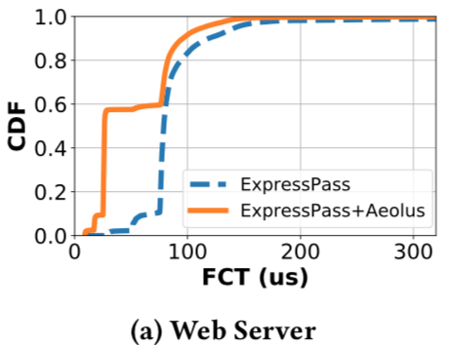
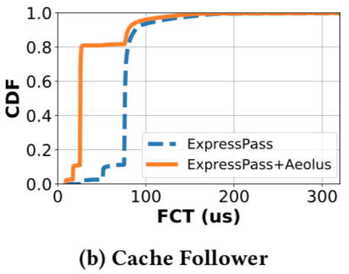
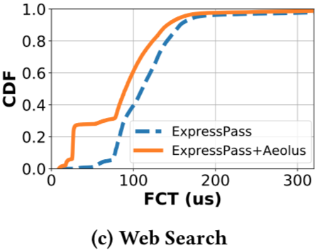
Evaluation: ExpressPass + Aeolus
80%
60%
30%
Aeolus assists ExpressPass to significantly speed up small flows by removing 1 RTT extra delay
Notes:
First, we evaluate whether Aeolus can assist ExpressPass to remove the one RTT extra delay without hurting the good properties of PCC. [c] These three figures show the flow completion times of 0-100KB small flows across three workloads including web server, cache follower and web search. [click] As we can see, with Aeolus, a large portion of small flows complete within the first RTT. [click] This indicates that Aeolus can assist ExpressPass to significantly speed up small flows by removing 1 RTT extra delay. [click]

Slide 39
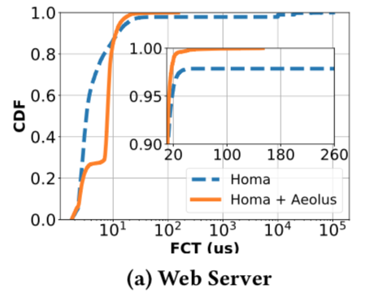
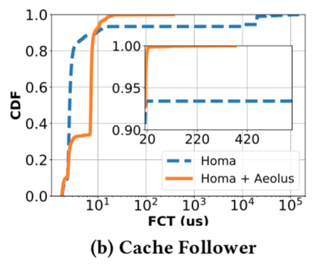
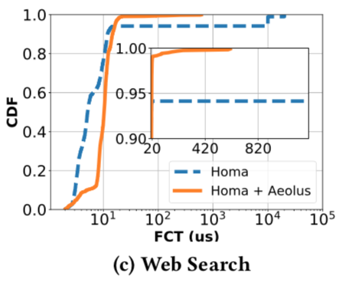
Evaluation: Homa + Aeolus
tail>100ms
tail>100ms
tail<180us
tail>30ms
tail<400us
tail<800us
Aeolus can assist Homa to eliminate large queues & loss of scheduled packets, thus significantly improve the tail FCTs.
39
Notes:
Second, we evaluate how Aeolus can assist Homa to preserve the good properties of PCC, without pausing new flows in the first RTT. [c] These three figures show the FCTs of small flows under Homa, with and without Aeolus across three different workloads. [click] As we can see, without Aeolus, flows suffer from very large tail FCT due to packet loss caused by first-rtt burst. [c] But with Aeolus, there is no scheduled packet loss and the tail FCT is reduced from > 100ms to be < 800us. [click] This indicates that Aeolus can assist Homa to eliminate large queues & loss of scheduled packets, thus significantly improve the tail FCTs. [c]

Slide 40
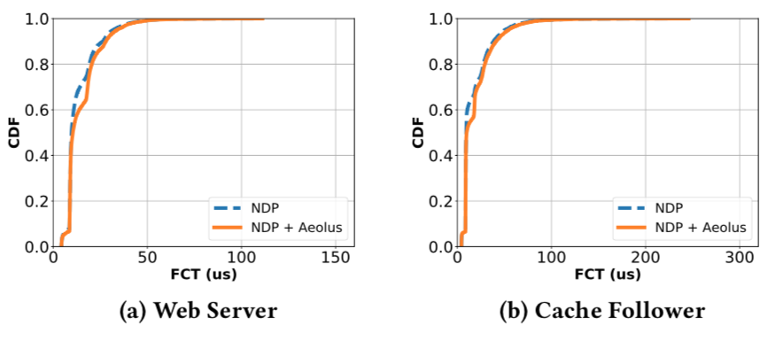
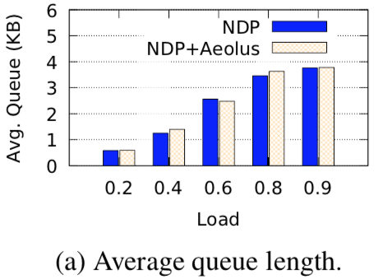
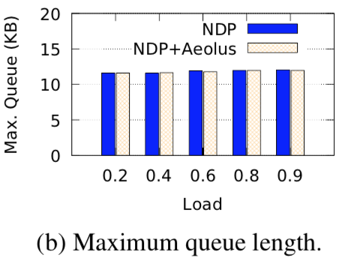
Evaluation: NDP + Aeolus
FCT of 0-100KB flows with 100Gbps link speed
Queue length for the web server workload
Aeolus can assist NDP to achieve similar performance without using expensive customized switches.
40
Notes:
Third, we evaluate whether Aeolus can assist NDP to achieve similar performance without support from expensive customized switches. [c] The two figures on the left show the FCT of small flows under NDP with and without Aeolus across two workloads. [c] The two figures on the right show the average and the maximum queue length under both schemes using web server workload. As we can see, regarding all the measured metrics, both schemes achieve very similar performance. [c] The results indicate that, Aeolus can assist NDP to achieve similar performance without using expensive customized switches. [c]

Slide 41
Aeolus Recap
Problem: PCC requires one extra RTT to prepare schedule
Aeolus: a general building block for augmenting PCC schemes
Line Rate Fast Start → eliminate one RTT extra delay for new flows
Selective Dropping → preserve all the good properties of PCC
ECN-based Implementation → compatible with commodity hardware
Notes:
Now let me do a brief recap of Aeolus. Aeolus is motivated by the problem that proactive transports requires 1 extra RTT for scheduling packet transmission. To solve this problem, we designed Aeolus, a general building block for augmenting PCC schemes. With Aeolus, three important goals are achieved, including Eliminate one RTT extra delay for new flows, Preserve all the good properties of PCC and Work with commodity switch hardware [click]

Slide 42
Practical Challenges of PCC
Notes:
After introducing Aeolus, I want to talk a little bit about some practical challenges that people may be faced with when deploying PCC in production data centers

Slide 43
Typical Research Assumptions of DCN
All the flows can be controlled by a single transport scheme
Operators know/explicitly control the path of every packet
The RTT variation is very small (due to small cable length)
DC switches are shallow-buffered and programmable (P4)
Network core is free of congestion (because of non-blocking topology and fine-grained load balancing)
Notes:
Here are some typical assumptions made by research community

Slide 44
Microsoft Data Center Region
Tier 3 – Regional
T3-1
T3-2
T3-3
T3-4
…
…
…
Tier 2 – Data center
T2-1-1
T2-1-2
T2-1-8
T2-4-1
T2-4-2
T2-4-4
…
…
…
Tier 1 – Row Leaf
T1-1
T1-2
T1-7
T1-8
T1-1
T1-2
T1-7
T1-8
T1-1
T1-2
T1-7
T1-8
…
…
…
Tier 0 – Rack
T0-1
T0-2
T0-20
T0-1
T0-2
T0-20
T0-1
T0-2
T0-20
Servers
Servers
Servers

Slide 45
Microsoft Data Center Region
Tier 3 – Regional
T3-1
T3-2
T3-3
T3-4
…
…
…
Tier 2 – Data center
T2-1-1
T2-1-2
T2-1-8
T2-4-1
T2-4-2
T2-4-4
…
…
…
Tier 1 – Row Leaf
T1-1
T1-2
T1-7
T1-8
T1-1
T1-2
T1-7
T1-8
T1-1
T1-2
T1-7
T1-8
…
…
…
Tier 0 – Rack
T0-1
T0-2
T0-20
T0-1
T0-2
T0-20
T0-1
T0-2
T0-20
Servers
Servers
Servers
rack

Slide 46
Microsoft Data Center Region
Tier 3 – Regional
T3-1
T3-2
T3-3
T3-4
…
…
…
Tier 2 – Data center
T2-1-1
T2-1-2
T2-1-8
T2-4-1
T2-4-2
T2-4-4
…
…
…
Tier 1 – Row Leaf
T1-1
T1-2
T1-7
T1-8
T1-1
T1-2
T1-7
T1-8
T1-1
T1-2
T1-7
T1-8
…
…
…
Tier 0 – Rack
T0-1
T0-2
T0-20
T0-1
T0-2
T0-20
T0-1
T0-2
T0-20
Servers
Servers
Servers
cluster

Slide 47
Microsoft Data Center Region
Tier 3 – Regional
T3-1
T3-2
T3-3
T3-4
100km
500us propagation delay
…
…
…
Tier 2 – Data center
T2-1-1
T2-1-2
T2-1-8
T2-4-1
T2-4-2
T2-4-4
300m
…
…
…
Tier 1 – Row Leaf
T1-1
T1-2
T1-7
T1-8
T1-1
T1-2
T1-7
T1-8
T1-1
T1-2
T1-7
T1-8
40m
…
…
…
Tier 0 – Rack
T0-1
T0-2
T0-20
T0-1
T0-2
T0-20
T0-1
T0-2
T0-20
5m
Servers
Servers
Servers

Slide 48
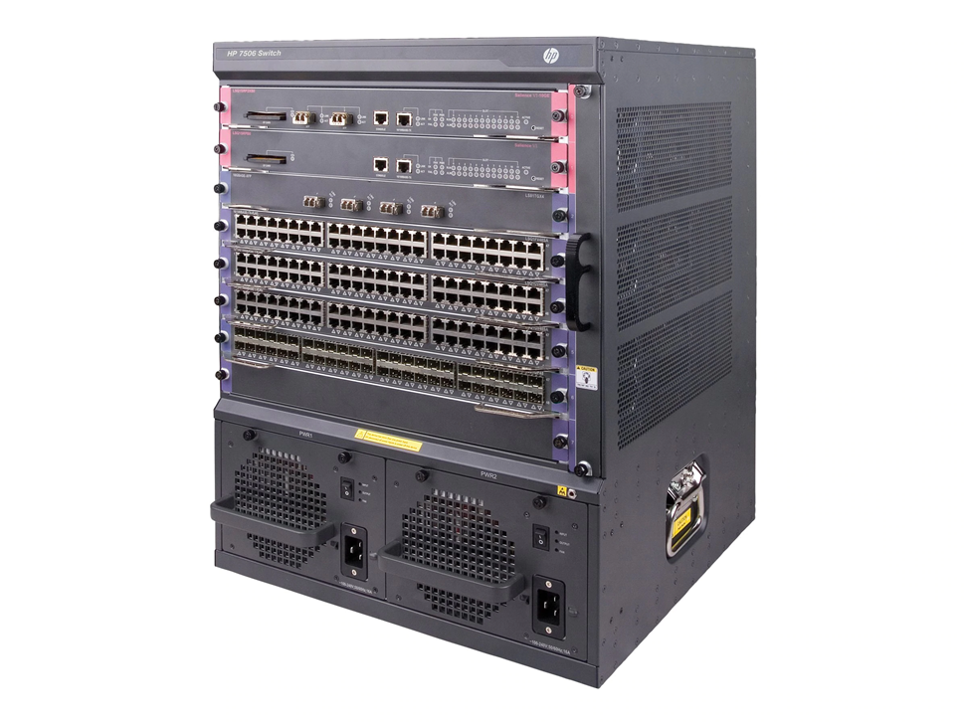
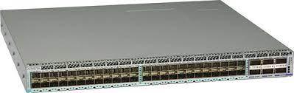
Heterogenous Switch Hardware
Tier 3 – Regional
T3-1
T3-2
T3-3
T3-4
Multi-ASIC Deep-buffered chassis switch
…
…
…
Tier 2 – Data center
T2-1-1
T2-1-2
T2-1-8
T2-4-1
T2-4-2
T2-4-4
…
…
…
Tier 1 – Row Leaf
T1-1
T1-2
T1-7
T1-8
T1-1
T1-2
T1-7
T1-8
T1-1
T1-2
T1-7
T1-8
Single-ASIC Shallow-buffered switch
…
…
…
Tier 0 – Rack
T0-1
T0-2
T0-20
T0-1
T0-2
T0-20
T0-1
T0-2
T0-20
Servers
Servers
Servers

Slide 49
Routing: BGP + ECMP
Tier 3 – Regional
T3-1
T3-2
T3-3
T3-4
Autonomous System
…
…
…
Tier 2 – Data center
T2-1-1
T2-1-2
T2-1-8
T2-4-1
T2-4-2
T2-4-4
…
…
…
Tier 1 – Row Leaf
T1-1
T1-2
T1-7
T1-8
T1-1
T1-2
T1-7
T1-8
T1-1
T1-2
T1-7
T1-8
…
…
…
Tier 0 – Rack
T0-1
T0-2
T0-20
T0-1
T0-2
T0-20
T0-1
T0-2
T0-20
Servers
Servers
Servers
Notes:
Each T0 is a unique AS. All the T1 of a cluster share a AS.

Slide 50


Routing: BGP + ECMP

Slide 51
Practical Challenges
Flows are controlled by different transport schemes, e.g., first-party & third-party, DC & WAN
Operators use BGP/ECMP for load balancing, and routes will change due to link up and down events
RTT variation is large due to the long cables between T2 and T3
T2 and T3 use multi-ASIC deep-buffered chassis switches
Network core has congestion due to topology over-subscription and ECMP

Slide 52
Some Questions Related to PCC
How to design a PCC that can co-exist with other transport schemes?
How to design a PCC that can work under high RTT variations inside a DC region?
Notes:
Given these practical challenges, we can revisit many research problems that have been welly studied by our community and ask some new questions. Here are two questions in my mind related to PCC. The first question is … All existing PCC schemes implicitly assume that PCC can control every flow in a DC. This is impossible in production DC.

Slide 53
FTE/Intern Opportunities at Microsoft
Networking Research @ MSR (my team)
Manager: Ranveer Chandra
Research in all areas related to networked systems
Azure networking:
Manager: Albert Greenberg
Design, develop and operate Microsoft’s cloud networks
Office of the CTO @ Azure for Operators (a new org)
Manager: Victor Bahl
Converge cloud and telecommunications infrastructures (5G)
Notes:
Last but most importantly, I want to share some job opportunities with you.

Slide 54
Thanks!
Notes:
This is the end of my talk and thank you so much for your attention. Look forward to visiting Duke physically after the pandemic

