Slide 1
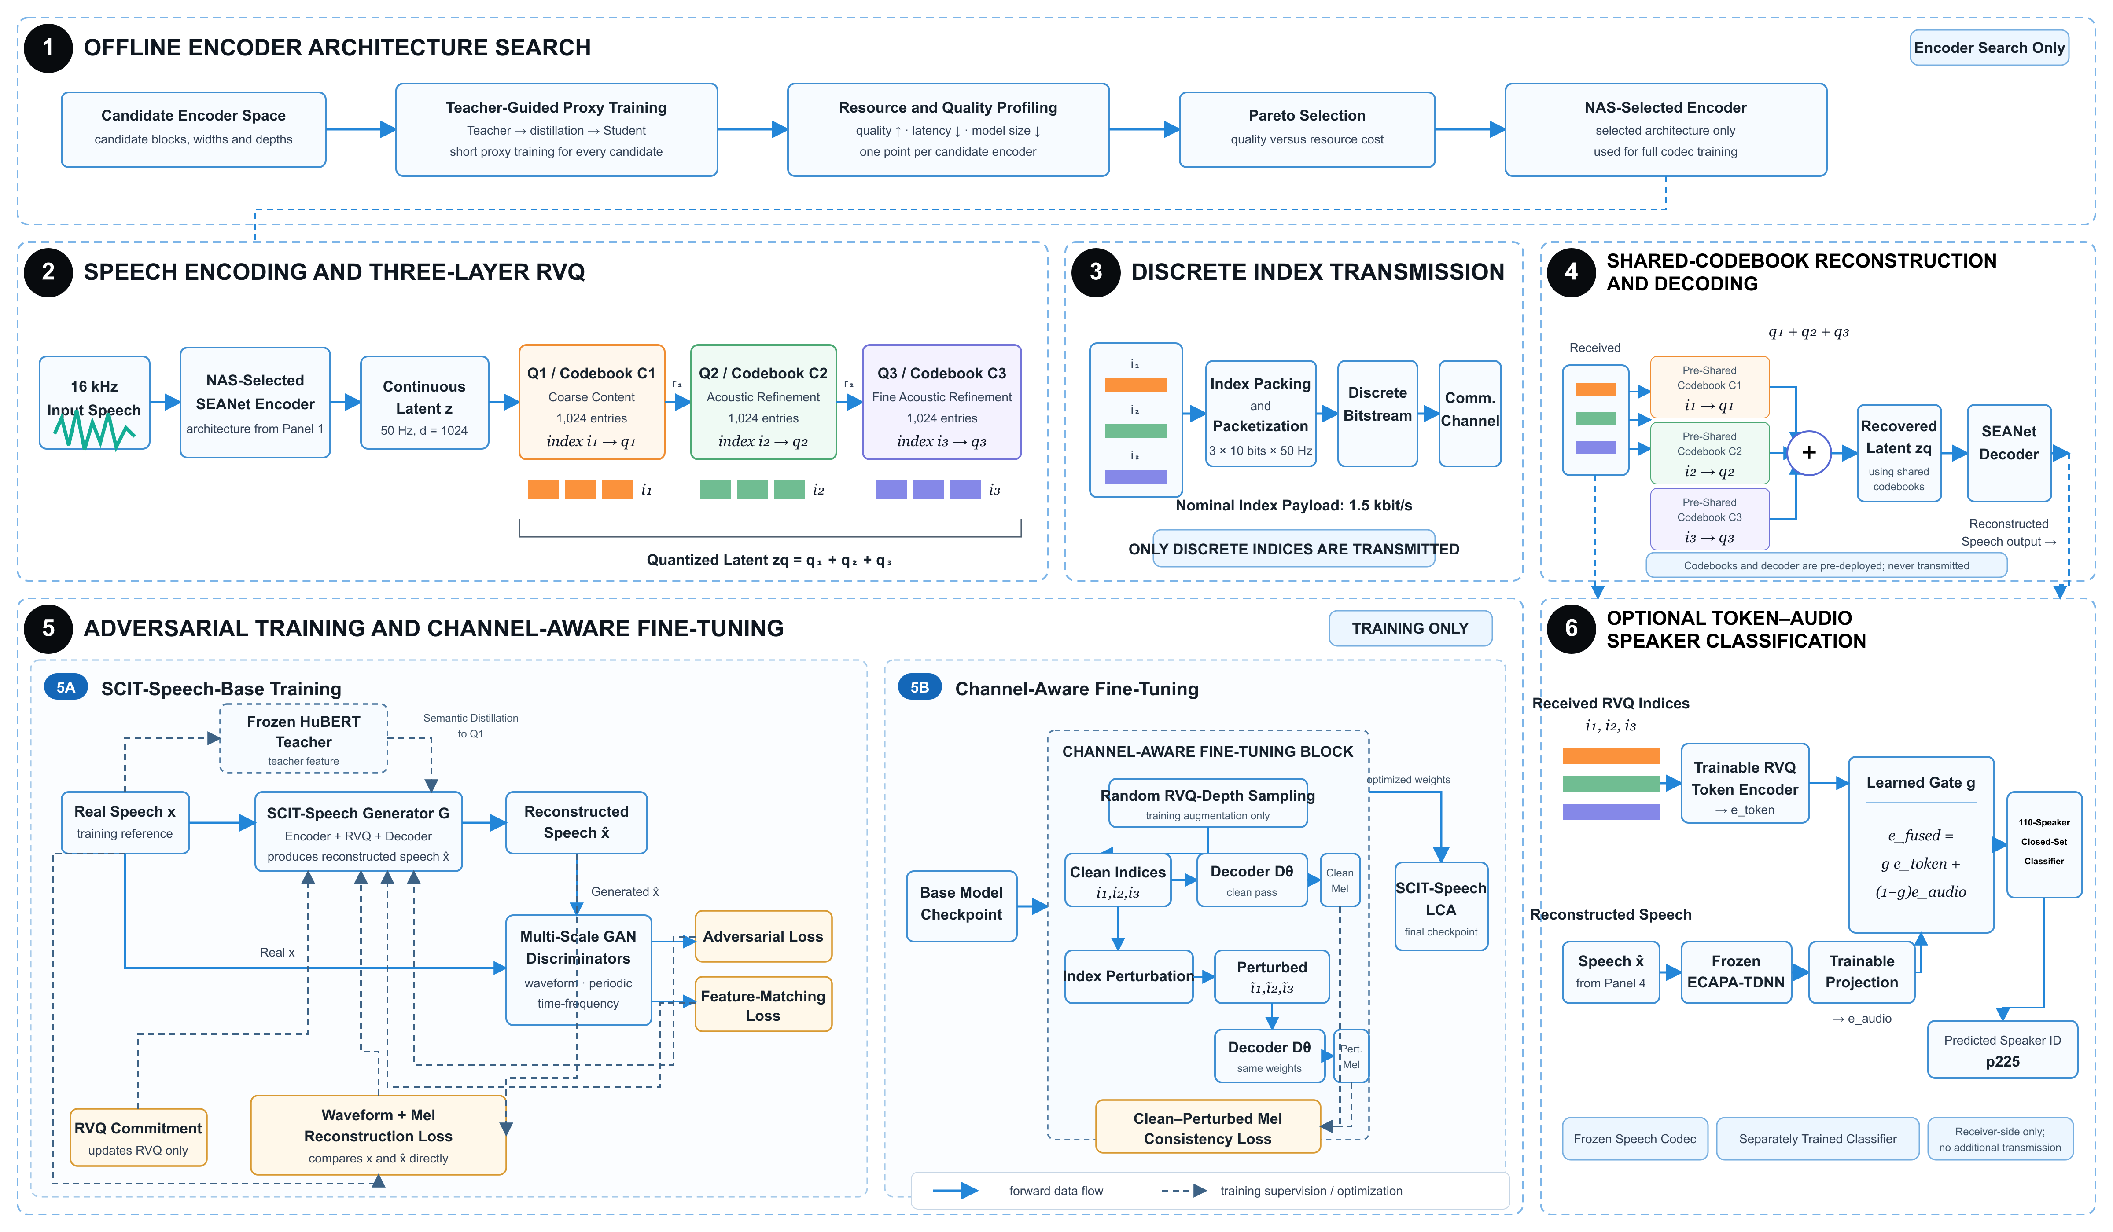
Notes:
Source: figures/scit_speech_figure_blueprint.svg. The full-slide image is the 4800 × 2800 high-resolution render of that SVG, used to preserve all labels, arrowheads, and layout across PowerPoint renderers.

