Slide 1
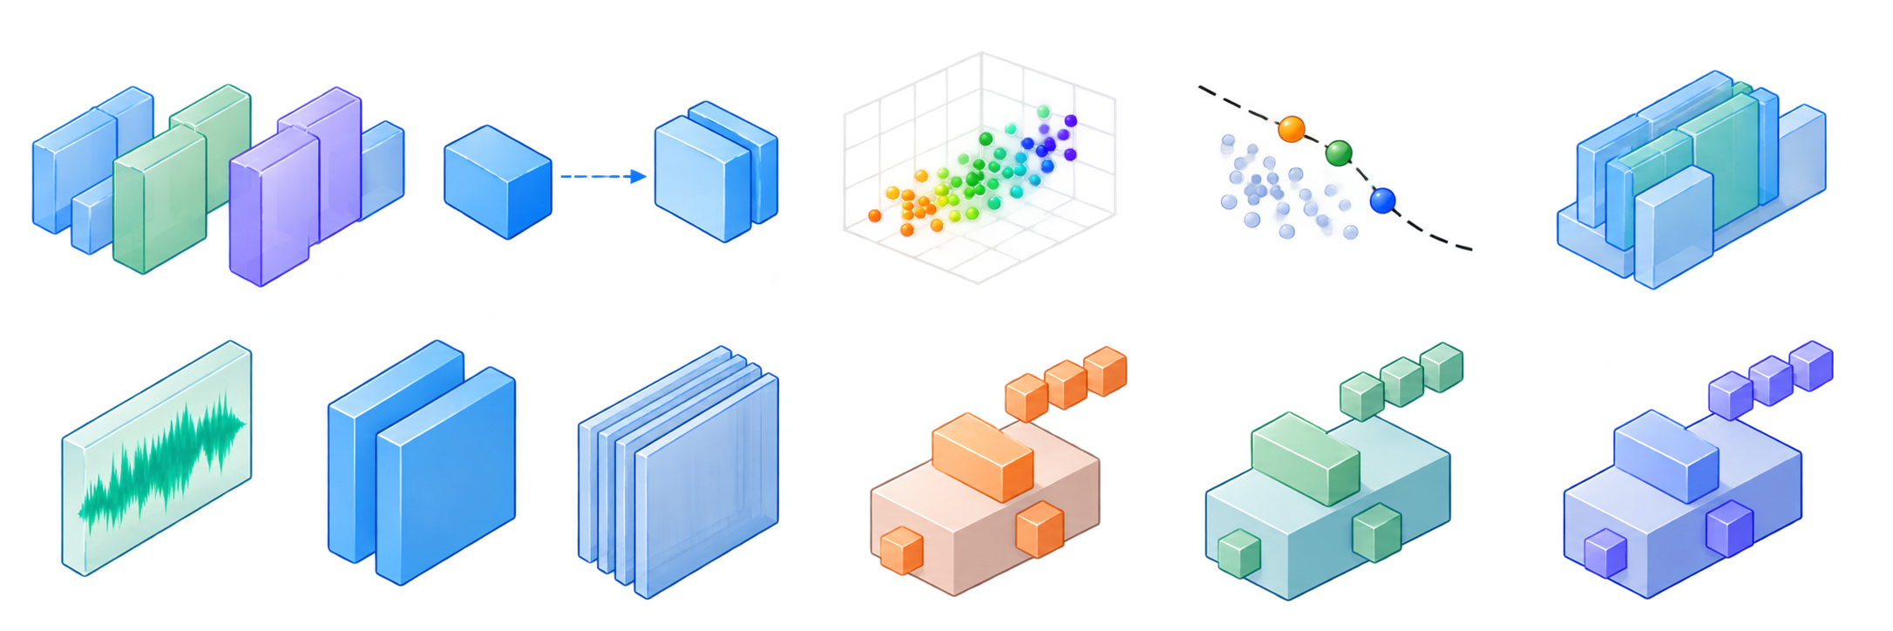








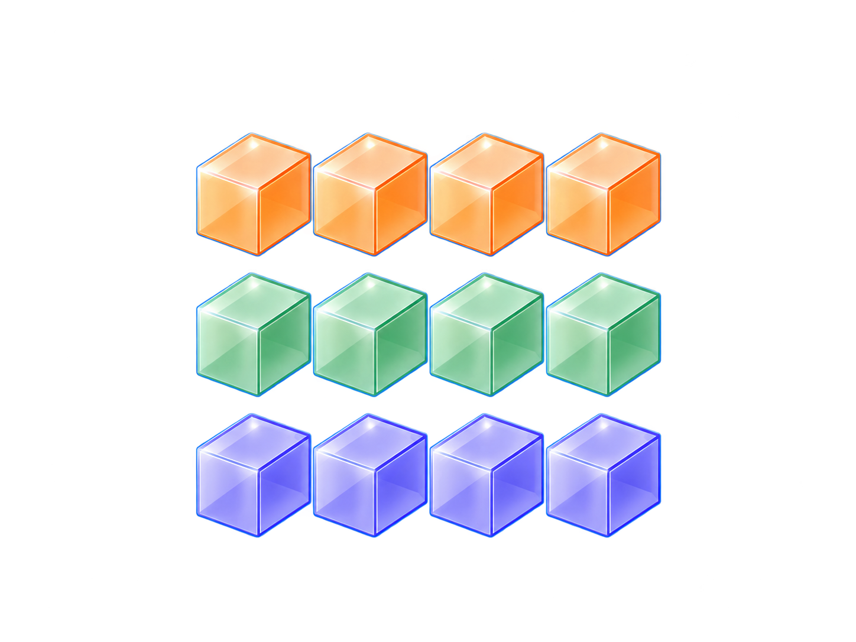
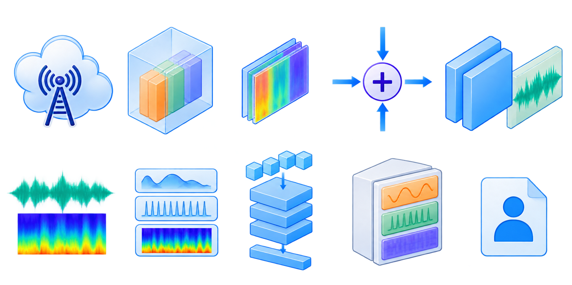







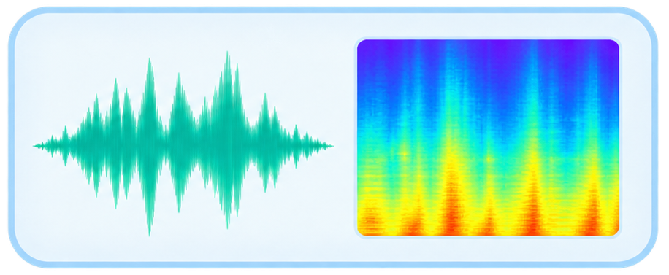


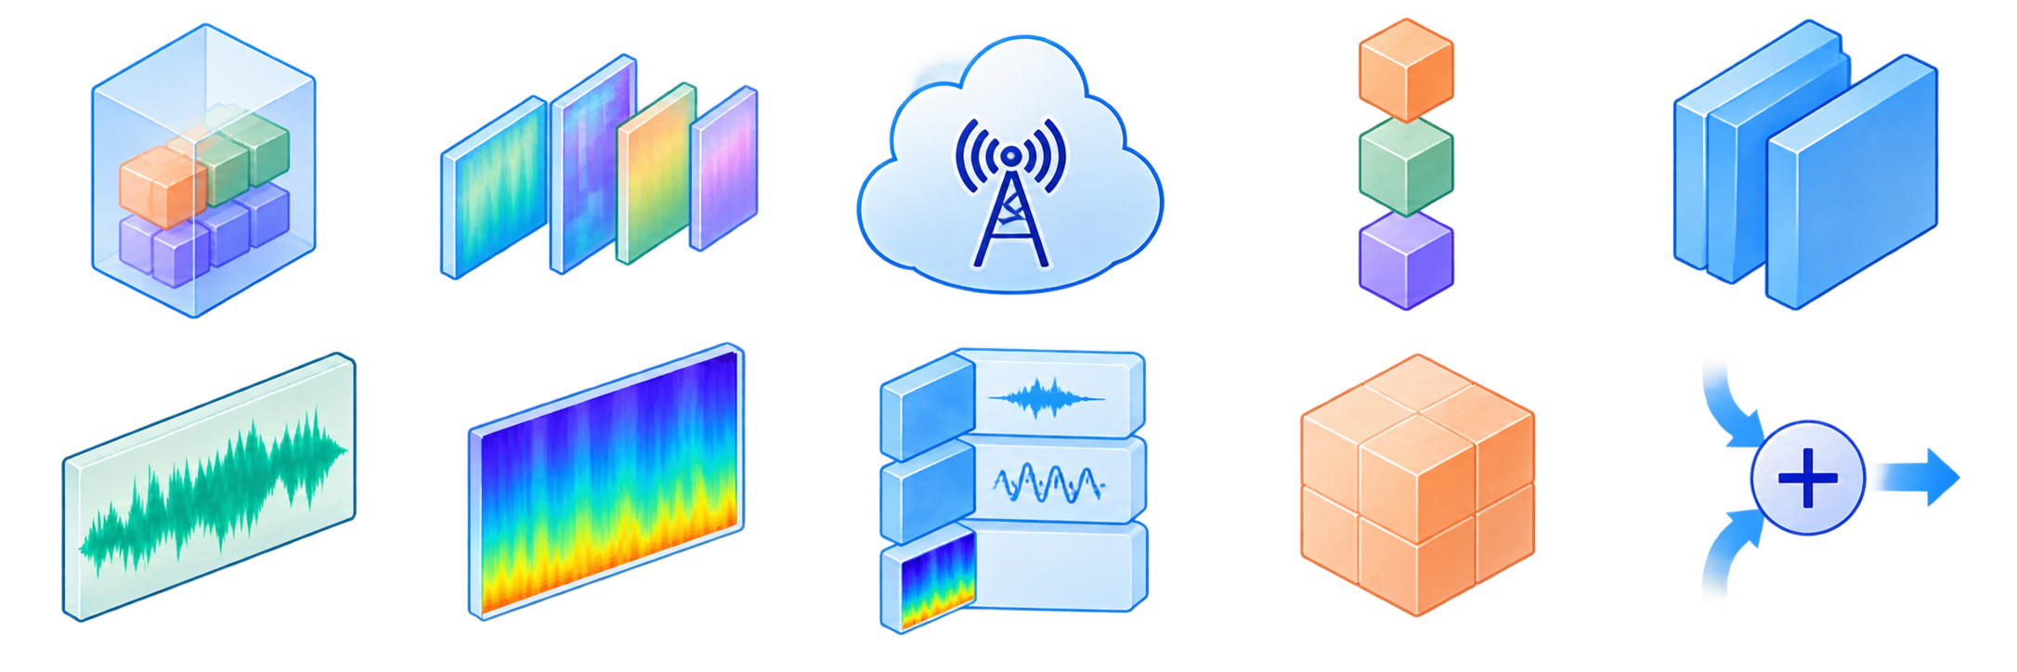

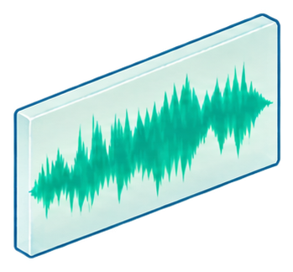


















1 OFFLINE ENCODEER ARCHITECTURE SEACH
2 SPEECH ENCODING AND THREE-LAYER RVQ
Pareto Front
TRAIN
K-means Init
EMA Update
Residual Features $$r_{0},r_{1},r_{2}$$
Teahcer
Student
Quanlity
Latency
Model Size
Resource Cost
Canditate Ecoder Space
Teahcer-Guied Proxy Training
Resource and
quality Profiling
ParetoSelection
NAS-Selected Encoder
16k Hz Input Speech
SEANet Encoder
Conytinous Latent z 50 HZ,d=1014
Code Books $$C_{1},C_{2},C_{3}$$
Nearest-Codeword Lookup
$$Indices:i_{1},i_{2},i_{3}$$
Codewords:$q_{1},q_{2},q_{3}$
3 DISCRETE INDEX TRANSMISSION
4 Transmission
5 SHARED CODEBOOK DECODING
Nominal Index Payload 1.5k bit/s
$$q_{1}$$
$$i_{1}$$
$$q_{2}$$
$$i_{2}$$
Three-layers Descrete indices
indices packing and
packetization
Descrete
Index Bitstream
$$i_{3}$$
$$q_{3}$$
QKD-Assisted
Secure Transmission
Indecs
Recovered
Quantized Latent $Z_{q}$
Preshared Codebooks
Retrieved Codebook
Vectors
SEANet Decoder
Reconstructed
Speech
5 ADVERSARIAL TRAINING AND CHANEL-AWARE
6 SPEAKER CLASSIFICATION
x: direct reconstruction reference
index perturbation
Ramdam RVQ DeepSampling
Frozen HUBERT Teacher
Multi-Scale GAN Discriminators
Waveform and Mel reconstruction
indices
Sematic Disillation to Q1
Waveform
Perturbed lndeces
Cleaned lndeces
$$i_{1}$$
$$i_{2}$$
$$i_{3}$$
Real $x$
$$i_{1}$$
$$i_{2}$$
$$i_{3}$$
$$i_{1}$$
$$i_{2}$$
$$i_{3}$$
$$i_{1}$$
Trainable RVQ Token
TokenSpeaker Embeding
Periodict
$$i_{2}$$
Time-Frequency
$$i_{3}$$
SCIT-Speech Generator
Cleaned MEl
Shared Decoder
Perturbed MEl
Frozen ECAPA-TDMN
Trainable Projection
Audio Speaker Embeding
RVQ Commitent
Reconstructed
Speech $\hat{x}$
Adverstarial Loss
Reconstruction loss
Predicted Speaker ID
SCIT-Speech-Base
Training
clean-perturbed Mel Consistency Loss
Speaker
Classifier
Feature-Matching Loss
Learned Gate $g$
Best Model Checkpoint

Slide 2







1 Offline Encoder Architecture Search
2 Speech Encoding and Three-Layer RVQ
Pareto Front
TRAIN
K-means Init
EMA Update
Residual Features $$r_{0},r_{1},r_{2}$$
Teahcer
Student
Quanlity
Latency
Model Size
Resource Cost
Candidate Encoder Space
Teahcer-Guied Proxy Training
Resource and
quality Profiling
ParetoSelection
NAS-Selected Encoder
16k Hz Input Speech
SEANet Encoder
Continuous Latent z 50 HZ,d=1024
Nearest-Codeword Lookup
Code Books $$C_{1},C_{2},C_{3}$$
$$Indices:i_{1},i_{2},i_{3}$$
Codewords:$q_{1},q_{2},q_{3}$
3 Index Packing and Packetization
4 Transmission
5 Shared Codebook Decoding
Nominal Index Payload 1.5k bit/s
$$q_{1}$$
$$i_{1}$$
$$q_{2}$$
$$i_{2}$$
Three-layer Discrete Indices
Discrete
Index Bitstream
$$i_{3}$$
$$q_{3}$$
Indices Packing
Recovered
Quantized Latent $Z_{q}$
QKD-Assisted
Secure Transmission
Indices
Preshared Codebooks
Retrieved Codebook
Vectors
SEANet Decoder
Reconstructed
Speech
6 Adversarial Training and Channel-Aware Fine-Tuning
7 Speaker Classification
Channel-Aware Fine-Tuning
Token Speaker Embeding
SCIT-Speech-BaseTraining
Reconstructed
Speech $\hat{x}$
Ramdom RVQ-Deepth Sampling $L∈\{1,2,3\}$
$$i_{1}$$
$$i_{2}$$
$$i_{3}$$
Trainable RVQ Token Encoder
Real speech x
Q1: frozen HuBERT distillation
RVQ: commitment loss
Cleaned Mel
$$i_{1}$$
Cleaned lndices
$$i_{2}$$
indices
Generated
$$i_{1}$$
$$i_{2}$$
$$i_{3}$$
$$i_{3}$$
Audio Speaker Embeding
ECAPA-TDNN
Trainable Projection
Multi-Scale GAN Discriminators
index perturbation
Mel consistency loss
Generator G
Waveform
DiscriminatorLoss $L_{D}$
Decode+ Mel Transform
Reconstructed Speech
Speaker
Classifier
Adversarial + feature matching
Periodic
$${\tilde{i}}_{1}$$
$${\tilde{i}}_{2}$$
$${\tilde{i}}_{3}$$
Reconstruction loss:
compare x and $\hat{x}$
Time-Frequency
Predicted Speaker ID
Learned Gate $g$
Perturbed lndices
Perturbed MEl

Slide 6
