Slide 1
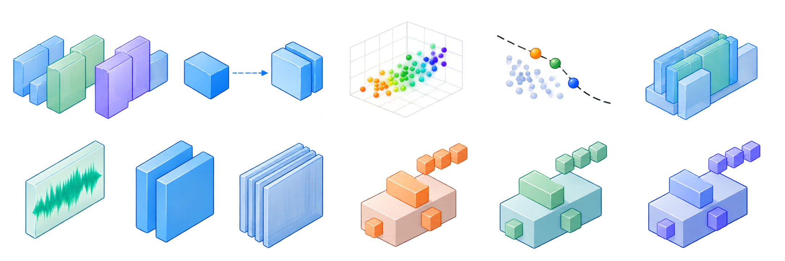
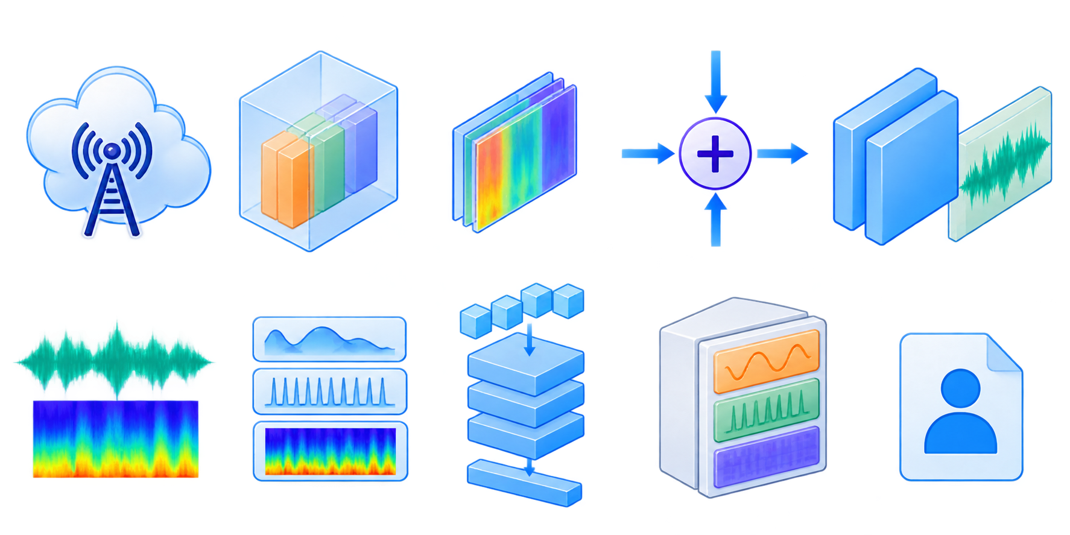

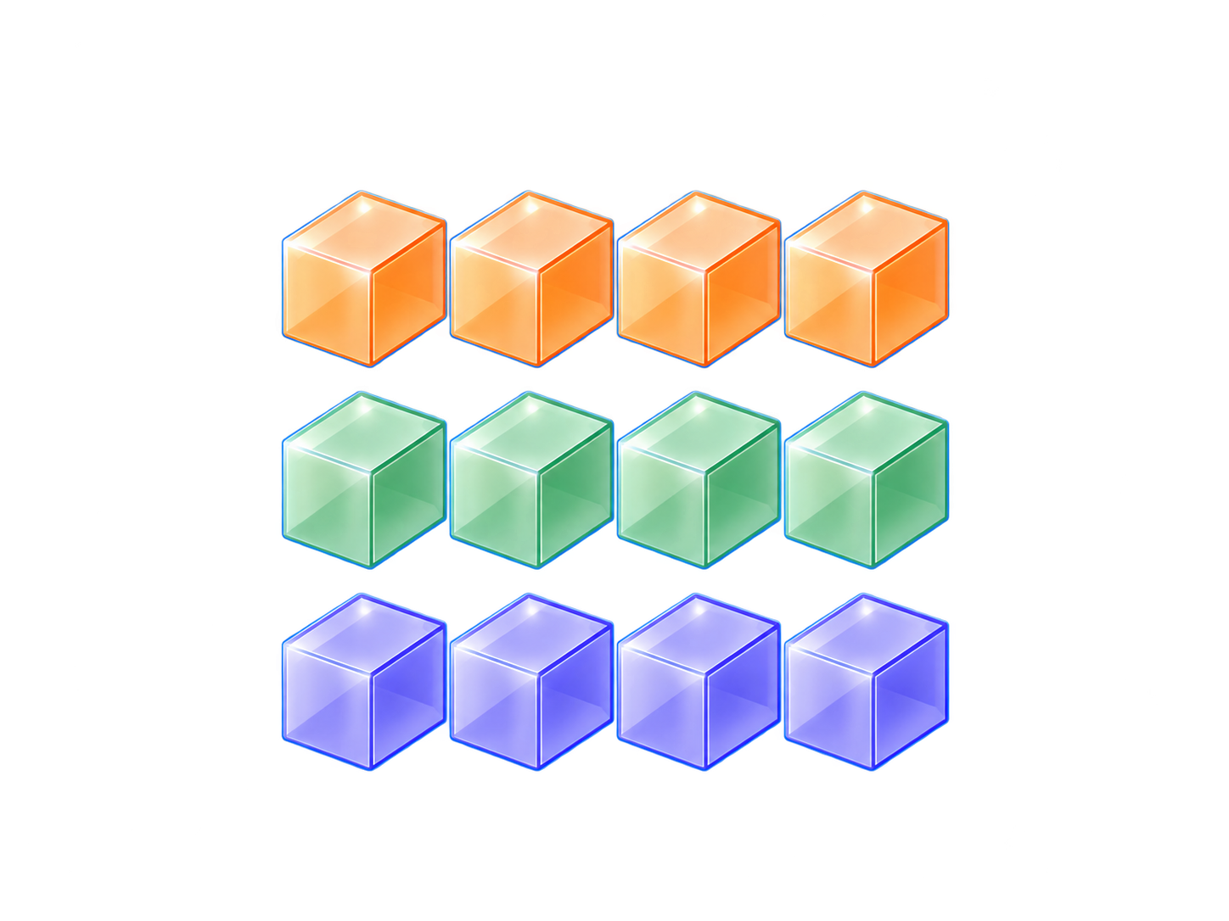




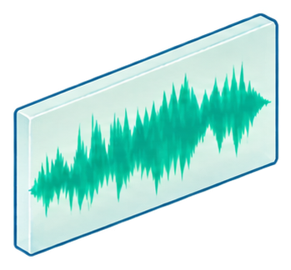





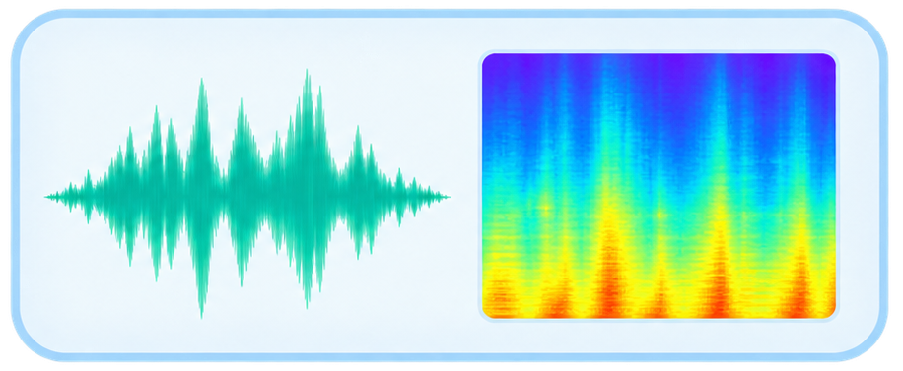
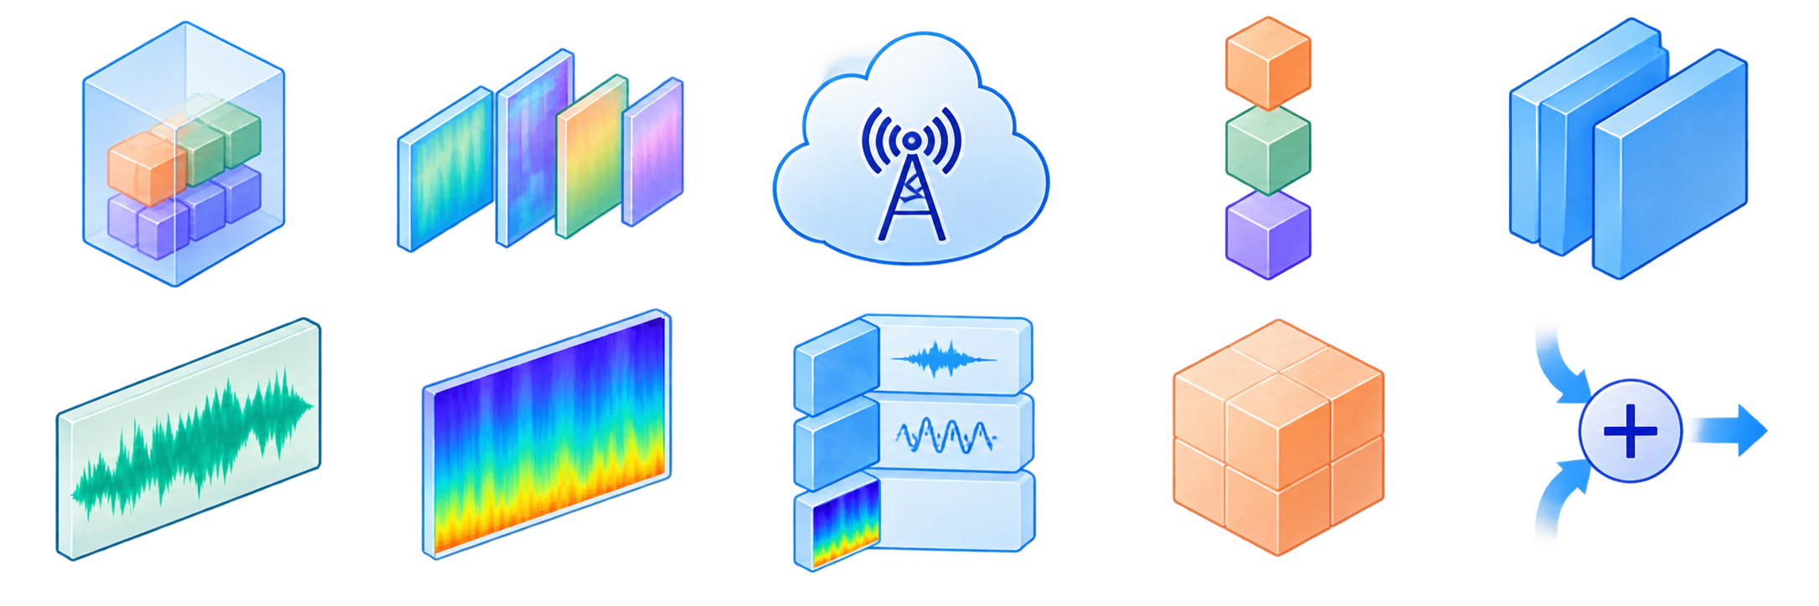









1 OFFLINE ENCODEER ARCHITECTURE SEACH
Teahcer
Student
Pareto Front
Quanlity
Latency
Model Size
Resource Cost
Canditate Ecoder Space
Teahcer-Guied Proxy Training
Resource and
quality Profiling
Pareto Selection
NAS-Selected Encoder
2 SPEECH ENCODING AND THREE-LAYER RVQ
3 DISCRETE INDEX TRANSMISSION
4 SHARED CODEBOOK DECODING
$$i_{1−3}$$
$$q_{1}$$
SEANet Decoder
$$q_{2}$$
Q1 Codebook C1 Coarse Content
Q2 Codebook C2 Acoustic Refinement
Q3 Codebook C3
Fine Acoustic Refinement
16k Hz Input Speech
Nas-Selected SEANet Encoder
Conytinous Latent z 50 Hz,d~1014
Three-layers Descrete indices
indices packing and
packetization
Descrete
Index Bitstream
$$q_{3}$$
Recovered
Quantized Latent z
Quantized Latent = $q_{1}+q_{2}+q_{3}$
Nominal Index Payload:1.5k bit/s
Preshared Codebooks
Frozen HUBERT Teacher
Waveform
Best Model Checkpoint
Ramdam RVQ DeepSampling
Trainable RVQ Token
Speaker
Classifier
Waveform and Mel reconstruction
$$i_{1}$$
$$i_{1}$$
$$i_{2}$$
$$i_{3}$$
Learned Gate $g$
Periodict
index perturbation
$$i_{2}$$
Time-Frequency
Cleaned MEl
$$i_{3}$$
Perturbed MEl
TokenSpeaker Embeding
SCIT-Speech Generator
SCIT-Speech Discri
Perturbed lndeces
Cleaned lndeces
$$i_{1}$$
$$i_{2}$$
$$i_{3}$$
$$i_{1}$$
$$i_{2}$$
$$i_{3}$$
Predicted Speaker ID
Shared Decoder
Frozen ECAPA-TDMN
Audio Speaker Embeding
RVQ Commitent
reconstruction loss
clean-perturbed Mel Consistency Loss

Slide 5
