Slide 1
Chapter 4
Block ciphers
M133040036
李元禎

Slide 2
Outline
basic definitions and properties
Constructing block ciphers
Data Encryption Standard (DES)
Advanced Encryption Standard (AES)
Various Types of attacks
Pseudo-random Functions (PRF)

Slide 3
Basic Definitions and Properties

Slide 4
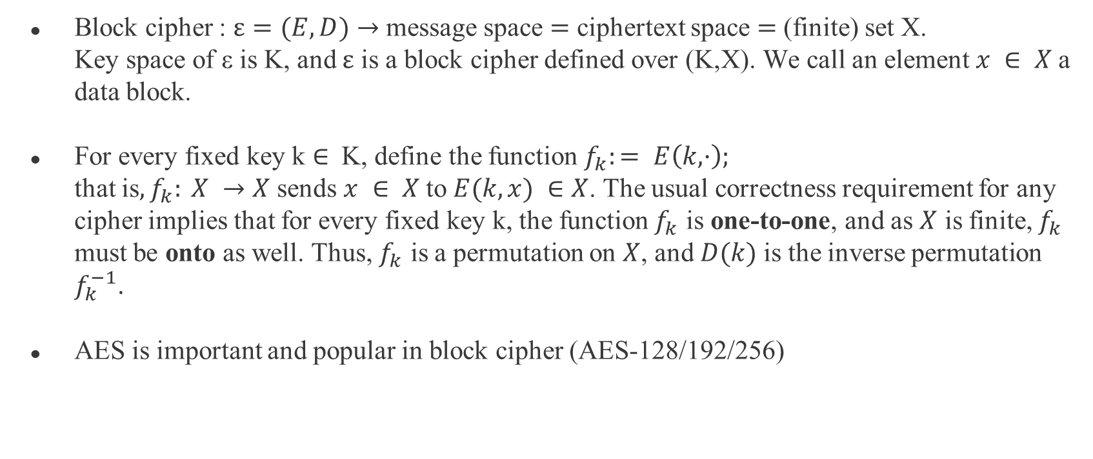
Basic Definitions and Properties
Block cipher : $ε=(E,D)$ $→$ message space $=$ ciphertext space $=$ (finite) set X.
Key space of ε is K, and $ε$ is a block cipher defined over (K,X). We call an element $x ∈ X$a data block.
For every fixed key k $∈$ K, define the function $f_{k}:= E\left(k, ·\right);$
that is$, f_{k}: X →X$ sends $x ∈ X$to $E(k,x) ∈X$. The usual correctness requirement for any cipher implies that for every fixed key k, the function $f_{k}$ is one-to-one, and as $X$ is finite, $f_{k}$ must be onto as well. Thus, $f_{k}$ is a permutation on $X$, and $D(k)$is the inverse permutation $f_{k}^{−1}$.
AES is important and popular in block cipher (AES-128/192/256)

Slide 5
Security Game
The definition of security for a block cipher is a kind of black box test. The intuition is the following: an efficient adversary is given a “black box”. Which the adversary cannot see inside the box, but he can probe it with questions.
Security means that the adversary should not be able to tell which type of function is inside the box a randomly keyed block cipher, or a truly random permutation. Put another way, a secure block cipher should be computationally indistinguishable from a random permutation.

Slide 6
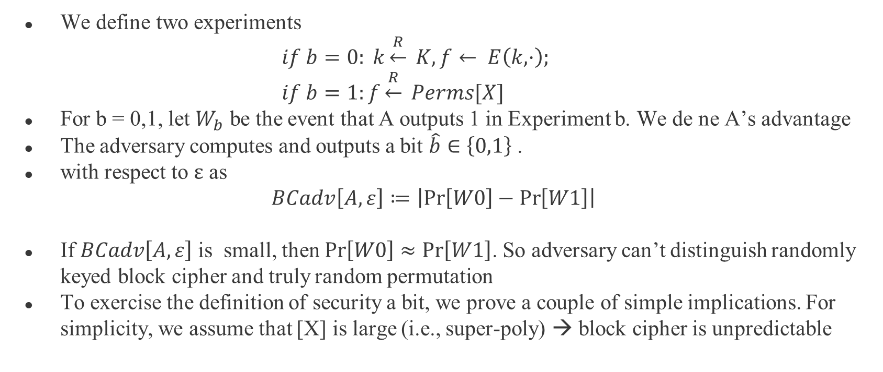
Attack Game
We define two experiments
$if b=0: k\underset{←}{R} K, f← E\left(k, ·\right);$
$if b=1:f\underset{←}{R} Perms[X]$
For b = 0,1, let $W_{b}$ be the event that A outputs 1 in Experiment b. We de ne A’s advantage
The adversary computes and outputs a bit $\hat{b}∈\left\{0,1\right\}$.
with respect to $ε$ as
$BCadv\left[A,ε\right]≔\left|\operatorname{Pr}\left[W0\right]−\operatorname{Pr}\left[W1\right]\right|$
If $BCadv\left[A,ε\right]$ is small, then $\operatorname{Pr}\left[W0\right]≈\operatorname{Pr}\left[W1\right]$. So adversary can’t distinguish randomly keyed block cipher and truly random permutation
To exercise the definition of security a bit, we prove a couple of simple implications. For simplicity, we assume that [X] is large (i.e., super-poly) → block cipher is unpredictable

Slide 7
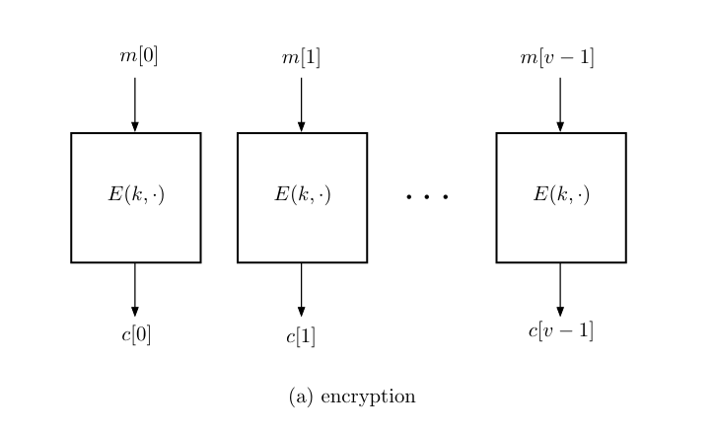
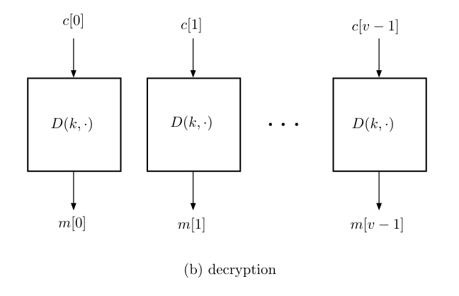
Electronic Codebook Mode (ECB)
Electronic codebook mode (ECB mode) :
If the messages too long, break up the message into a sequence of data blocks, and encrypt each data block separately.

Slide 8
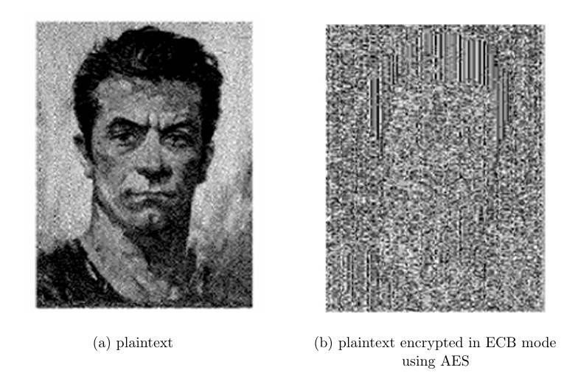

ECB Challenges
ECB problem : adversary can easily distinguish an encryption of two messages
$m0,m1 ∈X2,$where m0 consists of two equal blocks (i.e., m0[0] = m0[1]) and m1 consists of two unequal blocks
The ECB cipher does not satisfy our definition of semantic security, and its use as an encryption scheme is strongly discouraged.

Slide 9
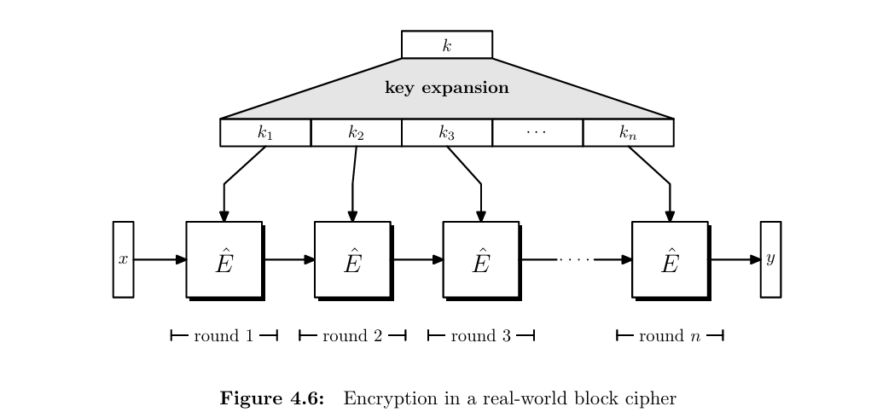
Encryption in a Real-world Block Cipher

Slide 10
Constructing Block Ciphers

Slide 11
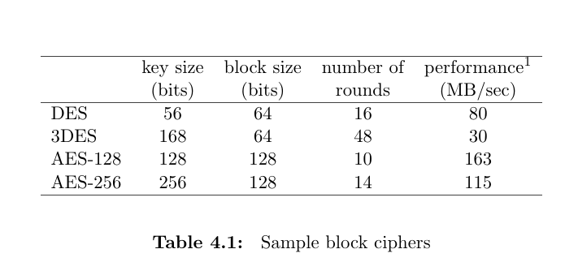

Iterated Cipher
iterated cipher : all block ciphers used in practice use the same basic framework
→First : picks a simple block cipher $\hat{ε}:= ( \hat{E},\hat{D})$, $\hat{ε}$: round cipher
→Second : picks a simple PRG G to expand the key k ,G the key expansion function.

Slide 12
Data Encryption Standard (DES)

Slide 13
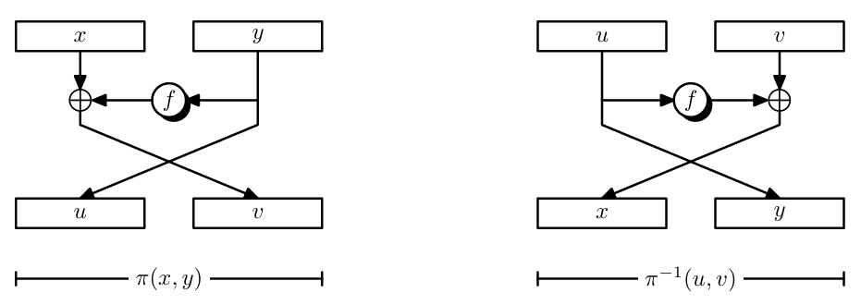
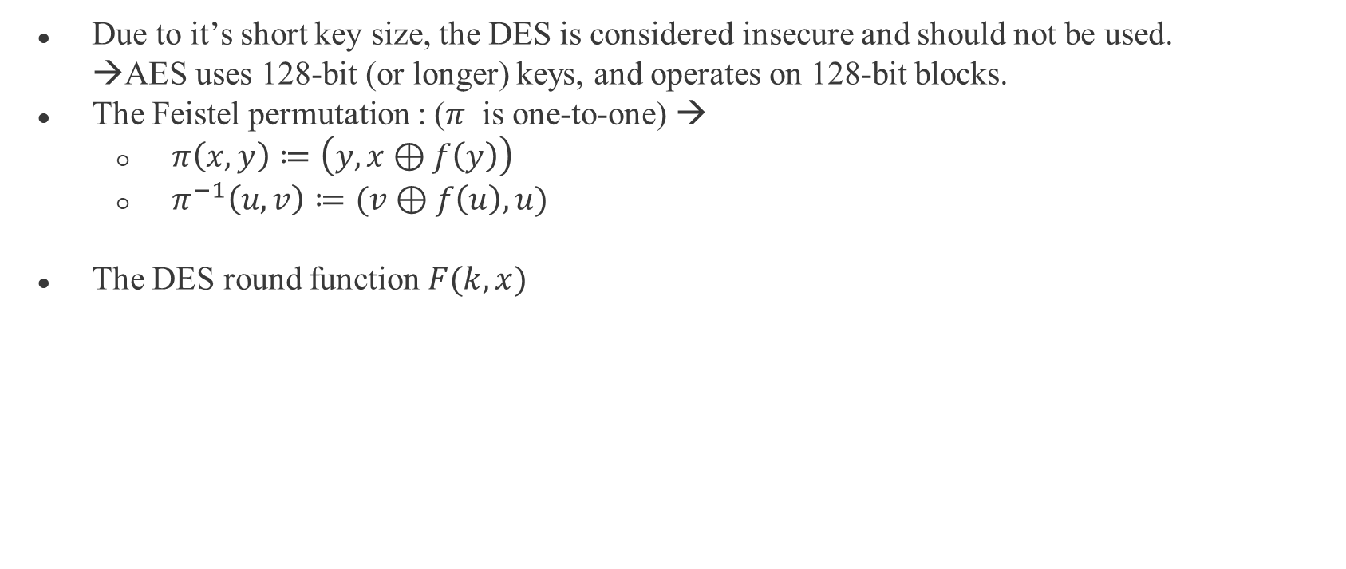
Data Encryption Standard (DES)
Due to it’s short key size, the DES is considered insecure and should not be used.
→AES uses 128-bit (or longer) keys, and operates on 128-bit blocks.
The Feistel permutation : ($π$ is one-to-one) →
  $π\left(x,y\right)≔\left(y, x⊕f\left(y\right)\right)$
  $π^{−1}\left(u,v\right)≔(v⊕f\left(u\right),u)$
The DES round function $F(k,x)$

Slide 14
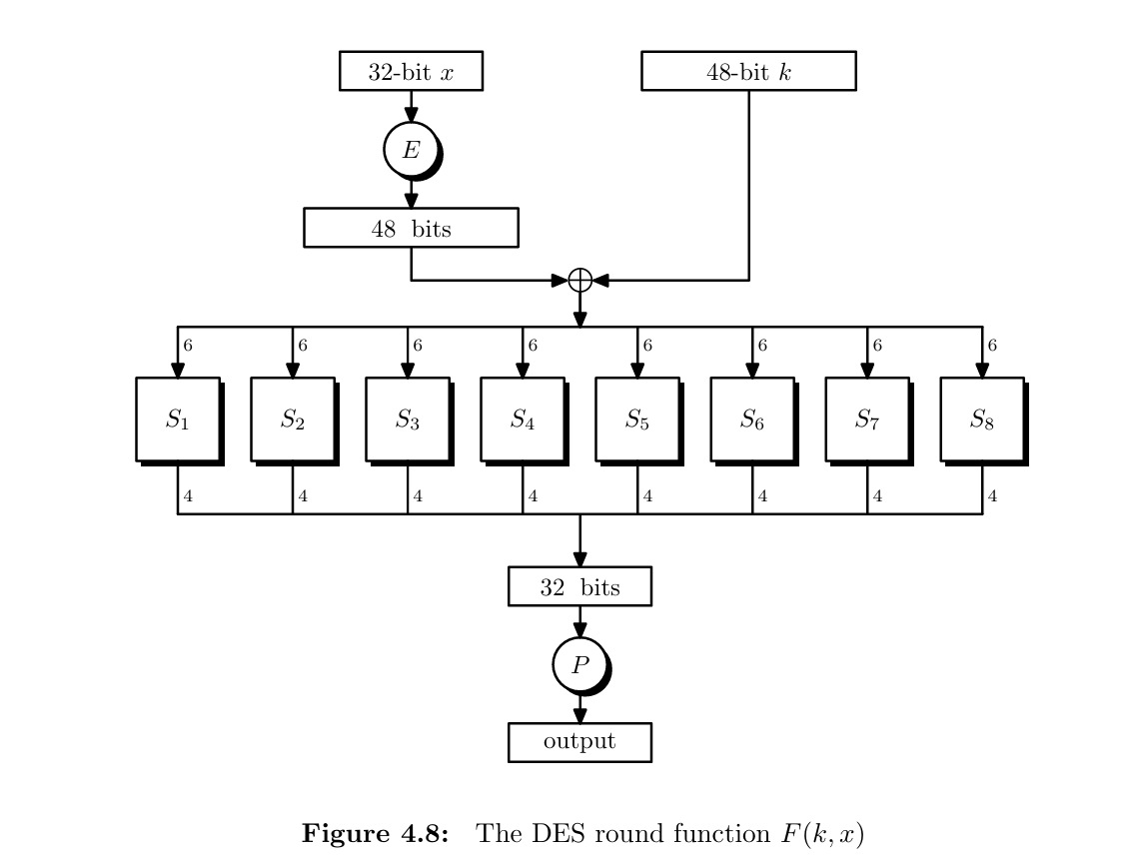
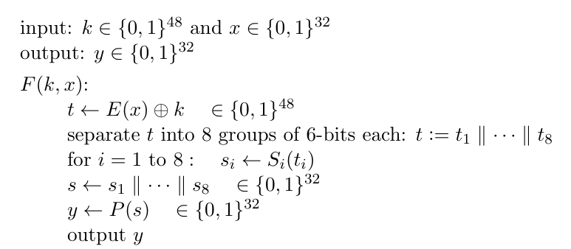

DES Round Function
E : expands a 32-bit input to 48-bit
P : mixing permutation
→make it look more confuse
exp: ${ S}_{1}→S_{8}$
${ S}_{2 }→S_{7}$ ……
Algorithm :

Slide 15
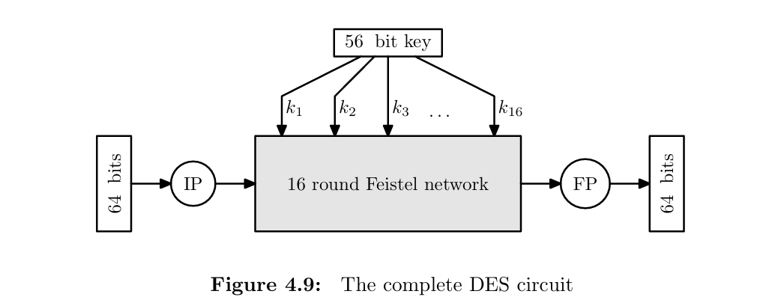
DES Round Function
IP , FP : initial and final permutations

Slide 16
DES Challenges
DES can be cracked using exhaustive search in just a 22 hours.
→ 56-bit key is way too short
→ The minimum safe key size these days is 128 bits

Slide 17

Is AES-128 Vulnerable to Exhaustive Search?
If scanning a space of size 256 takes 22 hours
$\left(22 hours\right)2^{128−56} ≈118 ⋅ {10}^{20} years$
Beside , more sophisticated brute-force attacks on AES-128 exploiting time-space tradeoffs.

Slide 18

Triple-DES
Problem : the 56-bit key space is too small.
→ Iterate the cipher several time using independent keys.
$E3( \left(k1, k2, k3\right), x) := E(k3, E(k2, E(k1, x))$
Keys length : 3 $×$ 56 = 168 bits.
Why not use Double-DES
→ meet in the middle

Slide 19
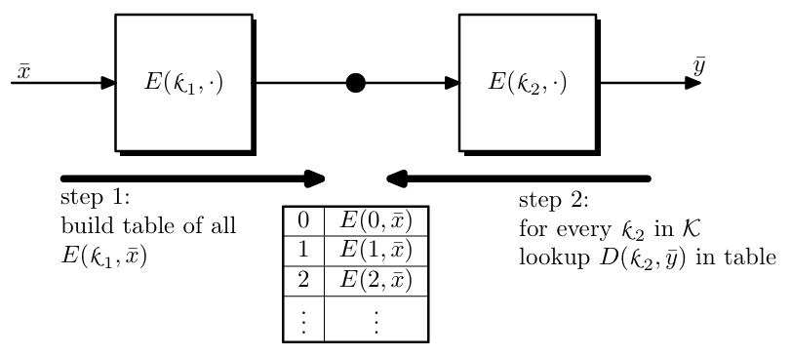
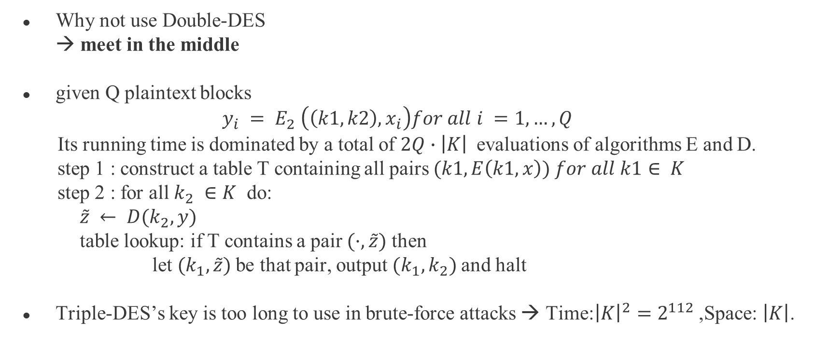
Meet in the Middle
Why not use Double-DES
→ meet in the middle
given Q plaintext blocks
$$y_{i} = E_{2} \left(\left(k1, k2\right), x_{i}\right)for all i =1,…, Q$$
Its running time is dominated by a total of $2Q∙\left|K\right|$evaluations of algorithms E and D.
step 1 : construct a table T containing all pairs $(k1, E\left(k1, x\right)) for all k1∈ K$
step 2 : for all $k_{2} ∈K$ do:
$\tilde{z} ← D(k_{2}, y)$
table lookup: if T contains a pair $(·,\tilde{z})$ then
let $(k_{1}, \tilde{z})$be that pair, output $(k_{1}, k_{2})$and halt
Triple-DES’s key is too long to use in brute-force attacks → Time:${\left|K\right|}^{2}=2^{112}$ ,Space: $\left|K\right|$.

Slide 20
Advanced Encryption Standard (AES)

Slide 21
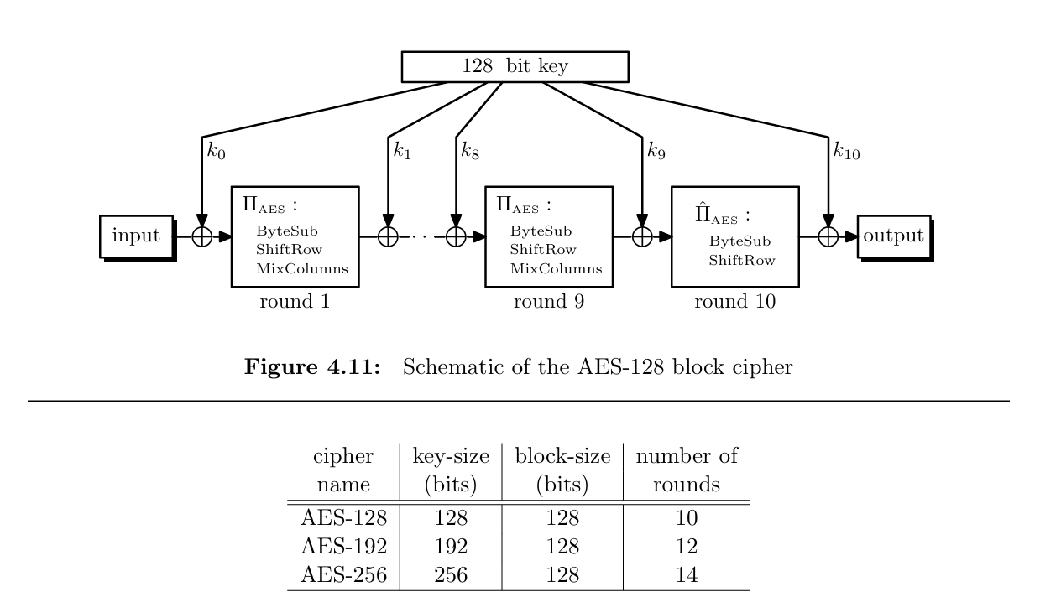
Advanced Encryption Standard (AES)
No MixCol

Slide 22
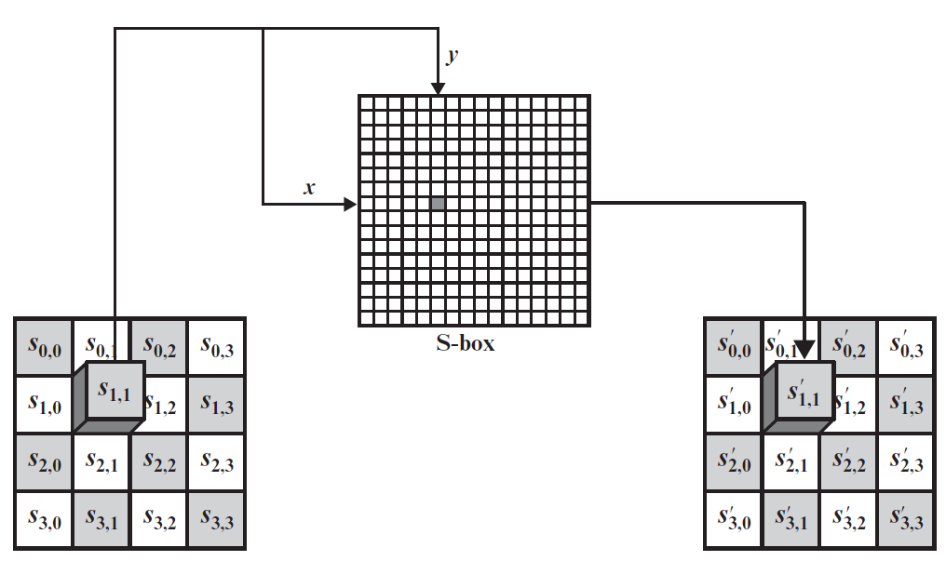
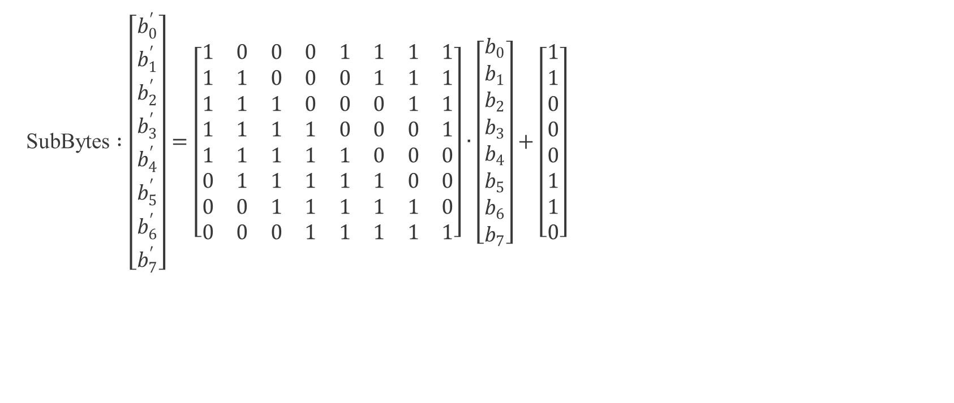
AES round permutation (SubBytes)
SubBytes $:\left[\begin{matrix}b_{0}^{′} \\ b_{1}^{′} \\ b_{2}^{′} \\ b_{3}^{′} \\ b_{4}^{′} \\ b_{5}^{′} \\ b_{6}^{′} \\ b_{7}^{′}\end{matrix}\right]=\left[\begin{matrix}1 & 0 & 0 & 0 & 1 & 1 & 1 & 1 \\ 1 & 1 & 0 & 0 & 0 & 1 & 1 & 1 \\ 1 & 1 & 1 & 0 & 0 & 0 & 1 & 1 \\ 1 & 1 & 1 & 1 & 0 & 0 & 0 & 1 \\ 1 & 1 & 1 & 1 & 1 & 0 & 0 & 0 \\ 0 & 1 & 1 & 1 & 1 & 1 & 0 & 0 \\ 0 & 0 & 1 & 1 & 1 & 1 & 1 & 0 \\ 0 & 0 & 0 & 1 & 1 & 1 & 1 & 1\end{matrix}\right]∙\left[\begin{matrix}b_{0} \\ b_{1} \\ b_{2} \\ b_{3} \\ b_{4} \\ b_{5} \\ b_{6} \\ b_{7}\end{matrix}\right]+\left[\begin{matrix}1 \\ 1 \\ 0 \\ 0 \\ 0 \\ 1 \\ 1 \\ 0\end{matrix}\right]$

Slide 23
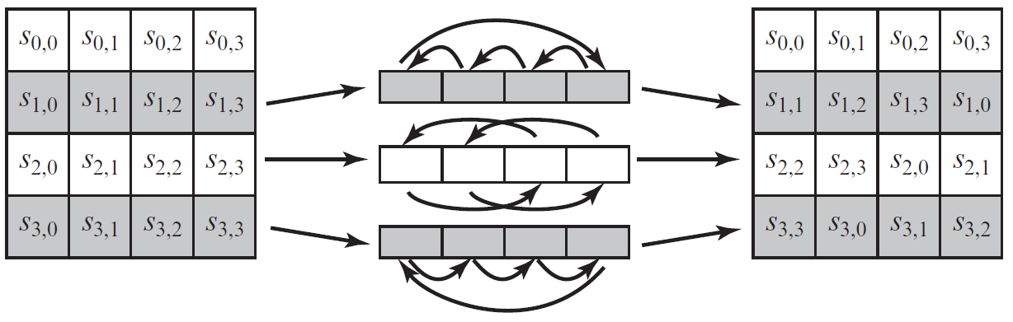
AES round permutation (ShiftRow)

Slide 24
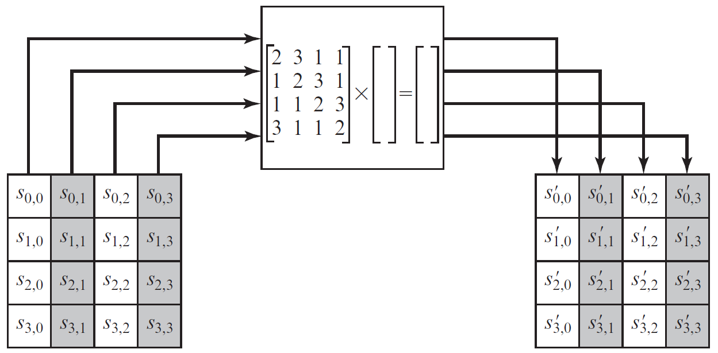
AES round permutation (MixColums)

Slide 25
AES round permutation (SubBytes)
SubByte optimization → S-box
store a 4KB table

Slide 26
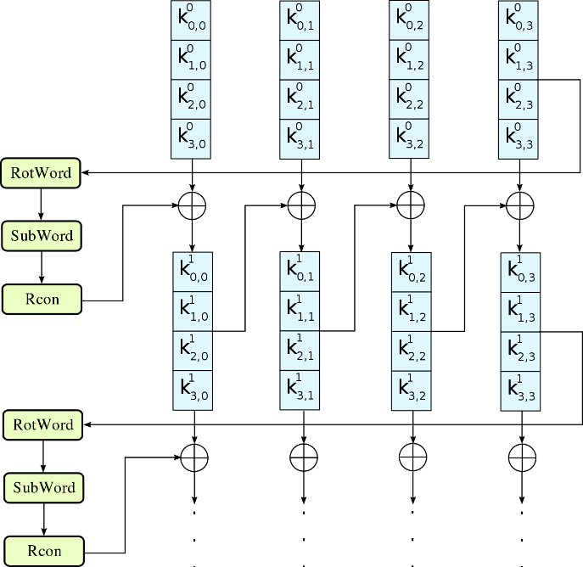


AES-128 Key Expansion
$for i = 1,…,10,$
the 128-bit round key $k_{i} = (w_{i,0},w_{i,1},w_{i,2},w_{i,3})$is generated from the preceding round key $k_{i−1}$ =
$(w_{i−1,0},w_{i−1,1},w_{i−1,2},w_{i−1,3})$as follows:
$g_{i}$ is a constant
$$w_{i,0}←w_{i−1,0}⊕g_{i}(w_{i−1,3})$$
$$w_{i,1}←w_{i−1,1}⊕w_{i,0}$$
$$w_{i,2}←w_{i−1,2}⊕w_{i,1}$$
$$w_{i,3}←w_{i−1,3}⊕W_{i,2}$$

Slide 27
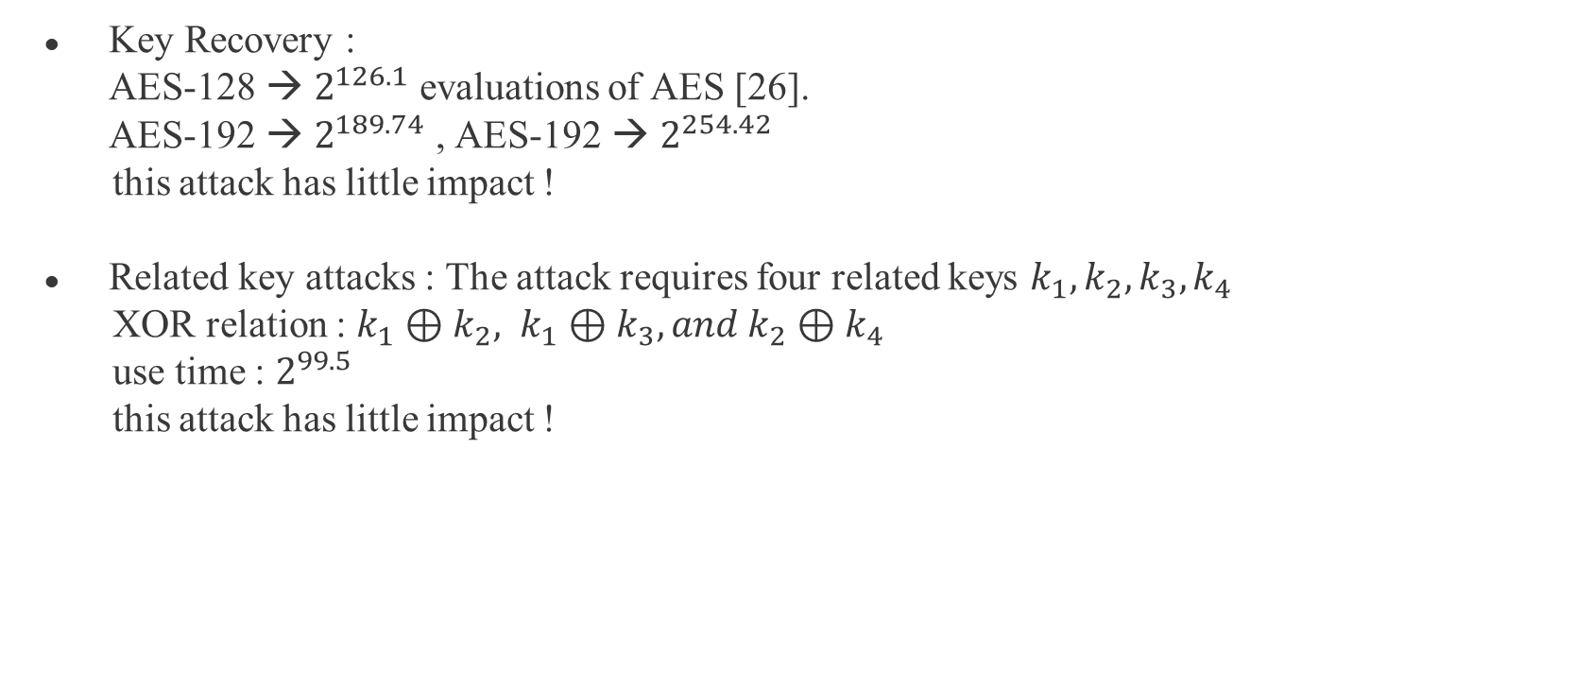
Security of AES
Key Recovery :
AES-128 → $2^{126.1}$ evaluations of AES [26].
AES-192 → $2^{189.74}$ , AES-192 → $2^{254.42}$
this attack has little impact !
Related key attacks : The attack requires four related keys $k_{1}, k_{2}, k_{3}, k_{4}$
XOR relation : $k_{1}⊕k_{2}, k_{1}⊕k_{3}, and k_{2}⊕k_{4}$
use time : $2^{99.5}$
this attack has little impact !

Slide 28
Various Types of attacks

Slide 29
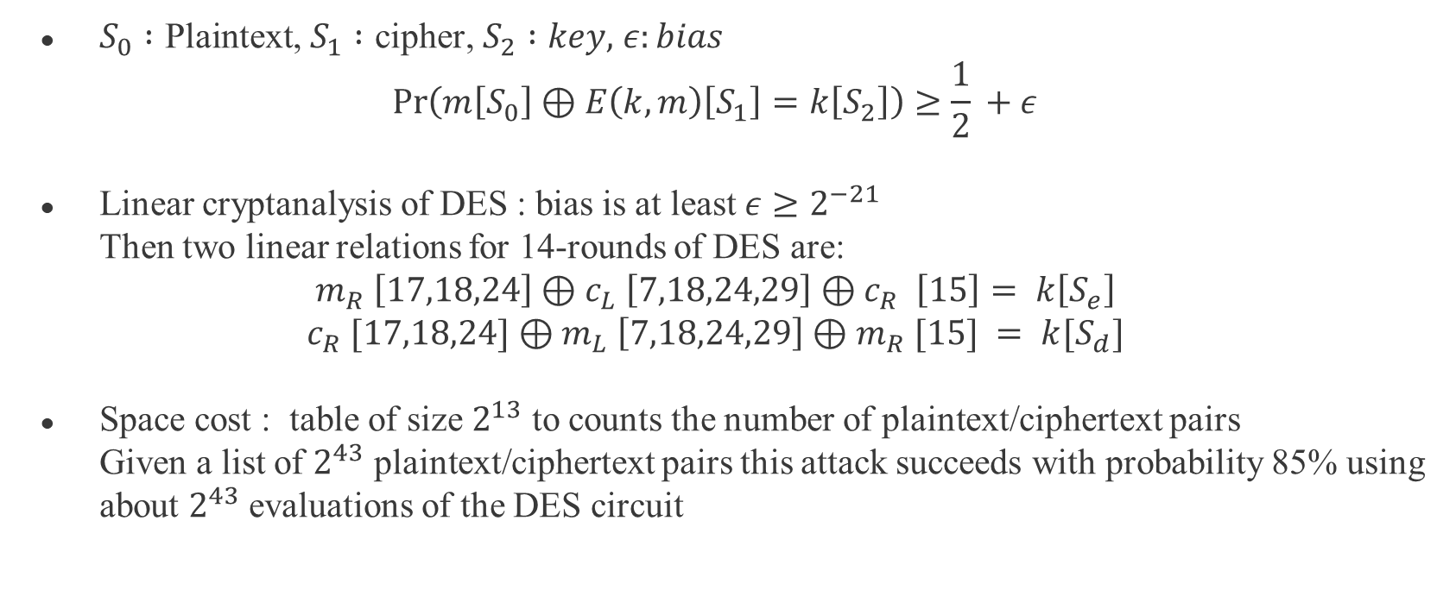
Algorithmic Attacks
$S_{0} :\text{Plaintext}\text{,}$ $S_{1} :\text{cipher}\text{,}$ $S_{2} :key,$ $ε:bias$
$$\operatorname{Pr}\left(m\left[S_{0}\right]⊕E\left(k,m\right)\left[S_{1}​\right]=k\left[S_{2}\right]\right)≥\frac{1}{2}​+ε$$
Linear cryptanalysis of DES : bias is at least $ε≥2^{−21}$
Then two linear relations for 14-rounds of DES are:
$$m_{R} \left[17,18,24\right]⊕c_{L} \left[7,18,24,29\right]{⊕c}_{R} \left[15\right]= k\left[S_{e}\right]$$
$$c_{R} [17,18,24]⊕m_{L} \left[7,18,24,29\right]⊕m_{R} [15] = k[S_{d}]$$
Space cost : table of size $2^{13}$ to counts the number of plaintext/ciphertext pairs
Given a list of $2^{43}$ plaintext/ciphertext pairs this attack succeeds with probability 85% using about $2^{43}$ evaluations of the DES circuit

Slide 30
Side-channel Attacks
Information inadvertently leaked by its physical implementation.
Timing side channel : Timing information can let attacker know response time to certain requests. The response time can leak information about a secret key.
Power side channel : Attacker analysis the chip at any given time, and know what time is the AES calculating.

Slide 31
Fault Injection Attacks
the hardware to introduce errors while running the cryptosystem , thus attacker can exploit the malformed output to learn information about the secret key.
→this attack down AES performance two times and is hardly done in practice.

Slide 32

Quantum Exhaustive Search Attacks
Using a quantum computer can solve the exhaustive search problem in time $\sqrt{\left|K\right|}$.
→AES-128 : $\sqrt{2^{128}}=2^{64}$ (steps).
Computations involving 264 steps can already be done in a reasonable amount of time on a classical computer. If a quantum computer is built that could handle a computation of that size, then AES-128 will no longer be secure.

Slide 33
Pseudo-random Functions (PRF)

Slide 34
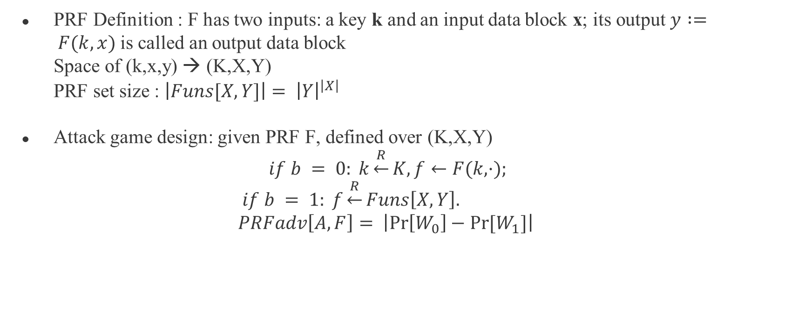
Pseudo-random Functions (PRF)
PRF Definition : F has two inputs: a key k and an input data block x; its output $y := F(k,x)$is called an output data block
Space of (k,x,y) → (K,X,Y)
PRF set size : $\left|Funs[X,Y]\right|= {\left|Y\right|}^{\left|X\right|}$
Attack game design: given PRF F, defined over (K,X,Y)
$$if b = 0: k\underset{←}{R}K, f←F(k,·);$$
$$if b = 1: f\underset{←}{R}Funs\left[X,Y\right]. \\ PRFadv\left[A,F\right]= \left|\operatorname{Pr}\left[W_{0}\right]−Pr⁡[W_{1}]\right|$$

Slide 35
When is a secure block cipher a secure PRF?
Does this imply that E is also a secure PRF?
Ans : YES ! (N is super-poly)
proof : birthday attack

Slide 36

PRF Switching Lemma
Let $ε = (E,D)$be a block cipher defined over $(K,X),$and let $N := \left|X\right|$.
Proof :
$\left|BCadv\left[A,ε\right]−PRFadv[A,E]\right|≤\frac{Q^{2}}{2N} (proof by difference Lemma)$
N is super-poly and Q is poly-bounded → $Q^{2}/2N$is negligible
→ $BCadv\left[AE\right]is negligible⟺PRFadv\left[AE\right]is negligible$

Slide 37
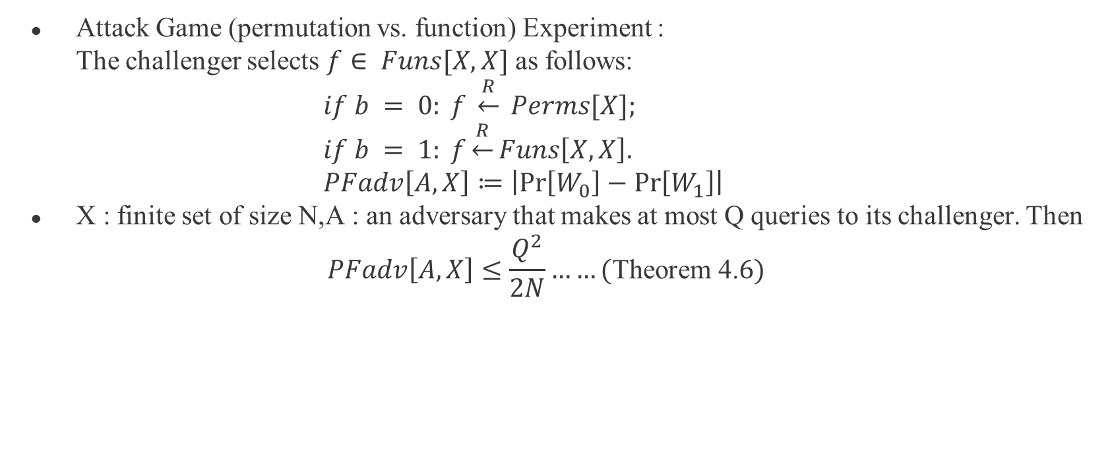
PRF Switching Lemma
Attack Game (permutation vs. function) Experiment :
The challenger selects $f∈ Funs[X,X]$as follows:
$if b = 0: f \underset{←}{R} Perms[X];$
$if b = 1: f\underset{←}{R}Funs\left[X,X\right].$
$PFadv\left[A,X\right]≔\left|\operatorname{Pr}\left[W_{0}\right]−\operatorname{Pr}\left[W_{1}\right]\right|$
X : finite set of size N,A : an adversary that makes at most Q queries to its challenger. Then
$$PFadv\left[A,X\right]≤\frac{Q^{2}}{2N}……(\text{Theorem}\text{ 4.}6)$$

Slide 38
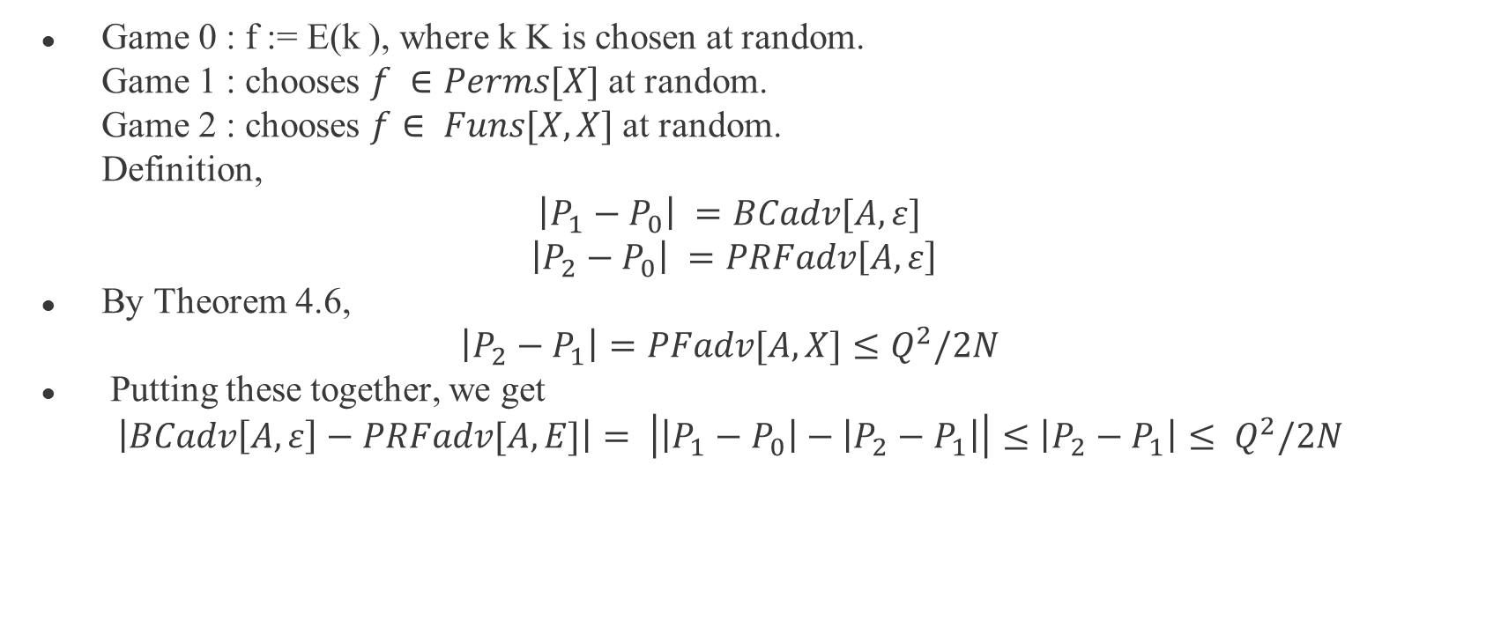
PRF Switching Lemma
Game 0 : f := E(k ), where k K is chosen at random.
Game 1 : chooses $f ∈Perms[X]$at random.
Game 2 : chooses $f∈ Funs[X,X]$at random.
Definition,
$$\left|P_{1}−P_{0}\right| =BCadv[A,ε]$$
$$\left|P_{2}−P_{0}\right| =PRFadv\left[A,ε\right]$$
By Theorem 4.6,
$\left|P_{2}−P_{1}\right|=PFadv[A,X]≤Q^{2}/2N$
Putting these together, we get
$$\left|BCadv\left[A,ε\right]−PRFadv[A,E]\right|= \left|\left|P_{1}−P_{0}\right|−\left|P_{2}−P_{1}\right|\right|≤\left|P_{2}−P_{1}\right|≤ Q^{2}/2N$$

Slide 39
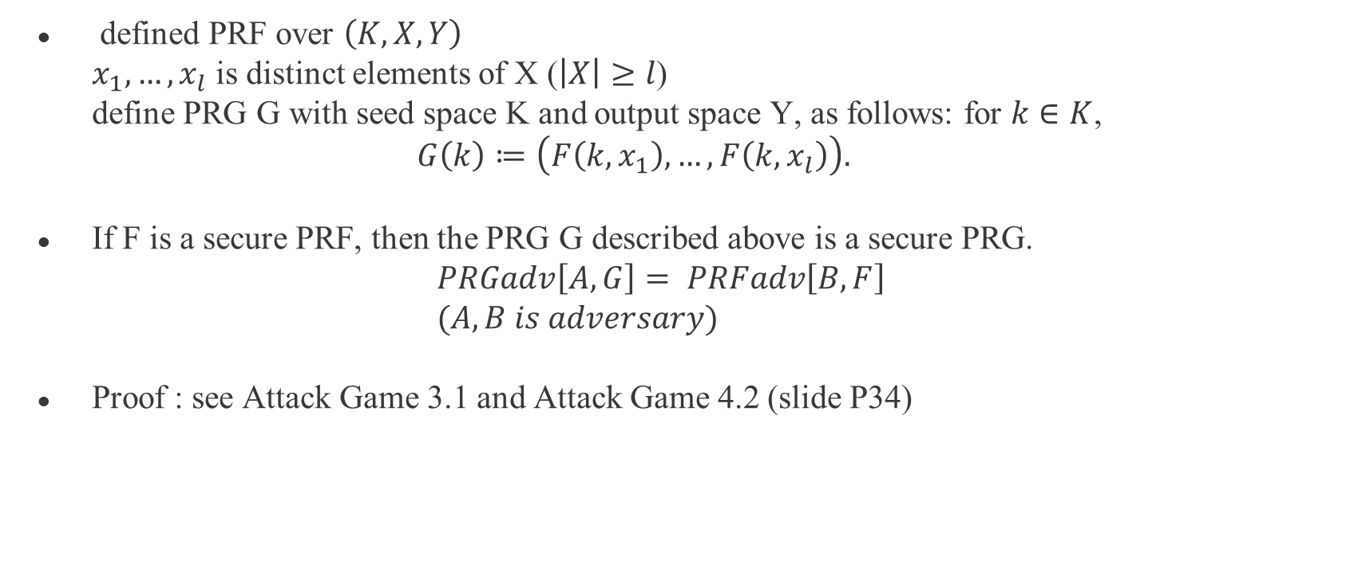
Constructing PRGs from PRFs
defined PRF over $\left(K,X,Y\right)$
$x_{1},…,x_{l}$ is distinct elements of X ($\left|X\right|≥l$)
define PRG G with seed space K and output space Y, as follows: for $k∈K$,
$G\left(k\right)≔\left(F\left(k,x_{1}\right),…,F\left(k,x_{l}\right)\right).$
If F is a secure PRF, then the PRG G described above is a secure PRG.
$PRGadv\left[A,G\right]= PRFadv\left[B,F\right]$
$(A,B is adversary)$
Proof : see Attack Game 3.1 and Attack Game 4.2 (slide P34)

Slide 40
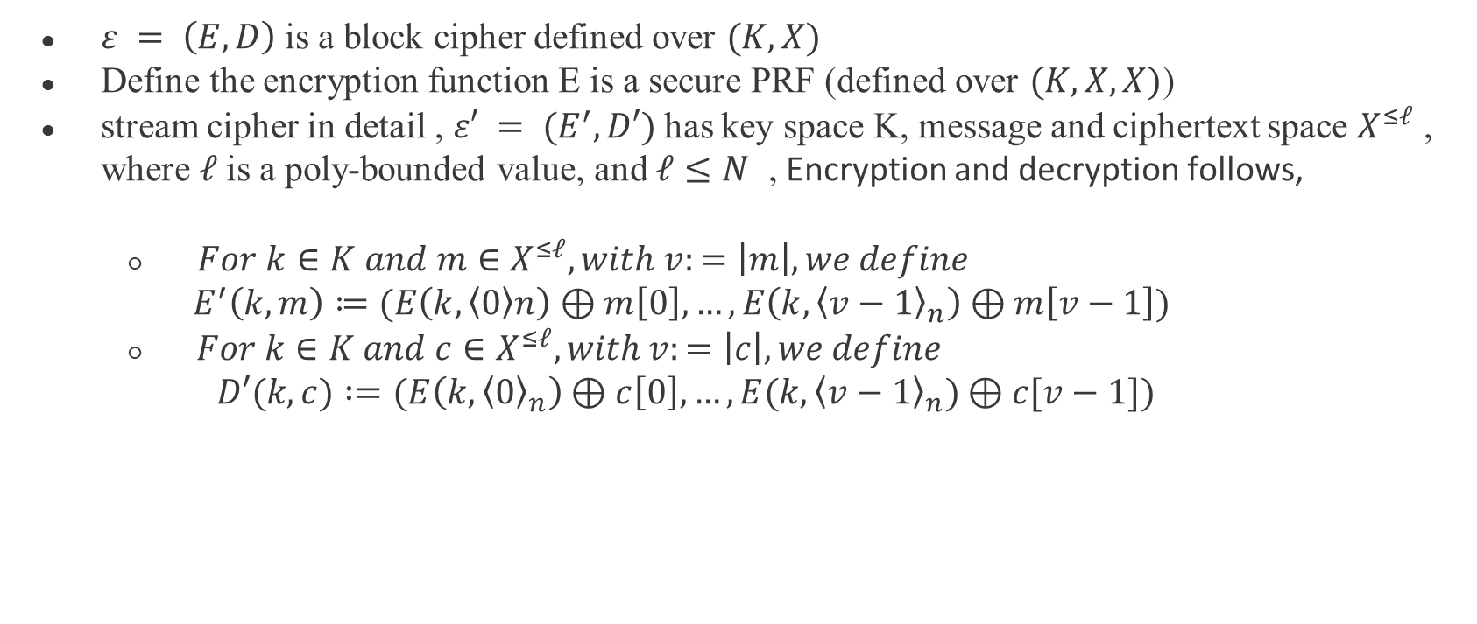
Deterministic counter mode
$ε = \left(E,D\right)$is a block cipher defined over $(K,X)$
Define the encryption function E is a secure PRF (defined over $(K,X,X)$)
stream cipher in detail , $ε′ = (E^{′},D′)$has key space K, message and ciphertext space $X^{≤ℓ}$ , where $ℓ$is a poly-bounded value, and $ℓ≤N$ , Encryption and decryption follows,
  $For k∈K and m∈X^{≤ℓ},with v:=\left|m\right|, we define$
  $E^{′}\left(k,m\right)≔(E\left(k, \left\langle 0\right\rangle n\right)⊕m\left[0\right],…,E\left(k, {\left\langle v−1\right\rangle }_{n}\right)⊕m\left[v−1\right])$
  $For k∈K and c∈X^{≤ℓ},with v:=\left|c\right|, we define$
  $$D′(k,c) :=(E\left(k, {\left\langle 0\right\rangle }_{n}\right)⊕c\left[0\right],…, E(k,{\left\langle v−1\right\rangle }_{n})⊕c[v−1])$$

Slide 41
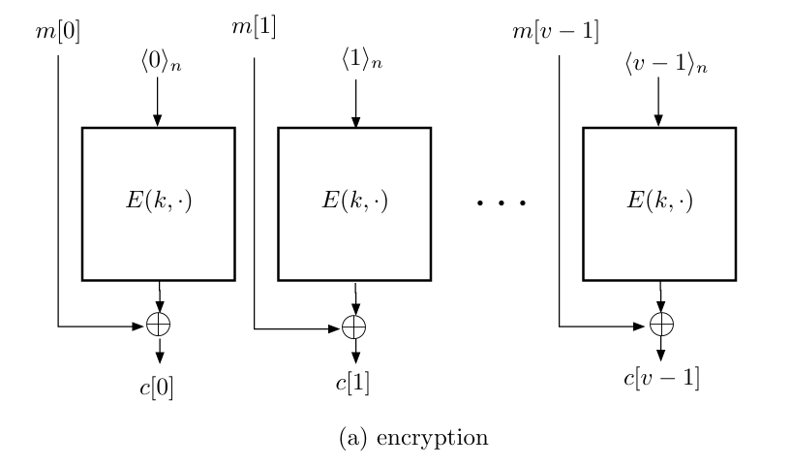
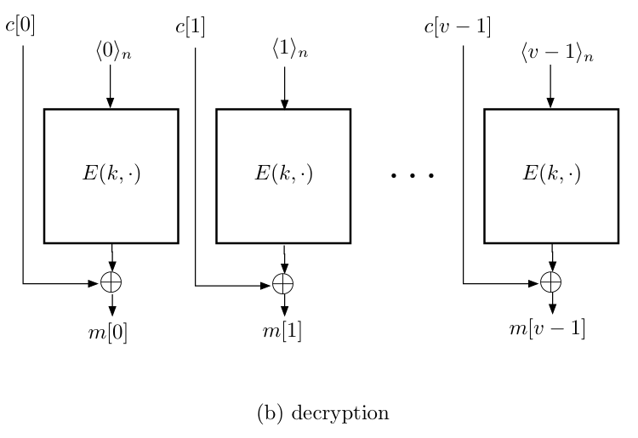
Deterministic counter mode

Slide 42
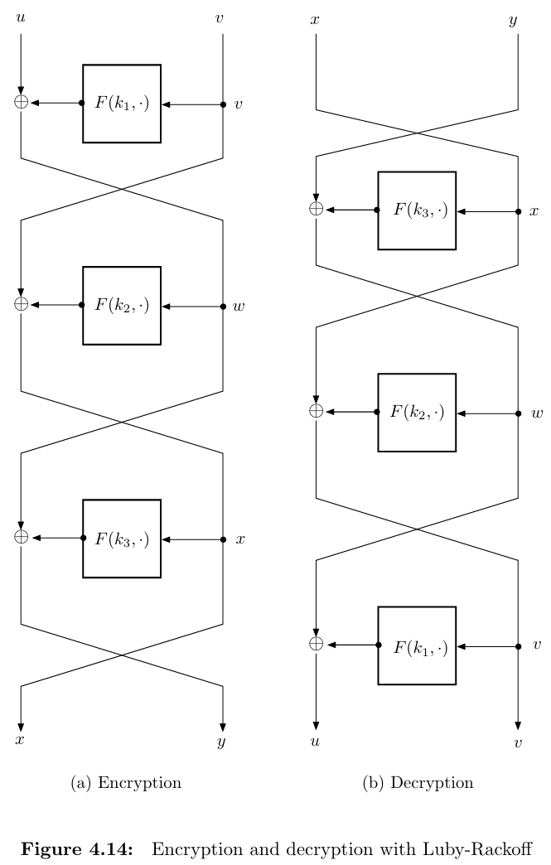

Constructing block ciphers from PRFs
Rackoff construction: data block $\left(u,v\right)$, key (k1,k2,k3)
Encryption:
  $w←u⊕F\left(k_{1},v\right)$
  $x ←v⊕F\left(k_{2},w\right)$
  $y ←w⊕F\left(k_{3},x\right)$
  $output \left(x,y\right).$
Decrytion
  $w←u⊕F\left(k_{3},x\right)$
  $v ←v⊕F\left(k_{2},w\right)$
  $u ←w⊕F\left(k_{1},v\right)$
  $output \left(u,v\right).$

Slide 43
Thank you for listening

