Slide 1
Chapter 1: Introduction

Slide 2
Outline
What Operating Systems Do
Computer-System Organization
Computer-System Architecture
Operating-System Operations
Resource Management
Security and Protection
Virtualization
Distributed Systems
Kernel Data Structures
Computing Environments
Free and Open-Source Operating Systems

Slide 3
Outline
What Operating Systems Do
Computer-System Organization
Computer-System Architecture
Operating-System Operations
Resource Management
Security and Protection
Distributed Systems
Virtualization
Kernel Data Structures
Computing Environments
Free and Open-Source Operating Systems

Slide 4
什麼是作業系統？

Slide 5
Computer System Structure
Computer system can be divided into four components:
Hardware
CPU, memory, I/O devices
Operating system
System and Application programs –
Compilers, assembler, word processors, your first hello world program…
Users
People

Slide 6
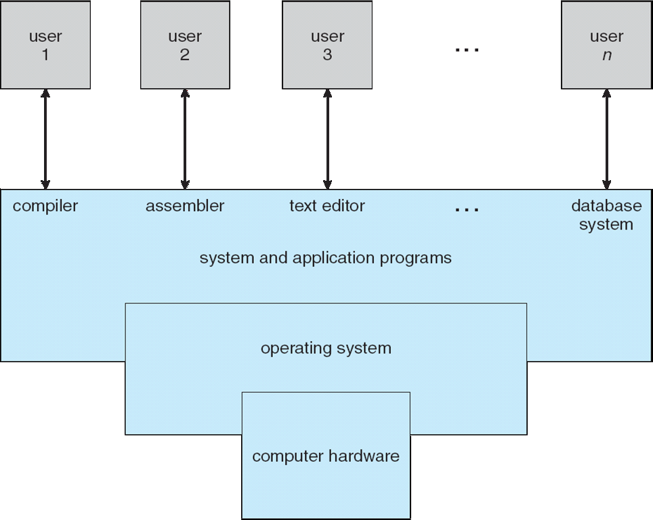
Four Components of a Computer System

Slide 7
如果沒有作業系統會發生什麼事?

Slide 8
What Operating Systems Do?
A software that acts between a users/applications and the computer hardware.
Goal
Manages the computer hardware and provides an environment for application programs to run
Program 1
Program 2
OS
Device 1
Device 2
Device 3

Slide 9
Defining Operating System
No universal accepted definition
Because of myriad designs and uses of OSes
Present in toasters (烤麵包機), spacecraft, game machines, TVs and industrial control systems
A more common definition
The OS is the one program running at all times on the computer
Usually called the kernel

Slide 10
Outline
What Operating Systems Do
Computer-System Organization
Computer-System Architecture
Operating-System Operations
Resource Management
Security and Protection
Distributed Systems
Kernel Data Structures
Computing Environments
Free and Open-Source Operating Systems

Slide 11
學習作業系統為什麼要學習電腦組織與架構？

Slide 12
Outline
What Operating Systems Do
Computer-System Organization
Interrupts
Storage structure
Computer-System Architecture
Operating-System Operations
Resource Management
Security and Protection
Distributed Systems
Kernel Data Structures
Computing Environments
Free and Open-Source Operating Systems

Slide 13
A Computer System
A computer system consists of CPU and multiple device controllers, connect through a bus (see the following slide)
Device controller: hardware
In charge of a specific device
Contains local buffer and special-purpose registers
Device drivers: software
Part of an OS (see the following slide)
A device driver for each device controller

Slide 14
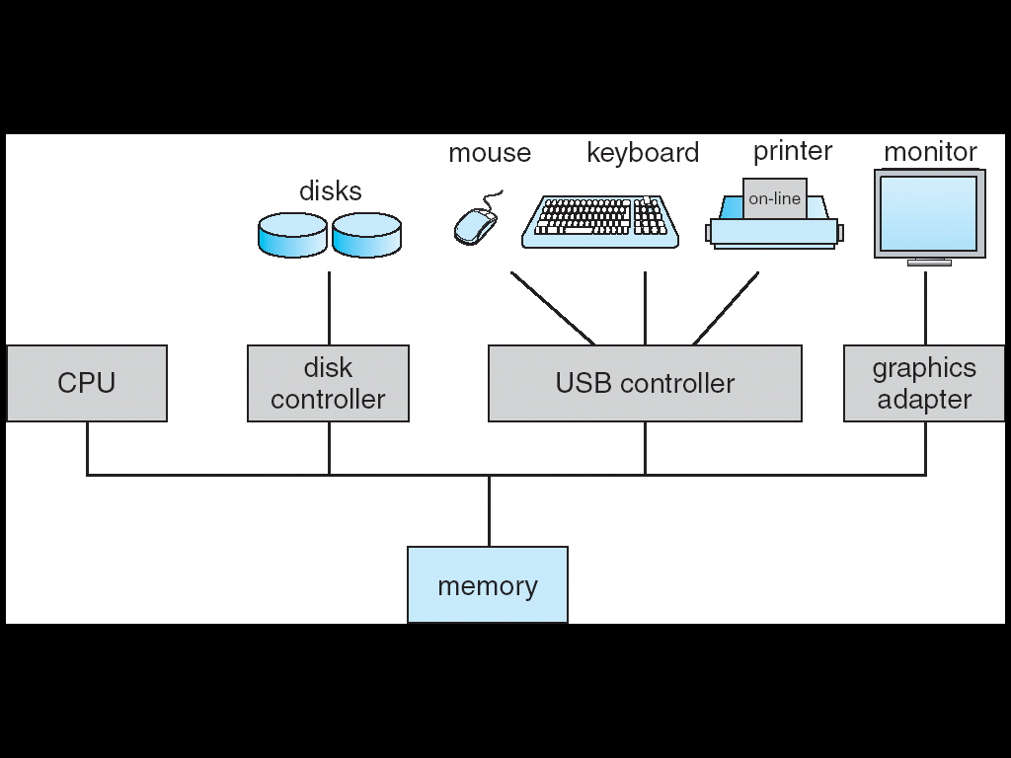
A Computer System
CPU registers
device registers
Local buffer

Slide 15
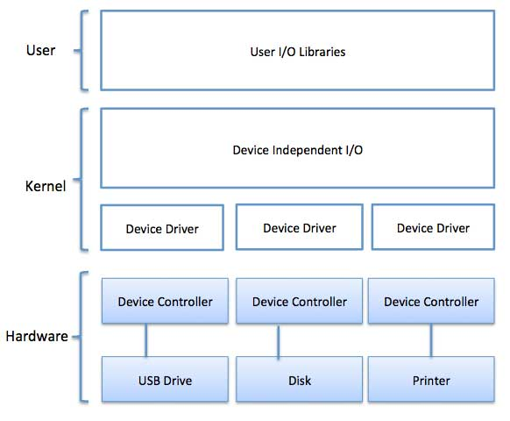
A Computer System
https://www.tutorialspoint.com/operating_system/os_io_software.htm

Slide 16
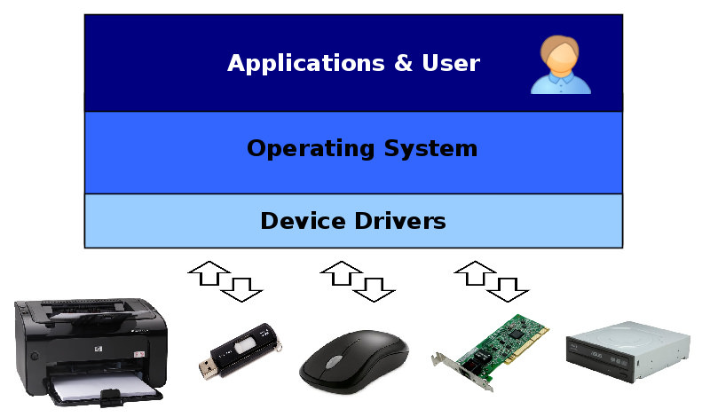
Device Driver
https://itw01.com/F9NUEAQ.html

Slide 17
問題 1: CPU如何通知周邊裝置？ 問題 2:周邊裝置如何通知CPU？
Answer 1: 藉由讀寫Device Controller的內部暫存器
Answer 2: Device controller informs CPU by causing an interrupt

Slide 18
Starting an I/O operation
Starting an I/O operation (e.g., read data from disks)
Device driver loads the appropriate registers within the device controller (see the following slide)
Device controller
Examines the contents of these registers
Determine what action to take
Start the actions
Transfer of data from the device to its local buffer
Once completed
Device controller informs the CPU via an interrupt

Slide 19
A Computer System
CPU registers
device registers
Local buffer

Slide 20
Interrupts
Interrupt: signals an occurrence of a hardware event.
The completion of an I/O, a keypress,
In general
Device controller raises an interrupt
By asserting a signal on the interrupt-request line
CPU catches the interrupt
CPU dispatches it to the interrupt handler
Interrupt handlers serve the device

Slide 21
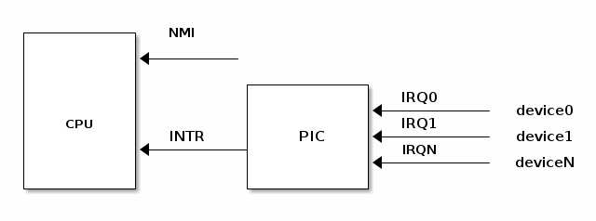

Interrupt Hardware Concepts
Programmable Interrupt Controller
CPU catch an interrupt
Raise an interrupt
https://www.renesas.com/eu/en/support/engineer-school/mcu-programming-peripherals-04-interrupts

Slide 22
CPU Dispatch an Interrupt to ISR
…
mov eax, 0x60;
…
0x1000
CPU
…..
interrupt
OS
CPU dispatch an interrupt to ISR
Interrupt Service
Routine (ISR)

Slide 23
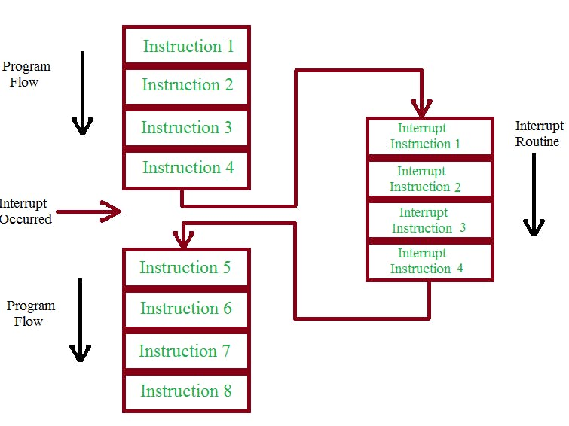


Interrupt Processing Flow
https://www.hackster.io/rafitc/interrupts-basics-f475d5

Slide 24
Interrupts (Cont.)
When an interrupt occurs, i.e., CPU is interrupted
Stop what it is doing
Transfer execution to a fixed address
Executes the interrupt service routine (ISR) for the interrupt
Interrupt service routine
Perform a state save
Service the interrupt
Perform a state restore
Executes a retrun_from_interrupt instruction
CPU resumes the interrupted computation

Slide 25
問題: What is a state?

Slide 26
問題: 為什麼要儲存state?然後復原state?

Slide 27
Without State Save and Restore
…
mov eax, 0x60;
add eax, ebx;
…
CPU
eax | 59
ebx | 25
eax | 10
ebx | 5
…..
interrupt
OS
Interrupt Service
Routine (ISR)

Slide 28
State Save and Restore
PC=0x1000
memory
eax=10, ebx=5
ecx =9, edx = 11
etc.
save
Interrupt
Start
……
Interrupt
End
process P1
process P1
restore
CPU
eax=10, ebx=5,
ecx=9, edx =11
pc= 0x1000…
CPU
eax=6, ebx=9,
ecx=3, edx =32
pc= 0x58000…
CPU
eax=10, ebx=5,
ecx=9, edx =11
pc= 0x1000…

Slide 29
With State Save and Restore
…
mov eax, 0x60;
add eax, ebx;
…
CPU
eax | 10
ebx | 5
eax | 59
ebx | 25
…..
interrupt
eax=10; ebx=5;
……
OS
Interrupt Service
Routine (ISR)

Slide 30
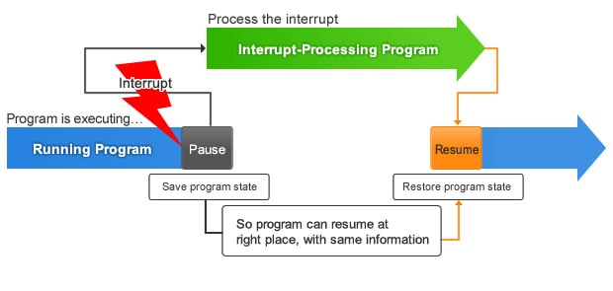
Interrupt Processing Flow
Interrupt Service Routine
https://www.renesas.com/eu/en/support/engineer-school/mcu-programming-peripherals-04-interrupts

Slide 31
Outline
What Operating Systems Do
Computer-System Organization
Interrupts
Storage structure
Computer-System Architecture
Operating-System Operations
Resource Management
Security and Protection
Virtualization
Distributed Systems
Kernel Data Structures
Computing Environments
Free and Open-Source Operating Systems

Slide 32
Storage Structure
There are many different storage media
Differ in sizes, speed, cost, volatility (揮發性)…
So, current storage systems are organized in hierarchy.
As shown in the following slide
The top four levels are constructed using semi-conductor memory

Slide 33
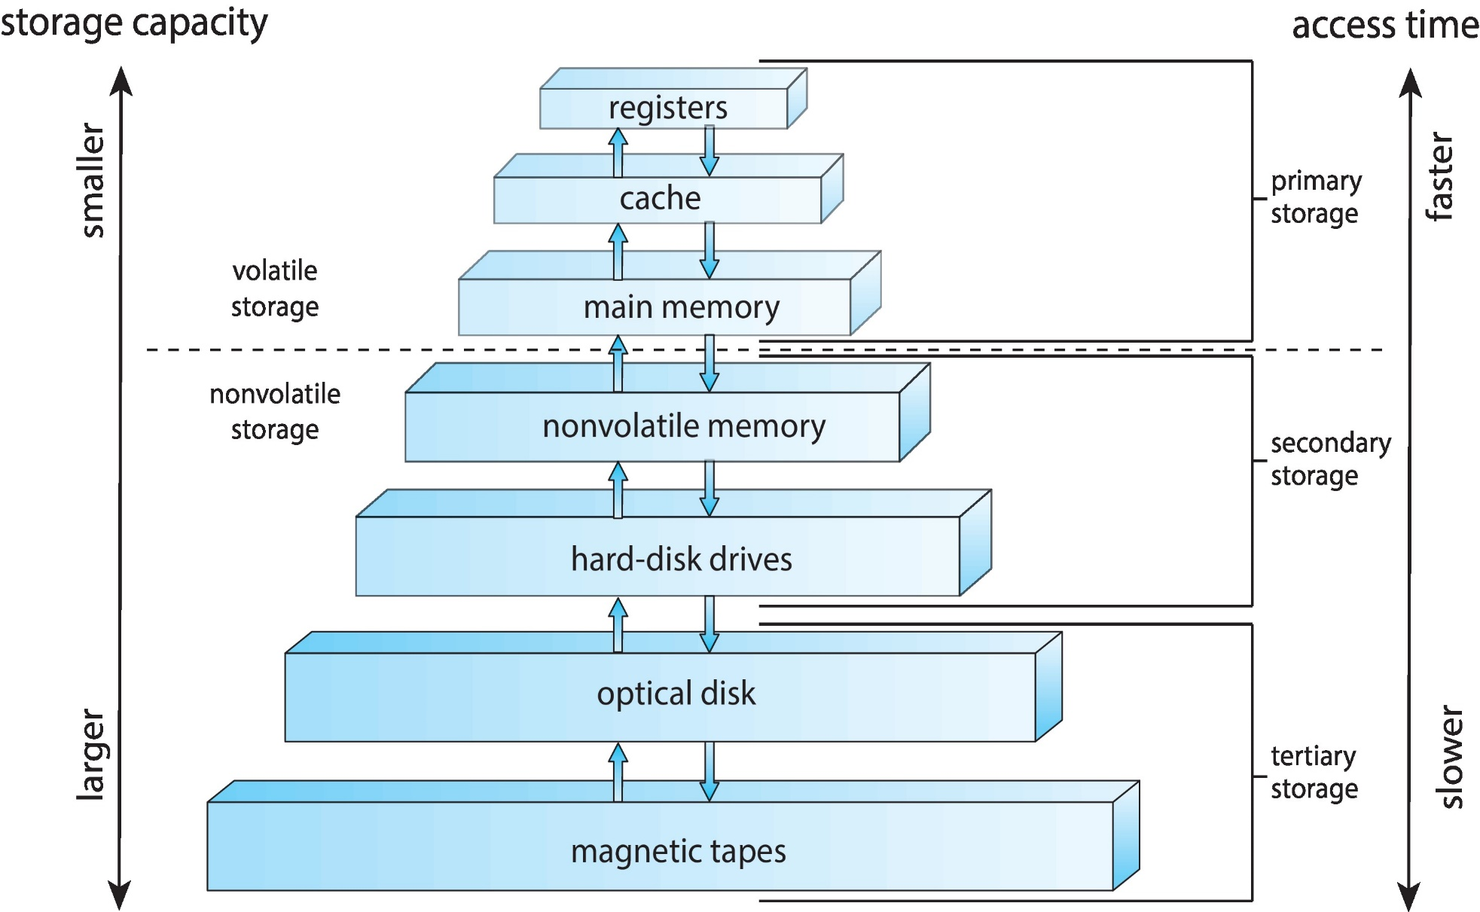
Storage-Device Hierarchy

Slide 34
Performance of Various Levels of Storage

Slide 35
Storage Structure (Cont.)
Primary storage
Main memory: RAM
The only large storage media that the CPU can access directly.
Secondary storage
Extension of main memory to provide large nonvolatile capacity
Main memory is usually too small and volatile
Electrical-based: Nonvolatile Memory (NVM)
Flash memory (SSD): the most common method
Mechanical-based: hard-disk drives (HDD) (or called magnetic disks)
Most common secondary-storage device
Tertiary storage
Usually for storing backup copies

Slide 36
接下來介紹計算機系統架構

Slide 37
Outline
What Operating Systems Do
Computer-System Organization
Computer-System Architecture
Single-Processor Systems
Multiprocessor Systems
Clustered Systems
Operating-System Operations
Resource Management
Security and Protection
Virtualization
Distributed Systems
Kernel Data Structures
Computing Environments
Free and Open-Source Operating Systems

Slide 38
Single-Processor Systems
Only one general-purpose processor
But have other special-purpose processors
Disk controllers, USB controller, graphics adatpers…

Slide 39
A Computer System
CPU registers
device registers
Local buffer

Slide 40
Outline
What Operating Systems Do
Computer-System Organization
Computer-System Architecture
Single-Processor Systems
Multiprocessor Systems
Clustered Systems
Operating-System Operations
Resource Management
Security and Protection
Virtualization
Distributed Systems
Kernel Data Structures
Computing Environments
Free and Open-Source Operating Systems

Slide 41
Multiprocessor Systems
Advantages: increased throughput: gets more jobs done
Question: what is throughput?
Two management schemes
Asymmetric Multiprocessing:
A master processor controls the system. Defines a master-slave relationship.
Symmetric Multiprocessing (SMP):
The most common system
Each processor is peer, no master-slave relationship exists

Slide 42
Multiprocessor Systems
Approaches
Multi-processors: each processor with a single-core CPU
Multi-core systems: multiple cores on a single chip
Non-uniform memory access (NUMA)
Blade server

Slide 43
Multiprocessor Systems
Approaches
Multi-processors: each processor with a single-core CPU
Multi-core systems: multiple cores on a single chip
Non-uniform memory access (NUMA)
Blade server

Slide 44
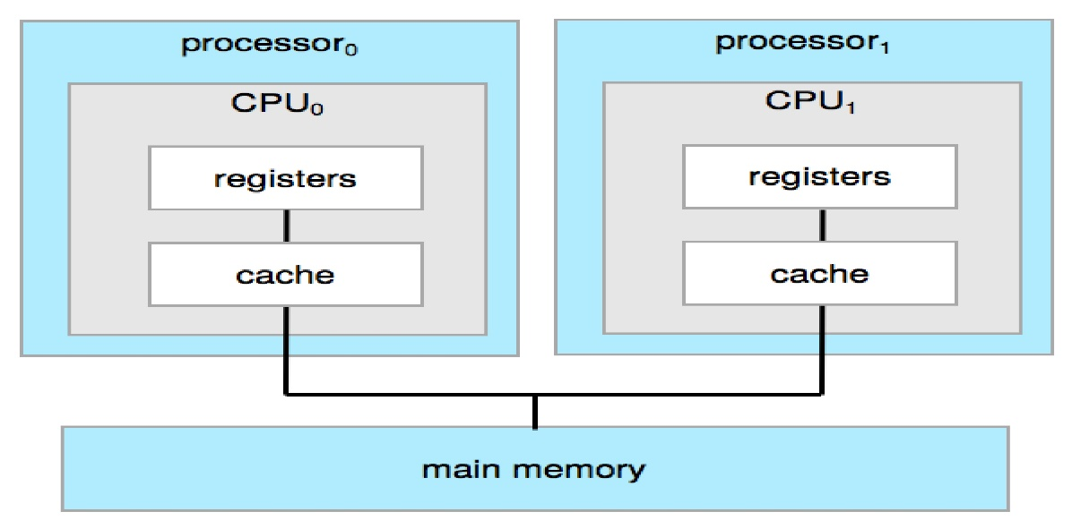
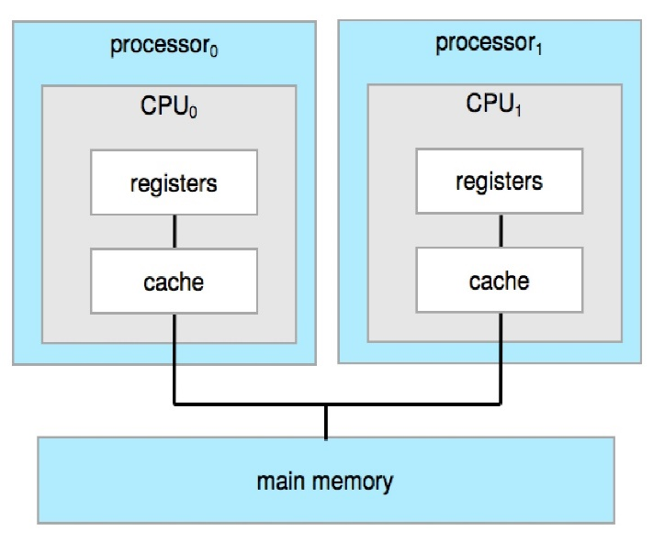
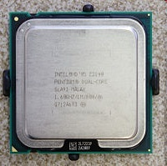
Multiprocessors Systems
main memory

Slide 45
Multiprocessor Systems
Approaches
Multi-processors: each processor with a single-core CPU
Multi-core systems: multiple cores on a single chip
Non-uniform memory access (NUMA)
Blade server

Slide 46
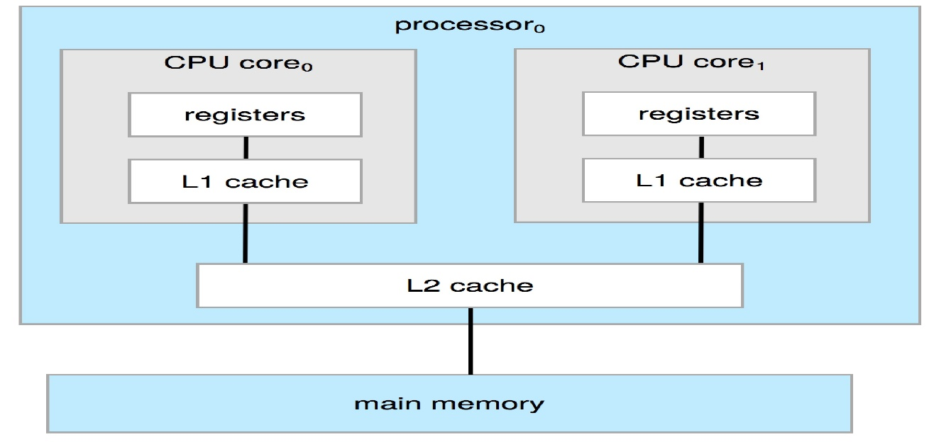
Multi-Core Systems
Multi-Core: multiple compute cores on a single chip
More efficient than multiple single-core chips
On-chip communication is faster than between-chip communication
A dual-core design with two cores on the same chip

Slide 47
Multiprocessor Systems
Approaches
Multi-processors: each processor with a single-core CPU
Multi-core systems: multiple cores on a single chip
Non-uniform memory access (NUMA)
Blade server

Slide 48
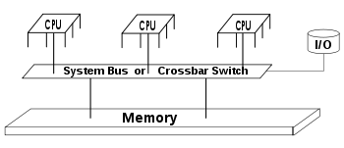
Non-Uniform Memory Access (NUMA)
Adding too many CPUs on multiprocessor systems
Contention for system bus becomes a bottleneck
Performance begins to degrade
See the following slide

Slide 49
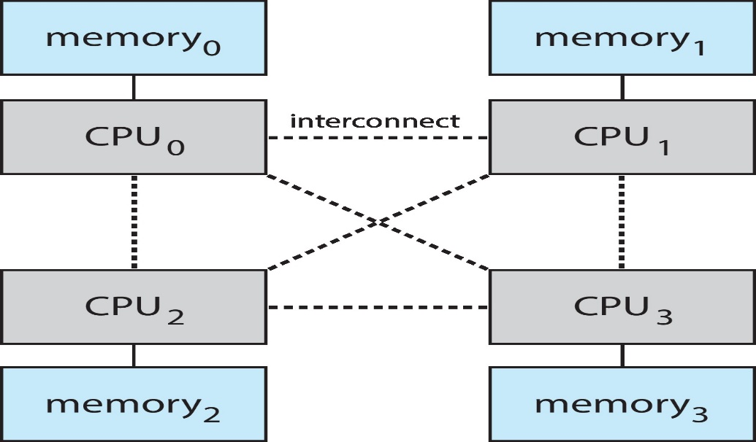
Non-Uniform Memory Access (NUMA) (Cont.)
Alternative approach: NUMA
Provide each CPU with its local memory
Accessed via a local bus
Increasing popular on servers and high-end computing systems

Slide 50
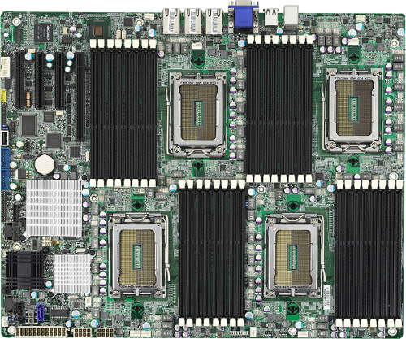
Non-Uniform Memory Access (NUMA) (Cont.)
https://blog.programster.org/kvm-numa-declaration

Slide 51
Non-Uniform Memory Access (NUMA) (Cont.)
Problem: memory access time is not the same
Accessing local memory speed >> accessing remote memory speed
OS need to manage memory carefully

Slide 52
Multiprocessor Systems
Approaches
Multi-processors: each processor with a single-core CPU
Multi-core systems: multiple cores on a single chip
Non-uniform memory access (NUMA)
Blade server

Slide 53
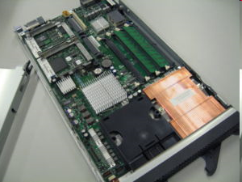
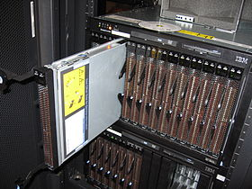
Blade Servers
Multiple processor boards are placed in the same box
Difference between previous approaches:
Each processor board boots independently and runs its own OS

Slide 54
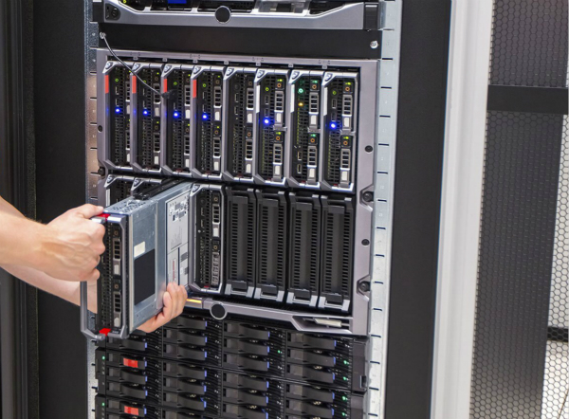
Blade Servers
http://www.fiberopticshare.com/wp-content/uploads/2019/05/blade-servers.jpg

Slide 55
Outline
What Operating Systems Do
Computer-System Organization
Computer-System Architecture
Single-Processor Systems
Multiprocessor Systems
Clustered Systems
Operating-System Operations
Resource Management
Security and Protection
Virtualization
Distributed Systems
Kernel Data Structures
Computing Environments
Free and Open-Source Operating Systems

Slide 56
Clustered Systems
A clustered system
Multiple computers that are connected via a local area network (LAN).
The key of a clustered system is high availability
Graceful degradation: continue providing service proportional to the level of surviving hardware
Fault tolerant: continue providing service even any single component is failed

Slide 57
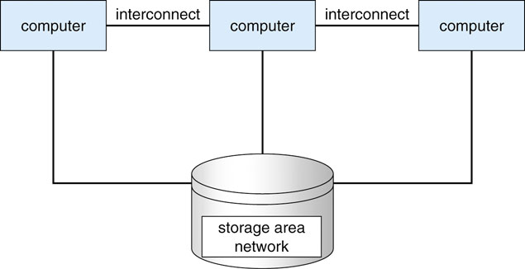
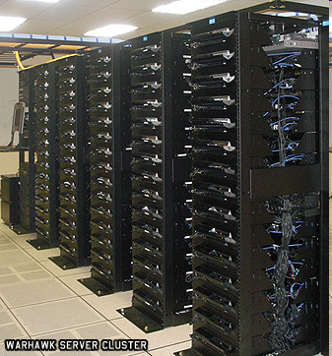
General Structure of a Clustered System
Now, some clusters support thousands of systems as well as nodes separated by miles
http://www.win.tue.nl/hashclash/rogue-ca/

Slide 58
Graceful Degradation
performance
graceful degradation
4
3
2
1
0
Number of Computers

Slide 59
Outline
What Operating Systems Do
Computer-System Organization
Computer-System Architecture
Operating-System Operations
Resource Management
Security and Protection
Virtualization
Distributed Systems
Kernel Data Structures
Computing Environments
Free and Open-Source Operating Systems

Slide 60
看過電腦組織與架構，接下來介紹作業系統的基本運作方法

Slide 61
Outline
What Operating Systems Do
Computer-System Organization
Computer-System Architecture
Operating-System Operations
Multiprogramming and Multitasking
Dual-Mode and Multi-mode Operation
Timers
Resource Management
Security and Protection
Virtualization
Distributed Systems
Kernel Data Structures
Computing Environments
Free and Open-Source Operating Systems

Slide 62
基本問題：作業系統何時被執行？
Program 1
Program 2
OS
Device 1
Device 2
Device 3

Slide 63
Event-Driven OS
OS is event-driven
Event
Interrupt: driven by hardware
Trap (or exception): a software-generated interrupt, caused by
Error: Division by zero, illegal instructions
System calls or monitor calls
Functions provided by OS to provide service to applications
read(), write(), open()……

Slide 64
Event-Driven OS: Interrupt
…
mov eax, 0x60;
…
CPU
…..
interrupt
OS
Interrupt Service
Routine (ISR)

Slide 65
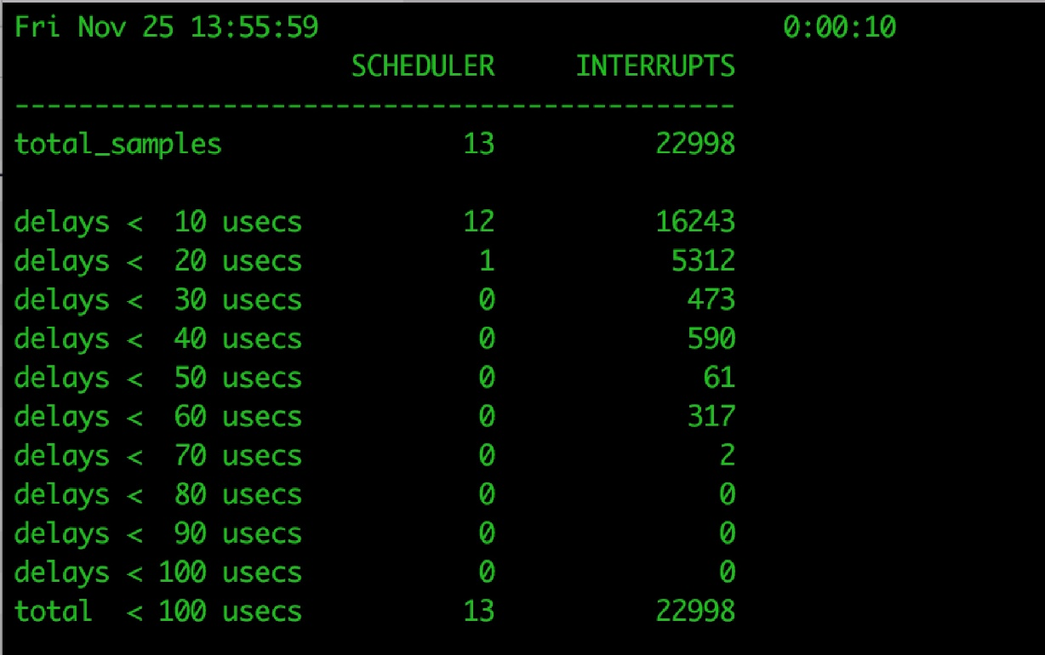
Interrupts
As shown in the figure, a quiet macOS desktop generated 23,000 interrupts over 10 seconds

Slide 66
Event-Driven OS: Trap (Error)
…
a = b/0;
…
CPU
…..
trap
OS

Slide 67
Event-Driven OS: Trap (System Call)
…
int 0x10; // read();
…
CPU
…..
trap
OS

Slide 68
補充：何謂System Calls

Slide 69
Example
#include<stdio.h> #include<sys/types.h> #include<sys/stat.h>
#include<fcntl.h> #include<unistd.h>
#include<stdlib.h> //for exit()
#include <string.h> //for strlen()
int main(){
int fd;
fd = open("myfile.txt", O_CREAT | O_WRONLY, 0600);
if (fd < 0){
printf("Failed to open the fild.\n");exit(1); }
int size;
size = write(fd, "e", strlen("e") );
close(fd);
printf("length of write data=%d \n", strlen("e"));
printf("Number of bytes written on success=%d \n\n", size);
exit(0);
}

Slide 70
按照程式執行的規則，當呼叫open()時，程式應該會跳到對應的open() function。
這個例子：open()就是一個system call
問題：open() function在哪裡？

Slide 71
Program 1
open()…
Program 2
read()…
User Mode
open(), read()
Kernel Mode
open()
{
….
}
read() OS
{
…
}
Storage

Slide 72
補充結束

Slide 73
Summary: Interrupts and Traps
…
open()
…
…
a=0;
b=10/a;
…
…
Trap caused by System Call to
ask the kernel provide services
Trap caused by software error
OS (or Kernel)
Interrupt cause
kernel to service I/O devices
…
Hardware
NIC
Keyboard

Slide 74
OS is Event-Driven
Program 1
Program 2
User Mode
read(), write()
exceptions
Kernel Mode
OS
interrupts
Device 1
Device 2
Device 3

Slide 75
Outline
What Operating Systems Do
Computer-System Organization
Computer-System Architecture
Operating-System Operations
Multiprogramming and Multitasking
Dual-Mode and Multi-mode Operation
Timers
Resource Management
Security and Protection
Virtualization
Distributed Systems
Kernel Data Structures
Computing Environments
Free and Open-Source Operating Systems

Slide 76
Operating-System Structure
Single-programming systems
Multi-programmed systems
Time-sharing (or multitasking) systems

Slide 77
Operating-System Structure
Single-programming systems
Multi-programmed systems
Time-sharing (or multitasking) systems

Slide 78
Operating-System Structure: Single-programming systems
Single-programming systems
One job at a time
After a job is finished, then the next job
Very inefficient
CPU is idle when the running program is doing I/O (next slide)

Slide 79
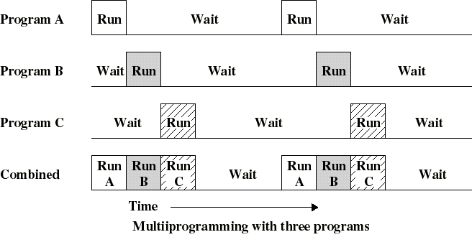
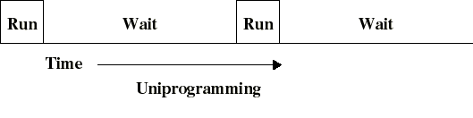
Uni- vs. Multi-Programming
(a) uni-programming
(b) multi-programming

Slide 80
Operating-System Structure
Single-programming systems
Multi-programmed systems
Time-sharing (or multitasking) systems

Slide 81
Operating-System Structure: Multiprogramming
Why use multiprogramming? for efficiency
Run multiple programs keep either the CPU or the I/O devices busy at all times
Give an example in your usual life: 小朋友玩遊戲

Slide 82
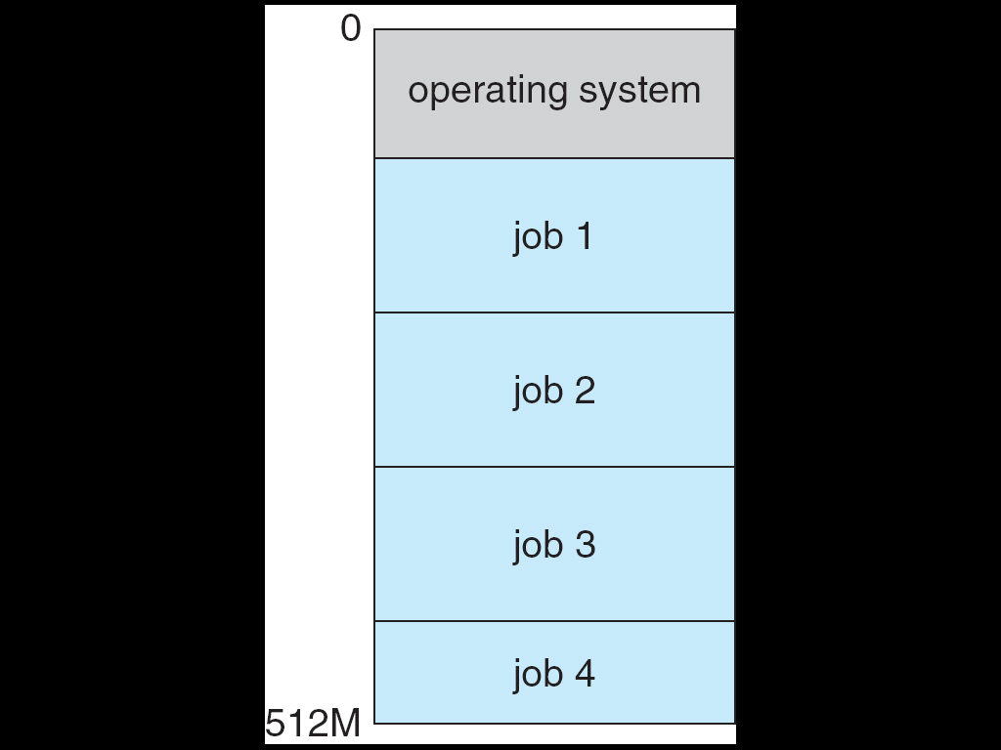
Memory Layout for a Multiprogramming System
A set of jobs is kept in memory

Slide 83
Operating-System Structure
Single-programming systems
Multi-programmed systems
Time-sharing (or multitasking) systems

Slide 84
Operating-System Structure: Timesharing (Multitasking)
Problem of Multi-programming systems
Does not provide user interaction: see the following slide
Solutions: Timesharing (Multitasking)
Logical extension of multiprogramming
CPU switches jobs so frequently (not until jobs doing I/O)
Users can interact with each job frequently
Create an interactive computing environment (e.g., using keyboards or mouse)
Response time is short

Slide 85
Problems of Multiprogramming Systems
program A
RUN
wait
program B
(word)
wait
RUN
Bad: long response time
interactive task

Slide 86
Timesharing (Multitasking)
program A
RUN
wait
RUN
program B
(word)
wait
RUN
Good: short response time
interactive task

Slide 87
Outline
What Operating Systems Do
Computer-System Organization
Computer-System Architecture
Operating-System Operations
Multiprogramming and Multitasking
Dual-Mode and Multi-mode Operation
Timers
Resource Management
Security and Protection
Virtualization
Distributed Systems
Kernel Data Structures
Computing Environments
Free and Open-Source Operating Systems

Slide 88
Dual-Mode and Multimode Operations
To ensure proper execution of the system
Must distinguish between the execution of OS code and user program code
Why? (see the following slide)
Solution: CPU supports dual-mode or multimode operations

Slide 89
Distinguish Between the Execution Of OS Code And User Program Code
…
cli;
…
CPU
…..
V
…
cli;
…
OS

Slide 90
Dual-Mode Operation
Modern CPUs have at least two execution modes:
User mode – execution done on behalf of a user
Monitor mode– execution done on behalf of operating system
Also called supervisor mode, system mode, or privileged mode
Can executed all of the instructions, including privileged instructions
Controlled by a mode bit.

Slide 91
1.3.1 SIC Machine Architecture (Cont.)
Registers
Five registers
Each register is 24 bits in length
Mnemonic | Number | Special use
A | 0 | Accumulator
X | 1 | Index register
L | 2 | Linkage register
PC | 8 | Program counter
SW | 9 | Status word

Slide 92
1.3.1 SIC Machine Architecture (Cont.)
Status Word register contents

Slide 93
Dual-Mode Operation (Cont.)
Privileged instructions
Instructions that may cause harm
Can only be executed in the supervisor mode.
Example:
I/O control, timer management, interrupt management
Why uses Dual-mode operation?
For protection
Privileged instruction can only execute in kernel mode
If executed in user mode, hardware will cause a trap
Trap cause CPU jump to the OS, that terminates the application (next slide)

Slide 94
Dual-Mode Operation
…
mov eax,10
cli; //clear interrupt
…
User Mode
Executing privilege instruction cause a trap to the OS
trap
Kernel Mode
OS (or Kernel)
…
Hardware
NIC
Keyboard

Slide 95
Dual-Mode Operation
…
cli;
…
CPU
…..
mode = 0;
trap
OS

Slide 96
Dual-Mode Operation (Cont.)
Entering Monitor Mode (the same as entering OS)
As the result of an interrupt
Through a system call trap
As a result of an error trap
User
Process
read(), trap
User Mode
System Call Interface
Kernel Mode
File System
I/O interrupt
Hardware

Slide 97
Mode Bit Change: Interrupt
…
out eax, 0x60;
…
CPU
…..
mode = 1;
mode = 0;
interrupt
OS
Interrupt Service
Routine (ISR)

Slide 98
Mode Bit Change : Trap (Error)
…
a = b/0;
…
CPU
…..
mode = 0;
mode = 1;
trap
OS

Slide 99
Mode Bit Change : Trap (Error) (Cont.)
…
cli;
…
CPU
…..
mode = 0;
mode = 1;
trap
OS

Slide 100
Dual-Mode Operation: Trap (System Call)
…
int 0x 10; // read();
…
CPU
…..
mode = 0;
mode = 1;
trap
OS

Slide 101
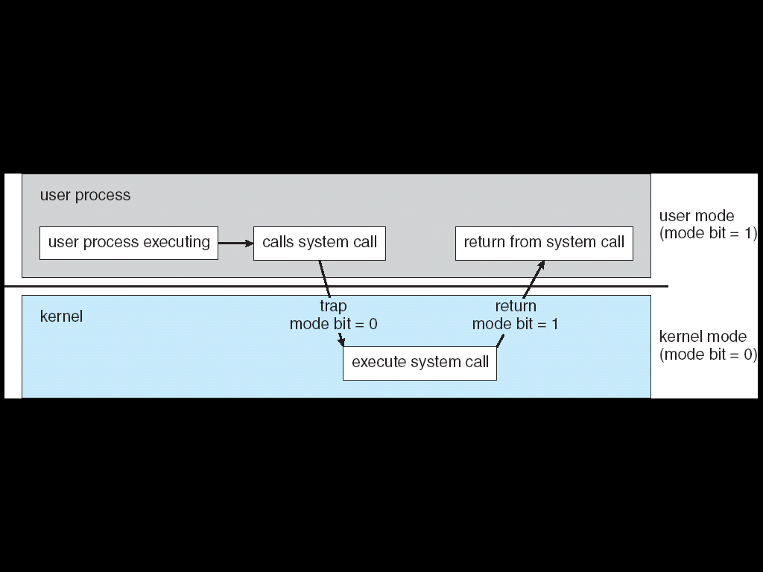
Dual-Mode Operation: Trap (System Call)

Slide 102
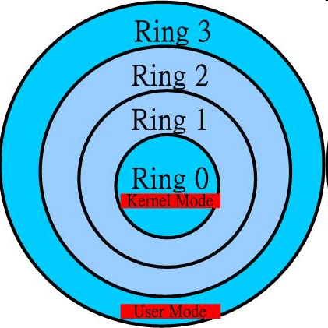
Multi-Mode
Examples
x86 CPU has four protection rings (modes)
Windows runs in the ring 0 (kernel mode)
User applications runs in the ring 3 (User mode)
ARM8 has seven modes

Slide 103
Outline
What Operating Systems Do
Computer-System Organization
Computer-System Architecture
Operating-System Operations
Multiprogramming and Multitasking
Dual-Mode and Multi-mode Operation
Timers
Resource Management
Security and Protection
Virtualization
Distributed Systems
Kernel Data Structures
Computing Environments
Free and Open-Source Operating Systems

Slide 104
Timer
Question: how to prevent a user program from getting the CPU forever ? (next slide)
That is, how to implement time sharing systems?
See the following three slides
We must have a way to enter OS
System call traps
Error Traps
Interrupts
Your choice?
See the following next slide

Slide 105
Problem
…
program A
RUN
program B
(word)
wait
Bad: long response time
interactive task

Slide 106
Problem: Example
User
Applications
…
for (;;)
a=a+1;
…
Applications executes a infinite loop, occupying CPU
User Mode
Kernel Mode
OS (or Kernel)
Hardware

Slide 107
Problem: Example (Cont.)
…
for (;;) a=a+1;
…
CPU
…
add eax, ebx;
…
…..
OS
Interrupt Service
Routine (ISR)

Slide 108
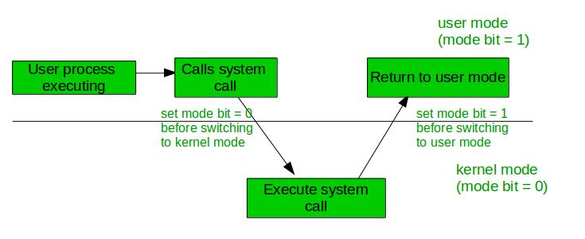
Your Choice?
?
1
0
OS
https://www.geeksforgeeks.org/dual-mode-operations-os/

Slide 109
Solution
We must have a way to enter OS
System call traps
Error Traps
Interrupts

Slide 110
Timer (Cont.)
Solution: timer
Cause timer interrupt periodically
CPU is returned back to the OS
Run another task or still the same task
An so on…(see the following two slides)
Clearly, instructions that modify the content of the timer are privileged

Slide 111
With a Timer
User
Applications
…
for (;;)
a=a+1;
…
User
Applications
…
for (;;)
a=a+1;
…
Change to execute another application
User Mode
Kernel Mode
timer_interrupt_handler()
{
If (current process executes too long)
change to execute another application
}
Interrupt cause
CPU just to the kernel
Hardware
Timer

Slide 112
With a Timer (Cont.)
…
for (;;) a=a+1;
…
CPU
…
add eax, ebx;
…
…..
interrupt
Timer
OS
Interrupt Service
Routine (ISR)

Slide 113
結論：作業系統的基本運作方法和CPU/硬體有密切關係
Time Sharing
Dual-Mode Operation
Timer

Slide 114
Outline
Computer-System Organization
Computer-System Architecture
Operating-System Operations
Resource Management (SKIP!)
Process Management
Memory Management
File-System Management
Mass-Storage Management
Cache Management
I/O System Management
Security and Protection
Virtualization
Distributed Systems
Kernel Data Structures
Computing Environments
Free and Open-Source Operating Systems

Slide 115
Outline
What Operating Systems Do
Computer-System Organization
Computer-System Architecture
Operating-System Operations
Resource Management
Security and Protection
Virtualization
Distributed Systems
Kernel Data Structures
Computing Environments
Free and Open-Source Operating Systems

Slide 116
Protection and Security
Protection –controlling access to resources
Distinguish between authorized and unauthorized usage
Security – defense of the system against attacks

Slide 117
Protection and Security (Cont.)
To achieve protection and security, systems must distinguish among users
User identifier (user IDs): unique, one per user
User ID is associated with all of the user’s files and processes
Group identifier (group ID):unique, one per group
Also associated with each process and file

Slide 118
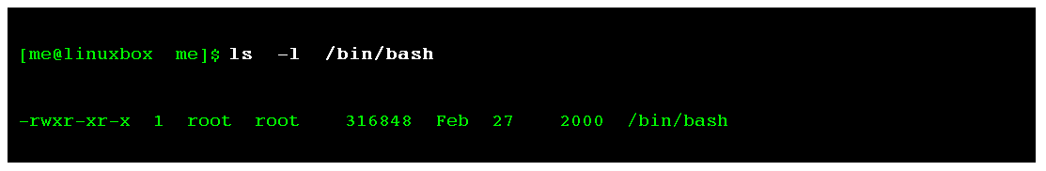
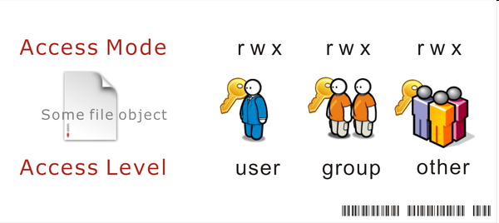
User and Group IDs in Linux
user
group

Slide 119
Protection and Security (Cont.) (Skip!)
Privilege escalation (上升）
Allows user to change its effective ID with more right temporary
Example: setuid in UNIX
Run as the effective UID of the owner of the file
This file must have the setuid attribute, “chmod u+s file”
E.g., change your own password, which requires the root privilege to update the password file.

Slide 120

Setuid in Linux (Skip!)
user id = joe
effective uid=root
Execute “passwd”
user id = joe
effective uid=joe
user id = joe
effective uid=joe

Slide 121
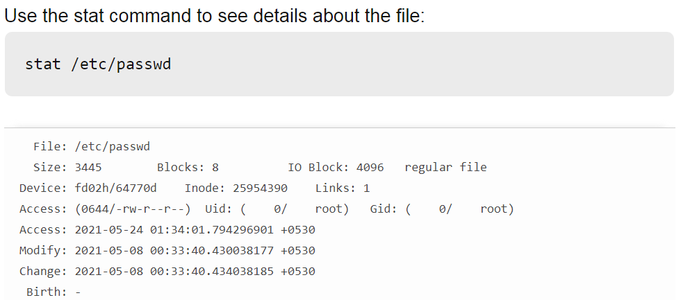
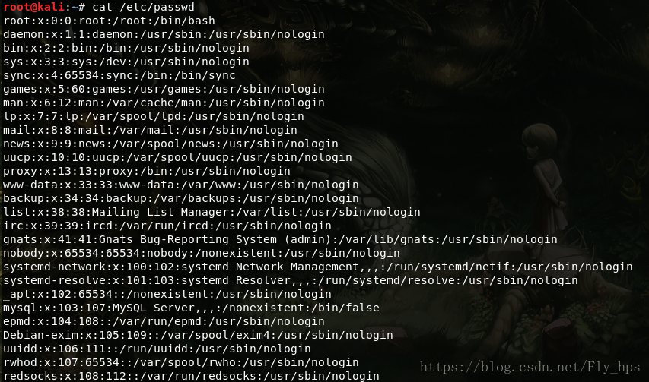
/etc/passwd檔案 (Skip!)
https://www.itread01.com/content/1541164686.html

Slide 122
Outline
What Operating Systems Do
Computer-System Organization
Computer-System Architecture
Operating-System Operations
Resource Management
Security and Protection
Virtualization (Skip!)
Distributed Systems (Skip!)
Kernel Data Structures
Computing Environments
Free and Open-Source Operating Systems

Slide 123
Outline
What Operating Systems Do
Computer-System Organization
Computer-System Architecture
Operating-System Operations
Resource Management
Security and Protection
Virtualization
Distributed Systems
Kernel Data Structures (Skip!)
Computing Environments
Free and Open-Source Operating Systems

Slide 124
Kernel Data Structures
Lists, Stacks, and Queues
Trees
Hash Functions and Maps
Similar to standard programming data structures

Slide 125
List
Singly linked list
Doubly linked list
Circular linked list

Slide 126
Stack and Queue
Stack: last in, first out (LIFO)
Insert an item: push
Remove an item: pop
Queue: first in, first out (LIFO)

Slide 127
Tree
General tree
A parent may have an unlimited number of children
Binary tree
A parent may have at most two children
Binary search tree
Two children and value(left_child) <= value(right_child)
Search performance is O(n)
Balanced binary search tree
Search performance is O(lg n)
Binary search tree

Slide 128
Hash Functions and Maps
Hash function can create a hash map
Bitmap – string of n binary digits representing the status of n items

Slide 129
Outline
What Operating Systems Do
Computer-System Organization
Computer-System Architecture
Operating-System Operations
Resource Management
Security and Protection
Distributed Systems
Kernel Data Structures
Computing Environments (Skip!)
Free and Open-Source Operating Systems

Slide 130
Outline
What Operating Systems Do
Computer-System Organization
Computer-System Architecture
Operating-System Operations
Resource Management
Security and Protection
Distributed Systems
Kernel Data Structures
Computing Environments
Free and Open-Source Operating Systems

Slide 131
Open-Source Operating Systems
Operating systems made available in source-code format
Windows: just binary, closed-source
Started by Free Software Foundation (FSF), which has “copyleft” GNU Public License (GPL)
Examples include GNU/Linux, BSD UNIX, and Sun Solaris

Slide 132
Summary
Computer System Structure
Hardware, operating system, system and application programs, users
Computer-System Organization
Interrupts
Storage structure
Computer-System Architecture
Single-Processor Systems
Multiprocessor Systems
Clustered Systems
Operating-System Operations
Multiprogramming and Multitasking
Dual-Mode and Multi-mode Operation
Timers

