Slide 1
Chapter 3: Processes

Slide 2
Outline
Process Concept
The Process
Process State
Process Control Block
Process Scheduling
Operations on Processes
Interprocess Communication
IPC in Shared-Memory Systems
IPC in Message-Passing Systems
Examples of IPC Systems
Communication in Client-Server Systems

Slide 3
Overview
Process – a program in execution
Also called jobs, tasks
Program – passive ;
Process – active

Slide 4
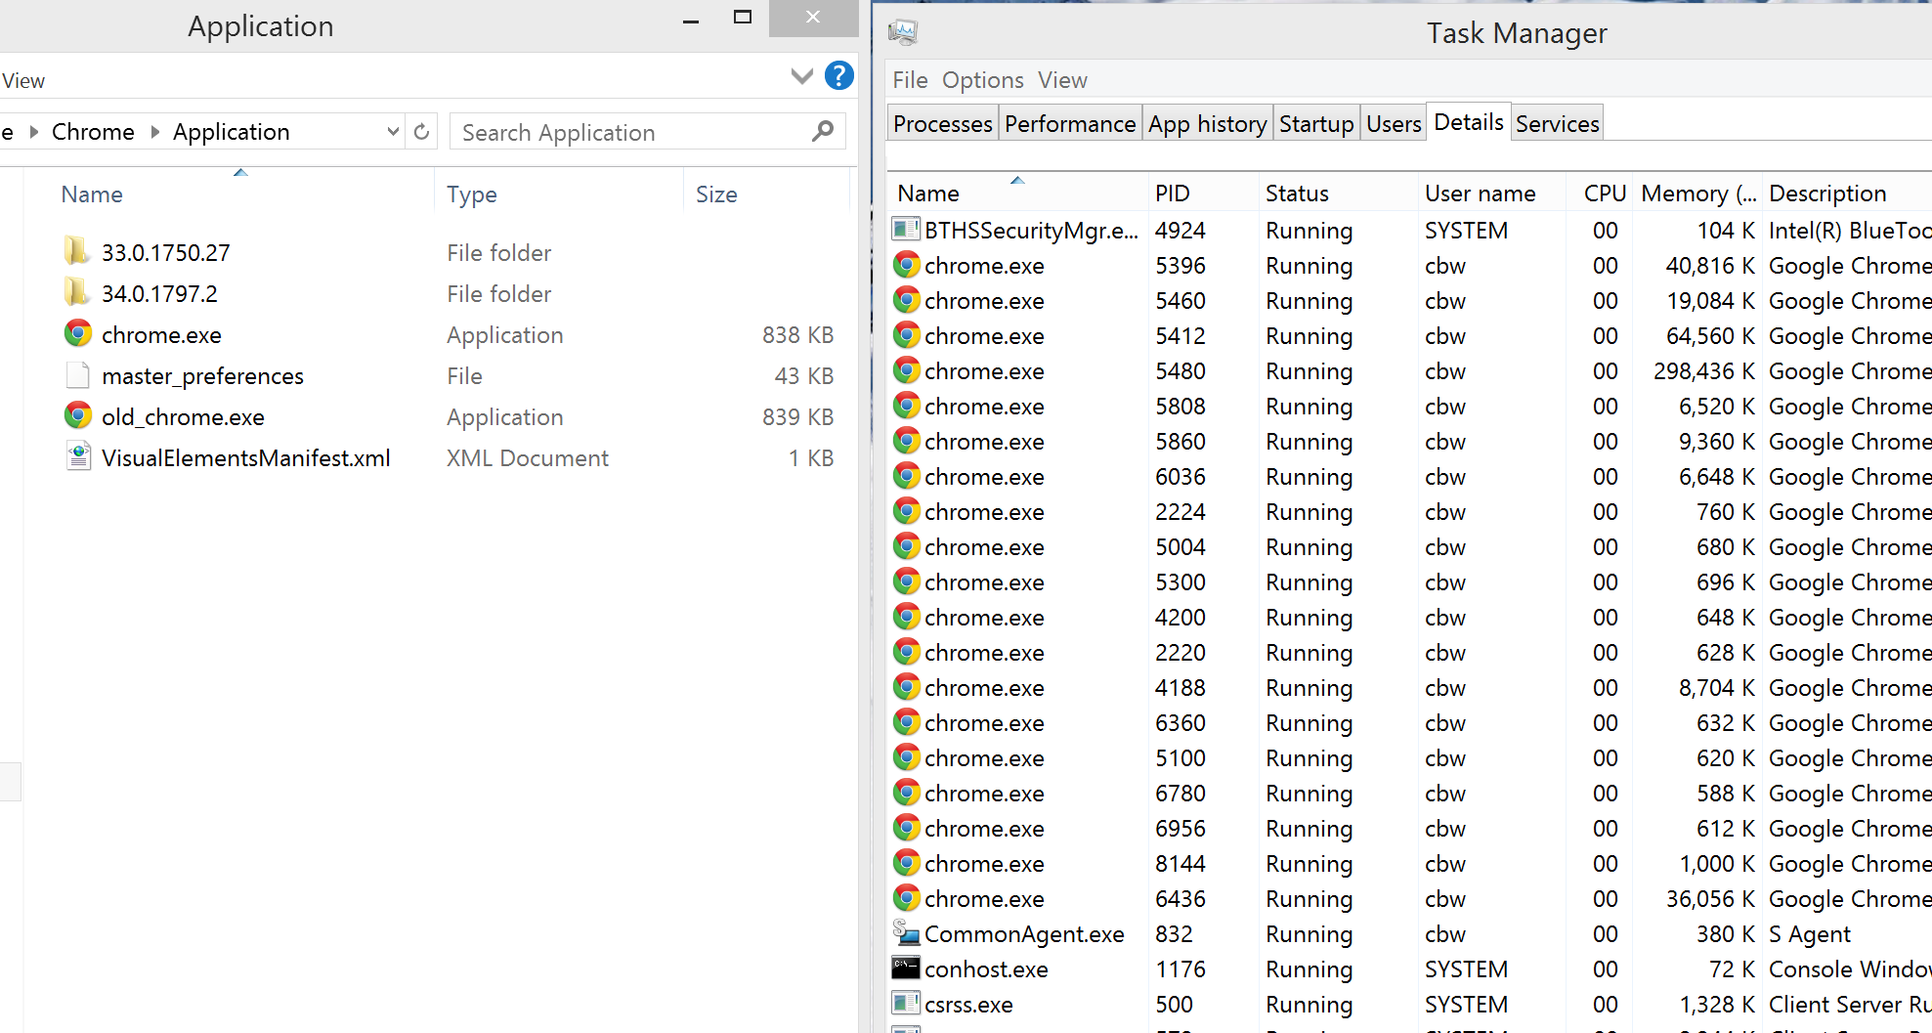
Programs and Processes
Process
The running instantiation of a program, stored in RAM
Program
An executable file in storage
CS 5600 Computer Systems

Slide 5
Overview (Cont.)
A process need certain resources:
CPU
Status of the current activity: PC (Program Counter), registers…
Memory
Text section: program code (fixed size)
Data section: global variable (fixed size)
Stack section: temporary data
Parameter, return address, local variable…
Heap section: memory that are dynamically allocated by calling malloc() and free()
Files……

Slide 6
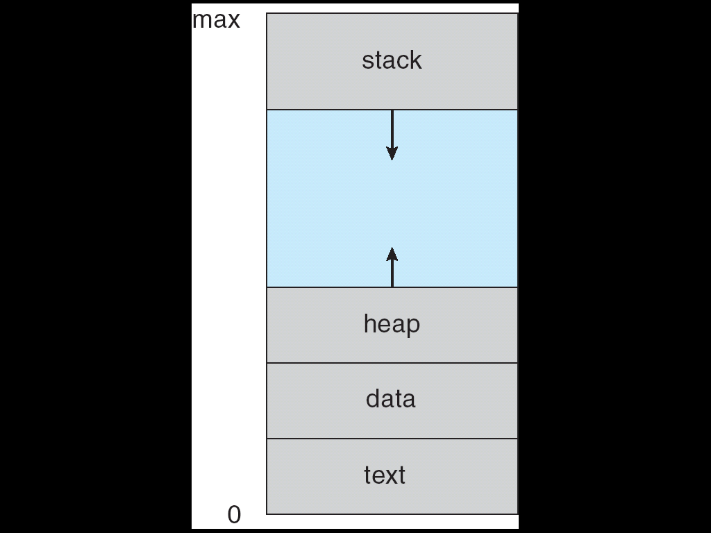
Process
CPU
eax=10, ebx=5,…
pc= 0x1000

Slide 7
複習: EIP (or PC)
EIP
1009
1000
mov eax, Y;
1003
add eax, 4;
1006
mov ebx 3;
1009
imul ebx;
100C
mov X, eax;
100F
…
1012
…

Slide 8
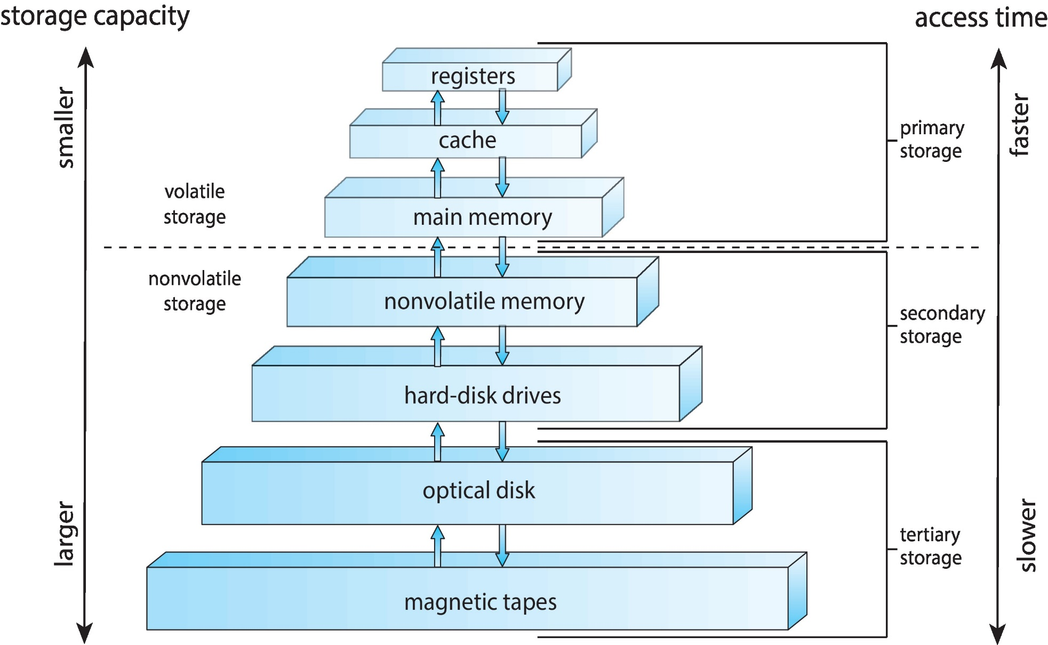
Again: Storage-Device Hierarchy

Slide 9
Stack: Example 1
main()
{
.
.
a = a + 1;
function_1(…);
exit(1);
}
function_1()
{
b = b - 1;
function_2(…);
return;
}
function_2()
{
…
return;
}
stack
ESP
arugment
return address
local variables
ESP
argument
return address
local variables
ESP
argument
return address
local variables

Slide 10
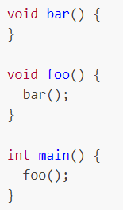
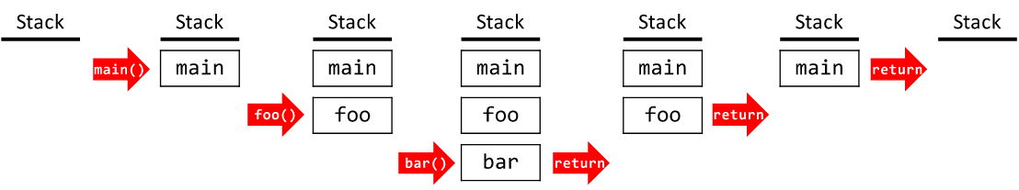
Stack: Example 2
stack frame
https://eecs280staff.github.io/notes/02_ProceduralAbstraction_Testing.html

Slide 11
Stack: Example 3
By the time Sub3 is called, the stack contains three stack frames
stack frame
stack frame
stack frame

Slide 12
Heap
main()
{
.
.
malloc(1024);
……;
b = b - 1;
malloc(2048)
……;
malloc(512);
free(512)
free(2048);
free(1024);
}
heap

Slide 13
Actual Memory Layout of a C Program
As shown in the following slide, in fact
The global data section is divided into initialized data and uninitialized data sections
A separate section is provided for the argc and argv parameters

Slide 14
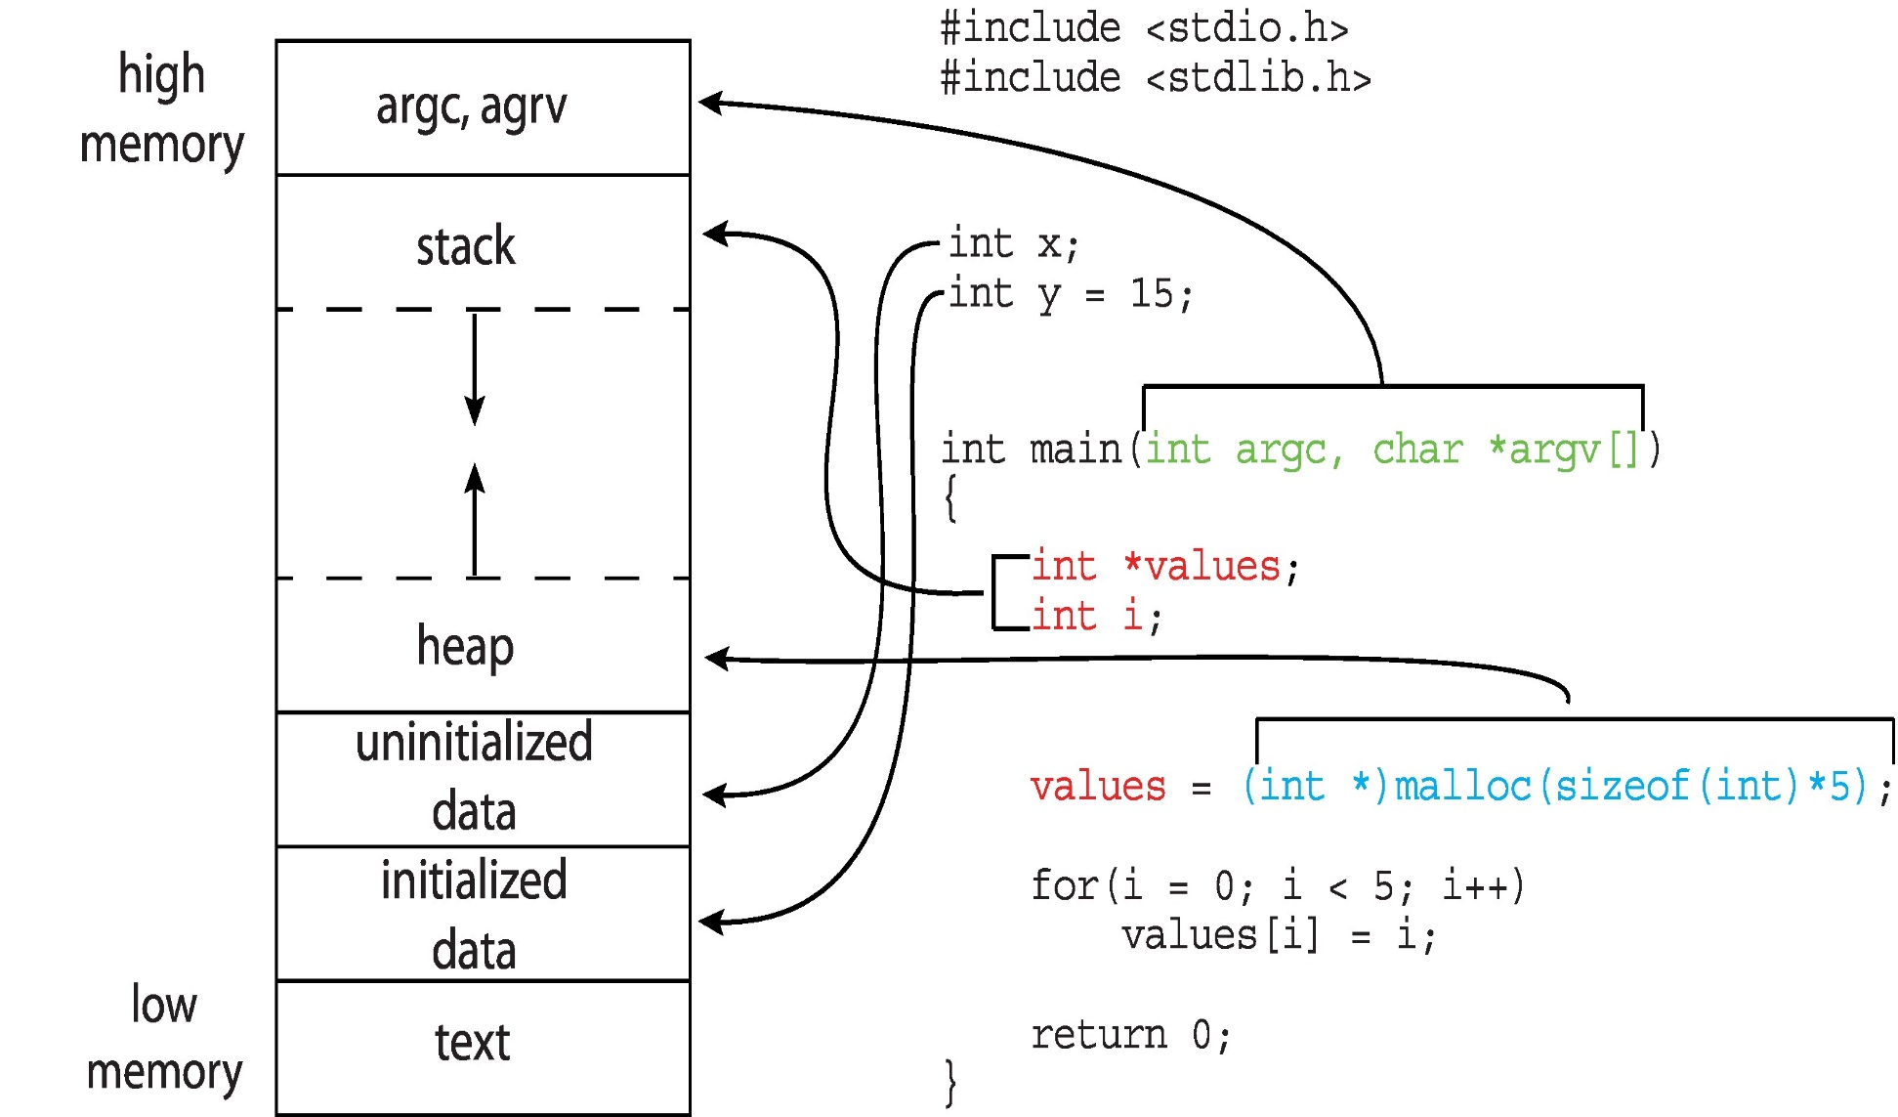
Actual Memory Layout of a C Program

Slide 15
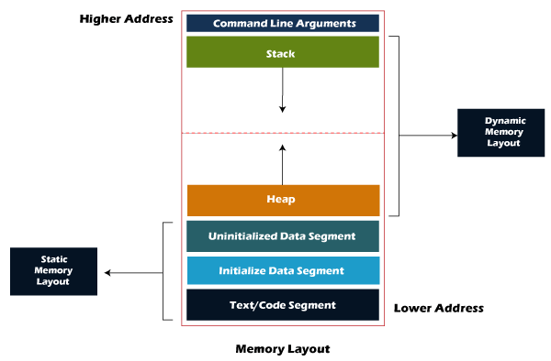
Actual Memory Layout of a Process
https://techaccess.in/2021/05/07/sections-of-a-process/

Slide 16
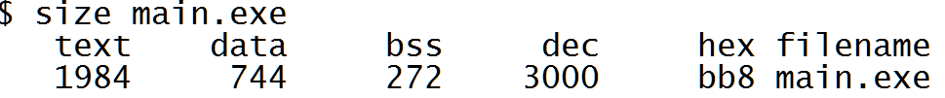
Memory Layout of a C Program
To obtain the size of the segment of a program
size executable-file-name
text: code segment
data: initialized global data
bss (block start by symbol): uninitialized global data
dec and hex: sum of three sections

Slide 17
Outline
Process Concept
The Process
Process State
Process Control Block
Process Scheduling
Operations on Processes
Interprocess Communication
IPC in Shared-Memory Systems
IPC in Message-Passing Systems
Examples of IPC Systems
Communication in Client-Server Systems

Slide 18
Process State
As a process executes, it changes state
new: The process is being created
running: Instructions are being executed
waiting: The process is waiting for some event to occur
ready: The process is waiting to be assigned to a processor
The process is runable
terminated: The process has finished execution
Only one process can be running on a core
Many processes may be ready or waiting

Slide 19
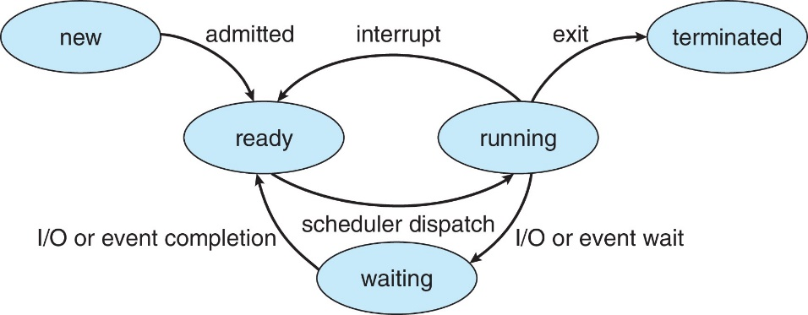
Diagram of Process State

Slide 20
Outline
Process Concept
The Process
Process State
Process Control Block
Process Scheduling
Operations on Processes
Interprocess Communication
IPC in Shared-Memory Systems
Examples of IPC Systems
Communication in Client-Server Systems

Slide 21
Process Control Block (PCB) (or Process Descriptor)
For each process, OS maintain a data structure called process control block (also called task control block, process descriptor, task descriptor) to keep information with each process
Keep information associated with each process
Process state
Program counter: address of the next instruction
Saved when an interrupt occurs or context switches occurs
CPU registers
Saved when an interrupt or context switches occurs (introduce later)
CPU scheduling information: process priority……
Memory-management information
Will be introduced later
Accounting information
CPU time and real time used…..(see following slide)
I/O status information
Open files and devices…

Slide 22
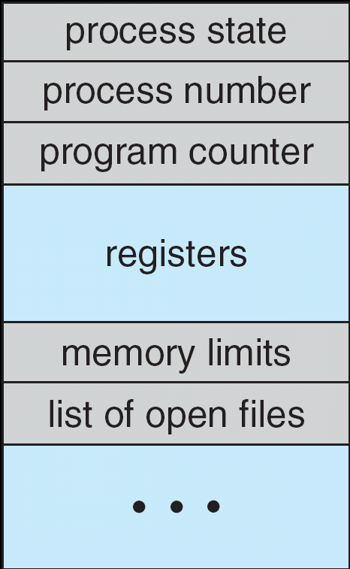
Process Control Block (PCB)

Slide 23
Process Control Block (PCB)
…
out eax, 0x60;
add eax, ebx;
…
…
out eax, 0x30;
add ebx, ebx;
…
…..
P1 PCB
pc = x, eax=y, …..,
OS
P2 PCB
pc = i, eax=j, …..,
OS

Slide 24
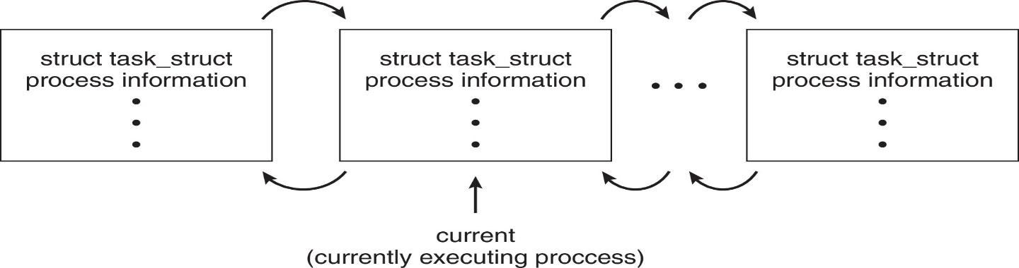
Process Representation in Linux
Represented by the C structure task_struct
pid t_pid; /* process identifier */ long state; /* state of the process */ unsigned int time_slice /* scheduling information */ struct task_struct *parent;/* this process’s parent */ struct list_head children; /* this process’s children */ struct files_struct *files;/* list of open files */ struct mm_struct *mm; /* address space of this process */

Slide 25
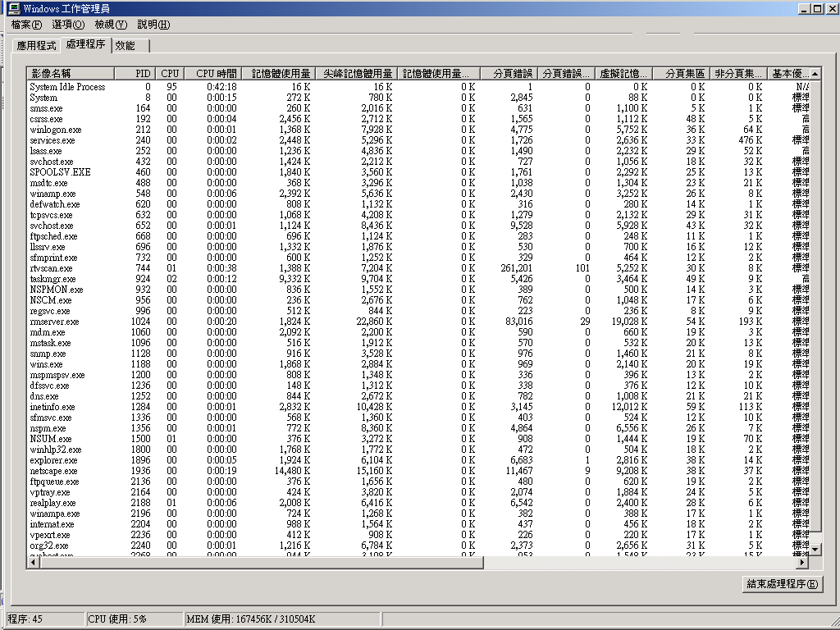
Accounting

Slide 26
Outline
Process Concept
Process Scheduling
Operations on Processes
Inter-Process Communication
IPC in Shared-Memory Systems
Examples of IPC Systems
Communication in Client-Server Systems

Slide 27
Process Scheduling
Term Definition
Process scheduler (or CPU scheduler)
Selects a ready processes for execution on a CPU core
Degree of multiprogramming
The number of processes currently in memory

Slide 28
Outline
Process Concept
Process Scheduling
Scheduling Queues
CPU Scheduling
Context Switch
Operations on Processes
Interprocess Communication
IPC in Shared-Memory Systems
Examples of IPC Systems
Communication in Client-Server Systems

Slide 29
CPU Scheduler(CPU排程演算法)需要什麼資料結構？

Slide 30
Scheduling Queues
OS maintains scheduling queues of processes
Ready queue – set of all processes residing in main memory, ready and waiting to execute
A set of wait queues – set of processes waiting for events, e.g., completion of I/O
Processes migrate among the ready queue and various wait queues (see following two slides)

Slide 31
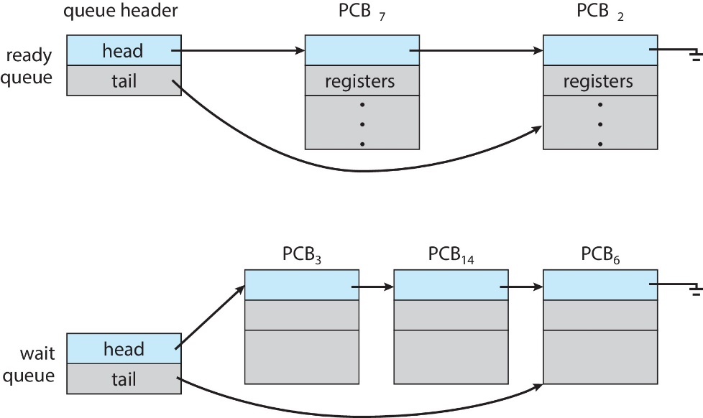
The Ready Queue and Wait Queues

Slide 32
Diagram of Process State

Slide 33
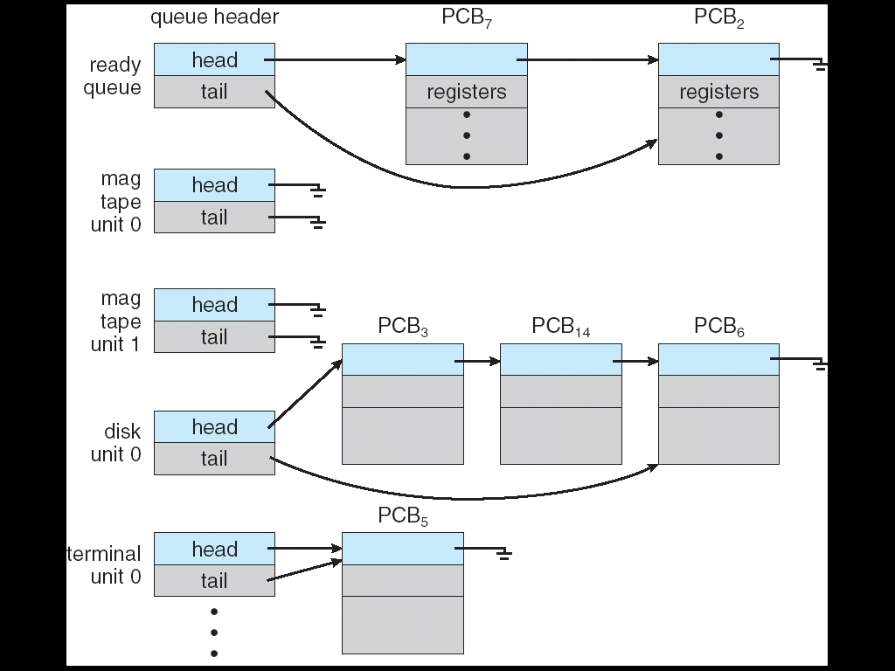
Various I/O Wait Queues
There may be a set of wait queues

Slide 34
Queuing-Diagram Representation of Process Scheduling
Once a process is executing, one of following events would occur (see the following slide)
The process issue an I/O request
The process is placed in an I/O wait queue
The process creates a new child process
The process is placed in a wait queue waiting for child’s termination
The process is removed from the core due to interrupt
The process is placed in the interrupt wait queue
The process is removed from the core, due to its time slice expire
The process is put back in the ready queue

Slide 35
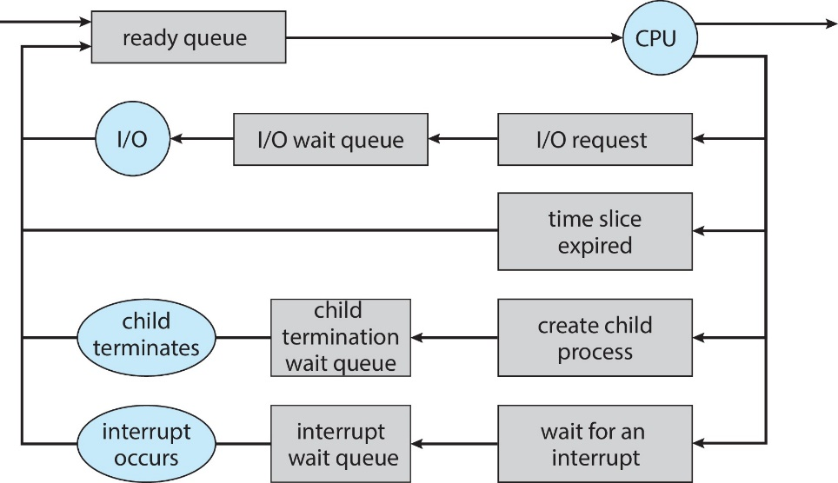
Queuing-Diagram Representation of Process Scheduling
terminate
Free PCB
and
resources

Slide 36
Outline
Process Concept
Process Scheduling
Scheduling Queues
CPU Scheduling
Context Switch
Operations on Processes
Interprocess Communication
IPC in Shared-Memory Systems
Examples of IPC Systems
Communication in Client-Server Systems

Slide 37
什麼是CPU Scheduler?

Slide 38
CPU Scheduling
CPU Scheduler (or Process Scheduler)
Select a process from ready queues and allocates a CPU core to it
See the following two slides

Slide 39
CPU Scheduler
User
Applications
…
for (;;)
a=a+1;
…
User
Applications
…
for (;;)
a=a+1;
…
Change to execute another application
User Mode
Kernel Mode
CPU_scheduler ()
{
If (current process executes too long)
select another process to run
}
Hardware

Slide 40
Example: Scheduler is Invoked when a Timer Interrupt Occurs
…
for (;;) a=a+1;
…
CPU
…
add eax, ebx;
…
…..
interrupt
Timer
CPU Scheduler
OS
Interrupt Service
Routine (ISR)

Slide 41
CPU Scheduling (CPU)
CPU scheduler is invoked very frequently
At least once very 100 milliseconds
Why?
But, CPU scheduler cannot be invoked extremely too frequently
Why?

Slide 42
CPU Scheduling
Some OS introduces an intermediate from of scheduling
Swapping
Swapping
Removes processes from memory when memory space is not enough
Reduce the degree of multiprogramming
At some later time, the process can be re-introduced into memory
Increase the degree of multiprogramming

Slide 43
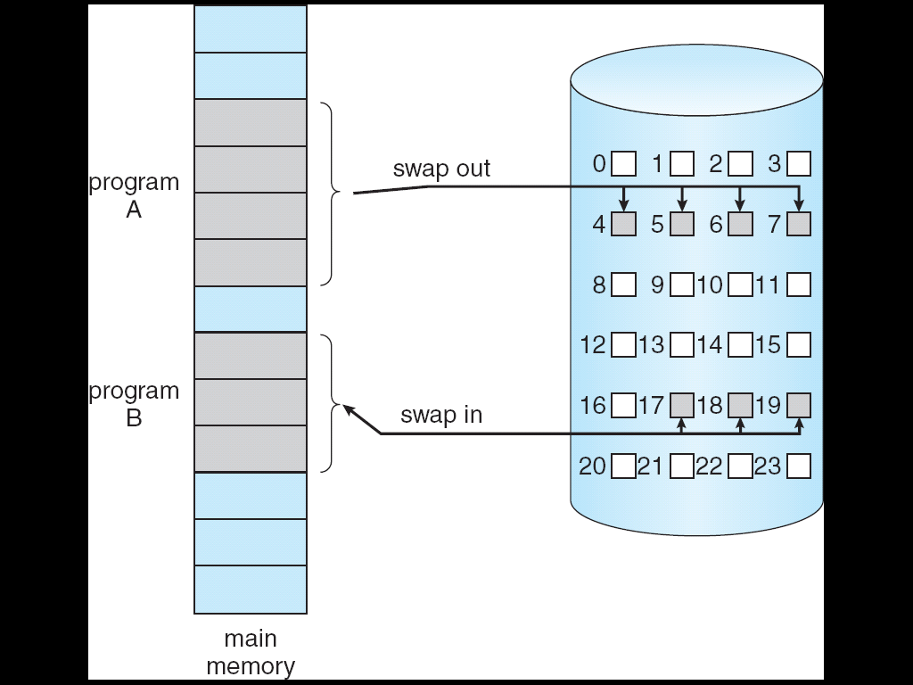
Swap Out and Swap In

Slide 44
CPU排程演算法會在第五章介紹!

Slide 45
Outline
Process Concept
Process Scheduling
Scheduling Queues
CPU Scheduling
Context Switch
Operations on Processes
Interprocess Communication
IPC in Shared-Memory Systems
Examples of IPC Systems
Communication in Client-Server Systems

Slide 46
CPU排程演算法會伴隨Context Switch!
什麼是Context Switch?

Slide 47
Context Switch
Context switch: CPU switches from one process to another process
OS must save the state (context) of the old process in its PCB
Then OS must restore the saved state (context) of the new process from PCB

Slide 48
複習： 問題: What is a state?

Slide 49
複習：Storage-Device Hierarchy

Slide 50
Context Switch (Cont.)
Context (state):
CPU registers (including Program Counter),
Memory areas
Various tables
……
They constitute the environment or context of a process.

Slide 51
複習： 問題: 為什麼要儲存state?然後復原state?

Slide 52
複習：Without State Save and Restore
…
out eax, 0x60;
add eax, ebx;
…
CPU
eax | 59
ebx | 25
eax | 10
ebx | 5
…..
…
add eax, 0x30;
add ebx, eax;
…
OS

Slide 53
Context Switch
P1’s PCB
PC=0x1000
eax=10, ebx=5
ecx =9, edx = 11
etc.
save
context
switch
……
context
switch
process P1
process P1
restore
CPU
eax=6, ebx=9,
ecx=3, edx =32
pc= 0x58000…
CPU
eax=10, ebx=5,
ecx=9, edx =11
pc= 0x1000…
CPU
eax=10, ebx=5,
ecx=9, edx =11
pc= 0x1000…

Slide 54
所以，切換Process時 (Context Switch)，必須要儲存當下Process的state，然後復原接下來要執行的Process的state! 儲存的state記錄會在PCB當中(Page 18).

Slide 55
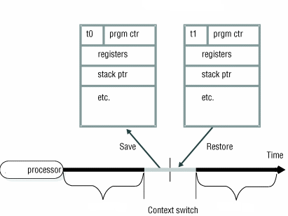
Context Switch
P0’s PCB
P1’s PCB
process P0
process P1

Slide 56
Context Switch 1
…
out eax, 0x60;
add eax, ebx;
…
CPU
context
switch
eax | 59
ebx | 25
eax | 10
ebx | 5
…
out eax, 0x30;
add ebx, ebx;
…
…..
P1 PCB
eax=10; ebx=5;……
P1 PCB
eax=x; ebx=y;……
OS
P2 PCB
eax=59; ebx=25;……
OS

Slide 57
Context Switch 2
…
out eax, 0x60;
add eax, ebx;
…
CPU
context
switch
eax | 10
ebx | 5
eax | 100
ebx | 35
…
out eax, 0x60;
add eax, ebx;
…
…..
P1 PCB
eax=10; ebx=5;……
P1 PCB
eax=x; ebx=y;……
OS
P2 PCB
eax=59; ebx=25;……
P2 PCB
eax=100; ebx=35;……
OS

Slide 58
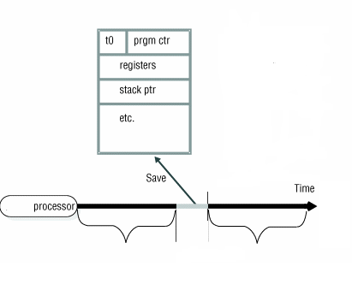
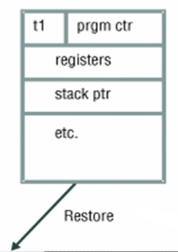
比較：ISR Has no State to Be Saved/Restored
P0’s PCB
P0’s PCB
process P0
ISR

Slide 59
Context Switch (Cont.)
Context-switch time is overhead
System does not execute user applications while switching
Hardware support for reducing context switch overhead
Existence of special instructions
A single instruction to save/load all registers
(See p. 13 in Chapter 5 of Assembly Language)
Sun UltraSPARC provides multiple sets of registers
Content switch ⇨ change to use the current register set

Slide 60
複習：Related Instructions
PUSHFD and POPFD
Push and pop the EFLAGS register
PUSHAD pushes 32-bit general-purpose registers on stack
Order: EAX, ECX, EDX, EBX, ESP, EBP, ESI, EDI
POPAD pops the same registers off stack in reverse order
PUSHA and POPA do the same for 16-bit registers
.data
saveFlags DWORD ?
.code
pushfd ; push flags on stack
pop saveFlags ; copy into a variable
push saveFlags ; push saved flag values
popfd ; copy into a variable

Slide 61
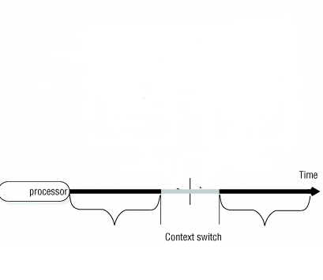
Multiple Sets of Registers
CPU
eax₁=1;
ebx₁=5;
ecx₁=8;
edx₁=6;
……
eax₂=4;
ebx₂=3;
ecx₂=7;
edx₂=8;
……
……
process P1
process P2

Slide 62
Outline
Process Concept
Process Scheduling
Operations on Processes
Process creation
Process termination
Interprocess Communication
IPC in Shared-Memory Systems
Examples of IPC Systems
Communication in Client-Server Systems

Slide 63
問題：當Double Click某一個應用程式，發生了什麼事情呢?
解答: Windows檔案總管(or Shell in Linux)會create一個process(or 請OS creates一個process)，執行此一應用程式

Slide 64
Process Creation
A process may create several new processes
The creating process is called parent
The new processes are called children of that process
Forming a tree of processes (next slide)

Slide 65
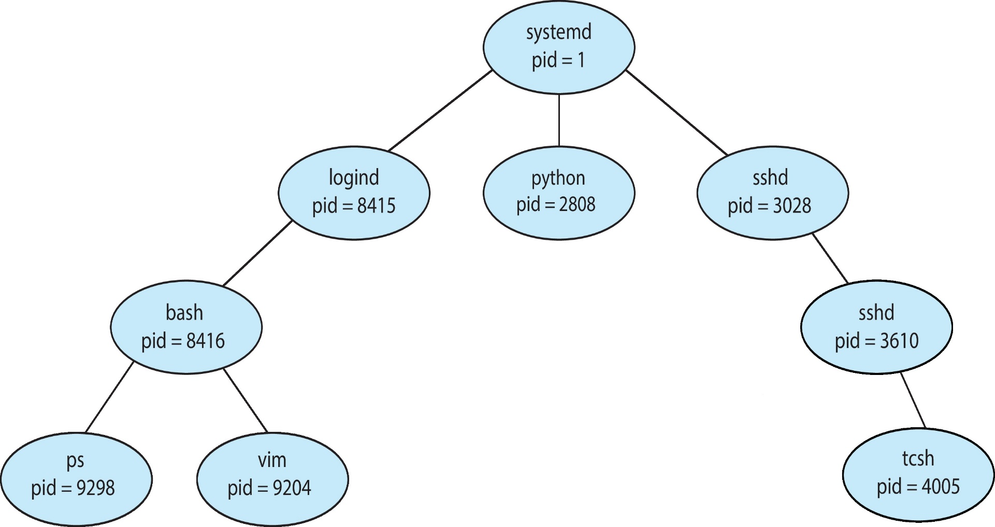
A Tree of Processes in Linux
OS identify processes according to a unique process identifier (or pid)

Slide 66
Process Creation (Cont.)
Execution
Parent and children execute concurrently, or
Parent waits until children terminate
wait() system call in Linux
Address space
Child duplicate of parent (has the same program and data as the parent), or
fork() system call creates a new process in Linux
Child has a new program loaded into it
exec() system call replaces the process’ memory space with a new program in Linux

Slide 67
The fork() System Call
Memory
Copy from original image
Original image
fork()
New image
NCHU System & Network Lab

Slide 68
The exec() System Call
Memory
Copy from original image
Original image
fork()
Load another image
New image
exec()
NCHU System & Network Lab

Slide 69
UNIX Process Creation
See the following slide!
Each process has a unique process id (PID)
A new process is created by the fork() system call
The new (child) process duplicates the address space of the parent process
Child and parent continue execution at the instruction after the fork() system call
Child: return value of fork is 0
Parent: return value of fork is PID of the child process
The execlp() system call is used to load a new binary file into memory – destroying the old code

Slide 70
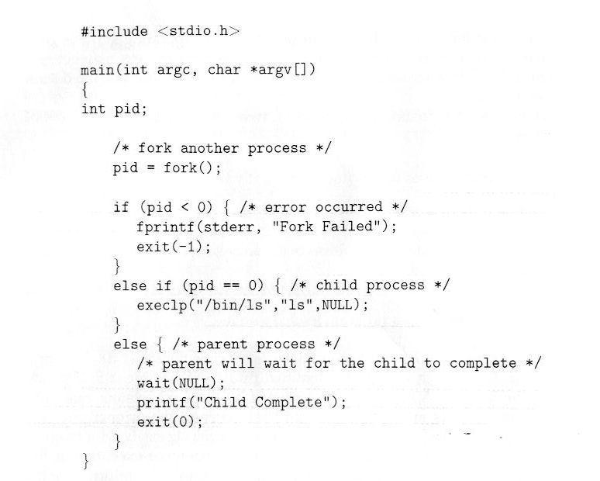
C Program Forking Process

Slide 71
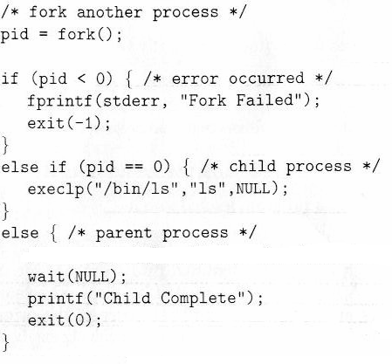
pid=153
memory
parent’ code
pid=0
ls
child’ code

Slide 72
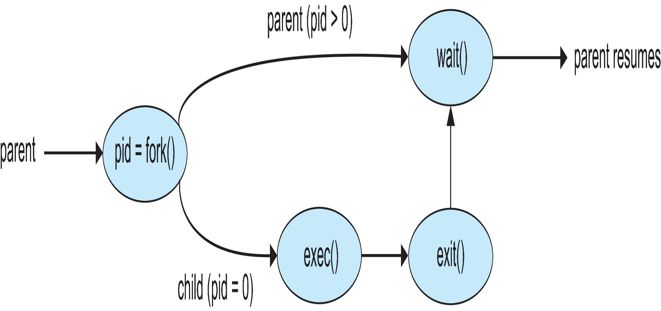
Process Creation

Slide 73
Outline
Process Concept
Process Scheduling
Operations on Processes
Process creation
Process termination
Interprocess Communication
IPC in Shared-Memory Systems
Examples of IPC Systems
Communication in Client-Server Systems

Slide 74
Process Termination
Process invokes exit() system call
Return a status value with its process identifier to parent
Parent obtains the status value and the process identifier of the child via the wait() system call
Then, process’ resources are deallocated by OS
#include <sys/wait.h>
pid_t pid;
int status;
pid_t wait(int *stat_loc);
#include <stdlib.h>
void exit(int status);

Slide 75
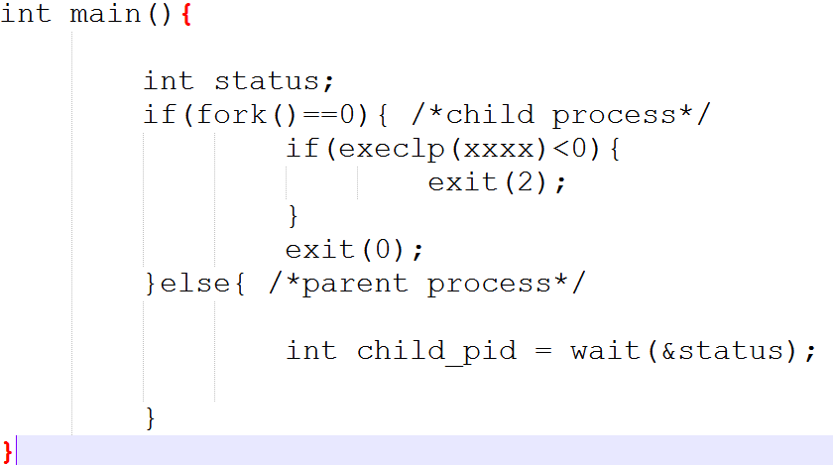

Slide 76
Process Termination in Linux
When a process terminates and before parent calls wait()
The terminated process becomes a zombie(殭屍) process
Since its process control block (PCB) still exists for storing the exit status value
See the following two slides
But, if parent did not invoke wait() and is terminated
The child process becomes as orphans
Thus, Linux set the child’s parent to the init
init process periodically calls wait() to collect children’s exit status value
See the following next slide

Slide 77
Zombie Process
wait()
fork()
parent
exit status value
child
exec()
exit()
zombie

Slide 78
Zombie Process
A = A +1;
…
wait();
CPU
…
exit(1);
OS
P1 PCB
P2 PCB
Zombie Process
P2 PCB
exit status = 1
OS

Slide 79
Orphans Process
init
exit()
fork()
parent
child
exec()
a=a+1;
b=b-1;
…
orphan

Slide 80
Outline
Process Concept
Process Scheduling
Operations on Processes
Interprocess Communication
IPC in Shared-Memory Systems
Examples of IPC Systems
Communication in Client-Server Systems

Slide 81
Cooperating Processes
Processes may share data with each other ⇨ cooperating processes
Why ?
Information sharing
Computation speedup
Modularity
Construct the system in a modular fashion

Slide 82
Interprocess Communication (IPC)
Cooperating processes require an interprocess communication (IPC) mechanism
Two common models
Message passing
Shared memory

Slide 83
Communications Models
(a) Message passing. (b) Shared memory

Slide 84
問題：如何實現Message Passing?

Slide 85
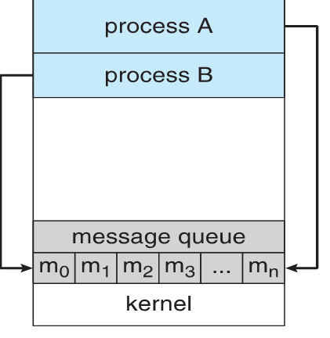
Message Passing
receive_msg()
Process A
send_msg()
send_msg()
Process B
memory copy
memory copy

Slide 86
問題：如何實現Shared Memory?

Slide 87
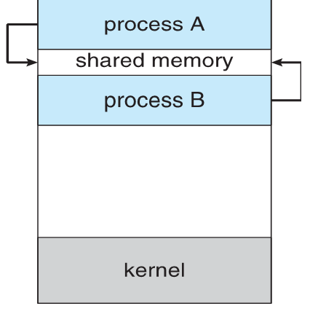
Shared Memory

Slide 88
Interprocess Communication (IPC) (Cont.)
Comparisons
Message passing
Useful for exchanging smaller amounts of data
Easier to implement
Slower; requires system calls for sending/receiving messages (via memory copying)
No conflict need to be avoided
Shared memory
Faster; requires no system calls when reading/writing data
But need protection and synchronization

Slide 89
複習：Microkernel

Slide 90
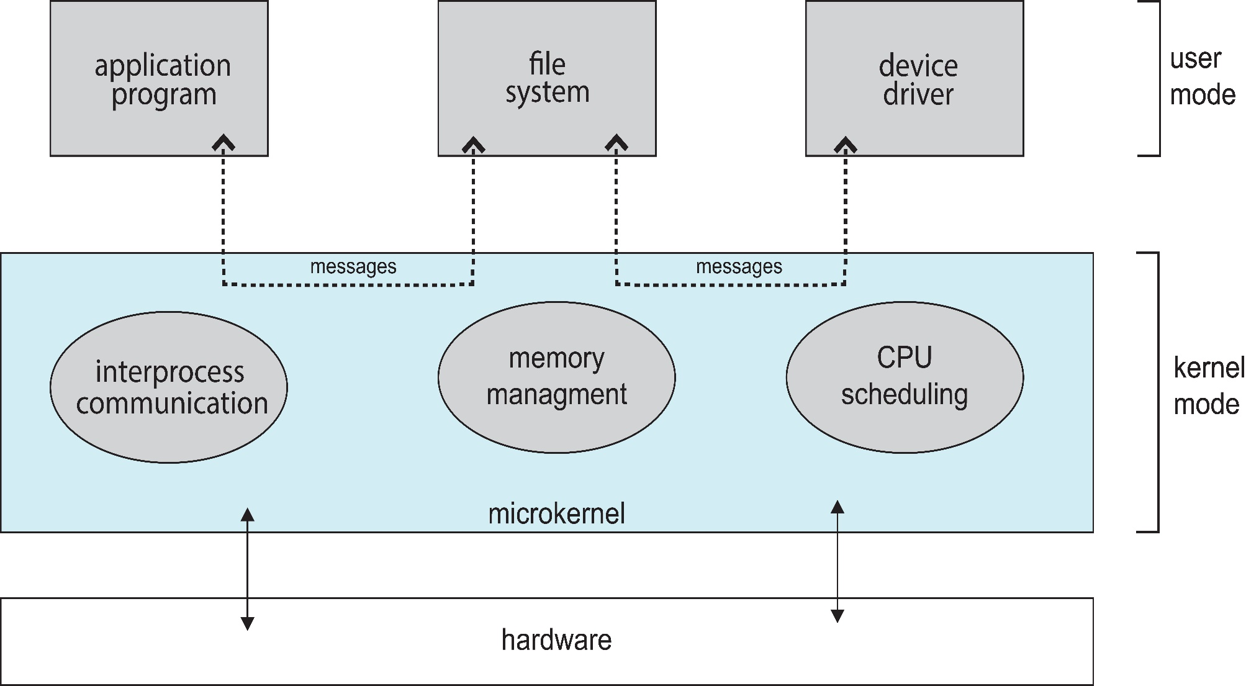
Microkernel System Structure

Slide 91
問題：為何Microkernel效能不好？

Slide 92
Microkernel (Cont.)
Advantages:
Easier to extend the OS
By adding new services to user space and do not require kernel modification
Easier to port the OS to new architectures
The kernel is small and the changes tend to be fewer
More reliable and more secure
Most services are running as user processes
If a service failed, the rest of the OS remains untouched
Disadvantages:
Performance overhead by message passing between services
Window NT: microkernel, Windows XP: a monolithic kernel

Slide 93
複習結束：Microkernel

Slide 94
Outline
Process Concept
Process Scheduling
Operations on Processes
Interprocess Communication
IPC in Shared-Memory Systems
IPC in Message Passing Systems
Examples of IPC Systems
Communication in Client-Server Systems

Slide 95
Shared-Memory
Communicating processes need to establish a region of shared memory
Reside in the address space of the process creating the shared-memory region
Other processes using this region must attach it to their address space
Shared memory remove the restriction that one process cannot access another process’s memory

Slide 96
Shared Memory

Slide 97
Example: Producer-Consumer Problem (Skip!)
A paradigm for cooperating processes
Producer process produces information that is consumed by a consumer process
Use a buffer to contain the data items
And the buffer, in, and out variables use shared memory
#define BUFFER_SIZE 10
typedef struct {
. . .
} item;
item buffer[BUFFER_SIZE]; //in shared memory
int in = 0; //in shared memory
int out = 0; //in shared memory

Slide 98
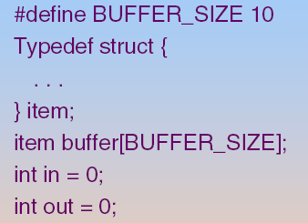
Bounded-Buffer – Shared-Memory Solution (Skip!)
in: next free position
out: first full position
Buffer is empty
in == out
Buffer is full
((in+1)%BUFFER_SIZE)== out
out
in

Slide 99
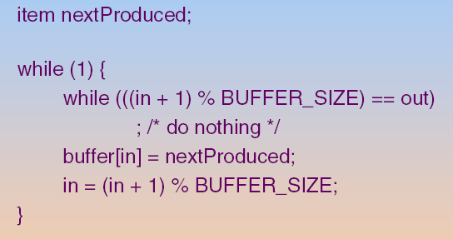
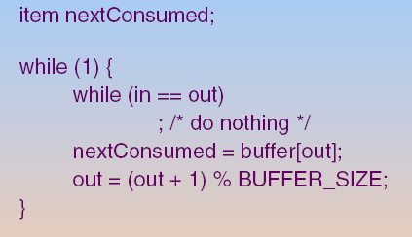
Bounded-Buffer – Shared-Memory Solution (Skip!)
Producer
Consumer
Problem? Both processes attempt to access the buffer concurrently?
=> Addressed in Chapter 6 and Chapter 7

Slide 100
Outline
Process Concept
Process Scheduling
Operations on Processes
Interprocess Communication
IPC in Shared-Memory Systems
IPC in Message Passing Systems
Examples of IPC Systems
Communication in Client-Server Systems

Slide 101
Message-Passing Systems
Message-passing provides two operations:
send(message)
receive(message)

Slide 102
Outline
Process Concept
Process Scheduling
Operations on Processes
Interprocess Communication
IPC in Shared-Memory Systems
IPC in Message Passing Systems
Synchronous or asynchronous communication
Examples of IPC Systems
Communication in Client-Server Systems

Slide 103
Synchronous or Asynchronous
Message passing may be either blocking or non-blocking
Also known as synchronous or asynchronous
Blocking - process suspended until I/O completed
Easy to use but insufficient for some needs
Nonblocking - I/O call returns immediately with as much as data available
With a return value indicating how many bytes were transferred

Slide 104
Synchronous or Asynchronous I/O Example
Program 1
Program 2
recvfrom ()…
User Mode
recvfrom()
Kernel Mode
recvfrom ()
{
….
….
….
}
OS
網路卡

Slide 105
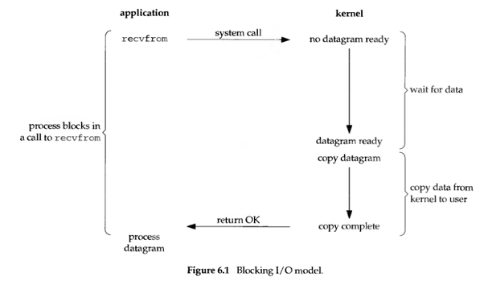
Blocking I/O
https://medium.com/@clu1022/%E6%B7%BA%E8%AB%87i-o-model-32da09c619e6

Slide 106
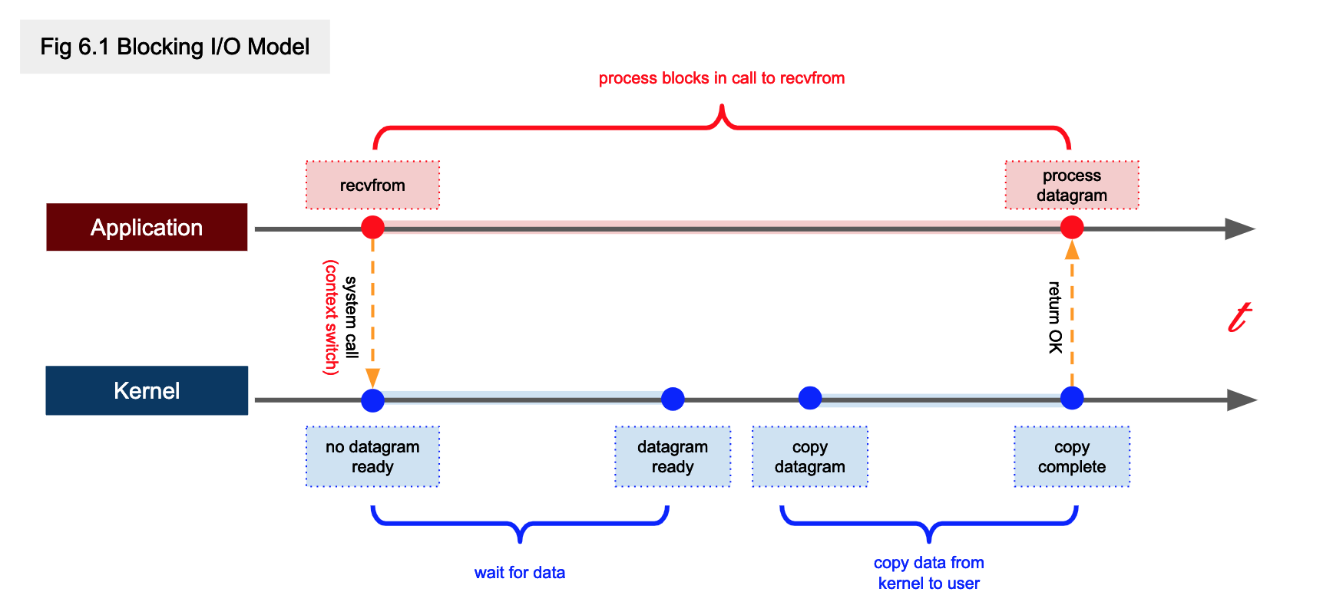
Blocking I/O
https://rickhw.github.io/2019/02/27/ComputerScience/IO-Models/

Slide 107
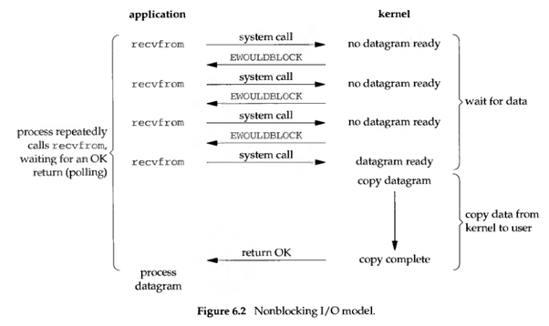
Non-Blocking I/O
https://medium.com/@clu1022/%E6%B7%BA%E8%AB%87i-o-model-32da09c619e6

Slide 108
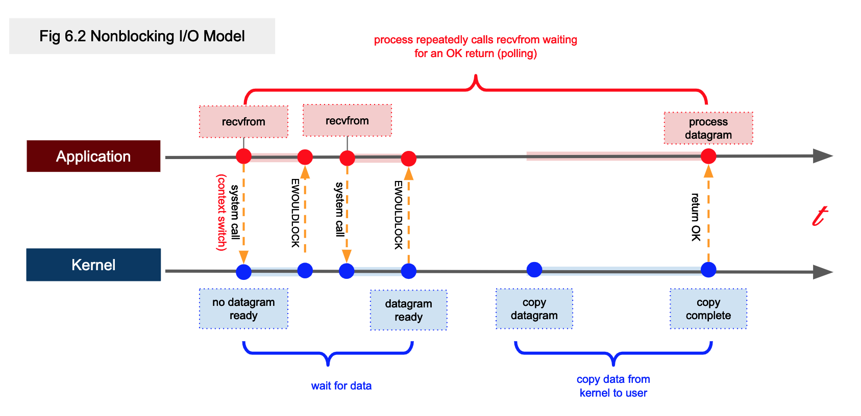


Non-Blocking I/O
https://rickhw.github.io/2019/02/27/ComputerScience/IO-Models/

Slide 109
Blocking and Nonblocking I/O
Blocking is considered synchronous
Blocking send: sender blocked until the message is received by the receiver
Blocking receive: receiver blocks until a message is available
Non-blocking is considered asynchronous
Non-blocking send: sender sends the message and resumes operation
Non-blocking receive: receiver retrieves either a valid message or a null

Slide 110
Outline
Process Concept
Process Scheduling
Operations on Processes
Interprocess Communication
IPC in Shared-Memory Systems
IPC in Message Passing Systems
Examples of IPC Systems (Skip!)
Communication in Client-Server Systems

Slide 111
POSIX Shared Memory
shm_open():
create or open a shared memory object
mmap():
memory map the shared memory object
Then, access the shared memory as ordinary memory
shm_unlink ():
remove the shared memory object

Slide 112
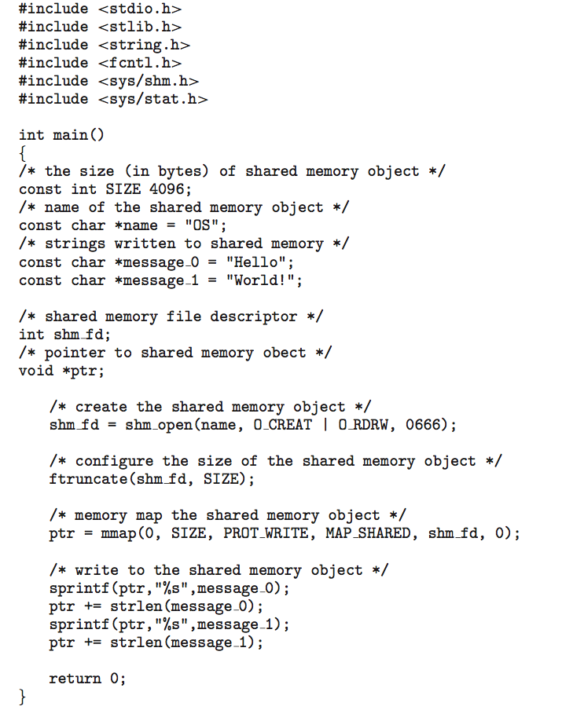
POSIX Shared Memory: Producer

Slide 113
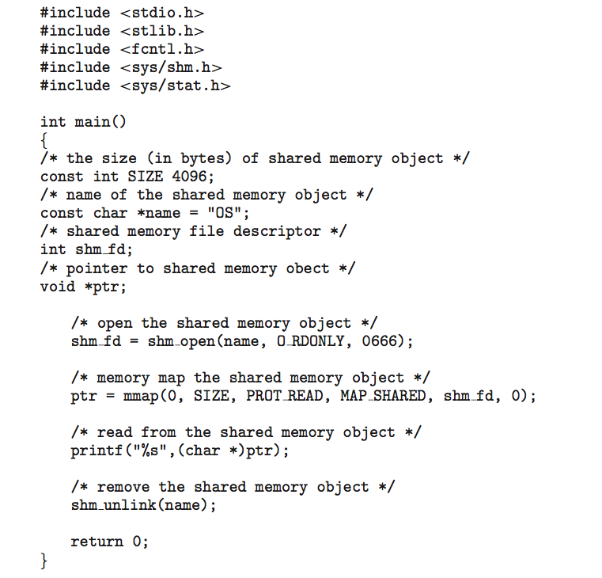
POSIX Shared Memory: Consumer

Slide 114
Chapter 3: Processes
Overview
Process Scheduling
Operations on Processes
Interprocess Communication
Examples of IPC Systems
Communication in Client-Server Systems (Skip!)
Sockets
Remote Procedure Calls (RPC)
pipe()

