Slide 1

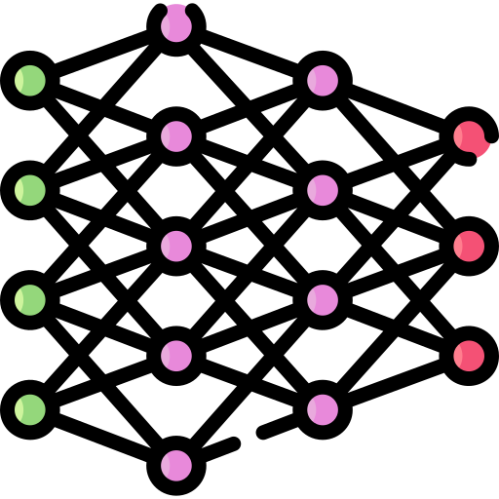









































Input
Brownian Bridge Architecture
Progressive Learning Strategy
User History $s$
Forward Process (Item $→$ History)
Stage 1: Sparse Embedding Pretraining
…
$$q(x_{t}|x_{t−1},x_{T}=e_{s})$$
Noise Variance
$$δ_{t}=m⋅β_{t}(1−β_{t})$$
Sequence Encoder
Item Embedding Table
Sequence Encoder $h_{φ}$
(Transformer)
$$t=0$$
$$t=1$$
$$t=t$$
$$t=T−1$$
$$t=T$$
Target Item
$$x_{0}$$
$$x_{0}$$
$$x_{1}$$
…
$$x_{t}$$
…
$$x_{T−1}$$
$$x_{T}$$
Intermediate State
$$x_{t}$$
Recommendation Loss (CE)
$$=e_{y}$$
$$=e_{s}$$
$$x_{T}$$
User History
Learn discriminative embeddings
History Representation
$$e_{s}$$
Reverse Process (History $→$ Item)
Forward
(noising)
Stage 2: Preference-Centric Diffusion Training
$$p_{θ}(x_{t−1}|x_{t},x_{T}=e_{s})$$
Load Staget-1 embeddings
Jointly optimize all components
Target Item $y$
Reverse
(denoising)
Denoiser $g_{θ}$
$$e_{s}$$
$$x_{t}$$
$$e_{t}$$
$${\hat{x}}_{0}$$
Sequence Encoder
Denoiser
(
(
+
$$λ$$
+
Item Representation
History Representation
Noisy State
Timestep Embedding
Combined Loss (CE & MSE)
$$e_{y}$$
Prediction
Learn both diffusion & recommendation
Inference (History $→$ Item)
Iteratively denoising for T steps
Retrieval Top-K Items
$$x_{T}=e_{s}$$
$${\hat{x}}_{0}$$
Final List
Given user history $s$
$$x_{T}$$
$$x_{T−1}$$
…
$$x_{t}$$
…
$$x_{1}$$
$$x_{0}$$
Prediction
History Representation
Item Representation
Noisy State
Timestep Embedding
Item Embedding Table
Sequence Encoder
/ Denoiser

