Slide 1



GradCraft: Elevating Multi-task Recommendations through Holistic Gradient Crafting
USTC & Kuaishou Technology
Yimeng Bai, Yang Zhang, Fuli Feng, Jing Lu, Xiaoxue Zang, Chenyi Lei, Yang Song
01/15
Notes:
Hello everyone, I am baiyimeng from University of Science and Technology of China.
I am delighted to introduce our work here.
The title of our presentation is "GradCraft: Elevating Multi-task Recommendations through Holistic Gradient Crafting."
This research was done when I was interning at Kuaishou.

Slide 2
Outline
Background
Methodology
Experiment
Conclusion
02/15
Notes:
Next, I will present the background, methodology /metho daology/, experiment, and conclusion of our research.

Slide 3
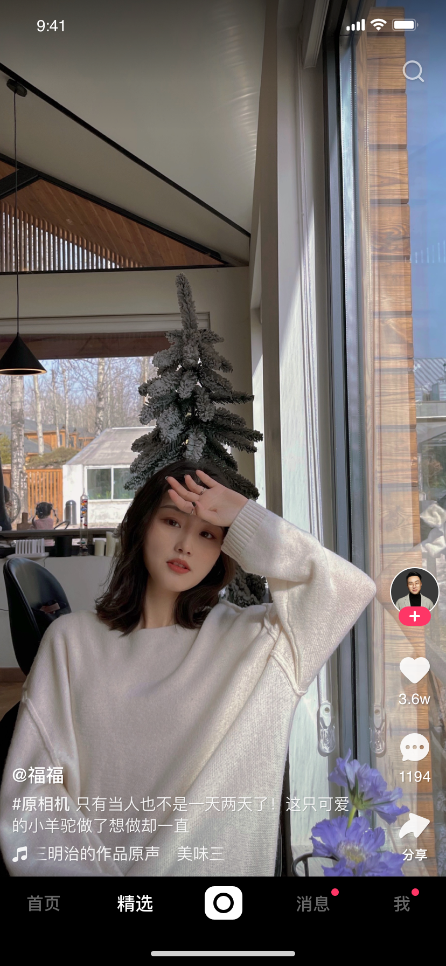
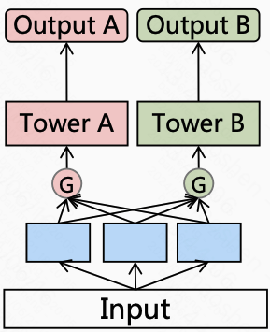



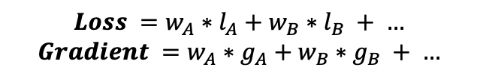
Background
What is Multi-task Recommendation
Feedback Loop
Why Muti-task Learning
TaskA: long view
TaskB: like
TaskC: follow
Collecting
Data
Learning
TaskD: forward
…
Serving
$$Loss =w_{A}∗l_{A}+w_{B}∗l_{B} + …$$
$$Gradient =w_{A}∗g_{A}+w_{B}∗g_{B} + …$$
User
System
03/15
Notes:
Let's begin with the background.
Multi-task recommendation involves a system that simultaneously models various user behaviors, such as liking, long viewing, following, and forwarding.
Multi-task learning is essential here because it allows us to optimize these tasks collectively, leveraging shared information to improve recommendations.

Slide 4











Background
Challenge in Multi-task Recommendations
Task Heterogeneity
Task Cardinality
TaskA: long view
TaskB: like
Viewing: long view
Engagement: like
TaskC: follow
Engagement behavior is sparser than viewing behavior
…
Gradient perspective: gradient magnitudes are different.
Gradient perspective: gradient directions are different.
$$g_{B}$$
$$g_{A}$$
$$g_{C}$$
$$g_{B}$$
$$∥g_{A}∥=10$$
$$∥g_{B}∥=1e−4$$
$$g_{A}$$
$$g_{C}$$
Conflicting task pairs (inner product < 0)
04/15
Notes:
A significant challenge in multi-task recommendations arises from the Task Heterogeneity /He te rou gen neity/ and Task Cardinality /kɑdinalti/, which can cause misaligned gradients.
Firstly, task heterogeneity refers to the different characteristics of tasks.
For example, engagement behavior is sparser than viewing behavior, leading to differences in gradient magnitudes.
Consequently, tasks with larger gradient magnitudes tend to dominate the optimization process.
Secondly, in practical settings, we usually have plenty of tasks to optimize, resulting in a rise in potential conflicting task pairs.
Here, conflict is defined by the inner product of gradient vectors being negative.
This would lead to the negative transfer or seesaw phenomenon.

Slide 5
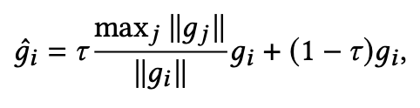
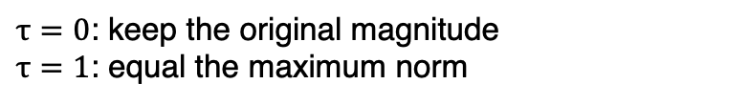

Methodology
Gradient Magnitude Adjustment
Key: ensure an appropriate level of magnitude balance
How: align gradient norm with the maximum norm among tasks
For$i$in range(T):
Number of tasks
Hyper-parameter: control the proximity to the maximum norm
$τ=0$: keep the original magnitude
$τ=1$: equal the maximum norm
Mitigate interference from magnitudes for subsequent manipulation
05/15
Notes:
First, our approach addresses these challenges by focusing on adjusting the gradient magnitudes.
Instead of aiming for perfect uniformity across all tasks, we concentrate on reducing significant differences in gradient norms, particularly those that could vary by several orders of magnitude.
By doing this, we prevent any one task from dominating the others while still maintaining the unique characteristics of each task.
To achieve this, we adjust the gradient norm for each task by blending its original norm with the maximum norm. The extent of this adjustment is controlled by a parameter we call tau.

Slide 6





















Methodology
Gradient Direction Deconfliction
Key: ensure task gradient does not conflict with other gradients
How: global gradient projection
$$z$$
$$z$$
$$z$$
$$g_{B}$$
$$g_{B}$$
$$g_{B}$$
$$g_{A}$$
$$g_{A}$$
$$g_{A}$$
$${g′}_{C}$$
$$y$$
$$y$$
$$y$$
$$g_{C}$$
$$g_{C}$$
$${g′′}_{C}$$
$${g′′}_{C}$$
$$x$$
$$x$$
$$x$$
$$g_{C}g_{A}^{T}<0$$
$$g_{C}g_{B}^{T}<0$$
Global gradient projection
$${g′′}_{C}g_{A}^{T}=0$$
$${g′′}_{C}g_{B}^{T}=0$$
06/15
Notes:
Next, we focus on gradient direction deconfliction, ensuring task gradients do not conflict with each other.
For instance, imagine we have three tasks—A, B, and C.
Initially, the gradient of task C might conflict with those of A and B, as indicated by a negative inner product.
Subsequently, we employ projections and retaining the orthogonal /aor sao ge no/ part of C, effectively making its inner product with A and B zero.
This helps align the tasks, preventing conflicts in gradient directions.

Slide 7









Methodology
Gradient Direction Deconfliction
For each task, our method simultaneously addresses all conflicting tasks
Comparison: PCGrad [1] is one vs one, our projection method is one vs all
When only two tasks: our projection method degrades to PCGrad
$$g_{B}$$
$$g_{B}$$
$${g′′}_{C}$$
$$g_{B}$$
$${g′′}_{C}$$
$$g_{C}$$
$$g_{C}$$
$${g′}_{C}$$
$$g_{C}g_{B}^{T}<0$$
PCGrad
$${g′′}_{C}g_{B}^{T}=0$$
[1] Gradient Surgery for Multi-Task Learning. NeuralIPS 2020.
07/15
Notes:
Our gradient projection method builds on the standard PCGrad approach but takes it a step further.
While PCGrad resolves conflicts between tasks one at a time, our method handles conflicts with all conflicting tasks simultaneously.
Put simply, PCGrad uses a one-vs-one strategy, while our method adopts a one-vs-all approach. When there are only two tasks, our method naturally simplifies to PCGrad.

Slide 8
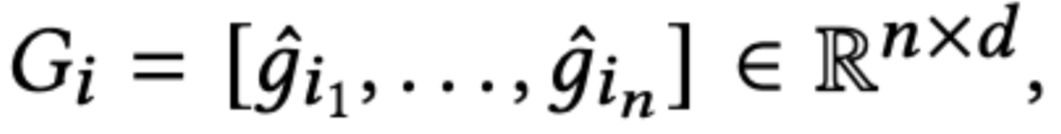
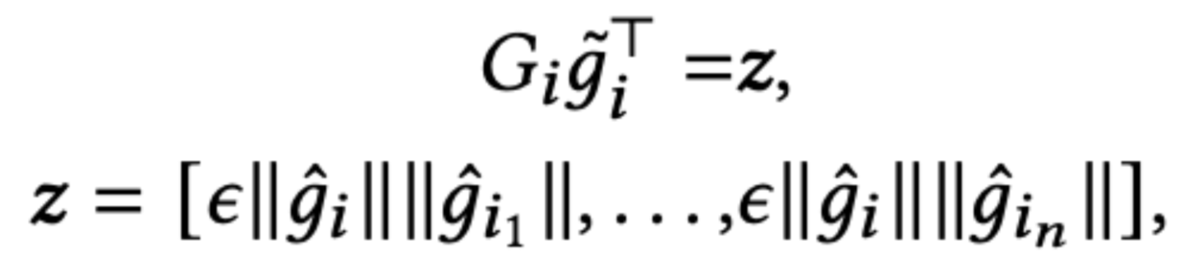
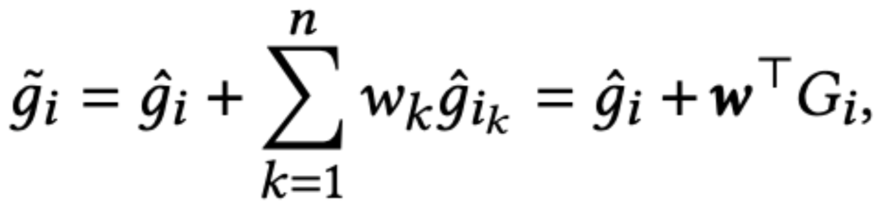
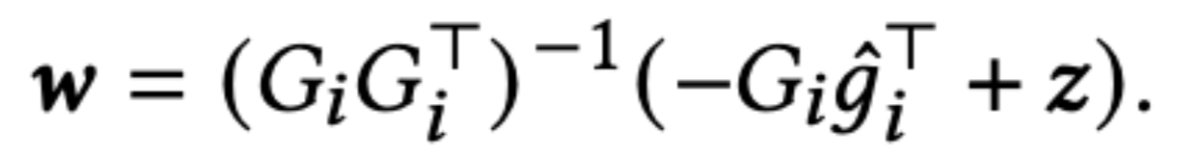



Methodology
Gradient Direction Deconfliction
Formulation of global gradient projection
Stack all conflicting gradients
For$i$in range(T):
Input: ${\hat{g}}_{i}$
Set the projection target
Hyper-parameter: allow the positive inner product
Give the projection to the space
Output: ${\tilde{g}}_{i}$
Solve the weight vector
08/15
Notes:
We formally define our global gradient projection method as follows:
For a given task ii, we start by stacking all conflicting gradients into a tensor.
The next step is to establish a projection target, where our goal is for the resulting gradient to avoid having a nonnegative inner product with the gradients of other tasks.
The hyper-parameter epsilon is to allow the target of positive inner product.
Once this target is set, we project the gradient into the linear space and solve for the weight vector.
This process allows us to obtain the updated gradient for each task, ensuring better alignment and reducing conflicts.

Slide 9
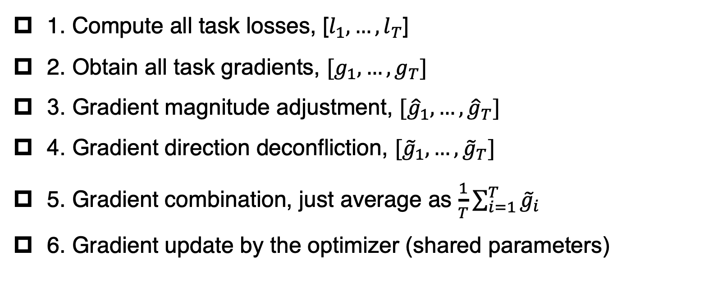
Methodology
Overall Framework of GradCraft
1. Compute all task losses, [$l_{1},…,l_{T}$]
2. Obtain all task gradients, $[g_{1}, …, g_{T}]$
3. Gradient magnitude adjustment, $[{\hat{g}}_{1},…,{\hat{g}}_{T}]$
4. Gradient direction deconfliction, $[{\tilde{g}}_{1},…,{\tilde{g}}_{T}]$
5. Gradient combination, just average as $\frac{1}{T}\sum_{i=1}^{T}{{\tilde{g}}_{i}}$
6. Gradient update by the optimizer (shared parameters)
09/15
Notes:
OK, now we can summarize our proposed GradCraft.
First, we compute the loss for each task and perform backpropagation and flatten operations to obtain the gradient vectors.
Next, we apply our magnitude adjustment and direction deconfliction methods to these gradients.
Finally, we average the updated gradients and use them to update the network parameters with an optimizer.

Slide 10
Experiment
Offline Experiment Setting
Dataset: Kuaishou (private), Wechat (public)
Task (Binary for simplicity):
  Viewing behavior: EffectiveView (EV), LongView (LV), CompleteView (CV)
  Engagement behavior: Like, Follow, Forward
Evaluation: average value of all tasks’ AUC and GAUC
Baseline:
  Simple: Single, EqualWeighting
  Other multi-task learning methods like Uncertainty and PCGrad
Backbone: PLE [1]
[1] Progressive layered extraction (ple): A novel multi-task learning (mtl) model for personalized recommendations. RecSys 2020.
10/15
Notes:
Now, let's move on to the experimental section.
In our offline experiments, we used datasets from Kuaishou and WeChat, focusing on binary tasks such as EffectiveView, LongView, and engagement behaviors like Like and Follow.
We choose these tasks as they belong to two different categories, therefore leading to more serious imbalance issue.
We evaluated the performance using AUC and GAUC metrics, comparing our approach against baselines like Single, EqualWeighting, and other methods like PCGrad.
The backbone model is set to the classic multi-task learning model.

Slide 11
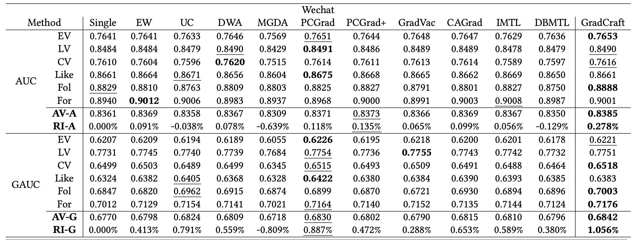
Experiment
Offline Experiment Result
11/15
Notes:
Our offline experiments consistently demonstrated that GradCraft outperforms existing methods, showing significant improvements in handling multi-task recommendations.
This success highlights the effectiveness of our holistic approach to gradient crafting.

Slide 12
Experiment
Online Experiment on Kuaishou
Setting:
  Traffic: 1 week, 15 million users
  Baseline: the SOTA multi-task learning method on our platform
  Evaluation:
    the average time users spend watching videos (WT)
    the number of effective video viewing records (VV)
    the instances of video sharing (Share)
Result: WT +0.505%, VV +0.950%, Share +1.746%
12/15
Notes:
In our online experiment on the Kuaishou platform, we tested GradCraft with 15 million users over the course of a week.
The results were impressive—GradCraft led to increases in average watch time, effective views, and video shares, outperforming the state-of-the-art methods we had been using before.

Slide 13
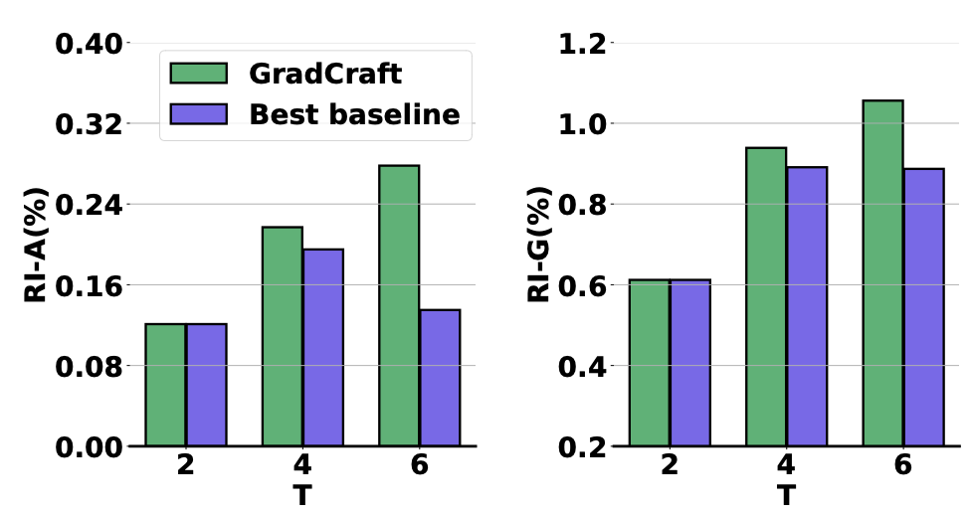
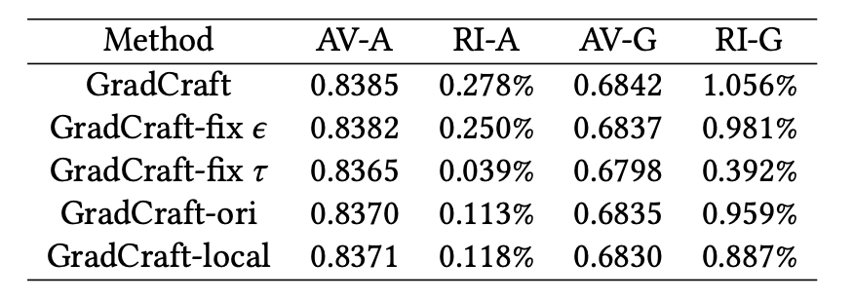



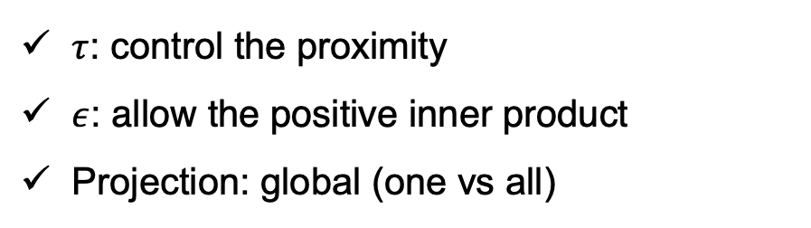
Experiment
In-depth Analysis
Ablation Study
Effect of Task Number T
Magnitude:
$τ$: control the proximity
$ε$: allow the positive inner product
Projection: global (one vs all)
Direction:
$$ε=0$$
$$τ=1$$
$$τ=0$$
GradCraft scales up effectively with the increasing complexity introduced by a growing number of tasks.
one vs one
13/15
Notes:
Lastly, we conducted an in-depth analysis.
First, we performed an ablation study. In the magnitude adjustment, we used the parameter tau, and in the Direction deconfliction, we used epsilon.
To verify the effectiveness of these key designs, we created model variants by removing these components, and the results confirmed their importance.
Next, we examined the effect of the number of tasks T.
Our findings GradCraft scales up effectively with the increasing complexity introduced by a growing number of tasks.

Slide 14
Conclusion
Multi-task Learning in RecSys
Challenge: task heterogeneity and cardinality
Motivation: appropriate magnitude balance and global direction balance
Methodology:
  Gradient magnitude adjustment
  Gradient direction deconfliction
Offline experiment on real-world datasets
Online experiments on Kuaishou platform
Future work: apply to other domains and improve the efficiency
14/15
Notes:
In conclusion, multi-task learning in recommendations faces challenges of task heterogeneity and cardinality, which GradCraft addresses through gradient magnitude adjustment and direction deconfliction.
Our experiments demonstrate its efficacy, and future work will focus on applying these techniques to other domains and improving efficiency.
Thank you for your attention.

Slide 15
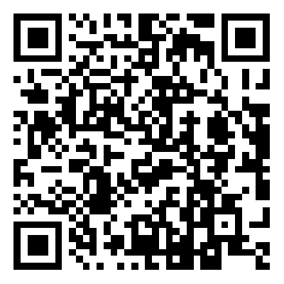
Thanks
The code has been released at
https://github.com/baiyimeng/GradCraft
15/15

