Slide 1
Classification of Different Phenotypes of Refractory Epilepsy using Big Data Analysis
Xiaobing Li

Slide 2
I. Introduction and motivation
II. Problem formulation
III. Approach and implementation
IV. Experiment Design and evaluation
V. Conclusion

Slide 3
I. Introduction and motivation
Drug-resistant epilepsy(DRE) is a major clinical and societal problem for ~30% epilepsy patients
The phenotypes of the DRE population can be quite diverse and related to many factors, such as the type of syndrome, underlying etiology, patient history of seizure, etc..

Slide 4
II. Problem formulation
giving limited information of a huge population of epilepsy patients, whether we can develop models/strategies to identify DRE patients and classify different phenotypes of DRE

Slide 5
III. Approach and implementation
Data source
Analytic infrastructure
R studio and a local Spark cluster
Implementation
Initial statistics
Feature extraction
Feature selection
DRE prediction
DRE clustering

Slide 6
IV. Experiment Design and evaluation
Data Preparation
Feature Extraction
Feature Selection
DRE Prediciton
K-means clustering

Slide 7
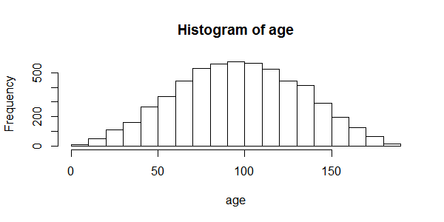
Data preparation
Total patient: 12664
Epilepsy patient: 5786
AED >=2: 2537
AED >=3: 934
AED >=4: 283

Slide 8
Feature Extraction
YOB
First event
First AED
Second AED
Third AED
Fourth AED
Fifth AED
Age
Sick age
Delay time
AED1_dose
AED2_dose
AED1_time
AED2_time
AED3_dose
AED3_time
…

Slide 9
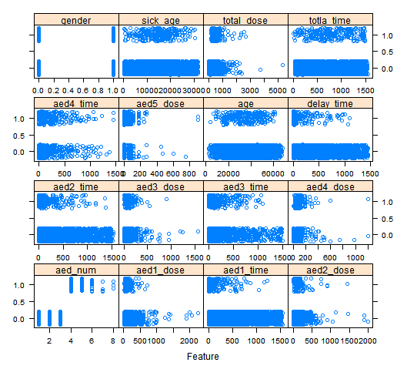
DRE = 1.0
Non-DRE= 0.0

Slide 10
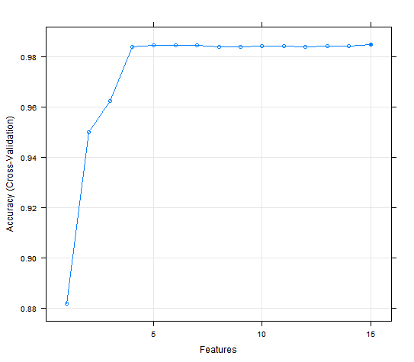
Feature Selection
Importance from highest to lowest:
1.aed2_time 2.aed3_time 3.aed1_time 4.aed4_dose
5.sick_age 6.aed5_dose 7.aed4_time 8.delay_time
9.Age 10.total_dose 11.aed1_dose 12.aed3_dose
13.totla_time 14.aed2_dose 15.gender

Slide 11
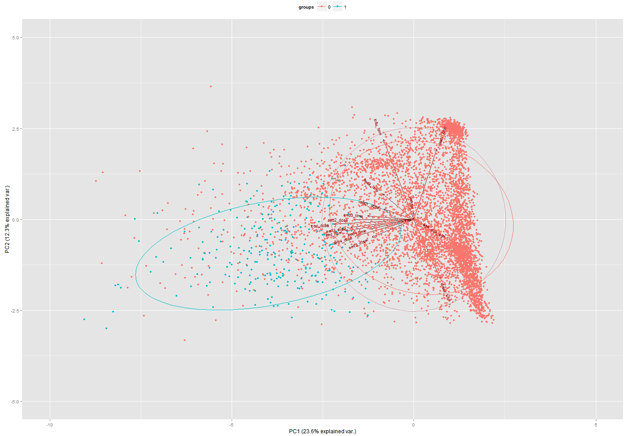
PCA visualization

Slide 12
DRE Prediciton
Confusion matrix | estimate of error rate: 0.51%
 | Non-DRE | DRE
Non-DRE | 5437 | 56 | Specificity = 98.98%
DRE | 0 | 5493 | Sensitivity = 100.00%

Slide 13
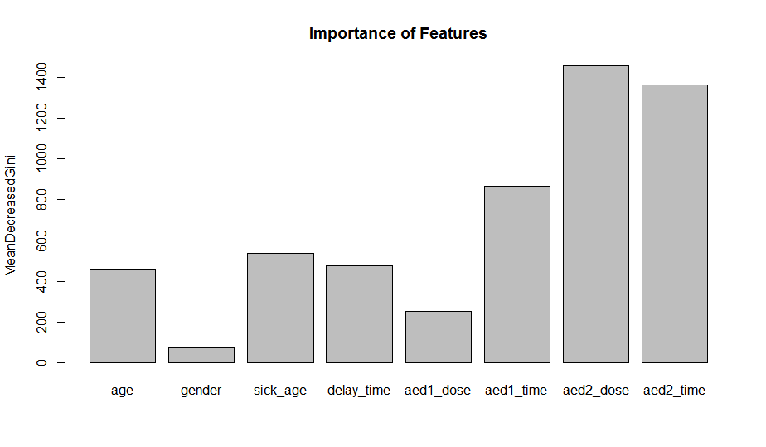

Slide 14
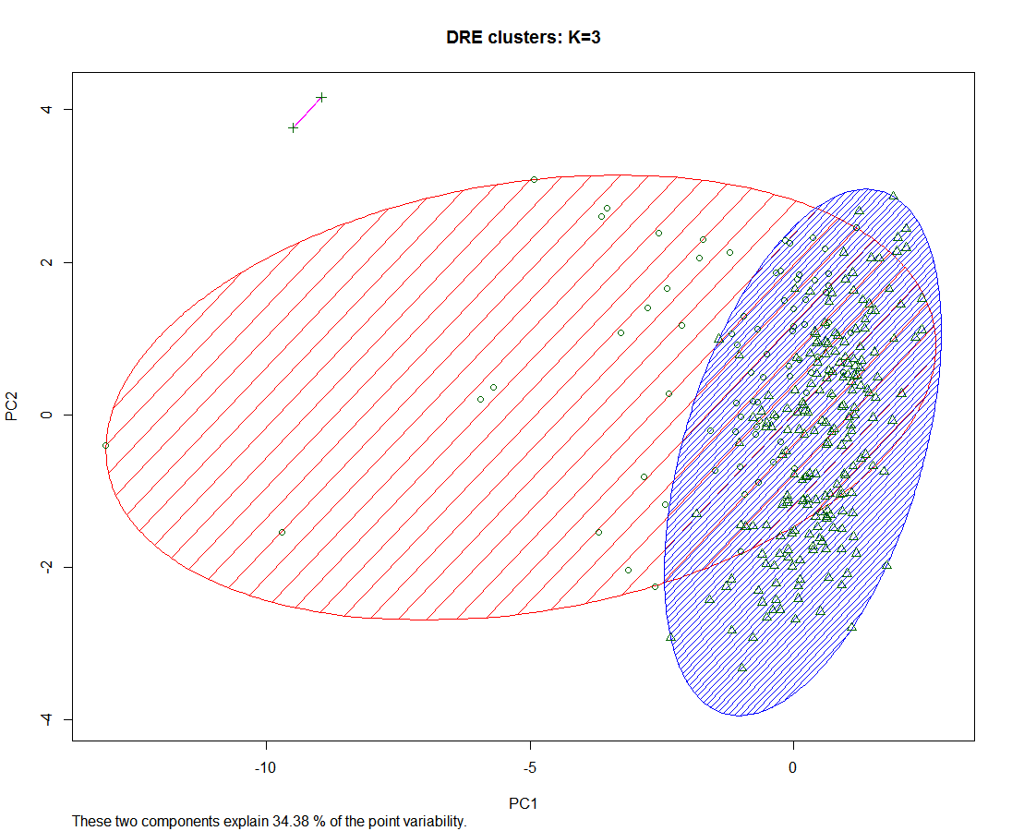
K-means clustering

Slide 15
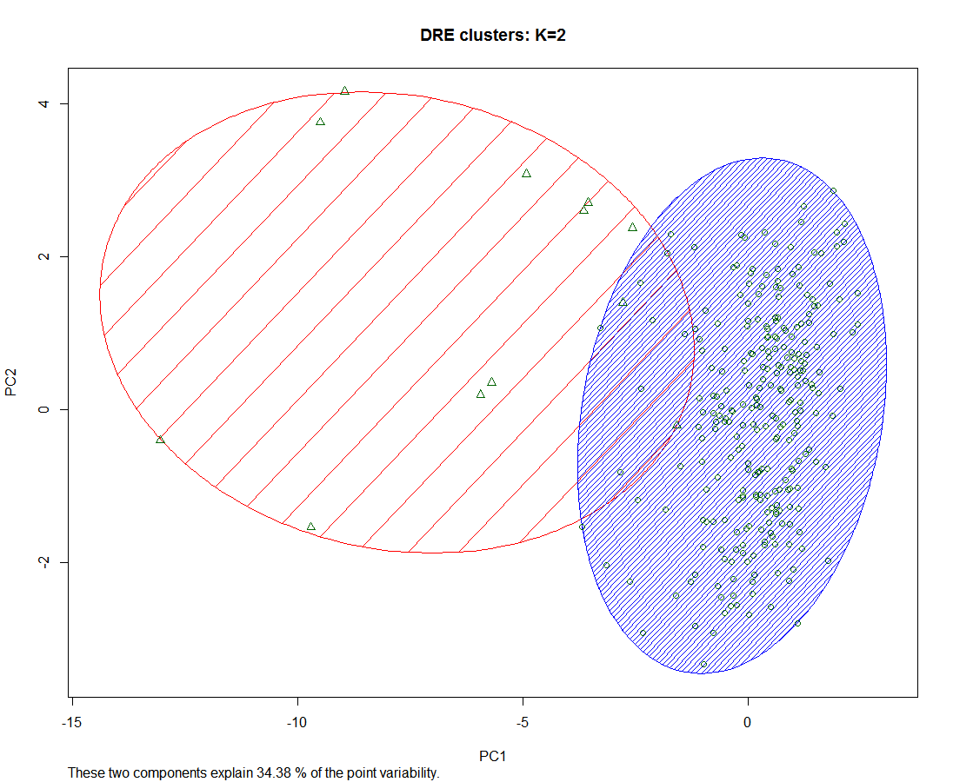

Slide 16
T-test for the features in two clusters
 | Age | Gender | Sick_age | Delay_time | AED1_dose | AED1_time | AED2_dose | AED2_time
P value | 0.008 | 0.365 | 0.010 | 0.003 | 0.040 | 0.813 | 0.009 | 0.250
 | AED3_dose | AED3_time | AED4_dose | AED4_time | AED5_dose | Total_dose | Total_time
 | 0.012 | 0.434 | 0.053 | 0.884 | 0.015 | 0.000 | 0.423

Slide 17
V. Conclusion
Time between first AED and second AED, time between second AED and third AED and dose of the second AED can be used to effectively predict DRE patients.
DRE patients can be classified as two groups, which have significantly different age, sick_age, delay_time and AED history.

Slide 18
Thank you!

