Slide 1
1
Mir2 Management Program Maual
Contents
1. Contents
2. Flow of Works about Characters
3. Flow of Works about Deposits and Accounts and IP
4. Web Service Main Page
5. Composition Of Common Windows And Buttons
6. Character – Restoring of characters
7. Character – Dealing with hackings
8. Character – Dealing with Abusers
9. Character – Restriction of characters
10. Character – Inquiry about the game
11. Character – Dealing of Changing Q & A
12. Character – View Game Logs & Register Web User
13. Consultation – Manage Consultation
14. Deposit & Account – Manage Deposits
15. Deposit & Account – Manage Notice of Individual Deposit
16. Deposit & Account – Manage Notice of Pcroom Deposit
17. Deposit & Account – View Statistics of Deposit
18. Deposit & Account – Manage Individual Accounts
19. Deposit & Account – Manage Pcroom Accounts
20. Ip – Add ip
21. Ip – Change ip
22. Ip – Stop ip
23. View Using Log(For Fixed Amount of Time)
24. Information - Pcroom
25. Information - Manager
26. Game To Web – Save Id
27. Game To Web – Connection Save
28. Game To Web – Game Log Save
29. Game To Web – Leave Usable Id & IP
30. Check Server
31. Check Remaining Time
32. Inquire Password

Slide 2
Character
Registration
Request
Dealing
Request of restoring the characer
Request of dealing the hacking
Dealing At
Game Server
Registration
At
Game server
User
Request of answering the inquiry
Request of changing the Q & A
Confirmation about request

Slide 3
Deposits & Accounts & IP
Registration
Request
Receipt of Request
Dealing
Bank
Deposit
Register Account
(Login Id)
Registration
At
Game server
User
Homepage
Notice of deposit
Bank
Deposit
Register Account
(IP)
Registration
At
Web server
Pcroom
Homepage
Notice of deposit
Add IPs
Manage IPs
Registration
At
Web server
Change IPs
Pcroom
Homepage
Stop IPs
Extend IPs
Type of Account
1. Fixed Amount of Days
2. Fixed Amount of Time
3. Mir Plus1
4. Mir Plus1
5. Mir Plus1
6. Free
Type of Payment
1. Bank(Cash to Account)
2. Bank(Account to Account)
2. Card
3. 700Ars
Type of Registration
1. New
2. Extend

Slide 4
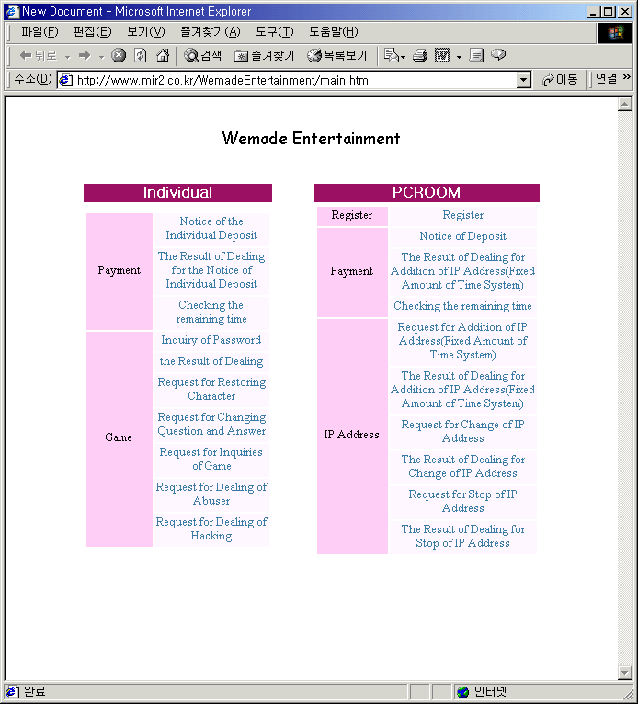
Web Service Main Page
Main Page

Slide 5
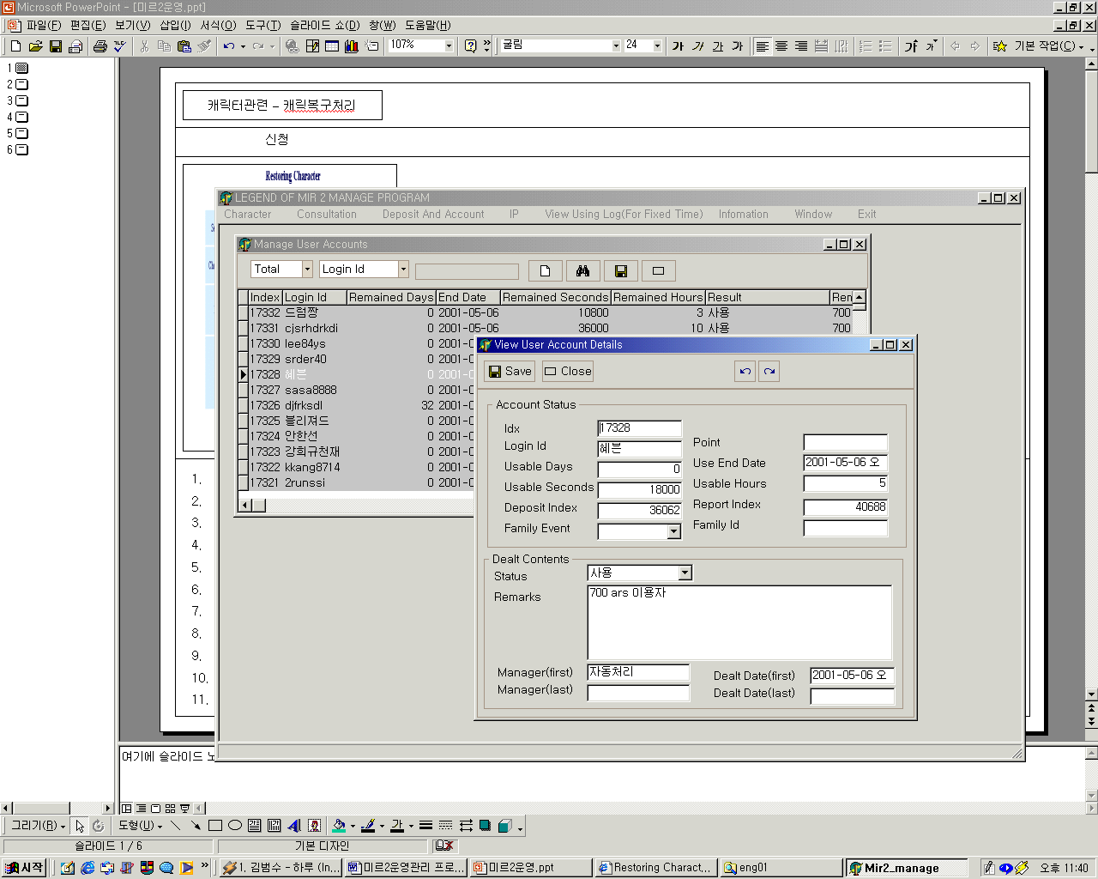
Composition Of Common Windows And Buttons
Screen Shot
Explanation
1
1. Title of Main Window
2. Menu
3. Title of Child Window
4. Search Item1
5. Search Item2
6. Search word
7. New
8. Search
9. Save
10. Close
11. Grid Title
12. Grid
13. Title of Details Window
14. Save
15. Close
16. Go Previous Record
17. Go Next Record
18. Status of Request
19. Status of dealing
* Details Window are shown when you doubleclick the grid.
2
3
7
8
9
10
4
5
6
11
13
14
15
16
17
12
18
19

Slide 6
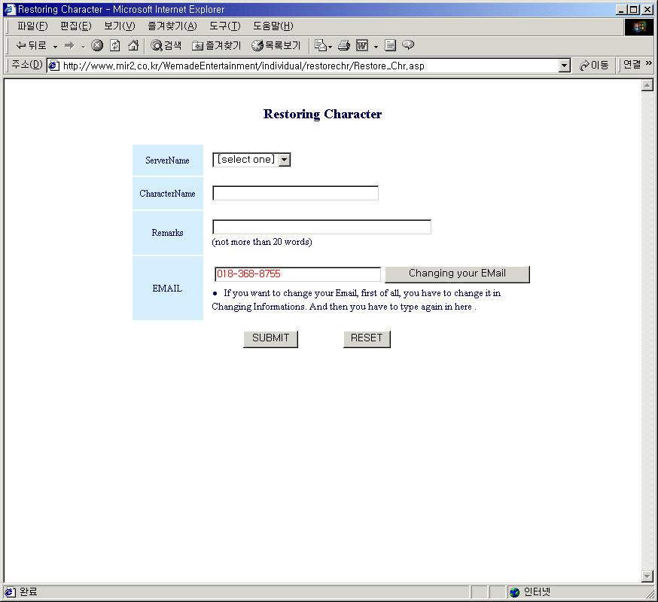
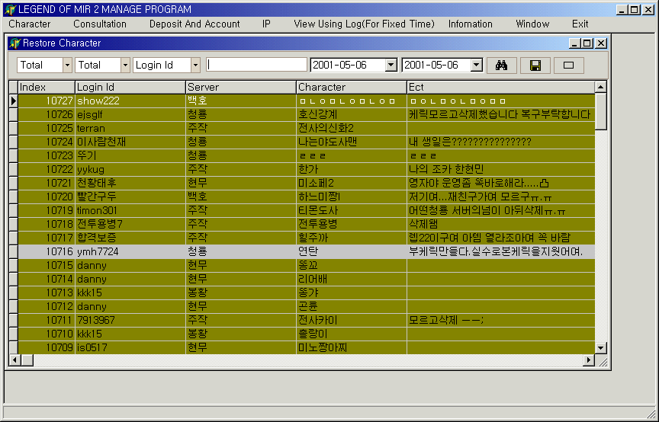
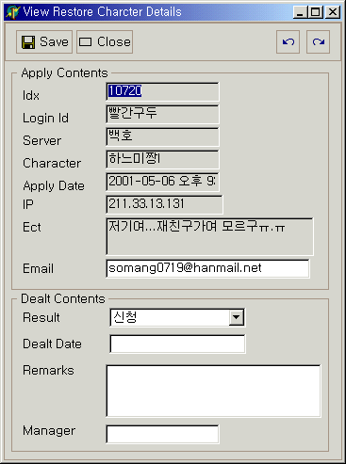
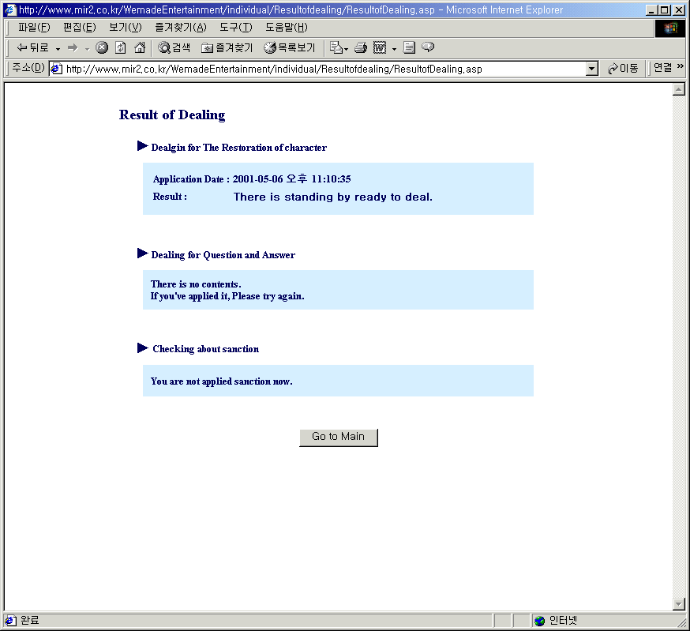
Character – Restoring of character
Request
Receipt of requests
Dealing
Result of Dealing
1
1
2
3
4
5
1
2
3
2
4
1
3
1.Sever
2.Character
3.Remarks
4.Email
*Required login to view this request page.
1. Search Item(Apply, Done, Rejected, Deleted)
2. Search Item(Server)
3. Search Item(Login id, Character)
4. Starting Date
5. Ending Date
1.Dealing
* To Restore Character Must be done in Game server directly
1. Result of restoration of character
2. Result of changing of Q & A
3. Result of restriction
*Required login to view this Result page.

Slide 7
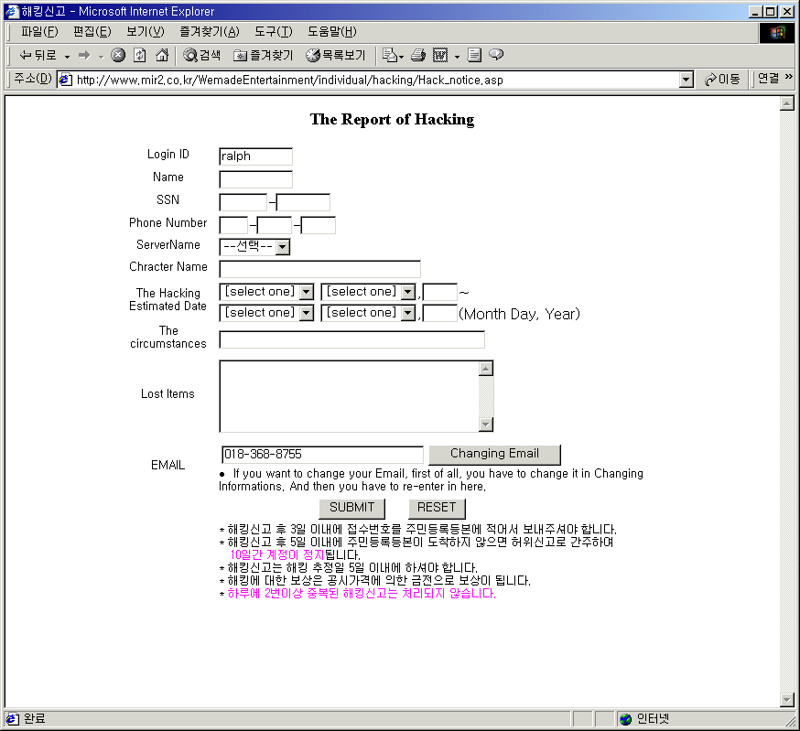
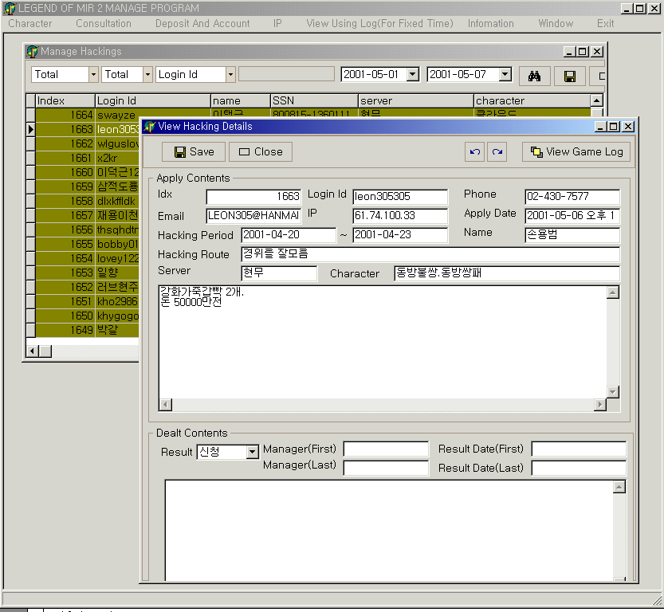
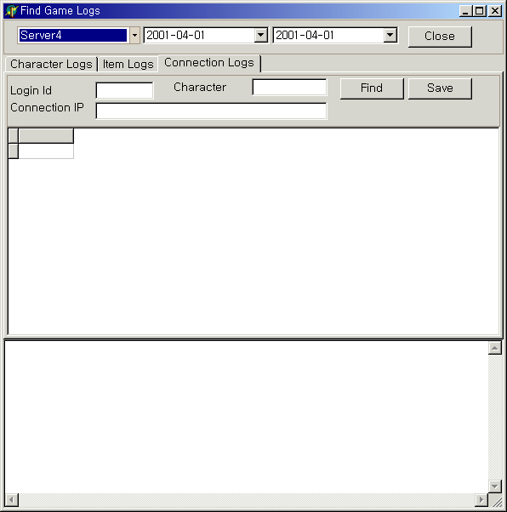
Character – Dealing with hacking
Request
Receipt of Request And Dealing
Searching Logs
Result of Dealing
1
2
3
1
1
2
3
4
5
2
4
5
6
3
6
1
4
5
6
7
8
2
9
10
7
3
11
1. Login Id
2. Name
3. Remarks
4. Social Security Number
5. Server
6. Character
7. Starting Date of Hacking
8. Ending Date of Hacking
9. Cause Of Hacking
10. Lost Items
11. Email
*Required login to view this
request page.
1. Search Item(Apply, Done, Rejected, Deleted)
2. Search Item(Server)
3. Search Item(Login id, Index)
4. Starting Date
5. Ending Date
6. Open Game Log Search Window
7. Dealing
*To view details , You must do double click.
1. Server
2. Starting Date of Hacking
3. Ending Date of Hacking
4. View Character Logs
5. View Item Logs
6. View Connection Logs
* After Searching Logs, You write the result in details windows.
1. Result of restoration of character
2. Result of changing of Q & A
3. Result of restriction
*Required login to view this result page.

Slide 8
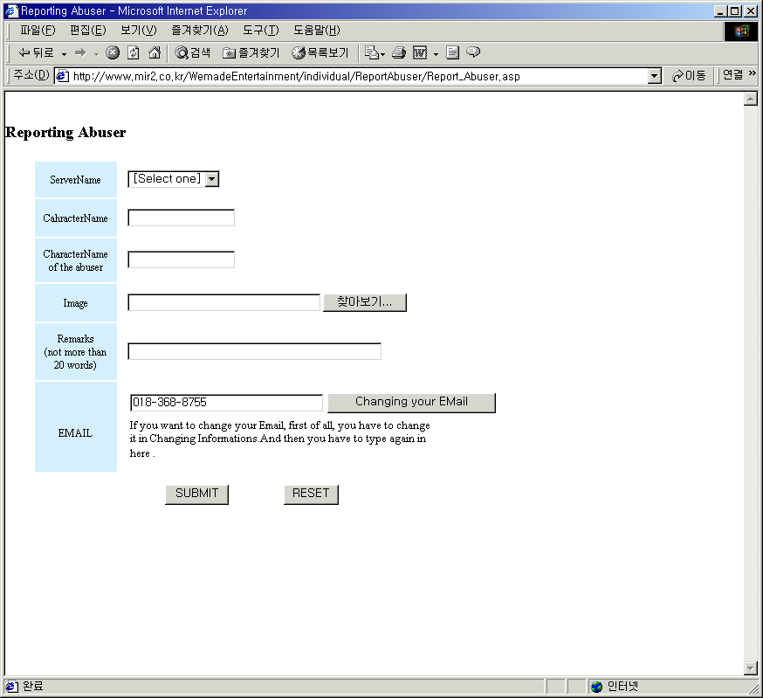
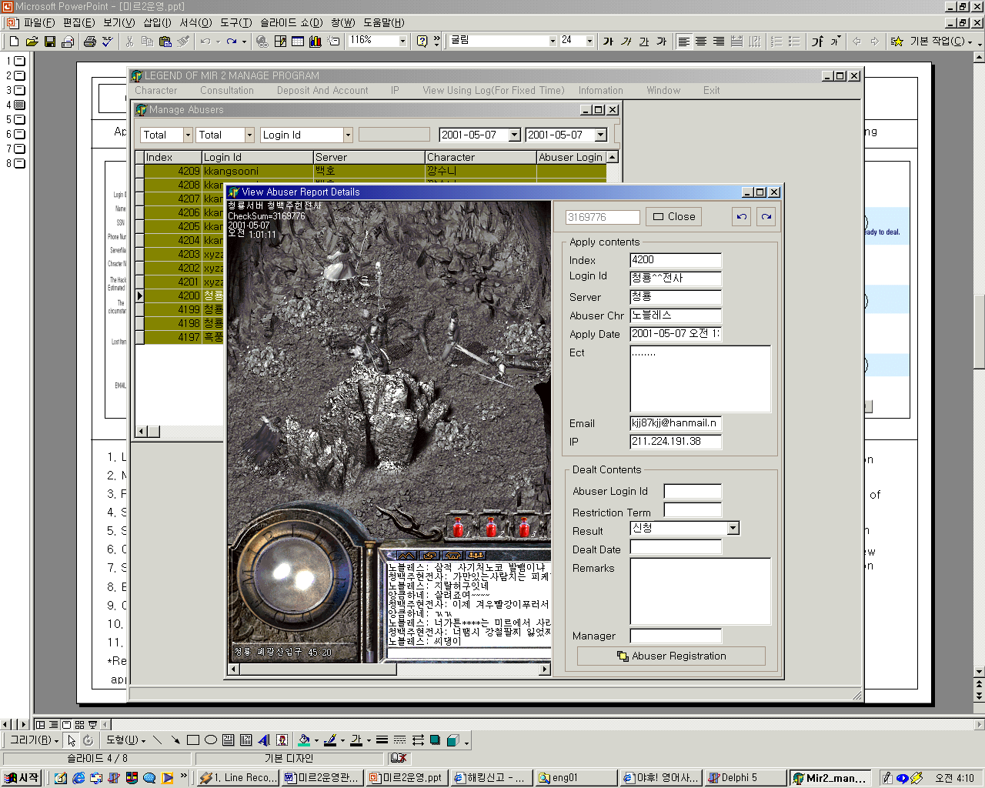
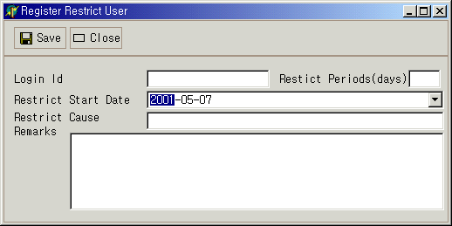
Character – Dealing with Abuser
Request
Receipt of Request And Dealing
Registration Abuser
Result of Dealing
1
1
2
3
4
5
1
2
2
3
1
4
3
4
5
2
5
6
7
6
3
7
1. Server
2. Character
3. Abuser Character
4. Image file name(include path)
5. Etc
6. Email
*Required login to view this
request page.
1. Search Item(Apply, Done, Rejected, Deleted)
2. Search Item(Server)
3. Search Item(Login id, Character, Abuser Id)
4. Starting Date
5. Ending Date
6. Dealing
7. Register Abuser Login id
* To restrict the abuser , manager must change abuser ‘s password directly in game server.
1. Abuser Login Id
2. Restrict Periods
3. Starting Date of Restriction
4. Cause
5. Remarks
6. View Connection Logs
*Abuser can’t do not use service center.
1. Result of restoration of character
2. Result of changing of Q & A
3. Result of restriction
*Required login to view this result page .

Slide 9
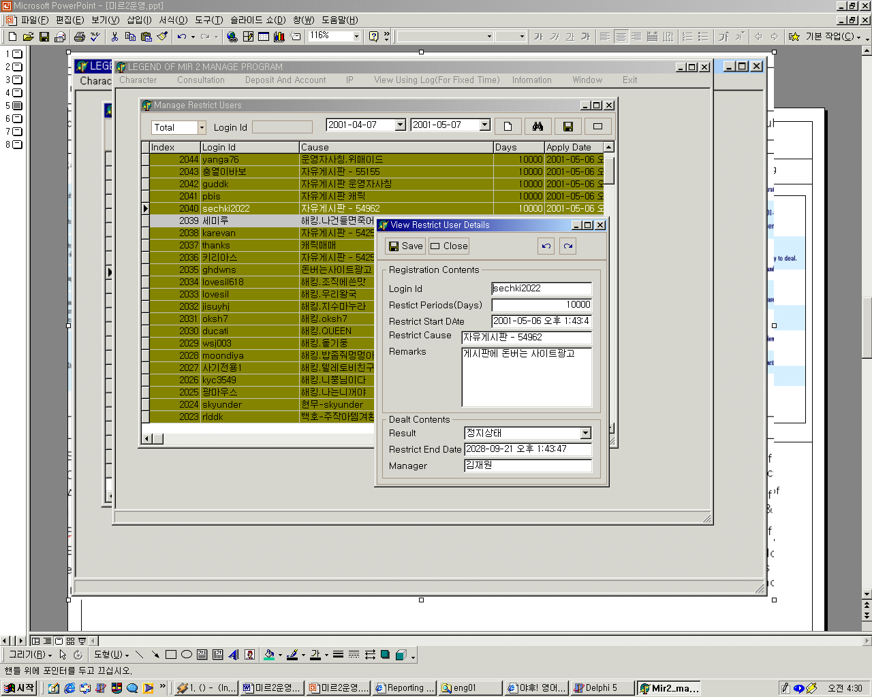
Character – Restriction of character
Request
Receipt of Request
Deal
Result of Dealing
Reporting of abuser
1
2
3
4
1
Dealing of Hacking
1
2
3
5
Etc
4
2
5
3
1. Search Item(Apply, Done, Rejected, Deleted)
2. Search Item(Login Id)
3. Starting Date
4. Ending Date
5. Detail Window
*To view details , You must do click grid double.
1. Abuser Login Id
2. Restrict Periods
3. Starting Date of Restriction
4. Cause
5. Remarks
6. View Connection Logs
*Abuser can’t do not use service center.
1. Result of restoration of character
2. Result of changing of Q & A
3. Result of restriction
*Required login to view this result page.

Slide 10
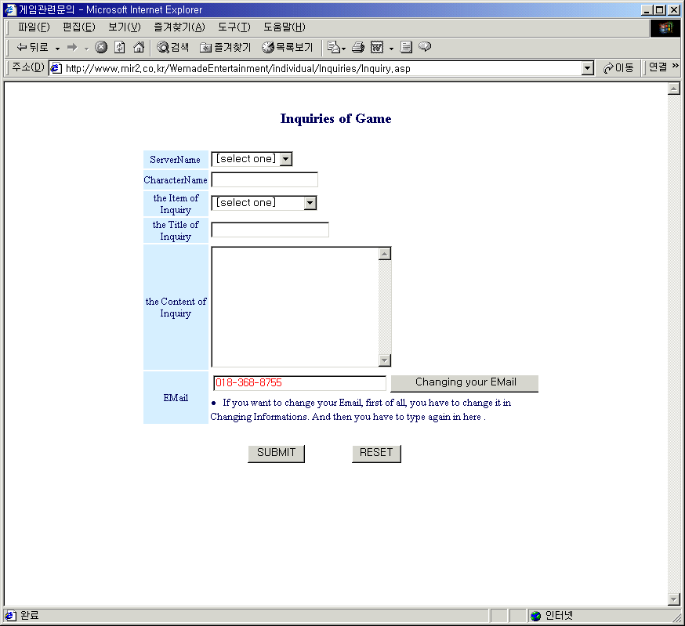
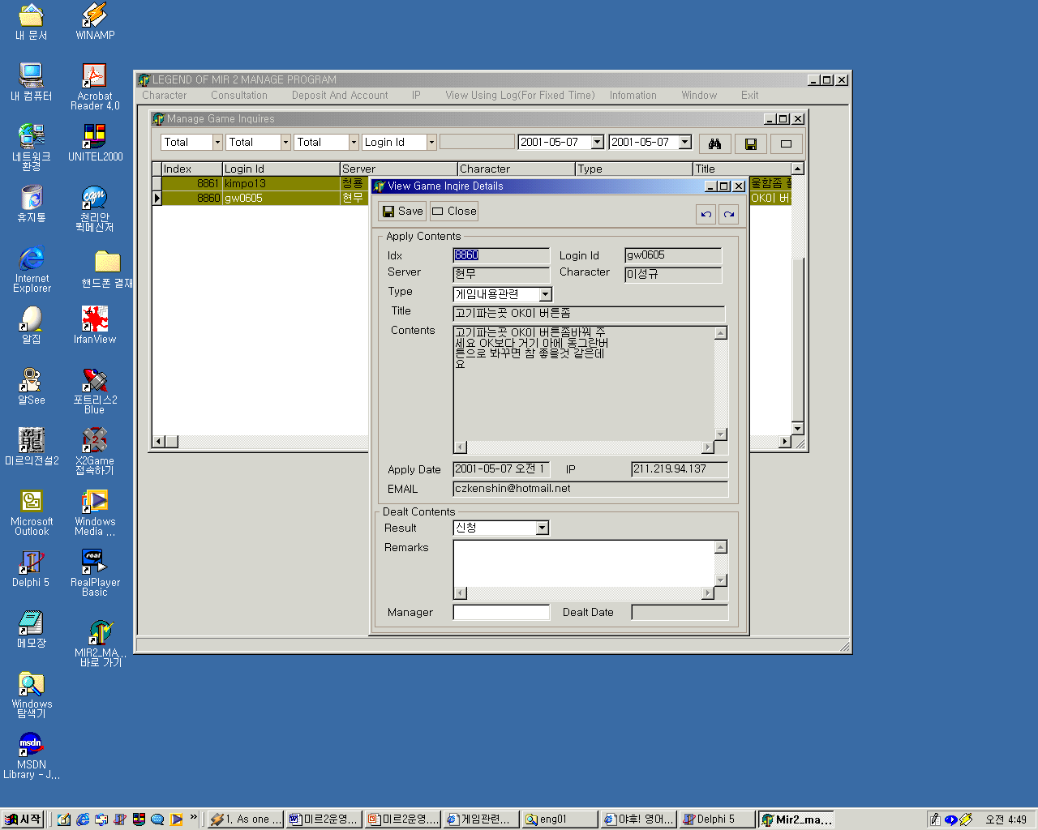
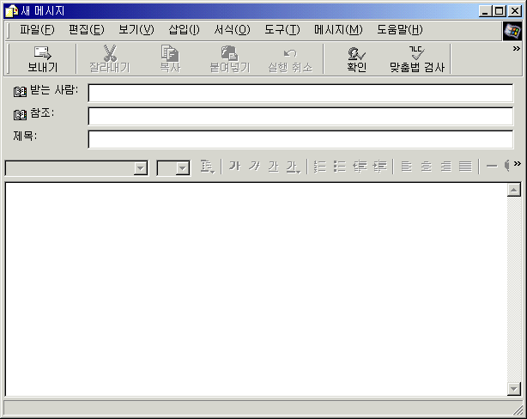
Character – Inquiry about the game
Request
Receipt of Request
Deal
1
1
2
3
4
5
6
2
3
4
5
1
6
7
1. Sever
2. Character
3. Type of inquiry
4. Title
5. Contents
6. Email
*Required login to view this request page.
1. Search Item(Apply, Done, Rejected, Deleted)
2. Search Item(Server)
3. Search Item(Type of inquiry)
4. Search Item(Login id, Character)
5. Starting Date
6. Ending Date
7. Deal
*To view details , You must do double click.
1.Deal
*After reading the inquiry,manager must write the reply by email

Slide 11
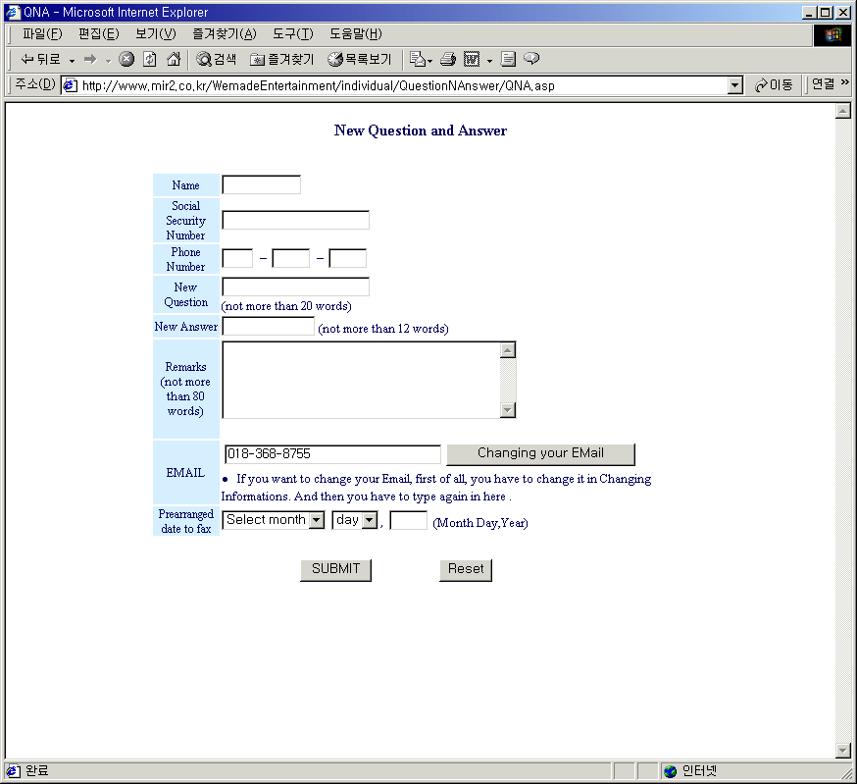
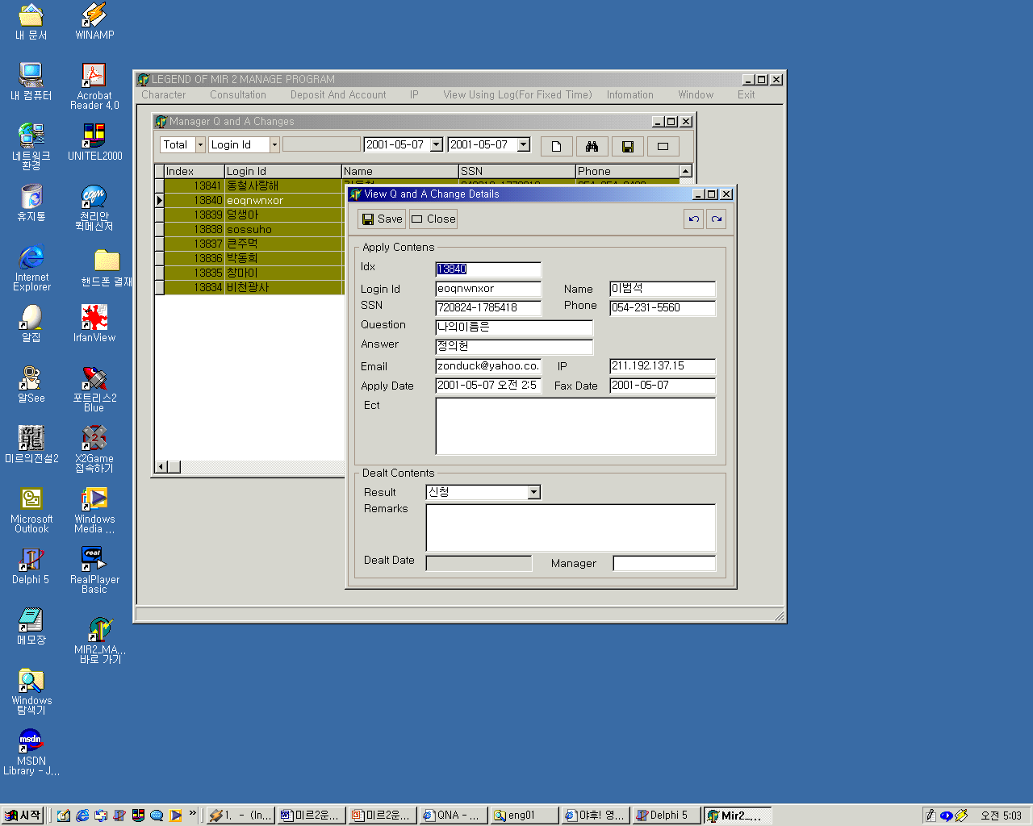
Character – Dealing of Changing Q & A
Request
Receipt of Request
Settlement
Result of Dealing
1
1
2
3
4
2
1
3
Game server
4
5
6
2
7
5
3
8
1. Name
2. SSN
3. Phone
4. New question
5. New answer
6. Remarks
7. Email
8. Date to be send document
*Required login to view this request page.
1. Search Item(Apply, Done, Rejected, Deleted)
2. Search Item(Login id, Name, Index)
3. Starting Date
4. Ending Date
5. Settlement
*To view details , You must click grid double.
* To Change Q&A Manager Must do that in Game server directly
1. Result of restoration of character
2. Result of changing of Q & A
3. Result of restriction
*Required login to view this result page.

Slide 12
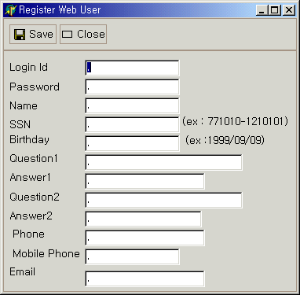
Character – View Game Logs & Register Web User
View game logs
Register web user
1
2
3
4
5
6
1. Server
2. Starting Date
3. Ending Date
4. View Character Logs
5. View Item Logs
6. View Connection Logs
* If user’s login id does not exist in web server , manager can input the user’s information in this window.

Slide 13
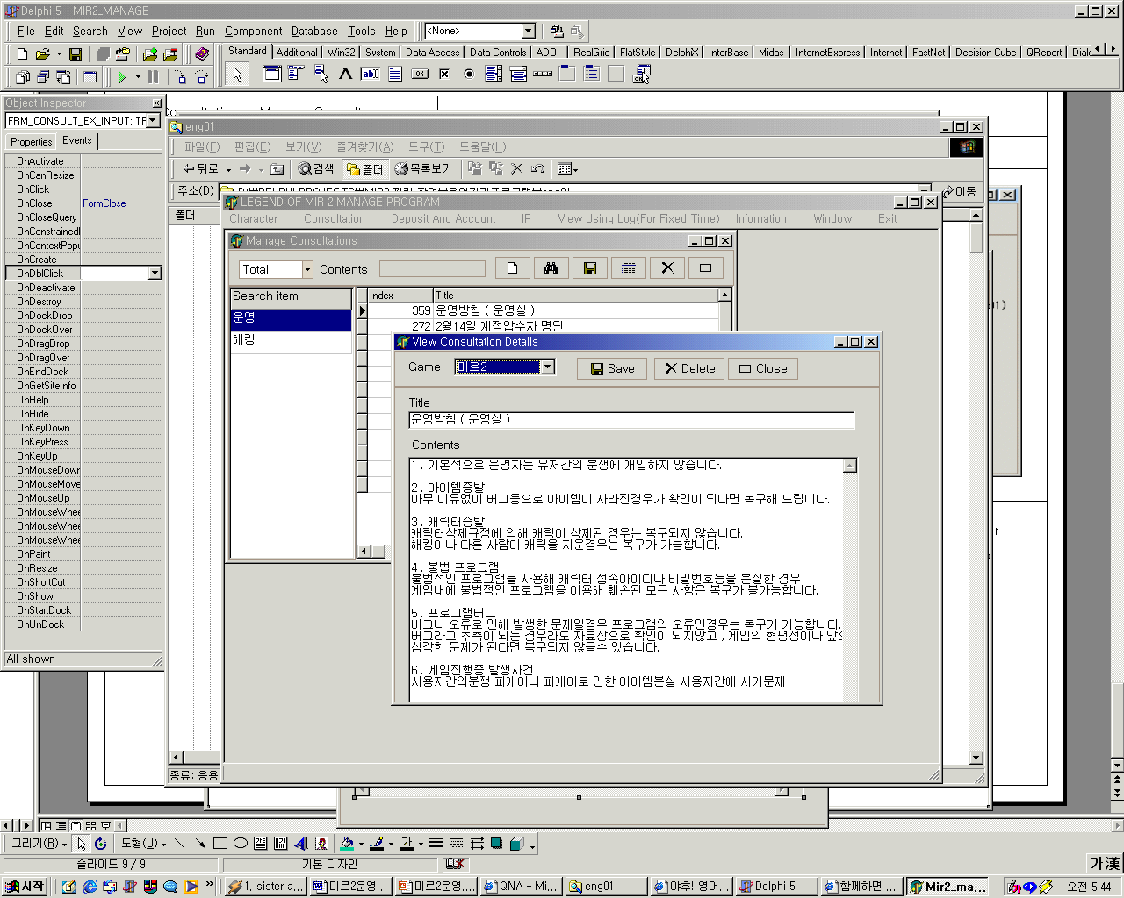
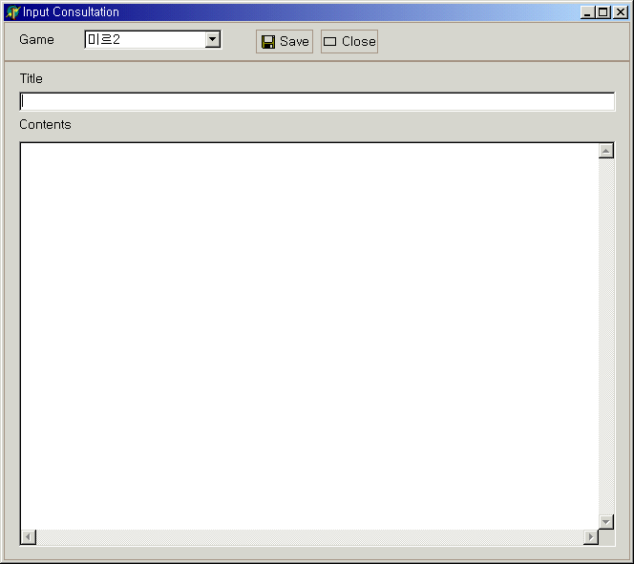
Consultation – Manage Consultation
Search consultation
Input consultation
1
1
2
2
3
3
1. Type of consultation
2. Searching item
3. Details
* You can Delete Search item by pressing the del key after selecting the search item.
1. Game Type
2. Title
3. Contents

Slide 14
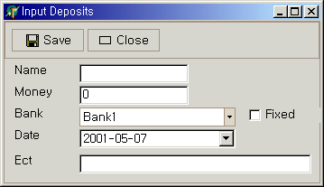
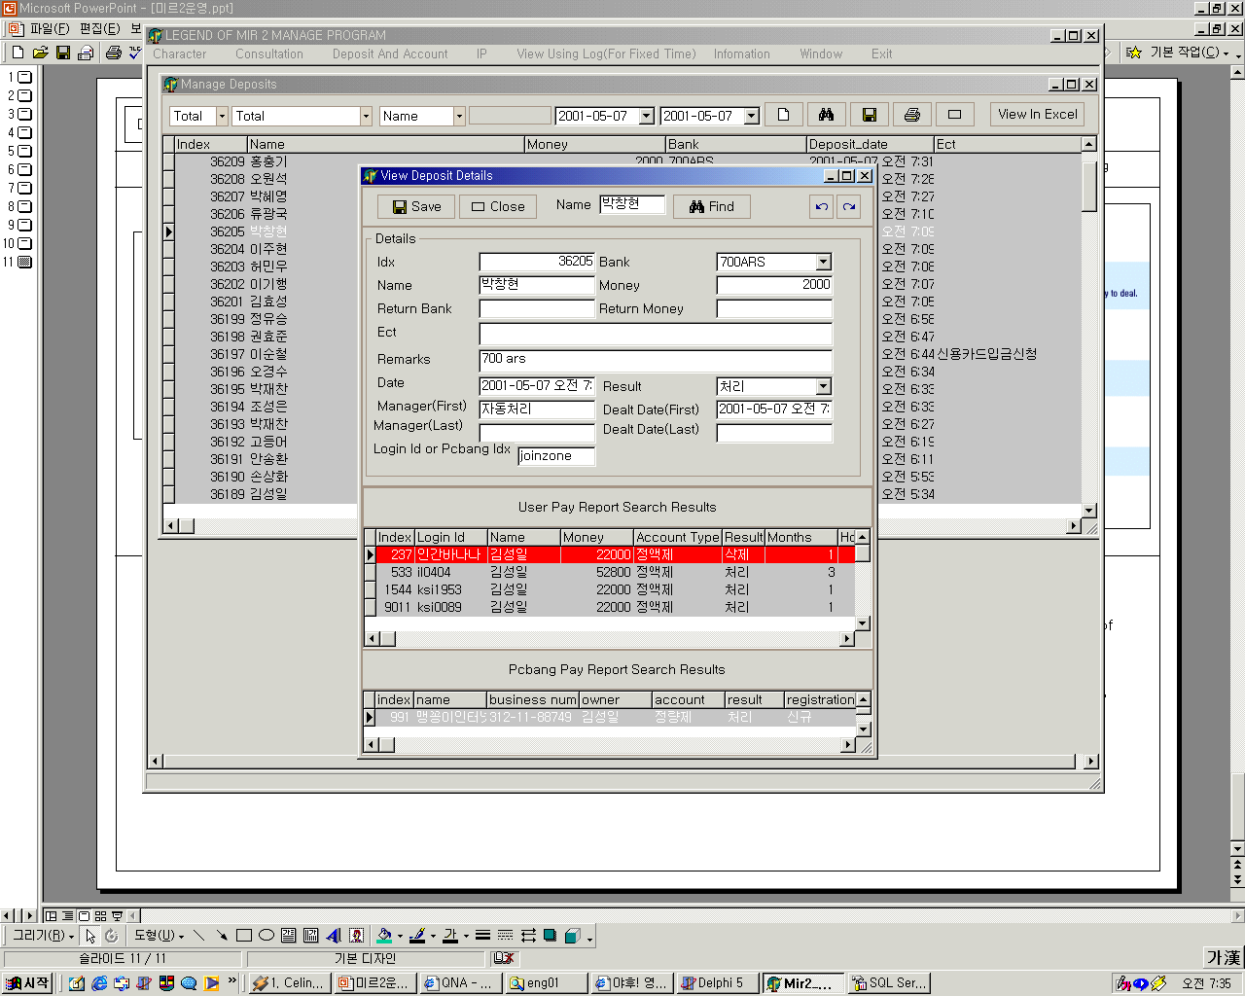
Deposit & Account – Manage Deposits
Request
Input Deposit
Settlement
Bank
1
1
2
3
6
4
2
5
3
4
1. Name
2. Money
3. Bank
4. Deposit Date
5. Detail Window
6. Fix Bank
1. View with Excel
2. Settlement
3. Results which is searched in notice of indevidual deposit
4. Results which is searched in notice of pcroom deposit
*To View with excel, Excel must be installed.

Slide 15
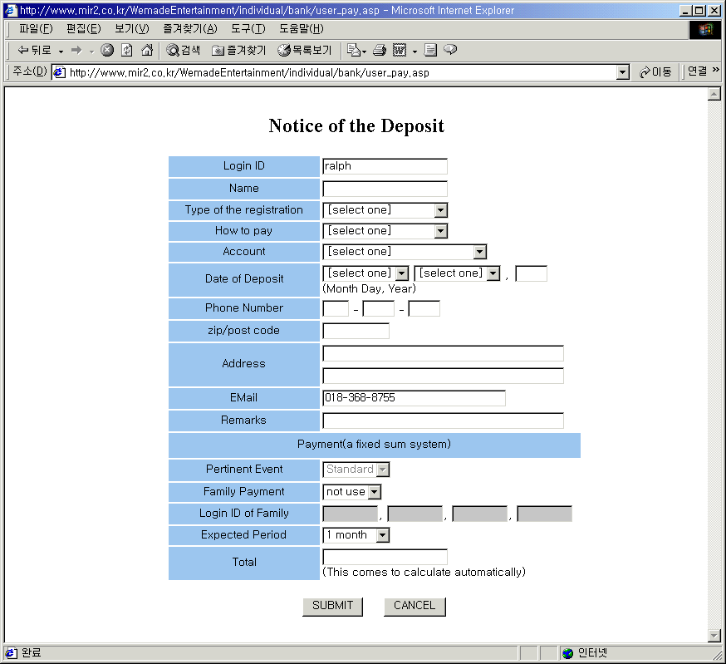
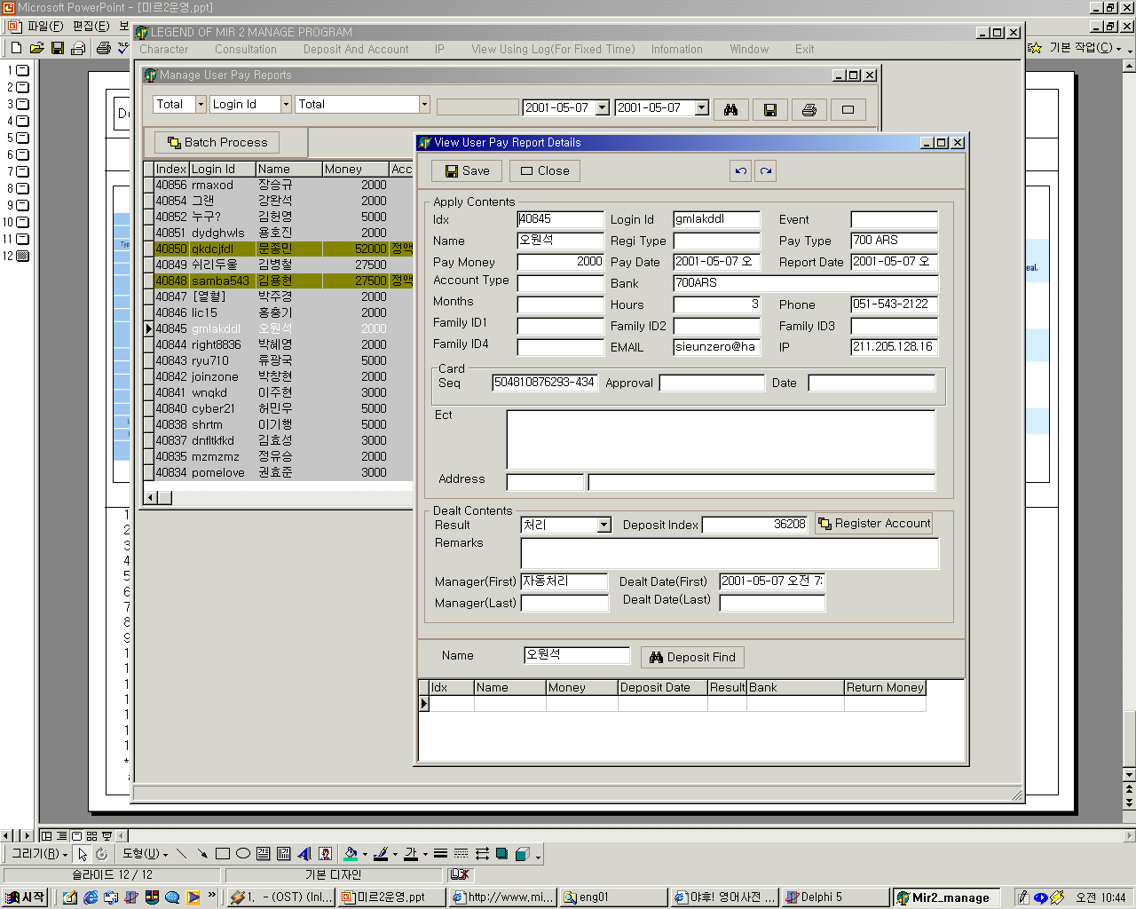
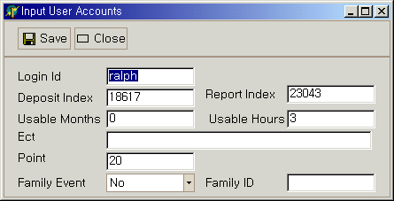
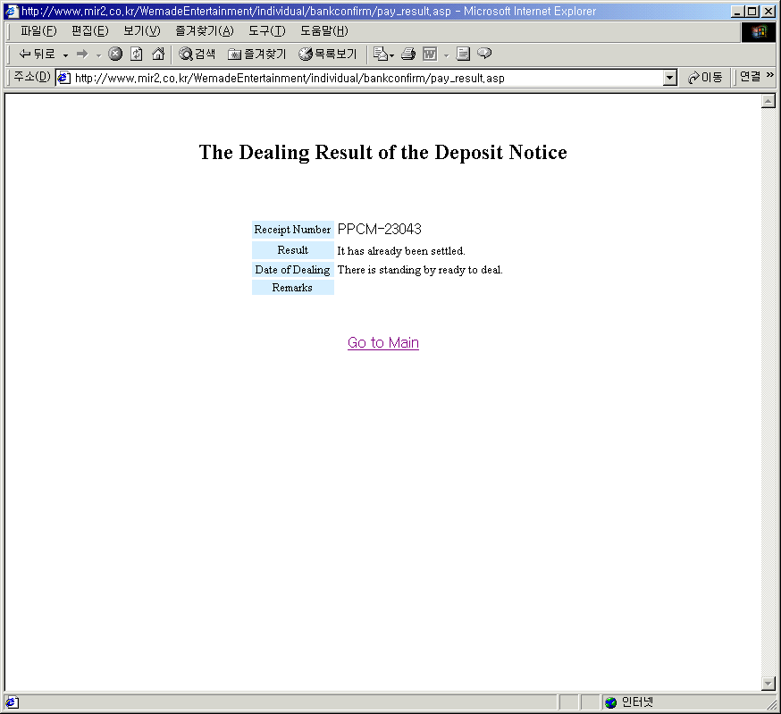
Deposit & Account – Manage notice of individual deposit
Request
Receipt of Request And Dealing
Register Individual Account
Result of Dealing
1
1
2
3
4
5
3
2
1
5
4
2
3
6
4
5
1
7
6
2
8
7
3
9
8
9
4
10
11
6
7
12
14
13
15
8
16
1. Login Id
2. Name
3. Registration type
4. Pay type
5. Account type
6. Date of deposit
7. Phone
8. Zip code
9. Address
10. Email
11. Remarks
12. Pertinent event
13. Family event
14. Family id
15. Months
16. Money
*Required login to view this
request page.
1. Search Item(Apply, Done, Rejected, Deleted)
2. Search Item(Login id, Name, Index)
3. Bank
4. Starting Date
5. Ending Date
6. Deal
7. Register Individual Account
8. Search Deposits with pay name
*To view details , You must do double click.
1. Login id
2. Deposit index
3. Notice index
4. Months
5. Hours
6. Etc
7. Point
8. Family event
9. Fmily id
* If Family Event is requested , Every Login id must be registered.
1. Notice Number
2. Result
3. Date of dealing
4. Remarks
*Required login to view this result page.

Slide 16
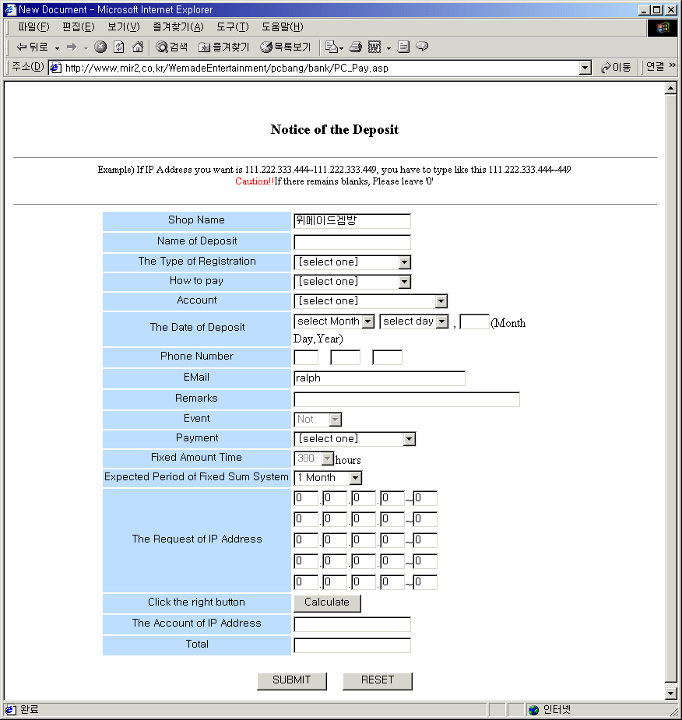
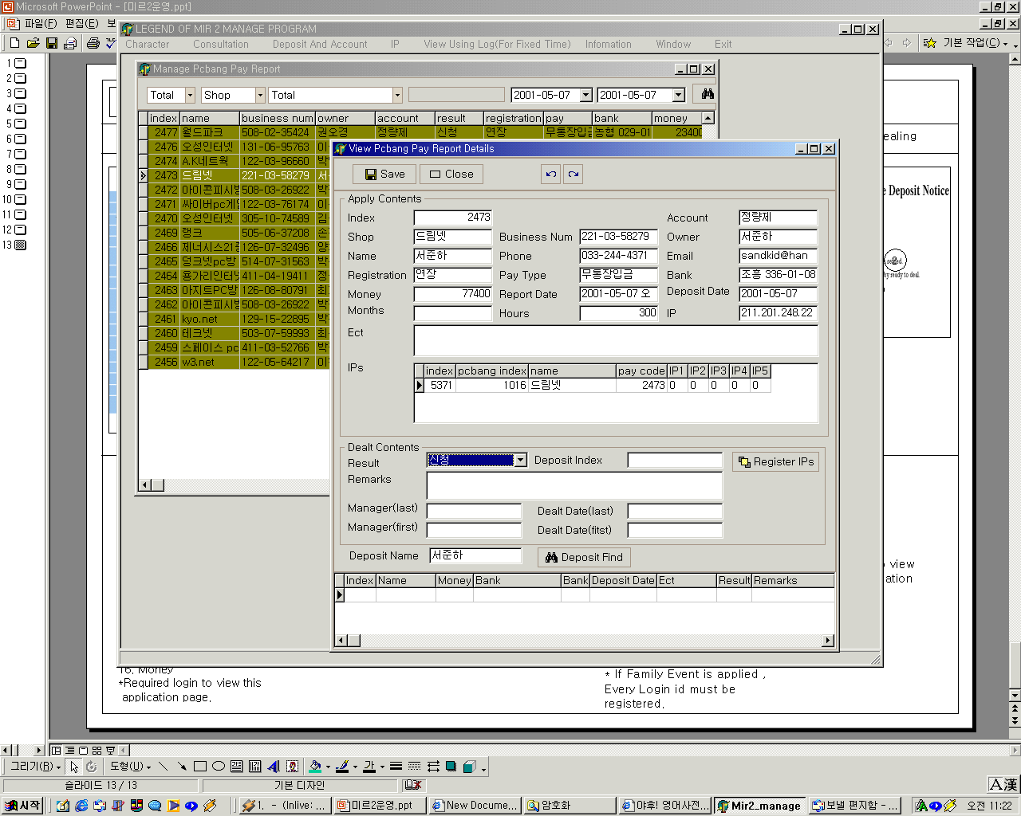
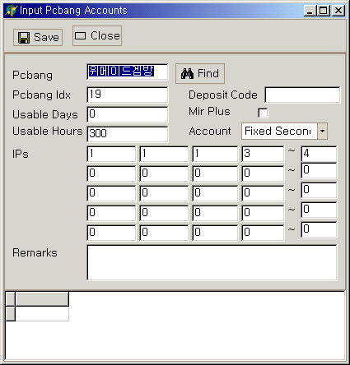
Deposit & Account – Manage Notification of Deposit
Request
Receipt of Request And Dealing
Register Pcroom Account
Result of Dealing
1
2
3
4
5
1
1
4
2
3
3
2
5
6
5
4
7
1
6
2
7
8
3
9
8
4
10
9
11
12
13
6
7
14
15
8
16
1. Pcroom name
2. Name of deposit
3. Type of registration
4. Type of payment
5. Bank
6. Date of deposit
7. Phone
8. Email
9. Remarks
10. Event
11. Type of account
12. Amount of fixed hours
13. Amount of fixed months
14. Ips to be use
15. Count of ips
16. Money to be paid
*Required login to view this
request page.
1. Search item(Apply, Done, Rejected, Deleted)
2. Search item(Shop, Owner, Index,…)
3. Bank
4. Starting date
5. Ending date
6. Dealing
7. Register Pcroom account
8. Search Deposits with name of deposit
1. Pcroom name
2. Pcroom index
3. Deposit index
4. Amount of fixed days
5. Amount of fixed hours
6. Account type
7. IPs
8. Remarks
9. Search result
1. Notice Number
2. Result
3. Date of dealing
4. Remarks
*Required login to view this result page.

Slide 17
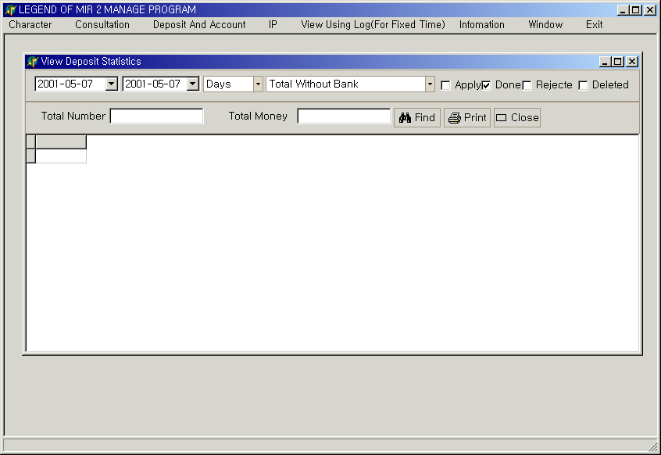
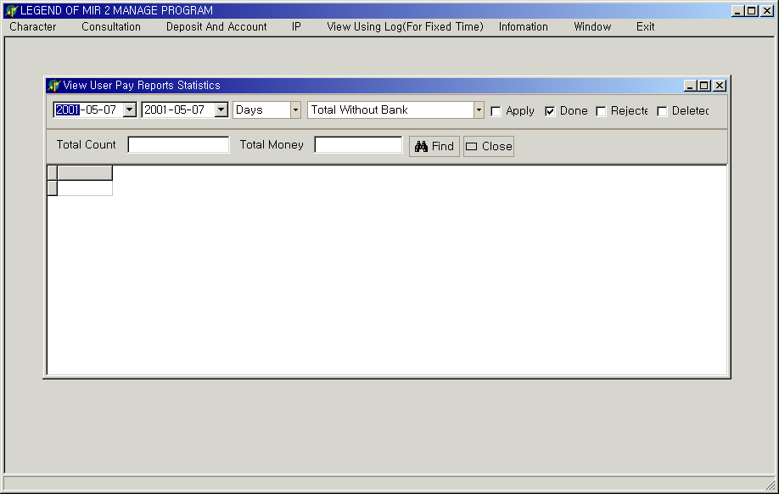
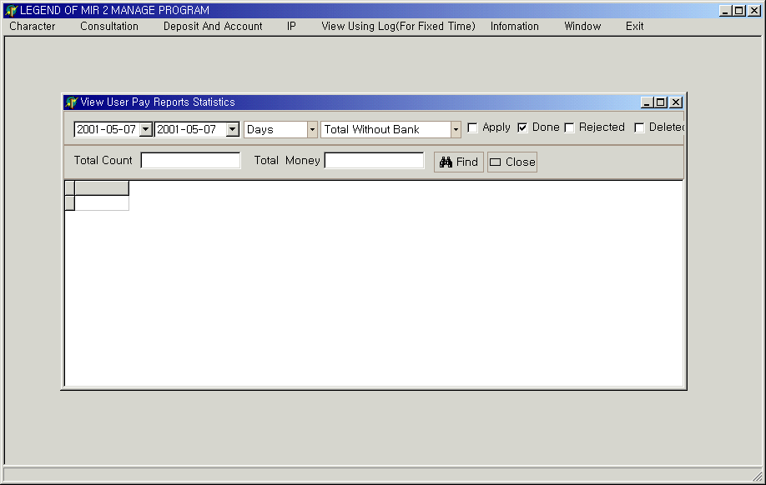
Deposit & Account – View Deposit Statistics
View deposit statistics
View statistics of individual deposit
View statistics of pcroom deposit
1
2
3
4
5
6
7
1. Starting date of searching
2. Ending date of searching
3. Search item( per days, months, year)
4. Search item(bank)
5. The status of request
6. Total count
7. Total money
*The same as you see in left window
*The same as you see in left window

Slide 18
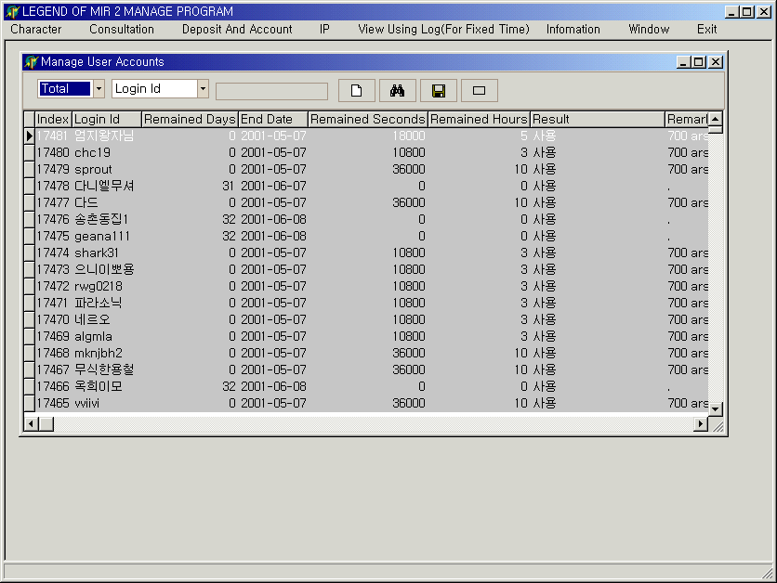
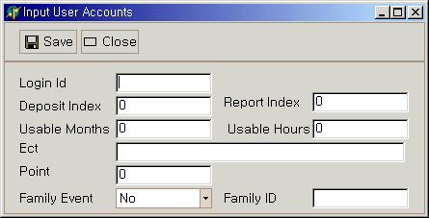
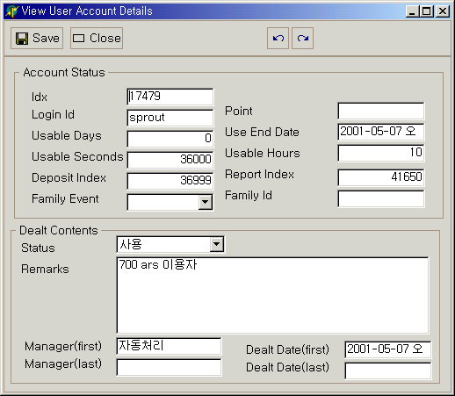
Deposit & Account – Manage Individual Accounts
List of individual accounts
Registration new individual account
View individual account details
1
2
1
1
2
3
4
5
6
7
8
9
2
1. Search item(use, stop)
2. Search item(login id, deposit index,..)
1. Login id
2. Deposit index
3. Notice index
4. Amount of fixed months
5. Amount of fixed hours
6. Remarks
7. Point
8. Family
9. Family id
1. Status of individual account
2. Status of dealing

Slide 19
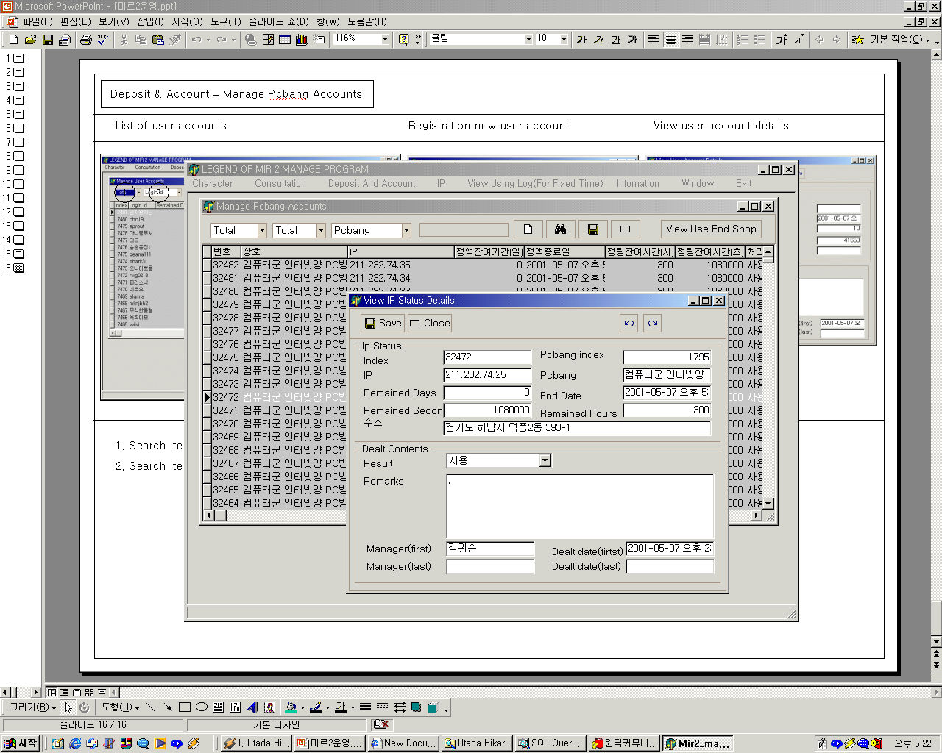
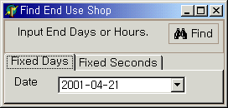
Deposit & Account – Manage Pcroom Accounts
List of Pcroom accounts and view details
Registration new Pcroom account
Search List which is expecting ending
1
1
2
3
4
4
2
3
5
6
7
1
2
8
5
9
6
1. Search item(use, stop)
2. Search item(Type of account)
3. Search item(Pcroom, Ip, owner..)
4. View List which is expecting ending.
5. Status of ip
6. Status of dealing
1. Pcroom name
2. Pcroom index
3. Deposit index
4. Amount of fixed days
5. Amount of fixed hours
6. Account type
7. IPs
8. Remarks
9. Search results
1. Search List which ‘s ending date is less then specific date
2. Search List which ‘s remained days is less then specific days

Slide 20
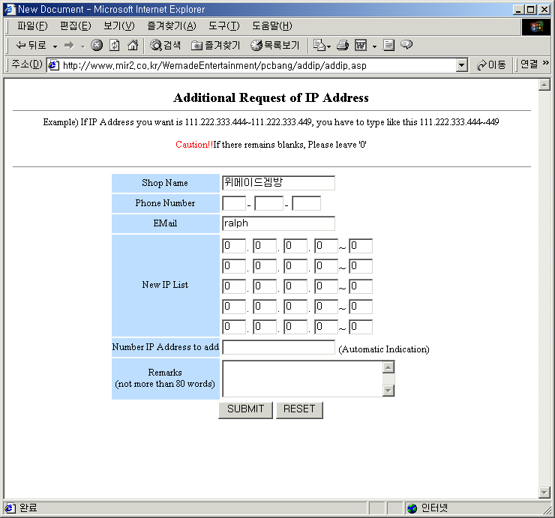
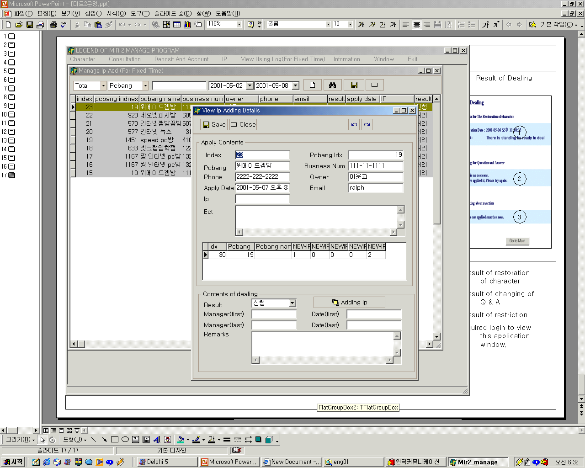
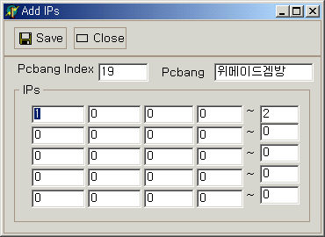
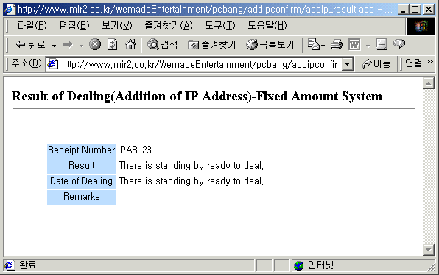
Ip – Adding ip
Request
List of Requestion And Dealing
Adding IPs
Result of Dealing
1
2
3
4
1
2
1
1
2
3
2
3
3
4
5
5
6
7
6
1. Pcroom name
2. Phone
3. Email
4. IPs
5. Count of ips
6. Remarks
*Required login to view this
request page.
1. Search Item(Apply, Done, Rejected, Deleted)
2. Search Item(Pcroom, Ownwer,..)
3. Starting date
4. Ending date
5. IPs
6. Dealing
7. Add IPs registration
1. Pcroom Index
2. Pcroom Name
3. Ips
1. Dealing Index
2. Result
3. Date of dealing
*Required login to view
this result page window.

Slide 21
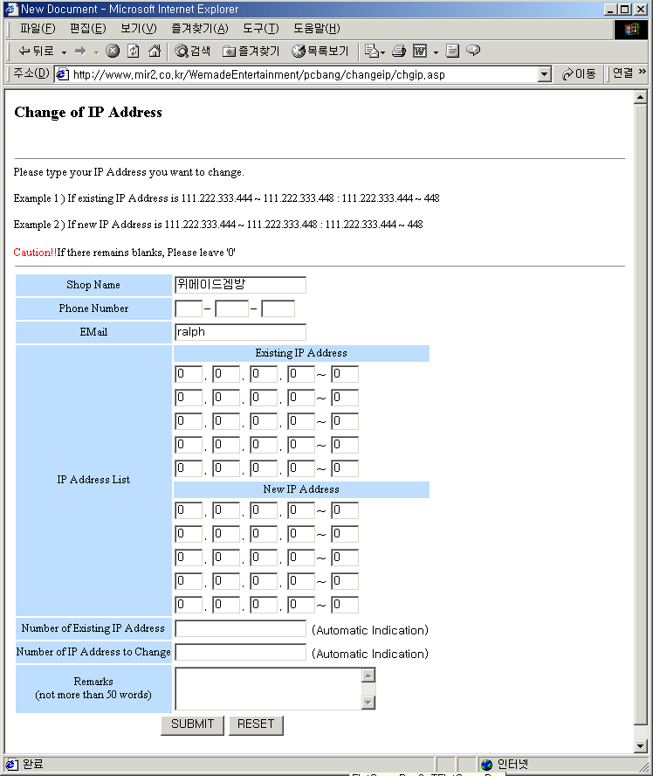
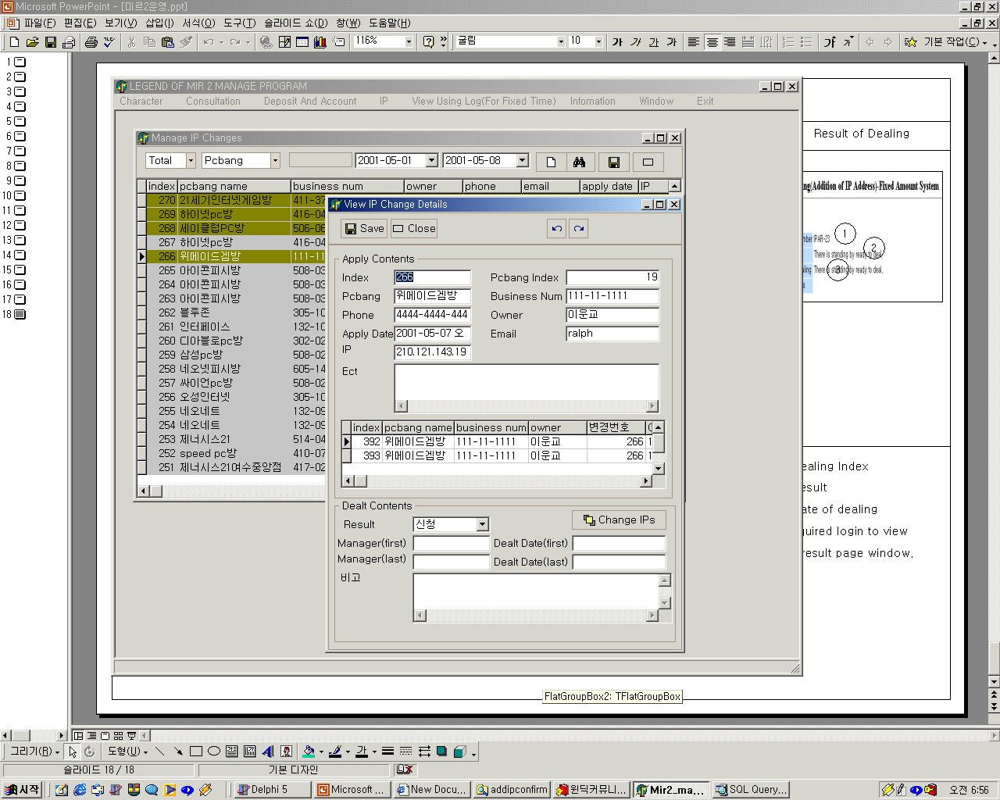
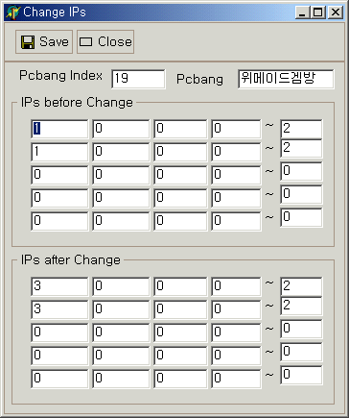
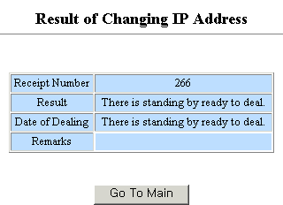
Ip – Changing ip
Request
List of Requestion And Dealing
Changing IPs
Result of Dealing
3
4
1
2
1
2
1
1
3
2
2
3
3
4
4
5
5
6
7
6
7
1. Pcroom name
2. Phone
3. Email
4. Ips before change
5. Ips after change
6. Count of ips
7. Remarks
*Required login to view this
request page.
1. Search Item(Apply, Done, Rejected, Deleted)
2. Search Item(Pcroom, Ownwer,..)
3. Starting date
4. Ending date
5. IPs
6. Dealing
7. Change IPs registration
1. Pcroom Index
2. Pcroom Name
3. Ips before change
4. Ips after change
1. Dealing Index
2. Result
3. Date of dealing
*Required login to view
this result page window.

Slide 22
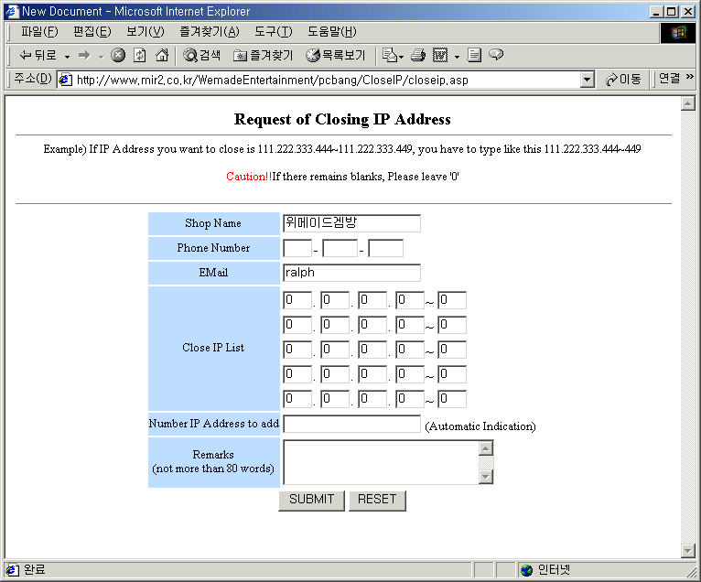
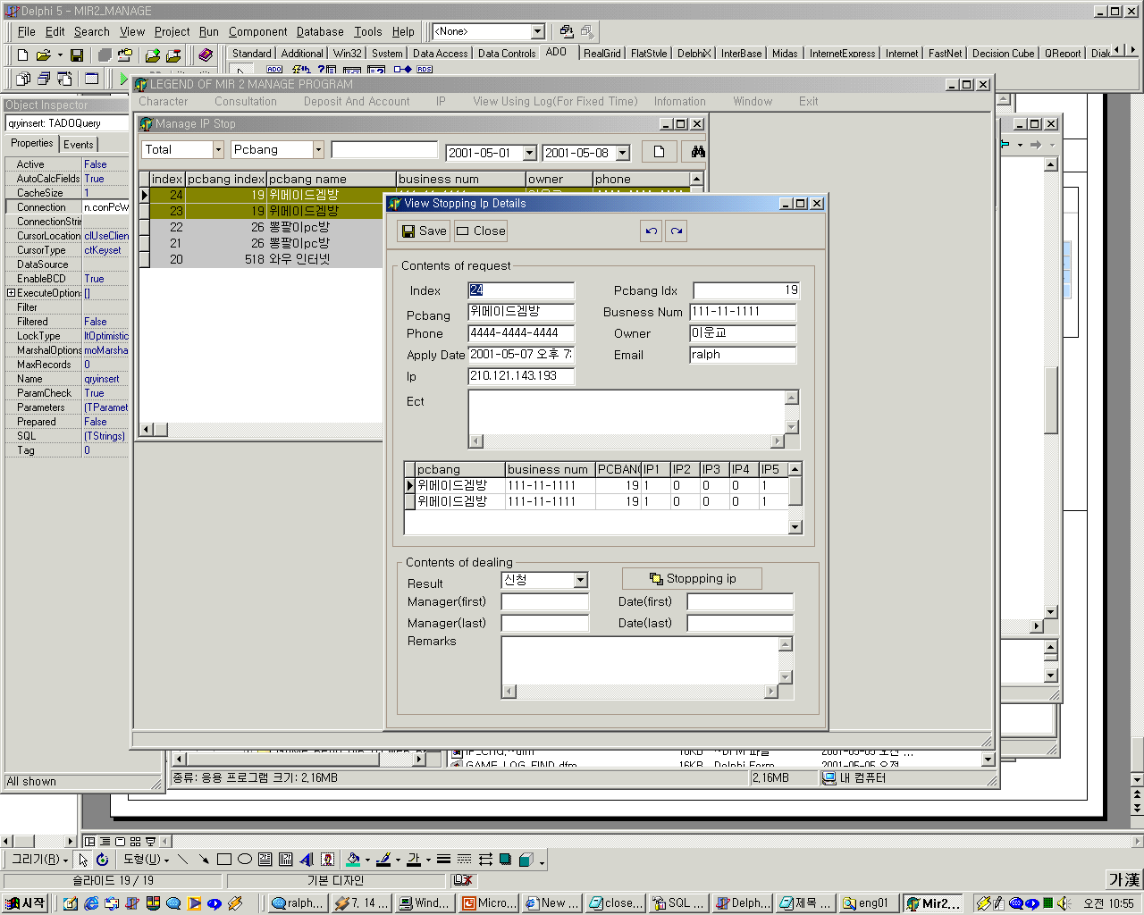
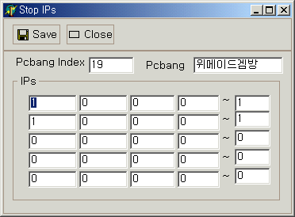
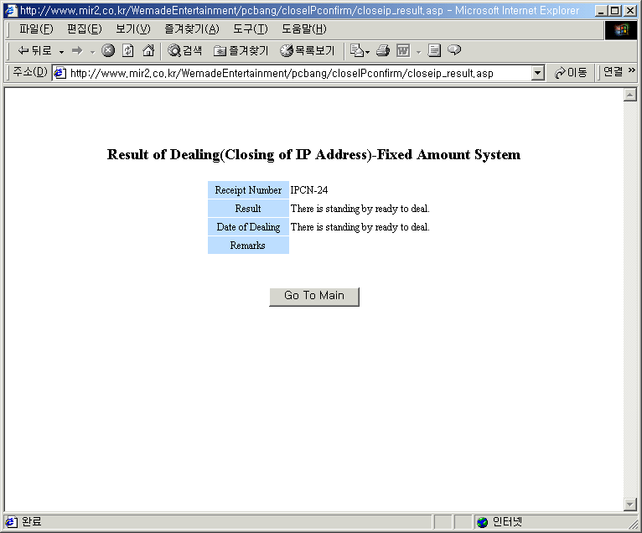
Ip – Stopping ip
Request
List of Requestion And Dealing
Stopping IPs
Result of Dealing
1
2
3
4
2
1
1
2
1
3
2
3
3
4
5
5
6
7
6
1. Pcbang name
2. Phone
3. Email
4. Ips
5. Count of ips
6. Remarks
*Required login to view this
request page.
1. Search Item(Apply, Done, Rejected, Deleted)
2. Search Item(Pcroom, Ownwer,..)
3. Starting date
4. Ending date
5. IPs
6. Dealing
7. Stopping IPs registration
1. Pcroom Index
2. Pcbang Name
3. Ips
1. Dealing Index
2. Result
3. Date of dealing
*Required login to view
this result page window.

Slide 23




View Using Log(For Fixed Time)
For Individual
Search Results
For Pcbang
Search Results
1
2
1
2
3
4
5
3
6
1. Starting date of searching
2. Ending date of searching
3. Login Id
1.Starting date of searching
2. Ending date of searching
3. Pcroom name
4. Pcbang index
5. Night Discount ( 02:00 ~ 10:00)
6. Pcroom List
*To get correct result , You must search with pcroom index

Slide 24


Information - Pcroom
Registration
Pcroom List And View Details
1
2
1
2
3
3
4
8
5
6
4
7
9
8
10
5
11
12
13
14
6
15
16
7
1. Pcroom name
2. Business number
3. Owner name
4. Owner SSN
5. Items of business
6. Type of business
7. Pcroom Phone
8. Home Phone
9. Pcroom zipcode
10. Pcroom address
11. Home zipcode
12. Home address
13. Kind of internet line
14. Emal
15. Count of having ips
16. Motive of registration
1. Search item(Status of request)
2. Search item(Pcroom name, owner..)
3. View List with excel
4. Pcroom details
5. Dealing
6. List of notice of pay
7. List of ip status
8. Search 6 and 7
*To view with excel, Excel must be installed.

Slide 25


Information - Manager
Registration
Manager List And View Details
1
2
1
2
3
3
4
5
4
1. Name
2. Id
3. Password
4. Type of manager
5. Date of registration
1. Search item(Status of manager)
2. New manger registration
3. View manager details
4. dealing

Slide 26



Game To Web – Save Id
Main Program
Select Folder
Select Folder
1
2
3
4
1
4
2
5
5
6
3
1
6
7
1. Time
2. Start or Stop
3. Close
4. Days
5. Description
6. Folder
7. Message
1. Index
2. Description
3. Folder
4. Apply
5. Close
6. Search
*Select Folder

Slide 27


Game To Web – Connection Save
Main Program
Select Folder
Select Folder
1
2
3
4
1
4
2
5
5
6
3
6
1
7
1. Start or Stop
2. Close
3. Days
4. Time
5. Servr
6. Folder
7. Status
1. Index
2. Server
3. Folder
4. Apply
5. Close
6. Search
*Select Folder

Slide 28


Game To Web – Game Log Save
Main Program
Select Folder
Select Folder
1
2
4
1
4
5
3
2
6
1
5
6
3
7
1. Start or Stop
2. Close
3. Days
4. Time
5. Servr
6. Folder
7. Status
1. Index
2. Server
3. Folder
4. Apply
5. Close
6. Search
*Select Folder

Slide 29

Game To Web – Leave Usable Id & IP
Main Program
Select Folder
1
5
2
6
1
3
4
7
1. Folder
2. Time
3. IP File
4. Id File
5. Search
6. Start
7. Close
*Select Folder

Slide 30



Check server
Main Program
1. Server Count
2. Connect login server
3. Disconnect login server
4. Sound off
5. Close
6. Status
7. Setting Login server
8. Setting Game server name
1
2
3
4
5
7
6
8

Slide 31


Check Remaing Time
Check Remaining Time (User)
Check Remaining Time (Pcroom)
1. A Fixed Days System
2. A Fixed Amount of Time System
1. A Fixed Days System
2. A Fixed Amount of Time System

Slide 32




Inquire Password
1. Input Login ID
2. Input Name
3. Input Answer
4. View Password
1
2
3
4

