Slide 1
Analysis and Prediction of Olympic Games
Team members: Siyuan Ji
Notes:
My project is about prediction of gold medals of all countries in the Tokyo Olympic Games in 2020. The Olympic Games are held every four years. The Winter Olympic Games are held two years apart from the Summer Olympic Games.

Slide 2
Research Questions What real world problem you are trying to solve?
According to the data of previous Olympic Games, including the sex, height, weight, nationality of competitors, competition items and medals, our task is to analyse and predict the number of gold medals of each country in the Tokyo Olympic Games in 2020 based on the given data.
Value of the project
The Olympic Games are the world's sports events, and new records are broken every year. Researching the data of past years can show the changes of each Olympic Games and do the summary statistics of previous years. It is useful for countries and spectators who like to watch games to predict the future outcomes. More spectators are more willing to buy tickets to support competitions that their national teams can win.

Slide 3
Describe the meta data of your dataset.
We will explore a dataset on the modern Olympic Games, including all the Games from Athens 1896 to Rio 2016. The data have been scraped from www.sports-reference.com .
Notes:
I have researched the changes of the age of men and women and the number of participants in the Olympic Games, which may have more influence factors on the future Olympic Games. Using time series to predict the number of gold medals in the Tokyo Olympic Games in 2020 is conducive to promoting the development of national sports.
I use time series model to forecast and compare the results of 2016 Olympic Games

Slide 4
How dataset was collected?
We collected the all match data from 120 years of Olympic history athletes and results to predict Gold medals won by 20 countries in 2020 Tokyo Olympic Games.
The meta data of your dataset

Slide 5
Data munging and statistical summary
Distribution of the age of gold medalists.
Women in Athletics.
Medals per country.
Disciplines with the greatest number of USA Gold Medals.
Evolution of the Olympics over time.
Based on the data of the top 20 countries in the Rio Olympic gold medals and using only the data of the Summer Olympic Games, we predict the number of medals in these 20 countries in the Tokyo Olympic Games in 2020.

Slide 6
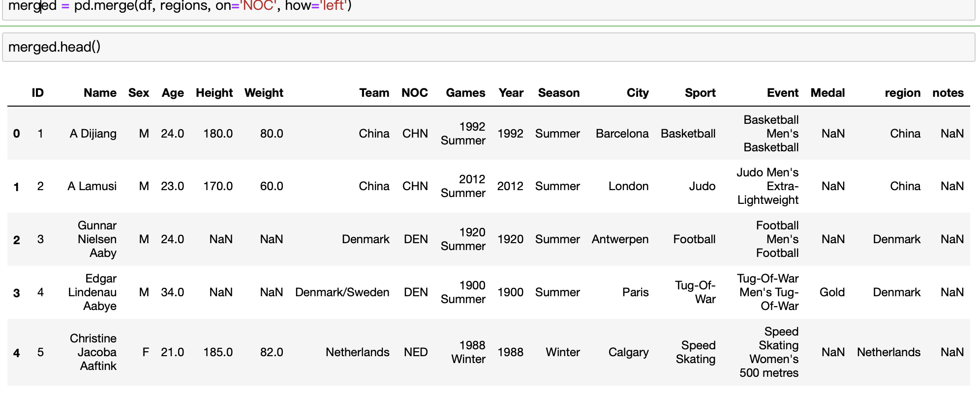
Data cleanup
We can now join the two dataframes using as key the NOC column with the Pandas 'Merge' function
Notes:
The columns are the following:
ID - Unique number for each athlete;
Name - Athlete's name;
Sex - M or F;
Age - Integer;
Height - In centimeters;
Weight - In kilograms;
Team - Team name;
NOC - National Olympic Committee 3-letter code;
Games - Year and season;
Year - Integer;
Season - Summer or Winter;
City - Host city;
Sport - Sport;
Event - Event;
Medal - Gold, Silver, Bronze, or NA.
There's some duplication of information.

Slide 7
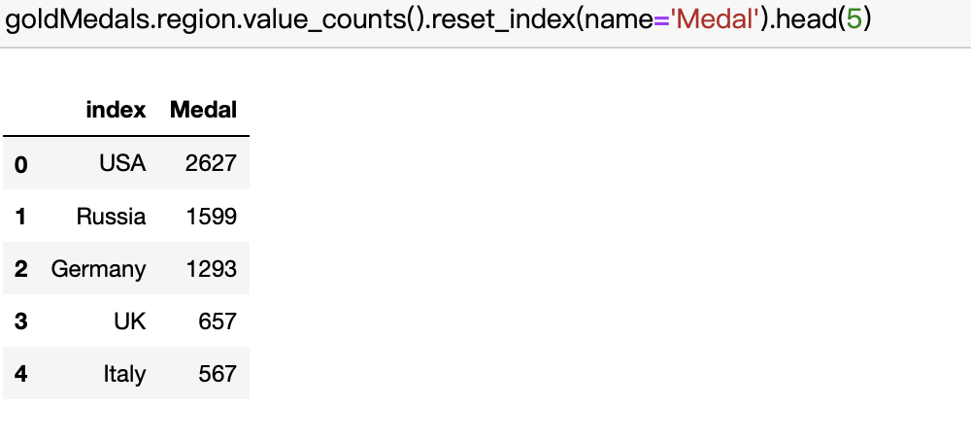
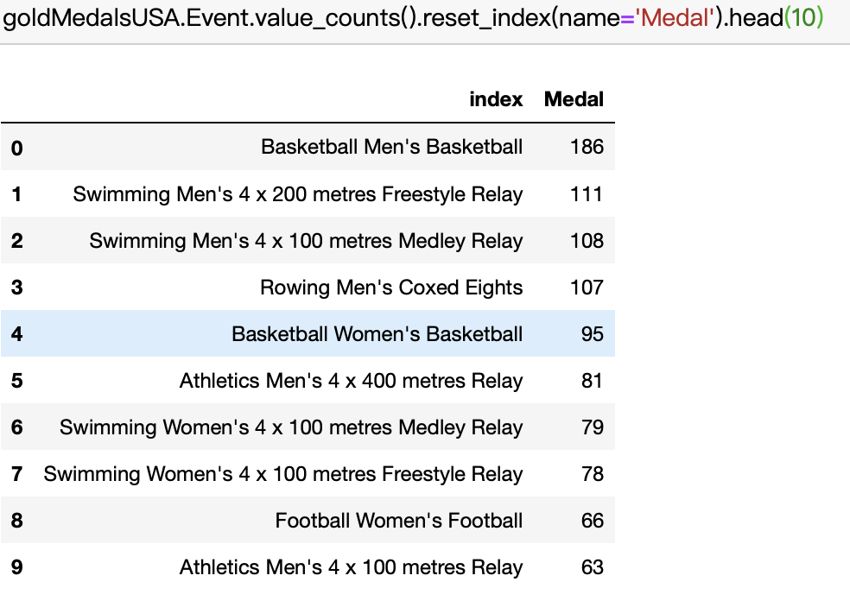
Summary statistics and interpretation
Let's now review the top 5 gold medal countries
Of course, basketball is the leading discipline!
Notes:
the United States won the most gold medals is basketball, the United States basketball is called the dream team, but because it is a team event, so each team. Members all have gold medals. The part that affects me is that there are many medals in the team games, but only one medal in the medal list. I used the data of the top 20 countries in London Olympic Games to predict, because there is no need to predict the countries with too small medals.

Slide 8
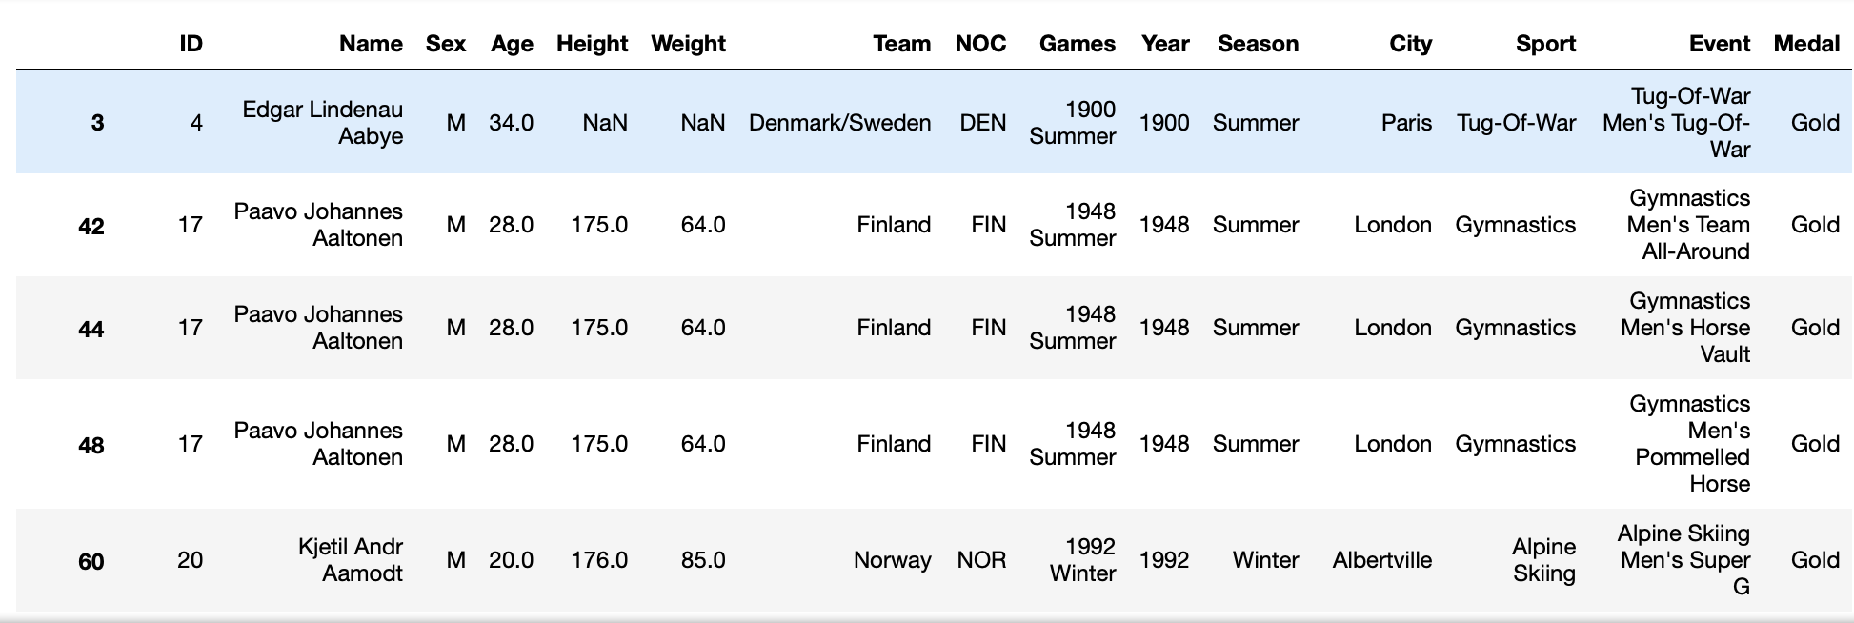
summarize statistical attribute of the data
Notes:
In the early Olympic Games, the height and weight data of athletes are missing, and many countries have experienced a split renaming, such as the disintegration of the Soviet Union, the number of medals of the Russian team inherited from the Soviet Union,

Slide 9
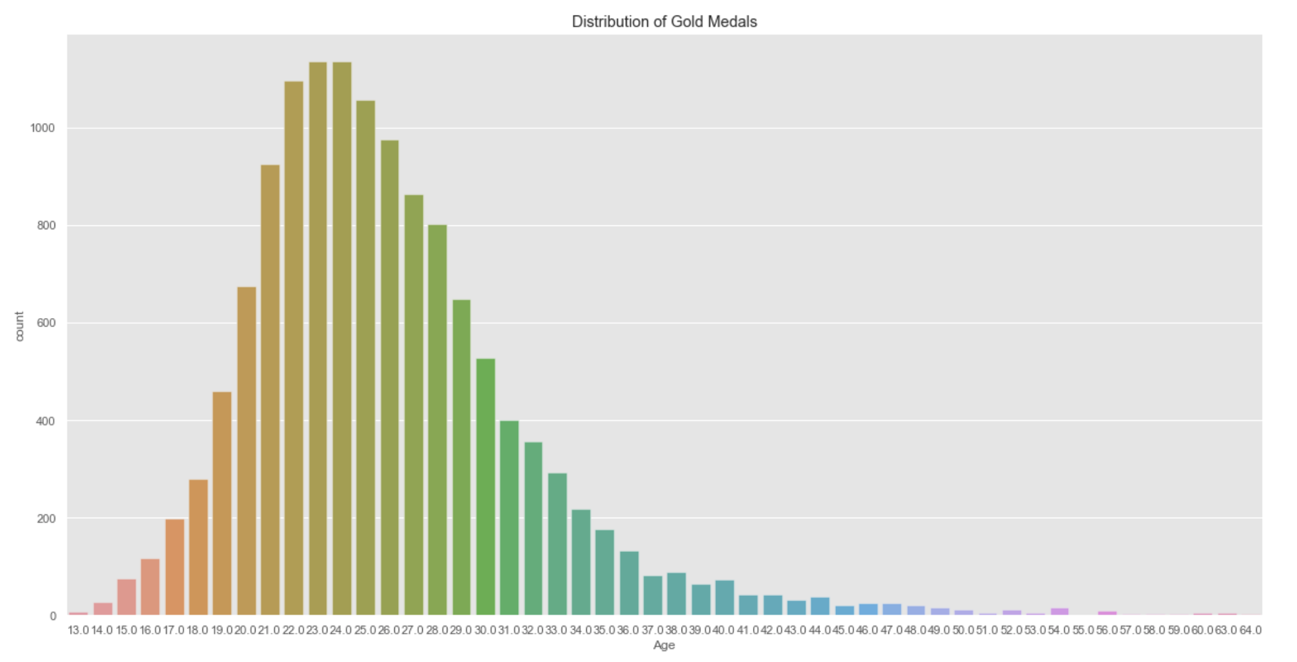
Data visualization
We can see that most of the gold medalists are in the 20-30 age range.

Slide 10
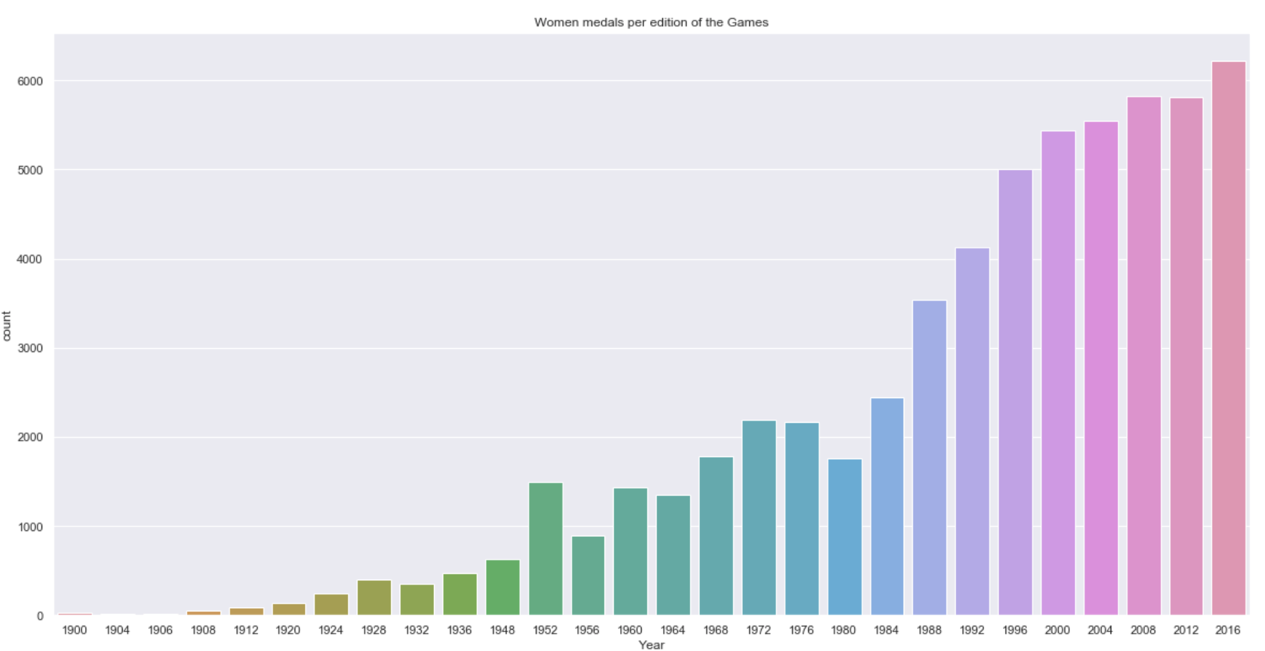
From the figure, we can see that more and more women athletes participate in the Olympic Games, and increase year by year.

Slide 11
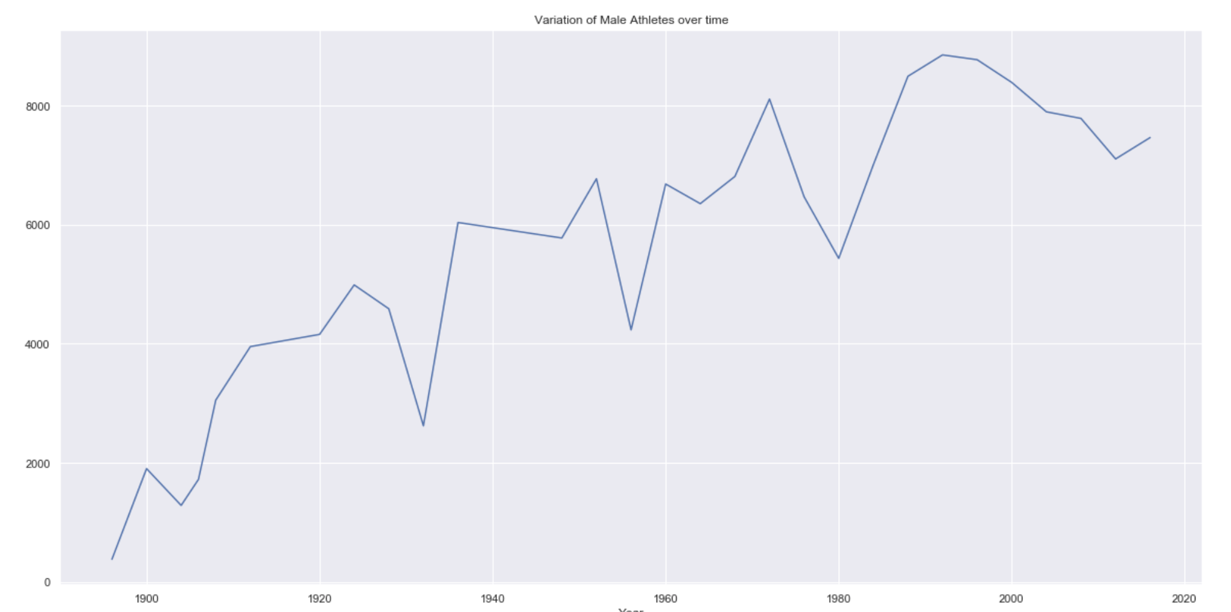
The overall trend shows a growth trend, but there are three nodes declining. The first node is due to the Second World War, the second node is due to Contradictions between the Nationality of the People's Republic of China and the Republic of China, and the third is due to the Cold War boycott of the Moscow Olympic Games launched by the United States.

Slide 12
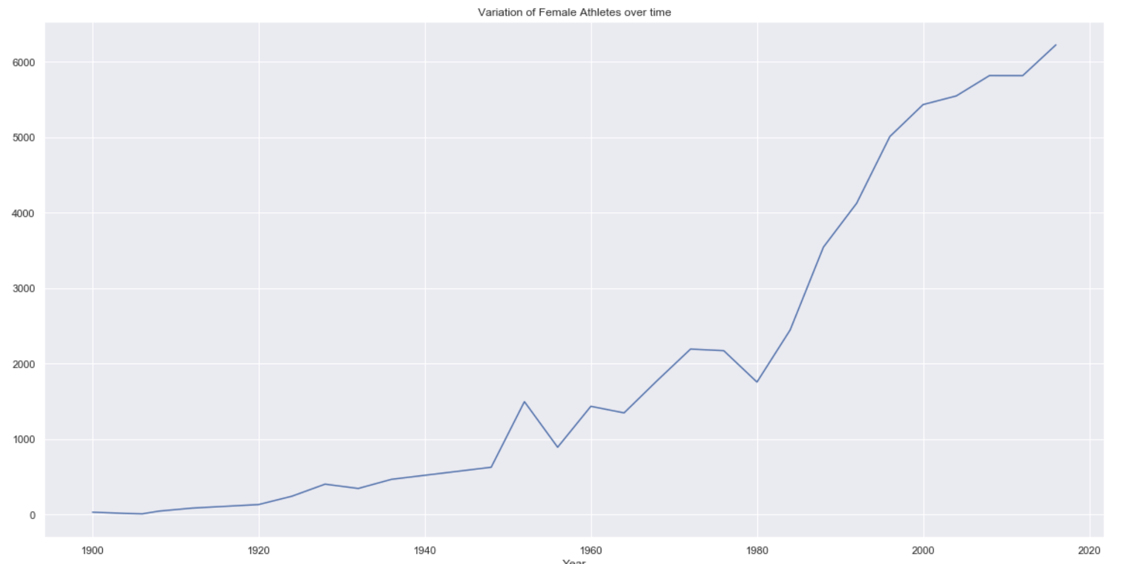
Women athletes participating in the Olympic Games have been showing a rapid growth trend.

Slide 13
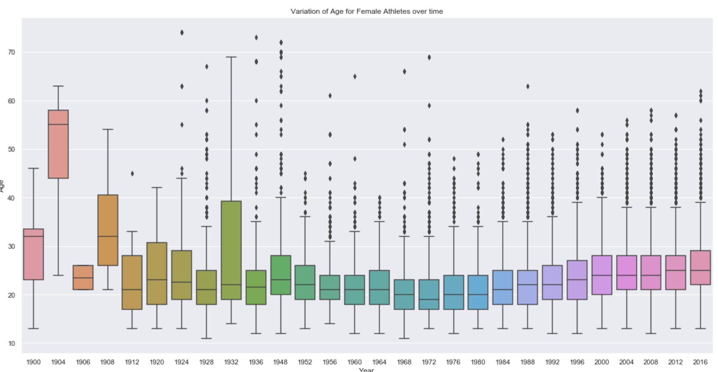
The age trend of female athletes has increased a little in recent years.

Slide 14
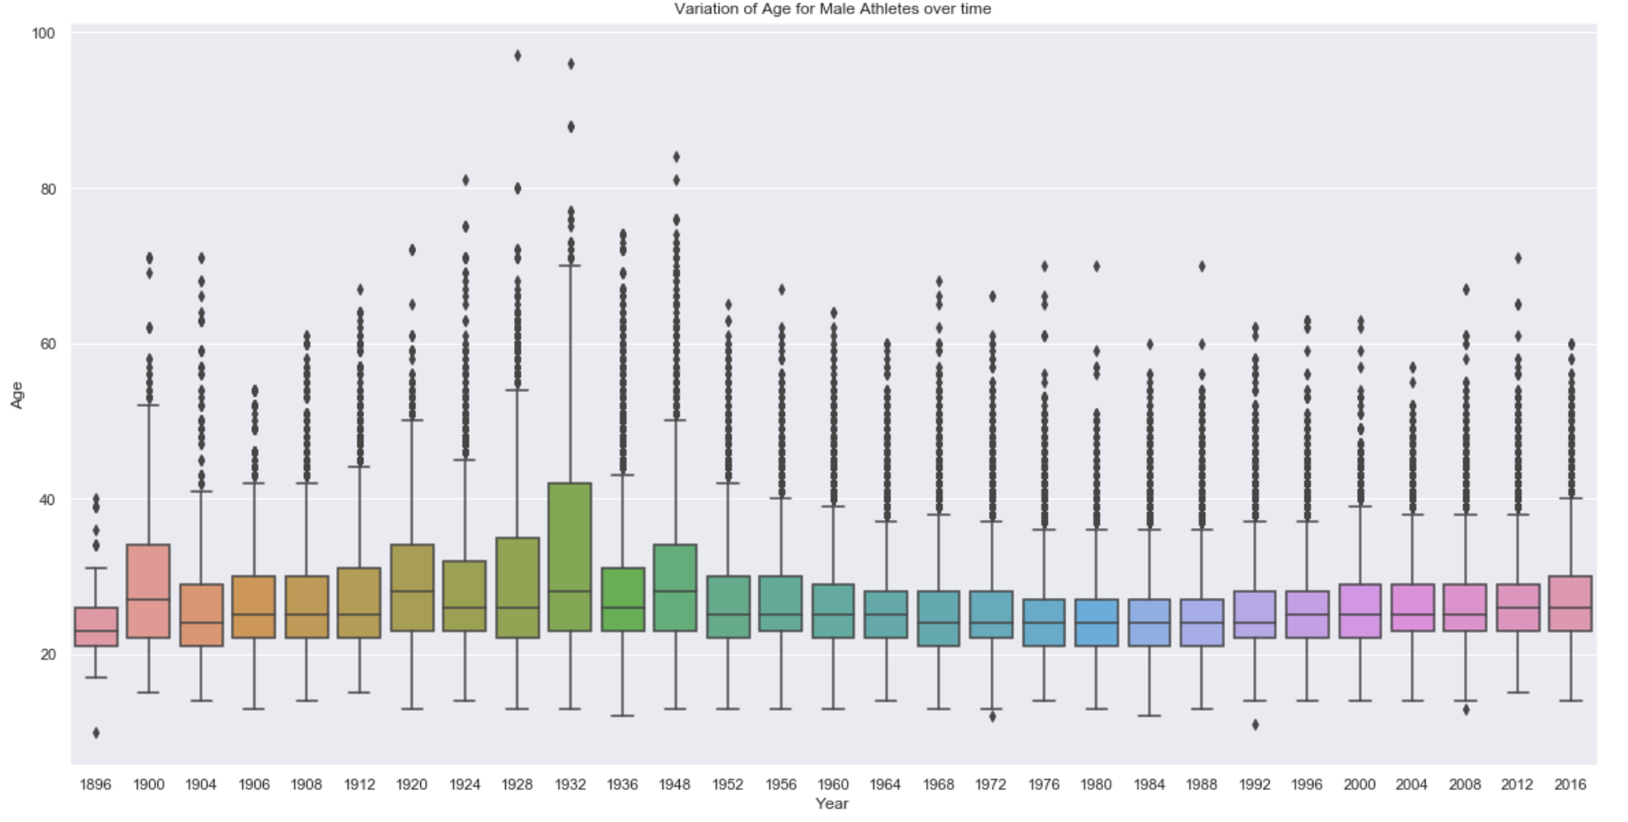
It can be seen from the boxplot that the age of male athletes has not changed much.

Slide 15
Modelling activity
Hypothesis you tested about predictors
I use the results before 2012 as variables to predict the known results in 2016, using the 2016 Olympic gold medal table as a prediction hypothesis, and finally predicting 2020 plus 2016 as variables.
Motivation you to use this model
The Autoregressive Moving Average (ARMA) method models the next step in the sequence as a linear function of the observations and resiudal errors at prior time steps.It combines both Autoregression (AR) and Moving Average (MA) models.
The method is suitable for univariate time series without trend and seasonal components.

Slide 16
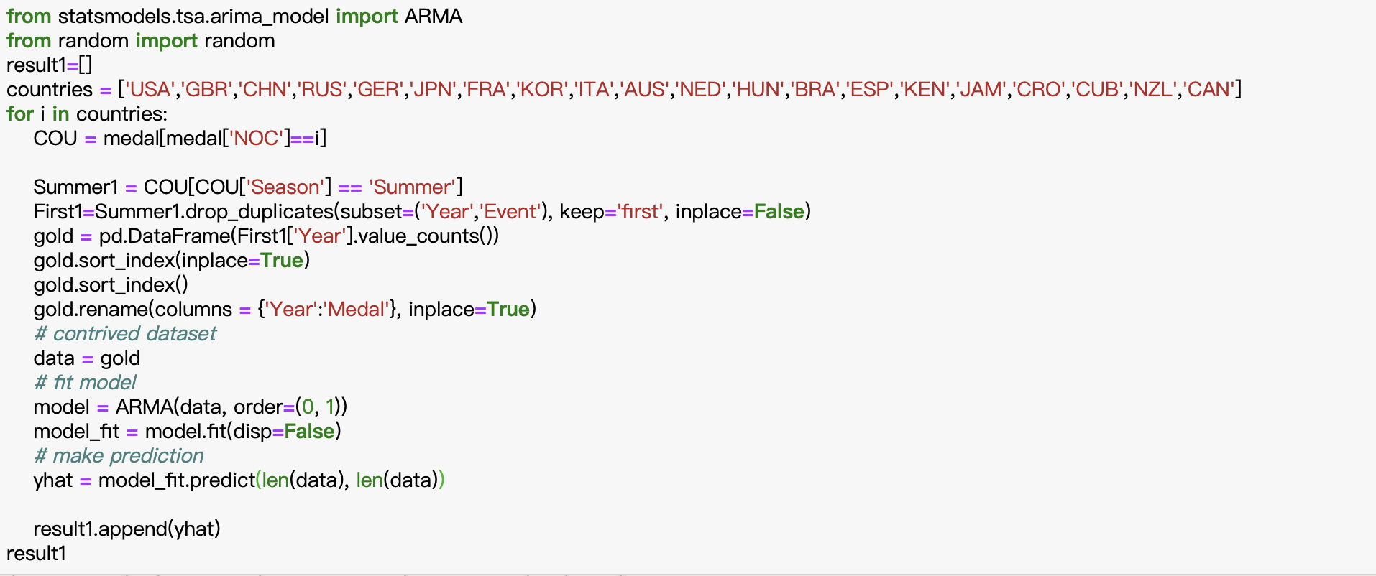

Final Model parameter

Slide 17
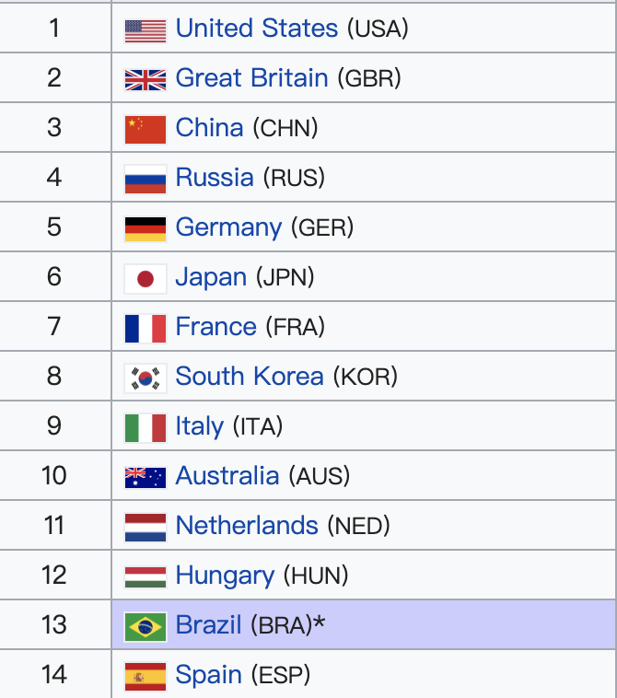
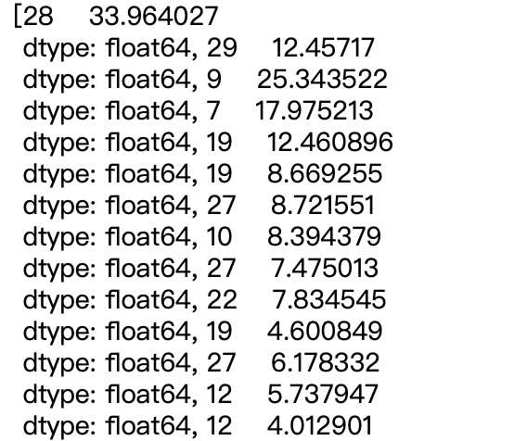
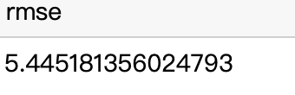
Conclusion
From the predict result we can see, USA will win the most gold medal.
From result we can see if we only predict Total number of gold medals, the RMSE is 5.44,which is not bad.
Notes:
Using data from 2012 and previous years to predict the 2016 medal list is similar except for Britain, which values the influence of the Olympic Games after the London Olympic Games, encourages athletes to win gold medals, pays attention to athletes' training and adapts to the Brazilian climate. As for the prediction of 2020, the Japanese team, as the host, can adapt to the Japanese climate better, can play a better level, and the cancellation and reduction of strong sports in some countries can produce errors in the prediction results.

