Slide 1
Encoder：
Half-pel motion estimation (reduce distortion)
DPCM of DC coefficients (save bit-rate)
Decoder:
(1) In-loop filter (reduce blocking artifacts)

Slide 2
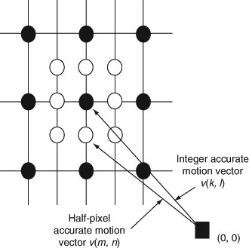
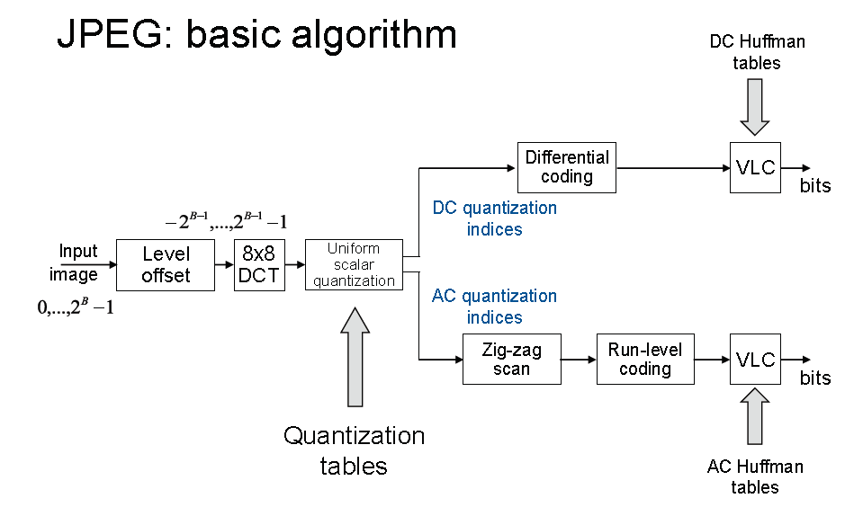


1. Half-pel ME
based on Integer-pixel ME
bilinear interpolation
compute SSE of 9 positions around optimal Integer pixel
Half-pel Motion vector is represented as
3-digit decimal number: position+ integer MV
e.g. 144: integer MV 44
half-pel MV relative position: 1
1
2
3
4
5
6
7
8
9
2. DPCM of DC coefficients
Figure 1: Half-pel ME Illustration [1]
3. optimal LS filter
Figure 2: JPEG encoder Block diagram [2]
(1) DC coefficients of Y channel: DPCM
(2) AC coefficients of Y channel and all coefficients of chrominance channel: Run-length coding
Figure 3: LS problem of optimal Filter [3]
(1) Kernel solves the LS problem (luminance channel of encoded Image and
filtered reconstructed Image)
(2) computed by encoder using conjugate gradient method and transmitted to decoder
(3) In-loop filter: filtered reconstructed Image used for ME for following frame
[1] https://doi.org/10.1007/978-0-387-78414-4_116
[2] IVC lecture slides
[3] D. Kim, H. Oh, O. Urhan, S. Erturk and T. Chang, "Optimal Post-Process
/In-Loop Filtering for Improved Video Compression Performance,"

Slide 3
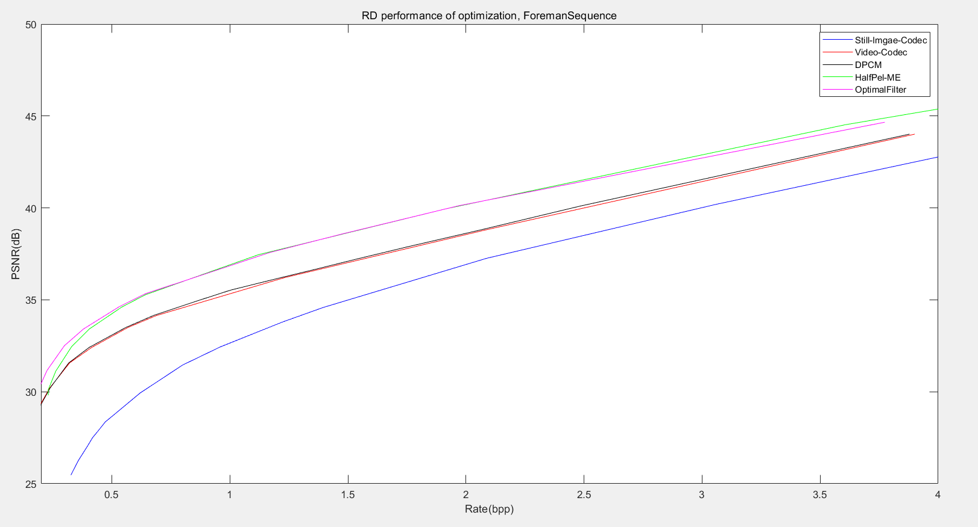
(1) All 3 methods can improve RD performance.
(2) Half-pel ME and In-loop filter bring more improvement .

