Slide 1
实战项目-扩展开发
Arweave存储开发
Arweave
Produced By Adams

Slide 2
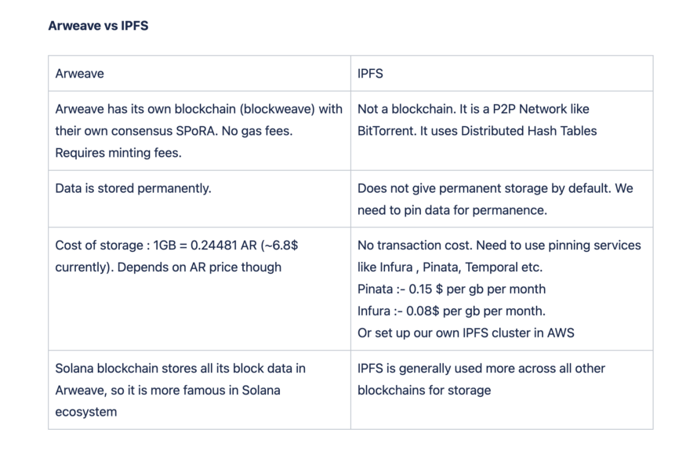
存储设施领域的项目
IPFS
FILECOIN
ARWEAVE
StoreJ

Slide 3
查询语言：GRAPHQL
Arweave有索引能力
Graphql：任何数据模型适用
Arweave的模式：transaction block
Arweave提供了graphql的js sdk
用这里的ql：https://gql-guide.vercel.app/
用这个工具：https://arweave.dev/graphql

Slide 4
有关ArWeave资料浏览
https://dev.mirror.xyz/GjssNdA6XK7VYynkvwDem3KYwPACSU9nDWpR5rei3hw
https://gql-guide.vercel.app/
https://pbillingsby.hashnode.dev/querying-the-arweave-network-with-graphql
https://gist.github.com/saarim-mirror/2605fda5baf8b428385c872f6eb5d6d5
https://www.npmjs.com/package/arweave-graphql
https://dev.mirror.xyz/
https://itgyf4hcvo4s7vey4ryl6k7vinodi62gsbuzlbkhgff5lynaus4a.arweave.net/RM2C8OKruS_UmORwvyv1Q1w0e0aQaZWFRzFL1eGgpLg

Slide 5
实战项目-扩展开发
Arweave环境与编码
环境与编码
Produced By Adams

Slide 6
环境与配置
本地开发链
开发链：npx arlocal
测试币：http://127.0.0.1：1984/mint/<address>/balance
挖矿：http://127.0.0.1:1984/mine
npm i arweave arweave-wallet-connector use-arconnect

Slide 7
钱包访问
import { ArweaveWebWallet } from 'arweave-wallet-connector'
function Test() {
//const ar = useArConnect()
const wallet = new ArweaveWebWallet({
name: 'Your application name',
logo: 'URL of your logo to be displayed to users'
})
wallet.setUrl('arweave.app')
wallet.keepPopup= true

Slide 8
初始化代码
const arweave = Arweave.init({
host: '127.0.0.1',
port: 1984,
protocol: 'http'
});

Slide 9
存储代码
export const toArweave = async function (entity) {
let tx = await arweave.createTransaction({
data: entity,
});
tx.addTag('Content-Type', 'image/jpeg');
await arweave.transactions.sign(tx);//
const response = await arweave.transactions.post(tx);
const myurl = "http://127.0.0.1:1984/" + tx.id;
messageBox("success", "", myurl)
return myurl;
}

