Slide 1


gas和转账
白玉琪

Slide 2
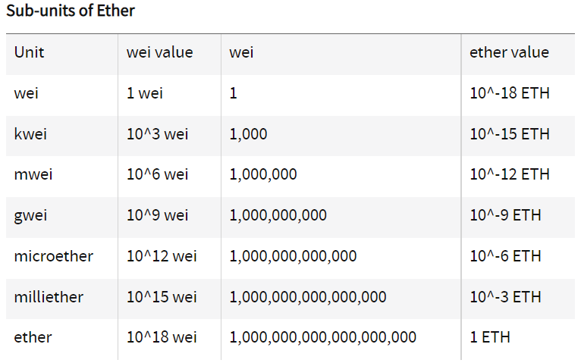
以太坊货币单位
Notes:
更多模版：亮亮图文旗舰店https://liangliangtuwen.tmall.com

Slide 3
gas
https://github.com/wolflo/evm-opcodes/blob/main/gas.md
gas是完全由执行逻辑决定的，一个固定的逻辑的合约函数执行，gas没有变化，有变化的是gas的价格
Notes:
更多模版：亮亮图文旗舰店https://liangliangtuwen.tmall.com

Slide 4
gas price
https://docs.soliditylang.org/en/v0.8.15/introduction-to-smart-contracts.html?highlight=gas%20price#gas
https://solidity-by-example.org/gas/
Notes:
更多模版：亮亮图文旗舰店https://liangliangtuwen.tmall.com

Slide 5
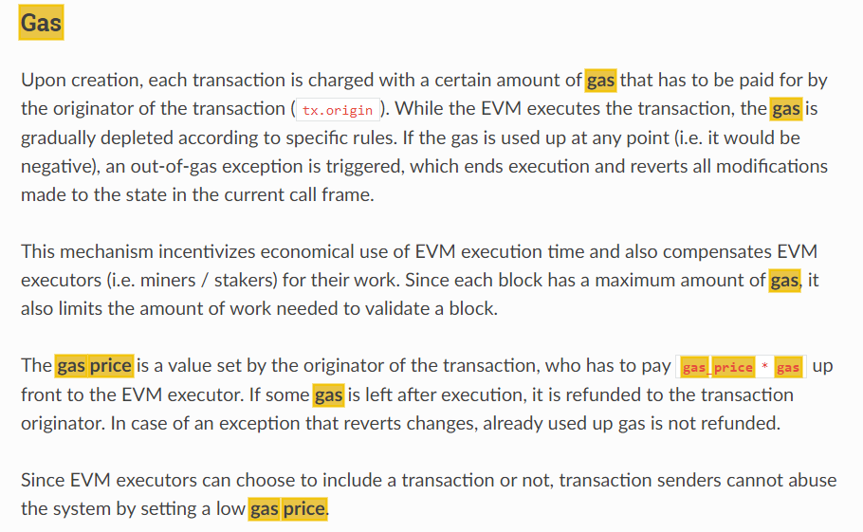
gas price
Notes:
更多模版：亮亮图文旗舰店https://liangliangtuwen.tmall.com

Slide 6
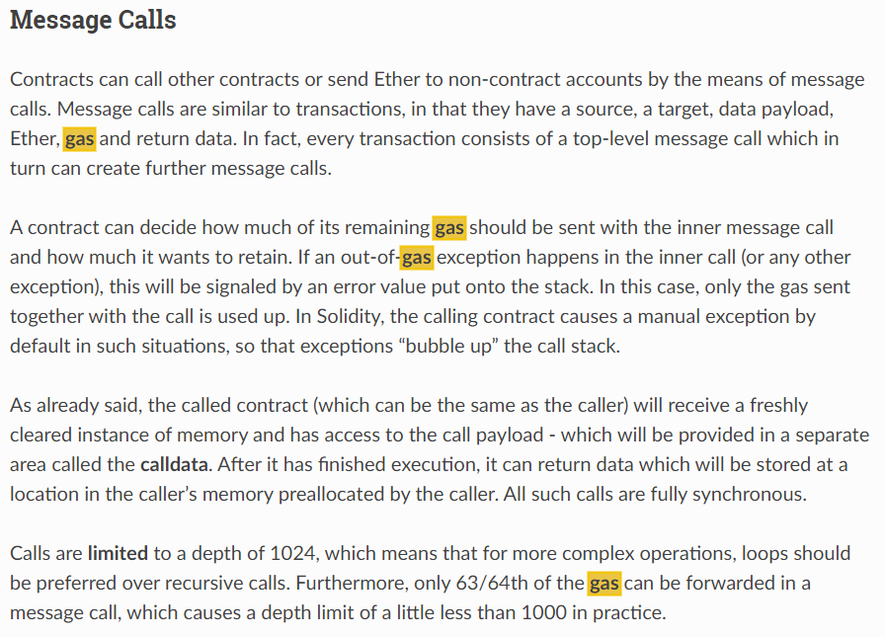
gas price
Notes:
更多模版：亮亮图文旗舰店https://liangliangtuwen.tmall.com

Slide 7
gas
gas limit(transaction中是gas， block中是gaslimit)：内部账号之间的调用也可设置gaslimit
gas price：交易中设置，内部账号之间的调用不能设置

Slide 8
函数定义中的payable
gas
gas limit(transaction中是gas， block中是gaslimit)：内部账号之间的调用也可设置gaslimit
gas price：交易中设置，内部账号之间的调用不能设置

Slide 9
函数调用中的gas选项
fname{gas:<gas>, value:<value>}()
Notes:
更多模版：亮亮图文旗舰店https://liangliangtuwen.tmall.com

Slide 10
三种转账方式
https://ethereum.stackexchange.com/questions/19341/address-send-vs-address-transfer-best-practice-usage/38642#38642
address.transfer()
throws on failure
forwards 2,300 gas stipend (not adjustable), safe against reentrancy
should be used in most cases as it's the safest way to send ether
address.send()
returns false on failure
forwards 2,300 gas stipend (not adjustable), safe against reentrancy
should be used in rare cases when you want to handle failure in the contract
address.call.value().gas()()
receive
Notes:
更多模版：亮亮图文旗舰店https://liangliangtuwen.tmall.com

Slide 11
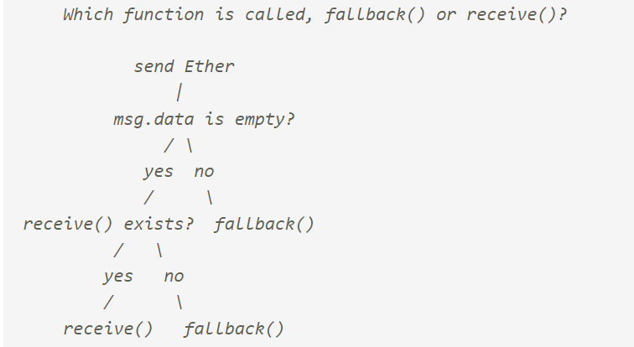
转账逻辑
Notes:
更多模版：亮亮图文旗舰店https://liangliangtuwen.tmall.com

Slide 12
EIP1559
base fee
max priority fee
max fee
type0 和type2
Notes:
更多模版：亮亮图文旗舰店https://liangliangtuwen.tmall.com

