Slide 1
elasticsearch
Shifa Khan github/shifakhan @findshifa

Slide 2
Why do we need search options?

Slide 3
We need it to make our lives easier
Find stuff that is relevant to us Find it faster

Slide 4
How do we add seach features to our projects?
Options available:
Standard Database Query
Lucene libraries
Solr
Sphinx
Elasticsearch

Slide 5





elasticsearch
. . .

Slide 6
Topics for today!
Full Text Searching RESTful ES Elasticsearch in Rails Advanced features of ES
Note: ES = ElasticSearch

Slide 7
What is elasticsearch?
Database server
Implemented with RESTful HTTP/JSON
Easily scalable (hence the name
elasticsearch)
Based on Lucene

Slide 8
Features of elasticsearch
Schema-free
Real-time
Easy to extend with a plugin system for new functionality
Automatic discovery of peers in a cluster
Failover and replication
Community support: Multiple clients available in various languages for easy integration
Tire gem- ruby client available for ActiveModel integration

Slide 9
Terminology
Relational database
Elasticsearch
Database
Index
Table
Type
Row
Document
Column
Field
Schema
Mapping

Slide 10
Inside ES
DOC-TYPE
Data Structure of Elasticsearch
INDEX

Slide 11
An Index can have multiple types.
DOC-TYPE
Each type can have multiple documents.
INDEX
Each document contains data in
JSON format
DOC-TYPE
{..}
{..}
Document

Slide 12

Searches can also be performed in multiple indices
DOC-TYPE
INDEX
DOC-TYPE

Slide 13
How does elasticsearch work?

Slide 14
Full text searching
Inverted indexing
Analysis

Slide 15
FULL TEXT SEARCH
stars shine
sky
stars stars
sky
cloudy sky
[0]
[1]
[2]

Slide 16
FULL TEXT SEARCH
stars shine
sky
stars stars
sky
cloudy sky
WORD | LOCATION
stars | 0,1
shine | 0
sky | 0,1,2
cloudy | 2

Slide 17
FULL TEXT SEARCH
stars shine
sky
stars stars
sky
cloudy sky
 | WORD | LOCATION
 | stars | 0,1
 | shine | 0
 | sky | 0,1,2
 | cloudy | 2

Slide 18
FULL TEXT SEARCH
stars shine sky
stars stars sky
cloudy sky
WORD | LOCATION | POSITION
stars | 0 | 0
 | 1 | 0,1
shine | 0 | 1
sky | 0 | 2
 | 1 | 2
 | 2 | 1
cloudy | 2 | 0

Slide 19
FULL TEXT SEARCH
stars shine sky
stars stars sky
cloudy sky
WORD | LOCATION | POSITION
stars | 0 | 0
 | 1 | 0,1
shine | 0 | 1
sky | 0 | 2
 | 1 | 2
 | 2 | 1
cloudy | 2 | 0
Are these positions in the document are consecutive
?

Slide 20
FULL TEXT SEARCH
stars shine sky
stars stars sky
cloudy sky
WORD | LOCATION | POSITION
stars | 0 | 0
 | 1 | 0,1
shine | 0 | 1
sky | 0 | 2
 | 1 | 2
 | 2 | 1
cloudy | 2 | 0
We find the words in consecutive positions in Document 1

Slide 21
ANALYSIS
Analyzing is extracting “terms” from given text.
Processing natural language to make it computer searchable.

Slide 22
Ruby is a dynamic, reflective, general-purpose OOP language that combines syntax inspired by Perl with Smalltalk-like features. Ruby was first designed and developed in the mid-1990s by Yukihiro "Matz" Matsumoto in Japan.
Stopwords:-removal of words of less semantic significance
ruby dynamic reflective general purpose oop language combine syntax inspire perl smalltalk feature first design develop mid 1990 yukihiro matz matsumoto japan

Slide 23
Ruby is a dynamic, reflective, general-purpose OOP language that combines syntax inspired by Perl with Smalltalk-like features. Ruby was first designed and developed in the mid-1990s by Yukihiro "Matz" Matsumoto in Japan.
Lowercase and punctuation marks
ruby dynamic reflective general purpose oop language combine syntax inspire perl smalltalk feature first design develop mid 1990 yukihiro matz matsumoto japan

Slide 24
Ruby is a dynamic, reflective, general-purpose OOP language that combines syntax inspired by Perl with Smalltalk-like features. Ruby was first designed and developed in the mid-1990s by Yukihiro "Matz" Matsumoto in Japan.
Stemmer:-Deriving root of words
ruby dynamic reflective general purpose oop language combine syntax inspire perl smalltalk feature first design develop mid 1990 yukihiro matz matsumoto japan

Slide 25
ES Analyzer
Analyzer:
Consists of one tokenizer and multiple token filters eg: Whitespace, Snowball,etc
Tokenizer:
It tokenizes all words. Splits sentences into individual 'terms' . Ngram and EdgeNgram highly useful for autocomplete feature. Path hierarchy tokenizers.
Token filter:
Actions on tokenized words, basic lowercase to phonetic filters and stemmers (available in many languages)

Slide 26
Popular Analyzers
ES is easy to use. Readymade analyzers for general usage.
Snowball – excellent for natural language
Standard tokenizer, with standard filter, lowercase filter, stop filter, and snowball filter
●
Some fancy analyzers: Pattern analyzers
For all the Regular expressions guys out there! "type": "pattern",
"pattern":"\\s+"
●

Slide 27
How do we access Elasticsearch?

Slide 28
How do we access Elasticsearch?
Its RESTful

Slide 29
How do we access Elasticsearch?
Its RESTful
GET POST
PUT DELETE

Slide 30
PUT /index/type/id
action?

Slide 31
PUT /index/type/id
where?

Slide 32
PUT /twitter_development/type/id

Slide 33
PUT /twitter_development/type/id
what?

Slide 34
PUT /twitter_development/tweet/id

Slide 35
PUT /twitter_development/tweet/id
which?

Slide 36
PUT /twitter_development/tweet/1

Slide 37
curl -XPUT 'localhost:9200/twitter_development/tweet/1' -d '{
"tweet" : " Elasticsearch is cool! ", "name" : "Mr Developer"
}'

Slide 38
curl -XPUT 'localhost:9200/twitter_development/tweet/1' -d '{
"tweet" : " Elasticsearch is cool! ", "name" : "Mr Developer"
}'
{
"_index":"twitter_development", "_type":"tweet",
"_id":"1", "_version": 1,
"ok":true
}

Slide 39
Similarly,
curl -XGET 'http://localhost:9200/twitter/tweet/1'

Slide 40
Similarly,
curl -XGET 'http://localhost:9200/twitter/tweet/1'
{
"_index" : "twitter",
"_type" : "tweet",
"_id" : "1", "_source" : {
"tweet" : " Elasticsearch is cool! ", "name" : "Mr Developer"
}
}

Slide 41
Also
GET /index/_search
GET /index1,index2/_search GET /ind*/_search
GET /index/type/_search
GET /index/type1,type2/_search GET /index/type*/_search
GET /_all/type*/_search
Search all types (columns)
Search multiple or all indices (databases)

Slide 42
Similarly,
DELETE
Delete document
curl -XDELETE 'http://localhost:9200/twitter/tweet/1'
curl -XDELETE 'http://localhost:9200/twitter/'
Delete index
curl -XDELETE 'http://localhost:9200/twitter/tweet/_query'-d '{
"term" : { "name" : "developer" }
}'

Slide 43
Elasticsearch in Rails

Slide 44
ES in your RAILS app
Install ES from website. Start service.
In your browser check 'http://localhost:9200' for confirmation.
Add 'tire' to Gemfile.
In your model file (say 'chwink.rb' ) add- include Tire::Model::Search
include Tire::Model::Callbacks
Run rake environment tire:import CLASS=Chwink 6.In rails console type
Chwink.search(“world”) or Chwink.tire.search(“world”) 7.Results!

Slide 45
Request for Model.search
curl -XGET 'http://localhost:9200/chwink_development/chwink/_search?
-d '{
"query": { "query_string": {
"query": "world"
}
}
}'

Slide 46
Autocomplete feature implementation
and
Some examples of readymade and custom
analyzers

Slide 47
Querying
More types of queries and use cases:
Faceting : Allowing multiple filters
Pagination : Limiting per page results
Sort : Sorting results by relevance and scoring (using Elasticsearch's scoring algorithm)

Slide 48
Advanced features of Elasticsearch

Slide 49
USP of Elasticsearch
BIG! Data Analysis in Real Time

Slide 50
Automatic discovery of peers in a cluster Failover and replication

Slide 51
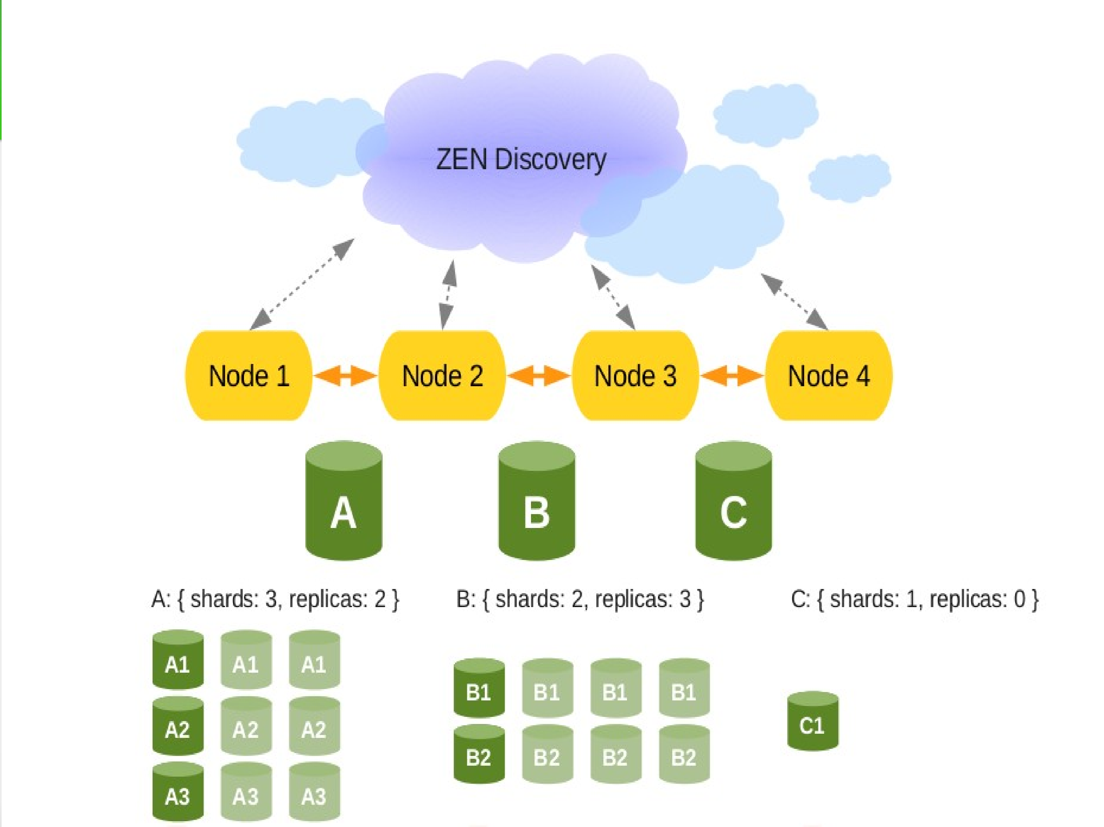

Slide 52
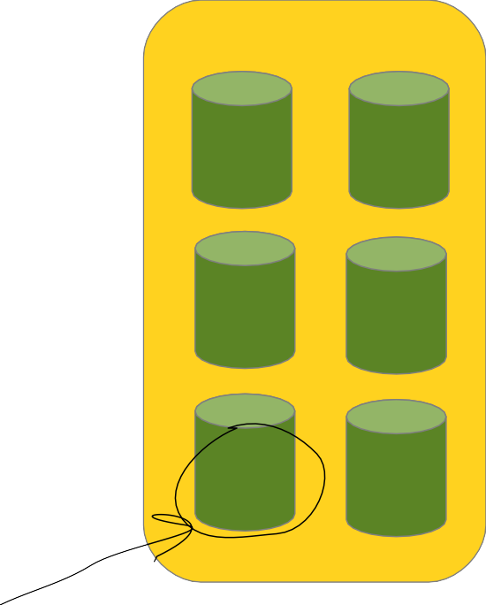
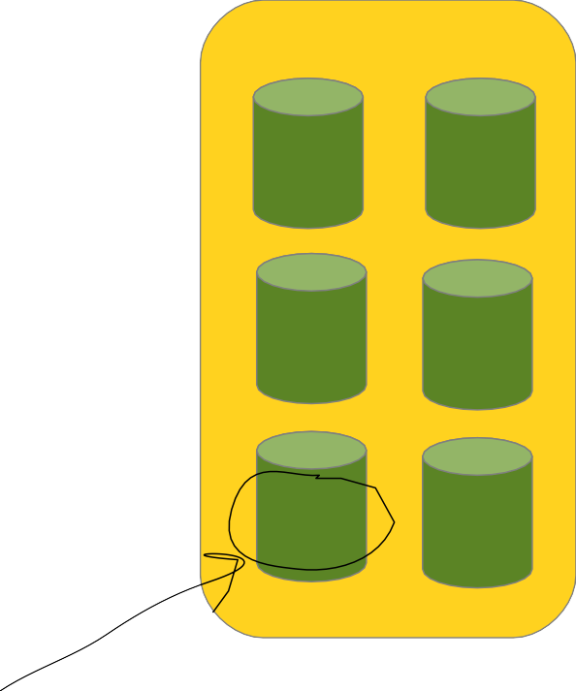
Automatic Discovery Module
Node 1
Node 2
Node 3
A1
B1
B2
B1
A2
A3
C1
A2
A3
A1
A2
B1
A3
B2
A2
B2
A1
B2
Shard
Replica

Slide 53
Automatic Discovery Module
When a new node is added...
Node 1
Node 2
Node 3
Node 4
C1
B2
A3
A2
A1
B2
A1
B2
A2
B1
B1
A2
A3
B1
A3
B1
B2
A1

Slide 54
High Availability
For each index you can specify:
●
Number of shards
Each index has fixed number of shards
Shards improve indexing performance
●
Number of replicas
Each shard can have 0-many replicas, can be changed dynamically
Replicas improve search performance

Slide 55
Tips
Make sure you make separate indices for test and development environment
Eg: Add index_name "Chwink_#{Rails.env}" to your model
file
During tests whenever you save an object make sure you add : Chwink.tire.index.refresh after each test case.
Make sure you delete and recreate the index after tests.
Eg: You can add this to your Rspec configuration file config.after(:each) do
Chwink.tire.Chwink_test.delete Chwink.tire.create_elasticsearch_index
end
Debug using log files :
Add to Tire config file: logger "tire_#{Rails.env}.log"

Slide 56
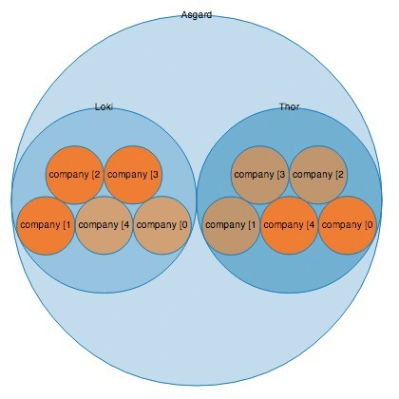

Room for exploration...
Big Desk plugin!
Plug-in for analysis of your search data!

Slide 57
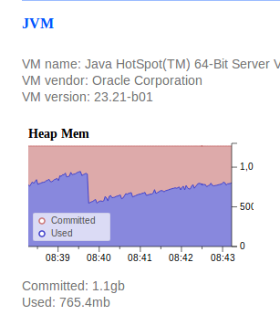
Room for exploration...
Big Desk plugin!
Plug-in for analysis of your search data!

Slide 58
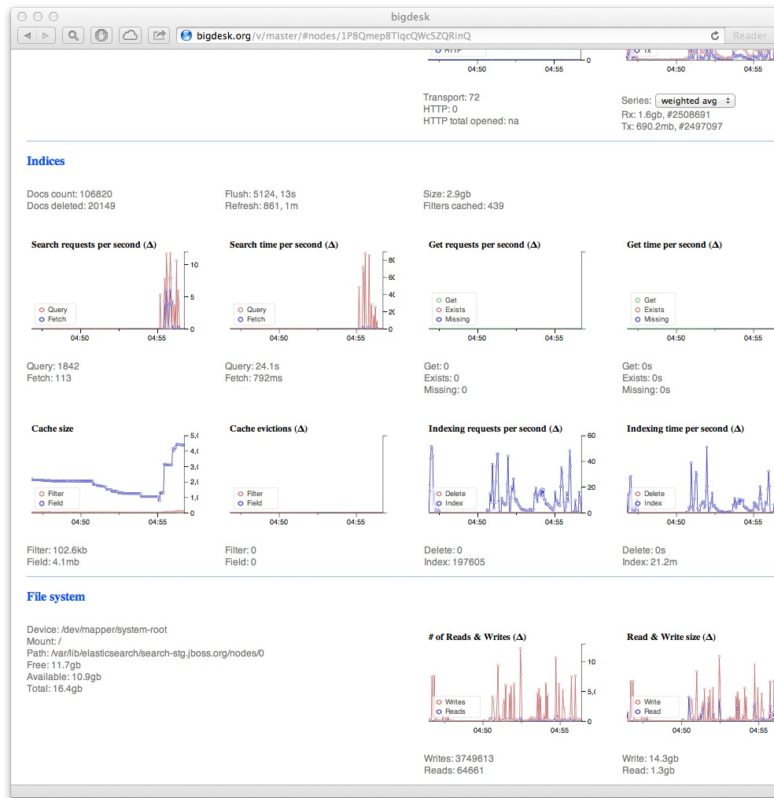
Room for exploration...
Big Desk plugin!
Plug-in for analysis of your search data!

Slide 59
Now you can go ahead and start exploring Elasticsearch for yourself!!

Slide 60
Thank you!
Questions are welcome!

