Slide 1
Java Persistence Architecture (JPA)
Mimi Opkins
CECS 493
Fall 2016

Slide 2
Using the Java Persistence Architecture
You may have seen how to access a database with JDBC.
Nowadays, many programmers prefer to use an object/relational (O/R) mapper rather than raw SQL commands.
The Java Persistence Architecture (JPA) provides a standard O/R mapper for the Java EE technology stack.

Slide 3
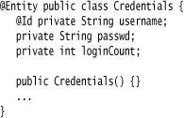
A Crash Course in JPA
An O/R mapper translates between database tables and Java objects that you manipulate in your program.
Your program never touches the database directly. In JPA, you use annotations to mark the classes that should be stored in the database. (These classes are called entities.)
For example, here is a Credentials class with the requisite annotations:

Slide 4

Entity Requirements
For a class to be an entity, there are three requirements:
The class must be annotated with @Entity.
Each object must have a unique primary key, marked with the @Id annotation.
The class must have a default constructor.
You use additional annotations to denote relationships between entities.
For example, here is how you express the fact that each Person has one associated Credentials entity and zero or more associated roles:
The O/R mapper translates these annotations into foreign keys or join tables.

Slide 5
Entity Mapper
You use an entity manager to create, read, update, and delete entity objects. The following call adds a new entity to the database:
EntityManager em = ...;
em.persist(entity);
To change an existing entity, modify the Java object and commit the current transaction. The changes are automatically saved.
You remove an entity by calling em.remove(entity).

Slide 6

JPQL
To read data, you issue a query in JPQL, an object-oriented query language that is similar to SQL. For example, the following query finds the Credentials objects for a given username:
SELECT c FROM Credentials c WHERE c.username = :username
The colon indicates a parameter that should be set when issuing the query. Here is how to get the query results:

Slide 7
Behind the Scenes
We use a @SuppressWarnings annotation because the getResultList() method returns a raw List, and that list is assigned to a parameterized List<Credentials>. We want a list with the appropriate type parameter so that we can get the elements as Credentials objects.
Behind the scenes, the entity manager
issues an SQL query,
constructs Credentials objects from the result (or finds them in its cache),
and returns them in a list.

Slide 8
Using JPA in a Web Application
When using JPA in a web application, you need to deal with two issues:
1. Obtaining an entity manager
2. Handling transactions
Both of these issues are much simpler when you use an EJB session bean.
To get an entity manager, you first obtain an entity manager factory, which the JSF implementation will inject into a managed bean. Place this annotated field into the managed bean class:
@PersistenceUnit(unitName="default") private EntityManagerFactory emf;
“Persistence units” are configured in an XML file:
jpa/src/java/META-INF/persistence.xml
Each unit has a name (here, "default"), a data source, and various configuration parameters.
You obtain an entity manager by calling:
EntityManager em = emf.createEntityManager();
When you are done with the entity manager, call: em.close();

Slide 9
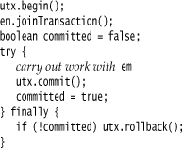
Transactions
In a request scoped managed bean, you can inject an entity manager directly. This is not feasible for other scopes because the entity manager is not threadsafe. However, the entity manager factory is threadsafe.
You should wrap any work with the entity manager into a transaction. Obtain a transaction manager with the injection:
@Resource private UserTransaction utx;
Then use this outline:

Slide 10
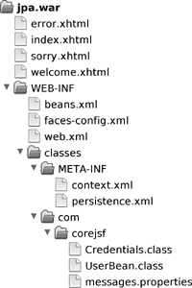
Directory structure of the JPA demo application
Our example program uses JPA to access the database instead of SQL.

Slide 11
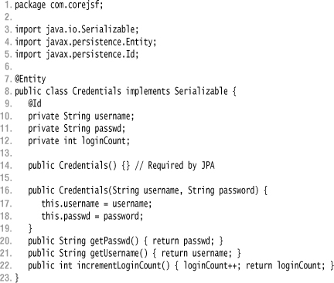
jpa/src/java/com/corejsf/Credentials.java

Slide 12
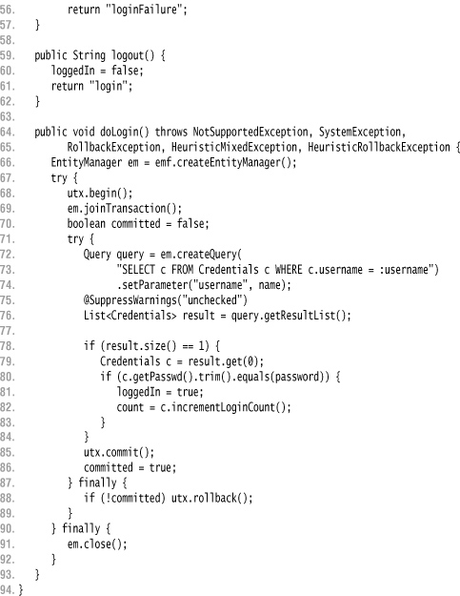
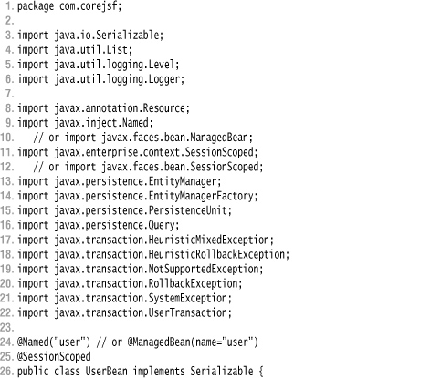
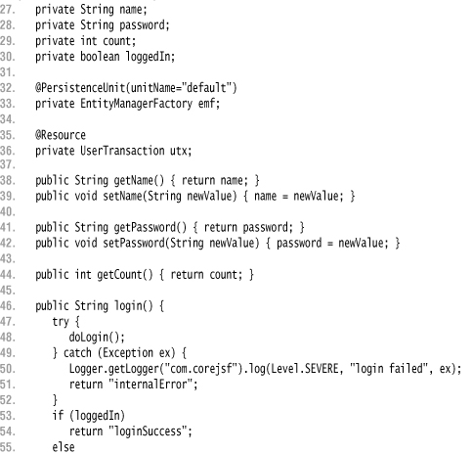
jpa/src/java/com/corejsf/UserBean.java

Slide 13
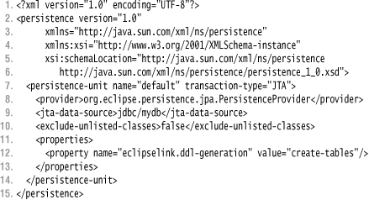
jpa/src/java/META-INF/persistence.xml

Slide 14
Using Managed Beans and Stateless Session Beans
We now move to a full EJB architecture where the JSF managed beans communicate with stateless session beans, objects that are managed by the application server.
There is a significant benefit: By default, session bean methods are automatically transactional.
The application server takes care of the transaction handling whenever a session bean method is invoked.
Similarly, the application server takes care of threading, simply by providing a pool of beans and issuing one for each request.
The beans are called stateless because they should keep no state between requests.
That feature enables the application server to pick any available bean for a particular request, or to create new ones when needed.

Slide 15
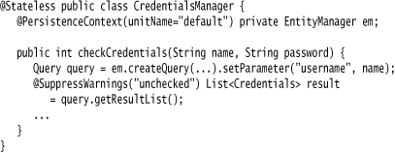
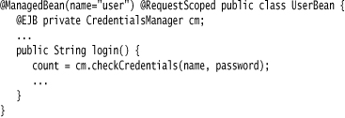
Stateless Session Bean
A stateless session bean is annotated with @Stateless.
You inject an entity manager and simply use it, without declaring any transactions:
Then inject the stateless session bean into one or more managed beans with the @EJB annotation:

Slide 16
Entity Objects
This is a very straightforward programming model. You place the application logic into the managed beans and the business logic into the stateless session beans.
The only drawback is that you need to transport a fair amount of data between the two types of beans.
You can use entity objects instead, but you have to be aware of a significant restriction.
When an entity object is returned from a stateless session bean to a JSF managed bean, it becomes detached. The entity manager no longer knows about the object.
If the managed bean changes the entity, it must merge it back into the entity manager. That is usually achieved by a call to another session bean method, which calls em.merge(entity).

Slide 17
Detached Entities
Detached entities have another issue. When an entity holds a collection of other entities, that collection is not a simple hash set or array list, but by default a lazy collection that only fetches elements on demand.
If you want to send such an entity to a JSF managed bean, you need to ensure that the dependent entities are prefetched, usually by adding fetch instructions in the JPQL query.
If you use stateless session beans in your JSF application, you need to learn enough about EJB 3 entities to solve these issues. You can avoid this issue by using stateful session beans.
We continue our sample application, now implementing the same functionality with a managed bean and a stateless session bean.

Slide 18
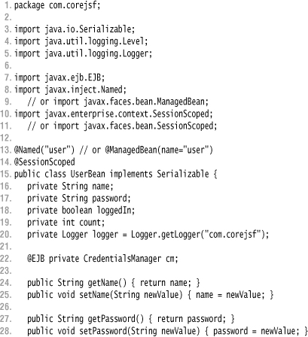
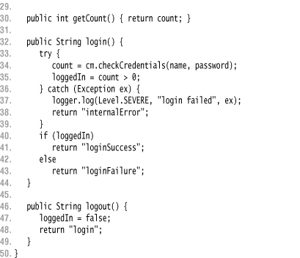
slsb/src/java/com/corejsf/UserBean.java

Slide 19
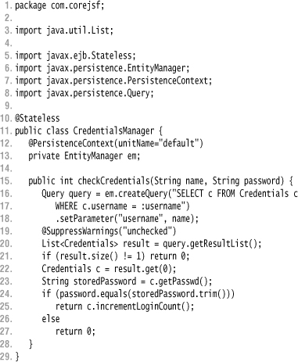
slsb/src/java/com/corejsf/CredentialsManager.java

Slide 20
Stateful Session Beans
A stateless session bean is essentially a place to put one or more methods—it is a rather degenerate object.
The EJB architecture also defines stateful session beans, which can hold state, just like regular Java objects.
Of course, stateful session beans are much more heavyweight. The EJB container manages them, perhaps caching them or moving them to another server for load balancing.
The container also provides for access control and transaction support when methods are invoked.
With CDI, your application can be composed of stateful session beans and entity beans, both managed by the EJB container.
The JSF pages reference stateful session beans directly. Then the issue of detached entities goes away, and it becomes very simple to access the database from your web application.
Of course, you are now relying on the EJB container to manage all your beans. For a simple single-server application, this is a significant overhead, even though EJB containers have become lighter weight and faster than they used to be.

Slide 21
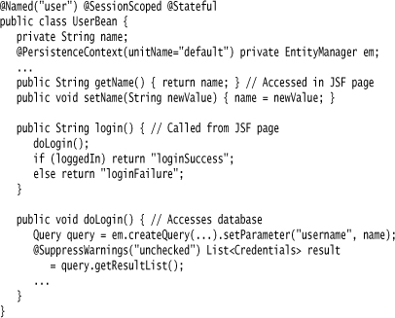
Here is how you use a stateful session bean with JSF:
In the JSF page, you use #{user.name} and #{user.login} in the usual way.
Our sample application has now become extremely simple.
The stateful session bean interacts with the JSF pages and the database.
The use of JPA has eliminated cumbersome SQL.
Transaction handling is automatic.

Slide 22
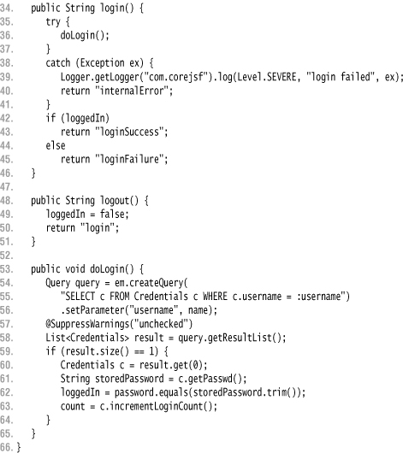
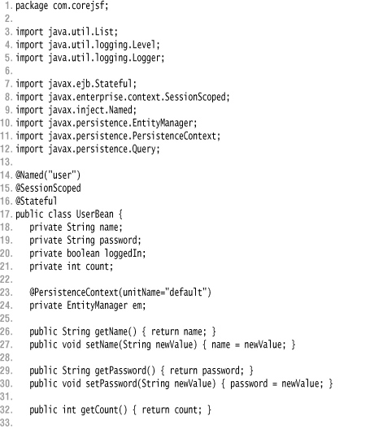
sfsb/src/java/com/corejsf/UserBean.java

Slide 23
Persistence API
The Java Persistence API (JPA) was introduced as part of the Java EE 5 platform.
Its goal is to facilitate data acquisition from relational databases without the complexity of numerous sql statements.
The idea is to use an object oriented approach to data storage.
Data is handled without the need to create deployment descriptors.
Instead annotations are used which are read by the container.

Slide 24
Java Transaction API-JTA
The Java Transaction API (JTA) is part of the J2EE platform.
The API gives you the ability to perform distributed transactions, that is, an application can use the API to perform transactions on more than one data store in the network at the same time.
But to do this efficiently, it helps to have another component operating in the application server: a J2EE transaction manager.
A transaction manager helps to efficiently schedule and execute the potentially large number of transactions coming in through the application server.

Slide 25
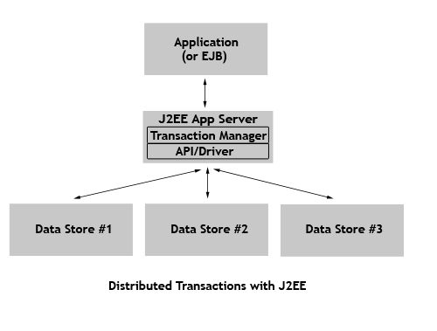

Slide 26
Java Transaction API
The data source must be registered on the server and is specified using the JNDI name.
Transactions can be:
Container Managed
Application Managed.
If the transactions are container-managed JTA transactions, the data source must be a JTA data source. This is the preferred way.
It must be specified in the descriptor file persistence.xml

Slide 27
Java Transaction API
If the transactions are application-managed, the data source is specified according to the JDBC database connection registered with the IDE .
You use this approach if you are not deploying in a EE container (like GlassFish).

Slide 28
Persistence API-Entities
Entity
A table in a database.
An Entity is represented by a class
Instance of entity corresponds to a row in the database.
A number of rules cover the implementation of an entity class.
Note: The database is sometimes referred as: Data Source or Data Store

Slide 29
Persistence API-Entity Relationships
Relationships are the same as relationships between tables in a database:
One-To-One:
Each instance of the entity (row) is related to single instance of another entity (to a single row of another table).
One-To-Many:
An entity instance can be related to more than one instance of another entity. But an instance of the other Entity can only relate to one instance of the first.

Slide 30
Persistence API-Entity Relationships
Many-To-One:
Multiple instances (rows) of an Entity can be related to one instance of another Entity. But an instance of the other Entity can relate to only one instance of the first Entity.
Many-To-Many:
An instance of one Entity relates to many instances of another Entity and vice versa.
For every relationship there is an owning side and inverse side.
The relationship can be unidirectional –it has only an owning side.
Or, bidirectional – it ha s both an owning side and an inverse side.

Slide 31
Example Relationships
Authors
Owner
Titles
Inverse
Many To Many
bidirectional
Inverse
Inverse
Owner
One-To-Many
Bidirectional
One-To-Many
Bidirectional
Owner
Publishers

Slide 32
Persistence API-Entity Class
Entity Class
The class has instance variables
The class has accessor and mutator methods that follow the Java Beans convention for naming the methods.
The persistent state can be accessed either through the instance variables or through the getter methods (accessors).
Persistent Fields (if fields are mapped with annotations)
Persistent Properties (if getter methods are mapped with annotations)
This is done through annotations to one or the other but not both in a class.

Slide 33
Persistence API-Entity Class
Annotations are handled by package javax.persistence
Fields annotated with Transient are not persisted (saved).
Annotations apply to other parts of the program i.e.
The class needs to be annotated with the @Entity annotation.
The type of relationship needs to be annotated with @OneToOne for example.
Other annotations apply to different parts of the class.

Slide 34
Persistence API-Entity Class
Every Entity must have a unique primary key field that enables clients to locate instances (rows) of an Entity.
Primary Keys can be:
simple (consisting of a single field) or
Composite (consting of one or more persistent field)s and or properties)
Composite primary keys are represented by a primary key class.

Slide 35
Persistence API-Entity Class
Entities support:
Inheritance. An Entity class can inherit a non Entity class and a non Entity class can inherit an Entity class.
The non Entity classes can have persistent states information (annotations on their fields or properties).
If , however, the non Entity class is a super class, it has no persistent state as such.
Polymorphism.
You can have an abstract Entity class and subclasses of the abstract Entity class that implement parts of the abstract class in different ways each.
Association (using another class by instantiating an object of that class).

Slide 36
Persistence API-Entity Inheritance Strategies
Single Table of the database per class hierarchical inheritance.
A Table of the database per concrete Entity class.
A “Join” strategy
Fields/properties of a subclass are mapped to a different table than the super class.

Slide 37
Persistence API-Entity Management
There is an Entity Manager object represented by an instance of: javax.persistence.EntityManager
Each manager object is associated with a persistent context (scope).
Each manager object:
Removes persistent entity instances.
Finds Entities by using the primary key.
Allows queries to be run on Entities.

Slide 38
Persistence API-Entity Management
An Entity Manager can be:
Container-managed in which case it (persistence) propagates to all application components (EJBs) with a single Java Transaction Architecture (JTA) transaction via a special annotation.
Application-managed in which case the persistence does not propagate to other applications (EJBs).

Slide 39
Persistence API-Persistence Units
Persistence Unit defines all Entity classes that are managed by EntityManager instances within an application.
A name should be provided to describe the Persistence Unit in your application.
A Persistence Unit is defined in the persistence.xml configuration file.
Location of the file within the application in the server varies depending dependent on if the client is a client application or a web application.
The IDE will place it in the proper directory.

Slide 40
Persistence API-Entity Class
Assume you have a CUSTOMER table, whose schema is represented by the table in the next slide.

Slide 41
Customer Table Example
NAME | PK? | TYPE | NULL?
CUST_ID | Y | INTEGER | NOT NULL
FIRST_NAME |  | VARCHAR(50) | NOT NULL
LAST_NAME |  | VARCHAR(50)
STREET |  | VARCHAR(50)
APPT |  | VARCHAR(20) | NOT NULL
CITY |  | VARCHAR(25)
ZIP_CODE |  | VARCHAR(10) | NOT NULL
CUST_TYPE |  | VARCHAR(10) | NOT NULL
LAST_UPDATED_TIME |  | TIMESTAMP | NOT NULL

Slide 42
Customer Entity Class
import javax.persistence.*;
import java.io.Serializable;
import java.util.Date;
@Entity(name = "CUSTOMER") //Name of the entity if name is different than the class ‘ name then us e@Table annotation.
public class Customer implements Serializable {
private long custId;
private String firstName;
private String lastName;
private String street;
private String appt;
private String city;
private String zipCode;
private String custType;
private Date updatedTime;
// Getters and setters go here ...................... }

Slide 43
Customer Entity Class
The Customer entity needs to know how to map the attributes (or properties) to the CUSTOMER table.
Through JPA annotations. Let us use Field persistence:

Slide 44
Customer Entity Class
import javax.persistence.*;
import java.io.Serializable;
import java.util.Date;
@Entity(name = "CUSTOMER") //Name of the entity
public class Customer implements Serializable {
@Id //signifies the primary key
@Column(name = "CUST_ID", nullable = false)
@GeneratedValue(strategy = GenerationType.AUTO) private long custId;
// 3 annotations define the field custId as a primary key.
//@GeneratedValue signifies a strategy to assign a unique value to your identity fields automatically.
//The types of strategies available are IDENTITY, SEQUENCE, TABLE, and AUTO.

Slide 45
Customer Entity Class
@Column(name = "FIRST_NAME", nullable = false,length = 50)
private String firstName;
@Column(name = "LAST_NAME", length = 50)
private String lastName;
// By default column name is same as attribute name
private String street;
@Column(name = "APPT",nullable = false) private String appt;
// By default column name is same as attribute name
private String city;
@Column(name = "ZIP_CODE",nullable = false)
// Name of the corresponding database column
private String zipCode;

Slide 46
Customer Entity Class
@Column(name = "CUST_TYPE", length = 10)
private String custType;
@Version
@Column(name = "LAST_UPDATED_TIME")
private Date updatedTime;
//@Version signifies a version field in an entity.
JPA uses a version field to detect concurrent modifications to a data store record.
When the JPA runtime detects multiple attempts to concurrently modify the same record, it throws an exception to the transaction attempting to commit last. This prevents you from overwriting the previous commit with stale data.
// Getters and setters go here ...................... }

Slide 47
Customer Entity Class-xml file
An descriptor file called persistence.xml is needed to describe the persistence unit (database).
<?xml version="1.0"?>
<persistence>
<persistence-unit name="testjpa" transaction-type="RESOURCE_LOCAL">
<provider>
org.apache.openjpa.persistence.PersistenceProviderImpl
</provider>
<class>
entity.Customer
</class>
<properties>
<property name="openjpa.ConnectionURL" value="jdbc:derby://localhost:1527/D:\OpenJPA\Derby\MyCustomer;create=true"/>

Slide 48
Customer Entity Class-xml file
<property name="openjpa.ConnectionDriverName" value="org.apache.derby.jdbc.ClientDriver"/>
<property name="openjpa.ConnectionUserName" value="admin"/> <property name="openjpa.ConnectionPassword" value="admin"/>
<property name="openjpa.Log" value="SQL=TRACE"/>
</properties>
</persistence-unit>
</persistence>
Note: openjpa is proprietary to openSource version.

Slide 49
Customer Entity Class-xml file
Another version of the .xml file that will apply to GlassFish is:
<persistence>
<persistence-unit name= "testjpa“>
<jta-data-source>jdbc/MyCustomer</jta-data-source>
<jar-file>NameofJar.jar<jar-file>
<class>path1.path2.Customer</class>
</persistence-unit>
<persistence>
The data source (data base uses JTA – Java Transaction API)
Class describes the entity class (or classes if more than one)

Slide 50
Customer Entity Class-xml file
Notice that:
persistence.xml can have multiple persistence units. Each unit can be used by different JPA vendor or can be used to persist to different databases.
The vendor-specific persistence provider name is specified in the <provider> tag. The entity class names are specified in the <class> tag.
The database connection properties can be specified within the <properties> tag. Note that the property name will differ for each vendor.

Slide 51
Customer Entity Class-xml file
In the openSource version of the persistence.xml the transaction was defined as an application managed transaction via :
transaction-type="RESOURCE_LOCAL“
You can do the same in NetBeans if you want the application to manage the transaction.
In the NetBeans version we indicated that the transaction was container managed.
jdbc/MyCustomer was the name of the JTA data source (same name was used in the openSource version).

Slide 52
Customer Entity Class-A class that inserts a record
public static void main(String[] args) {
EntityManagerFactory entityManagerFactory = Persistence.createEntityManagerFactory("testjpa");
EntityManager em = entityManagerFactory.createEntityManager();
EntityTransaction userTransaction = em.getTransaction(); userTransaction.begin();
Customer customer = new Customer();
customer.setFirstName("Charles");
customer.setLastName("Dickens");
customer.setCustType("RETAIL");

Slide 53
Customer Entity Class-A class that inserts a record
customer.setStreet("10 Downing Street");
customer.setAppt("1");
customer.setCity("NewYork");
customer.setZipCode("12345");
em.persist(customer);
userTransaction.commit();
em.close();
entityManagerFactory.close();
}

Slide 54
Customer Entity Class-A class that inserts a record
The work of the Persistence class is pretty simple: Persistence is a bootstrap class that is used to obtain an EntityManagerFactory
In the classpath resources, the Persistence class searches for javax.persistence.spi.PersistenceProvider files in META-INF/services/directory. It reads the PersistenceProvider implementation class names from each file.
It then calls createEntityManagerFactory() on each PersistenceProvider with the persistenceUnitName until it gets an EntityManagerFactory back that isn't null.

Slide 55
Customer Entity Class-A class that inserts a record
EntityManagerFactory is a factory for creating an EntityManager. EntityManagerFactory should be cached and should ideally be called once for each persistence unit name in the whole application.
EntityManager manages entities; it is responsible for their addition, updating, and deletion.
The transaction is committed when the transaction object userTransaction invokes comit.

Slide 56
Customer Entity Class-finding a record
Finding a record with a primary key is as simple as
OpenJPAEntityManager oem = OpenJPAPersistence.cast(em);
Object objId = oem.getObjectId(customer);
Customer cust = em.find(Customer.class, objId);
//where em is the EnityManager object
//customer is the Customer object
//Because the primary key is unknown up front, the application must cast EntityManager to OpenJPAEntityManager to get the primary key object by passing the customer object that was persisted earlier. This logic might differ for other vendors.

Slide 57
Customer Entity Class-finding a record
A more generic approach that can relate to GlassFish better is :
@PersistenceContext
EntityManager em; //instead of OpenJPAEntityManager
public void findCustomer(int custID)
{
Customer cust=em.find(Customer.class, custID);
…………………………

Slide 58
Customer Entity Class-A Composite Primary Key
Assume that the CUSTOMER table doesn't have a CUST_ID field, but that FIRST_NAME and LAST_NAME together make up the primary key.
You need to create a separate class, generally called an identity class, with attributes the same as the IDs; then you reference the identity class in the entity class.

Slide 59
Customer Entity Class-A Composite Primary Key
public final class CustomerId implements serializable{
public String firstName;
public String lastName;
//default constructor
//accessor/mutator methods
// override equal() method
//override hascode() method
.................. }
The identity class can be a separate class or an inner class. If the class is an inner class, it must be static and should be referenced in the entity class.

Slide 60
Customer Entity Class-A Composite Primary Key
@Entity
@IdClass(Customer.CustomerId.class)
public class Customer implements Serializable{
@Id
@Column(name = "FIRST_NAME", nullable = false, length = 50)
private String firstName;
@Id
@Column(name = "LAST_NAME", length = 50)
private String lastName;
@Column(name = "APPT",nullable = false)
private String appt;
................

Slide 61
Customer Entity Class-A Composite Primary Key
The entity class is annotated with the annotation:
@IdClass
to specify the primary key class (identity class) in the entity class
Another possible annotations is:
@Embeddable
Which will be used on the identity class.

Slide 62
Difference Between @IdClass and @Embeddable Annotations
Notice that when the @IdClass annotations is used the fields in the identity class match the fields in the entity class.
When @Embeddable is used as the annotation in the identity class class we have :
@Embeddable
public final class CustomerId implements serializable{
public String firstName;
public String lastName;
//accessor/mutator methods
// override equal() method
//override hashcode() method
.................. }

Slide 63
Difference Between @IdClass and @Embeddable Annotations
The entity class does not have to be annotated with @IdClass instead:
@Entity
public class Customer implements Serializable{
CustomerId primaryKey;
public Customer() {..}
@EmbeddedId
public CustomerId getPrimaryKey() { return primaryKey; }
public void setPrimaryKey(CustomerId pk) { primaryKey = pk;
……………………………………………………………
}

