Slide 1
Resource orchestration optimization of kubernetes cluster in large scale
Patrickxie (谢谆志）

Slide 2
Background
Cloud has been the general trend. How to manage so many clusters ,resources and businesses
1
How to ensure load balancing of cluster nodes
2
Improper resource requests
3
How to expand horizontally more quickly and flexibly
4
Multi-tenant resource preemption

Slide 3
How do you manage so many clusters ,resources and businesses
…
Business N
Business 1
Business 2
Business 3
Region1
Region N
Cluster1
Cluster2
…
Cluster2
…
Cluster1
Cluster2
Cluster2
…

Slide 4
How to ensure load balancing of cluster nodes？

Slide 5
Dynamic-Scheduler
The native K8S scheduling is based on the resource request of Pod. However, in many cases, some nodes have low resource requests but high load, while some nodes have high resource requests but low load.
Pod
Kube-scheduler
Assigned to Node2
Node1
Node2
Request Load Level
Request Load Level
Real Load Level
Real Load Level

Slide 6
Dynamic-Scheduler
Kube-scheduler
Pod
Dynamic-scheduler
Node1 has a lower load
Assigned to Node1
Node1
Node2
Request Load Level
Request Load Level
Real Load Level
Real Load Level

Slide 7
Dynamic-Scheduler
Prometheus
Dynamic-scheduler-node-annotator
Record to node annotation
Node1
Node2
telegraf
telegraf
1h Load
5m Load
1h Load
1d Load
5m Load
1d Load

Slide 8
Dynamic-Scheduler Predicate
Dynamic-scheduler
Pod
5m Load >65% filtered
1h Load >70% filtered
Add node1 to priority candidate list
Node1
Node2
Node3
5m Load
90%
1h Load
75%
5m Load
50%
5m Load
40%
1h Load
40%
1h Load
30%

Slide 9
Dynamic-Scheduler Priority
Dynamic-scheduler
Pod
Assigned to Node1
(1-0.4)*10+(1-0.3)*10=13
(1-0.5)*10+(1-0.4)*10=11
(1-0.5)*10+(1-0.6)*10=9
Node1
Node2
Node3
1h Load
60%
5m Load
50%
5m Load
50%
5m Load
40%
1h Load
40%
1h Load
30%

Slide 10
DeScheduler
If the pod is enabled high-load automatic migration
Descheduler
Node2 load is high
Node1
Node2
Node3
Real Load Level
Pod1
Pod1 migrate to Node1
Pod1
Pod2
Pod2 migrate to Node3
Pod2
Pod3
Real Load Level
Real Load Level

Slide 11
How to expand horizontally more quickly and flexibly

Slide 12
HPA-controller
Supporting horizontal scaling of business is one of the essential functions on the cloud, but the HPA Controller of native K8S use only one goroutine to handle the scaling of all businesses in the cluster, and personalization configuration is not supported.
HPA1
HPA2
…
HPAn
Worker
HPA1

Slide 13
HPAPlus-controller
An HPA corresponds to a gorountine and each HPA is individually configurable
HPA1
HPA2
…
Worker
HPAn
HPA can be turned on/off separately
Support for separate configuration of compute cycles
Support configuring tolerance for each HPA separately
Support Cron HPA
HPA1
HPA2
HPAn

Slide 14
CronHPA
07-28 10:00
07-28 11:00
Scale up to 100
Scale down to 3

Slide 15
How do CronHPA work with HPA
HPA takes over the work
If workload still high load and HPA maxReplicas > CronHPA replicas
HPA takes over the work
07-28 10:00
07-28 11:00
CronHPA scale up
CronHPA takes over the work

Slide 16
How to solve the problem of improper resource requests

Slide 17
Node Resource Oversold
Node resource requests are full, but the actual load is not high.
Oversold webhook
Replace node status’s allocatable resource
Update node status
Node
Node
Allocatable Resource
Oversold Resource
Allocatable Resource
Allocated Resource
Oversold
Allocated Resource
Real Resource Load
Real Resource Load

Slide 18
Node Resource Oversold
Actual load is also high.
Node
Node
Allocatable Resource
Allocatable Resource
Not Oversold
Allocated Resource
Allocated Resource
Real Resource Load
Real Resource Load

Slide 19
How to solve the multi-tenant resource preemption problem

Slide 20
DynamicQuota
How to prevent resource preemption between different businesses and provide resource guarantee for important activities.
Kube-scheduler
No resources Pending
Cluster
Product4 Used Resource
Product3 Used Resource
Product2 Pod
Product1 Used Resource

Slide 21
DynamicQuota
Other products cannot use the resources of product2
Cluster1
Cluster2
Cluster3
Product2 Quota
Product2 Quota
Product2 Pod
Product2 Quota
Product2 Pod
Product2 Pod
Product1 Quota
Product1 Quota
Product1 Quota
Product1 Pod
Product1 Pod
Product1 Pod

Slide 22
How to deal with some products occupying quota but not using it
Cluster
Cluster
Product2’s quota has been used up
Product2 Quota
Product2 Quota
Product2 Used Quota
Product2 Used Quota
Product1 Quota
Product1 lends its quota to Product2
Product1 has many unused quota
Product1 Quota
Product1 Used Quota
Product1 Used Quota

Slide 23
Product Quota Allocation
Allocate Product2 100 quota
Quota allocation module
Cluster 1 allocates 50 quota
Cluster 2 allocates 20 quota
Cluster 3 allocates 30 quota
Cluster1
Cluster2
Cluster3
Product2 Used Quota 25
Product2 Used Quota 15
Product2 Used Quota 10
Other Product Quota
Other Product Quota
Other Product Quota

Slide 24
Quota Adjustment
Quota adjustment cronjob
Cluster1
Cluster2
Cluster3
Product2 Quota
Product2 Quota
Quota transfer
Product2 Quota
Quota transfer
Used Quota
Product2 Quota
Used Quota
Used Quota

Slide 25
Offline Quota Control
Cluster1
Online pool(70%)
Cannot exceed quota of Product1
Product2 Quota
Product1 Quota
Online Pod
Online Pod
Offline pool(30%)
Offline Pod
Offline Pod
Cannot exceed Offline Quota

Slide 26
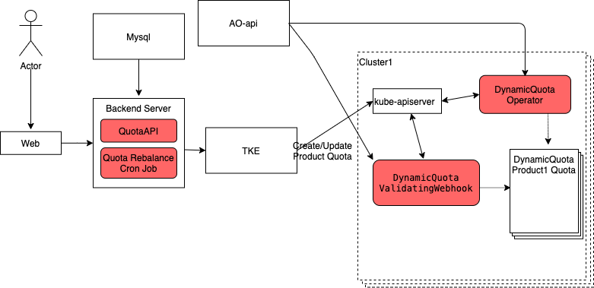
DynamicQuota System Architechture Diagram

Slide 27
QA

