Slide 1
Global Illumination Models
June 2019

Slide 2
Global Illumination
Global Illumination (GI) is a system that models how light is bounced off of surfaces onto other surfaces (indirect light) rather than being limited to just the light that hits a surface directly from a light source (direct light). Modelling indirect lighting allows for effects that make the virtual world seem more realistic and connected, since objects affect each other’s appearance.
One classic example is ‘color bleeding’ where, for example, sunlight hitting a red sofa will cause red light to be bounced onto the wall behind it. Another is when sunlight hits the floor at the opening of a cave and bounces around inside so the inner parts of the cave are illuminated too.

Slide 3
Summary of Illumination Models
Local illumination model: Phong
Ambient
Diffuse
Specular
Point light sources
No: shadows, inter-object light reflection
“More global” illumination model: Ray Tracing
Shadows
Area light sources (via distributed ray tracing)
No: inter-object light reflection
– Improvements in fidelity come at the expense of computational complexity

Slide 4
Ray Tracing
Ray tracing: More accurate than Phong, but not without its own limitations.
Strengths:
Easy to implement
General and extensible
Better handling of global issues (shadows, reflection, etc.).
Shortcomings:
Optimizing not easy: Involves non-trivial data structures.
Not truly global: Relies on the Phong illumination model to compute illumination at each point. Ignores inter-object light reflection.
Too “Specular”: Ray-traced images are best for highly specular objects (glass and metallic balls), but specular reflection is not common in typical real-world scenes.

Slide 5
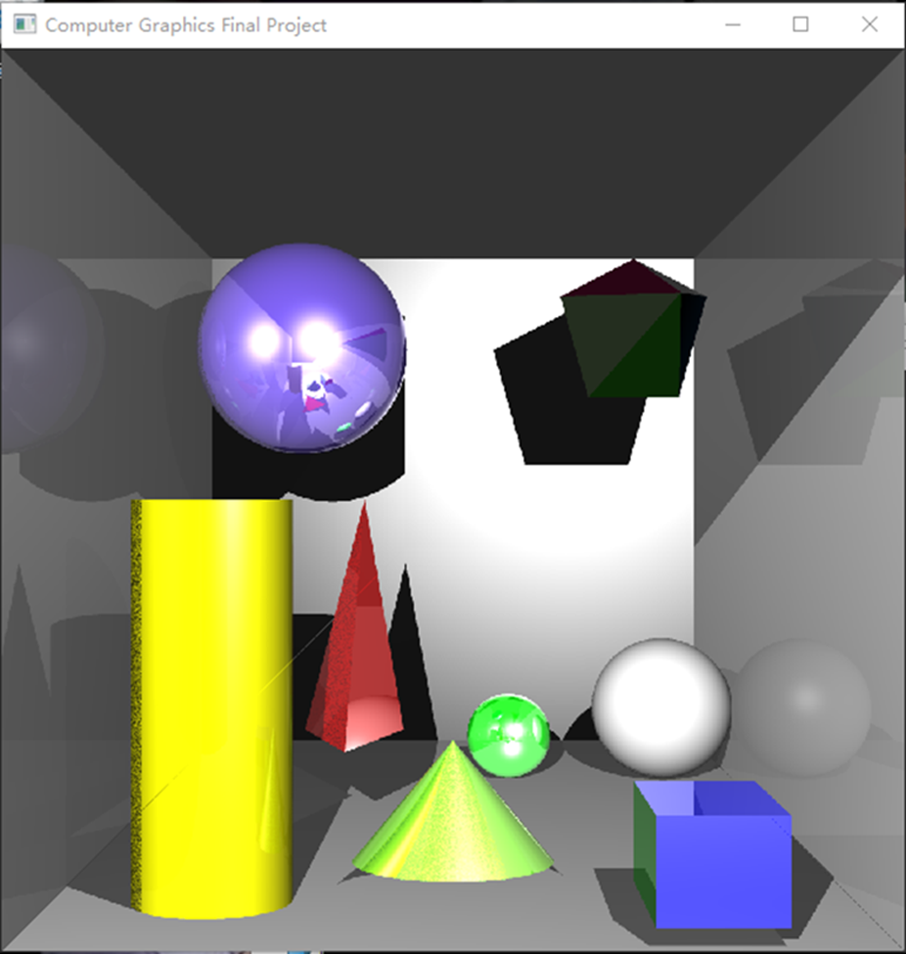
Introduction of the model
Environment: Windows 10 、OpenGL 、C++
The project use the basic ray tracing algorithms to implement ambient, diffuse, specula high light and shadows. And there are simple implementations of transparency and refraction.
Objects (one cylinder、three spheres 、one cone、one tetrahedron、 one pentagonal pyramid、one cube、two light source) are included in the project.
https://github.com/qinxinlei/global_illumination

Slide 6
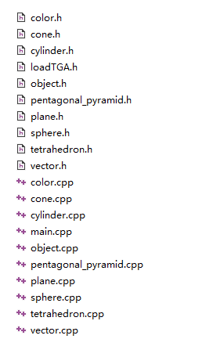
The explanation of model——Color
RGB color mode
RGB color mode
RGB color mode
color.h and color.cpp define the color information used in the project. And the RGB color mode is used.
const Color Color::WHITE = Color(1, 1, 1);
const Color Color::BLACK = Color(0, 0, 0);
const Color Color::RED = Color(1, 0, 0);
const Color Color::GREEN = Color(0, 1, 0);
const Color Color::BLUE = Color(0, 0, 1);
const Color Color::GRAY = Color(0.2f, 0.2f, 0.2f);
const Color Color::YELLOW = Color(1, 1, 0);

Slide 7
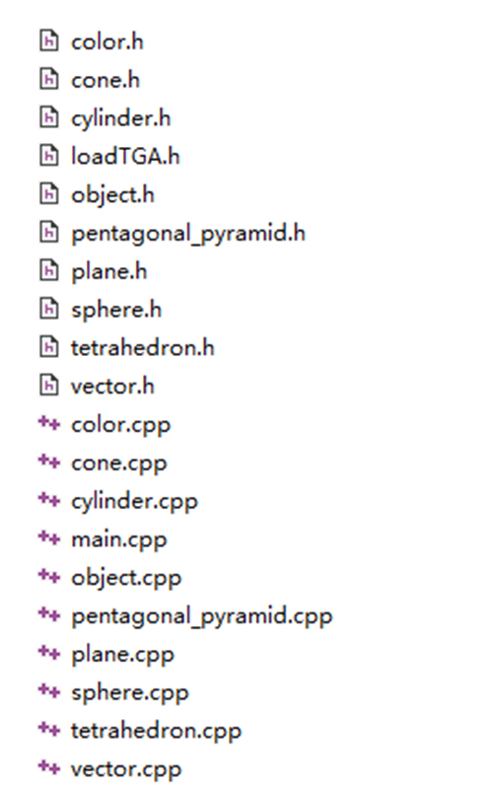
The explanation of model——Object
The cone, cylinder, plane figure, sphere, tetrahedron and pentagonal pyramid are defined and realized respectively through cone.h, cylinder.h, plane.h, sphere.h, tetrahedron.h, pentagonal_pyramid.h. In addition, a cube is implemented through the combination definition of planes.
Each of these models inherits two important data definitions, object.h and object.cpp, the other is vector.h and vector.cpp. The Object class definition implements the most basic property setting and obtaining method of the model, while the Vector defines and implements the basic transformation operation of model coordinates in the scene.

Slide 8
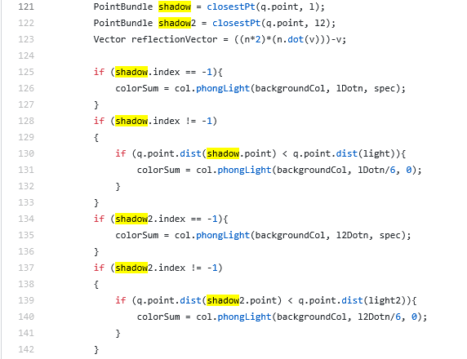
light souce and shadows
The code on the left defines the shadow information generated by the interaction between the two light sources and the object.

Slide 9

the experimental result

Slide 10
Thanks!

