Slide 1






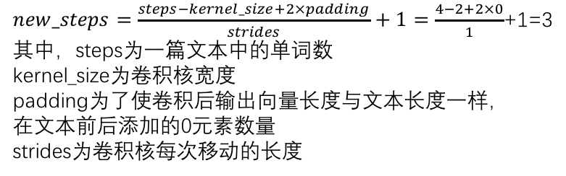

CONV1D卷积神经网络运算过程
kernel_size=2行
W1
W2
W3
W4
$$\left[\begin{matrix}d_{11} & d_{12} & … & d_{18} \\ d_{21} & d_{22} & … & d_{28} \\ d_{31} & d_{32} & … & d_{38} \\ d_{41} & d_{42} & … & d_{48}\end{matrix}\right]$$
t=1
$$f(W_{2×8}∙X_{1:2}+b)$$
$$\left[\begin{matrix}f_{11} & f_{21} & f_{31} & f_{41} \\ f_{12} & f_{22} & f_{32} & f_{42} \\ f_{13} & f_{23} & f_{33} & f_{43}\end{matrix}\right]$$
new_steps=3行
filters=4列
$$f(W_{2×8}∙X_{2:3}+b)$$
$$\left[\begin{matrix}d_{11} & d_{12} & … & d_{18} \\ d_{21} & d_{22} & … & d_{28} \\ d_{31} & d_{32} & … & d_{38} \\ d_{41} & d_{42} & … & d_{48}\end{matrix}\right]$$
t=2
$new_steps=\frac{steps−kernel_size+2×padding}{strides}+1=\frac{4−2+2×0}{1}$+1=3
其中，steps为一篇文本中的单词数
kernel_size为卷积核宽度
padding为了使卷积后输出向量长度与文本长度一样，
在文本前后添加的0元素数量
strides为卷积核每次移动的长度
$$\left[\begin{matrix}d_{11} & d_{12} & … & d_{18} \\ d_{21} & d_{22} & … & d_{28} \\ d_{31} & d_{32} & … & d_{38} \\ d_{41} & d_{42} & … & d_{48}\end{matrix}\right]$$
$$f(W_{2×8}∙X_{3:4}+b)$$
t=3
Embedding层输出的1篇文本矩阵

Slide 2
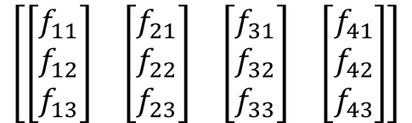
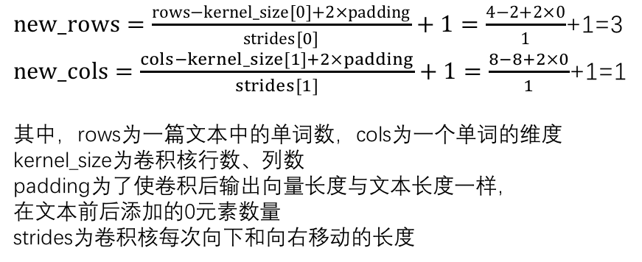




CONV2D卷积神经网络运算过程
kernel_size=2行8列
W1
W2
W3
W4
$$\left[\begin{matrix}\left[\begin{matrix}d_{11} & d_{12} & … & d_{18} \\ d_{21} & d_{22} & … & d_{28} \\ d_{31} & d_{32} & … & d_{38} \\ d_{41} & d_{42} & … & d_{48}\end{matrix}\right]\end{matrix}\right]$$
t=1
$$f(W_{2×8}∙X_{1:2}+b)$$
$$\left[\begin{matrix}\left[\begin{matrix}f_{11} \\ f_{12} \\ f_{13}\end{matrix}\right] & \left[\begin{matrix}f_{21} \\ f_{22} \\ f_{23}\end{matrix}\right] & \left[\begin{matrix}f_{31} \\ f_{32} \\ f_{33}\end{matrix}\right] & \left[\begin{matrix}f_{41} \\ f_{42} \\ f_{43}\end{matrix}\right]\end{matrix}\right]$$
new_rows=3行
new_cols=1列
filters=4个
$$f(W_{2×8}∙X_{2:3}+b)$$
$$\left[\begin{matrix}\left[\begin{matrix}d_{11} & d_{12} & … & d_{18} \\ d_{21} & d_{22} & … & d_{28} \\ d_{31} & d_{32} & … & d_{38} \\ d_{41} & d_{42} & … & d_{48}\end{matrix}\right]\end{matrix}\right]$$
t=2
$new_rows=\frac{rows−kernel_size[0]+2×padding}{strides[0]}+1=\frac{4−2+2×0}{1}$+1=3
$new_cols=\frac{cols−kernel_size[1]+2×padding}{strides[1]}+1=\frac{8−8+2×0}{1}$+1=1
其中，rows为一篇文本中的单词数，cols为一个单词的维度
kernel_size为卷积核行数、列数
padding为了使卷积后输出向量长度与文本长度一样，
在文本前后添加的0元素数量
strides为卷积核每次向下和向右移动的长度
$$\left[\begin{matrix}\left[\begin{matrix}d_{11} & d_{12} & … & d_{18} \\ d_{21} & d_{22} & … & d_{28} \\ d_{31} & d_{32} & … & d_{38} \\ d_{41} & d_{42} & … & d_{48}\end{matrix}\right]\end{matrix}\right]$$
t=3
$$f(W_{2×8}∙X_{3:4}+b)$$
Embedding层输出的1篇文本矩阵

