Slide 1
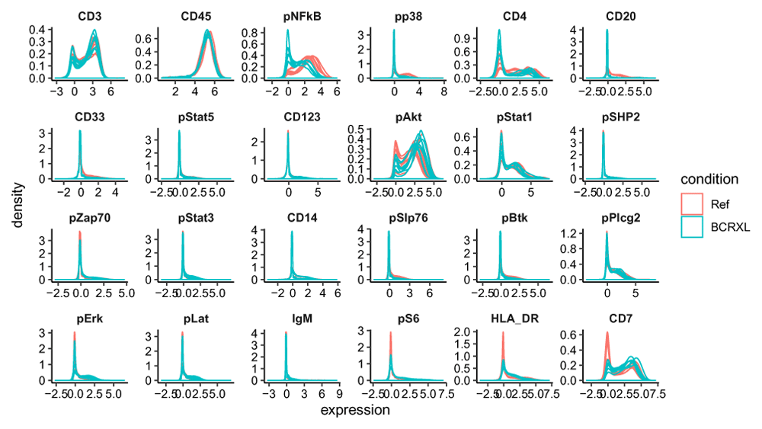

Figure 1. Per-sample smoothed densities of marker expression (arcsinh-transformed) of 10 lineage markers...
Nowicka M, Krieg C, Crowell HL et al. CyTOF workflow: differential discovery in high-throughput high-dimensional cytometry datasets [version 4]. F1000Research 2019, 6:748 (doi: 10.12688/f1000research.11622.4)
Notes:
Figure 1. Per-sample smoothed densities of marker expression (arcsinh-transformed) of 10 lineage markers and 14 functional markers in the PBMC dataset.
Two conditions: unstimulated (Ref) and stimulated with BCR/FcR-XL (BCRXL) for each of the 8 healthy donors are presented and colored by experimental condition.
Nowicka M, Krieg C, Crowell HL et al.. CyTOF workflow: differential discovery in high-throughput high-dimensional cytometry datasets [version 4]. F1000Research 2019, 6:748 (doi: 10.12688/f1000research.11622.4)

