Slide 1
15.1.2018
- Paper presentation
- general news / ongoing projects
- gitlab organization
- zotero: how to organze papers
- next meeting(s)/doodle

Slide 2
Current progress on scRNAseq

Slide 3
Data
10X single Cell RNASeq of lymphocides, FACS sorted
8000 cells input
Cellranger performed the automated analysis on a local installation on TARS

Slide 4
Web_summary.html

Slide 5
Analysis in R
Load data from cellranger
Filter genes/cells
Visualize gene on tSNE axes
Plot highest expressing genes
tSNE with different cluster numbers (k)
Pagoda2 (just started)

Slide 6
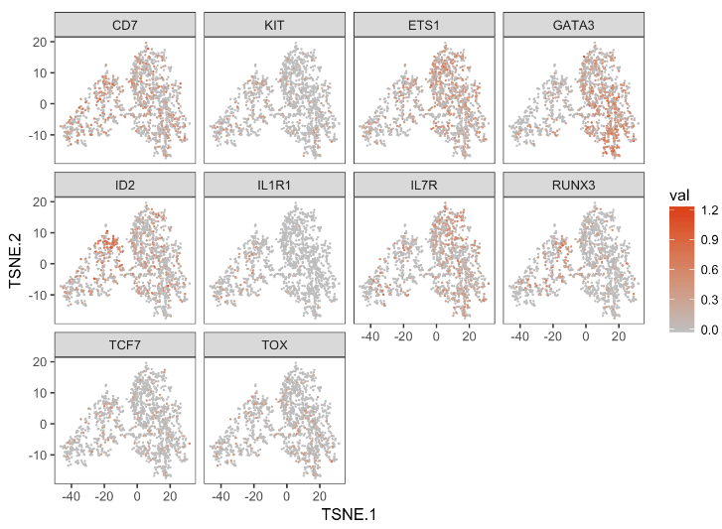
Plot interesting genes on tSNE axes

Slide 7
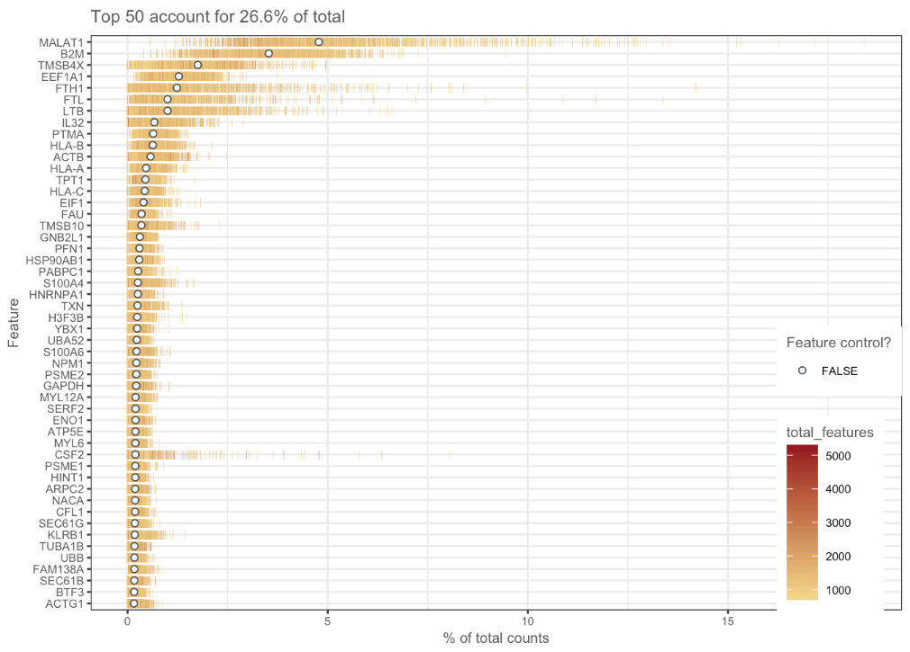
highest expressing genes

Slide 8
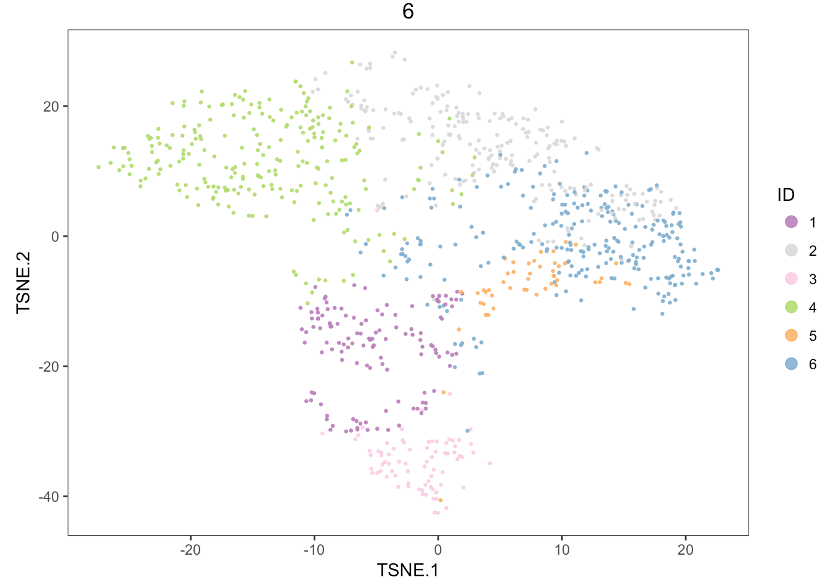

Slide 9
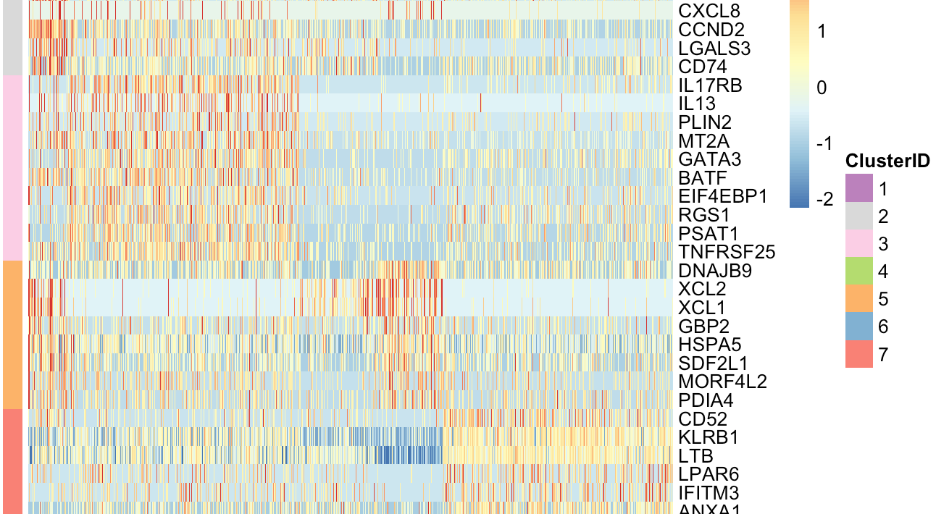

Slide 10
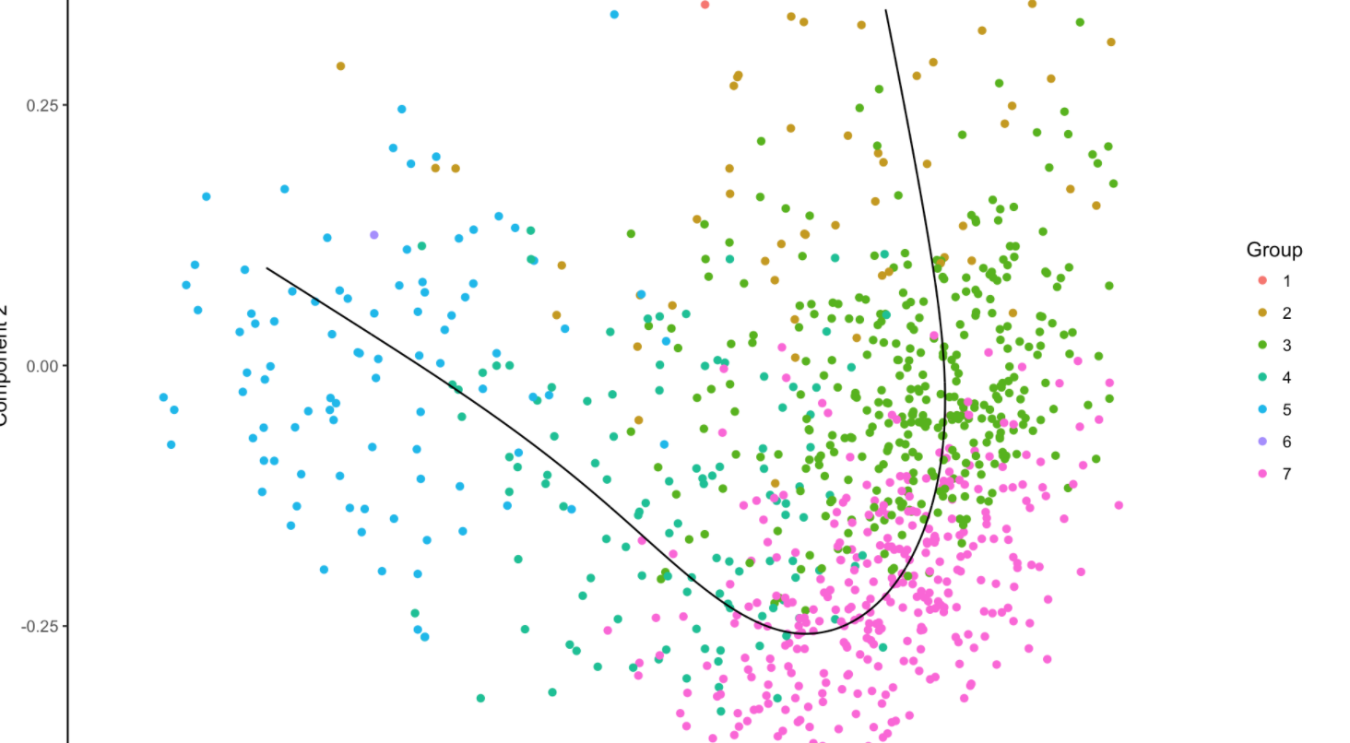
Scorpius

Slide 11
15.1.2018
- Paper presentation
- general news / ongoing projects
- gitlab organization
- zotero: how to organze papers
- next meeting(s)/doodle

