Slide 1


/
Introduction to Android Bootcamp
09.20.2015

Slide 2
About Us
Rafa M

Slide 3

About Us
Computer Science, Grad. Aug 2016
App developer with 4 years professional experience
5 games on BlackBerry (2009)
6 games on Android (2010+)
1 game on iOS (2013)
~4 million total downloads
VP of TAMUHack
Bob Timm

Slide 4
more introductions

Slide 5
is everyone set up?

Slide 6
let’s talk layouts

Slide 7
download and import
goo.gl/Wcc8oL

Slide 8
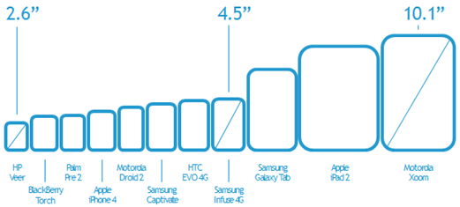
problem: endless screen sizes

Slide 9
solution: xml layouts
Layouts are defined in xml
Much like a website is developed in relative coordinates
Many different view types
RelativeView
LinearView
TextView
ImageView

Slide 10
strings and colors
How does Android handle different languages when using strings?
Folders by locale
Is there some way to apply global styling and colors?
Styles and Colors xml
How do these values translate to code?
The big “R”

Slide 11
permissions and dependencies
How does Android handle app permissions?
Accessing the internet, bluetooth, etc.
AndroidManifest.xml
How does Android import other codebases and sdks?
How do we add Parse to this project? (GitHub)
The gradle build file

Slide 12
let’s talk material
Material and why it’s a great guideline
Unified UX (where are my HCI peeps?)
Users have something they understand
It looks great out of the box
Material Icons some great assets, already made for you.
Multiple screen sizes.
Why are there different sizes?

Slide 13
recyclerview and its view holder
A newer view (great interview question)
Problems with ListView
Generic and reusable list items
A means to recycle views and populate with different data without having to inflate a new view
Better than a ListView in most cases

Slide 14
fragments make up activities
Activities are the entry point: where views meet code
You can only have one Activity showing at a time
Any Activity can have many Fragments, or none at all.
Fragments make our lives easier when going to large screen sizes.
Fragments aren’t required to make an app, but remember them when you want to expand your abilities and make your project much more manageable.

Slide 15
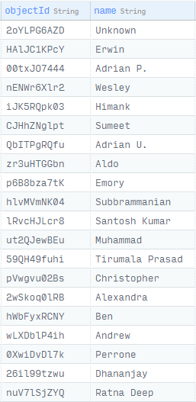
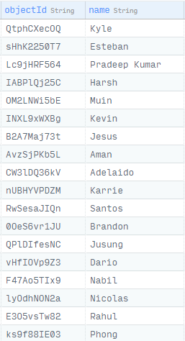
UIDs

Slide 16
you just made an app
what’s next?

Slide 17
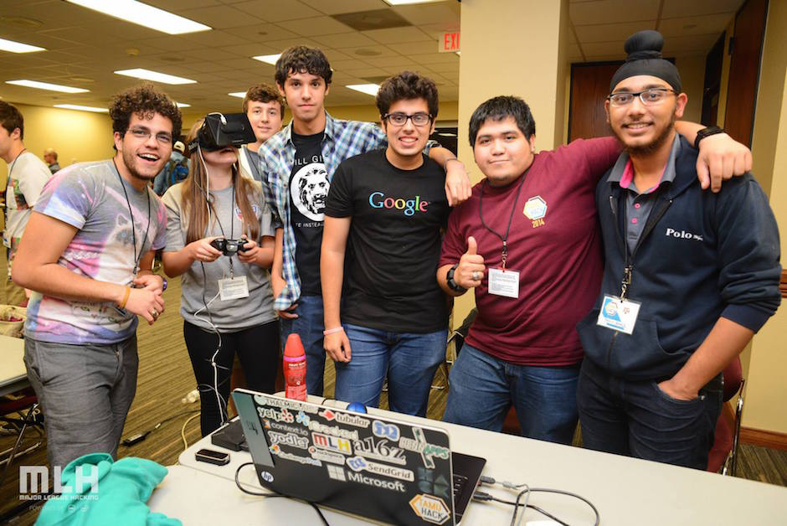
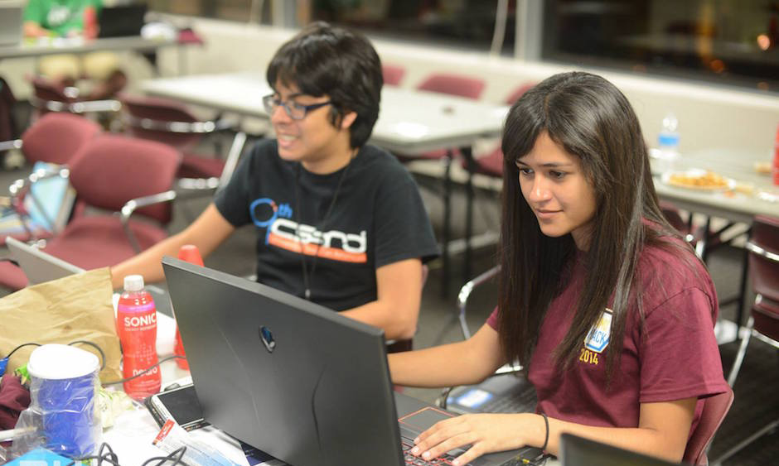
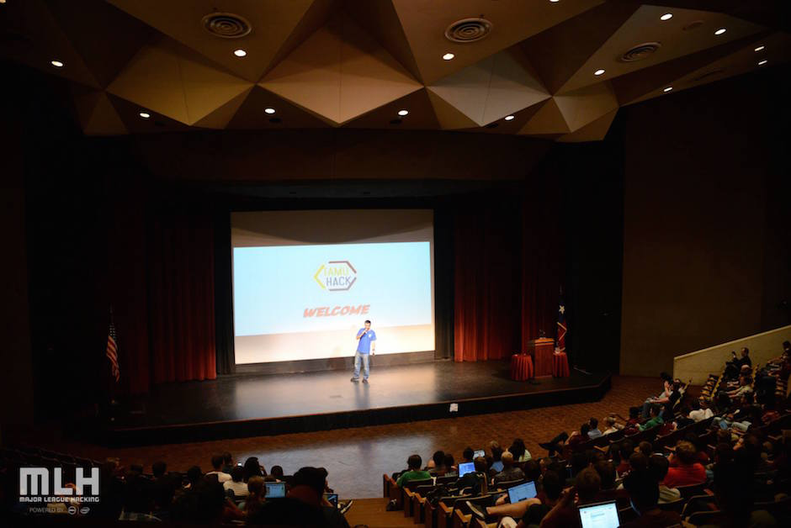
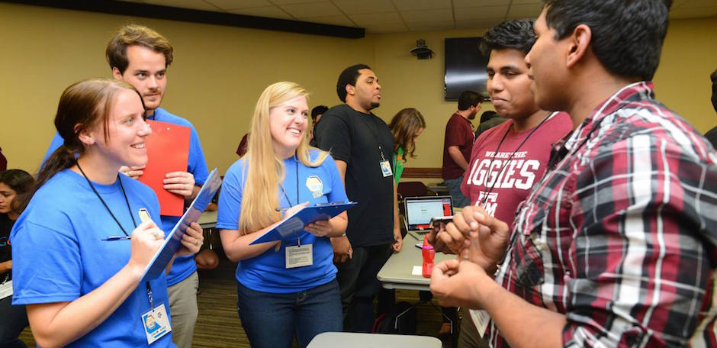
H A C K A T H O N S

Slide 18
TAMUHack Oct 9th-10th
Free Food
Career fair
Travel
Build your network
Build your resume/portfolio
Win prizes
tamuhack.com/apply

Slide 19
Upcoming Hackathons
HackTX - University of Texas - Sept 26/27
MavHack - UT Arlington - October 2/3
TAMUHack - Texas A&M - October 9/10
Money 20/20 - Las Vegas - October 23/24
Code Red - Univ of Houston - November 26/27

Slide 20
please take our survey
goo.gl/ZORZa9

