Slide 1
TradeShift
DS600 CLOUD COMPUTING FOR ECONOMICS
Large washers, share of US imports
Before and after the 2016 duties on China
China
Before
75.1%
Where did US imports go when the tariffs hit?
A data pipeline, a web app and an AWS deployment that trace trade diversion across 10 US tariff actions, 2016–2019.
After
1.7%
Vietnam
Before
0.0%
After
41.5%
By Jaanvi Bajaj, Aryan Singh, Nikhil Balaji
Source: US Census Bureau; 12 months before vs after, HS 8450.20
Notes:
TradeShift asks a simple question: when the United States put tariffs on goods from one country, where did those imports go instead? We built a full system to answer it. It downloads public trade data, finds the products where buying moved from one country to another, explains each shift in plain English, and runs as a website on Amazon Web Services. The example on this slide is the clearest one we found. After the 2016 anti-dumping duties on Chinese washing machines, China's share of US imports of large washers fell from 75.1% to 1.7%, while Vietnam's rose from nothing to 41.5%.

Slide 2
Four parts, built end to end
WHAT WE BUILT
Public trade data goes in; a searchable web app running on AWS comes out.
1
2
3
4
Data
Analysis
Web app
Cloud
US Census monthly imports, UN Comtrade and SingStat. 140 months, Jan 2015 – Aug 2026.
→
Market shares, a shift detector, a statistical check and plain-English summaries.
→
Nine pages to explore results, save analyses, add notes and search.
→
One CloudFormation template builds the whole system on AWS in about 13 minutes.
All code, tests and documents are in the GitHub repository jaanvi-bajaj/TradeShift-Project.
Notes:
The project has four connected parts. First, the data: monthly US imports from the Census Bureau, plus UN Comtrade and Singapore's statistics office. Second, an analysis pipeline that cleans the data, measures each country's share of each product, flags shifts and checks them statistically. Third, a web application where anyone can explore the results, save an analysis, add notes and search. Fourth, a cloud deployment: one CloudFormation template builds the whole system on AWS in about 13 minutes, with no manual steps.

Slide 3
Everything is on GitHub
THANK YOU
github.com/jaanvi-bajaj/TradeShift-Project
README
Overview and screenshots
WALKTHROUGH
Build it on AWS, step by step
RUNBOOK
Technical details and fixes
docs/report.md
The full written report
docs/testing.md
Every test and its result
docs/cost_estimate.md
Cost per session
Processed data and the software bundle are attached as releases, so anyone can rebuild the system from scratch.
Notes:
Everything is in the GitHub repository: the code, the CloudFormation template, the tests and the documentation. README gives the overview, WALKTHROUGH explains step by step how to build it on AWS, RUNBOOK has the technical details, and the docs folder holds the full report, the test results, the cost estimate and the screenshots shown here. The processed data and the software bundle are attached as releases, so anyone can rebuild the system from scratch.

Slide 4
140 months of trade data, checked to the total
DATA
Monthly US imports by country and product, with two other sources for comparison and checks.
Source | What we use | Period
US Census trade API | US imports by country and HS6 product, monthly (the main dataset) | Jan 2015 – Aug 2026
UN Comtrade | Japan's imports (second importer); US import weights; Singapore's exports to the US | 2015 – 2026; weights 2017 – 2020
SingStat | Singapore's official re-exports and domestic exports to the US | 2015 – 2026
Federal Register, USTR | Tariff dates, taxed countries and covered products | 2016 – 2019
0.0%
difference from the Census all-country total, in every one of 140 months
11.2m
monthly rows, keeping the top 15 suppliers of each product
5,826
6-digit products tracked
Raw downloads (about 900 MB) stay off GitHub because UN Comtrade's terms restrict redistribution; the processed data is published as a release.
Notes:
Our main source is the US Census trade API, which gives monthly US imports by country and by 6-digit product code (HS6), from January 2015 to August 2026: 140 months. UN Comtrade adds Japan as a second importer for comparison, import weights for 2017 to 2020, and Singapore's exports to the US. SingStat provides Singapore's official re-export figures. To keep the data manageable we keep the top 15 suppliers of each product and group the rest as rest of world, which leaves 11.2 million monthly rows. As a quality check, our country rows add up exactly to the Census all-countries total in every one of the 140 months.

Slide 5
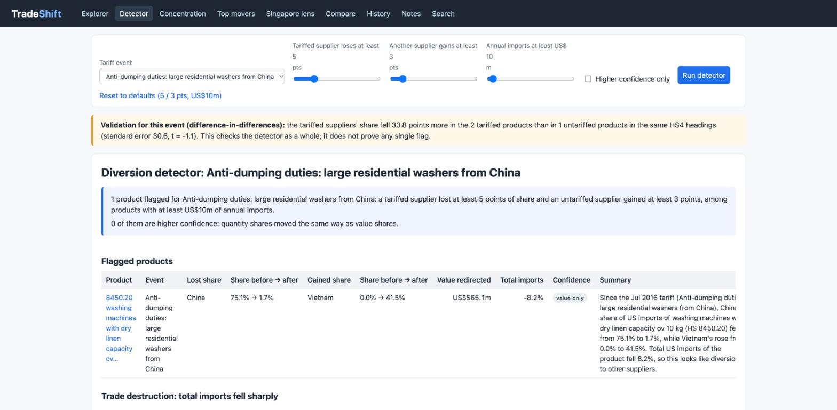
A web app to explore every result
WEB APP
Nine pages. Every number is formatted for reading, and every shift has a one-sentence summary and a source link.
Explorer any product's suppliers over time
Detector flags for any tariff, live thresholds
Concentration how many countries supply each product
Top movers the 20 biggest shifts
Singapore lens re-export estimates
Compare two countries, products or importers
History saved analyses, export and import
Notes comments attached to analyses
Search find saved work by product and date
Detector page: the 2016 washer duties, with adjustable thresholds
Notes:
Everything is available in a web application with nine pages. Explorer charts any product's suppliers over time. Detector lets you choose a tariff and adjust the thresholds to see which products are flagged. Concentration shows how many countries each product is bought from, before and after. Top movers, Singapore lens and Compare give ready-made views, and History, Notes and Search let users keep their work. Every number is formatted for reading, and every flagged shift comes with a plain-English sentence and a link to the official source. The screenshot shows the Detector page for the 2016 washer duties.

Slide 6
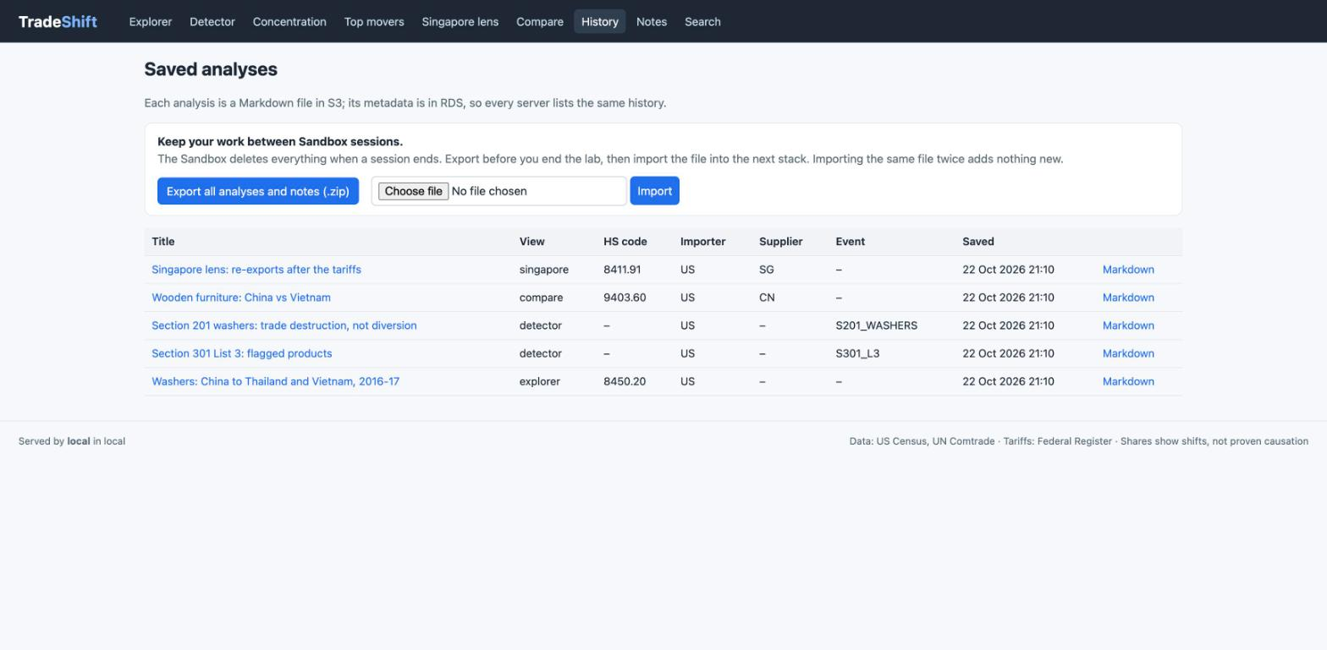
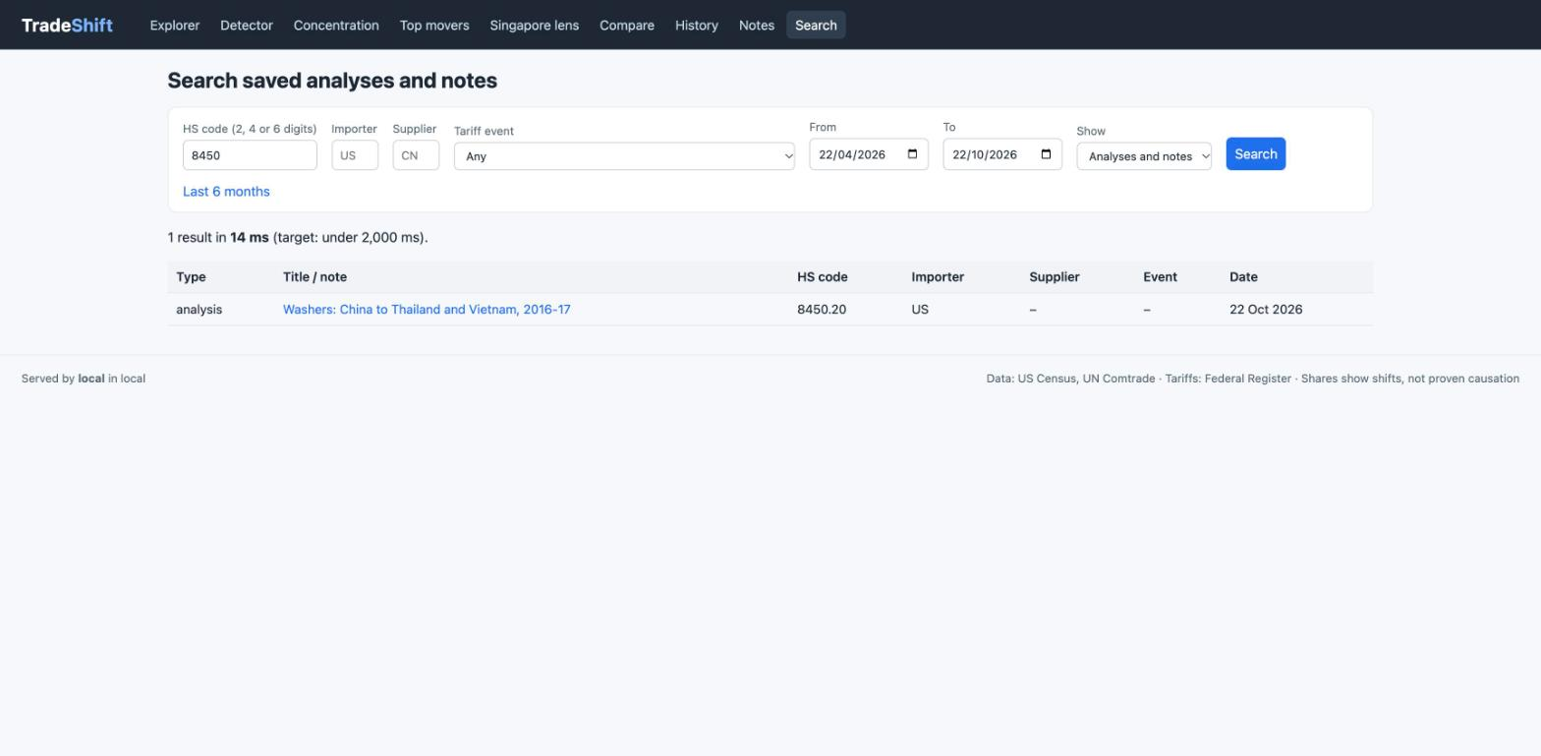
Save, annotate, search
SAVED WORK
Saved analyses live in S3 and the database, not on a server, so they survive when a server is replaced.
History: reopen saved analyses; export and import them as a zip
Search: HS 8450 over the last 6 months, answered in 24 ms in the cloud
Tested: an analysis saved on one server reopened unchanged, with its note, after that server was deleted and replaced.
Notes:
Users can save any analysis, add notes to it, and find it again later. Saved analyses are stored in Amazon S3 and the database, not on a web server, so they survive when a server fails or is replaced; we tested this. History can also export everything to a zip file and import it again, which is how we carry saved work between AWS Sandbox sessions. Search finds saved analyses by product code and date range; in the cloud it returned results in 24 milliseconds.

Slide 7
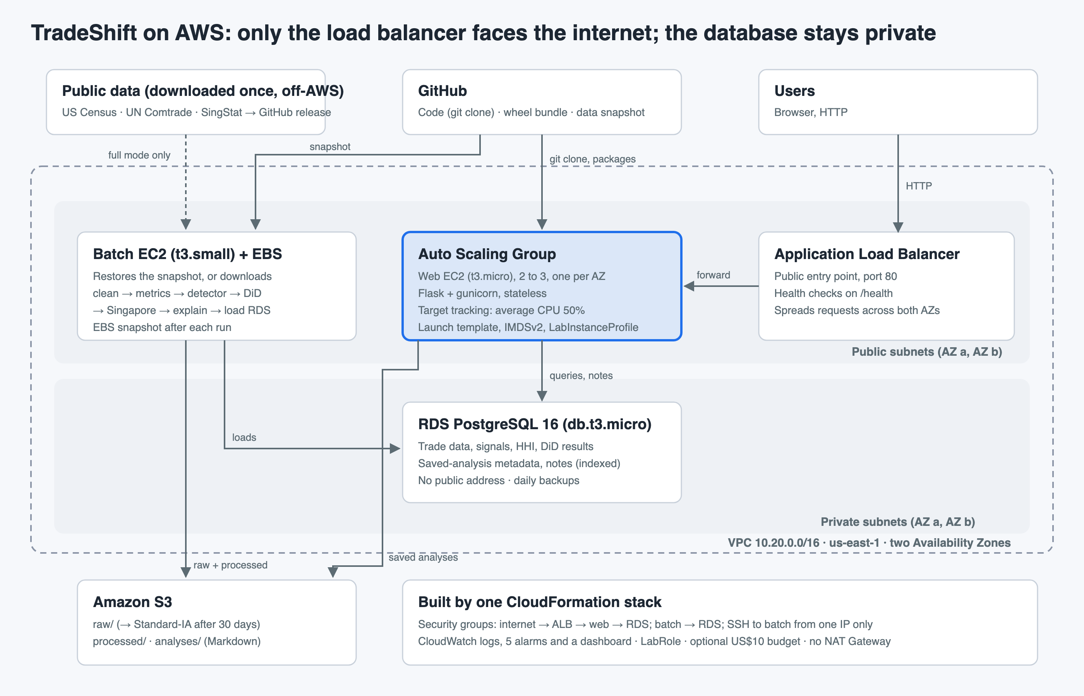
One CloudFormation stack builds everything
ARCHITECTURE
About 13 minutes from Submit to a working site, with no manual steps. Only the load balancer faces the internet.
Load balancer spreads visitors across two zones
Auto Scaling Group: 2 web servers, a 3rd when CPU passes 50%
RDS PostgreSQL in private subnets, no public address
Batch server loads the data on first boot
S3 stores data files and saved analyses
CloudWatch: logs, 5 alarms, one dashboard
Notes:
The whole system is built by one CloudFormation template. Visitors reach an Application Load Balancer, the only part that faces the internet. It spreads requests across two web servers in two Availability Zones, and an Auto Scaling Group adds a third server when average CPU passes 50%. The database is Amazon RDS PostgreSQL, placed in private subnets and reachable only from our own servers. A separate batch server loads the data, Amazon S3 stores data files and saved analyses, and CloudWatch collects logs, alarms and a dashboard. From pressing Submit to a working website takes about 13 minutes.

Slide 8
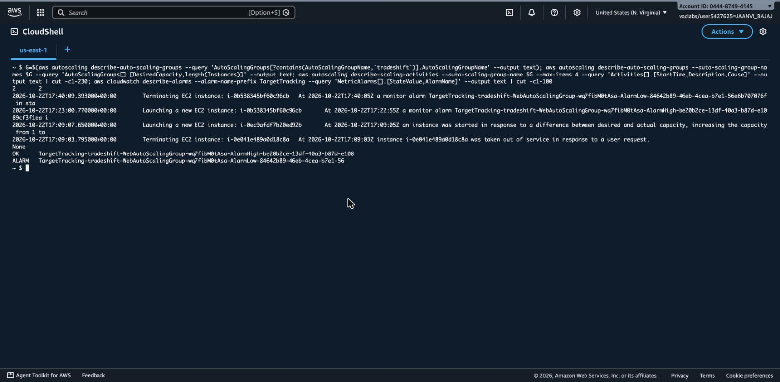
Every cloud test passed
TESTING
Run on the AWS Academy Sandbox in us-east-1, with the full real dataset.
✓
Build
CREATE_COMPLETE first time, about 13 min; 11.2m rows loaded in 239 s
✓
Load balancing
Requests split 10 / 10 across servers in two zones
✓
Failover
Server deleted, site stayed up; replacement serving in 171 s
✓
Auto scaling
5,856 requests, all OK; 2 → 3 servers, then back to 2
CloudShell: the scaling history, 2 → 3 at 17:22:55 UTC and back to 2 at 17:40:05 UTC
✓
Security
Database unreachable from outside the VPC
Notes:
We tested each cloud requirement on the AWS Academy Sandbox. The stack built from scratch on the first attempt in about 13 minutes, loading 11.2 million rows in under four minutes. Requests were split 10 and 10 between the two servers. When we deleted a web server, the site stayed up and a replacement was serving traffic after 171 seconds, with the saved analysis and its note intact. Under a seven-minute load test of 5,856 requests, all of which succeeded, the group scaled from 2 to 3 servers and back to 2 when the load stopped. And the database could not be reached from outside the network.

Slide 9
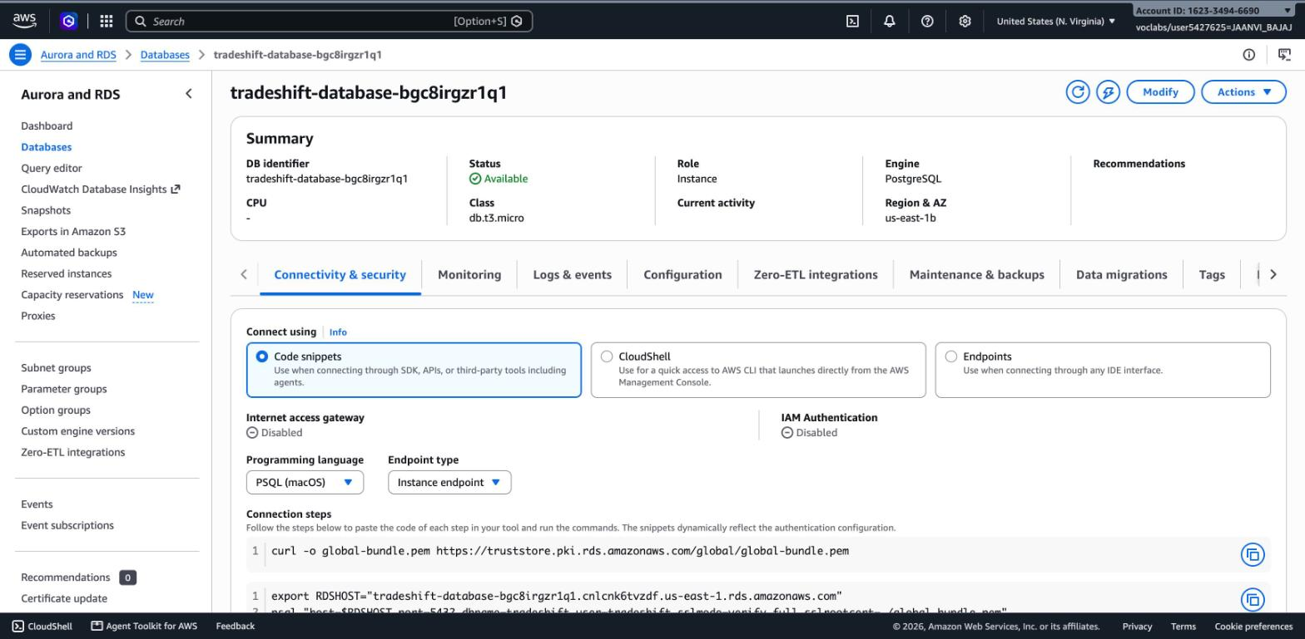
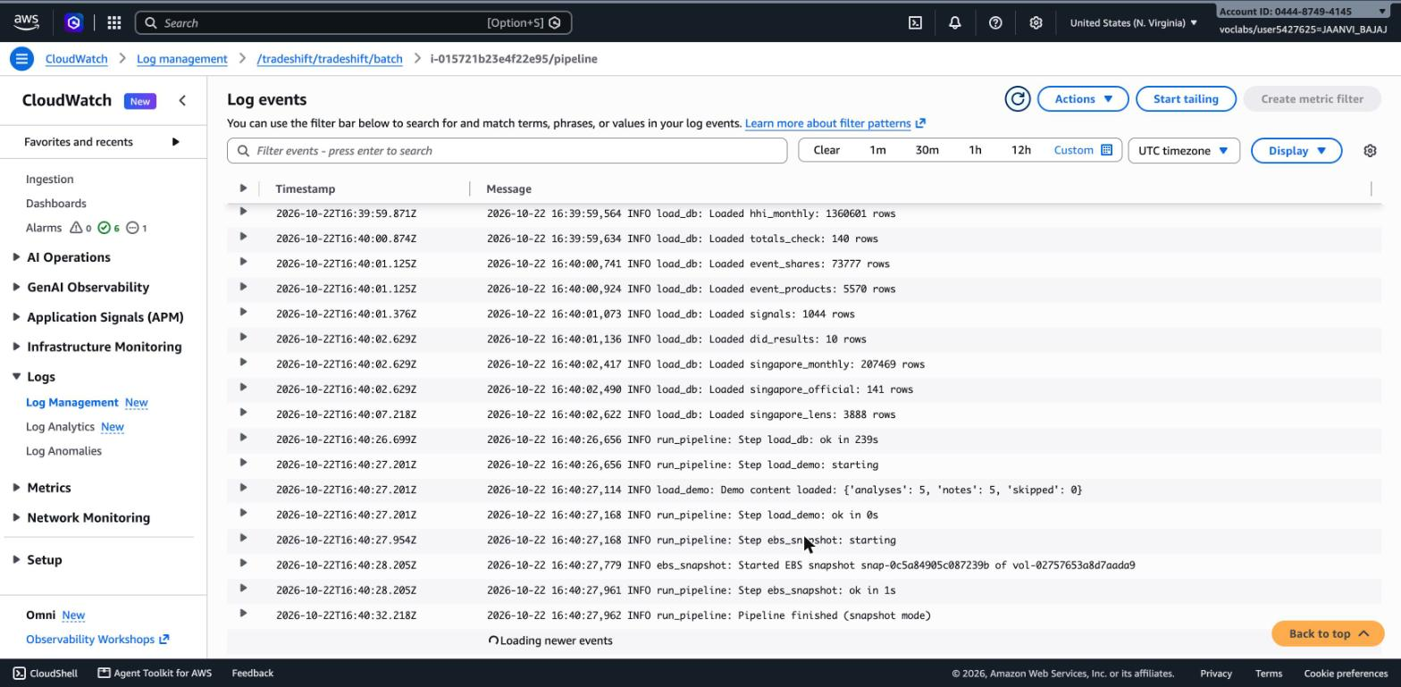
Proof from the AWS console
SECURITY AND MONITORING
The database has no public access, and every step of the data load is logged in CloudWatch.
RDS: internet access gateway is disabled and the database has no public address. Its security group accepts port 5432 only from the web and batch servers; a connection from outside the VPC fails.
CloudWatch: the batch server restored the 144 MB snapshot in 25 s, loaded 11.2 million rows into RDS in 239 s, then took an EBS snapshot. The log stays in CloudWatch after the server is gone.
Notes:
These two screenshots are taken straight from the AWS console. On the left, the RDS database settings show that it has no public access. On the right, the CloudWatch log of the batch server shows the data being loaded during a fresh build: the snapshot is restored, verified, and 11.2 million rows are written to the database. Keeping these logs in CloudWatch means we can check what happened on a server even after it has been replaced.

Slide 10
About US$0.35 per 3-hour session
COST
Approximate us-east-1 on-demand prices for everything the stack runs.
Item, 3 hours | Approx. cost
2 web servers (t3.micro) | US$0.06
Batch server (t3.small) | US$0.06
RDS PostgreSQL (db.t3.micro) | US$0.06
Application Load Balancer | US$0.07
Public IPv4 addresses (5) | US$0.08
EBS, S3, CloudWatch | US$0.03
Total | ≈ US$0.35
How we kept it low
No NAT Gateway: it alone would cost more than all the servers
Smallest instance sizes the Sandbox allows
Raw files move to cheaper S3 storage after 30 days; logs kept 7 days
Whole stack deleted after each session
Optional US$10 budget alert in the template
Notes:
Running the full system for a 3-hour Sandbox session costs about 35 US cents at on-demand prices. We kept costs low by using the smallest instance sizes, skipping a NAT Gateway (which alone would cost more than all our servers), moving raw files to cheaper storage after 30 days, keeping logs for only 7 days, and deleting the whole stack after each session. The template also includes an optional US$10 budget alert. Spot instances could cut the web tier's cost further outside the Sandbox, because the web servers hold no data.

