Slide 1
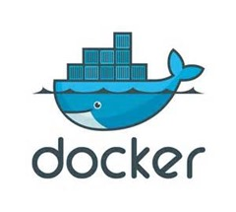
DOCKER ON CLOUD
ADVANCES IN DATA SCIENCES
YOGITA JAIN
ANTRIKSH ANTRIKSH
SWETA BAJAJ
GitHub: https://github.com/bajajsweta/DataScienceNotebooks
DockerHub: https://hub.docker.com/r/sweta/datasciencenotebooks/
Under the guidance of Professor Srikanth Krishnamurthy

Slide 2
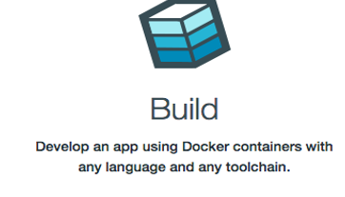
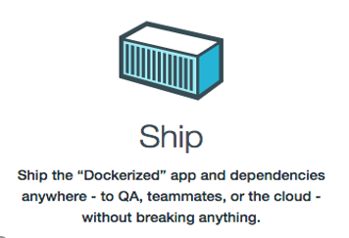
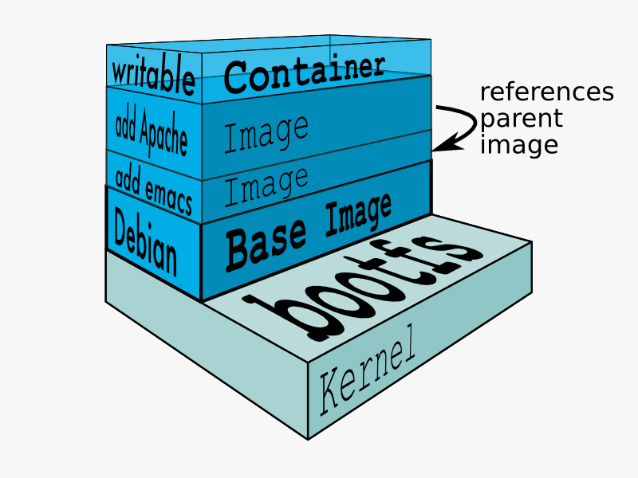
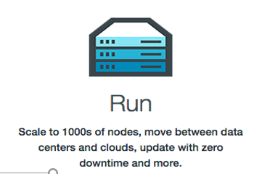
What is Docker?

Slide 3
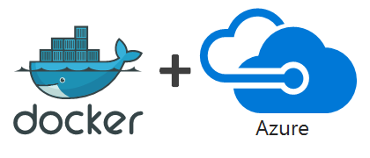
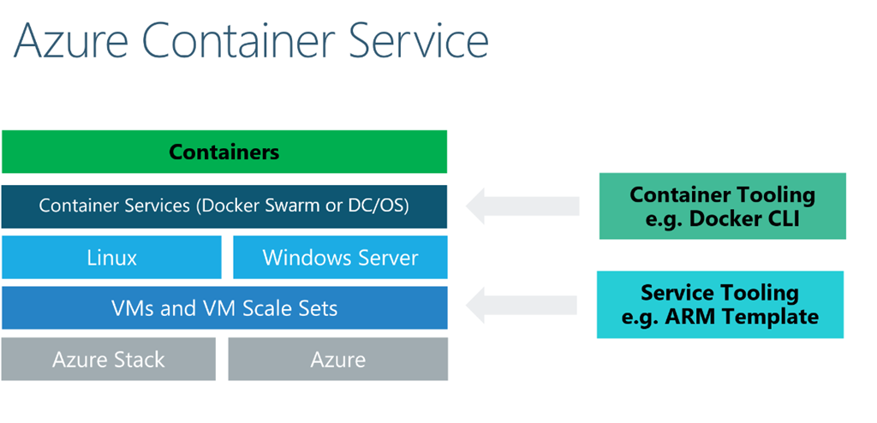
Docker with Windows Azure
Azure Container Service (ACS) provides a way to simplify the creation, configuration, and management of a cluster of virtual machines that are preconfigured to run containerized applications.
ACS leverages Docker images to ensure that your application containers are fully portable. It also supports Docker Swarm for orchestration, to ensure that these applications can be scaled to thousands, even tens of thousands of containers.
Docker Swarm provides native clustering capabilities to turn a group of Docker engines into a single, virtual Docker Engine.

Slide 4
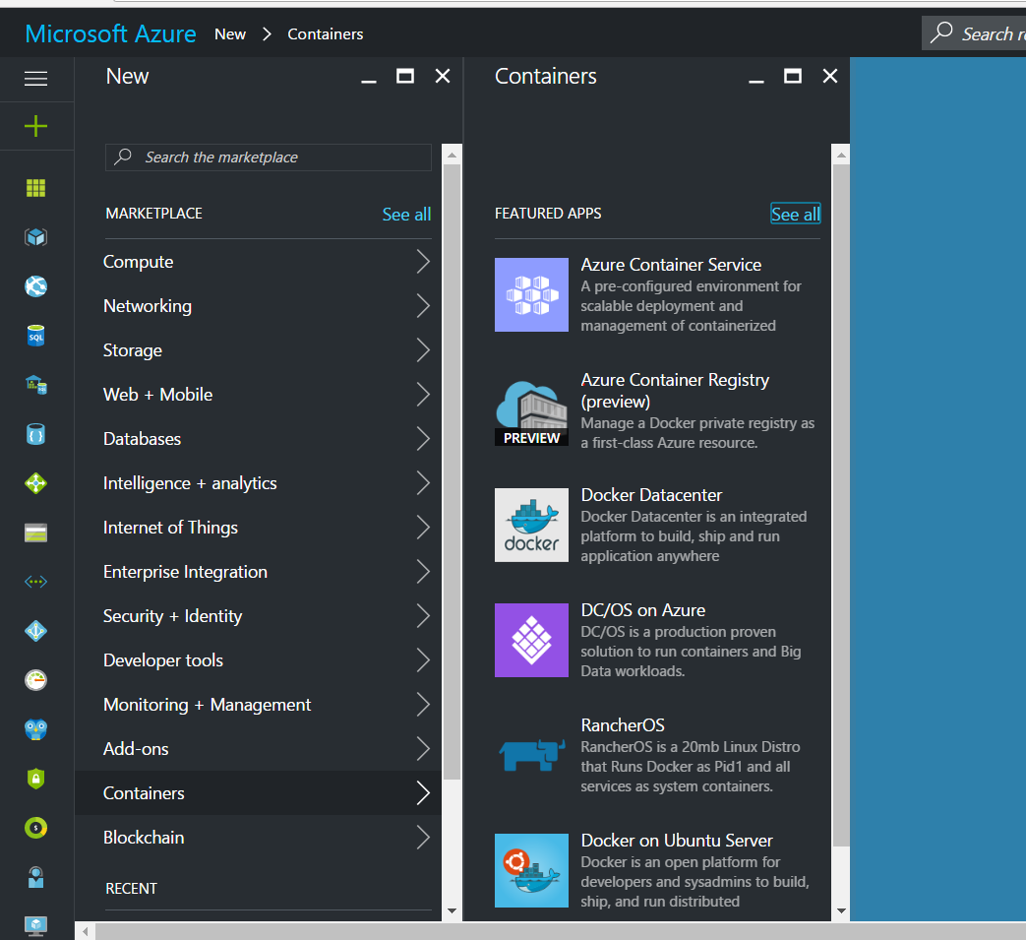
Azure Container Services
Create an Azure Container Service
Remote into an Azure Container Service using SSH
Create Docker images and run Docker containers in Azure
Run jobs in containers created from Docker images

Slide 5
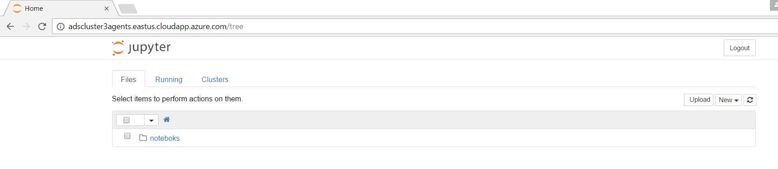
Pull & Run an image on Azure Container
Upon connection to ACS, either create a new image using a Dockerfile or pull an already existing image.
docker -H 127.0.0.1:22375 pull sweta/datasciencenotebooks
docker -H 127.0.0.1:22375 run -d -p 80:8888 -e "USE_HTTP=1" -v=/srv/notebooks:/srv/noteboks sweta/datasciencenotebooks
Jupyter running on cloud

Slide 6
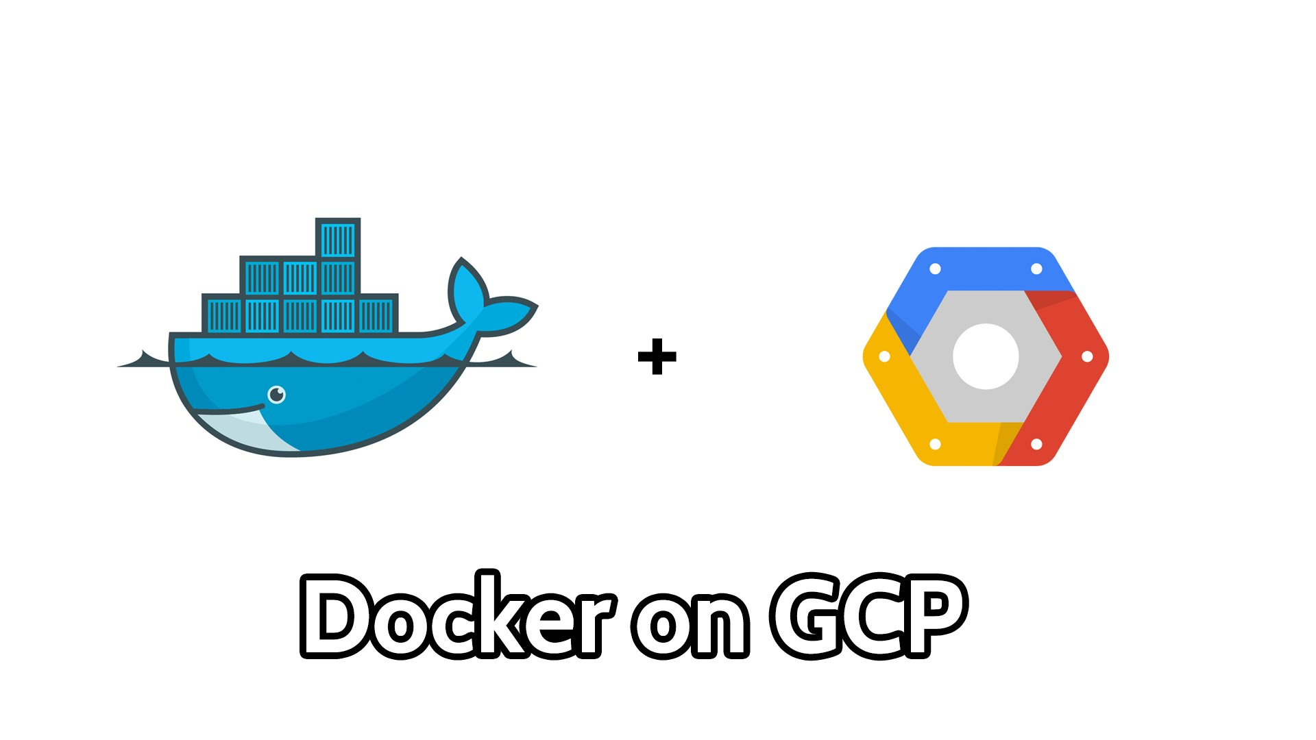
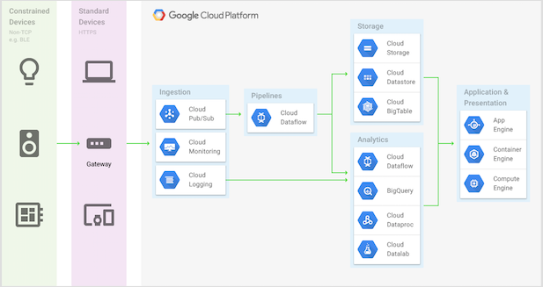
Docker with Google Cloud
Google Container Engine is a powerful cluster manager and orchestration system for running you Docker Containers
Container Engine is based on Docker and its VM is a container-optimized OS image that includes Docker and Kubernetes to manage containers.
Google Cloud Platform

Slide 7
Setting Up Docker Container
Set up a Free trial account on google cloud platform.
Create a Docker Container under Container Engine. A VM instance will be created in Compute Engine.
Configure network to allow HTTP and HTPPs traffic and change the ip address from ephemeral to static
Connect to the container using gcloud command.

Slide 8

Pull an image into Google Container
Upon connection, either create a new image using a Dockerfile or pull an already existing image.
docker pull sweta/datasciencenotebooks

Slide 9
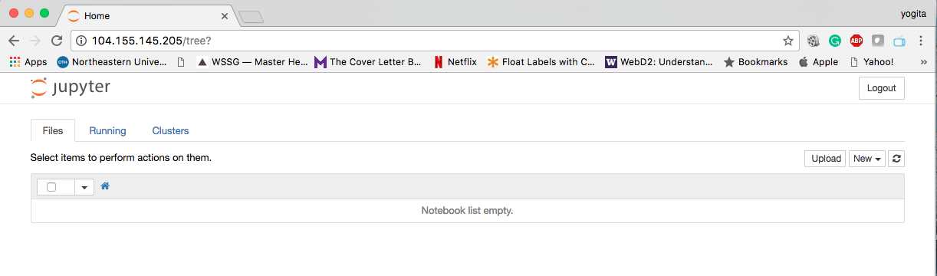
Run an image in Google Container
After pull, run the image.
docker run -d -p 80:8888 -e "USE_HTTP=1" sweta/datasciencenotebooks
Run the command will set up jupyter notebook on static IP address and port assigned to it.
type http:<static-ip-address>:80 in your browser and you will be connected to the jupyter notebook.
Jupyter running on cloud

Slide 10
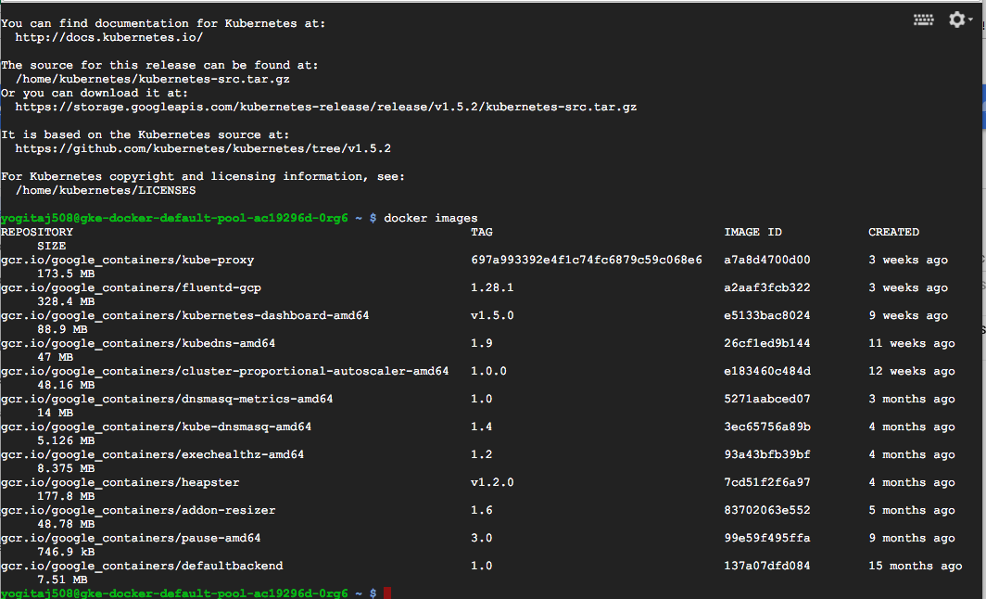
Configuration Steps
Once the instance is running, connect to the SSH client.
Type docker –v to check the version of Docker installed.
Login into the Docker account using
Now you can pull the docker images or file from the docker hub.

Slide 11
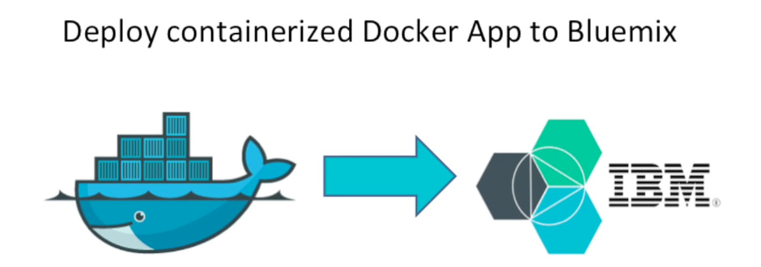
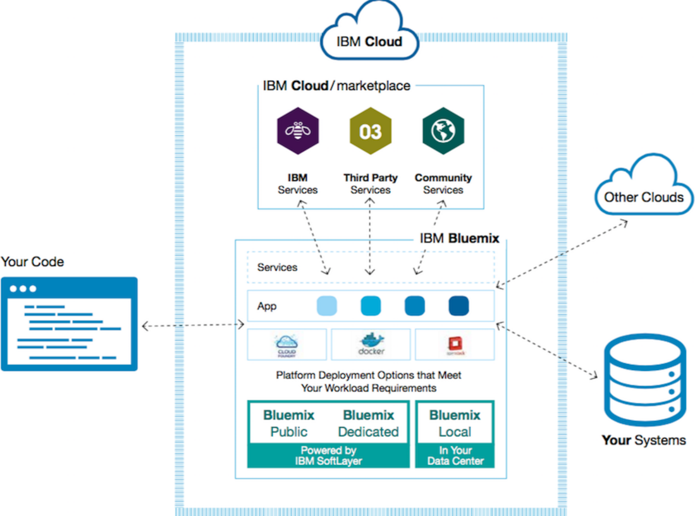
Docker on IBM Bluemix
IBM Bluemix is a cloud platform as a service (Paas) developed by IBM.
Supports several programming languages and services as well as integrated DevOps to build, run, deploy and manage applications on the cloud.
Based on Cloud Foundry open technology and runs on SoftLayer infrastructure.
Bluemix delivers enterprise-level services that can easily integrate with your cloud applications without you needing to know how to install or configure them

Slide 12
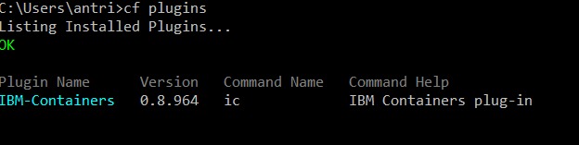
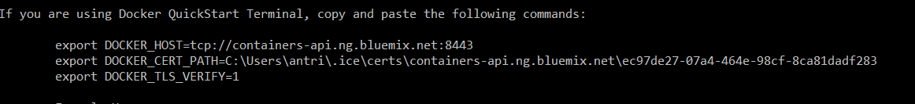
Configuration Steps
Login into blue mix using command line and check applications and Services
Install the IBM Bluemix Container Service Cloud Foundry plug-in for your operating system
Create a new Registry Name (Namespace) (Public such as a Docker hub)
Login into IBM container services
CF commands or Docker commands can be used to access Bluemix

Slide 13

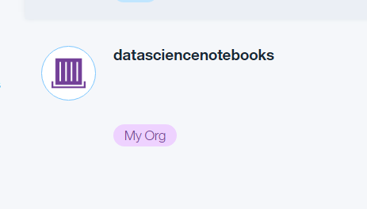
Pull an image into IBM Bluemix
Upon connection, either create a new image using a Dockerfile or pull an already existing image.
BLUEMIX requires images to be pulled to your local docker registry before it can be pushed to bluemix. Docker push and pull from bluemix to docker hub doesn’t work
Image will now be visible on Bluemix.

Slide 14
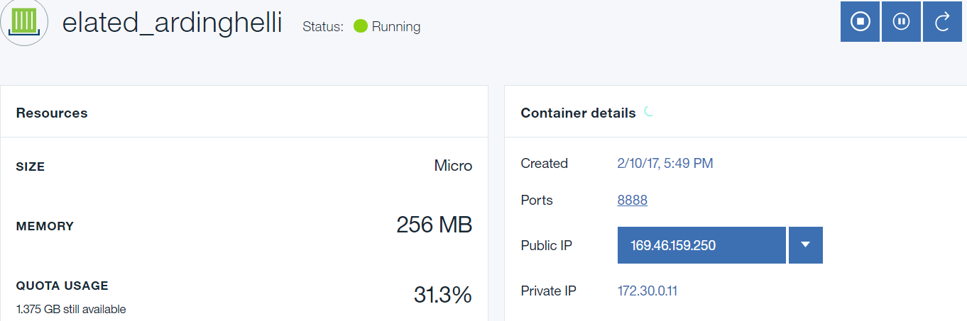
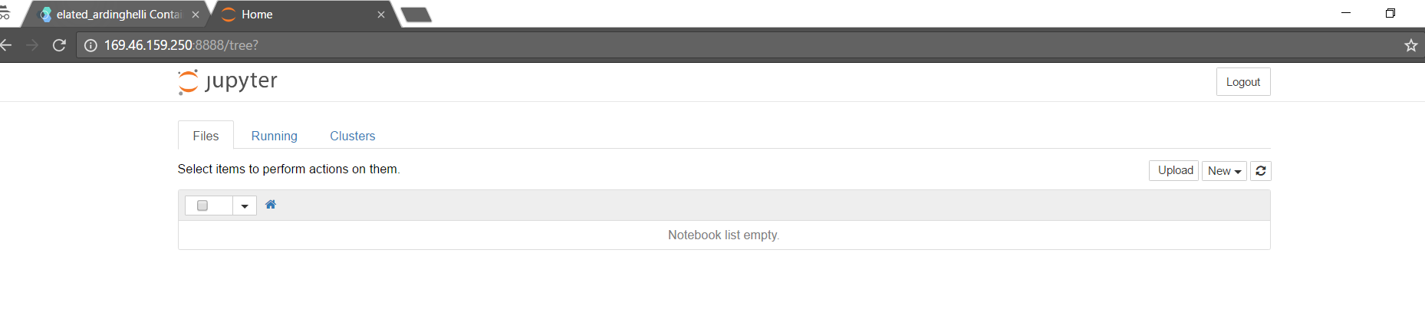
Run an image in IBM Bluemix
After pull, run the image using the below command
Docker container will be in running state on IBM Bluemix (Note the IP)
Jupyter running on cloud

Slide 15
Contact Details
Sweta Bajaj
Email Id: bajaj.sw@husky.neu.edu
Ph. No: (857)352-9065
LinkedIn: https://www.linkedin.com/in/swetabajaj
Yogita Jain
Email Id: jain.yo@husky.neu.edu
Ph. No: (857) 523-5230
LinkedIn: https://www.linkedin.com/in/yogita-jain
Antriksh Antriksh
Ph. No: (857)389-8882
Email Id: antriksh.a@husky.neu.edu
LinkedIn : https://www.linkedin.com/in/antriksh-sharma-64802383

Slide 16
References
https://docs.docker.com/
https://cloud.google.com/compute/docs/containers/
https://rominirani.com/docker-machine-to-control-docker-hosts-on-google-cloud-3a48b46809dc?gi=fc4ebe9a44c3
https://blogs.msdn.microsoft.com/uk_faculty_connection/2016/09/23/getting-started-with-docker-and-container-services/
https://console.ng.bluemix.net/docs/
https://azure.microsoft.com/en-us/services/container-service/
https://www.youtube.com/watch?v=-wjxpng6jYs

