Slide 1
ASSIGNMENT 2 :LENDING CLUB
TEAM 8

Slide 2
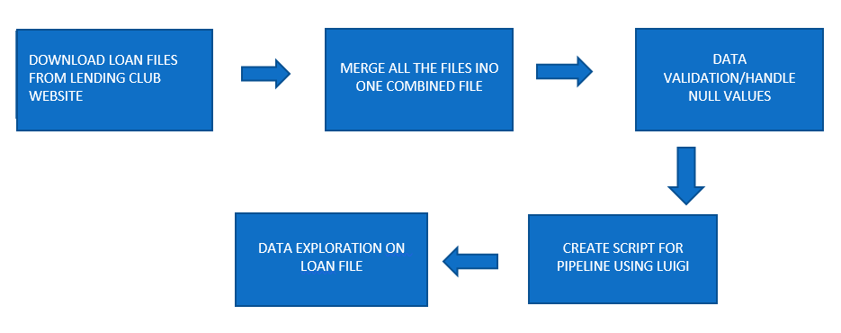
FLOW DIAGRAM OF THE STEPS PERFORMED

Slide 3
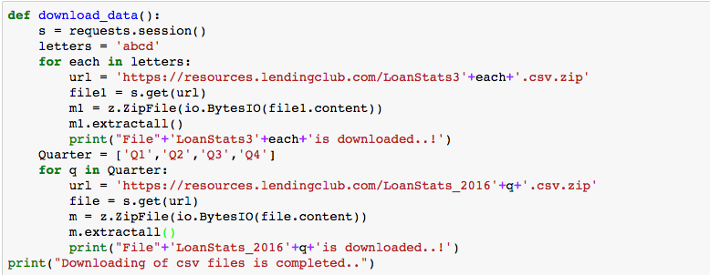
DOWNLOAD AND VALIDATION : LOAN DATA FILE

Slide 4
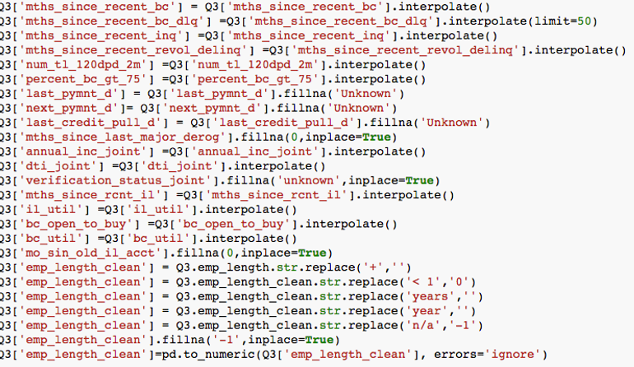
1) DIVIDED THE LOAN DATA SET INTO TWO DIFFERENT FILES : DOES NOT MEET THE CREDIT POLICY (STATUS: CHARGED OFF AND FULLY PAID) VALIDATION /CLEANING PERFORMED: 1) After checking the percentage of null/nans in each column, we dropped a few columns and filled nulls with unknown in categorical columns and interpolation on a few columns.

Slide 5
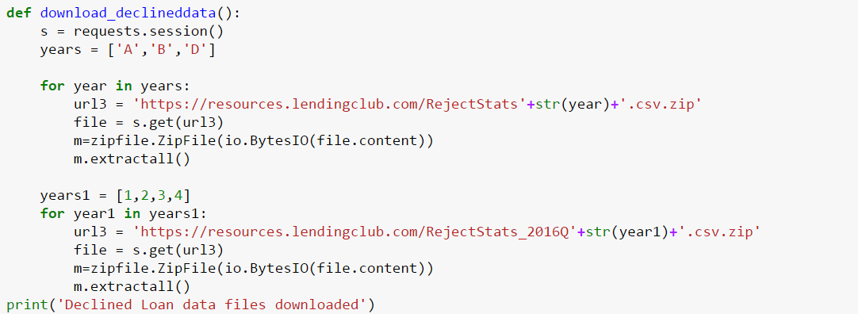
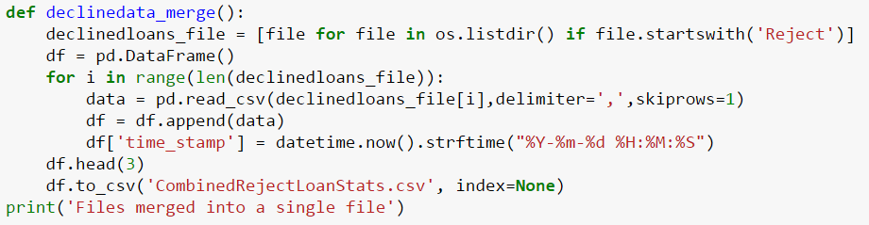
DECLINED LOAN DATASET : DOWNLOAD AND VALIDATION

Slide 6
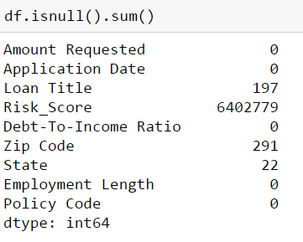
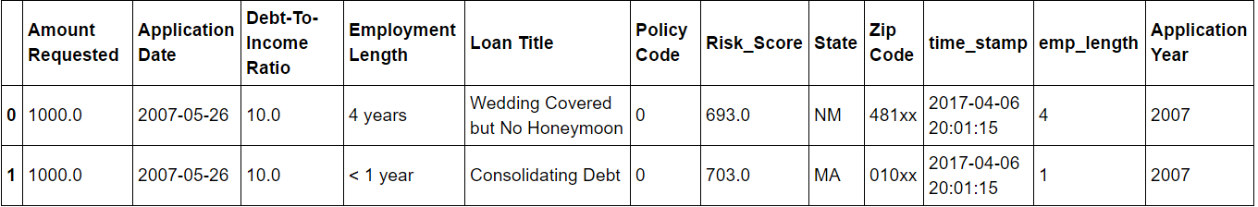
MISSING DATA HANDLING /CLEANING AND VALIDATION
REPLACED NUMERICAL VALUES WITH MEAN
REPLACED TEXT FIELDS WITH TEXT ENTRY LIKE “NO VALUE”
REPLACED DATE WITH BFILL TO MAINTAIN TIME SERIES FLOW
DELETED ROWS WHERE 3 COLUMNS HAD NULL VALUE (HERE STATE ENTRIES (22) HAD THIS CONDITION)
REPLACED NULL WITH -1 or oUT OF BOUNDARY VALUE FOR FIELDS wITH FIXED VALUES
6) REPLACED UN WANTED CHARACTERS
7) CONVERTED INTO NUMERICS
8) CREATED YEAR COLUMN

Slide 7
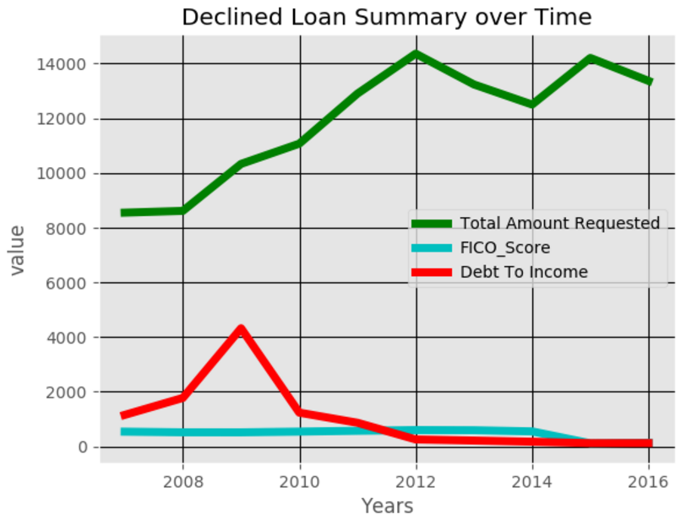
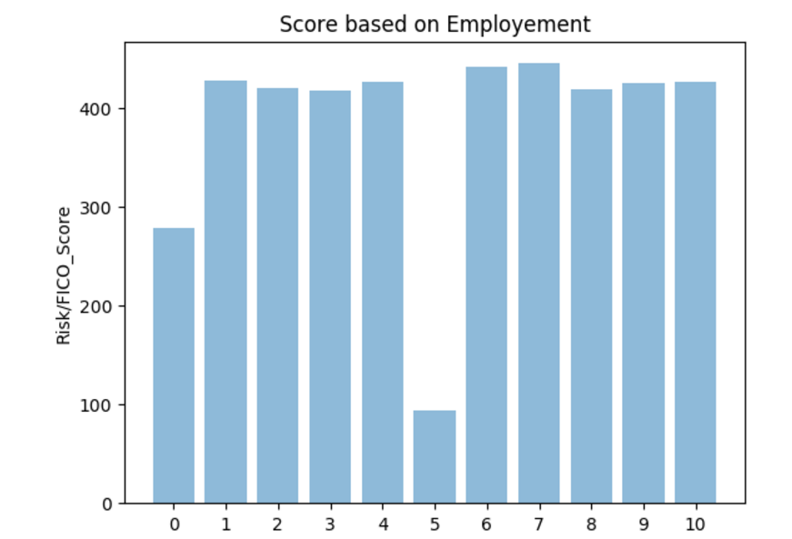
DATA EXPLORATION FOR DECLINED DATA SET
- SUMMARY OVER TIME AND SCORE WITH RESPECT TO EMPLOYEMENT YEARS DTI HIGHEST AROUND 2009, NO MAJOR SHIFT IN FICO_SCORE FICO SCORE IS LOWEST FOR UNEMPLOYEMENT PEOPLE (EXCEPTION EMPLOYEMENT LENGTH :5)

Slide 8
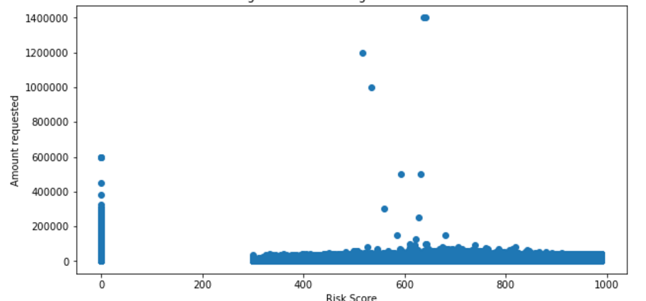
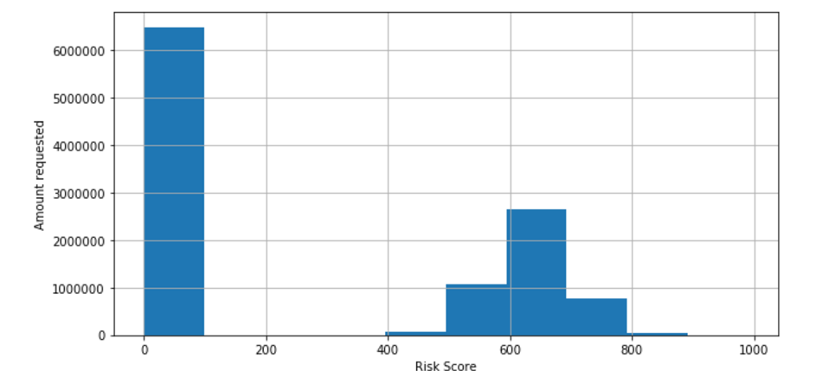
RISK SCORE ANALYSIS WITH RESPECT TO LOAN AMOUNT REQUESTED 1) MOST OF THE LOANS REJECTED HAD RISK SCORE BETWEEN 500 -700

Slide 9
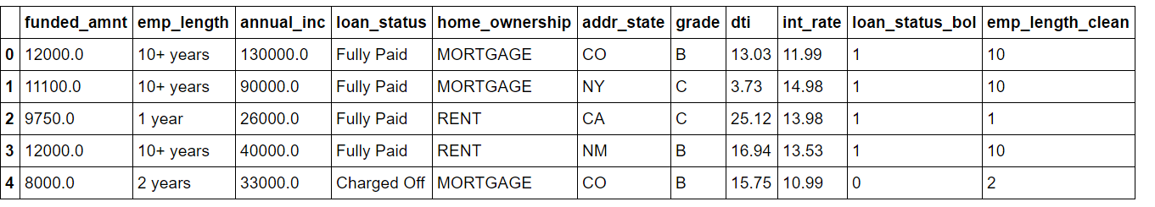
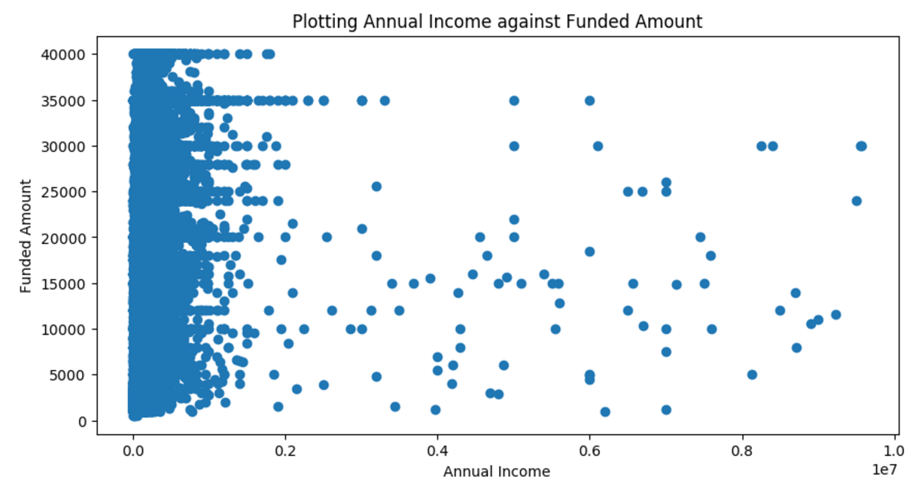
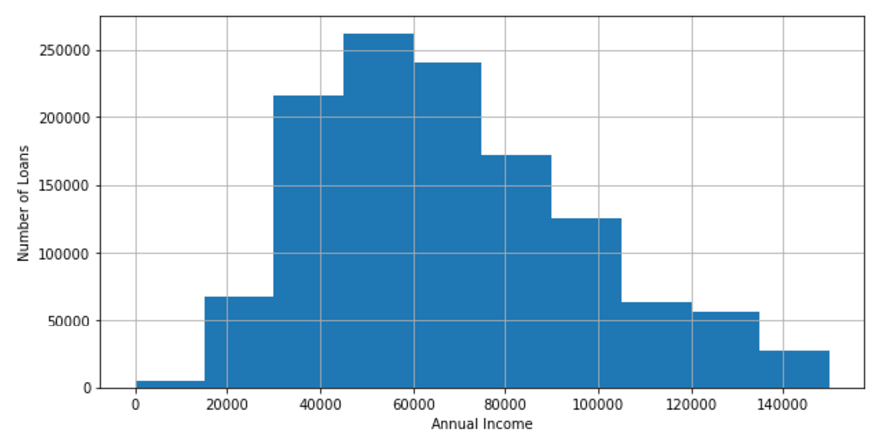
DATA EXPLORATION ON LOAN FILE
DERIVED COLUMN

Slide 10
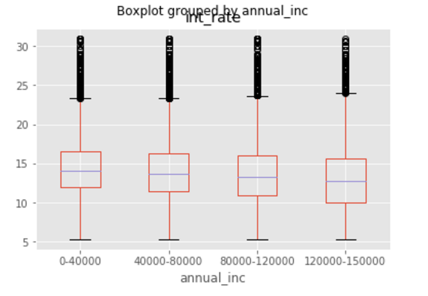
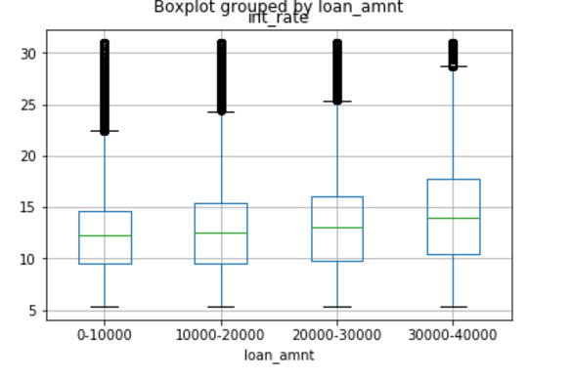
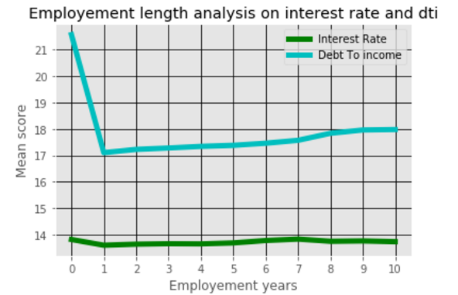
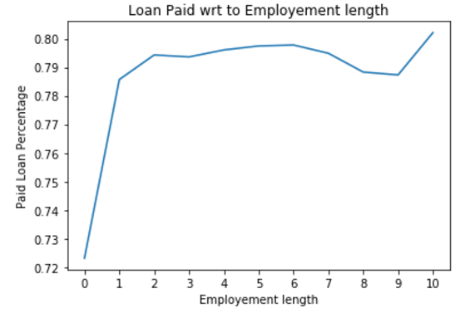
INTEREST RATE AND DTI VS ANNUAL INCOME
ANALYSIS BASED ON EMPLOYEMENT LENGTH

Slide 11
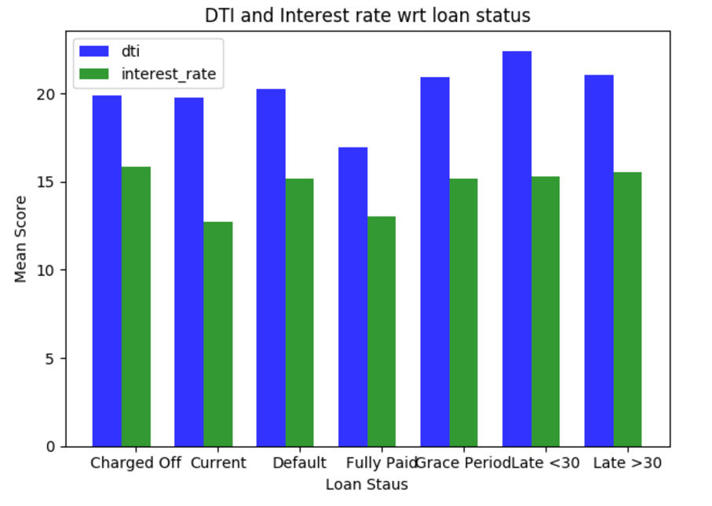
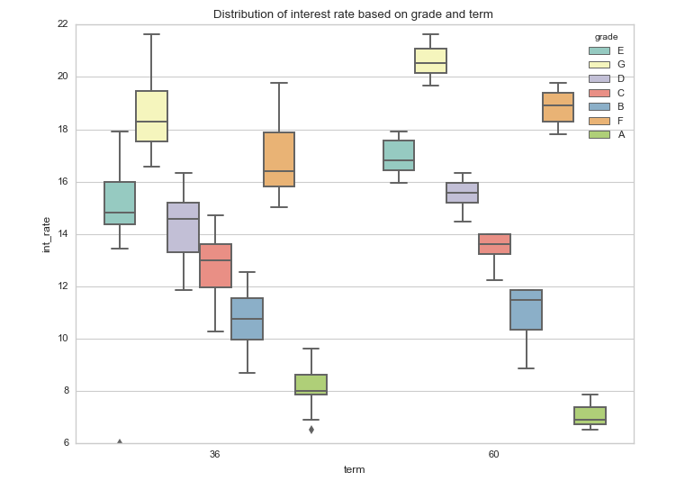
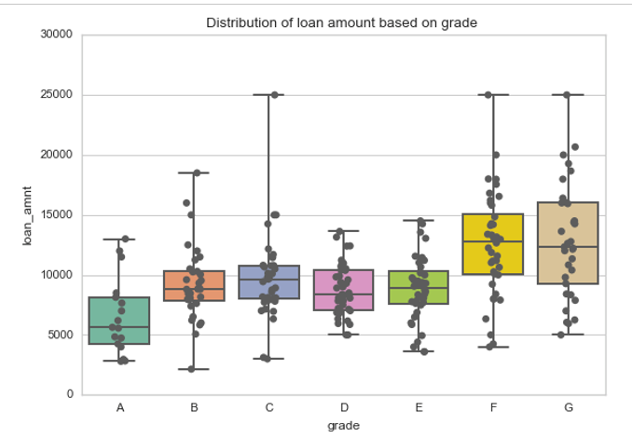

Slide 12
POWER BI ANALYSIS INSIGHTS
TIME SERIES ANALYSIS OF LOAN DATA
- The credit percentage used was maximum was for years 2012. Shows heavy purchases and spending as maximum credit is used.
- The credit provided to customer has increased since slowdown
- Interest rate is lowest for the loan which have been paid and higher for loans not paid.
- Debt to income ratio is lowest for paid loans and higher for loans not paid .
Paid Loan percentage is highest for customers employed for more years, highest for 10 years
STATE WISE ANALYSIS OF LOAN DATA
- Washington DC has the best paid percentage of loans, whereas Mississippi has the lowest paid percentage of loans.
- Iowa also has the lowest interest rate which might explain the highest paid loan percentage.
- North Dakota has the highest interest rate but not the lowest paid percentage.
- New Mexico has the highest debt to income ratio for all the states whereas Washington DC has the lowest debt to income ratio.

Slide 13
POWER BI INSIGHTS FOR DECLINED FILE
-There is no visible dependency between risk score and debt to income ratio for declined loans
-The highest number of failed loans are for the risk score around 500-700.
-Debt to income ratio is considerably high for higher risk score
-People with lower risk score have higher debt to income ratio.
- Iowa state has the highest fico/vantage score and least default values.

Slide 14
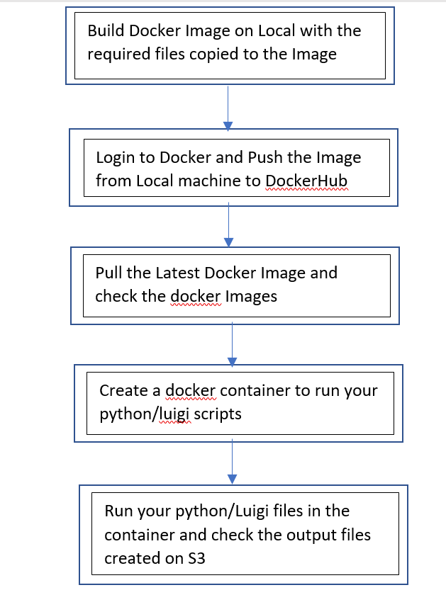
DOCKER AND LUIGI FLOW CHART:

Slide 15
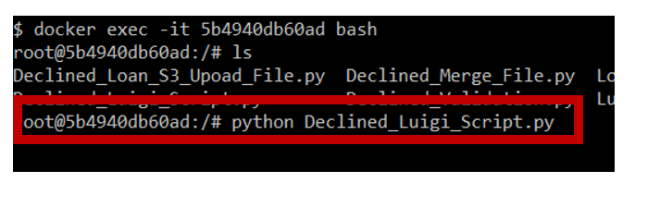
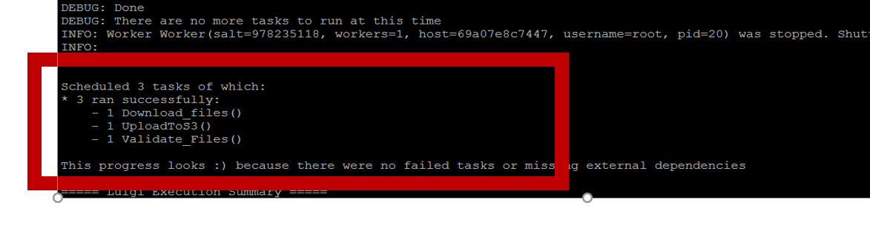
LUIGI SCRIPT

Slide 16
ANY QUESTIONS ????

