Slide 1
Pacman
Sarthak Agrawal
Sweta Bajaj

Slide 2
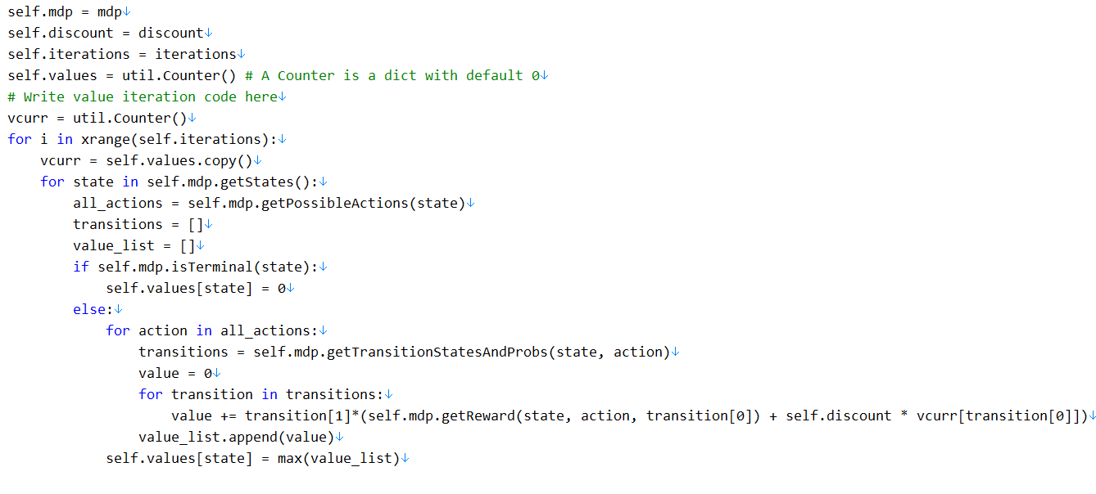
Question 1: Value Iteration
Value Iteration takes MDP on construction and runs value iteration for each specified number of iterations
computeActionFromValues(state)

Slide 3
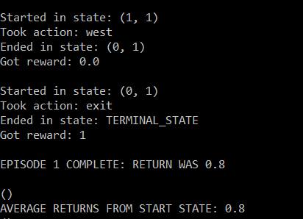
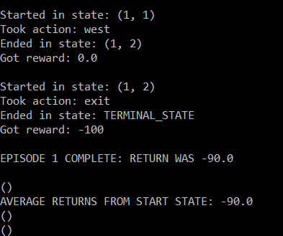
Question 2: Bridge Crossing Analysis
Discount – 0.8
Noise – 0.5
Discount – 0.9
Noise – 0.2

Slide 4
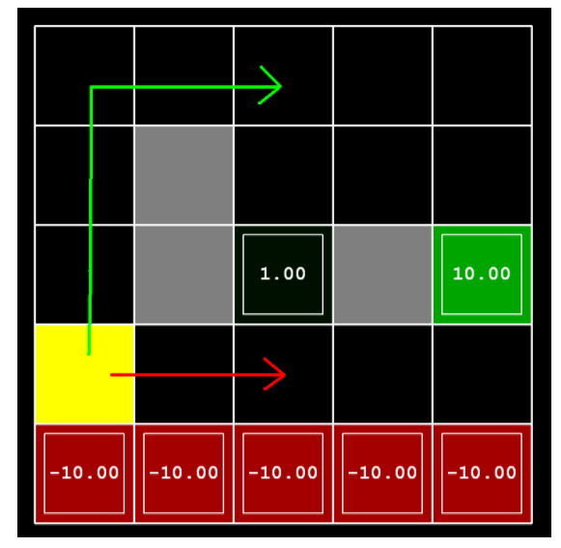
Question 3: Policy
Here we look at the positive payoff and negative payoff
Red area will is very close to the danger zone
The other positive payoff is a longer route

Slide 5
Question 6 – Bridge Crossing Revisited
Question 5: Epsilon Greedy
Implement epsilon-greedy in getAction()
Choose random action
Train on a noiseless Bridge Grid for some episodes
Observer the policy
Try combinations of epsilon and alpha with certain iterations

Slide 6
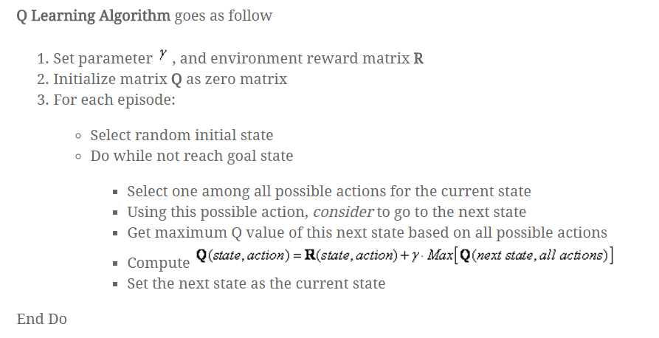
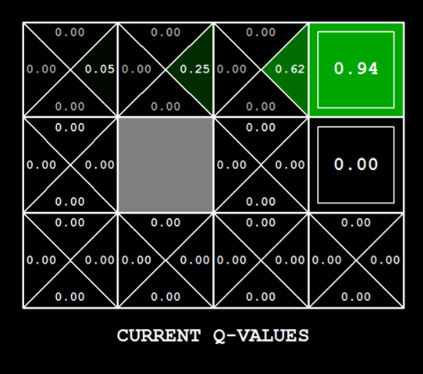
Question 7 - Q Learning

Slide 7
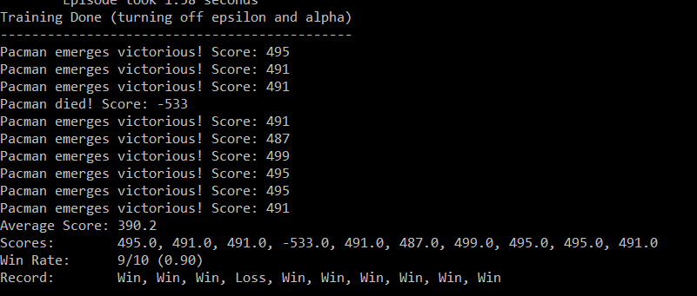
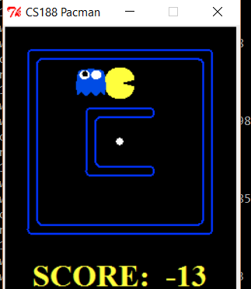
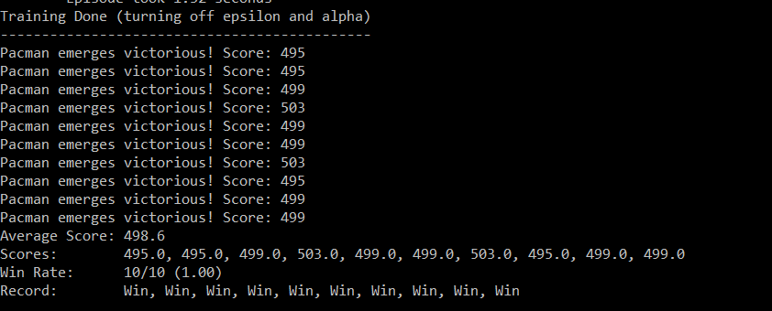
Pacman Q-Learning on Small Grid
Alpha –> 0.01
Alpha –> 0.2

Slide 8
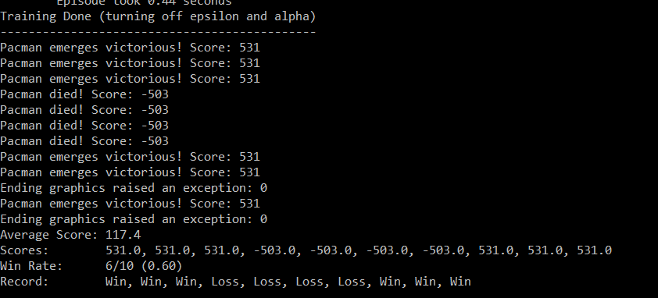
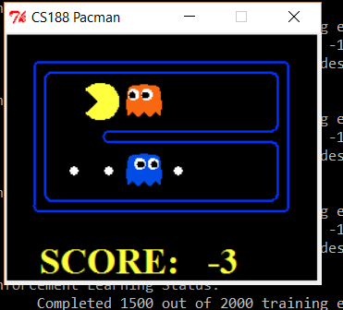
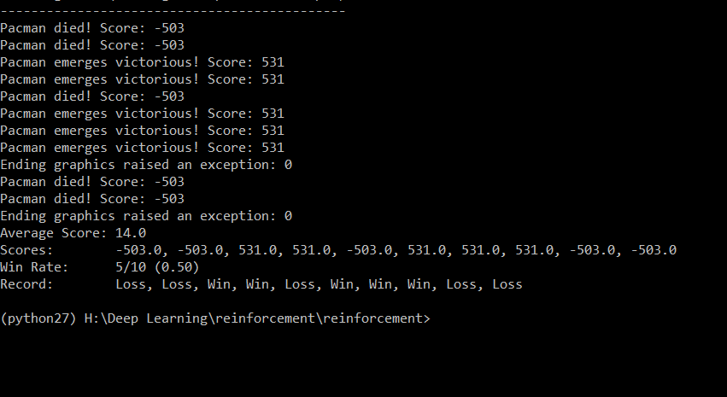
Pacman Q-Learning on Trapped Grid
Alpha –> 0.2
Alpha –> 0.01

Slide 9


Question 8 – Approximate Q Learning
Function
Learns the weighs of features function f(s,a)

Slide 10
References
https://github.com/lightninglu10/pacman-reinforcementlearning

