Slide 1
Unsupervised Learning – K Means Clustering CS4131 – Machine Learning
Faculty pic
Sudip Sanyal
Date: 12/10/2022

Slide 2
Unsupervised Learning
Imagine we have data points i.e. samples with feature vectors
No class labels are given
What type of information can we get out of that?
We can try to see if any grouping emerges naturally
This is a form of exploratory data analysis
In case any grouping or pattern emerges, then we can explore further to investigate the underlying reason(s)
Unsupervised learning is also used as a pre-processing step for supervised learning and outlier detection

Slide 3
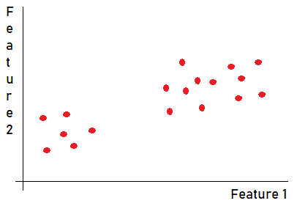
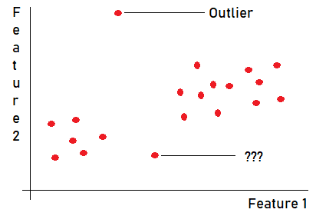
How many groups are there?

Slide 4
Clustering
Clustering is the process of grouping the samples such that
- samples within the cluster / group are “similar”
- samples from different clusters are “dissimilar”
Open questions
- How do we measure similarity?
- How many clusters?
- How do we compare performance of different algorithms?
- When do we call a sample an outlier?
- Can samples belong to more than one cluster, with different belongingness?

Slide 5
The basic idea
Samples are generated from some underlying process(es)
We want to infer something about these process(es)
There may be some (statistical) fluctuations
Samples generated from one process will not be identical
- Samples will be scattered around some central point
Each individual process will lead to a group / cluster
Samples that do not “belong to” any cluster are outliers

Slide 6
A real life example – from corporate sector
A company, XYZ, wants to manufacture pizza toppings (PT)
PTs can be (a) creamy (b) spicy
Different customers have different preferences
XYZ wants to find
- How many varieties of PTs to make?
- How many batches of each variety?
XYZ does a random sampling of customers to find their preferences

Slide 7
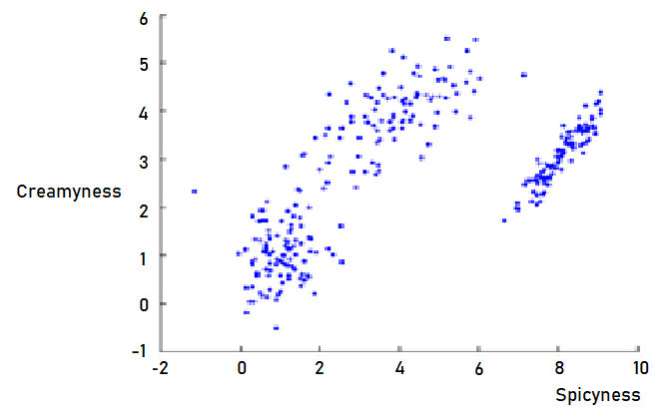
A real life example – from corporate sector

Slide 8
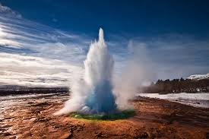
Another example – from Geology
Geysers – a geological formation
Shoots out spurts of water high above the ground
- called geyser eruptions
What is the underlying process(es)?
How many distinct processes?
Source: Getty Images/iStockphoto
Copyright: jesselindemann

Slide 9
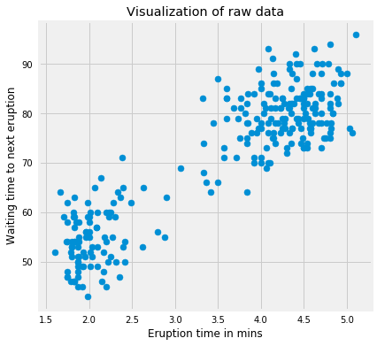
Another example – from Geology
Eruptions were observed to have
- different waiting time between successive eruptions
- different eruption times
Guess the number of underlying processes!
Data from -
Old Faithful Geyser Yellowstone National Park, USA
http://www.stat.cmu.edu/~larry/all-of-statistics/=data/faithful.dat

Slide 10
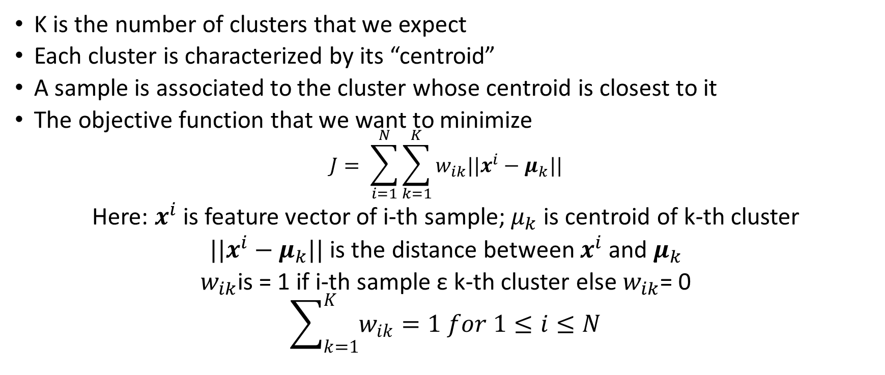
The K Means algorithm
K is the number of clusters that we expect
Each cluster is characterized by its “centroid”
A sample is associated to the cluster whose centroid is closest to it
The objective function that we want to minimize
$$J= \sum_{i=1}^{N}{\sum_{k=1}^{K}{w_{ik}||x^{i}−μ_{k}||}}$$
Here: $x^{i}$is feature vector of i-th sample; $μ_{k}$is centroid of k-th cluster
$||x^{i}−μ_{k}||$ is the distance between $x^{i}$and $μ_{k}$
$w_{ik}$is = 1 if i-th sample ε k-th cluster else $w_{ik}$= 0
$$\sum_{k=1}^{K}{w_{ik}=1 for 1≤i≤N}$$

Slide 11
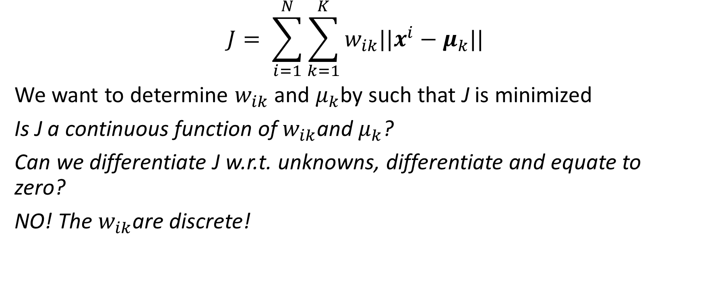
The K Means algorithm contd.
$$J= \sum_{i=1}^{N}{\sum_{k=1}^{K}{w_{ik}||x^{i}−μ_{k}||}}$$
We want to determine $w_{ik}$ and $μ_{k}$by such that J is minimized
Is J a continuous function of $w_{ik}$and $μ_{k}$?
Can we differentiate J w.r.t. unknowns, differentiate and equate to zero?
NO! The $w_{ik}$are discrete!

Slide 12
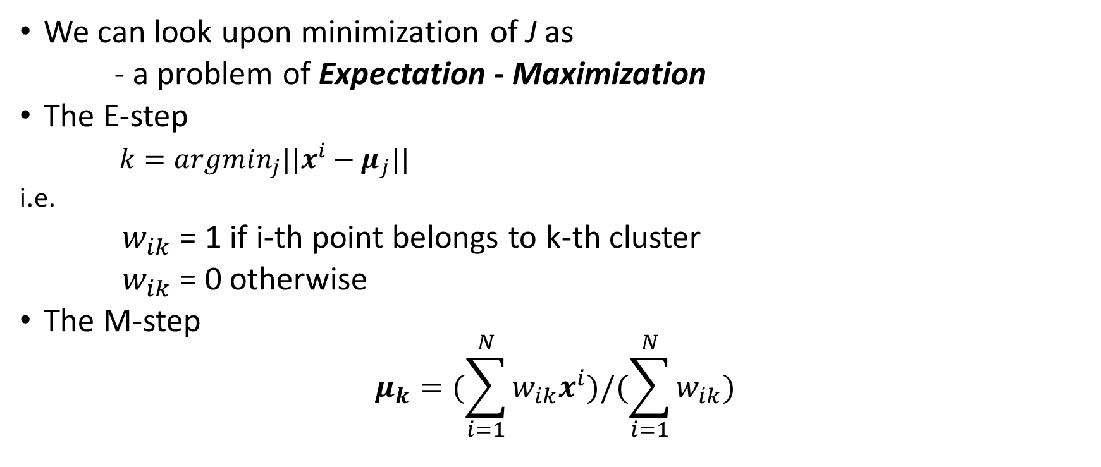
Deriving K Means algorithm
We can look upon minimization of J as
- a problem of Expectation - Maximization
The E-step
$k=argmin_{j}||x^{i}−μ_{j}||$
i.e.
$w_{ik}$ = 1 if i-th point belongs to k-th cluster
$w_{ik}$ = 0 otherwise
The M-step
$$μ_{k}=(\sum_{i=1}^{N}{w_{ik}x^{i})/(\sum_{i=1}^{N}{w_{ik})}}$$

Slide 13
The algorithm
Specify number of clusters K
Initialize centroids by first shuffling the dataset and then randomly selecting K data points for the centroids without replacement
While(there is no change in position of centroids)
{
For(each sample)
{
Compute distance between the sample and all centroids
Assign sample to the closest cluster (centroid)
}
Recompute the centroids for all clusters
}

Slide 14
Issues to consider
Results of K Means are sensitive to
- Choice of number of clusters, K
- Initialization of cluster centroids
- Choice of distance measure
Important precautions
- Normalize the data – reduces problems due to scale
- Use several different initializations of cluster centroids
- Accept the one that has minimum value of J
- Select distance measure based on problem at hand

Slide 15
Estimating the number of clusters
K Means is very sensitive to choice K
Use the “Elbow” method to estimate K
Note: Minimum value of K = 1; Maximum value of K = N
The Elbow method
For (K = 1 to N)
{
Run K Means
Compute the final J value
}
Plot J versus K
Note the “Elbow” point in the plot
J drops rapidly as K increases.
After some value of K the rate of change of J is not so rapid. This is the elbow point.

Slide 16
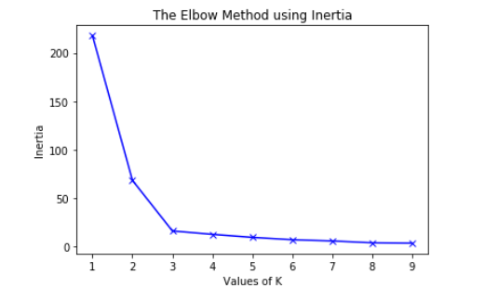
A sample graph for elbow method

Slide 17
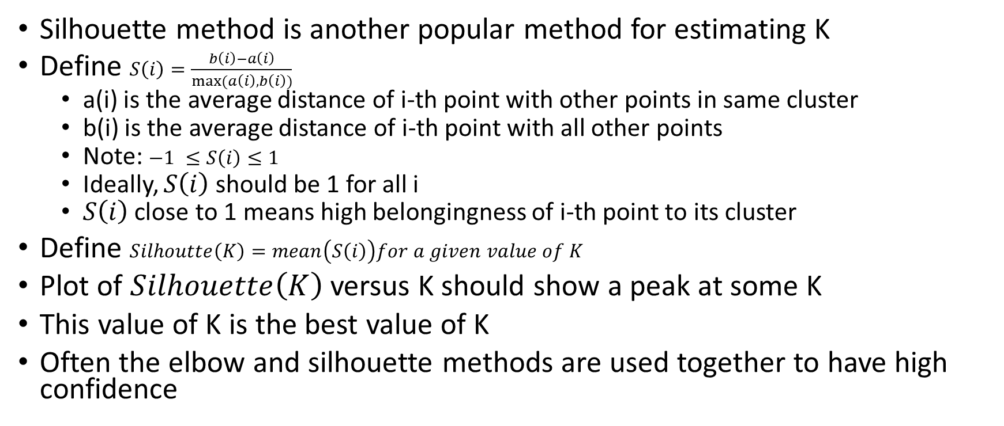
Silhouette method for estimating K
Silhouette method is another popular method for estimating K
Define $S\left(i\right)=\frac{b\left(i\right)−a\left(i\right)}{max⁡(a\left(i\right), b\left(i\right))}$
a(i) is the average distance of i-th point with other points in same cluster
b(i) is the average distance of i-th point with all other points
Note: $−1 ≤S\left(i\right)≤1$
Ideally, $S\left(i\right)$ should be 1 for all i
$S\left(i\right)$ close to 1 means high belongingness of i-th point to its cluster
Define $Silhoutte\left(K\right)=mean\left(S\left(i\right)\right)for a given value of K$
Plot of $Silhouette\left(K\right)$ versus K should show a peak at some K
This value of K is the best value of K
Often the elbow and silhouette methods are used together to have high confidence

Slide 18
Keywords
<Unsupervised Learning>
<Clustering>
<K Means>
<Objective Function>
<Expectation Maximization>
<Elbow Method>
<Silhouette Method>

Slide 19
Thank you

